Slide 1
Executive Secretary Report for 2025 May LMSC Interim Telecon
Jon Rosdahl
IEEE Executive Secretary
jrosdahl@ieee.org
Notes:
R0: Draft prepared for the 802 LMSC 2025 May Interim Telecon
R1: update to add 6.02 agenda item – Student Outreach Program.
R2: update with comments during the Telecon.

Slide 2
Event Conduct and Safety Statement
IEEE believes that science, technology, and engineering are fundamental human activities, for which openness, international collaboration, and the free flow of talent and ideas are essential. Its meetings, conferences, and other events seek to enable engaging, thought-provoking conversations that support IEEE’s core mission of advancing technology for humanity. Accordingly, IEEE is committed to providing a safe, productive, and welcoming environment to all participants, including staff and vendors, at IEEE-related events.

Slide 3
Event Conduct and Safety Statement
IEEE has no tolerance for discrimination, harassment, or bullying in any form at IEEE-related events. All participants have the right to pursue shared interests without harassment or discrimination in an environment that supports diversity and inclusion. Participants are expected to adhere to these principles and respect the rights of others.
IEEE seeks to provide a secure environment at its events. Participants should report any behavior inconsistent with the principles outlined here, to onsite staff, security or venue personnel, or toeventconduct@ieee.org.

Slide 4
Executive Secretary Agenda Items
Closing Plenary:
  3.01: Future Venue Update
    802 Venue Contract Status update
    Registration Status – 2025 July 802 Plenary
    Notes for Madrid
  6.05 Student Outreach Program

Slide 5
Future 802 Plenary Venue Contract Status
2025 July 27-August 1 –Melia Castilla Madrid, Madrid, Spain (NOTE: Week of July 27)
2025 November 9-14 – Marriott Marquis Queen’s Park, Bangkok, Thailand
2026 March 8-13 - Hyatt Regency Vancouver, Vancouver, Canada (Changed from Chicago)
2026 July 12-17 – Le Centre Sheraton Montreal, Montreal (July 2022 attrition offset)
2026 November 8-13 - Marriott Marquis Queen’s Park, Bangkok, Thailand
2027 March 14-19 – Hilton Atlanta, Atlanta, GA, United States Replacement to be found
2027 July 11-16 - Gothia Towers, Gothenburg, Sweden – Contract pending
2027 November 14-19 – Hawaiian Village, Oahu, Hawaii, United States
2028 July 9-14 – Sheraton Le Centre Montreal, Montreal, Quebec, Canada
802 EC Approved – Contract is in negotiations and will be sent to IEEE CEE and IEEE Legal.
Contracts Executed
As of May 2, 2025
Notes:
Dark Blue – Covid Rebooks Yellow – Special Date change
Green – 2023 RFP Assignments Light blue – 2024 Sept Telecon Approved Location
White – Booked Prior to Covid.
Odd years Europe – Even Years Asia
------------------------------------------------------------------------------------------------------
2025 July - Melia Castilla Madrid – July 27-Aug 1 - Contract and amendment executed.
Room Block Review and request to update.
2025/2026 November – Marriott Marquis Queen’s Park – Executed Oct 28, 2024
2026 July – Hosting ITU WG15 – Sheraton le Centre Montreal Contract Executed 26 Feb
Error found after signing – Amendment in IEEE processing
2027 March – Hilton Atlanta
– need to get contract formalized – Problems with negotiations.
2027 July – Gothia Towers
– Site Visit 21-22 Aug 2024 - Was successful.
– Contract still in negotiation. – Target end of March.
2028 July 9-14 – Sheraton Le Centre Montreal – Executed.
Error found after signing – Amendment in IEEE processing

Slide 6
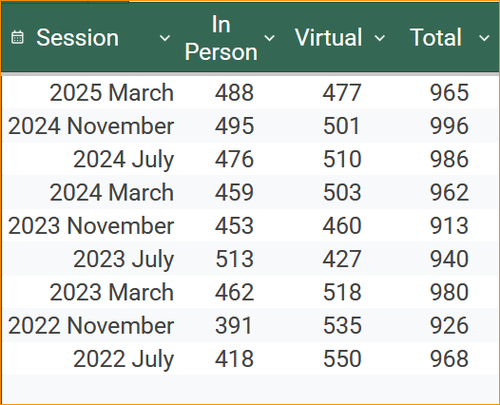
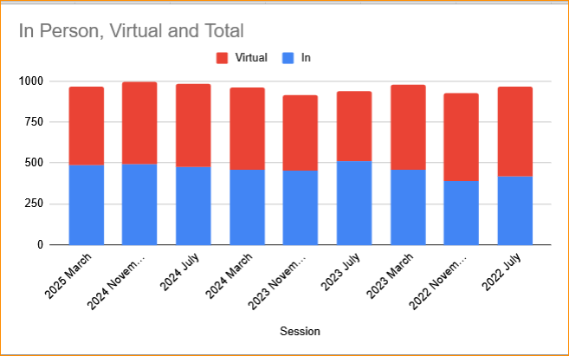
IEEE 802 Mixed-mode Plenary Attendance

Slide 7
RFP for 2027 March 802 Plenary Session
In regard to the 2027 March 802 Plenary, after our discussion at the closing meeting on March 14th, an RFP has been prepared for use by Face to Face Events to look for an APAC – (Asia Pacific) location as a replacement.
Dawn will be attending IMEX in Frankfurt and will provide a proposal for discussion at the 2025 July Plenary Session.
The RFP file is posted on Mentor: 802-EC-25/0095r0:
  https://mentor.ieee.org/802-ec/dcn/25/ec-25-0095-00-LMSC-ieee-802-rfp-target-0327.xlsx

Slide 8
Notes for Madrid
2025 July 27 – Aug 1– Madrid
  Social – Award presentation for Paul
  IETF/IEEE 802 Leadership Meeting 2025 July 26 Saturday 9am-1pm
  Reminder – Basic Schedule moved 1 hour (start 9 am) add PM3 before dinner
  Nominal Time Blocks CET:
      AM0=08:00-09:00;
      AM1=09:00-11:00;
      AM2=11:30-13:30;
      Lunch 13:00-14:30
      PM1=14:30-16:30;
      PM2=17:00-19:00;
      PM3=19:30-21:30
  Note: 802 LMSC Opening is 08:00-10:15 CET
  802 LMSC Closing is 13:00-18:00 CET

Slide 9
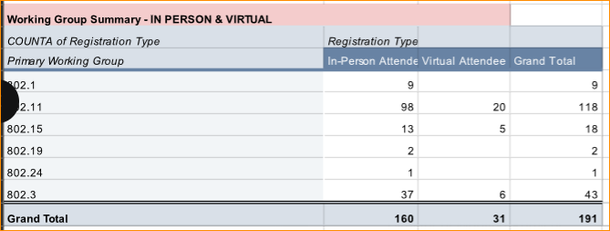
2025 May 5 Registration Status Report

Slide 10
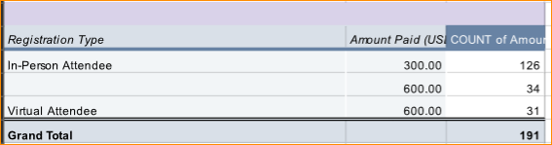
2025 May 5 Hotel Discount report
Hotel Room Block: 2585 (pending) 2415 Contracted:
2025 May 5 Pickup – 1059 (41%) Require 75%.

Slide 11
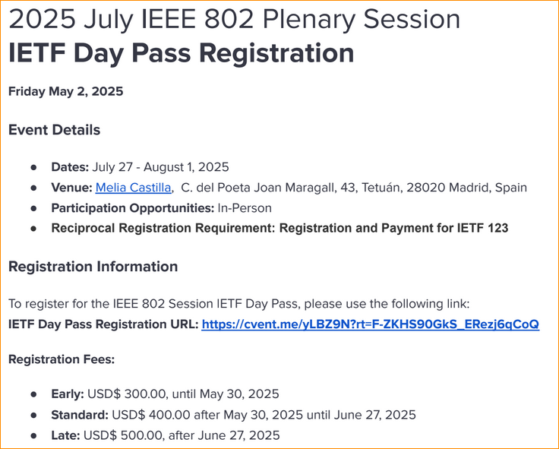
IETF One Day Pass Registration

Slide 12
6.05 Student Outreach Program
Approved new Text for Chair’s Guidelines March 14, 2025. Not yet posted to LMSC website (currently only redline for 11/17/2023)
Action item for WG Chairs – Ensure Students are not granted voting rights in WG
Today, Review direction and definition
  We have programed the certification of Students per updated policy.
  Please respond to emails you may receive.

Slide 13
IEEE 802 LMSC Chair's Guidelines and Standards Committee Policy Decisions, v37 11/17/2023
4.2 Student Fees
(LMSC motion origin, motion approved 17 November 2022.)
This guideline defines how IEEE 802 will handle student registration fees.
Moved: Student registration fee at the IEEE 802 plenary sessions of $150.
  1) This motion is effective from the November 2022 plenary session onward.
  2) Professors and academic staff need to pay the full registration fee. There are no exceptions to that rule. Retirees, out of work attendees also pay the full rate. IEEE 802 already has a number of university members attending and they will continue to pay the full fee.
  3) The student discount is based upon:
    a) Student attendance will not count toward voting rights.
    b) Students will not be included in the Membership Data Base for future meeting announcements. Since students are expected to change status rapidly, we don't want to try to keep track of their address.
    c) Students might join a Working Group Chair's reflector, at the discretion of the Working Group Chair.
  To obtain this discount, a member of the LMSC needs to certify the student. This will typically require the LMSC member to confirm that the individual is a student and that the LMSC member has explained the process for attending IEEE 802 meetings.
  Registration form will be filled out and fee will be paid at the meeting in normal manner. Student Badge will designate "student".
  A student is defined as currently taking at least 50% of a normal full-time academic program in an IEEE designated field of interest for the current academic year.
  The number of student discounts at a meeting will be limited to the first 10 applications.

Slide 14
Text to replace Chair’s Guideline section 4.2
  4.2 Student Fees
  (LMSC Motion approved 14 March 2025.)
  This guideline defines how IEEE 802 LMSC will handle student registration.
  Student registration fees for the IEEE 802 Plenary sessions are to be set concurrently with a motion setting the IEEE 802 Plenary session meeting registration fees. Any restrictions on number of students allowed for a session would also be set in said motion.
  Student registration fees only applies to an individual student. A Student is defined as currently taking at least 50% of a normal full-time academic program in an IEEE designated field of interest for the current academic year.
  Student Attendance does not count toward voting rights.
  Students may join an IEEE 802 LMSC subgroup reflector at the discretion of the IEEE 802 LMSC subgroup chair.
  A member of the IEEE 802 LMSC is required to certify a student’s status and request a registration link from the meeting planner for access to student registration. The IEEE 802 LMSC member who certified the student should explain the process for attending IEEE 802 meetings.
  The Meeting Planner will provide a list of Students and the IEEE 802 LMSC certifier to the IEEE 802 LMSC Chair for reporting during the IEEE 802 LMSC Opening Meeting.

Slide 15
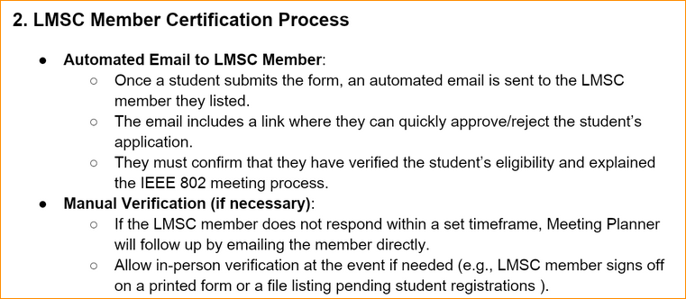
Current LMSC Member Certification Process
Proposed Student Fees Process documented in 802-EC-25/103:
https://mentor.ieee.org/802-ec/dcn/25/ec-25-0103-00-LMSC-proposed-method-to-manage-student-registration-for-ieee-802-plenary-sessions.docx

Slide 16
Proposed Changes to approve during June Telecon
Change title of 4.2 to Student Outreach Program
2. Add(insert) preamble to describe Student Outreach Program purpose and goals:
4.2.1 Purpose: Encourage university students to participate in IEEE 802 LMSC standards activities by reducing the required session fees.
4.2.2 [existing text]
3. Update Cert process per feedback/discussion.

Slide 17
New Text to replace Chair’s Guideline section 4.2
  4.2 Student Fees Student Outreach Program
  (LMSC Motion to be presented 2025 June 03 on the IEEE 802 LMSC Telecon.)
  4.2.1 Purpose: The Student Outreach Program is to encourage university students to participate in the IEEE 802 LMSC standards activities. The program provides for reduced session fees for students.
  4.2.2 This guideline defines how IEEE 802 LMSC will handle student registration:
  Student registration fees for the IEEE 802 Plenary sessions are to be set concurrently with a motion setting the IEEE 802 Plenary session meeting registration fees. Any restrictions on number of students allowed for a session would also be set in said motion.
  Student registration fees only applies to an individual student. A Student is defined as currently taking at least 50% of a normal full-time academic program in an IEEE designated field of interest for the current academic year.
  Student Attendance does not count toward voting rights.
  Students may join an IEEE 802 LMSC subgroup reflector at the discretion of the IEEE 802 LMSC subgroup chair.
  Students are to be invited to the New Member Orientation meetings. A member of the IEEE 802 LMSC is required to certify a student’s status and request a registration link from the meeting planner for access to student registration. The IEEE 802 LMSC member who certified the student should explain the process for attending IEEE 802 meetings.
  The Meeting Planner will provide a list of Students and the IEEE 802 LMSC certifier to the IEEE 802 LMSC Chair for reporting during the IEEE 802 LMSC Opening Meeting.
  The 802 WG Chairs shall verify that attendance credit is not granted to students on the list.

Slide 18
Ongoing - Call for Interest – 802 Executive Secretary –
Venue Preparation, Selection, and Contracting
The IEEE 802 LMSC Chair, James Gilb, has asked all appointed LMSC members to prepare a succession plan. The preparation of someone to step into the roles that need orientation and training so that they would be ready to take over the role and responsibilities.
One Role that I have is the IEEE 802 Executive Secretary.
The next 2 slides outlines the role and responsibilities required.
If you or someone you know would be interested in taking an active part in this role in the future, please have them contact me.

Slide 19
Executive Secretary Responsibilities
3.4.6 Executive Secretary
  The responsibilities of the Executive Secretary include:
    a) Scheduling meetings in coordination with the Standards Committee Chair and distributing a meeting notice at least 30 days before the meeting
    b) Oversee all activities related to Standards Committee sponsored meeting facilities and services
    c) With the Treasurer, ensure that Standards Committee sponsored sessions are compliant with IEEE financial policies
    d) Present summaries of venue options to the Standards Committee, select venues with approval of the Standards Committee, and sign approved proposals on behalf of IEEE 802
    e) Coordinate with conference service providers and Standards Committee Chair on major decisions
    f) Oversee maintenance of Standards Committee registration database
    g) Carry out the duties of the Treasurer if the Treasurer is unavailable.
Notes:
IEEE 802 LMSC Policies and Procedures -- ec-20-0124-05-00EC

Slide 20
IEEE 802 LMSC Chair's Guidelines and Standards Committee Policy Decisions, v37 11/17/2023
2.10.6 Executive Secretary Responsibilities
  1) IEEE 802 sessions: Efficiency improvement
    a) Ensure existing automated tools are operating properly (e.g., registration database,
    attendance monitoring, document handling, IEEE 802 web page, etc.) in conjunction with
    the Recording Secretary
    b) Develop requirements for additional meeting services to improve IEEE 802’s efficiencies in
    developing standards (e.g., combined live and virtual meetings, purely virtual meetings,
    improved registration, attendance and document systems, etc.)
    c) Prototypes, deploys, tests, evaluates and summarizes test results of new systems.
    d) When appropriate work closely with IEEE SA staff to evaluate and/or implement new
    systems.
    e) Manage the introduction of new systems until they are operating smoothly.
    f) Provide guidance to IEEE SA Standards Committees, Working Groups and Staff outside of
    IEEE 802 in deploying new smoothly operating systems
  2) IEEE 802 plenary sessions: Facilities and services
    a) Oversee activities related to meeting facilities and services in conjunction with the Treasurer
    b) Assist in identification of future site choices/locations
    c) Coordinate with Conference Service Provider and the Standards Committee Chair on major
    decisions
  3) IEEE 802 registration database
    a) Responsible for database maintenance
    b) Oversee conference service staff on updates and additions
    c) Protection against loss/corruption of data
  4) Assist IEEE 802 Treasurer
    a) Review of expenditures and future budget preparations
    b) Identify meeting deadbeats and report to treasurer for collection

Slide 21
8.04 Monthly IEEE 802 LMSC Telecons
Announcement of 802 LMSC Interim Telecons
Tuesday 6 May 2025, 19:00-21:00 UTC
Tuesday 3 June 2025, 19:00-21:00 UTC
Call Time: Tuesday, 3:00 PM - 5:00 PM (UTC-04:00) Eastern Time (ET)
Recurrence: Occurs Generally the first Tuesday of every month.
From 7:00 PM to 9:00 PM, (UTC+00:00) Reykjavik, Iceland time zone.
Calls after July Plenary to be Scheduled during 2025 July IEEE 802 LMSC Closing Plenary meeting.
Notes:
802 Interim Telecons – 1st Tuesday of the following Months: January/February/April/May/June/August/September/October
Jan 7 , Feb 4, April 1, May 6, June 3, August 5, Sept 2, Oct 7

Slide 22
8.05 Call for Tutorials for July 2025
Tutorials may be held electronic: TBA
In person/Mixed-mode Tutorials: March (Mon/Tues)
Tutorial Request form:
  https://mentor.ieee.org/802-ec/dcn/23/ec-23-0128-00-00EC-802-tutorial-request-form-2023.docx
As a reminder, please refer to Chair's Guidelines section 2.5 Tutorials for the logistics for participating in sponsoring/presenting a Tutorial.
Note that Tutorial times are limited to 80 minutes with 10 minutes to allow for presenters to setup and depart. (Starting at 18:15).
All requests for Tutorials must be made by 12 June 2025
Notes:
All official tutorial request forms must be submitted no later than 45 days in advance of the Plenary Session.
Approved Tutorial Requests will be assigned a time slot based on the order in which they were received.
The Final Tutorial Schedule will be posted at http://802world.org/plenary and http://ieee802.org no less than 30 days in advance of the Plenary Session.
Mentor Link to 2023 Tutorial Request form: https://mentor.ieee.org/802-ec/dcn/23/ec-23-0128-00-00EC-802-tutorial-request-form-2023.docx

