Slide 1
IEEE 802 March 2025
Public Visibility
Standing Committee Updates
March 2025

Slide 2
802 Public Visibility SC Scope, Duties, Membership
  Scope and Duties
  To raise public visibility and industry awareness in timely fashion of IEEE 802 WG / TAG activities
  Develop social media content based on IEEE 802 WG / TAG activities
    LinkedIn – https://www.linkedin.com/company/ieee802
    IEEE-SA 802 - https://standards.ieee.org/featured/802/index.html
  Content
    Review Pre 802 Plenary meetings for social media messaging: PARs to be considered, Tutorials, [802.3] Call-for-Interests, New Task Force formations
    Review Post 802 Plenary meetings for social media messaging: Study Group formations, IEEE 802 Position Approvals
    Other 802 related material for social media messaging: Press Releases, White Paper publications, Other 802 approved news, 802 WG / TAG Activities with IEEE-SA
    IEEE-SA Standards Board Related - PAR Approvals, Standards Approval, Standards Publication
  Membership
  Membership in the Standing Committee is open to anyone that wishes to participate (ideally at least one participant from each 802 WG and TAG)

Slide 3
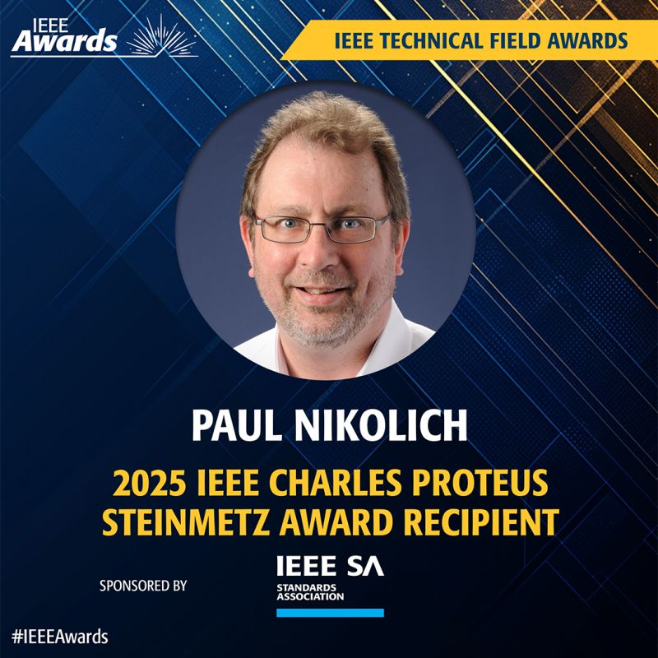
Linkedin Report
  https://www.linkedin.com/company/ieee802
  5053 total followers
  Last 365 days
    72291 Impressions
    1520 Reactions
  Latest Post
    Paul’s Award

Slide 4

WG Logos

Slide 5

WG Logos

Slide 6

WG Logos

Slide 7
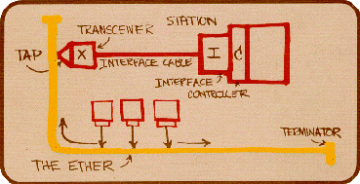
WG Logos

Slide 8
WG logos
3

Slide 9

WG Logos

Slide 10
WG logos

Slide 11
WG logos
9

Slide 12
Linkedin Posts for WGs
  WG/TIGs can post their short meeting reports. Below text will be the 802.19 report.
  IEEE 802.19 develops standards for coexistence between wireless standards of unlicensed devices and reviews coexistence assurance (CA) documents produced by working groups developing new wireless standards for unlicensed devices.
  802.19.3 Task Group continues to work on the 802.19.3a amendment. The amendment will update and expand coexistence recommendations to address new market requirements, increasing data traffic, greater device density of devices, and increased potential for congestion based on both IEEE Std 802.11-2020 and IEEE Std 802.15.4 sub-1 GHz standards. Below presentations were made:
  Experimental results of coexistence between IEEE 802.11ah and IEEE 802.15.4g using actual devices
  Coexistence Simulation of IEEE 802.11ah and IEEE 802.15.4g SUN PHYs Compliant with Japanese Standard ARIB STD-T108 version 1.5
  OFDM Windowing for Improved Reception Performance
  Planned Interference Measurements
  Presentations are available at https://mentor.ieee.org/802.19/documents
  For questions you can reach WG Chair @Tuncer Baykas

Slide 13

Linkedin Post for History AdHoc
IEEE 802 History Ad Hoc Group established to:
      Initiate electronic preservation of historical 802 documents
      Identify pertinent materials of historical interest, e.g., documents, audio recordings, video recordings, etc.
      Capture recollections of long time 802 LMSC participants
IEEE 802 History Ad Hoc Group prioritizes preserving the first 15 years (1979-1994) of historical material. If you are a 802 LMSC participant you can reach @Tuncer Baykas .
.

Slide 14
Adding Information about IEEE Senior Member Level to the WG Opening/Midweek Reports
https://www.ieee.org/membership/senior/
10 years in the profession. (5 for PhD holders)
The applicant must also provide three references from current IEEE members holding Senior Member, Fellow, or Honorary Member grade.
1) Tuncer Baykas volunteers to be one of them.

Slide 15
Inviting IEEE Region Leaders to Plenary Meetings
For Madrid meeting we can invite
IEEE Region 8 President
IEEE Region 8 President-Elect
IEEE Region 8 Technical Activities Chair
They can give talks to LMSC and WGs.
.

Slide 16




Inviting other IEEE Organizations
.

Slide 17
IEEE 802 Scholarship for Graduate Students
The Scholarship is for students whose thesis topic is related IEEE 802 technologies.
It enables the student to join IEEE plenary and related interim meetings after thesis proposal approval until graduation.
At the beginning of the scholarship the student will make a presentation to the related TG/WG.
At the end of the scholarship the student will present the thesis.

Slide 18

IEEE SA Standards Awards Nominations
Submit your nominations of deserving honorees today
https://standards.ieee.org/about/awards/nominate/
The nomination period is now open and will run until 31 July 2025.
IEEE SA CONFORMITY ASSESSMENT AWARD IEEE SA CORPORATE AWARD
IEEE SA STANDARDS BOARD DISTINGUISHED SERVICE AWARD
IEEE SA LIFETIME ACHIEVEMENT AWARD
IEEE SA INTERNATIONAL AWARD IEEE SA STANDARDS COMMITTEE AWARD FOR OUTSTANDING CONTRIBUTION TO ENTITY STANDARDS IEEE SA STANDARDS MEDALLION

