Slide 1
Wireless Treasurer Report 2025
Date: 2025-09-14
Authors:

Slide 2
Abstract
This file contains the Wireless Treasurer report for the Joint IEEE 802.11/.15 Wireless funds for 2025:
  R0: Presented to 12 Jan 802WCSC mtg and the January 13th 802WCSC Opening Plenary mtg in Kobe, Japan
  R1: Presented to 09 March 802WCSC mtg and the 802.11 and 802.15 WG Plenary meetings in Atlanta, GA, USA
  R2: Prepared for the 09 April 802WCSC Telecon (Telecon was cancelled, but file was posted.)
  R3: Presented to 11 May 802WCSC mtg and 12 May 802WCSC Opening Plenary Mtg in Warsaw.
  R4: Updated with discussions during 11 May 802WCSC mtg.
  R5: Updated typo on slide 16 (2025 Sept)
  R6: Presented to 27 July 802WCSC Mtg /802.11 closing plenary – 8-01-2025
  R7: Presented at 2025 August 20 802WCSC Telecon – Focus 2026 Session Fees.
  R8: Presented to 2025 Sept IEEE 802 Wireless Interim – 802WCSC and 802W Opening Plenary

Slide 3
802.11/.15 Joint Account Balance Overview
September 14, 2025
2026 Jan – Victoria – Deposits for Hotel and Conference Center paid = USD$41,178.54
Total Assets: USD$1,262,666.52

Slide 4
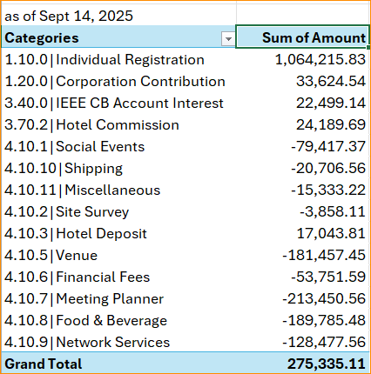
2025 Income/Expense Report Summary
Income/ Expense Report
January 1, 2025,
to
Sept 14, 2025

Slide 5
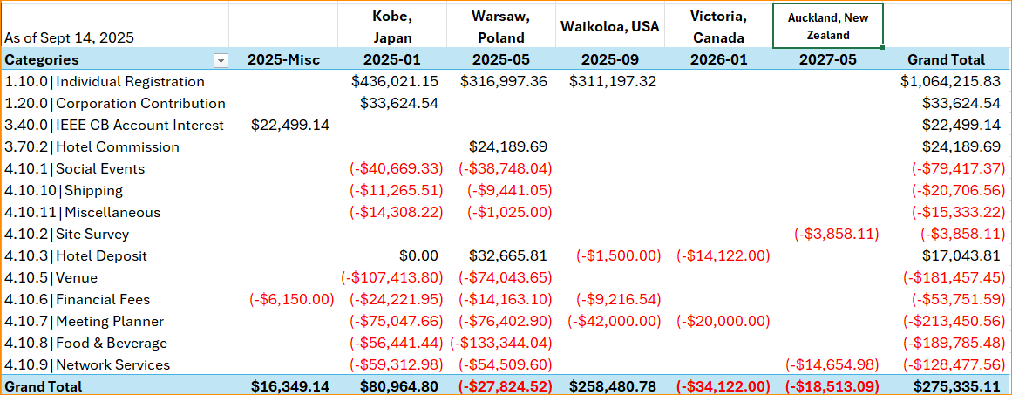
2025 Income/Expense Report
Notes:
Remember that this table has only transactions from January 1, 2025 through Sept14, 2025.
2025-MISC $6,000 = 2023 Audit Charges
Note the Grand Total (Net value) for Kobe, Japan = $80,964.80 (2024-2025) there is another charge for $3,990.75 from 2023 included for final Net value: $76,314.00 for 2025-01 – Kobe, Japan.

Slide 6
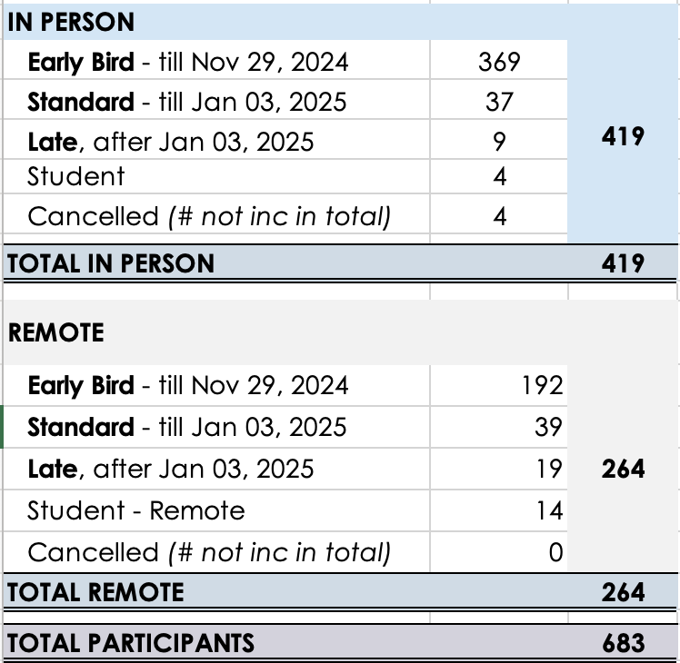
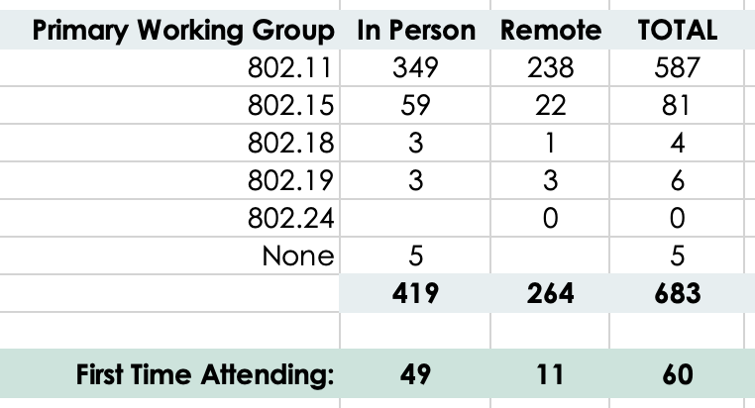
2025 January
IEEE 802W Mixed-Mode Interim
FINAL REGISTRATION
Jan 12-17, 2025
Kobe Convention Centre, JAPAN
Update: Sept 12, 2025

Slide 7
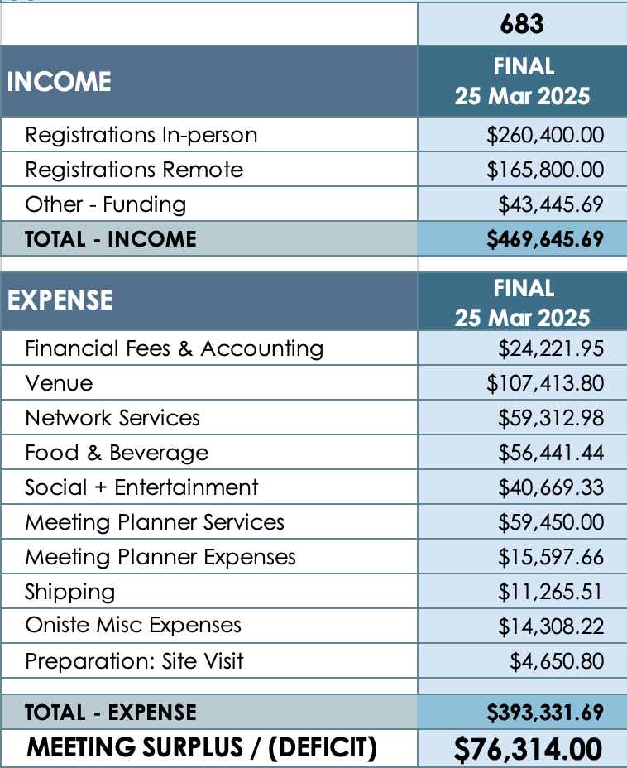
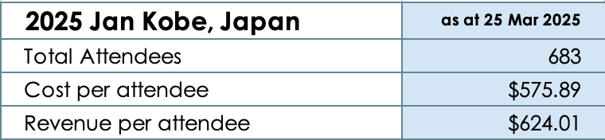
2025 January
IEEE 802W Mixed-Mode Interim
FINAL BUDGET
Jan 12-17, 2025
Kobe Convention Centre, Japan
Update: Sept 12, 2025
Notes:
The bottom line, surplus now includes the final amount Hiroshi paid from IEEE Japan Section on 7 June 2025 directly to IEEE 802W of US$5,420.94. Also, there is charge for $3,990.75 from 2023 included for final Net value: $76,314.00

Slide 8
2025 January
IEEE 802W Mixed-Mode Interim
FINALDEADBEAT LIST
Jan 12-17, 2025
Kobe Convention Centre, JAPAN
Update: Sept 12, 2025
Deadbeat past 60 days:
Weili, Liu, Shenzhen University, liuwl@szu.edu.cn

Slide 9
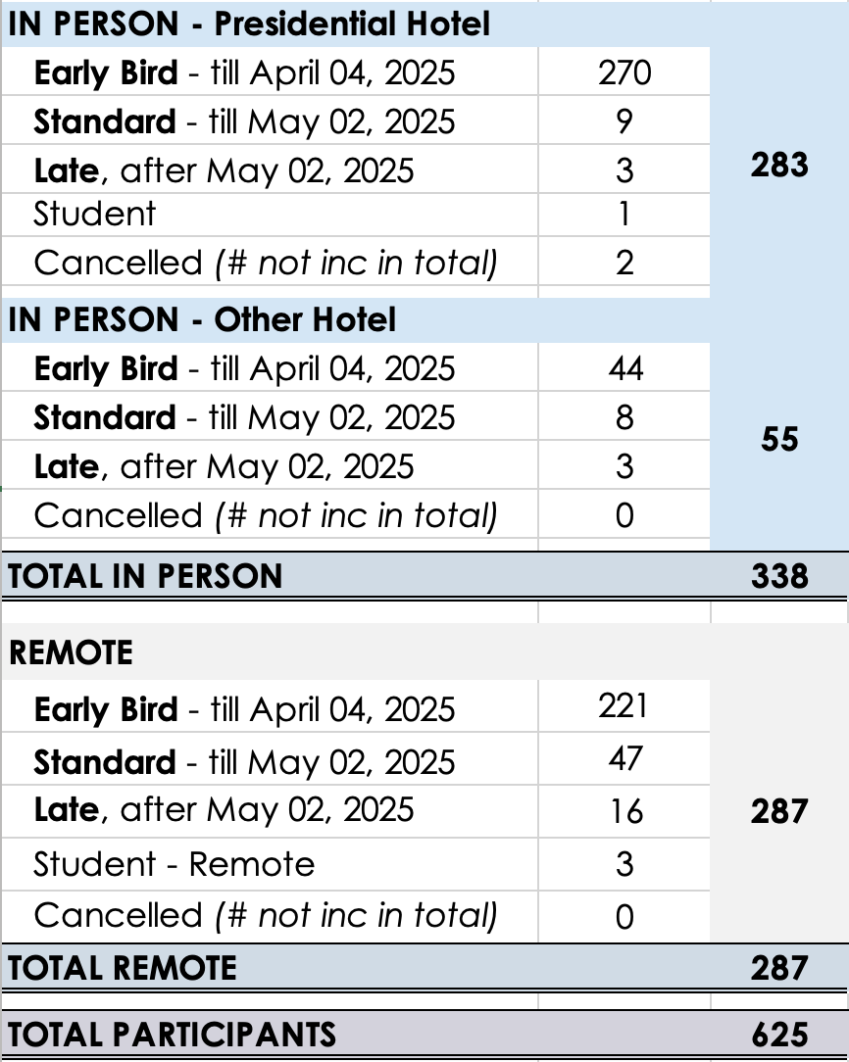
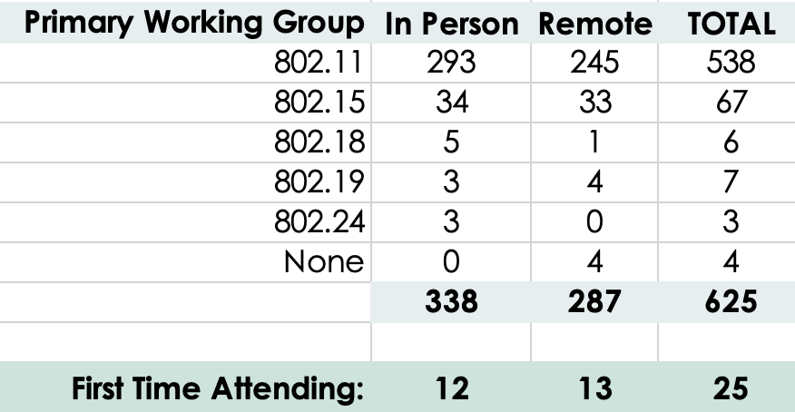
2025 May
IEEE 802W Mixed-Mode Interim
FINAL REGISTRATION
May 11 - 16, 2025
Warsaw Presidential Hotel, Poland
Update: Sept 12, 2025

Slide 10
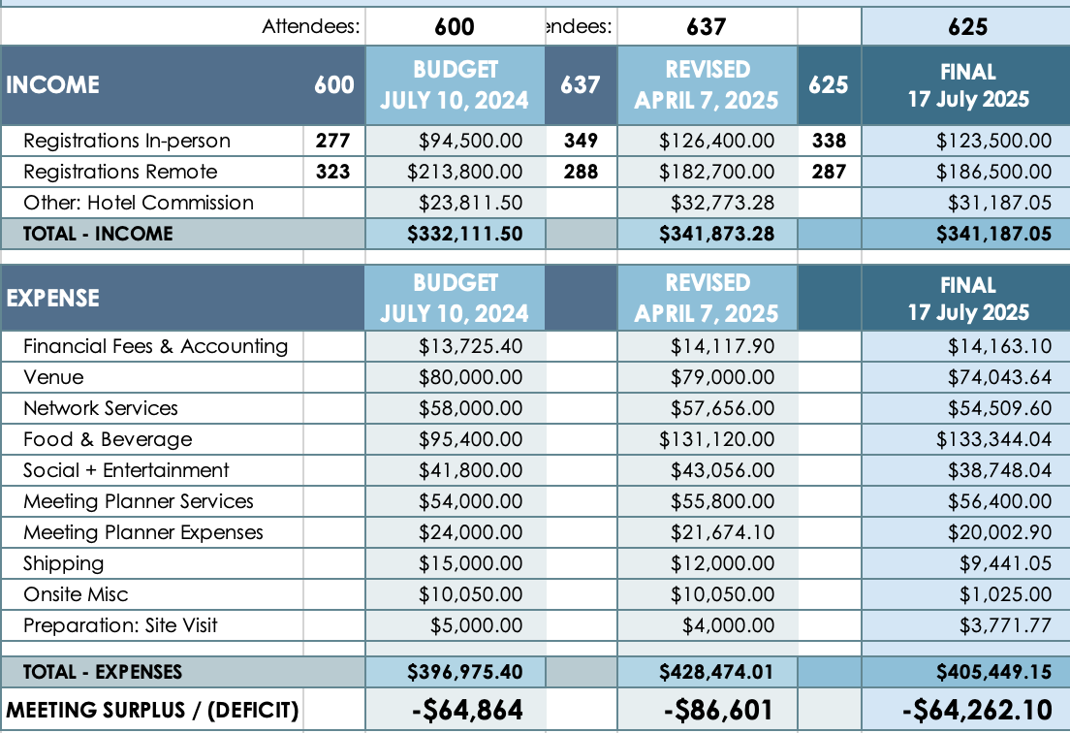
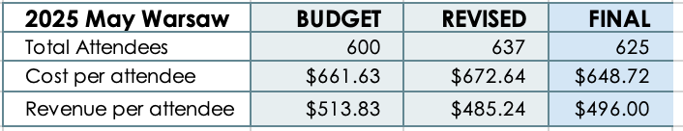
2025 May
IEEE 802W Mixed-Mode Interim
FINAL BUDGET
May 11 - 16, 2025
Warsaw Presidential Hotel, Poland
Update: Sept 12, 2025

Slide 11
2025 May
IEEE 802W Mixed-Mode Interim
FINAL DEADBEAT LIST
May 11-16, 2025
Warsaw Presidential Hotel, POLAND
Update: Sept 12, 2025
4 potential non-registered attendees were identified. All paid prior to the deadline
Deadbeat past 60 days:
Nil

Slide 12
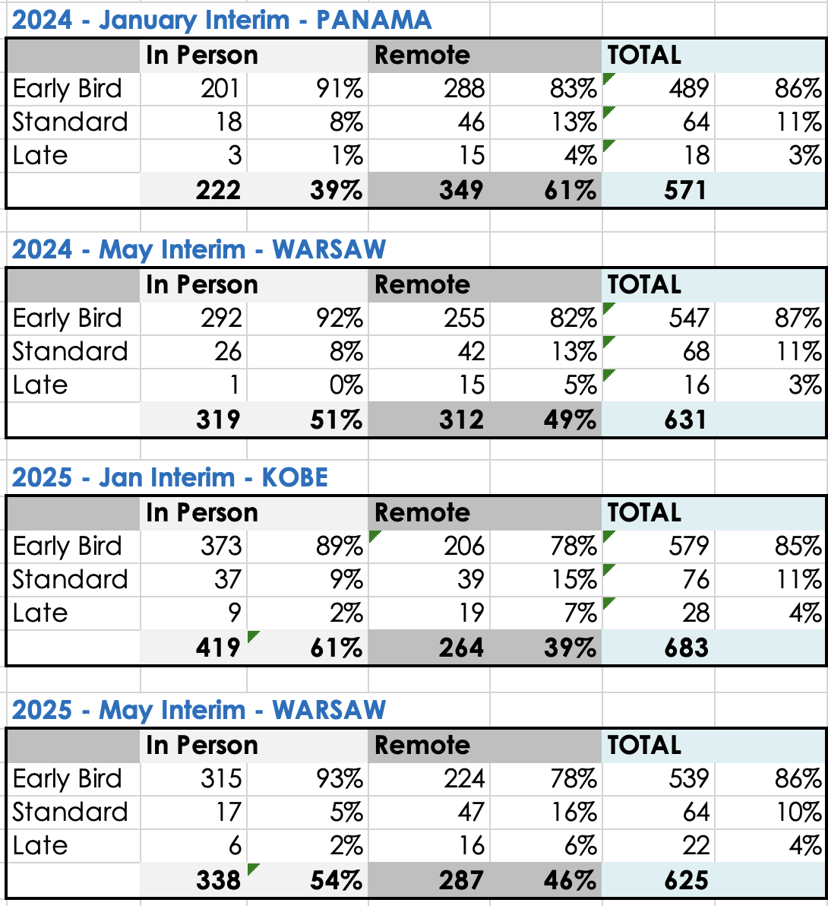
Notes:
Top level summary of country breakdown

Slide 13
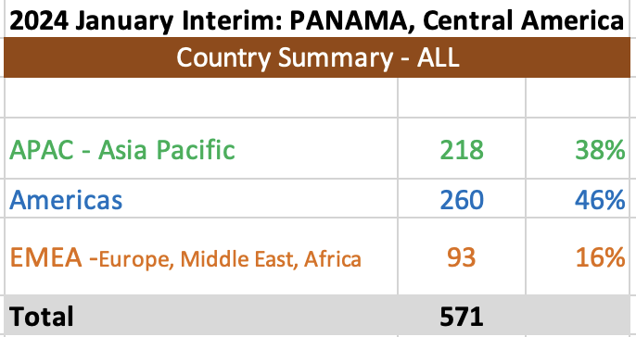
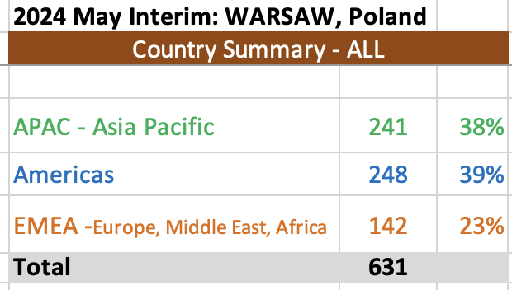
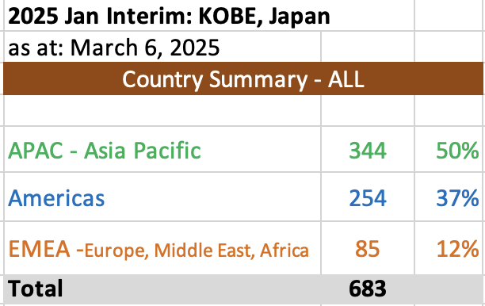
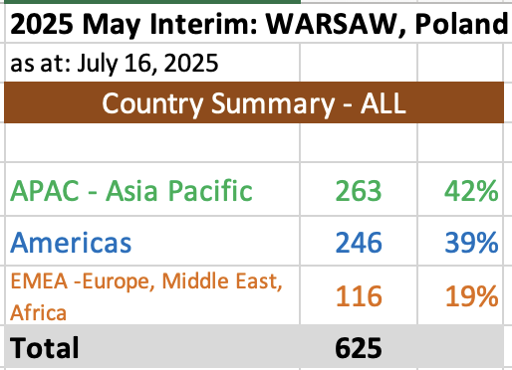
Notes:
Top level summary of country breakdown

Slide 14
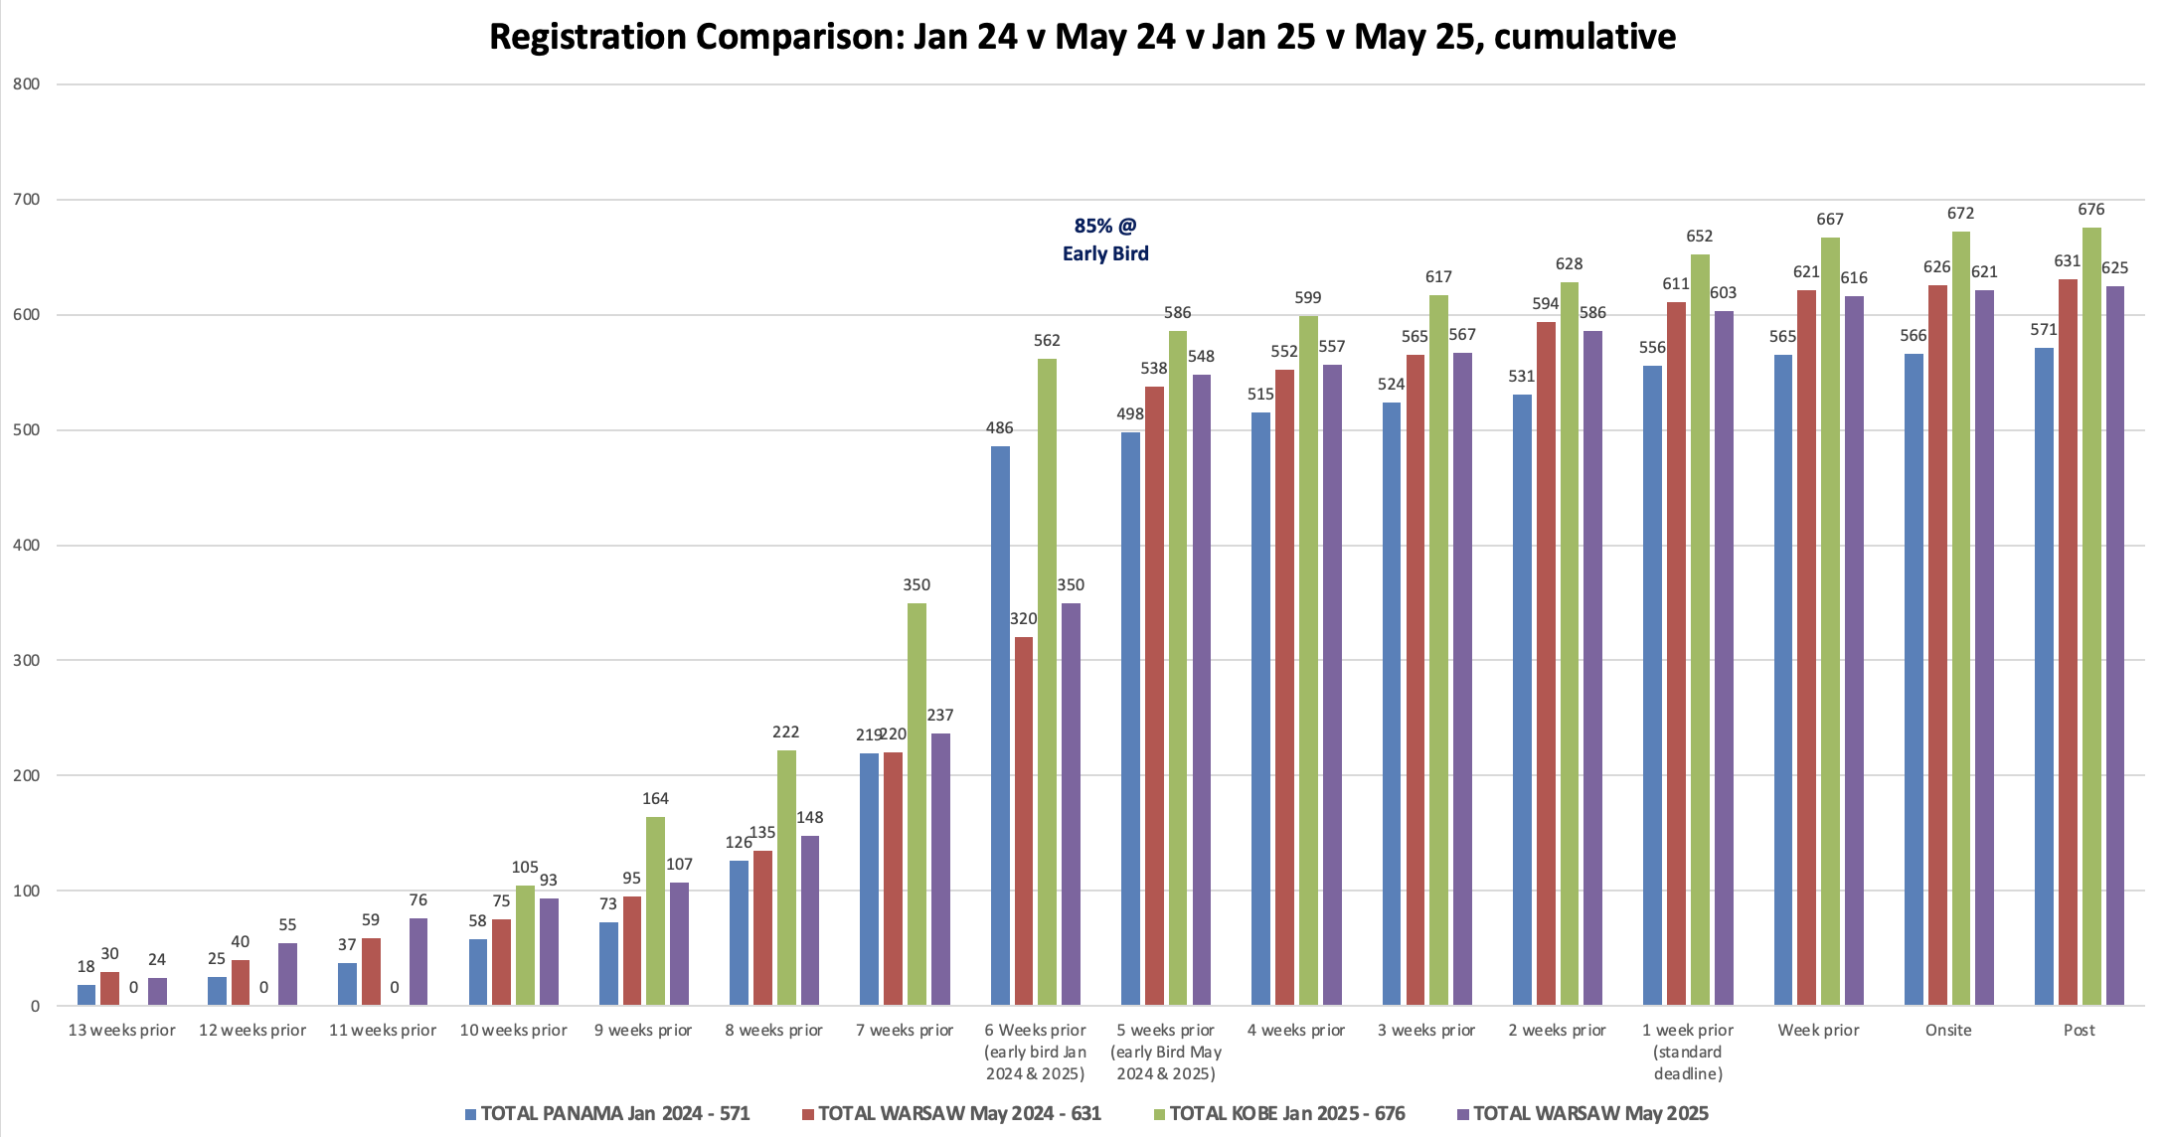
September 2025

Slide 15
2025 Sept IEEE 802W Mixed-mode Interim Budget report
Interim: Sept 2025 -Waikoloa Update Date: 2025-July 25
Income (BUDGET):
      Registrations In-person 337 => $131,600.00
      Registrations Virtual + Student 288 => $193,300.00
      Hotel Credits/Rebates $ 37,375.35
      Total Income: 625 = > $362,275.35 Est Income per person: $519.84
    Expense: Budget March 25 Budget July 25
Financial Fee: $ 10,995.00 $ 11,997.00
  Venue: $ 26,640.00 $ 26,025.00
  AV Services: $ 23,850.00 $ 24,850.00
  Networking $ 40,000.00 $ 40,455.00
  F&B $175,781.81 $267,653.27
  Social $ 51,718.91 $ 58,973.80
  Meeting Planner: $ 57,600.00 $ 57,110.00
  Shipping $ 7,000.00 $ 6,000.00
  Misc. $ 11,773.28 $ 11,373.28
  Site Visit $ 0.00 $ 0.00
  Total Expense: $(504,437.35) Budget Expense per Person: $807.10
Meeting Surplus/(Deficit) (-$142,162.00)
Notes:
802wfin-25-0019-00-Budg-BUDGET-2025 SEPT - 802W-Waikoloa
updated with 802wfin-25-0019-02-Budg-BUDGET-2025 SEPT - 802W-Waikoloa

Slide 16
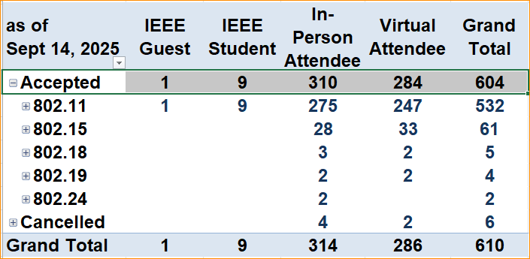
Registration Summary – 14 Sept 2025

Slide 17
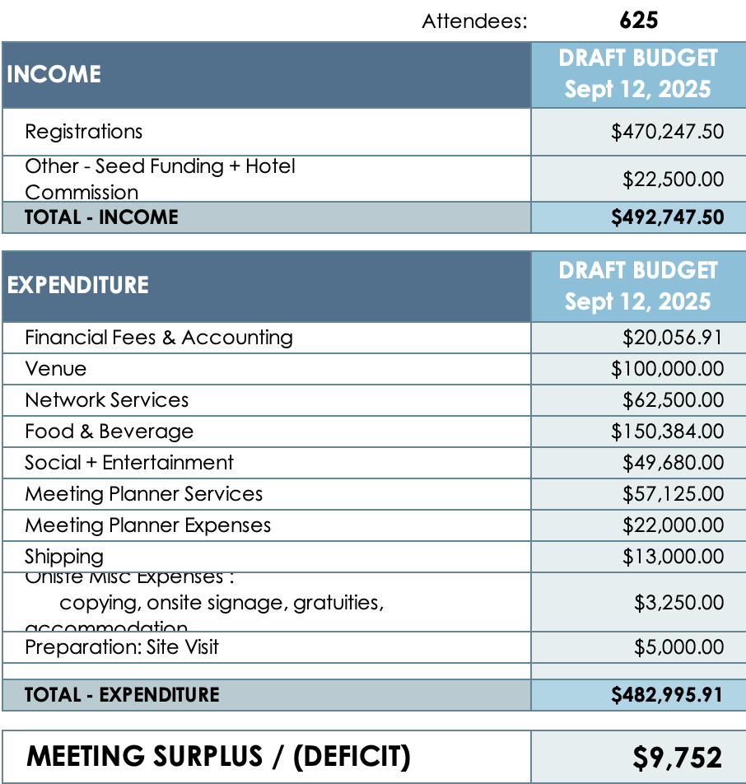
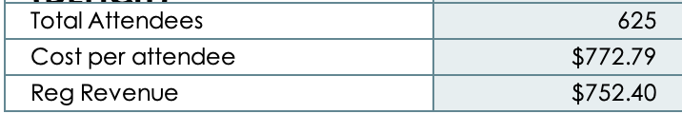
2026 May
IEEE 802W Mixed-Mode Interim
DRAFT BUDGET
May 10 - 15, 2026
Hilton Antwerp Old Town, BELGIUM
Update: Sept 12, 2025
Notes:
Based on 625 attendees.
Based on the following: noting that this hotel has a limit of 200 rooms available noting that the other in-person attendees will be directed to overflow hotels.
2026 IEEE 802 Wireless Interim Session fees are:
Early Bird: $800
Standard: $1,000
Late: $1,200
A $300 discount for 3-night Hotel Stay

Slide 18
2020 to 2024 Income/Expense Net Value
2020 - ($-141,672.88)
2021 - $18,813.00
2022 - $ 580,740.51
2023 - ($-25,454.64)
2024 - $ 16,706.13
2025 – ($-479,102.24) (Estimated)
Net income/Expense value 2020 to 2025 (Sept 14, 2025) = ($-29,970.12)
Notes:
Motion to set the 2025 Session Fees: July 14, 2024
Session Fees for 2025 remained the same as 2024 ($600/$800/$1000)
Motion to set the 2026 Session Fees: Aug 20, 2025
Session Fees for 2026 set to ($800/$1000/$1200)

Slide 19
Future Interim Meeting Fees
IEEE 802 Wireless Interim Session meeting fees are set by
  the IEEE 802W Exec Committee of the Joint Treasury
  Meeting fees are expected to balance actual costs to zero over 2-3 years.
Meeting Fees for 2025 802W Interims –
    $600/$800/$1,000 Mixed Mode – (In Hotel 3-night Stay Discount $300 (May/Sept))
Meeting Fee impact on budgets to be reviewed between now and Aug 20 802WCSC telecon.
Meeting fees for 2026 802W Interims to be set in August or during the 2025 Sept Session.

Slide 20
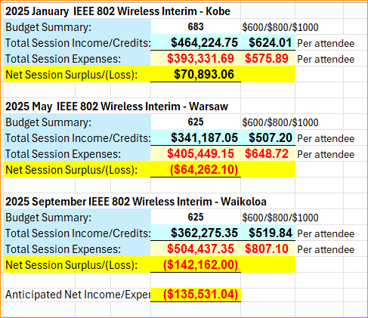
2025 Net Session Report

Slide 21
2026 Predicted Net Session Report

Slide 22
Deadbeat Consequences
No participation credit will be granted for said session.
Any participation credit acquired before said session toward membership in any IEEE 802 LMSC group is revoked.
Membership in any IEEE 802 LMSC group is terminated.
No participation credit will be granted for attendance at any subsequent IEEE 802 LMSC session until the individual has complied with the registration requirements for all previously attended IEEE 802 LMSC sessions by the start of said subsequent session.

Slide 23
These individuals are in arrears on IEEE 802 meeting fees
Until payment is made IEEE 802 rules mandate that they not attend meetings during any 802 plenary session, cannot complete registration for a meeting, voting rights are rescinded, and attendance credit is reset as if no meetings had been attended.
WG | Name | Affiliation | Session 1 | Session 2
3 | Rea, David | The Siemon Company (note - no longer with them) | Nov-21
1 | Bolia, Harsh | Analog Devices Inc. | Jul-21
3 | Rannow, R K | Silverdraft Supercomputing | Jul-21
15 | Rocha, alessandra | Wimax forum | Jul-21
11 | Roy, Richard |  | Jul-21
11 | Liu, Baosheng |  | Sep-21
11 | Hangbin, Zhao | China Mobile (Hangzhou) Information Technology Co., Ltd | May-24
11 | Liu, Wenchao | Self | May-24
11 | Hosseinianfa, Hamid | ex-Offino | Sep-24
11 | Liu, Weili | Shenzhen University | Jan-25
UPDATED THROUGH January 2025 802 Wireless Interim (INCLUSIVE), and payment activity through 2025-03-25.
Ben Rolfe (BCA); Jon Rosdahl (Qualcomm)

Slide 24
2020 – 2025 Historical Attendance
2020
  335 – Person - Irvine ($1622; -$3,648)
  000 – Canceled [Warsaw] ($1,500; -$6,750)
  NR – Virtual [Atlanta] (0; -$25,000)
2021
  NR – Virtual [Irvine] (0; -$12,500)
  NR – Virtual [Panama] (0, 0)
  497 – Virtual [Waikoloa] (-$32,767; $10,657)
2022
  600 – Virtual [Panama] (0; $28,703)
  527 – Virtual [Warsaw] (-$67,324; $208,230)
  499 (254/245) – Mixed - Waikoloa, ($23,324; $209,491)
2023
  605 (272/331) – Mixed Baltimore ($22,142; $110,497)
  528 (248/280) – Mixed Orlando (-$38,744.; -$24,566)
  536 (233/303) – Mixed Buckhead ($12,879; $34,070)
2024
  571 (222/349) – Mixed Panama ($15,740, $24,287)
  631 (319/312) – Mixed Warsaw (-$69,940, -$44,603)
  567 (277/290) – Mixed Waikoloa (-$60,990, -$82,258)
2025
  683 (419/264) – Mixed Kobe (-$8,045, $70,893.06)
  625 (338/287) – Mixed Warsaw (-$64,864, -$64,262.10)
  604 (319/285) – Mixed Waikoloa (-$68,430, -$142,162)
Notes:
doc.: IEEE 802.15-11/0204r0
March 2011
Historical Attendance:
Number attending the meeting (Local/Remote) [Virtual/Mixed/Person]- Location - (Initial Budget, final budget )
The numbers in red are a negative (loss), and the black are a positive
Note 2022 January was originally scheduled for a replacement for 2021 Jan Irvine – The Hotel did not reopen, and Panama was scheduled for 2022 Jan, but we did remain virtual – No Budget for that meeting, but Irvine paid a penalty for cancelling, and F2F Events was paid a fee. Balance is shown.
Note 2023 January was originally scheduled to be at the Marriott Baltimore hotel. The Hotel cancelled on Sept 2, and paid a penalty to move the meeting to the Hilton Baltimore:
Note 2024 Warsaw: Originally budget (2021) was for 280 total mixed mode ($34k) – Updated Budget for Dec 2023 Budget 600 pax (-$69,990)

Slide 25
Historical
Income/Expense reports

Slide 26
2025 Income/Expense Report Summary
Income/ Expense Report
January 1, 2025,
to
September 14, 2025

Slide 27
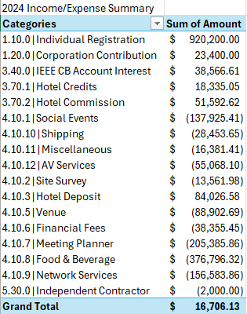
2024 Income/Expense Report Summary
Income/ Expense Report
January 1, 2024,
to
December 31, 2024

Slide 28
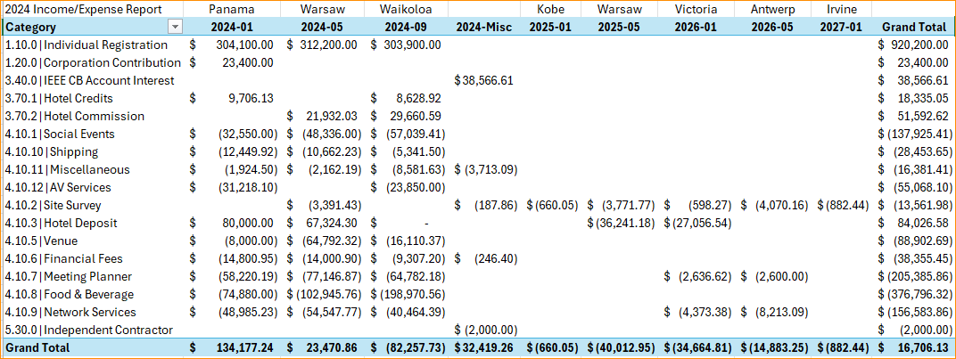
2024 Income/Expense Report

Slide 29
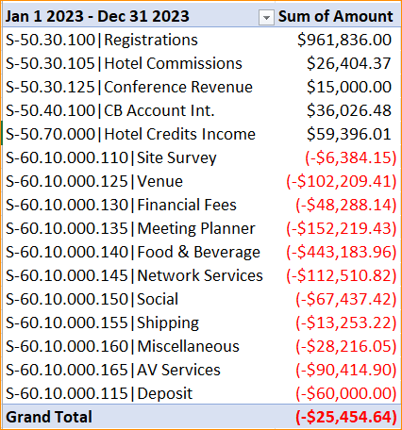
Income/ Expense Report
Jan 1, 2023, to
Dec 31, 2023

Slide 30
2023 Income/Expense Report
Notes:
2023-05 Orlando Attrition Fees = $8,403.11.

Slide 31
2023 Meeting Final Session Budget Report
2023 Net: $175,589.11

Slide 32
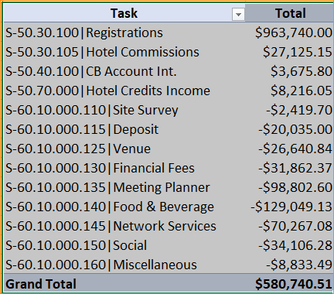
Income/ Expense Report
Jan 1, 2022, to
Dec 31, 2022

Slide 33
2022 Income/Expense Report

Slide 34
Income/ Expense Report
Jan 1, 2021, to
Dec 31, 2021
Task | Total
S-50.30.100|Registrations | $ 26,610.00
S-50.40.100|CB Account Int. | $ 1,213.96
S-50.50.000|Other | $ 38,437.50
S-60.10.000.130|Financial Fees | $ (2,416.80)
S-60.10.000.135|Meeting Planner | $ (42,500.00)
S-60.10.000.160|Miscellaneous | $ (2,531.66)
Grand Total | $ 18,813.00

Slide 35
2020 Actual Income Statement
Financial Row | 2020 - Misc | 2020-01 Irvine, CA | 2020-05 Warsaw, Poland | 2020-09 - Atlanta | 2021-01 Irvine, CA | 2021-09 Waikoloa, HI | 2022-01 Irvine, CA | 2022-05 Warsaw, Poland | Total
 | Amount | Amount | Amount | Amount | Amount | Amount | Amount | Amount | Amount
Ordinary Income/Expense
Income
2.11 - Registrations | $0.00 | $275,800.00 | $0.00 | $0.00 | $0.00 | $0.00 | $0.00 | $0.00 | $275,800.00
2.12 - Hotel Commissions | $0.00 | $33,123.40 | $0.00 | $0.00 | $0.00 | $0.00 | $0.00 | $0.00 | $33,123.40
3.40 - IEEE CB Account Interest | $3,824.93 | $0.00 | $0.00 | $0.00 | $0.00 | $0.00 | $0.00 | $0.00 | $3,824.93
Total - Income | $3,824.93 | $308,923.40 | $0.00 | $0.00 | $0.00 | $0.00 | $0.00 | $0.00 | $312,748.33
Expense
4.111 - Deposit | $0.00 | $0.00 | ($35.00) | $0.00 | $0.00 | $0.00 | $0.00 | $67,324.30 | $67,289.30
4.113 - Venue | $0.00 | $29,524.67 | $0.00 | $0.00 | $0.00 | $0.00 | $0.00 | $0.00 | $29,524.67
4.12 - Financial Fees | $5,120.76 | $12,625.78 | $0.00 | $0.00 | $0.00 | $0.00 | $0.00 | $0.00 | $17,746.54
4.13 - Meeting Planner | $0.00 | $52,702.30 | $6,785.00 | $25,000.00 | $12,500.00 | $12,500.00 | $12,500.00 | $0.00 | $121,987.30
4.14 - Food & Beverage | $0.00 | $145,643.01 | $0.00 | $0.00 | $0.00 | $0.00 | $0.00 | $0.00 | $145,643.01
4.15 - Network Services | $0.00 | $40,444.57 | $0.00 | $0.00 | $0.00 | $0.00 | $0.00 | $0.00 | $40,444.57
4.16 - Social | $0.00 | $24,201.67 | $0.00 | $0.00 | $0.00 | $0.00 | $0.00 | $0.00 | $24,201.67
4.17 - Shipping | $0.00 | $1,867.30 | $0.00 | $0.00 | $0.00 | $0.00 | $0.00 | $0.00 | $1,867.30
4.18 - Misc Expense | $154.57 | $5,562.28 | $0.00 | $0.00 | $0.00 | $0.00 | $0.00 | $0.00 | $5,716.85
Total - Expense | $5,275.33 | $312,571.58 | $6,750.00 | $25,000.00 | $12,500.00 | $12,500.00 | $12,500.00 | $67,324.30 | $454,421.21
Net Income | ($1,450.40) | ($3,648.18) | ($6,750.00) | ($25,000.00) | ($12,500.00) | ($12,500.00) | ($12,500.00) | ($67,324.30) | ($141,672.88)
Notes:
Misc Expenses for 2020:
SLIKSVN Inv # F20200053 – Subversion for $138.07
Post office – Stamps/envelopes - $16.50
2020-05 – Warsaw Poland – Session Cancelled- $35 is wire transfer shortage – still payable to MTG-Events.
Misc Expenses Finance Fees are the Authorize.net monthly charges that have no meeting to be applied to.
Audit fee for 2019 $5030.76 included in 4.12 in 2020 – Misc
All expenses/income for 2020 included.

Slide 36
2020 Meeting Income Statement
Financial Row | 2020 - Misc | 2020-01 Irvine, CA | 2020-05 Warsaw, Poland | 2020-09 - Atlanta | Total
 | Amount | Amount | Amount | Amount | Amount
Ordinary Income/Expense
Income
2.11 - Registrations | $0.00 | $275,800.00 | $0.00 | $0.00 | $275,800.00
2.12 - Hotel Commissions | $0.00 | $33,123.40 | $0.00 | $0.00 | $33,123.40
3.40 - IEEE CB Account Interest | $3,824.93 | $0.00 | $0.00 | $0.00 | $3,824.93
Total - Income | $3,824.93 | $308,923.40 | $0.00 | $0.00 | $312,748.33
Expense
4.111 - Deposit | $0.00 | $0.00 | ($35.00) | $0.00 | ($35.00)
4.113 - Venue | $0.00 | $29,524.67 | $0.00 | $0.00 | $29,524.67
4.12 - Financial Fees | $5,120.76 | $12,625.78 | $0.00 | $0.00 | $17,746.54
4.13 - Meeting Planner | $0.00 | $52,702.30 | $6,785.00 | $25,000.00 | $84,487.30
4.14 - Food & Beverage | $0.00 | $145,643.01 | $0.00 | $0.00 | $145,643.01
4.15 - Network Services | $0.00 | $40,444.57 | $0.00 | $0.00 | $40,444.57
4.16 - Social | $0.00 | $24,201.67 | $0.00 | $0.00 | $24,201.67
4.17 - Shipping | $0.00 | $1,867.30 | $0.00 | $0.00 | $1,867.30
4.18 - Misc Expense | $154.57 | $5,562.28 | $0.00 | $0.00 | $5,716.85
Total - Expense | $5,275.33 | $312,571.58 | $6,750.00 | $25,000.00 | $349,596.91
Net Income | ($1,450.40) | ($3,648.18) | ($6,750.00) | ($25,000.00) | ($36,848.58)

Slide 37
2019 Meeting Income Statement
 | 2019 Misc. | 2019-01 St. Louis, MO | 2019-05 Atlanta, GA | 2019-07 Vienna | 2019-09 Hanoi, Vietnam | Total
 | Amount | Amount | Amount | Amount | Amount | Amount
Income
1.20 - Received from Corps. | $0.00 | $0.00 | $0.00 | $10,000.00 | $0.00 | $10,000.00
2.11 - Registrations | $0.00 | $208,450.00 | $222,385.00 | $7,700.00 | $258,450.00 | $696,985.00
2.12 - Hotel Commissions | $0.00 | $26,248.01 | $33,410.00 | $0.00 | $14,577.21 | $74,235.22
3.40 - IEEE CB Interest | $7,289.88 | $0.00 | $0.00 | $0.00 | $0.00 | $7,289.88
Total - Income | $7,289.88 | $234,698.01 | $255,795.00 | $17,700.00 | $273,027.21 | $788,510.10
Expense
4.110 - Site Survey | $0.00 | $1,946.63 | $0.00 | $0.00 | $0.00 | $1,946.63
4.113 - Venue | $0.00 | $14,948.26 | $19,656.77 | $19,610.58 | $76,430.88 | $130,646.49
4.12 - Financial Fees | $4,790.64 | $9,460.17 | $10,101.84 | $1,313.52 | $9,315.05 | $34,981.22
4.13 - Meeting Planner | $0.00 | $50,816.66 | $52,729.03 | $3,000.00 | $39,655.83 | $146,201.52
4.14 - Food & Beverage | $0.00 | $109,819.77 | $121,097.42 | $0.00 | $61,677.00 | $292,594.19
4.15 - Network Services | $0.00 | $34,765.03 | $38,060.46 | $0.00 | $46,446.41 | $119,271.90
4.16 - Social | $0.00 | $20,398.05 | $23,958.20 | $0.00 | $34,875.00 | $79,231.25
4.17 - Shipping | $0.00 | $2,261.37 | $2,953.27 | $0.00 | $0.00 | $5,214.64
4.18 - Misc Expense | $139.42 | $3,949.20 | $5,488.84 | $350.00 | $6,395.50 | $16,322.96
Total - Expense | $4,930.06 | $248,365.14 | $274,045.83 | $24,274.10 | $274,795.67 | $826,410.80
Net Income | $2,359.82 | ($13,667.13) | ($18,250.83) | ($6,574.10) | ($1,768.46) | ($37,900.70)
Notes:
Misc Expenses for 2019: SlikSVN Invoice # F20190061 – Subversion for $139.42

Slide 38
2018 Meeting Income Statement
 | 2018 Misc | 2018-01 Irvine, CA | 2018-05 Warsaw, Poland | 2018-09 Waikoloa, HI | Total
 | Amount | Amount | Amount | Amount | Amount
Income
2.11 – Registrations | $9,692.47 | $229,401.00 | $271,975.00 | $204,100.00 | $715,168.47
2.12 - Hotel Commissions | $0.00 | $27,029.84 | $18,580.73 | $29,898.48 | $75,509.05
3.40 - IEEE CB Interest | $5,558.51 | $0.00 | $0.00 | $0.00 | $5,558.51
Total - Income | $15,250.98 | $256,430.84 | $290,555.73 | $233,998.48 | $796,236.03
Expense
4.113 - Venue | $0.00 | $21,998.13 | $74,375.00 | $20,418.26 | $116,791.39
4.12 - Financial Fees | $3,172.65 | $10,460.72 | $10,815.18 | $9,582.23 | $34,030.78
4.13 - Meeting Planner | $0.00 | $44,271.69 | $36,309.56 | $45,651.01 | $126,232.26
4.14 - Food & Beverage | $0.00 | $113,654.62 | $82,350.00 | $109,462.83 | $305,467.45
4.15 - Network Services | $0.00 | $49,500.24 | $35,148.80 | $32,417.75 | $117,066.79
4.16 - Social | $0.00 | $19,049.98 | $24,390.00 | $23,859.22 | $67,299.20
4.17 - Shipping | $10.00 | $1,518.52 | $5,157.59 | $4,234.22 | $10,920.33
4.18 - Misc Expense | $155.72 | $6,412.30 | $8,348.50 | $6,792.03 | $21,708.55
Total - Expense | $3,338.37 | $266,866.20 | $276,894.63 | $252,417.55 | $799,516.75
Net Income | $11,912.61 | ($10,435.36) | $13,661.10 | ($18,419.07) | ($3,280.72)
Notes:
Financial fees in 2018 Misc includes Audit Fees for 2017 Audit.
The Registrations in 2018 Misc is the 802Wireless share of closing the 802.16 Treasury
The 2018 Misc 4.18 Expense = SLIK SVN Invoice #F20180126 - Depository for 802.11 Tools. And a box of envelops.

Slide 39
2017 Meeting Income Statement
 | 2017 Misc. | 2017-01 Atlanta, GA | 2017-05 Daejeon, Korea | 2017-09 Waikoloa, HI | Total
 | Amount | Amount | Amount | Amount | Amount
Income
1.20 - Received from Corp. | $0.00 | $0.00 | $30,500.00 | $0.00 | $30,500.00
2.11 - Registrations | $0.00 | $216,701.00 | $200,600.00 | $188,650.00 | $605,951.00
2.12 - Hotel Commissions | $0.00 | $25,987.40 | $0.00 | $27,626.46 | $53,613.86
3.40 - IEEE CB Account Interest | $2,678.78 | $0.00 | $0.00 | $0.00 | $2,678.78
3.96 - Miscellaneous Income | $0.00 | $69,810.00 | $0.00 | $0.00 | $69,810.00
Total - Income | $2,678.78 | $312,498.40 | $231,100.00 | $216,276.46 | $762,553.64
Expense
4.113 - Venue | $0.00 | $15,630.90 | $44,703.85 | $20,899.57 | $81,234.32
4.12 - Financial Fees | $0.00 | $4,763.20 | $14,969.00 | $8,828.25 | $28,560.45
4.13 - Meeting Planner | $0.00 | $47,235.53 | $45,255.00 | $47,733.13 | $140,223.66
4.14 - Food & Beverage | $0.00 | $114,318.11 | $42,940.00 | $92,152.42 | $249,410.53
4.15 - Network Services | $0.00 | $32,925.72 | $30,613.05 | $37,841.50 | $101,380.27
4.16 - Social | $0.00 | $22,415.04 | $17,550.00 | $21,687.36 | $61,652.40
4.17 - Shipping | $80.33 | $3,159.50 | $10,000.00 | $4,392.61 | $17,632.44
4.18 - Misc Expense | $0.00 | $1,060.00 | $7,402.50 | $1,145.83 | $9,608.33
Total – Expense | $80.33 | $241,508.00 | $213,433.40 | $234,680.67 | $689,702.40
Net Ordinary Income | $2,598.45 | $70,990.40 | $17,666.60 | ($18,404.21) | $72,851.24
Notes:
2017 January Interim session - Miscellaneous Income is the penalty that the Hyatt Regency Atlanta paid for cancelling the meeting.
The meeting was relocated to the Grand Hyatt Atlanta in Buckhead.

Slide 40
2016 Meeting Income Statement
 | 2016 | 2016-01 | 2016-05 | 2016-09 | Total
 | Misc. | Atlanta, GA | Waikoloa, HI | Warsaw, Poland
 | Amount | Amount | Amount | Amount | Amount
Income
2.11 - Registrations | $0.00 | $321,625.00 | $235,050.00 | $264,450.00 | $821,125.00
2.12 - Hotel Commissions | $0.00 | $65,445.12 | $33,228.32 | $0.00 | $98,673.44
3.40 - IEEE CB Acct Interest | $1,640.57 | $0.00 | $0.00 | $0.00 | $1,640.57
3.70 - Other Receipts | $0.00 | $1.00 | $0.00 | $0.00 | $1.00
Total - Income | $1,640.57 | $387,071.12 | $268,278.32 | $264,450.00 | $921,440.01
Expense
4.10 - Meetings & Social Events Expense | $0.00 | $99,214.06 | $0.00 | $0.00 | $99,214.06
4.110 - Site Survey | $0.00 | $416.38 | $0.00 | $0.00 | $416.38
4.113 - Venue | $0.00 | $17,958.96 | $19,850.88 | $59,497.00 | $97,306.84
4.12 - Financial Fees | $0.00 | $11,601.61 | $8,825.17 | $18,423.00 | $38,849.78
4.13 - Meeting Planner | $0.00 | $78,555.59 | $47,118.14 | $43,853.00 | $169,526.73
4.14 - Food & Beverage | $0.00 | $87,189.96 | $101,535.76 | $67,757.00 | $256,482.72
4.15 - Network Services | $0.00 | $78,640.89 | $40,776.81 | $35,806.62 | $155,224.32
4.16 - Social | $0.00 | ($636.40) | $24,090.47 | $31,204.00 | $54,658.07
4.17 - Shipping | $13.46 | $5,793.01 | $6,923.06 | $7,803.13 | $20,532.66
4.18 - Misc Expense | $0.00 | $8,337.06 | $4,905.46 | $7,980.50 | $21,223.02
Total - Expense | $13.46 | $387,071.12 | $254,025.75 | $272,324.25 | $913,434.58
Net Ordinary Income | $1,627.11 | $0.00 | $14,252.57 | ($7,874.25) | $8,005.43
2016 Meeting Income Report
Notes:
January 2016 – Line item 4.10 – 802 Sponsored Interim, balance of funds ($99,214.06) returned to 802 Treasury for 802 Interim.

Slide 41
2015 Meeting Income Statement
 | 2015 | 2015-01 | 2015-05 | 2015-07 | 2015-09 | 2015-11 | Total
 | Misc. | Atlanta, GA | Vancouver, Canada | Waikoloa, HI | Bangkok, Thailand | Dallas, TX
 | Amount | Amount | Amount | Amount | Amount | Amount | Amount
Income
1.30 - Received from Foundations | $0.00 | $0.00 | $0.00 | $0.00 | $7,754.00 | $0.00 | $7,754.00
2.11 - Registrations | $0.00 | $377,350.00 | $243,250.00 | $0.00 | $309,400.00 | $0.00 | $930,000.00
2.12 - Hotel Commissions | $0.00 | $55,839.56 | $9,095.10 | $0.00 | $0.00 | $0.00 | $64,934.66
3.40 - IEEE CB Interest | $974.56 | $0.00 | $0.00 | $0.00 | $0.00 | $0.00 | $974.56
Total - Income | $974.56 | $433,189.56 | $252,345.10 | $0.00 | $317,154.00 | $0.00 | $1,003,663.22
Expense
4.10 - Meetings Expense | $0.00 | $185,196.00 | $0.00 | $0.00 | $0.00 | $0.00 | $185,196.00
4.110 - Site Survey | $1,867.43 | $0.00 | $0.00 | $0.00 | $1,209.08 | $0.00 | $3,076.51
4.111 - Deposit | $0.00 | $0.00 | $0.00 | $0.00 | $0.00 | $0.00 | $0.00
4.113 - Venue | $0.00 | $54,999.48 | $9,389.30 | $0.00 | $84,001.00 | $0.00 | $148,389.78
4.12 - Financial Fees | $0.00 | $27,600.51 | $17,398.04 | $0.00 | $22,450.00 | $0.00 | $67,448.55
4.13 - Meeting Planner | $0.00 | $75,058.66 | $52,270.74 | $0.00 | $48,725.00 | $0.00 | $176,054.40
4.14 - Food & Beverage | $0.00 | $81,373.75 | $93,491.26 | $914.99 | $83,405.00 | $270.29 | $259,455.29
4.15 - Network Services | $0.00 | $0.00 | $50,873.54 | $0.00 | $53,986.00 | $0.00 | $104,859.54
4.16 - Social | $0.00 | $0.00 | $9,015.95 | $0.00 | $0.00 | $0.00 | $9,015.95
4.17 - Shipping | $0.00 | $1,511.30 | $4,418.54 | $0.00 | $0.00 | $0.00 | $5,929.84
4.18 - Misc Expense | $0.00 | $7,449.26 | $820.80 | $2,959.02 | $5,276.00 | $0.00 | $16,505.08
Total - Expense | $1,867.43 | $433,188.96 | $237,678.17 | $3,874.01 | $299,052.08 | $270.29 | $975,930.94
Net Income | ($892.87) | $0.60 | $14,666.93 | ($3,874.01) | $18,101.92 | ($270.29) | $27,732.28
2015 Meeting Income Report
Notes:
January 2015 – 802 Sponsored Plenary – Line item 4.10 returned balance of funds ($185,196) to 802 Treasury for 802 Interim
Site Survey -

Slide 42
2014 Meeting Income Statement
 | CB Interest | 2014-01 Century City, CA | 2014-05 Waikoloa, HI | 2014-09 Athens, Greece | Total
 | Amount | Amount | Amount | Amount | Amount
Income
2.11 - Registrations | $0.00 | $294,150.00 | $257,800.00 | $337,050.00 | $889,000.00
2.12 - Hotel Commissions | $0.00 | $8,738.60 | $7,666.92 | $0.00 | $16,405.52
3.40 - IEEE CB Interest | $898.58
Total - Income | $898.58 | $302,888.60 | $265,466.92 | $337,050.00 | $906,304.10
Expense
4.110 - Site Survey |  | $0.00 | $2,339.14 | $0.00 | $2,339.14
4.113 - Venue | $0.00 | $19,200.06 | $17,505.03 | $74,085.00 | $110,790.09
4.12 - Financial Fees | $0.00 | $19,396.46 | $17,676.21 | $25,215.85 | $62,288.52
4.13 - Meeting Planner | $0.00 | $51,061.35 | $44,330.15 | $50,379.00 | $145,770.50
4.14 - Food & Beverage | $0.00 | $129,456.46 | $93,164.43 | $125,851.00 | $348,471.89
4.15 - Network Services | $0.00 | $47,590.07 | $43,254.69 | $45,592.42 | $136,437.18
4.16 - Social | $0.00 | $33,673.00 | $21,411.32 | $0.00 | $55,084.32
4.17 - Shipping | $0.00 | $3,576.33 | $10,678.59 | $9,547.23 | $23,802.15
4.18 - Misc Expense | $0.00 | $1,016.92 | $1,158.30 | $5,280.50 | $7,455.72
Total - Expense | $0.00 | $304,970.65 | $251,517.86 | $335,951.00 | $892,439.51
Net Income | $0.00 | ($2,082.05) | $13,949.06 | $1,099.00 | $13,864.59

Slide 43
Historical Attendance

Slide 44
2003 – 2019 Historical Attendance
2003
  420 - Ft. Lauderdale ($47,287 - $42,118)
  561 - DFW ($72,916 - $78,354)
  491 - Singapore ($22,077, -$32,319)
2004
  650 - Garden Grove ( $13,250, $82,403.08)
  714 - Berlin ($25, 914, $41,257)
2005
  802 - Monterey ($11,858, $63,183)
  523 - Cairns (Australia) ($60,750, -$51,375)
  759 - Garden Grove ($87,772, $94,114)
2006
  740 - Hawaii (13,690, $32,272)
  564 - Jacksonville ($450,$55,163)
  350 - Melbourne ($38,855, -$23,184)
2007
  478 - Montreal ($750, $17,425)
  439 - Hawaii ($28,200, $17,720)
2008
  361 - Taipei ($126,352, -$24,636)
  402 - Jacksonville ($1,850, $39,459)
  379 – Hawaii ($13,343, $8,557)
2009
  355 – LA ($4,724, $9,835)
  344 – Montreal ($8,676, $29,948)
  500 – Hawaii ($16,793, $17,330)
2010
    428 – LA ($9,000, $33,307)
    426 - Beijing ($0)
    384 – Hawaii ($1,161, $316)
2011
    410 – LA ($13,378, $ 30,810)
    351 – Indian Wells ($9,128, $20,536)
    313 – Okinawa ($22,669, $0)
2012
    359 – Jacksonville ($16,398, $30,932)
    335 – Atlanta ($680, $100.35)
    314 – Indian Wells (-$7,665, $15,480)
2013
    356 – Vancouver (-$15,259, -$5,857)
    337 – Hawaii (-$10,533, -$12,227)
    279 – Nanjing ($0, $7,475)
2014
    426 – LA (-$9,313, -$2,082)
    337 – Waikoloa ($8,940, $13,949)
    341 – Athens (-$63,050, $1,099)
2015
  665 – Atlanta ($190,625, $0)¹
  357 – Vancouver ($6,323, $14,667)
  329 – Bangkok (-$3,147, $18,102)
2016
  698 – Atlanta (-$33,625, $0)¹
  324 – Waikoloa (-$22,740, $14,253)
  267 – Warsaw ($1,025, -$7,874)
2017
  317 – Atlanta (-$8,268, -$733.50)
  215 – Daejeon ($26,050.00, $17,666.60)
  267 - Waikoloa (-$17,750, -$18,404.21)
2018
  312 – Irvine (-$12,380, -$10,435.36)
  271 – Warsaw ($5,965.00, $13,661.10)
  283-- Waikoloa (-$9,425, -$18,419.07)
2019
293 – St Louis (-$30,408, -$13,667.13)
293 – Atlanta (-$32,243, -$20,163.50)
279 - Hanoi ($18,847, -$1,748.46)
Notes:
doc.: IEEE 802.15-11/0204r0
March 2011
Historical Attendance:
Number attending the meeting (Initial Budget, final budget )
The numbers in red are a negative (loss), and the black are a positive
2017 Atlanta had a cancellation credit – the $733.50 loss is without the cancellation credit
2004-January (Vancouver) and 2007 January (London) Interims were hosted by IEEE 802 – The IEEE 802 LMSC Treasury was used for accounting.
2015-January and 2016-January Interims (Atlanta) were hosted by IEEE 802 and surplus was moved to 802. – The IEEE 802 LMSC Treasury was used for accounting
The 2010 Beijing and 2011 Okinawa meetings had a sponsor, and so were run on a net zero basis.
The 2013 Nanjing meeting had a sponsor, but we failed to include a site visit charge when settling with the Sponsor.
The 2013 Nanjing loss includes the site visit and a wire transfer finance charge.

