Slide 1
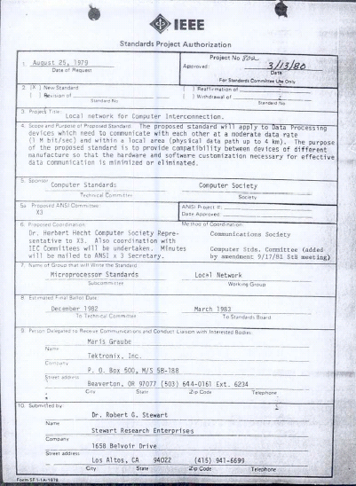
IEEE 802 LMSC 135th Plenary Session (6th mixed mode Plenary Session) 10 March 2024 to 15 March 2024
DCN ec-24-0067-00-00EC

Slide 2
2.01 Participant behavior in IEEE-SA activities is guided by the IEEE Codes of Ethics & Conduct
All participants in IEEE-SA activities are expected to adhere to the core principles underlying the:
IEEE Code of Ethics
IEEE Code of Conduct
The core principles of the IEEE Codes of Ethics & Conduct are to:
Uphold the highest standards of integrity, responsible behavior, and ethical and professional conduct
Treat people fairly and with respect, to not engage in harassment, discrimination, or retaliation, and to protect people's privacy.
Avoid injuring others, their property, reputation, or employment by false or malicious action
The most recent versions of these Codes are available at
http://www.ieee.org/about/corporate/governance

Slide 3
2.01 Participants in the IEEE-SA “individual process” shall act independently of others, including employers
The IEEE-SA Standards Board Bylaws require that “participants in the IEEE standards development individual process shall act based on their qualifications and experience”
This means participants:
Shall act & vote based on their personal & independent opinions derived from their expertise, knowledge, and qualifications
Shall not act or vote based on any obligation to or any direction from any other person or organization, including an employer or client, regardless of any external commitments, agreements, contracts, or orders
Shall not direct the actions or votes of other participants or retaliate against other participants for fulfilling their responsibility to act & vote based on their personal & independently developed opinions
By participating in standards activities using the “individual process”, you are deemed to accept these requirements; if you are unable to satisfy these requirements then you shall immediately cease any participation

Slide 4
2.01 IEEE-SA standards activities shall allow the fair & equitable consideration of all viewpoints
The IEEE-SA Standards Board Bylaws (clause 5.2.1.3) specifies that “the standards development process shall not be dominated by any single interest category, individual, or organization”
This means no participant may exercise “authority, leadership, or influence by reason of superior leverage, strength, or representation to the exclusion of fair and equitable consideration of other viewpoints” or “to hinder the progress of the standards development activity”
This rule applies equally to those participating in a standards development project and to that project’s leadership group
Any person who reasonably suspects that dominance is occurring in a standards development project is encouraged to bring the issue to the attention of the Standards Committee or the project’s IEEE-SA Program Manager

Slide 5
3.00 Chair’s Announcements

Slide 6
3.00 Chair’s Announcements
Reminder #1: Please use IMAT to log your attendance
Reminder #2: Please remind your groups to consider nominating individuals to leadership positions in the
IEEE
Computer Society
Standards Association

Slide 7
3.001 Endorsement/Affiliation letters

Slide 8
3.01 March 2024 802 LMSC Elections
IEEE 802 LMSC Elections to be conducted at the March 2024 Plenary Session
802 Working Group and Technical Advisory Groups to hold elections for Chair and Vice Chair positions during the plenary session
Reminder to Chairs, please record and report numerical results of all elections
802 Executive Committee Elections/Confirmations at the closing 802 EC meeting
802 LMSC Chair to be elected by non-appointed EC voting members
802 LMSC Appointed position candidates to be confirmed by EC voting members
802 LMSC WG/TAG Chair and Vice Chair position candidates to be confirmed by EC voting members
Non-voting 802 LMSC position candidates to be confirmed by EC voting members

Slide 9
3.01 802 Chair and Appointed Officer Candidates
James Gilb is the only candidate standing for election as Chair of 802 LMSC
If Gilb is elected, he recommends Nikolich nominate the 802 Appointed Officer voting positions as follows: - First Vice Chair – David Halasz, Second Vice-Chair – George Zimmerman, - Recording Secretary - John D’Ambrosia, Executive Secretary - Jon Rosdahl - Treasurer – Clint Chaplin.
Nikolich also plans to appoint the following individuals to fill the non-voting positions of 802: - Member Emeriti Positions: Associate Treasurer – Jason Potterf, 802 Advisor - Geoff Thompson, 802 Past Chair – Paul Nikolich - Hibernating Working Group Chairs: 802.16 - Roger Marks, 802.21 - Subir Das and 802.22 - Apurva Mody - Standing Committee Chairs: 802/JTC1- Peter Yee; 802/ITU- Glenn Parsons; 802/PV-Tuncer Baykas; 802/IETF- Dorothy Stanley; 802/WC-Dorothy Stanley
Details of the March 2024 IEEE 802 LMSC Executive Committee election process are defined in https://mentor.ieee.org/802-ec/dcn/23/ec-23-0168-00-00EC-march-2024-802-ec-election-process.pdf

Slide 10
3.01 802 Elected Positions – Active Groups
 | Position | Individual | Vote | Endorse. / Affil.
802 LMSC | Chair | James Gilb | tbd | Submitted
802.1 | Chair | Glenn Parsons | 42 / 0 / 0 | Submitted
 | Vice-Chair | Jessy Rouyer | 42 / 0 / 0 | Submitted
802.3 | Chair | David Law | 143 / 0 / 0 | Submitted
 | Vice-Chair | Adam Healey | 146 / 0 / 1 | Submitted
802.11 | Chair | Robert Stacey | 336/ 17 / 30 | Submitted
 | Vice-Chair | Jon Rosdahl | 357 / 16 / 18 | Submitted
 | Vice-Chair | Stephen McCann | 338 / 06 / 10 | Submitted
802.15 | Chair | Clint Powell | 35 / 0 / 1 | Submitted
 | Vice-Chair | Ann Krieger | 38 / 0 / 1 | Submitted
 | Vice-Chair | Phil Beecher | 37 / 0 / 1 | Submitted
802.18 | Chair | Edward Au | 32 / 0/ 1 | Submitted
 | Vice-Chair | Al Petrick | 27 / 1/ 2 | Submitted
 | Vice-Chair | Gaurav Patwardhan | 28 / 2 / 3 | Submitted
802.19 | Chair | Tuncer Baykas | 16 / 0 / 1 | Submitted
 | Vice-Chair | Steve Shellhammer | 16 / 0 / 1 | Submitted
802.24 | Chair | Tim Godfrey | 10 / 0 / 1 | Submitted
 | Vice-Chair | Ben Rolfe | 9 / 0 / 1 | Submitted

Slide 11
3.01 Motion – IEEE 802 Standards Committee WG / TAG Officer Confirmations
Per IEEE 802 WG P&P Section 3.1 Election or Appointment of Officers
A Working Group may elect a new Chair or Vice Chair at any plenary session, subject to confirmation by the IEEE 802 LMSC Sponsor
Move to confirm the 802 LMSC elected positions on slide 09 of ec-24-00xx-00-00EC
WG/TAG Chair
WG/TAG Vice-Chair
All voting member of the LMSC Executive Committee are eligible to vote.
Moved: James Gilb Second: John D’Ambrosia

Slide 12
3.02 Motion – IEEE 802 LMSC Chair Election
Per IEEE 802 LMSC P&P Section 3.1 Election or appointment of LMSC officers
The LMSC Chair is elected by the WG Chairs and TAG Chairs who are Voting Members of the LMSC and is confirmed by the Computer Society VP of Standards Activities.
LMSC Chair Election candidate: James Gilb tally:

Slide 13
3.03 802 Voting Positions Appointed by Chair
 | Position | Individual | Endorse/ Affil.
802 | 1st Vice Chair | David Halasz | Submitted
 | 2nd Vice Chair | George Zimmerman | Submitted
 | Executive Secretary | Jon Rosdahl | Submitted
 | Recording Secretary | John D’Ambrosia | Submitted
 | Treasurer | Clint Chaplin | Submitted
Move to confirm the slate of appointments listed in the above table
Moved: James Gilb Second: David Law
All voting member of the LMSC Executive Committee are eligible to vote.

Slide 14
3.04 Motion - IEEE 802 LMSC Non-voting Positions Appointed by Chair Hibernating Chairs, Members Emeriti and Standing Committee Chairs
Per IEEE 802 P&P Section 4 Membership
Appointment to each non-voting membership position is subject to confirmation by the LMSC.
Move to confirm Hibernating Chairs, Emeriti and Standing Committee (SC) appointed positions
- Hibernating Working Group Chairs: 802.16 - Roger Marks, 802.21 - Subir Das and 802.22 - Apurva Mody - Member Emeritus Positions: Associate Treasurer – Jason Potterf, 802 Advisor - Geoff Thompson, Past Chair – Paul Nikolich - Standing Committee Chairs: 802/JTC1- Peter Yee; 802/ITU- Glenn Parsons; 802/Public Visibility-Tuncer Baykas; 802/IETF- Dorothy Stanley; 802/Wireless Charis-Dorothy Stanley
All voting member of the LMSC Executive Committee are eligible to vote.
Moved: James Gilb Second: John D’Ambrosia

Slide 15
3.041 Welcome new LMSC leadership members
Dave Halasz – 802 Vice Chair
Jason Potterf – 802 Assistant Treasurer
Stephen McCann – 802.11 Vice Chair
Gaurav Patwardhan – 802.18 TAG Vice Chair

Slide 16
3.05 Recognition
Outgoing IEEE 802 LMSC Leadership – Thank You!
Dorothy Stanley 802.11 WG Chair (06 years)
Stuart Kerry 802.18 TAG Vice Chair (03 years)
Roger Marks 802 Vice Chair (06 years)
Paul Nikolich 802 Chair (22 years)

Slide 17
8.06 EC Action Item recap
Review Recording Secretary’s list of Open Action Items

Slide 18
8.07 802/SA Meeting Reminder
None at this time

Slide 19
9.00 Any other Business
tbd

Slide 20
End of Closing EC Meeting
Please stay for a photograph immediately after the meeting adjourns

Slide 21
appendix

Slide 22
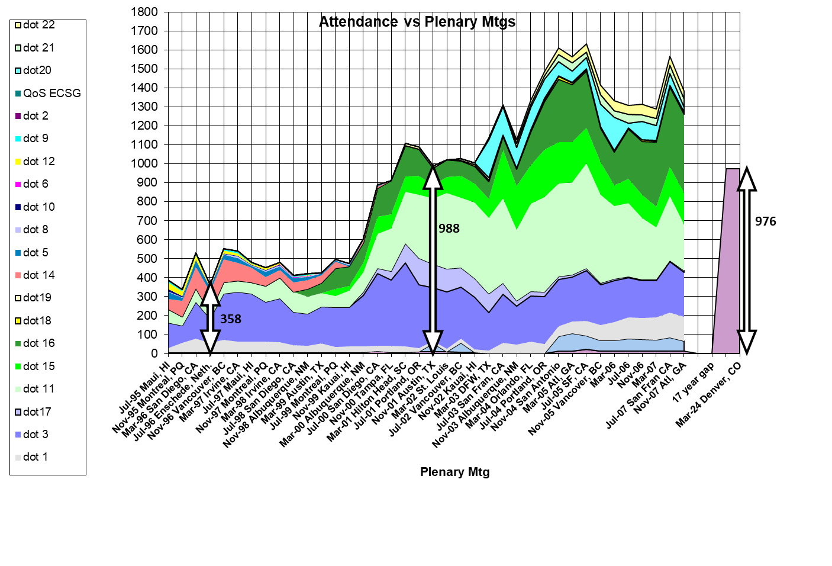

Slide 23
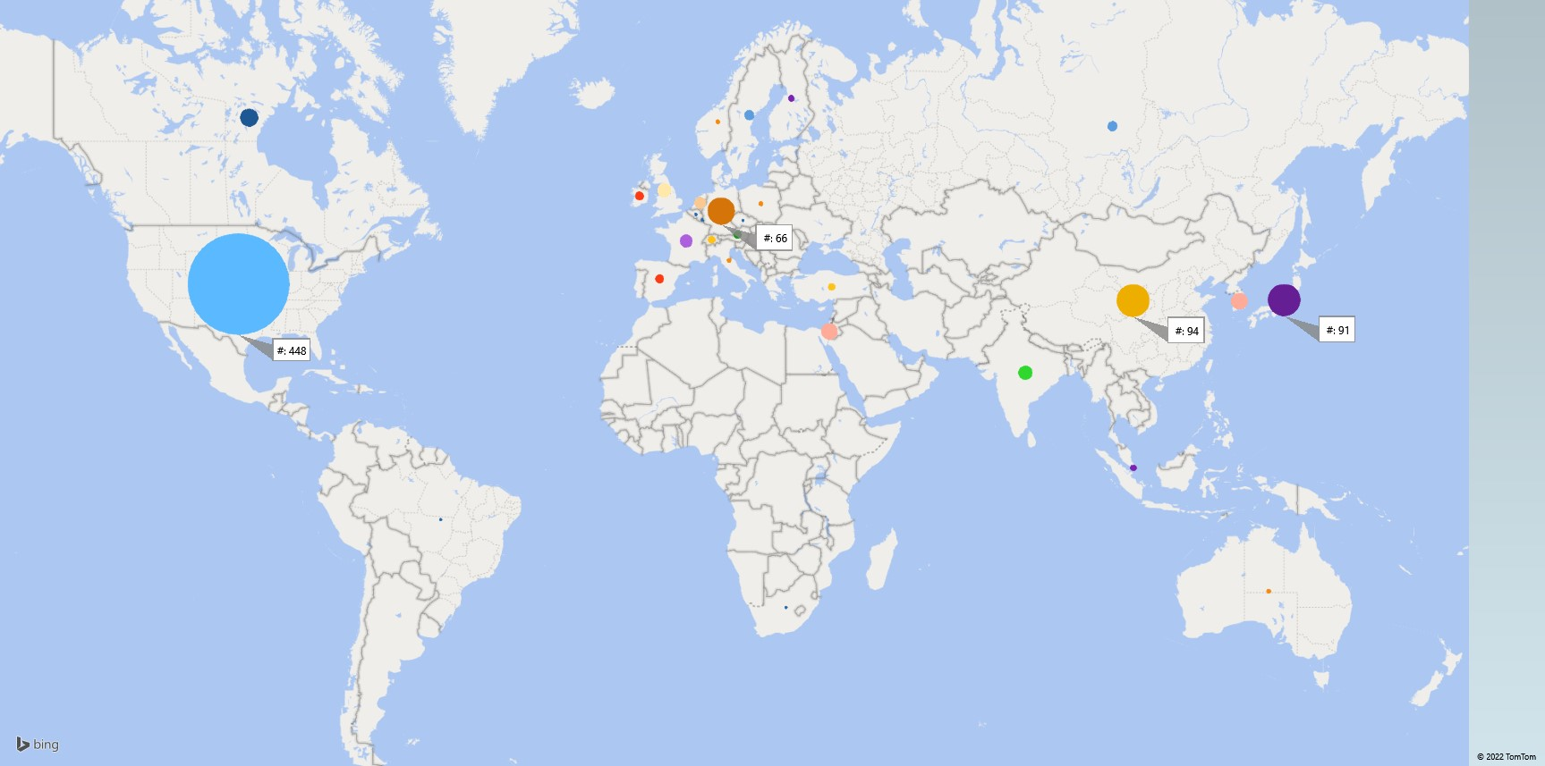
March 2022 Registrant Locations

Slide 24
Country | # | Continent
USA | 448 | Americas
Canada | 28 | Americas
Brazil | 1 | Americas
China | 94 | Asia/Oceania
Japan | 91 | Asia/Oceania
Republic of Korea | 24 | Asia/Oceania
India | 18 | Asia/Oceania
Taiwan (Province of China) | 17 | Asia/Oceania
Russian Federation | 9 | Asia/Oceania
Singapore | 4 | Asia/Oceania
Australia | 2 | Asia/Oceania
Germany | 66 | Europe Africa
Israel | 24 | Europe Africa
United Kingdom | 17 | Europe Africa
Country | # | Continent
France | 15 | Europe Africa
Netherlands | 12 | Europe Africa
Sweden | 9 | Europe Africa
Spain | 7 | Europe Africa
Ireland | 7 | Europe Africa
Austria | 6 | Europe Africa
Turkey | 5 | Europe Africa
Switzerland | 5 | Europe Africa
Finland | 4 | Europe Africa
Poland | 2 | Europe Africa
Norway | 2 | Europe Africa
Italy | 2 | Europe Africa
Hungary | 2 | Europe Africa
South Africa | 1 | Europe Africa
Luxembourg | 1 | Europe Africa
Czech Republic | 1 | Europe Africa
Belgium | 1 | Europe Africa

Slide 25
MAR 2022 & NOV 2021 Registrant Time Zones
Total 925 registrants
Total 1095 registrants

Slide 26
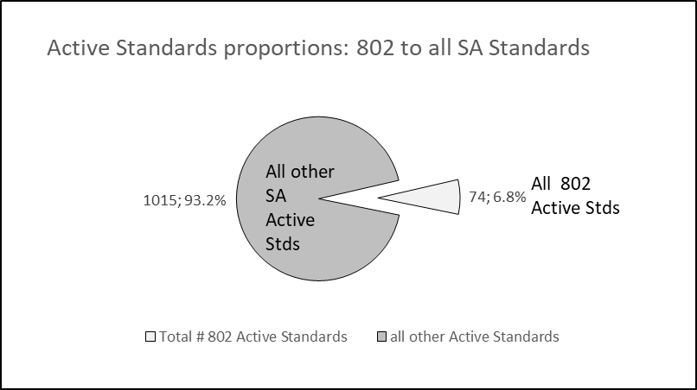
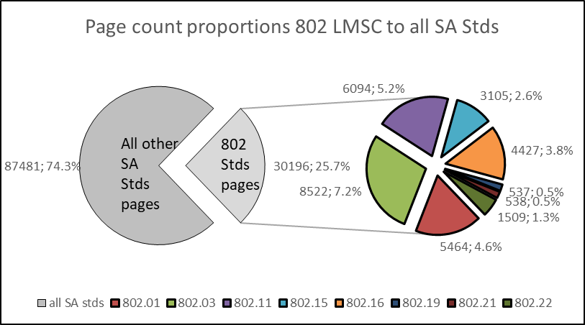
MAR 2022 802 LMSC Analytics

