Slide 1
Wireless Treasurer Report 2024
Date: 2024-12-18
Authors:

Slide 2
Abstract
This file contains the Wireless Treasurer report for the Joint IEEE 802.11/.15 Wireless funds for 2024:
  R0: Presented to January 15th 802WCSC Opening Plenary mtg in Panama
  R1: Prepared for the February 14th 802WCSC Telecon
  R2: Presented to the February 14th 802WCSC Telecon (Updated Panama and Warsaw Budget).
  R3: Presented to March 10th 802WCSC Meeting in Denver
  R4: Presented to May 12th 802WCSC Meeting in Warsaw
  R5: Presented to July 14th 802WCSC Meeting in Montreal
  R6/R7: Presented to the Aug 14th 802WCSC Telecon (R7 has corrections made as identified on call).
  No report was created for September 2024.
  R8: Presented to the Nov 10th 802WCSC Meeting in Vancouver
  R9: Minor updates noted in closing plenary applied.
  R10: Final Treasurer Report for 2024 – Presented to 802WCSC Dec 18, 2024

Slide 3

802.11/.15 Joint Account Balance Overview
November 09, 2024
2026 Jan – Victoria – Deposits for Hotel and Conference Center paid = $26,896.37
2025 May – Warsaw – Deposit paid = $35,742.15
Notes:
.

Slide 4
Income/ Expense Report
January 1, 2024, to
December 18, 2024
2024 Income/Expense Summary through 2024-12-18
Row Labels | Sum of Amount
1.10.0|Individual Registration | $920,200.00
1.20.0|Corporation Contribution | $23,400.00
3.40.0|IEEE CB Account Interest | $38,566.61
3.70.1|Hotel Credits | $18,335.05
3.70.2|Hotel Commission | $51,592.62
4.10.1|Social Events | -$137,925.41
4.10.10|Shipping | -$28,453.65
4.10.11|Miscellaneous | -$16,381.41
4.10.12|AV Services | -$55,068.10
4.10.2|Site Survey | -$13,561.98
4.10.3|Hotel Deposit | $84,026.58
4.10.5|Venue | -$88,902.69
4.10.6|Financial Fees | -$38,355.45
4.10.7|Meeting Planner | -$205,385.86
4.10.8|Food & Beverage | -$376,796.32
4.10.9|Network Services | -$156,583.86
5.30.0|Independent Contractor | -$2,000.00
Grand Total | $16,706.13

Slide 5
2024 Income/Expense Report
2024 Income/Expense Report per Session - Jan 1 - Dec 18,2024
 | Panama | Warsaw | Waikoloa |  | Kobe | Warsaw | Victoria | Antwerp | Irvine
Category | 2024-01 | 2024-05 | 2024-09 | 2024-Misc | 2025-01 | 2025-05 | 2026-01 | 2026-05 | 2027-01 | Grand Total
1.10.0|Individual Registration | $304,100.00 | $312,200.00 | $303,900.00 |  |  |  |  |  |  | $920,200.00
1.20.0|Corporation Contribution | $23,400.00 |  |  |  |  |  |  |  |  | $23,400.00
3.40.0|IEEE CB Account Interest |  |  |  | $38,566.61 |  |  |  |  |  | $38,566.61
3.70.1|Hotel Credits | $9,706.13 |  | $8,628.92 |  |  |  |  |  |  | $18,335.05
3.70.2|Hotel Commission |  | $21,932.03 | $29,660.59 |  |  |  |  |  |  | $51,592.62
4.10.1|Social Events | -$32,550.00 | -$48,336.00 | -$57,039.41 |  |  |  |  |  |  | -$137,925.41
4.10.10|Shipping | -$12,449.92 | -$10,662.23 | -$5,341.50 |  |  |  |  |  |  | -$28,453.65
4.10.11|Miscellaneous | -$1,924.50 | -$2,162.19 | -$8,581.63 | -$3,713.09 |  |  |  |  |  | -$16,381.41
4.10.12|AV Services | -$31,218.10 |  | -$23,850.00 |  |  |  |  |  |  | -$55,068.10
4.10.2|Site Survey |  | -$3,391.43 |  | -$187.86 | -$660.05 | -$3,771.77 | -$598.27 | -$4,070.16 | -$882.44 | -$13,561.98
4.10.3|Hotel Deposit | $80,000.00 | $67,324.30 | $0.00 |  |  | -$36,241.18 | -$27,056.54 |  |  | $84,026.58
4.10.5|Venue | -$8,000.00 | -$64,792.32 | -$16,110.37 |  |  |  |  |  |  | -$88,902.69
4.10.6|Financial Fees | -$14,800.95 | -$14,000.90 | -$9,307.20 | -$246.40 |  |  |  |  |  | -$38,355.45
4.10.7|Meeting Planner | -$58,220.19 | -$77,146.87 | -$64,782.18 |  |  |  | -$2,636.62 | -$2,600.00 |  | -$205,385.86
4.10.8|Food & Beverage | -$74,880.00 | -$102,945.76 | -$198,970.56 |  |  |  |  |  |  | -$376,796.32
4.10.9|Network Services | -$48,985.23 | -$54,547.77 | -$40,464.39 |  |  |  | -$4,373.38 | -$8,213.09 |  | -$156,583.86
5.30.0|Independent Contractor |  |  |  | -$2,000.00 |  |  |  |  |  | -$2,000.00
Grand Total | $134,177.24 | $23,470.86 | -$82,257.73 | $32,419.26 | -$660.05 | -$40,012.95 | -$34,664.81 | -$14,883.25 | -$882.44 | $16,706.13

Slide 6
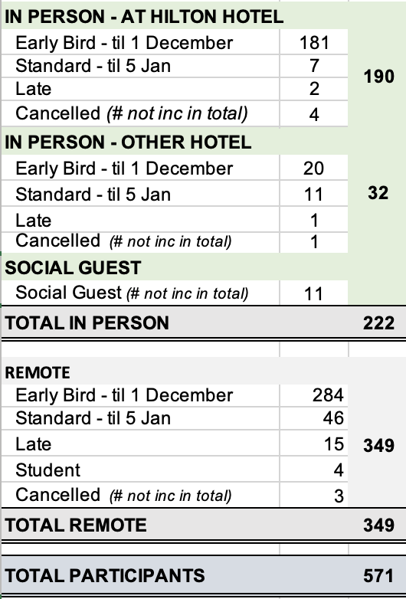
2024 January
IEEE 802W Mixed-Mode Interim
REGISTRATION REPORT - FINAL
January 14-19, 2024
Panama Hilton, Panama
Update Date: May 11, 2024
New Deadbeat:
Yunpeng Yang (penovol)
Pulian Technology
Shanghai
yyp9504@126.com

Slide 7
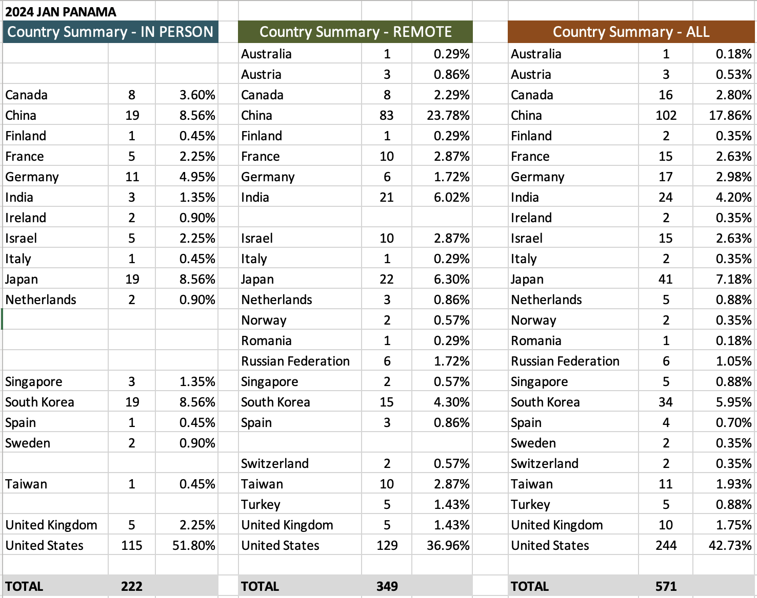
2024 January 802 Interim – Panama
Attendee Count by Country

Slide 8
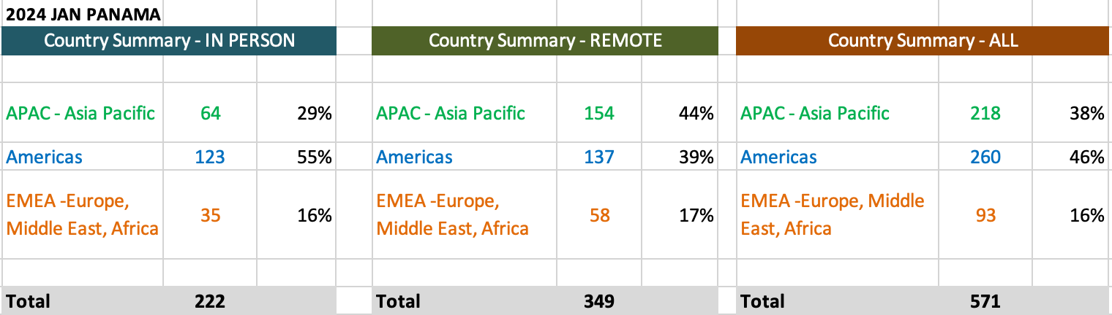
Summary of Attendees by Region

Slide 9
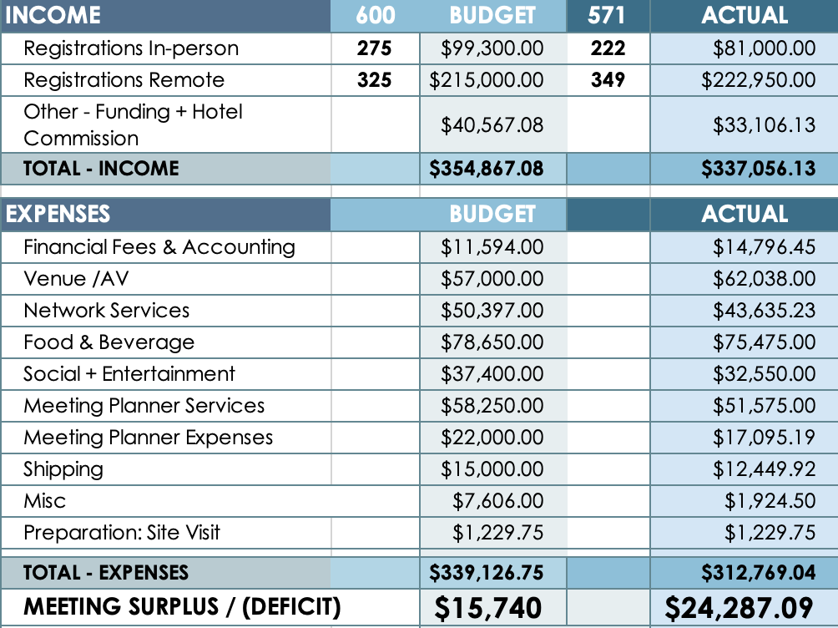
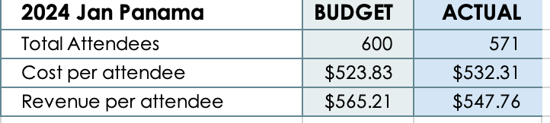
2024 January
IEEE 802W Mixed-Mode Interim Budget - FINAL
January 14-19, 2024
Panama Hilton, Panama
Update Date: May 11, 2024
New Deadbeat:
Yunpeng Yang (penovol) Pulian Technology, Shanghai, yyp9504@126.com

Slide 10
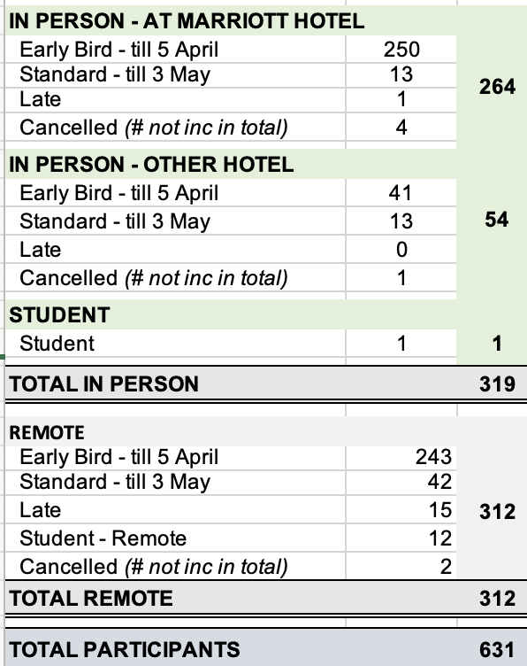
2024 May
IEEE 802W Mixed-Mode Interim
REGISTRATION REPORT
May 12-17, 2024
Marriott Warsaw
Update Date: August 12, 2024
Deadbeats:
Hangbin, Zhao, China Mobile (Hangzhou) Information Technology Co., Ltd, cmhi_zhb@163.com
Liu, Wenchao, Self, wenchaoliu93@gmail.com
Notes:
August Notes: we picked up 5 additional registrations through the process of checking the IMAT list. All paid except 2.

Slide 11
2024 May
IEEE 802W Mixed-Mode Interim
FINAL Budget
May 12-17, 2024
Marriott Warsaw, POLAND
Update Date: August 12, 2024
Notes:
The Deficit in the June update was -$52,750. The bottom line has improved with some final invoices and additional income from the potential deadbeats.

Slide 12
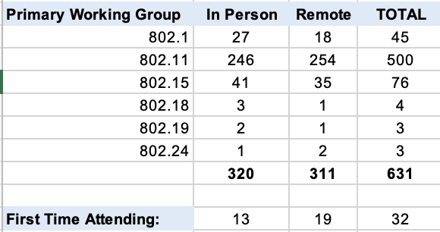
2024 May
IEEE 802W Mixed-Mode
REGISTRATION WG
May 12-17, 2024
Marriott Warsaw
Update Date: July 10, 2024

Slide 13
2024 Sept
IEEE 802W Mixed-Mode Interim
REGISTRATION REPORT
Sept 8-13, 2024
Hilton Waikoloa
Update Date: Nov 9, 2024
Total Registration collected: $305,900
Registration Fees and Deadlines
  Early $US 600.00 until June 21, 2024
  Standard $US 800.00 After June 21, until August 16, 2024
  Late/Onsite $US 1000 after August 16, 2024
  Student $US 100.00

Slide 14
2024 Sept IEEE 802W Mixed-mode Interim Budget report
Interim: Sept 2024 -Waikoloa Update Date: 2024-Sept 30
Income (BUDGET):
      Registrations In-person 277 => $111,450.00
      Registrations Virtual + Student 290 => $194,750.00
      Hotel Credits/Rebates $ 38,289.51 Average Registration
      Total Income: 567 = > $344,489.51 per person: $540.04
    Expense: Budget Actual
Financial Fee: $ 10,118,90 $ 11,238.80
  Venue: $ 26,640.00 $ 16,110.37
  AV Services: $ 24,000.00 $ 23,850.00
  Networking $ 29,650.00 $ 40,464.89
  F&B $232,700.77 $ 198,970.56
  Social $ 65,031.41 $ 55,255.78
  Meeting Planner: $ 67,400.00 $ 66,446.39
  Shipping $ 7,000.00 $ 5,341.00
  Misc. $ 8,212.02 $ 8,299.95
  Site Visit $ 0.00 $ 0.00
  Total Expense: $(470,753.10) $ (425,977.74) Budget Expense per Person: $751.28
Meeting Surplus/(Deficit) (-$81,488.23)
Notes:
Cost per person is up about $300.

Slide 15
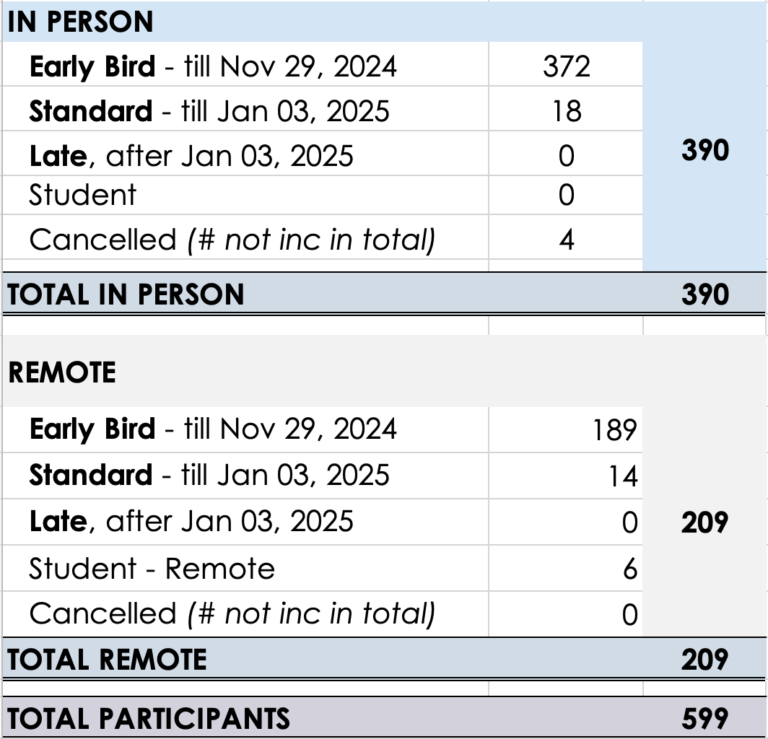
2025 January
IEEE 802W Mixed-Mode Interim
REGISTRATION REPORT
Jan 12-17, 2025
Kobe Convention Centre, JAPAN
Update: December 15, 2024
Notes:
DECEMBER UPDATE: there A LOT more in person registrations than anticipated. The main plenary room may be tight, other rooms are spacious

Slide 16
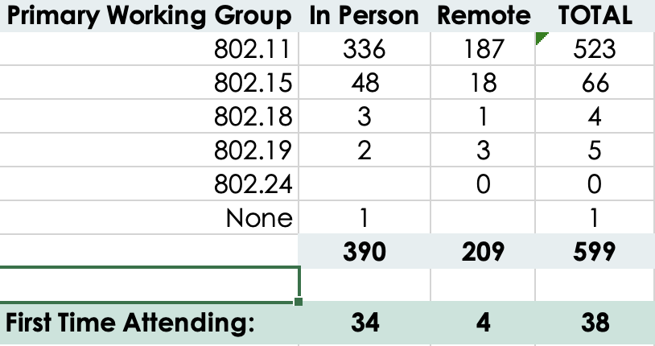
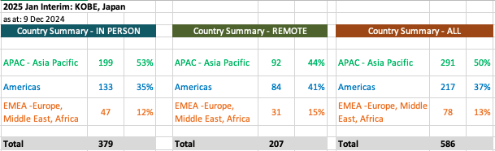
2025 January
IEEE 802W Mixed-Mode Interim
OVERVIEW
Jan 12-17, 2025
Kobe Convention Centre, JAPAN
Update: December 15, 2024
Notes:
DECEMBER UPDATE: there A LOT more in person registrations than anticipated. The main plenary room may be tight, other rooms are spacious

Slide 17
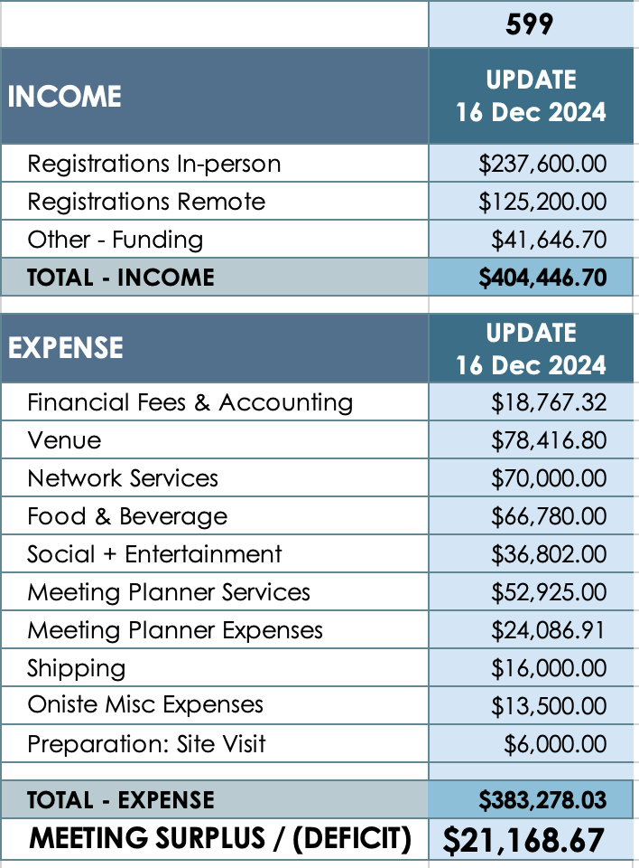
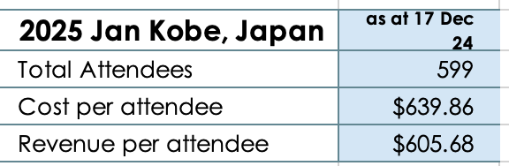
2025 January
IEEE 802W Mixed-Mode Interim
BUDGET UPDATE
Jan 12-17, 2025
Kobe Convention Centre, Japan
Update: December 15, 2024
Notes:
We have some contingencies factored into the expenses for this budget as there is quite a bit unknown, so anticipate the bottom line improving

Slide 18
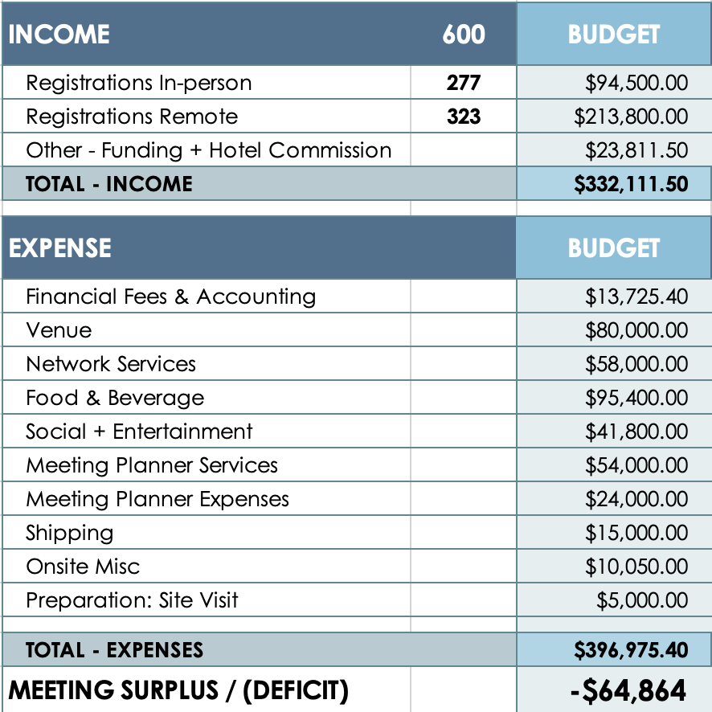
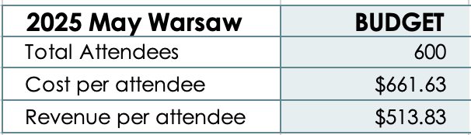
2025 May
IEEE 802W Mixed-Mode Interim
DRAFT BUDGET
May 11 - 16, 2025
Warsaw Presidential Hotel, Poland
Update: December 15, 2024
Notes:
DECEMBER Note: contract is finalized!!
Based on registration fees: 300/500/700 at hotel. 600/800/1000 remote and non hotel
The income projection has been adjusted to reflect the actual registration figures achieved from May 2024.
Likewise the anticipated expenditure has been updated to reflect slight increases as predicted

Slide 19
2024 May Interim Possible Deadbeats (after 16 July)
Individuals that joined the May 2024 802 Wireless Interim Session that we cannot match a registration record with and have not responded to requests for payment or registration receipt:
  Hangbin, Zhao, China Mobile (Hangzhou) Information Technology Co., Ltd, cmhi_zhb@163.com
  Liu, Wenchao, Self, wenchaoliu93@gmail.com
Please let me know if your name or your colleague's name is on this list.
These individuals will be added to the 802 Deadbeat list on July 17, 2024 (60 days in arrears) if the 2024 May 802 Wireless Interim Registration payment is not made.

Slide 20
2024 Sept Potential New Dead Beats
Deadbeat Date for 2024 Sept: (60 Days - Tues 19 Nov)
Hosseinianfa, Hamid - ex-Offino - SA-PIN: 228734 - $1000 due
Email: hosseinianfar_h@yahoo.com
No longer with Ofinno since July 2024 (about a week before the Montreal Session)
May 2024 - Attended 100% - Paid Registration
July 2024 - Attended 106% - Paid Registration
Sept 2024 - Attended 82% - NO Registration
Nov 2024 - Not Registered
Lim, Yeon Geun Newracom, Inc. - SA-PIN:208640 - $1000 due
Email: chaind3@gmail.com
Sept 2024 - Attended 24% - NO Registration
Nov 2024 - No Registered

Slide 21
2020 to 2024 Net Session Value
2020 - $(-215,674.97)
2021 - $( -26,309.74)
2022 - $ 454,714.16
2023 - $ 175,589.11
2024 - $ 16,706.13
Net Session value 2020 to 2024 (December 18, 2024) = $405,024.69
Session Fees for 2025 to remain the same as 2024 ($600/$800/$1000)
Bank Balance as of Dec 18, 2024: $990,506.52
Notes:
Motion to set the 2025 Session Fees: July 14, 2024

Slide 22
Future Interim Meeting Fees –2025
IEEE 802 Wireless Interim Session meeting fees are set by
  the IEEE 802W Exec Committee of the Joint Treasury
  Meeting fees are expected to balance actual costs to zero over 2-3 years.
Meeting Fees set for 2025 802W Interims –
    $600/$800/$1,000 Mixed Mode – ((No Hotel Discount January/but cheaper hotel)
    In Hotel 3-night Stay Discount $300 (May/Sept))

Slide 23
Deadbeat Consequences
No participation credit will be granted for said session.
Any participation credit acquired before said session toward membership in any IEEE 802 LMSC group is revoked.
Membership in any IEEE 802 LMSC group is terminated.
No participation credit will be granted for attendance at any subsequent IEEE 802 LMSC session until the individual has complied with the registration requirements for all previously attended IEEE 802 LMSC sessions by the start of said subsequent session.

Slide 24
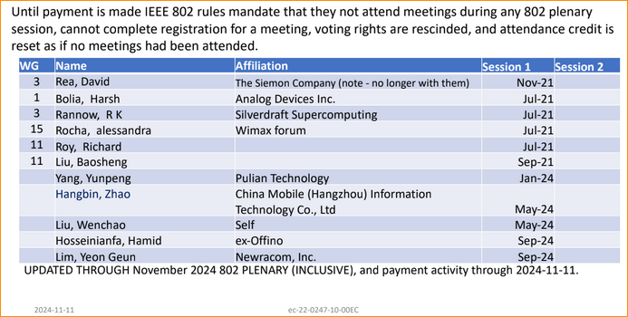
These individuals are in arrears on meeting fees

Slide 25
2020 – 2023 Historical Attendance
2020
  335 – Person - Irvine ($1622; -$3,648)
  000 – Canceled [Warsaw] ($1,500; -$6,750)
  NR – Virtual [Atlanta] (0; -$25,000)
2021
  NR – Virtual [Irvine] (0; -$12,500)
  NR – Virtual [Panama] (0, 0)
  497 – Virtual [Waikoloa] (-$32,767; $10,657)
2022
  600 – Virtual [Panama] (0; $28,703)
  527 – Virtual [Warsaw] (-$67,324; $208,230)
  499 (254/245) – Mixed - Waikoloa, ($23,324; $209,491)
2023
  605 (272/331) – Mixed Baltimore ($22,142; $110,497)
  528 (248/280) – Mixed Orlando (-$38,744.; -$24,566)
  536 (233/303) – Mixed Buckhead ($12,879; $34,070)
2024
  571 (222/349) – Mixed Panama ($15,740, $24,287)
  631 (319/312) – Mixed Warsaw (-$69,940, -$44,603)
  567 (277/290) – Mixed Waikoloa (-$60,990, -$82,258)
2025
  599 (390/209) – Mixed Kobe (-$1,799, $21,168.67)
Notes:
doc.: IEEE 802.15-11/0204r0
March 2011
Historical Attendance:
Number attending the meeting (Local/Remote) [Virtual/Mixed/Person]- Location - (Initial Budget, final budget )
The numbers in red are a negative (loss), and the black are a positive
Note 2022 January was originally scheduled for a replacement for 2021 Jan Irvine – The Hotel did not reopen, and Panama was scheduled for 2022 Jan, but we did remain virtual – No Budget for that meeting, but Irvine paid a penalty for cancelling, and F2F Events was paid a fee. Balance is shown.
Note 2023 January was originally scheduled to be at the Marriott Baltimore hotel. The Hotel cancelled on Sept 2, and paid a penalty to move the meeting to the Hilton Baltimore:
Note 2024 Warsaw: Originally budget (2021) was for 280 total mixed mode ($34k) – Updated Budget for Dec 2023 Budget 600 pax (-$69,990)

Slide 26
Historical
Income/Expense reports

Slide 27
2023 Meeting Final Session Budget Report
2023 Net: $175,589.11

Slide 28
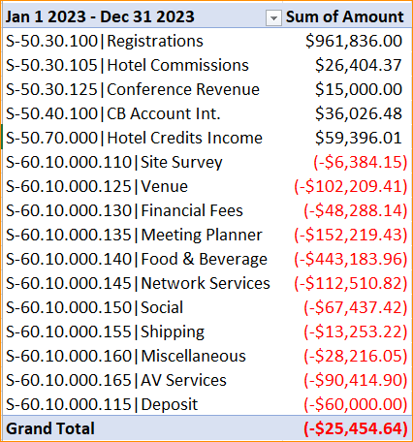
Income/ Expense Report
Jan 1, 2023, to
Dec 31, 2023

Slide 29
2023 Income/Expense Report
Notes:
2023-05 Orlando Attrition Fees = $8,403.11.

Slide 30
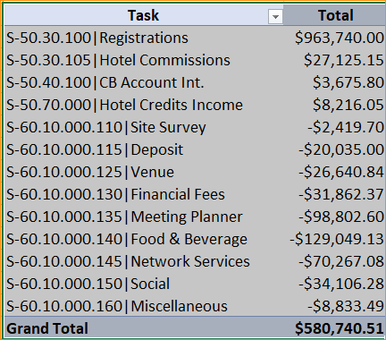
Income/ Expense Report
Jan 1, 2022, to
Dec 31, 2022

Slide 31
2022 Income/Expense Report

Slide 32
Income/ Expense Report
Jan 1, 2021, to
Dec 31, 2021
Task | Total
S-50.30.100|Registrations | $ 26,610.00
S-50.40.100|CB Account Int. | $ 1,213.96
S-50.50.000|Other | $ 38,437.50
S-60.10.000.130|Financial Fees | $ (2,416.80)
S-60.10.000.135|Meeting Planner | $ (42,500.00)
S-60.10.000.160|Miscellaneous | $ (2,531.66)
Grand Total | $ 18,813.00

Slide 33
2021 Meeting Income Statement – 2/28/2021
Financial Row | 2021 Misc | 2021 Misc | 2021-01 Irvine, CA | 2021-09 Waikoloa, HI | Total
 | Amount | Amount | Amount | Amount | Amount
Ordinary Income/Expense
Income
3.40 - IEEE CB Account Interest | $256.32 |  | $0.00 | $0.00 | $256.32
Total - Income | $256.32 |  | $0.00 | $0.00 | $256.32
Expense
4.13 - Meeting Planner | $0.00 |  | $12,500.00 | $12,500.00 | $25,000.00
Total - Expense | $0.00 |  | $12,500.00 | $12,500.00 | $25,000.00
Net Income | $256.32 |  | ($12,500.00) | ($12,500.00) | ($24,743.68)

Slide 34
2020 Actual Income Statement
Financial Row | 2020 - Misc | 2020-01 Irvine, CA | 2020-05 Warsaw, Poland | 2020-09 - Atlanta | 2021-01 Irvine, CA | 2021-09 Waikoloa, HI | 2022-01 Irvine, CA | 2022-05 Warsaw, Poland | Total
 | Amount | Amount | Amount | Amount | Amount | Amount | Amount | Amount | Amount
Ordinary Income/Expense
Income
2.11 - Registrations | $0.00 | $275,800.00 | $0.00 | $0.00 | $0.00 | $0.00 | $0.00 | $0.00 | $275,800.00
2.12 - Hotel Commissions | $0.00 | $33,123.40 | $0.00 | $0.00 | $0.00 | $0.00 | $0.00 | $0.00 | $33,123.40
3.40 - IEEE CB Account Interest | $3,824.93 | $0.00 | $0.00 | $0.00 | $0.00 | $0.00 | $0.00 | $0.00 | $3,824.93
Total - Income | $3,824.93 | $308,923.40 | $0.00 | $0.00 | $0.00 | $0.00 | $0.00 | $0.00 | $312,748.33
Expense
4.111 - Deposit | $0.00 | $0.00 | ($35.00) | $0.00 | $0.00 | $0.00 | $0.00 | $67,324.30 | $67,289.30
4.113 - Venue | $0.00 | $29,524.67 | $0.00 | $0.00 | $0.00 | $0.00 | $0.00 | $0.00 | $29,524.67
4.12 - Financial Fees | $5,120.76 | $12,625.78 | $0.00 | $0.00 | $0.00 | $0.00 | $0.00 | $0.00 | $17,746.54
4.13 - Meeting Planner | $0.00 | $52,702.30 | $6,785.00 | $25,000.00 | $12,500.00 | $12,500.00 | $12,500.00 | $0.00 | $121,987.30
4.14 - Food & Beverage | $0.00 | $145,643.01 | $0.00 | $0.00 | $0.00 | $0.00 | $0.00 | $0.00 | $145,643.01
4.15 - Network Services | $0.00 | $40,444.57 | $0.00 | $0.00 | $0.00 | $0.00 | $0.00 | $0.00 | $40,444.57
4.16 - Social | $0.00 | $24,201.67 | $0.00 | $0.00 | $0.00 | $0.00 | $0.00 | $0.00 | $24,201.67
4.17 - Shipping | $0.00 | $1,867.30 | $0.00 | $0.00 | $0.00 | $0.00 | $0.00 | $0.00 | $1,867.30
4.18 - Misc Expense | $154.57 | $5,562.28 | $0.00 | $0.00 | $0.00 | $0.00 | $0.00 | $0.00 | $5,716.85
Total - Expense | $5,275.33 | $312,571.58 | $6,750.00 | $25,000.00 | $12,500.00 | $12,500.00 | $12,500.00 | $67,324.30 | $454,421.21
Net Income | ($1,450.40) | ($3,648.18) | ($6,750.00) | ($25,000.00) | ($12,500.00) | ($12,500.00) | ($12,500.00) | ($67,324.30) | ($141,672.88)
Notes:
Misc Expenses for 2020:
SLIKSVN Inv # F20200053 – Subversion for $138.07
Post office – Stamps/envelopes - $16.50
2020-05 – Warsaw Poland – Session Cancelled- $35 is wire transfer shortage – still payable to MTG-Events.
Misc Expenses Finance Fees are the Authorize.net monthly charges that have no meeting to be applied to.
Audit fee for 2019 $5030.76 included in 4.12 in 2020 – Misc
All expenses/income for 2020 included.

Slide 35
2020 Meeting Income Statement
Financial Row | 2020 - Misc | 2020-01 Irvine, CA | 2020-05 Warsaw, Poland | 2020-09 - Atlanta | Total
 | Amount | Amount | Amount | Amount | Amount
Ordinary Income/Expense
Income
2.11 - Registrations | $0.00 | $275,800.00 | $0.00 | $0.00 | $275,800.00
2.12 - Hotel Commissions | $0.00 | $33,123.40 | $0.00 | $0.00 | $33,123.40
3.40 - IEEE CB Account Interest | $3,824.93 | $0.00 | $0.00 | $0.00 | $3,824.93
Total - Income | $3,824.93 | $308,923.40 | $0.00 | $0.00 | $312,748.33
Expense
4.111 - Deposit | $0.00 | $0.00 | ($35.00) | $0.00 | ($35.00)
4.113 - Venue | $0.00 | $29,524.67 | $0.00 | $0.00 | $29,524.67
4.12 - Financial Fees | $5,120.76 | $12,625.78 | $0.00 | $0.00 | $17,746.54
4.13 - Meeting Planner | $0.00 | $52,702.30 | $6,785.00 | $25,000.00 | $84,487.30
4.14 - Food & Beverage | $0.00 | $145,643.01 | $0.00 | $0.00 | $145,643.01
4.15 - Network Services | $0.00 | $40,444.57 | $0.00 | $0.00 | $40,444.57
4.16 - Social | $0.00 | $24,201.67 | $0.00 | $0.00 | $24,201.67
4.17 - Shipping | $0.00 | $1,867.30 | $0.00 | $0.00 | $1,867.30
4.18 - Misc Expense | $154.57 | $5,562.28 | $0.00 | $0.00 | $5,716.85
Total - Expense | $5,275.33 | $312,571.58 | $6,750.00 | $25,000.00 | $349,596.91
Net Income | ($1,450.40) | ($3,648.18) | ($6,750.00) | ($25,000.00) | ($36,848.58)

Slide 36
2019 Meeting Income Statement
 | 2019 Misc. | 2019-01 St. Louis, MO | 2019-05 Atlanta, GA | 2019-07 Vienna | 2019-09 Hanoi, Vietnam | Total
 | Amount | Amount | Amount | Amount | Amount | Amount
Income
1.20 - Received from Corps. | $0.00 | $0.00 | $0.00 | $10,000.00 | $0.00 | $10,000.00
2.11 - Registrations | $0.00 | $208,450.00 | $222,385.00 | $7,700.00 | $258,450.00 | $696,985.00
2.12 - Hotel Commissions | $0.00 | $26,248.01 | $33,410.00 | $0.00 | $14,577.21 | $74,235.22
3.40 - IEEE CB Interest | $7,289.88 | $0.00 | $0.00 | $0.00 | $0.00 | $7,289.88
Total - Income | $7,289.88 | $234,698.01 | $255,795.00 | $17,700.00 | $273,027.21 | $788,510.10
Expense
4.110 - Site Survey | $0.00 | $1,946.63 | $0.00 | $0.00 | $0.00 | $1,946.63
4.113 - Venue | $0.00 | $14,948.26 | $19,656.77 | $19,610.58 | $76,430.88 | $130,646.49
4.12 - Financial Fees | $4,790.64 | $9,460.17 | $10,101.84 | $1,313.52 | $9,315.05 | $34,981.22
4.13 - Meeting Planner | $0.00 | $50,816.66 | $52,729.03 | $3,000.00 | $39,655.83 | $146,201.52
4.14 - Food & Beverage | $0.00 | $109,819.77 | $121,097.42 | $0.00 | $61,677.00 | $292,594.19
4.15 - Network Services | $0.00 | $34,765.03 | $38,060.46 | $0.00 | $46,446.41 | $119,271.90
4.16 - Social | $0.00 | $20,398.05 | $23,958.20 | $0.00 | $34,875.00 | $79,231.25
4.17 - Shipping | $0.00 | $2,261.37 | $2,953.27 | $0.00 | $0.00 | $5,214.64
4.18 - Misc Expense | $139.42 | $3,949.20 | $5,488.84 | $350.00 | $6,395.50 | $16,322.96
Total - Expense | $4,930.06 | $248,365.14 | $274,045.83 | $24,274.10 | $274,795.67 | $826,410.80
Net Income | $2,359.82 | ($13,667.13) | ($18,250.83) | ($6,574.10) | ($1,768.46) | ($37,900.70)
Notes:
Misc Expenses for 2019: SlikSVN Invoice # F20190061 – Subversion for $139.42

Slide 37
2018 Meeting Income Statement
 | 2018 Misc | 2018-01 Irvine, CA | 2018-05 Warsaw, Poland | 2018-09 Waikoloa, HI | Total
 | Amount | Amount | Amount | Amount | Amount
Income
2.11 – Registrations | $9,692.47 | $229,401.00 | $271,975.00 | $204,100.00 | $715,168.47
2.12 - Hotel Commissions | $0.00 | $27,029.84 | $18,580.73 | $29,898.48 | $75,509.05
3.40 - IEEE CB Interest | $5,558.51 | $0.00 | $0.00 | $0.00 | $5,558.51
Total - Income | $15,250.98 | $256,430.84 | $290,555.73 | $233,998.48 | $796,236.03
Expense
4.113 - Venue | $0.00 | $21,998.13 | $74,375.00 | $20,418.26 | $116,791.39
4.12 - Financial Fees | $3,172.65 | $10,460.72 | $10,815.18 | $9,582.23 | $34,030.78
4.13 - Meeting Planner | $0.00 | $44,271.69 | $36,309.56 | $45,651.01 | $126,232.26
4.14 - Food & Beverage | $0.00 | $113,654.62 | $82,350.00 | $109,462.83 | $305,467.45
4.15 - Network Services | $0.00 | $49,500.24 | $35,148.80 | $32,417.75 | $117,066.79
4.16 - Social | $0.00 | $19,049.98 | $24,390.00 | $23,859.22 | $67,299.20
4.17 - Shipping | $10.00 | $1,518.52 | $5,157.59 | $4,234.22 | $10,920.33
4.18 - Misc Expense | $155.72 | $6,412.30 | $8,348.50 | $6,792.03 | $21,708.55
Total - Expense | $3,338.37 | $266,866.20 | $276,894.63 | $252,417.55 | $799,516.75
Net Income | $11,912.61 | ($10,435.36) | $13,661.10 | ($18,419.07) | ($3,280.72)
Notes:
Financial fees in 2018 Misc includes Audit Fees for 2017 Audit.
The Registrations in 2018 Misc is the 802Wireless share of closing the 802.16 Treasury
The 2018 Misc 4.18 Expense = SLIK SVN Invoice #F20180126 - Depository for 802.11 Tools. And a box of envelops.

Slide 38
2017 Meeting Income Statement
 | 2017 Misc. | 2017-01 Atlanta, GA | 2017-05 Daejeon, Korea | 2017-09 Waikoloa, HI | Total
 | Amount | Amount | Amount | Amount | Amount
Income
1.20 - Received from Corp. | $0.00 | $0.00 | $30,500.00 | $0.00 | $30,500.00
2.11 - Registrations | $0.00 | $216,701.00 | $200,600.00 | $188,650.00 | $605,951.00
2.12 - Hotel Commissions | $0.00 | $25,987.40 | $0.00 | $27,626.46 | $53,613.86
3.40 - IEEE CB Account Interest | $2,678.78 | $0.00 | $0.00 | $0.00 | $2,678.78
3.96 - Miscellaneous Income | $0.00 | $69,810.00 | $0.00 | $0.00 | $69,810.00
Total - Income | $2,678.78 | $312,498.40 | $231,100.00 | $216,276.46 | $762,553.64
Expense
4.113 - Venue | $0.00 | $15,630.90 | $44,703.85 | $20,899.57 | $81,234.32
4.12 - Financial Fees | $0.00 | $4,763.20 | $14,969.00 | $8,828.25 | $28,560.45
4.13 - Meeting Planner | $0.00 | $47,235.53 | $45,255.00 | $47,733.13 | $140,223.66
4.14 - Food & Beverage | $0.00 | $114,318.11 | $42,940.00 | $92,152.42 | $249,410.53
4.15 - Network Services | $0.00 | $32,925.72 | $30,613.05 | $37,841.50 | $101,380.27
4.16 - Social | $0.00 | $22,415.04 | $17,550.00 | $21,687.36 | $61,652.40
4.17 - Shipping | $80.33 | $3,159.50 | $10,000.00 | $4,392.61 | $17,632.44
4.18 - Misc Expense | $0.00 | $1,060.00 | $7,402.50 | $1,145.83 | $9,608.33
Total – Expense | $80.33 | $241,508.00 | $213,433.40 | $234,680.67 | $689,702.40
Net Ordinary Income | $2,598.45 | $70,990.40 | $17,666.60 | ($18,404.21) | $72,851.24
Notes:
2017 January Interim session - Miscellaneous Income is the penalty that the Hyatt Regency Atlanta paid for cancelling the meeting.
The meeting was relocated to the Grand Hyatt Atlanta in Buckhead.

Slide 39
2016 Meeting Income Statement
 | 2016 | 2016-01 | 2016-05 | 2016-09 | Total
 | Misc. | Atlanta, GA | Waikoloa, HI | Warsaw, Poland
 | Amount | Amount | Amount | Amount | Amount
Income
2.11 - Registrations | $0.00 | $321,625.00 | $235,050.00 | $264,450.00 | $821,125.00
2.12 - Hotel Commissions | $0.00 | $65,445.12 | $33,228.32 | $0.00 | $98,673.44
3.40 - IEEE CB Acct Interest | $1,640.57 | $0.00 | $0.00 | $0.00 | $1,640.57
3.70 - Other Receipts | $0.00 | $1.00 | $0.00 | $0.00 | $1.00
Total - Income | $1,640.57 | $387,071.12 | $268,278.32 | $264,450.00 | $921,440.01
Expense
4.10 - Meetings & Social Events Expense | $0.00 | $99,214.06 | $0.00 | $0.00 | $99,214.06
4.110 - Site Survey | $0.00 | $416.38 | $0.00 | $0.00 | $416.38
4.113 - Venue | $0.00 | $17,958.96 | $19,850.88 | $59,497.00 | $97,306.84
4.12 - Financial Fees | $0.00 | $11,601.61 | $8,825.17 | $18,423.00 | $38,849.78
4.13 - Meeting Planner | $0.00 | $78,555.59 | $47,118.14 | $43,853.00 | $169,526.73
4.14 - Food & Beverage | $0.00 | $87,189.96 | $101,535.76 | $67,757.00 | $256,482.72
4.15 - Network Services | $0.00 | $78,640.89 | $40,776.81 | $35,806.62 | $155,224.32
4.16 - Social | $0.00 | ($636.40) | $24,090.47 | $31,204.00 | $54,658.07
4.17 - Shipping | $13.46 | $5,793.01 | $6,923.06 | $7,803.13 | $20,532.66
4.18 - Misc Expense | $0.00 | $8,337.06 | $4,905.46 | $7,980.50 | $21,223.02
Total - Expense | $13.46 | $387,071.12 | $254,025.75 | $272,324.25 | $913,434.58
Net Ordinary Income | $1,627.11 | $0.00 | $14,252.57 | ($7,874.25) | $8,005.43
2016 Meeting Income Report
Notes:
January 2016 – Line item 4.10 – 802 Sponsored Interim, balance of funds ($99,214.06) returned to 802 Treasury for 802 Interim.

Slide 40
2015 Meeting Income Statement
 | 2015 | 2015-01 | 2015-05 | 2015-07 | 2015-09 | 2015-11 | Total
 | Misc. | Atlanta, GA | Vancouver, Canada | Waikoloa, HI | Bangkok, Thailand | Dallas, TX
 | Amount | Amount | Amount | Amount | Amount | Amount | Amount
Income
1.30 - Received from Foundations | $0.00 | $0.00 | $0.00 | $0.00 | $7,754.00 | $0.00 | $7,754.00
2.11 - Registrations | $0.00 | $377,350.00 | $243,250.00 | $0.00 | $309,400.00 | $0.00 | $930,000.00
2.12 - Hotel Commissions | $0.00 | $55,839.56 | $9,095.10 | $0.00 | $0.00 | $0.00 | $64,934.66
3.40 - IEEE CB Interest | $974.56 | $0.00 | $0.00 | $0.00 | $0.00 | $0.00 | $974.56
Total - Income | $974.56 | $433,189.56 | $252,345.10 | $0.00 | $317,154.00 | $0.00 | $1,003,663.22
Expense
4.10 - Meetings Expense | $0.00 | $185,196.00 | $0.00 | $0.00 | $0.00 | $0.00 | $185,196.00
4.110 - Site Survey | $1,867.43 | $0.00 | $0.00 | $0.00 | $1,209.08 | $0.00 | $3,076.51
4.111 - Deposit | $0.00 | $0.00 | $0.00 | $0.00 | $0.00 | $0.00 | $0.00
4.113 - Venue | $0.00 | $54,999.48 | $9,389.30 | $0.00 | $84,001.00 | $0.00 | $148,389.78
4.12 - Financial Fees | $0.00 | $27,600.51 | $17,398.04 | $0.00 | $22,450.00 | $0.00 | $67,448.55
4.13 - Meeting Planner | $0.00 | $75,058.66 | $52,270.74 | $0.00 | $48,725.00 | $0.00 | $176,054.40
4.14 - Food & Beverage | $0.00 | $81,373.75 | $93,491.26 | $914.99 | $83,405.00 | $270.29 | $259,455.29
4.15 - Network Services | $0.00 | $0.00 | $50,873.54 | $0.00 | $53,986.00 | $0.00 | $104,859.54
4.16 - Social | $0.00 | $0.00 | $9,015.95 | $0.00 | $0.00 | $0.00 | $9,015.95
4.17 - Shipping | $0.00 | $1,511.30 | $4,418.54 | $0.00 | $0.00 | $0.00 | $5,929.84
4.18 - Misc Expense | $0.00 | $7,449.26 | $820.80 | $2,959.02 | $5,276.00 | $0.00 | $16,505.08
Total - Expense | $1,867.43 | $433,188.96 | $237,678.17 | $3,874.01 | $299,052.08 | $270.29 | $975,930.94
Net Income | ($892.87) | $0.60 | $14,666.93 | ($3,874.01) | $18,101.92 | ($270.29) | $27,732.28
2015 Meeting Income Report
Notes:
January 2015 – 802 Sponsored Plenary – Line item 4.10 returned balance of funds ($185,196) to 802 Treasury for 802 Interim
Site Survey -

Slide 41
2014 Meeting Income Statement
 | CB Interest | 2014-01 Century City, CA | 2014-05 Waikoloa, HI | 2014-09 Athens, Greece | Total
 | Amount | Amount | Amount | Amount | Amount
Income
2.11 - Registrations | $0.00 | $294,150.00 | $257,800.00 | $337,050.00 | $889,000.00
2.12 - Hotel Commissions | $0.00 | $8,738.60 | $7,666.92 | $0.00 | $16,405.52
3.40 - IEEE CB Interest | $898.58
Total - Income | $898.58 | $302,888.60 | $265,466.92 | $337,050.00 | $906,304.10
Expense
4.110 - Site Survey |  | $0.00 | $2,339.14 | $0.00 | $2,339.14
4.113 - Venue | $0.00 | $19,200.06 | $17,505.03 | $74,085.00 | $110,790.09
4.12 - Financial Fees | $0.00 | $19,396.46 | $17,676.21 | $25,215.85 | $62,288.52
4.13 - Meeting Planner | $0.00 | $51,061.35 | $44,330.15 | $50,379.00 | $145,770.50
4.14 - Food & Beverage | $0.00 | $129,456.46 | $93,164.43 | $125,851.00 | $348,471.89
4.15 - Network Services | $0.00 | $47,590.07 | $43,254.69 | $45,592.42 | $136,437.18
4.16 - Social | $0.00 | $33,673.00 | $21,411.32 | $0.00 | $55,084.32
4.17 - Shipping | $0.00 | $3,576.33 | $10,678.59 | $9,547.23 | $23,802.15
4.18 - Misc Expense | $0.00 | $1,016.92 | $1,158.30 | $5,280.50 | $7,455.72
Total - Expense | $0.00 | $304,970.65 | $251,517.86 | $335,951.00 | $892,439.51
Net Income | $0.00 | ($2,082.05) | $13,949.06 | $1,099.00 | $13,864.59

Slide 42
Historical Attendance

Slide 43
2003 – 2019 Historical Attendance
2003
  420 - Ft. Lauderdale ($47,287 - $42,118)
  561 - DFW ($72,916 - $78,354)
  491 - Singapore ($22,077, -$32,319)
2004
  650 - Garden Grove ( $13,250, $82,403.08)
  714 - Berlin ($25, 914, $41,257)
2005
  802 - Monterey ($11,858, $63,183)
  523 - Cairns (Australia) ($60,750, -$51,375)
  759 - Garden Grove ($87,772, $94,114)
2006
  740 - Hawaii (13,690, $32,272)
  564 - Jacksonville ($450,$55,163)
  350 - Melbourne ($38,855, -$23,184)
2007
  478 - Montreal ($750, $17,425)
  439 - Hawaii ($28,200, $17,720)
2008
  361 - Taipei ($126,352, -$24,636)
  402 - Jacksonville ($1,850, $39,459)
  379 – Hawaii ($13,343, $8,557)
2009
  355 – LA ($4,724, $9,835)
  344 – Montreal ($8,676, $29,948)
  500 – Hawaii ($16,793, $17,330)
2010
    428 – LA ($9,000, $33,307)
    426 - Beijing ($0)
    384 – Hawaii ($1,161, $316)
2011
    410 – LA ($13,378, $ 30,810)
    351 – Indian Wells ($9,128, $20,536)
    313 – Okinawa ($22,669, $0)
2012
    359 – Jacksonville ($16,398, $30,932)
    335 – Atlanta ($680, $100.35)
    314 – Indian Wells (-$7,665, $15,480)
2013
    356 – Vancouver (-$15,259, -$5,857)
    337 – Hawaii (-$10,533, -$12,227)
    279 – Nanjing ($0, $7,475)
2014
    426 – LA (-$9,313, -$2,082)
    337 – Waikoloa ($8,940, $13,949)
    341 – Athens (-$63,050, $1,099)
2015
  665 – Atlanta ($190,625, $0)¹
  357 – Vancouver ($6,323, $14,667)
  329 – Bangkok (-$3,147, $18,102)
2016
  698 – Atlanta (-$33,625, $0)¹
  324 – Waikoloa (-$22,740, $14,253)
  267 – Warsaw ($1,025, -$7,874)
2017
  317 – Atlanta (-$8,268, -$733.50)
  215 – Daejeon ($26,050.00, $17,666.60)
  267 - Waikoloa (-$17,750, -$18,404.21)
2018
  312 – Irvine (-$12,380, -$10,435.36)
  271 – Warsaw ($5,965.00, $13,661.10)
  283-- Waikoloa (-$9,425, -$18,419.07)
2019
293 – St Louis (-$30,408, -$13,667.13)
293 – Atlanta (-$32,243, -$20,163.50)
279 - Hanoi ($18,847, -$1,748.46)
Notes:
doc.: IEEE 802.15-11/0204r0
March 2011
Historical Attendance:
Number attending the meeting (Initial Budget, final budget )
The numbers in red are a negative (loss), and the black are a positive
2017 Atlanta had a cancellation credit – the $733.50 loss is without the cancellation credit
2004-January (Vancouver) and 2007 January (London) Interims were hosted by IEEE 802 – The IEEE 802 LMSC Treasury was used for accounting.
2015-January and 2016-January Interims (Atlanta) were hosted by IEEE 802 and surplus was moved to 802. – The IEEE 802 LMSC Treasury was used for accounting
The 2010 Beijing and 2011 Okinawa meetings had a sponsor, and so were run on a net zero basis.
The 2013 Nanjing meeting had a sponsor, but we failed to include a site visit charge when settling with the Sponsor.
The 2013 Nanjing loss includes the site visit and a wire transfer finance charge.

