Slide 1
802.1 consent agenda items for LMSC Closing Plenary
November 2023
(V5 – 802.1 version #)

Slide 2
Agenda
PARs to NesCom
5.031 – P802.1ACea
5.032 – P802.1CB-2017/Cor1
5.033 – P802.1AXdz
Drafts to SA Ballot
5.034 – P802.1Qdj
5.035 – P802.1ASdn
5.036 – P802.1ASdm
5.037 – P802.1Qdx
Drafts to RevCom
5.038 – P802.1ASdr
5.039 – P802.1CS-2020/Cor1

Slide 3
Agenda
Liaisons and external communications (ME)
7.041 – Approve liaison of drafts for information to ISO/IEC JTC1/SC6 under the PSDO agreement
7.042 – Approve liaison of drafts for adoption to ISO/IEC JTC1/SC6 under the PSDO agreement
7.043 – Approve responses to ballot comments received from SC6 on FDIS and CIB ballots
Liaisons and external communications (II)
7.044 – Approve 802.1 communication to IETF DetNet

Slide 4
802.1 Motions 2023-11 Consent Agenda PARs to NesCom

Slide 5
Motion – 5.031
Approve forwarding P802.1ACea PAR documentation in https://www.ieee802.org/1/files/public/docs2023/ea-PAR-1123-v01.pdf to NesCom
Approve CSD documentation in https://www.ieee802.org/1/files/public/docs2023/ea-CSD-1123-v01.pdf
In the WG, Proposed: Mark Hantel, Second: Jessy Rouyer
Sending draft (y/n/a): 33 – 1 – 6
CSD (y/n/a): 33 – 0 – 7
In EC, mover: Glenn Parsons, Second: Roger Marks
(y/n/a): <y>,<n>,<a>

Slide 6
Motion – 5.032
Approve forwarding P802.1CB-2017/Cor1 PAR documentation in https://www.ieee802.org/1/files/public/docs2023/cb-cor1-PAR-1123-v01.pdf to NesCom
Note: there is no CSD statement since this maintenance project is not intended to provide any new functionality
In the WG, Proposed: Mark Hantel, Second: Norm Finn
Sending draft (y/n/a): 36 – 1 – 3
In EC, mover: Glenn Parsons, Second: Roger Marks
(y/n/a): <y>,<n>,<a>

Slide 7
Motion – 5.033
Approve forwarding P802.1AXdz PAR documentation in https://www.ieee802.org/1/files/public/docs2023/dz-PAR-1123-v01.pdf to NesCom
Approve CSD documentation in https://www.ieee802.org/1/files/public/docs2023/dz-CSD-1123-v01.pdf
In the WG, Proposed: Stephen Haddock, Second: János Farkas
PAR (y/n/a): 34 – 1 – 5
CSD (y/n/a): 35 – 0 – 6
In EC, mover: Glenn Parsons, Second: Roger Marks
(y/n/a): <y>,<n>,<a>

Slide 8
802.1 Motions 2023-11 Consent Agenda Drafts to SA Ballot

Slide 9
Motion – 5.034
Approve sending P802.1Qdj D2.0 to Standards Association ballot
Confirm the CSD for P802.1Qdj in https://mentor.ieee.org/802-ec/dcn/19/ec-19-0139-00-ACSD-p802-1qdj.pdf
P802.Qdj D1.3 had 100% approval at the end of the last WG ballot
In the WG, Proposed: Stephan Kehrer, Second: János Farkas
Sending draft (y/n/a): 34 – 0 – 1
CSD (y/n/a): 34 – 0 – 1
In EC, mover: Glenn Parsons, Second: Roger Marks
(y/n/a): <y>,<n>,<a>

Slide 10
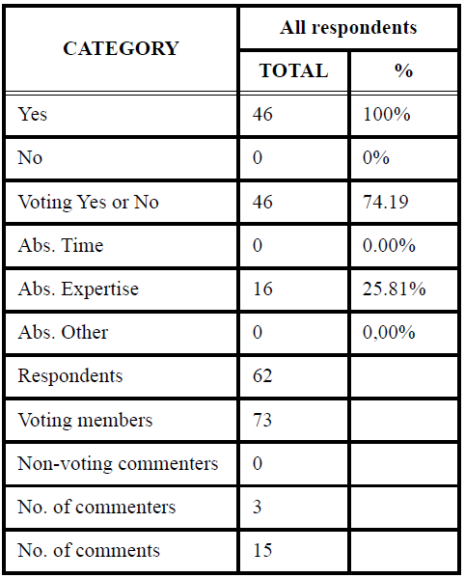
Supporting Information P802.1Qdj
WG ballot closed: 15 October 2023
All WG ballot requirements are met
The ballot resulted in
0 Disapprove votes
0 Must Be Satisfied (MBS) comments
Comment resolution available here: https://ieee802.org/1/files/private/dj-drafts/d1/802-1Qdj-d1-3-dis-v01.pdf
Ballot results:

Slide 11
Motion – 5.035
Approve sending P802.1ASdn D2.0 to Standards Association ballot
Confirm the CSD for P802.1ASdn in https://mentor.ieee.org/802-ec/dcn/20/ec-20-0202-00-ACSD-p802-1asdn.pdf
P802.ASdn D1.2 had 98% approval at the end of the last WG ballot
In the WG, Proposed: János Farkas, Second: Ludwig Winkel
Sending draft (y/n/a): 34 – 0 – 2
CSD (y/n/a): 34 – 0 – 1
In EC, mover: Glenn Parsons, Second: Roger Marks
(y/n/a): <y>,<n>,<a>

Slide 12
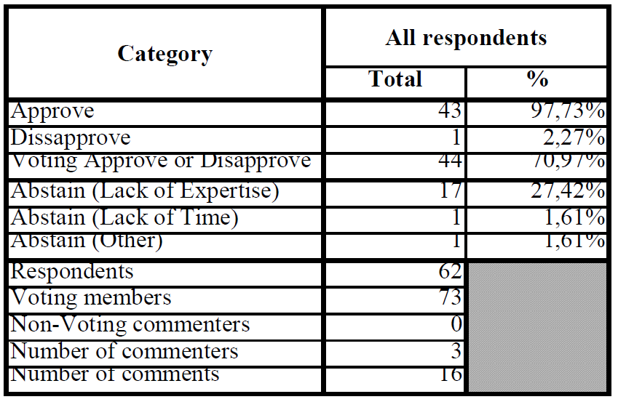
Supporting Information P802.1ASdn
WG ballot closed: 28 October 2023
All WG ballot requirements are met
The ballot resulted in
1 outstanding Disapprove votes
1 outstanding Must Be Satisfied (MBS) comments
Comment resolution available here: https://ieee802.org/1/files/private/asdn-drafts/d1/802-1ASdn-d1-2-dis-v01.pdf
Ballot results:

Slide 13
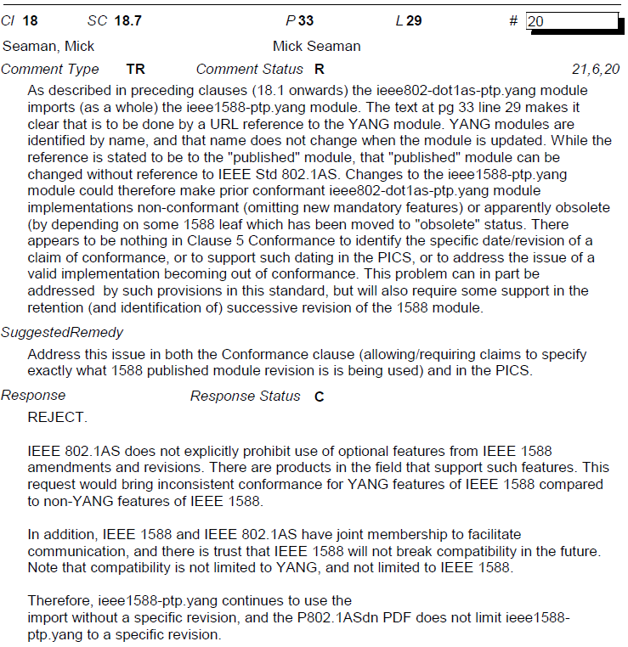
Supporting Information P802.1ASdn
1 disapprove vote associated with 1 MBS comment is maintained from the initial WG ballot on D1.0
https://ieee802.org/1/files/private/asdn-drafts/d1/802-1ASdn-d1-0-dis.pdf

Slide 14
Motion – 5.036
Conditionally approve sending P802.1ASdm D2.0 to Standards Association ballot
Confirm the CSD for P802.1ASdm in https://mentor.ieee.org/802-ec/dcn/20/ec-20-0093-01-ACSD-p802-1asdm.pdf
P802.ASdm D1.3 had 94% approval at the end of the last WG ballot
In the WG, Proposed: Geoffrey Garner, Second: János Farkas
Sending draft (y/n/a): 35 – 3 – 3
CSD (y/n/a): 36 – 2 – 3
In EC, mover: Glenn Parsons, Second: Roger Marks
(y/n/a): <y>,<n>,<a>

Slide 15
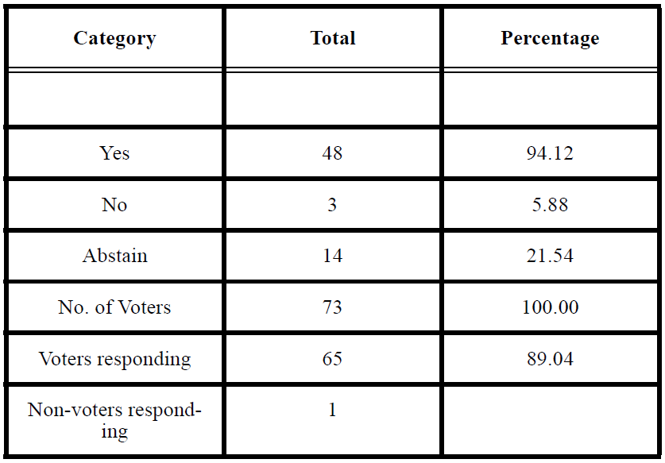
Supporting Information P802.1ASdm
WG ballot closed: 27 October 2023
All WG ballot requirements are met
The ballot resulted in
3 outstanding Disapprove votes
3 outstanding Must Be Satisfied (MBS) comments
Comment resolution available here: https://ieee802.org/1/files/private/asdm-drafts/d1/802-1ASdm-d1-3-dis-v01.pdf Recirculation ballot will be conducted during November/December with comment resolution in TSN TG meetings. A possible final recirculation in January/February if required with comment resolution in TSN TG meetings.
Ballot results:

Slide 16
Supporting Information P802.1ASdm
Voters maintaining Disapprove vote
Christian Boiger
Johannes Specht
Wants to see the subsequent drafts
Max Turner

Slide 17
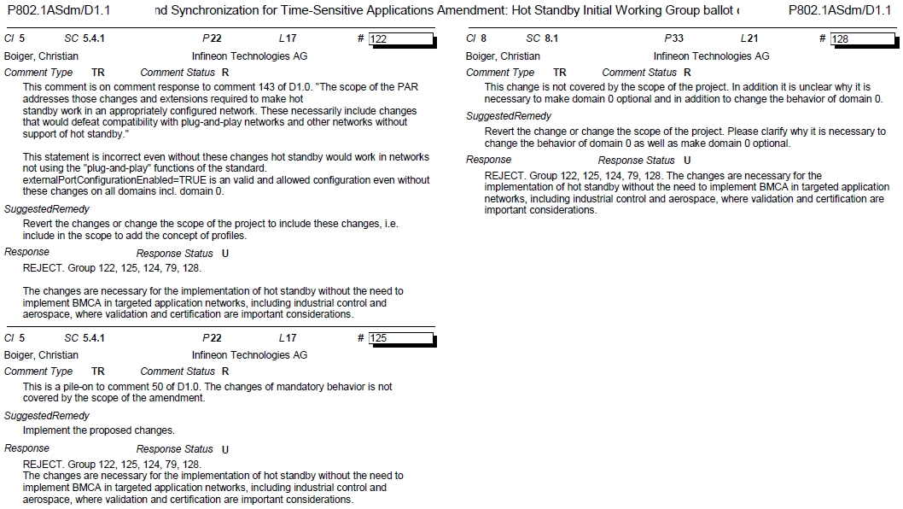
Supporting Information P802.1ASdm
Outstanding MBS comments associated with Disapprove vote from D1.1 (802-1ASdm-d1-1-dis-v01.pdf)

Slide 18
Motion – 5.037
Conditionally approve sending P802.1Qdx D2.0 to Standards Association ballot
Confirm the CSD for P802.1Qdx in https://mentor.ieee.org/802-ec/dcn/23/ec-23-0075-00-ACSD-p802-1qdx.pdf
P802.Qdx D1.0 had 81% approval at the end of the last WG ballot
In the WG, Proposed: János Farkas, Second: Jordon Woods
Sending draft (y/n/a): 30 – 2 – 8
CSD (y/n/a): 30 – 1 – 9
In EC, mover: Glenn Parsons, Second: Roger Marks
(y/n/a): <y>,<n>,<a>

Slide 19
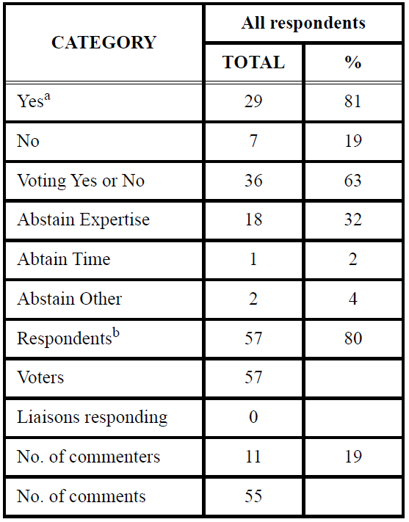
Supporting Information P802.1Qdx
WG ballot closed: 13 November 2023
All WG ballot requirements are met
The ballot resulted in
7 Disapprove votes
12 outstanding Must Be Satisfied (MBS) comments
Comment resolution available here: https://ieee802.org/1/files/private/dx-drafts/d1/802-1Qdx-d1-0-dis-v01.pdf
Recirculation ballot will be conducted during November/December with comment resolution in TSN TG meetings. A possible final recirculation in January/February if required with comment resolution in TSN TG meetings.
Ballot results:

Slide 20
Supporting Information P802.1Qdx
Voters maintaining Disapprove vote
Christian Boiger
Paul Bottorff
Marina Gutierrez
Hiroki Nakano
Jessy Rouyer
Michael Seaman
Johannes Specht
MBS comments are on the following slides
(commenter was not present during comment resolution)

Slide 21
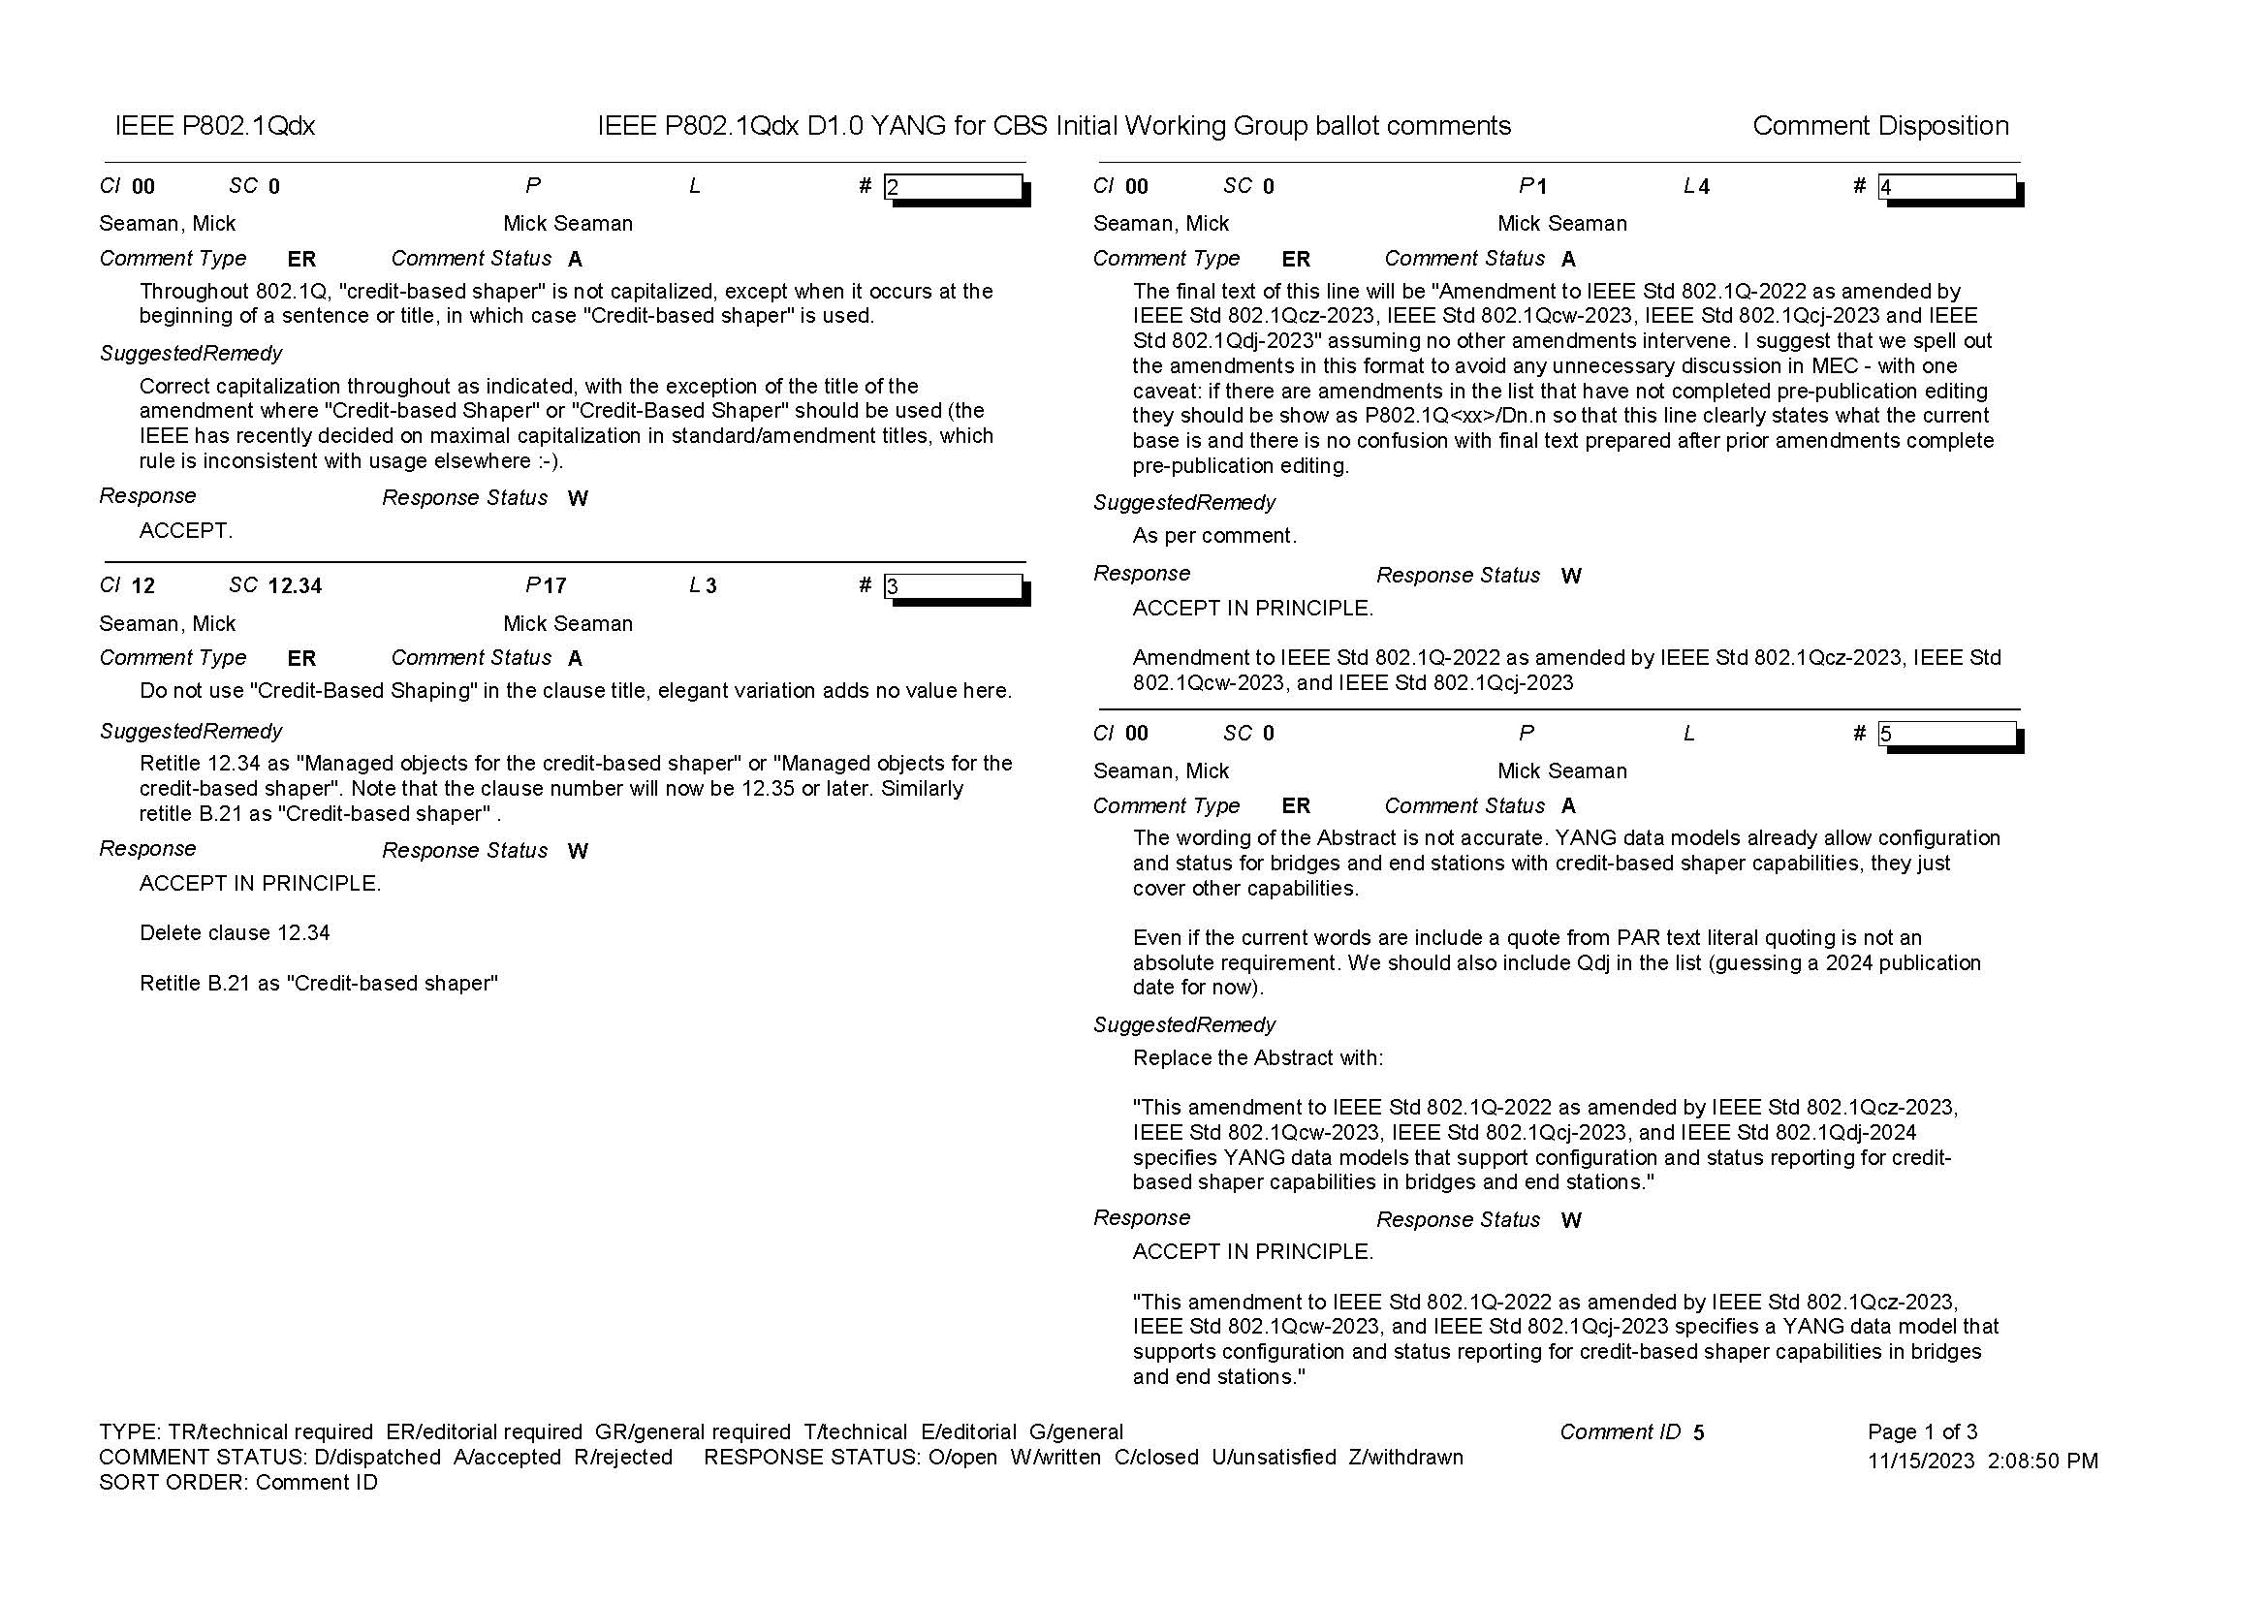
Supporting Information P802.1Qdx

Slide 22
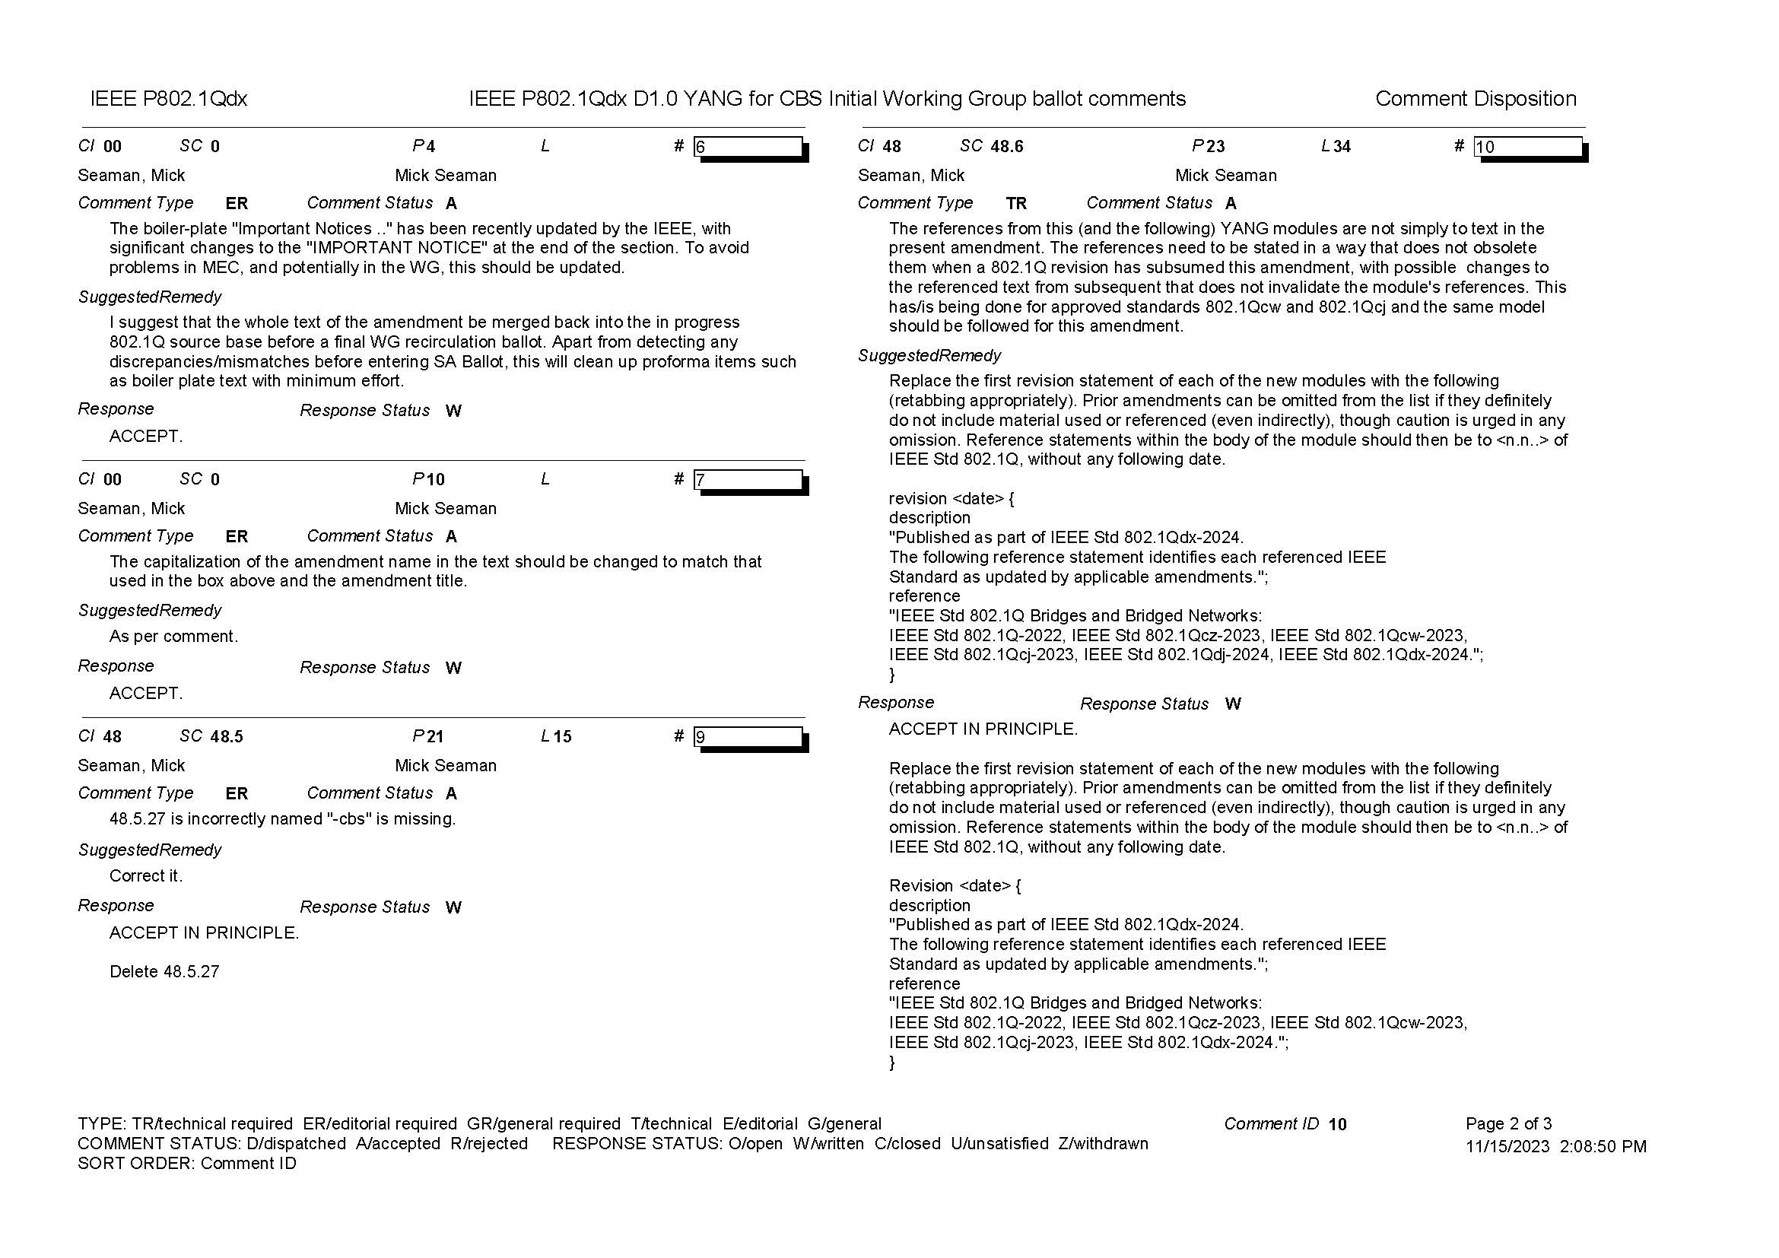
Supporting Information P802.1Qdx

Slide 23
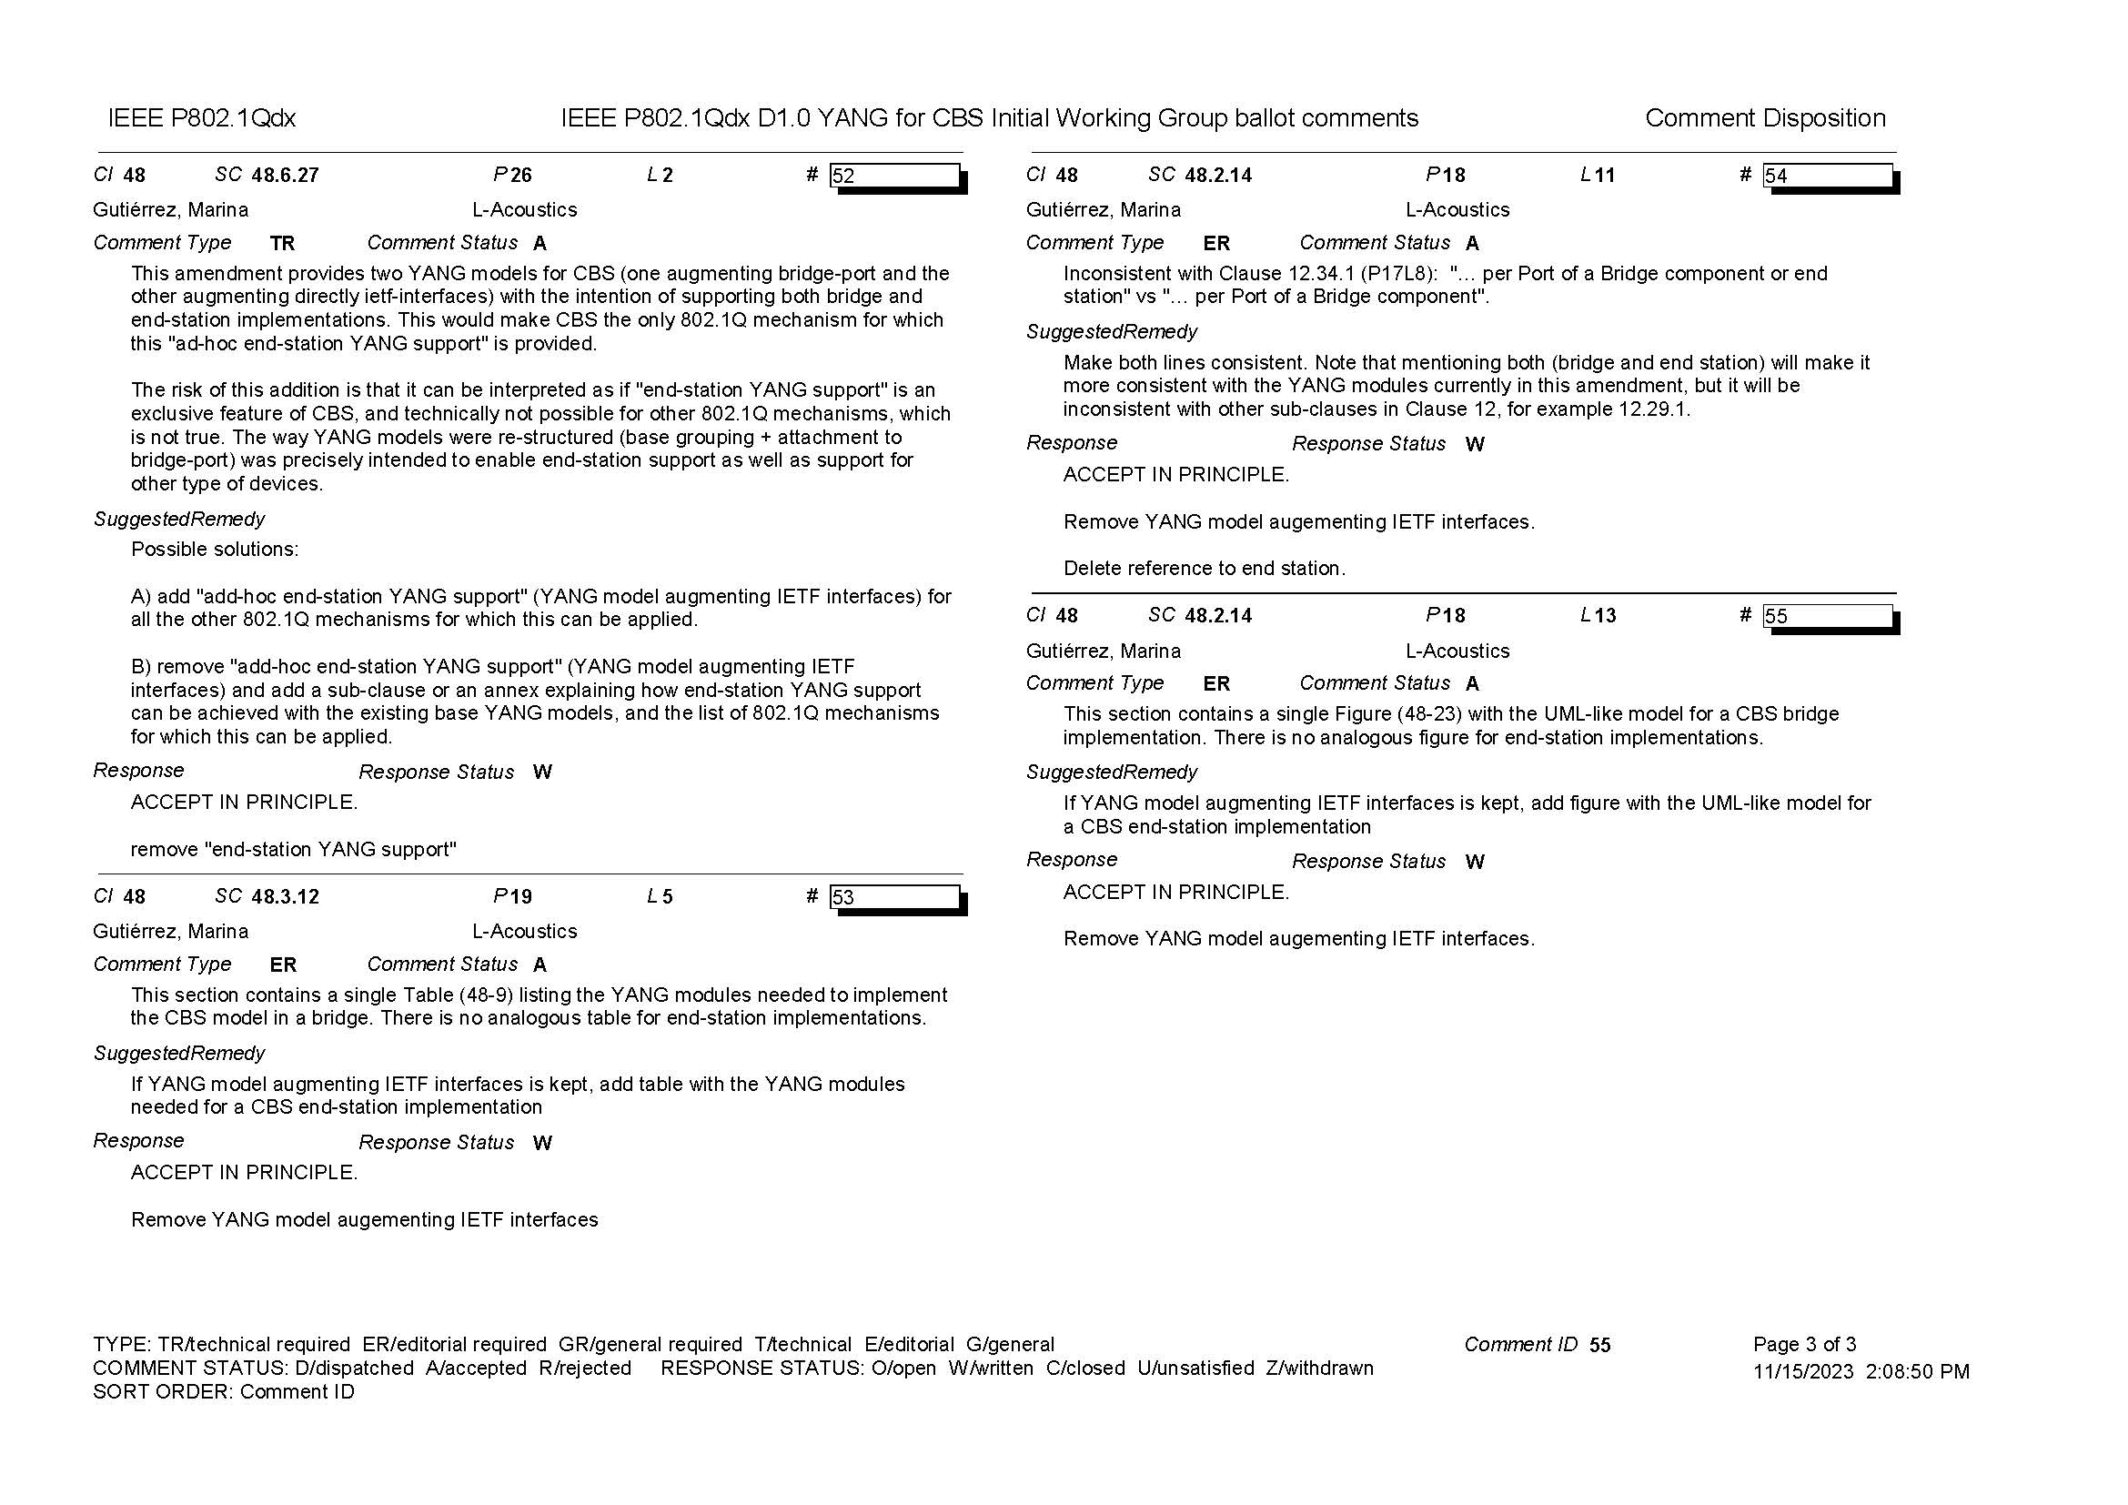
Supporting Information P802.1Qdx

Slide 24
802.1 Motions 2023-11 Consent Agenda Drafts to RevCom

Slide 25
Motion – 5.038
Approve sending P802.1ASdr to RevCom
Approve CSD documentation in https://mentor.ieee.org/802-ec/dcn/21/ec-21-0097-00-ACSD-p802-1asdr.pdf
P802.1ASdr had 97% approval at the end of the last SA ballot
In the WG, Proposed: Mark Hantel, Second: Silvana Rodrigues
Sending draft (y/n/a): 37 – 1 – 2
CSD (y/n/a): 37 – 1 – 0
In EC, mover: Glenn Parsons, Second: Roger Marks
(y/n/a): <y>,<n>,<a>

Slide 26
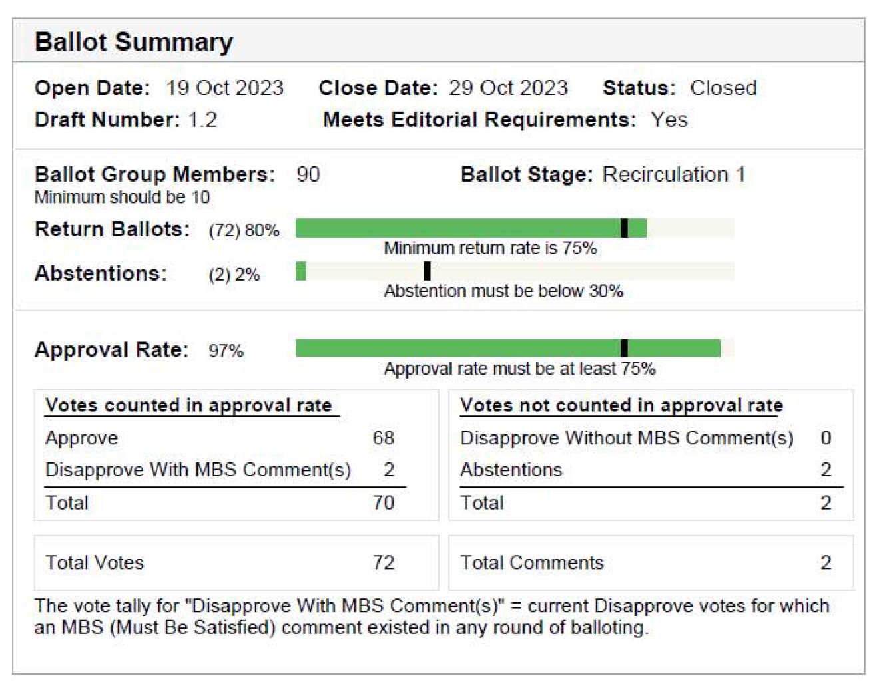
Supporting Information P802.1ASdr
SA recirculation ballot closed: 29 October 2023
All SA ballot requirements are met
The ballot resulted in
176 comments for SA initial ballot
2 outstanding Disapprove votes
172 outstanding Must Be Satisfied (MBS) comments
2 comments for the SA recirculation
No MBS comments
Final Comment resolution available here: https://www.ieee802.org/1/files/private/dr-drafts/d1/802-1ASdr-d1-2-sa-recirc1-dis-V00.pdf
Ballot results:

Slide 27
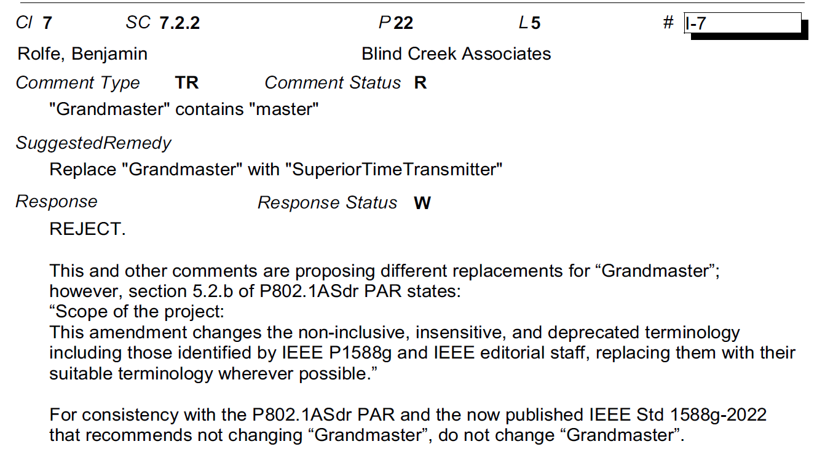
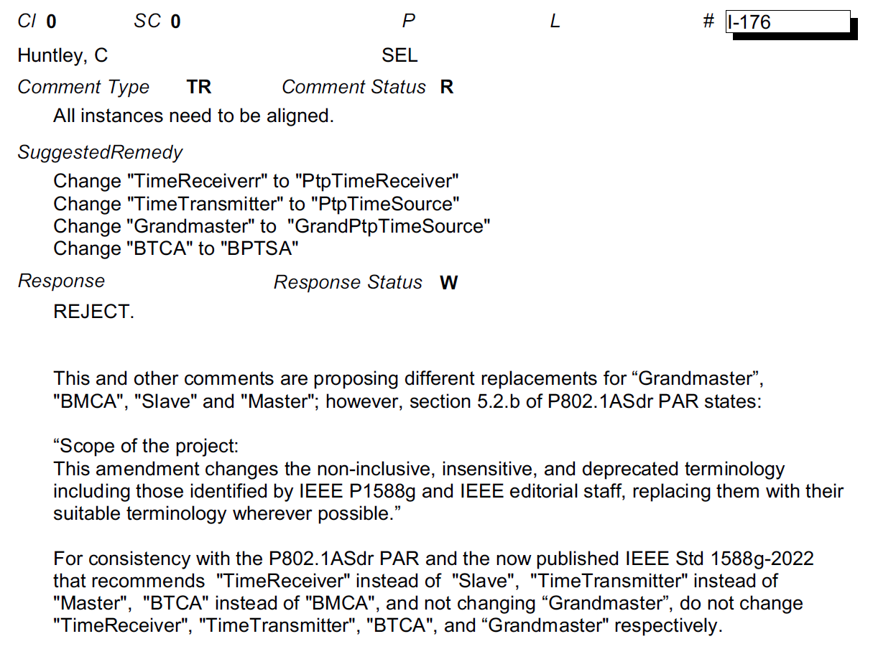
Supporting Information P802.1ASdr
2 disapprove votes associated with 172 MBS comments maintained from the initial SA ballot on D1.2
Rejected comments to the right.
One commenter added one comment (e.g. I-7) for each of the many instances of “Grandmaster” in the draft
Both disapprove votes are maintained from the initial SA ballot

Slide 28
Supporting Information P802.1ASdr
Initial SA ballot
2 Disapprove vote maintained (Benjamin Rolfe, C. Huntley)
172 MBS comments
https://www.ieee802.org/1/files/private/dr-drafts/d1/802-1ASdr-d1-2-dis-v00.pdf
First recirculation ballot
2 comments
https://www.ieee802.org/1/files/private/dr-drafts/d1/802-1ASdr-d1-2-sa-recirc1-dis-V00.pdf

Slide 29
Motion – 5.039
Conditionally approve sending P802.1CS-2020/Cor1 to RevCom
Note: there is no CSD statement since this maintenance project is not intended to provide any new functionality
P802.1CS-2020/Cor1 had 100% approval at the end of the last SA ballot
In the WG, Proposed: Mark Hantel, Second: Norm Finn
Sending draft (y/n/a): 38 – 0 – 2
In EC, mover: Glenn Parsons, Second: Roger Marks
(y/n/a): <y>,<n>,<a>

Slide 30
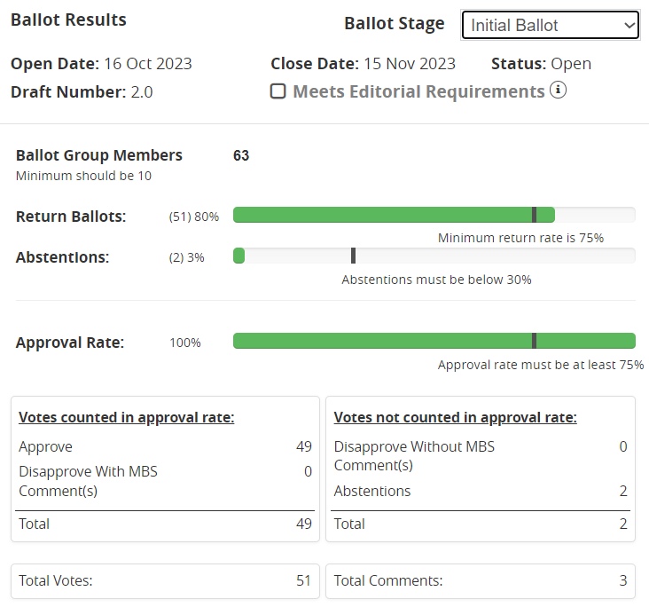
Supporting Information P802.1CS/Cor1
SA ballot closed:
15 November 2023
All SA ballot requirements are met
The ballot resulted in
0 Disapprove votes
3 comments
Ballot comment resolution will be held on Maintenance TG meetings in November/December.
Recirculation ballot will be conducted during December/January comment resolution in Maintenance TG meetings. A possible final recirculation in February if required with comment resolution in Maintenance TG meetings.

Slide 31
802.1 Motions 2023-11 Consent Agenda Liaisons and external communications (ME)

Slide 32
Motion – 7.041
Approve submission of the following draft(s) to ISO/IEC JTC1/SC6 for information under the PSDO agreement, once SA balloting begins.
IEEE P802.1Qdj, IEEE P802.1Qdx, IEEE P802.1ASdm, IEEE P802-REVc
In the WG, Proposed: Mark Hantel Second: Karen Randall
Sending draft (y/n/a): 37 – 0 – 3
In EC, mover: Glenn Parsons Second: Roger Marks
(y/n/a): <y>,<n>,<a>

Slide 33
Motion – 7.042
Approve submission of the following draft(s) to ISO/IEC JTC1/SC6 for adoption under the PSDO agreement, once approved and published.
IEEE 802.1ASdr, IEEE 802.1CS-2020/Cor1
In the WG, Proposed: Mark Hantel Second: Karen Randall
Sending draft (y/n/a): 36 – 0 – 4
In EC, mover: Glenn Parsons Second: Roger Marks
(y/n/a): <y>,<n>,<a>

Slide 34
Motion – 7.043
Approve submission of the following comment responses to ISO/IEC JTC1/SC6 for information under the PSDO agreement:
IEEE 802.1Qcz-2023
https://www.ieee802.org/1/files/public/docs2023/liaison-randall-SC6CommentResponseQcz-1123.pdf
IEEE 802.1AEdk-2023
https://www.ieee802.org/1/files/public/docs2023/liaison-randall-SC6CommentResponseAEdk-1123.pdf
In the WG, Proposed: Mark Hantel Second: Karen Randall
Sending draft (y/n/a): 34 – 0 – 5
In EC, mover: Glenn Parsons Second: Roger Marks
(y/n/a): <y>,<n>,<a>

Slide 35
802.1 Motions 2023-11 Consent Agenda Liaisons and external communications (II)

Slide 36
Motion – 7.044
Approve https://www.ieee802.org/1/files/public/docs2023/liaison-IETF-DetNet-status-update-1123-v01.pdf as communication to the IETF Deterministic Networking (DetNet) WG, granting the IEEE 802.1 WG chair (or his delegate) editorial license.
Proposed: János Farkas
Second: Norm Finn
In the WG (y/n/a): 37 – 0 – 3
In the EC, for information (or motion to block)

