Slide 1
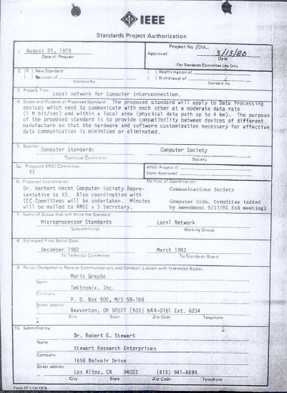
IEEE 802 LMSC 133rd Plenary Session (4th mixed mode Plenary Session) 10-14 July 2023
DCN ec-23-0142-00-00EC

Slide 2
3.00 Chair’s Announcements

Slide 3
3.00 Chair’s Announcements
Reminder #1: Please use IMAT to log your attendance
Reminder #2: Interim EC meeting scheduled for 19:00-21:00 UTC Tuesday 01 August (15:00-17:00 ET).
Reminder #3: Jodi Haasz will replace Ron Hotchkiss in the dot01 staff support role at close of this meeting
Reminder #4: After the closing EC meeting adjournment voluntary 802 EC group photograph
Reminder #5: 2022-2024 is Paul Nikolich’s final term as 802 Chairman. - 802 LMSC actively seeks qualified candidates for the 802 Chair and the 802 EC Appointed positions. - Candidates should meet with the holder of the position they seek to enable them to fully understand their responsibilities Chair First Vice Chair Second Vice Chair Treasure Recording Secretary Executive Secretary and Chair

Slide 4
3.00 Chair’s Announcements
Reminder #6: Please vote in upcoming IEEE Elections: BoD, Computer Society, Standards Association, etc. Balloting begins 15 August 2023, closes 02 October 2023 (Communication Society BoG elections closes 20 July 2023)
A partial list of positions and candidates:
2024 IEEE President-Elect candidates Roger U. Fujii and Kathleen A. Kramer
2024 IEEE Standards Association President-Elect candidates Mark Epstein, Gary R. Hoffman, and Robby Robson
2024-2025 IEEE Standards Association Board of Governors Member-at-Large candidates Position 1: Mehmet Ulema and Douglas N. Zuckerman Position 2: Kishik Park and Joseph S. Levy
2024 IEEE Technical Activities Vice President-Elect candidates Maciej J. Ogorzalek, Dalma Novak, and Rakesh Kumar
A full list of positions and candidates is available at https://www.ieee.org/about/corporate/election/candidates.html

Slide 5
8.07 802/SA Task Force Meeting Reminder
802/SA Task Force Electronic Meeting Monday 17 April 2023 16:00-17:00 ET was canceled due to lack of agenda items
Next 802/SA Task Force Electronic Meeting Tentatively scheduled for 16:00-17:00 ET Monday 14 August 2023 xx Poll 802 EC members if meeting should be cancelled for summer break xx
If not canceled, please submit agenda items to the 802 EC Reflector as appropriate no later than AOE Monday 17 August 2023

Slide 6
8.08 802 IEEE Milestone Project Status Update
Geoff Thompson

Slide 7
End of Opening EC Meeting

Slide 8
After the meeting adjourns
802 EC Members please gather at the front of the room for a voluntary group photograph

Slide 9
Parking Lot Items
tbd

Slide 10
3.0 Participant behavior in IEEE-SA activities is guided by the IEEE Codes of Ethics & Conduct
All participants in IEEE-SA activities are expected to adhere to the core principles underlying the:
IEEE Code of Ethics
IEEE Code of Conduct
The core principles of the IEEE Codes of Ethics & Conduct are to:
Uphold the highest standards of integrity, responsible behavior, and ethical and professional conduct
Treat people fairly and with respect, to not engage in harassment, discrimination, or retaliation, and to protect people's privacy.
Avoid injuring others, their property, reputation, or employment by false or malicious action
The most recent versions of these Codes are available at
http://www.ieee.org/about/corporate/governance

Slide 11
3.0 Participants in the IEEE-SA “individual process” shall act independently of others, including employers
The IEEE-SA Standards Board Bylaws require that “participants in the IEEE standards development individual process shall act based on their qualifications and experience”
This means participants:
Shall act & vote based on their personal & independent opinions derived from their expertise, knowledge, and qualifications
Shall not act or vote based on any obligation to or any direction from any other person or organization, including an employer or client, regardless of any external commitments, agreements, contracts, or orders
Shall not direct the actions or votes of other participants or retaliate against other participants for fulfilling their responsibility to act & vote based on their personal & independently developed opinions
By participating in standards activities using the “individual process”, you are deemed to accept these requirements; if you are unable to satisfy these requirements then you shall immediately cease any participation

Slide 12
3.0 IEEE-SA standards activities shall allow the fair & equitable consideration of all viewpoints
The IEEE-SA Standards Board Bylaws (clause 5.2.1.3) specifies that “the standards development process shall not be dominated by any single interest category, individual, or organization”
This means no participant may exercise “authority, leadership, or influence by reason of superior leverage, strength, or representation to the exclusion of fair and equitable consideration of other viewpoints” or “to hinder the progress of the standards development activity”
This rule applies equally to those participating in a standards development project and to that project’s leadership group
Any person who reasonably suspects that dominance is occurring in a standards development project is encouraged to bring the issue to the attention of the Standards Committee or the project’s IEEE-SA Program Manager

