Slide 1
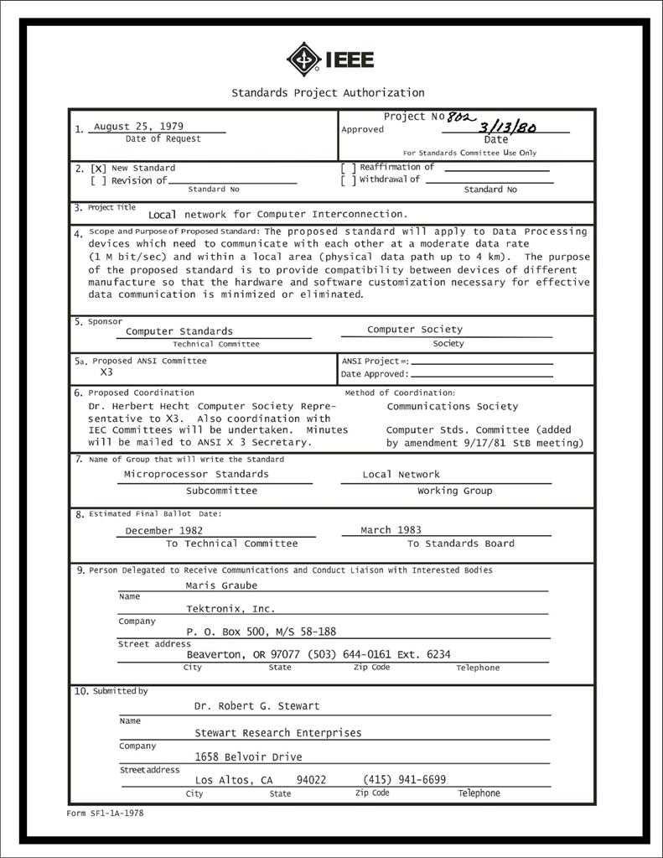
IEEE 802 LMSC Executive Committee 05 APR 2022 Electronic Meeting 19:00-21:00 UTC 15:00-17:00 ET
DCN ec-22-098-00-00EC

Slide 2
1.00 Meeting called to order/role call
2.00 Review/modify/approve agenda
2.01 Participation Slide Set URLs:
https://ieee802.org/sapolicies.shtml
https://standards.ieee.org/content/dam/ieee-standards/standards/web/documents/other/Participant-Behavior-Individual-Method.pdf
Participant behavior is guided by IEEE Code of Ethics & Conduct
Participants shall act independently of others, including employers
Standards activities shall allow the fair & equitable consideration of all viewpoints

Slide 3
3.00 Chair’s Announcements
Proforma:
Use IMAT to log your attendance
Please enable mute when you are not speaking
Please use the Chat function to request being put in the queue

Slide 4
3.05 802/SA Task Force status update
802/SA task force meeting held 25 April 2022 4-5pm ET
SA staff presented a high level timeline of the “Volunteer Document Management Solutions”
Nothing likely to start until 2023, Mentor and IMAT shall remain operational
SA staff to investigate SA’s ability to support mixed mode meetings and report back at the next 802/SA Task Force meeting.
Staff is unaware of any plans to terminate Webex support
Next meeting scheduled for 11 July 2022 4-5pm ET

Slide 5
9.0 EC Action Item Status Review
Action item review
tbd

Slide 6
Adjourn EC Meeting

Slide 7
802 Leadership Workshop-prior events
Index | Date | Location | Co-lead | Co-lead
8 | 2022 July 16 | Montreal Sheraton | George Zimmerman | Ben Rolfe
7 | 2018 July | San Diego Hyatt | John D’Ambrosia | Glenn Parsons James Gilb
6 | 2016 January | Atlanta Hyatt | David Law
5 | 2014 November | San Antonio Hyatt | Subir Das | Apurva Mody
4 | 2013 November | Dallas Hyatt | Adrian Stephens
3 | 2012 November | San Antonio Hyatt | Roger Marks | Steve Shellhammer
2 | 2011 November | Atlanta Hyatt | Bruce Kraemer | Jon Rosdahl
1 | 2009 July | San Francisco Hyatt | James Gilb | Geoff Thompson

