Slide 1
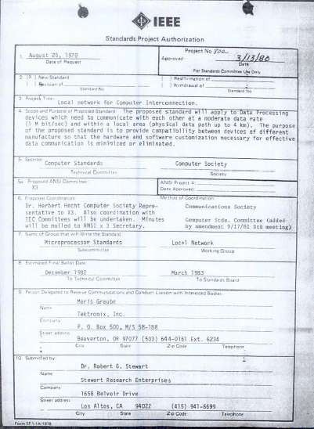
IEEE 802 LMSC
30 Oct 2020 to
13 Nov 2020
125th Plenary Session
(2nd electronic Plenary Session)
Draft 00 DCN ec-20-0222-00-00EC

Slide 2
3.0 Participant behavior in IEEE-SA activities is guided by the IEEE Codes of Ethics & Conduct
All participants in IEEE-SA activities are expected to adhere to the core principles underlying the:
  IEEE Code of Ethics
  IEEE Code of Conduct
The core principles of the IEEE Codes of Ethics & Conduct are to:
  Uphold the highest standards of integrity, responsible behavior, and ethical and professional conduct
  Treat people fairly and with respect, to not engage in harassment, discrimination, or retaliation, and to protect people's privacy.
  Avoid injuring others, their property, reputation, or employment by false or malicious action
The most recent versions of these Codes are available at
  http://www.ieee.org/about/corporate/governance

Slide 3
3.0 Participants in the IEEE-SA “individual process” shall act independently of others, including employers
The IEEE-SA Standards Board Bylaws require that “participants in the IEEE standards development individual process shall act based on their qualifications and experience”
This means participants:
  Shall act & vote based on their personal & independent opinions derived from their expertise, knowledge, and qualifications
  Shall not act or vote based on any obligation to or any direction from any other person or organization, including an employer or client, regardless of any external commitments, agreements, contracts, or orders
  Shall not direct the actions or votes of other participants or retaliate against other participants for fulfilling their responsibility to act & vote based on their personal & independently developed opinions
By participating in standards activities using the “individual process”, you are deemed to accept these requirements; if you are unable to satisfy these requirements then you shall immediately cease any participation

Slide 4
3.0 IEEE-SA standards activities shall allow the fair & equitable consideration of all viewpoints
The IEEE-SA Standards Board Bylaws (clause 5.2.1.3) specifies that “the standards development process shall not be dominated by any single interest category, individual, or organization”
  This means no participant may exercise “authority, leadership, or influence by reason of superior leverage, strength, or representation to the exclusion of fair and equitable consideration of other viewpoints” or “to hinder the progress of the standards development activity”
This rule applies equally to those participating in a standards development project and to that project’s leadership group
Any person who reasonably suspects that dominance is occurring in a standards development project is encouraged to bring the issue to the attention of the Standards Committee or the project’s IEEE-SA Program Manager

Slide 5
4.00 IEEE Staff
Michelle Turner role: 802 lead editorial support
title: Managing Editor, Content Production Management
Jodi Haasz role: 802 support
supports: dot01, dot03, dot24, dot16 groups
title: Operational Program Management Manager
Jonathan Goldberg (on leave) role: 802 lead
supports dot11, dot15, dot18, dot19, dot21, dot22 groups
title: Operational Program Management Manager
NOTE:
Jonathan Goldberg is on family leave this session, Jodi Haasz is picking up his responsibilities while he is out along with additional SA staff as required

Slide 6
5.01 Chair’s Announcements

Slide 7
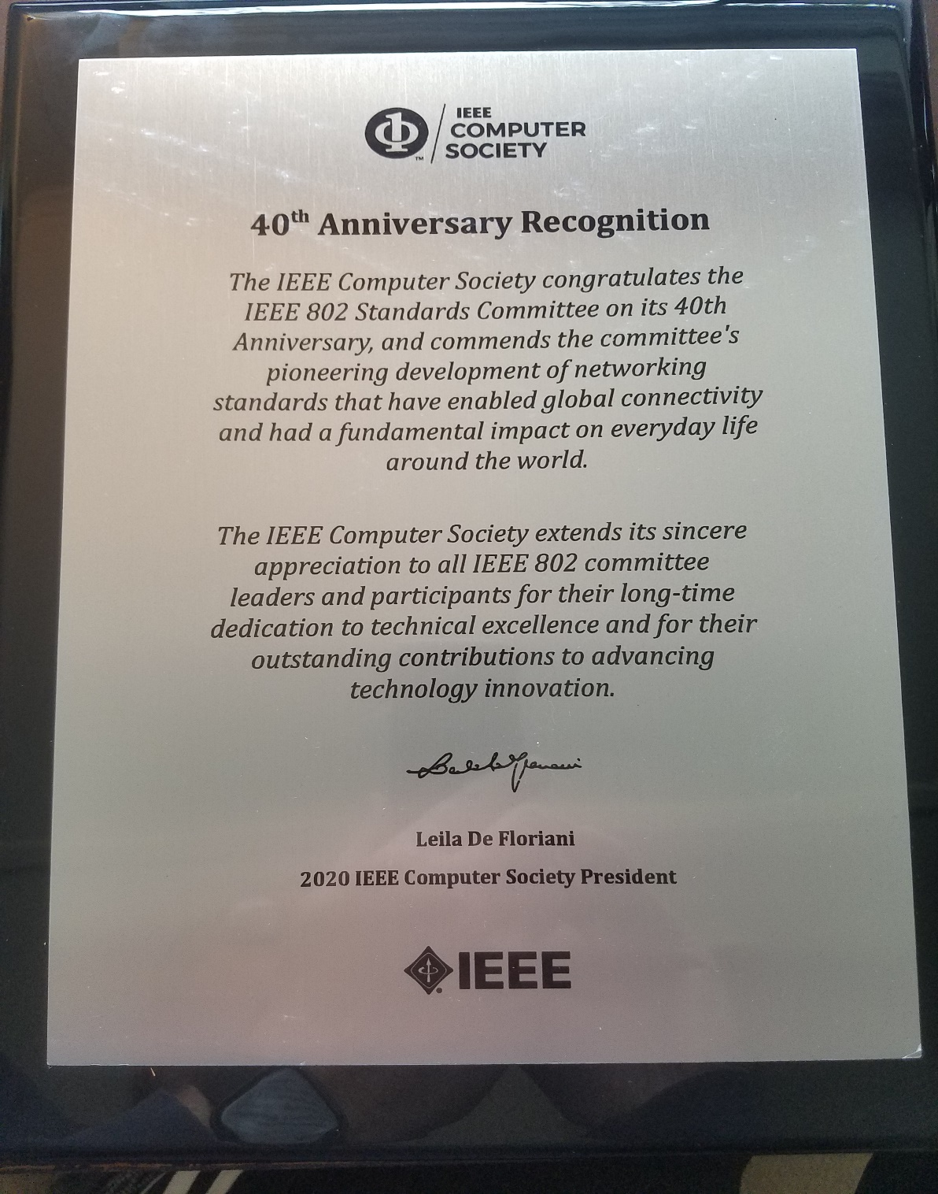
IEEE Computer Society
plaque
in recognition of
IEEE 802 LMSC’s
40th Anniversary

Slide 8
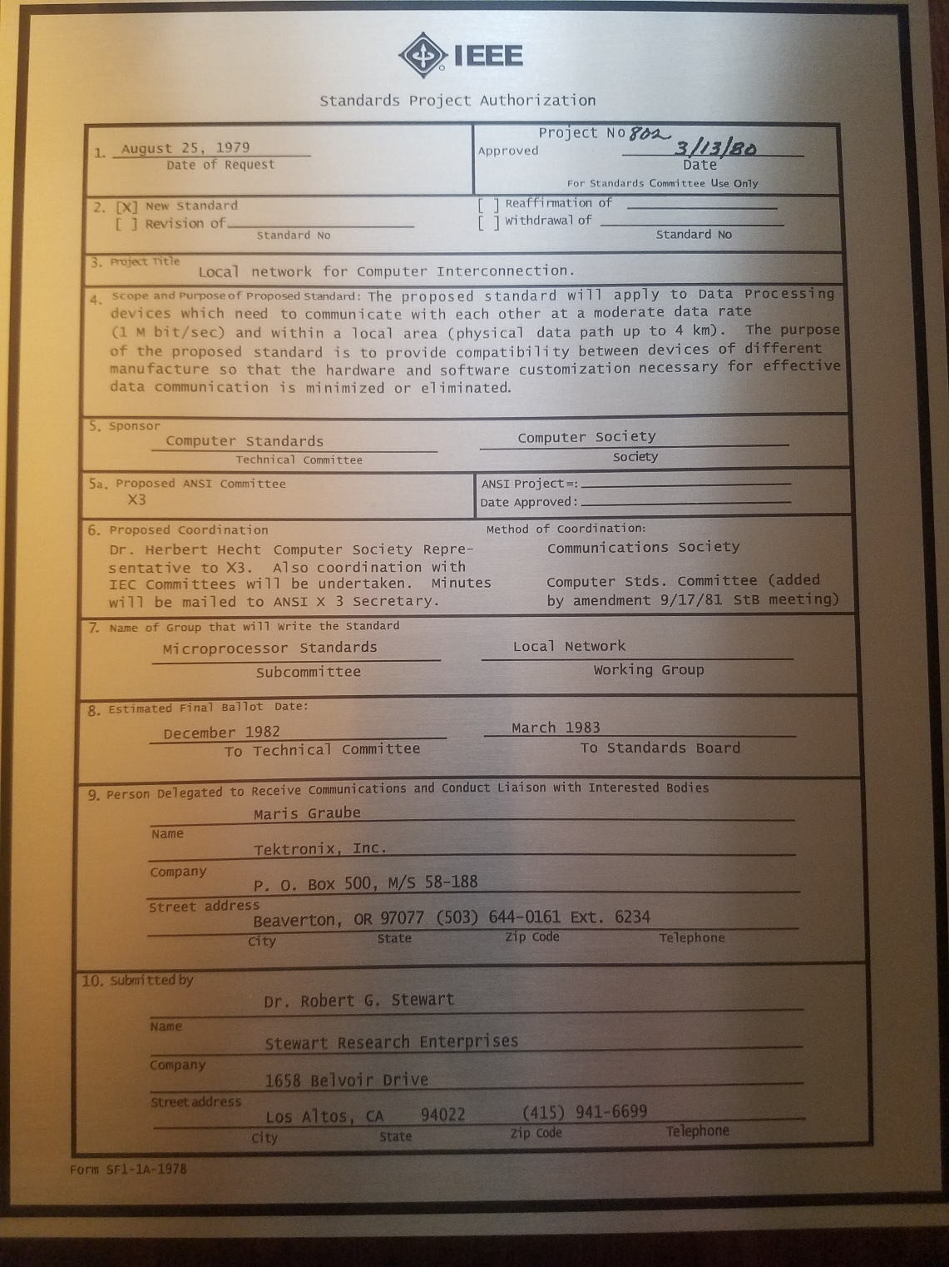
IEEE Standards Association
plaque
in recognition of
IEEE 802 LMSC’s
40th Anniversary

Slide 9
5.01 Chair’s Announcements
Chair’s opening remarks
  Reminder #1: Use IMAT to log your attendance
  Reminder #2: 2020 802 leadership elections/appointments
  Reminder #3: Interim EC meeting scheduled for 01 December 1-3PM ET
  Reminder #4: 802 EC to review Standing Committee Charters at the closing plenary meeting.

Slide 10
5.01 Chair’s Announcements
EC/WG/TAG meetings for the plenary

Slide 11
5.01 Chair’s Announcments
2020 Election Results
  Ray Liu IEEE President Elect 2021
  Cecilia Metra IEEE Division V (Computer Society) Director Elect 2021
  Steve Dukes IEEE SA BoG Member at Large 2021-2022
  Riccardo Mariani IEEE Computer Society 1st Vice President 2021
  Fabrizio Lombardi IEEE Computer Society 2nd Vice President 2021
Thank you to all who voted

Slide 12
5.02 IEEE Boards updates
SA Standards Board resolutions September 2020
  Ongoing follow-up on the SASB Ratification of the Actions taken by the IEEE 802 LMSC Sponsor in Connection with the 802.11 TGax Complaint until the project completes Sponsor ballot.
  The SASB updated the Scope of the SASB Ad Hoc on Terminology: Identify a process for the review of any/all terminology recommended or suggested for potential deprecation by the SASB,.
Computer Society BoG & SAB September 2020
  Ongoing support of the 802.3 WG ERs applications to NFPA
  CS leadership meeting with SA leadership at Nov. IEEE BoD meeting series to discuss SA support of CS/802.3 WG ER applicants
SA BoG resolutions August 2020
  Industry Connections oversight moved to SA BoG from SASB
  Approved the IEEE Public Policy Position Statement IEEE Standards Development Principles
  Renewed IEEE Adherence to WTO’s Principles of Standardization
IEEE BoD meetings November 2020
  Pending, schedule to meet 22-23 November

Slide 13
5.03 SA Standards Board Actions
Cummulative Project Authorization Approvals 2020
Nineteen IEEE 802 Projects have been approved by the SASB year-to-date
(one Corrigendum)
Cummulative Standards Ratifications 2020
Sixteen IEEE 802 Standards have been ratified by the SASB year-to-date
(one Corrigendum)

Slide 14
5.04
LMSC Email Ballot Recap
open date topic yes/no/abs/dnv* result
13JUL Approve Electronic Nov Plenary 09/00/00/04 pass
18AUG Approve Framemaker license funding 07/02/02/02 pass
18AUG Approve Nov Plenary Rules suspension 11/00/00/02 pass
22OCT Approve 802 ex-parte to FCC on DSRC 09/02/00/04 pass
* 802 chair is counted as DNV unless his vote is required

Slide 15
5.05 EC Affiliation Update
IEEE 802 Executive Committee Members
Position | Name | Affiliation
Chair | Paul Nikolich | Self, HPE, Huawei, Itron, YAS BBV Origin Wireless, Wyebot, octoScope
First Vice Chair | James P. K. Gilb | General Atomics Aeronautical Systems, Inc., Univ of San Diego
Second Vice Chair | Roger Marks | EthAirNet Associates, Huawei
Treasurer | George Zimmerman | CME Consulting, Analog Devices, Marvell, BMW, Cisco Systems, CommScope, Sen Tekse LLC
Recording Secretary | John D'Ambrosia | Futurewei, a U.S. subsidiary of Huawei
Executive Secretary | Jon Rosdahl | Qualcomm Technologies, Inc.
P802.1 High Level Interface (HILI) | Glenn Parsons | Ericsson
P802.3 Ethernet | David Law | Hewlett Packard Enterprise
P802.11 Wireless Local Area Network (WLAN) | Dorothy Stanley | Hewlett Packard Enterprise
P802.15 Wireless Personal Area Network (WPAN) | Bob Heile | Wireless Communication Consulting, LLC.
P802.18 Radio Regulatory TAG | Jay Holcomb | Itron Inc.
P802.19 Wireless Coexistence | Steve Shellhammer | Qualcomm Technologies, Inc.
P802.24 Vertical Network Applications TAG | Tim Godfrey | Electric Power Research Institute
Member Emeritus Member Emeritus | Geoff Thompson Clint Chaplin | Self, GraCaSI Standards Advisors Self, Samsung Research America
Hibernating Working Groups
P802.16 Broadband Wireless Access | Roger Marks | EthAirNet Associates
P802.21 Media-independent Handover | Subir Das | Perspecta Labs
P802.22 Wireless Regional Area Networks | Apurva Mody | A10 Systems, White Space Alliance

Slide 16
5.05 EC Affiliation Update
Changes in affiliation among EC members from previous slide?

Slide 17
5.06 Drafts to Sponsor Ballot
802.01: tbd
802.03: P802.3cp, P802.3cv
802.11: none
802.15: tbd
802.19: tbd

Slide 18
5.07 Drafts to RevCom
802.01: tbd
802.03: (for 01DEC 802 EC approval) P802.3cr, P802.3cu
802.11: possible Conditional Approval for P802.11ax, P802.11ay and P802.11ba
802.15: tbd
802.19: tbd

Slide 19
5.08 Draft Documents for EC to consider
802.EC: tbd
802.01: tbd
802.03: none
802.11: none
802.15: tbd
802.18: none
802.19: tbd
802.24: tbd
802/JTC1 SC: tbd
802/ITU SC: tbd
802/IETF SC: tbd
802/Wireless Chairs SC: tbd
802 Public Visibility Standing Committee: tbd
19

Slide 20
5.09 Draft PARs to NesCom
P802.1DP Standard: Time-Sensitive Networking Profile for Aerospace Onboard Ethernet Communications
P802.11bh Amendment: Enhanced service with randomized MAC addresses
P802.11bi Amendment: Enhanced service with Data Privacy Protection
P802.11REVme (via 48 hour maintenance policy)
P802.15.4aa Amendment: Japanese Rate Extension
P802.16t Amendment - Fixed and Mobile Wireless Access in Narrowband Channels
PAR withdrawal requests:
none

Slide 21
5.10 Pre-PAR activity
Group | New | Existing
dot01 | - tbd. | - Industries Connections deliberations on IEEE 802 network enhancements for the next decade..
dot03 | - 802.3 Beyond 400 Gb/s Ethernet | ICAID: New Ethernet Applications ad hoc (beyond 400G Ethernet)
dot11 | - none | - Advanced Access Network Interface (AANI) Standing Committee - Wireless Next Generation Standing Committee - Random and Changing MAC Address SG renewal (MAC Address and privacy topics)
dot15 | - none | TeraHertz activity Interest Groups: Vehicle Assisted Technology, Link Dependability SC: IETF/6tisch.

Slide 22
5.10 Pre-PAR activity
dot18 | None. | None.
dot19 | tbd | tbd
dot24 | tbd | tbd
dot ECSG | None. | None.

Slide 23
5.11 EC Action Item recap
Review Recording Secretary’s list of Open Action Items

Slide 24
5.12 Identify 802 Task Force Topics
802 Task Force Electronic Meeting
scheduled for Monday 21 December 2020 2-3pm ET
  Possible Topics
  Open portion of meeting:
    IEEE SA tools update & discussion
      Remote meeting tools: web conferencing, remote voting, etc.
      Mentor replacement investigation – status update
      SA to potentially fund Framemaker licenses – status update
    Schedule 2021 meetings (possibly 29MAR, 21JUN, 27SEP, 13DEC)
    Any other business, 5 min, all?
    Action item review, 5 min, Nikolich
  Closed portion of meeting:
    None at this time
  Adjourn

Slide 25
End of Opening EC Meeting

