Slide 1
IEEE 802 LMSC Public Visibility Campaign Wrap-up
John D’Ambrosia
Futurewei, U.S. Subsidiary of Huawei
ec-20-0081-00-00EC
May 27, 2020

Slide 2
Introduction
The following presentation provides an overview of the results of the IEEE 802 Public Visibility Campaign undertaken in conjunction with its 40th Anniversary
Also included
Appendix A - IEEE / Finn Partners Summary
Appendix B – IEEE SA Summary

Slide 3
Strategy Overview
Create a broad and global awareness campaign of IEEE 802 LAN/MAN Standards Committee and how the Standards developed by thousands of IEEE 802 technical experts over the past 40 years has enabled the industry to connect the world, which continuously evolves for the future.
Focus on the general technology audience (Tech standards, developers, and industry implementers) with the goal of reaching a broader global audience.
Emphasize key applications enabled by the IEEE 802 standards / technologies portfolio.
Leverage a combination of 802 technical experts and broader technology industry experts who have media training and can focus on specific topics that resonate with the media based on current trends
Mult-pronged effort with co-ordination between messaging plans
IEEE PR / Finn Marketing - IEEE 802 40th Anniversary Campaign
IEEE-SA New Identity Roll-out

Slide 4
Investment Summary
IEEE 802 | $100,000 Budget ($88,000 Total Cost) | Public Visibility Program
IEEE SA | Development Costs (unknown total actual cost) | IEEE SA 802 Mktg Webpage
IEEE TV | Editing Costs (unknown total actual cost) | “Man on the Street” Videos
IEEE TAB | $10,000 | Increased International Marketing Outreach

Slide 5
Summary of Program’s Social Media Channels
 | Channel | Detail
IEEE Marketing (Finn Partners) | IEEE Transmitter Page Twitter Linkedin Facebook Instagram Google Display | https://transmitter.ieee.org/802-standards/ @ieeeorg IEEE IEEE IEEE https://transmitter.ieee.org/802-standards/
IEEE SA | 802 Mktg Webpage Twitter Facebook Linkedin | https://standards.ieee.org/featured/802/index.html @ieeesa IEEE SA IEEE SA
IEEE 802 | Twitter Linkedin (JD) | @ieee802
Other IEEE Groups, Societies, Industry Organizations, Analysts | Communications Society, Photonics Society, TAB, Power & Energy, Strategy & Entrepreneurship, Engineers in Medicine & Biology, Ethernet Alliance, Wi-Fi Alliance, WI SUN Alliance, MEF, AVNU, EPIC, LightCounting, Dell’Oro

Slide 6
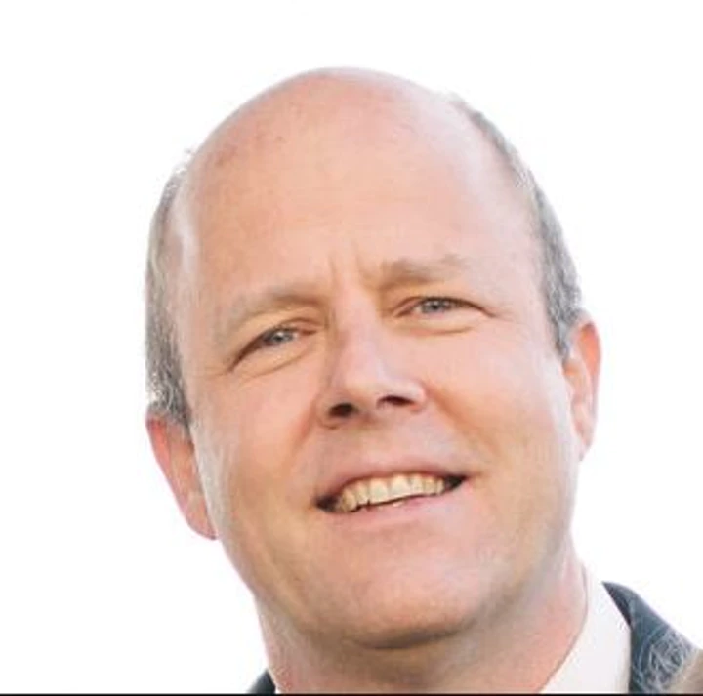
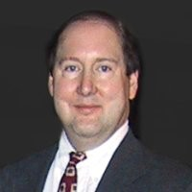
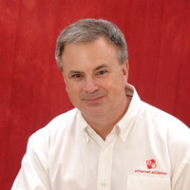
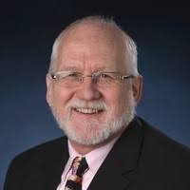
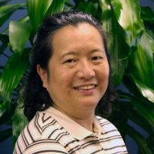
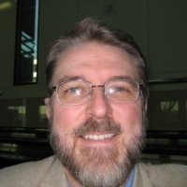
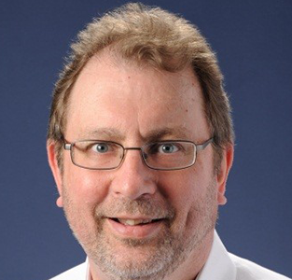
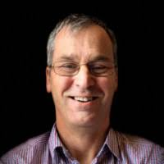
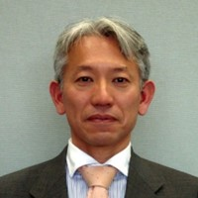
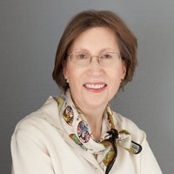
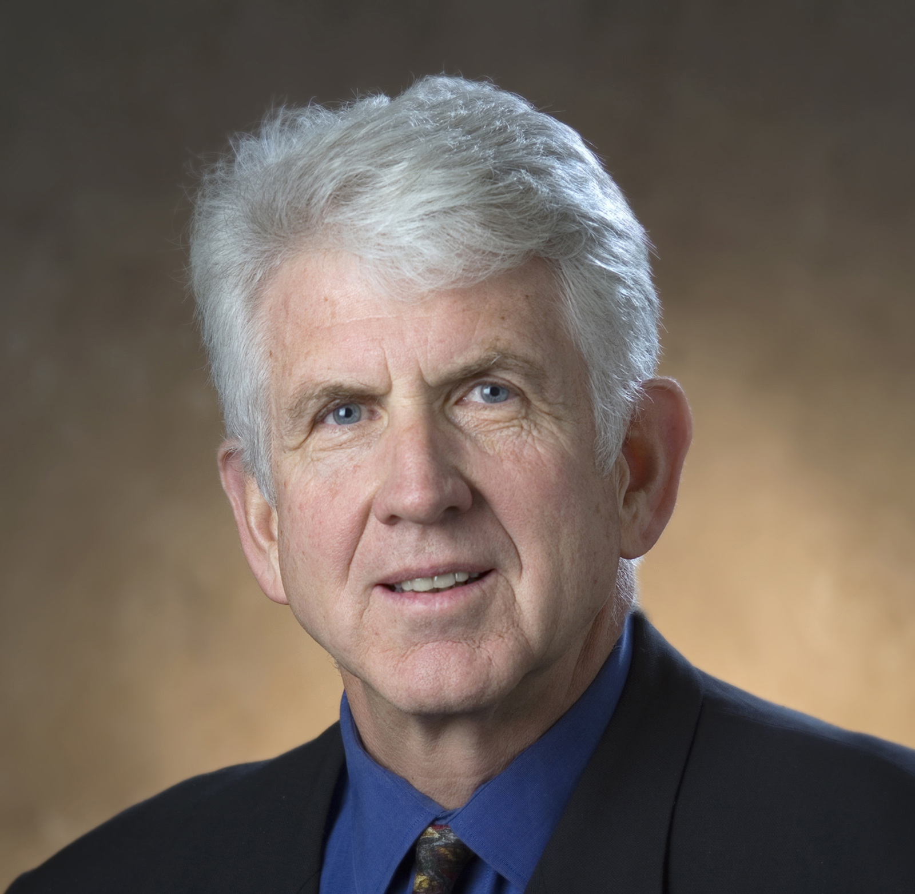
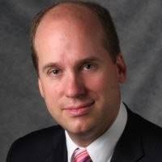
802 Content
The campaign was bolstered with a variety of content including six long form videos, five short form videos for social media, Man on the Street videos, one audio clip and four IEEE Transmitter blogs
Transmitter Article Snapshot
3 Ways the World Would Be a Different Place Without IEEE’s Family of 802 Standard
How Ethernet Has Enabled Today’s Hyper-Connected World
Why the Development of Wireless Networks Is Important for Global IoT Growth
How the Future of Wi-Fi Will Impact Our Workplaces and Lifestyles Worldwide
Video Snapshot
The IEEE 802 Standard That Changed The World
Standards that Connect
Worldwide Connectivity Enabled by 802
The Future of IoT, Connected Cars and Wi-Fi
Global Impact On Our Everyday Lives
The Future of IEEE’s 802 Standards
Referenced Standards: 802.1, 802.3, 802.11, 802.15
George Zimmerman
Tim Godfrey
John D’Ambrosia
Jim Lansford
Lei Wang
Steve Carlson
Paul Nikolich
Andrew Myles
Shoichi Kitazawa
Dorothy Stanley
Bob Metcalfe
Glenn Parsons

Slide 7
Campaign Coverage Overview
For the 40th anniversary of the creation of IEEE’s 802 standards, Finn Partners conducted targeted outreach to effectively engage media contacts at technology, business, network-focused and trade outlets. We showcased experts that work on a variety of standards within the 802 family.
Outreach over the course of the campaign focused on a variety of topics including the 40th Anniversary of 802 and its effects on the world, the technological and societal challenges of a world without 802, pushing the limits of future technology through 802 standards, vertical applications of 802 (education, manufacturing, automotive, etc.), 802’s effect on the Internet of Things, among others.
Our global efforts effectively drove significant and widespread media coverage in 14 countries in outlets such as The Next Web, BGR, SearchNetworking, IndustryWeek, Networks Europe, TechTudo, Baidu, Express Computers, ZDNet Korea, Elektronikpraxis and many more.
Total Secured Coverage (amount of media coverage mentioning IEEE 802): 161 (6 pending)
Total Global Unique Visitors Per Month (the total audience reached via coverage): 5,731,239,313
Secured Coverage by Region:
US: 19 (1 pending)
UK: 2 (1 pending)
Brazil: 11
India: 8
China: 30
Japan: 54
Korea: 25
Germany: 4 (pending)
Netherlands: 1 (syndication from US coverage)
Spain: 2 (syndication from US coverage)
France: 3 (syndication from US coverage)
Indonesia: 1 (syndication from US coverage)
Italy: 3 (syndication from US coverage)
Vietnam: 1 (syndication from US coverage)

Slide 8
Campaign Metrics At A Glance
33,575,461 views
1,434,884 Engagements
Awareness - How many people saw our campaign
Engagement - How many people interacted with our campaign on social
Website Traffic
KPI: Organic social + ALL paid ads impressions
KPI: Comments, reactions, shares, clicks, video views:
KPI: Transmitter landing page views, Transmitter articles, 802 YouTube page:
47,397 Views
Audience
Unique visitors per month for all secured global media coverage/readership
5,731,239,313 visitors

Slide 9
Program Goals Versus Actuals
METRIC | GOAL | ACTUAL | PERCENTAGE TO GOAL
Social Engagement (likes, comments, shares, clicks, video views) | 75,000 | 1,434,884 | 1913%
Video Views (Man on the Street, Landing page Videos, Social media videos) | 100,000 | 785,413 | 785%
Transmitter Articles | 4 | 4 | 100%
IEEE 802 Transmitter Landing Page Views | 35,000 | 45,543 | 130%
Global Secured Coverage | 40-50 | 161 (6 pending) | 322%
802 Marketing Page traffic (how many people clicked to see the 802 marketing page from our ads) | 500-2500 | 13,234 clicks, resulted in 3,274 views of page **Click through rate is typically 11.45%, this was a 24.7% click through rate **Total ad spend was $200 - that is a $.06 cost per click where industry average is $.90 **UX factors such as page load speeds and content can impact click through rate | 529%

Slide 10
Organic Social Performance
Total number of posts | 110
Impressions | 4,397,474
Likes / Reactions | 36,968
Comments / Replies | 514
Shares | 3,934
Link clicks | 13,688
Video views | 149,134
Channel | Facebook | LinkedIn | Instagram | Twitter
Impressions | 2,653,799 | 856,746 | 633,619 | 253,310
Engagements | 67,351 | 56,231 | 66,979 | 13,747
Throughout the 802 Standards campaign, organic social media garnered 4.3 million impressions, 13,000+ clicks, nearly 150,000 video views and over 200,000 engagements.
Engagement was high across all social channels:
Facebook garnered the most impressions at 2,653,799
Instagram garnered the most video views at 53,597
LinkedIn garnered the most clicks at 7,954
Corona Virus drove industry desire for content
Reaching Students and Young Professionals
~90% of IEEE’s social media audience are within the 18-44 age range. Many are students and academics.

Slide 11
Key Learnings + Highlights
Google Display Network paid advertising ( aka GDN) performed extremely well. GDN banners across the web and apps drove 46.29% of all traffic to the Transmitter 802 Standards page at an average Cost Per Click of just $0.14 per click.
802 video content garnered high engagement and gathered a following throughout the campaign. We saw an increase of views over time with over 450K views alone in the final two week period of the campaign (4/1-4/15) with a total of 750,294 views overall.
Our audience engaged the most with content that immediately asked a provoking question, such as what a world without Wi-Fi would look like, or content that established a link from 802 to popular industries and/or everyday life.
Media coverage resonated most when talking about the future applications of 802 and when discussing the various technologies 802 enables like Wi-Fi and Ethernet rather than the technical nuances of the standards. Examples included Wi-Fi sensing, Ethernet for autonomous vehicles, applications to the IoT, etc.
COVID-19 was at its peak during the majority of our campaign (April + March) yet we out performed all of our metrics. This was due to the fact that our existing content included topics like remote work and that we quickly made a shift in our campaign to highlight further relevance. This included changing the language of our organic, paid and website copy and our media pitching.

Slide 12
IEEE SA 802 MKTG WEBPAGE: BY THE NUMBERS
 | As of 3/4 | As of 3/11 | As of 3/18 | As of 3/25 | As of 4/1 | As of 4/8 | As of 4/15
Page Views | 906 | 1,602 | 2,378 | 3,073 | 3,671 | 3,809 | 3,951
Avg Time on page | 2:27 | 2:23 | 02:14 | 02:15 | 02:24 | 02:26 | 02:31
Form Submissions | 5 | 8 | 11 | 14 | 21 | 24
Total Clicks | 374 | 671 | 1024 | 1,398 | 1,582 | 1,654 | 1,758
Click-Through rate | 41.28% | 41.89% | 43.06% | 45.49% | 43.09% | 43.42% | 44.50%

Slide 13
IEEE SA SOCIAL MEDIA
as of 4/15 | Facebook | Twitter | LinkedIn | Totals
Number of posts | 4 | 11 | 4 | 19
Engagement (Likes/Shares/ Comments) | 55 | 338 | 56 | 449
Engagement Rate | .03% (Industry Benchmark .09%) | .66% (Industry Benchmark .07%) | 2.03% (Industry Benchmark .204%) | N/A
Reach/ Impressions | 6,582 | 30,542 | 778 | 37,902

Slide 14
INTEREST FORM SUBMISSIONS AS OF 05/04-2020
Total Working Group Interest Form Submissions as of 05/04 | 26
Number of Interest Form Submissions by Working Group | 3 802.1 Higher Layer LAN Protocols Working Group 5 802.3 Ethernet Working Group 6 802.11 Wireless LAN Working Group 7 802.15 Wireless Specialty Networks (WSN) Working Group 1 802.18 Radio Regulatory TAG 3 802.19 Wireless Coexistence Working Group 1 802.24 Vertical Applications TAG

Slide 15
IEEE 802 Social Media Stats
Through April 15
Twitter | # Users (as of 5/15) | 137
 | Tweets | 22
 | Impressions | 32,115
 | Engagements | 393
Linkedin (JD Personal account) | # Followers | 5,666
 | # Posts | 32
 | # Views | 27,590
 | # Likes | 230
#1 Tweet (14,972) –
Today marks the 40th Anniversary of IEEE 802. Congratulations to the 802 community & thanks to all our volunteers who helped develop the family of networking standards that shaped today's connected world
#1 Post (7,537) – Excerpt
I am a 20 year veteran of IEEE 802. We are seeing the standards developed by this organization used in ways many of us never imagined. My cousin passed from COVID-19 - in writing about this personal moment - it struck me how much networking is impacting our lives: #ieee802 #802standards #ethernet #ieee

Slide 16
Next Steps
Continue IEEE 802 Public Visibility Efforts
Formation – IEEE 802 Public Visibility Standing Committee
Focus on creation non-technical content IEEE 802 (focus on applications / future)
Continue relationship building with IEEE organizations and societies
Engage in participation in IEEE Public Visibility Efforts
Request 802 EC authorize use of remaining PV funds ($12k) for continued PV activities
We are actively seeking additional funding & sponsorship to continue public visibility activities on behalf of IEEE 802

Slide 17
Appendix A –
IEEE / Finn Partners
Summary
Notes:
Applications Space Experts; hyper scale data centers, social media, mobile apps, streaming video, etc.
Future - gaming, augmented reality, virtual reality
Industry Experts from Google, Facebook, Verizon, ATT, Automotive OEMs….and so on

Slide 18
IEEE 802 40th Anniversary Campaign Wrap Up Report
April 22, 2020

Slide 19
802 Content
The campaign was bolstered with a variety of content including six long form videos, five short form videos for social media, Man on the Street videos, one audio clip and four IEEE Transmitter blogs
Transmitter Article Snapshot
3 Ways the World Would Be a Different Place Without IEEE’s Family of 802 Standard
How Ethernet Has Enabled Today’s Hyper-Connected World
Why the Development of Wireless Networks Is Important for Global IoT Growth
How the Future of Wi-Fi Will Impact Our Workplaces and Lifestyles Worldwide
Glenn Parsons (video)
Paul Nikolich (video, audio, article)
John D’Ambrosia (article, video)
Video Snapshot
The IEEE 802 Standard That Changed The World
Standards that Connect
Worldwide Connectivity Enabled by 802
The Future of IoT, Connected Cars and Wi-Fi
Global Impact On Our Everyday Lives
The Future of IEEE’s 802 Standards
Lei Wang (article)
Tim Godfrey (article)
Dorothy Stanley
(video, article)
Bob Metcalfe (video)

Slide 20
802 Thought Leaders
Through video, social and traditional media, we utilized a wide range of IEEE members to demonstrate thought leadership around the family of 802 standards
IEEE 802 Standards Referenced
802.11 Wireless LAN
802.1 Higher LAN
802.3 Ethernet
802.15 Wireless Specialty Networks
George Zimmerman
Tim Godfrey
John D’Ambrosia
Jim Lansford
Lei Wang
Steve Carlson
Paul Nikolich
Andrew Myles
Shoichi Kitazawa
Dorothy Stanley
Bob Metcalfe
Glenn Parsons

Slide 21
Program Goals Versus Actuals
METRIC | GOAL | ACTUAL | PERCENTAGE TO GOAL
Social Engagement (likes, comments, shares, clicks, video views) | 75,000 | 1,434,884 | 1913%
Video Views (Man on the Street, Landing page Videos, Social media videos) | 100,000 | 785,413 | 785%
Transmitter Articles | 4 | 4 | 100%
IEEE 802 Transmitter Landing Page Views | 35,000 | 45,543 | 130%
Global Secured Coverage | 40-50 | 161 (6 pending) | 322%
802 Marketing Page traffic (how many people clicked to see the 802 marketing page from our ads) | 500-2500 | 13,234 clicks, resulted in 3,274 views of page **Click through rate is typically 11.45%, this was a 24.7% click through rate **Total ad spend was $200 - that is a $.06 cost per click where industry average is $.90 **UX factors such as page load speeds and content can impact click through rate | 529%

Slide 22
Campaign Metrics At A Glance
33,575,461 views
1,434,884 Engagements
Awareness - How many people saw our campaign
Engagement - How many people interacted with our campaign on social
Website Traffic
KPI: Organic social + ALL paid ads impressions
KPI: Comments, reactions, shares, clicks, video views:
KPI: Transmitter landing page views, Transmitter articles, 802 YouTube page:
47,397 Views
Audience
Unique visitors per month for all secured global media coverage/readership
5,731,239,313 visitors

Slide 23
MEDIA RELATIONS PERFORMANCE

Slide 24
Campaign Coverage Overview
For the 40th anniversary of the creation of IEEE’s 802 standards, Finn Partners conducted targeted outreach to effectively engage media contacts at technology, business, network-focused and trade outlets. We showcased experts that work on a variety of standards within the 802 family.
Outreach over the course of the campaign focused on a variety of topics including the 40th Anniversary of 802 and its effects on the world, the technological and societal challenges of a world without 802, pushing the limits of future technology through 802 standards, vertical applications of 802 (education, manufacturing, automotive, etc.), 802’s effect on the Internet of Things, among others.
Our global efforts effectively drove significant and widespread media coverage in 14 countries in outlets such as The Next Web, BGR, SearchNetworking, IndustryWeek, Networks Europe, TechTudo, Baidu, Express Computers, ZDNet Korea, Elektronikpraxis and many more.
Total Secured Coverage (amount of media coverage mentioning IEEE 802): 161 (6 pending)
Total Global Unique Visitors Per Month (the total audience reached via coverage): 5,731,239,313
Secured Coverage by Region:
US: 19 (1 pending)
UK: 2 (1 pending)
Brazil: 11
India: 8
China: 30
Japan: 54
Korea: 25
Germany: 4 (pending)
Netherlands: 1 (syndication from US coverage)
Spain: 2 (syndication from US coverage)
France: 3 (syndication from US coverage)
Indonesia: 1 (syndication from US coverage)
Italy: 3 (syndication from US coverage)
Vietnam: 1 (syndication from US coverage)

Slide 25
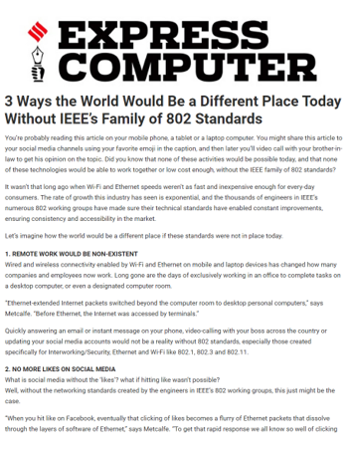
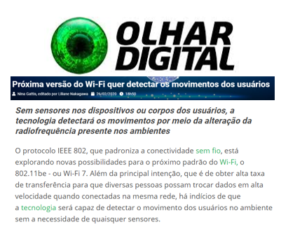
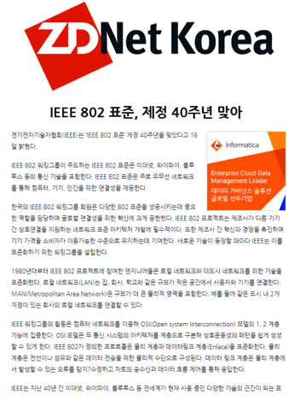
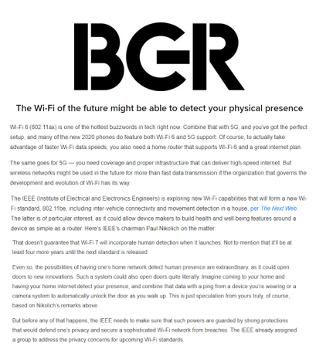
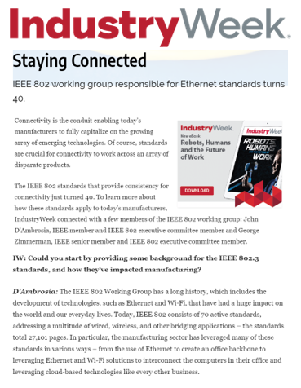
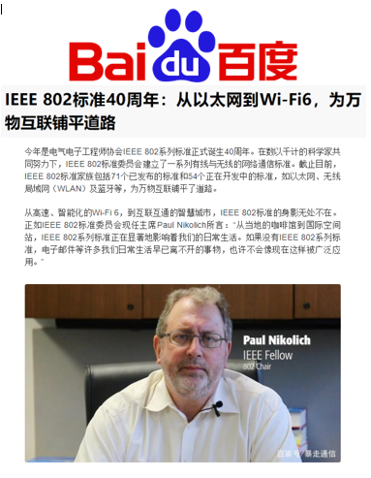
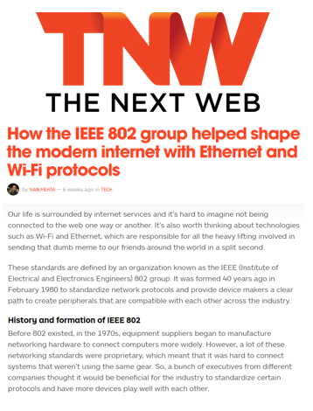
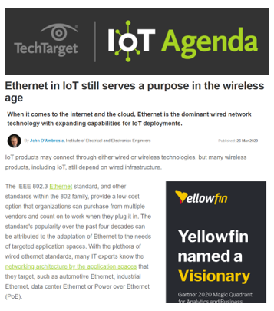
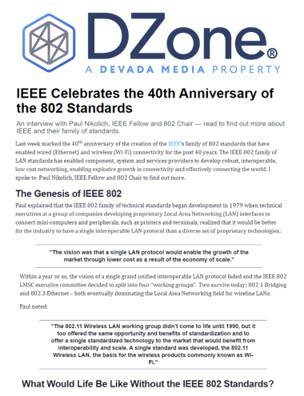
Campaign Coverage Highlights

Slide 26
PAID CHANNEL PERFORMANCE

Slide 27
Paid Advertising Performance
Channel | Budget Spend | Impressions | Link Clicks
Facebook | $1,949.97 | 24,580,610 | 136,005
Twitter | $1,500.00 | 676,943 | 24,474
Google | $3,550.03 | 3,920,434 | 23,893
** Benchmarks from STATISTA
**Variability based on channe
**Includes 802 marketing page ads
KPI | 802 Performance | **Industry Benchmark
Total Spend to Date | $7,000.00 | N/A
Average Cost per Click | $0.04 | $.09-$2.04
Average Click-through Rate | 0.63% | .1-.5%

Slide 28
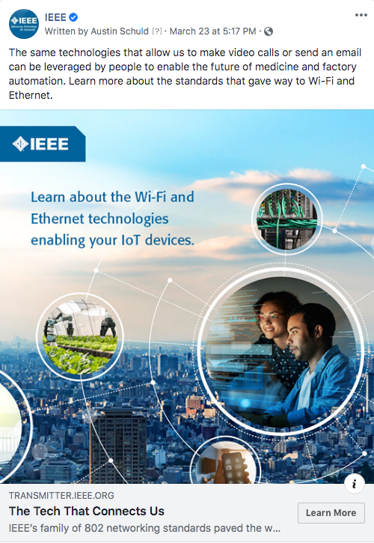
Highest Performing Ads
Number of total Ads | 11
Impressions | 10,910,006
Likes / Reactions | 4,873
Comments / Replies | 63
Shares | 88
Link clicks | 80,230
Why this worked
The ad was connecting a personal use case for technology to a much larger application of WiFi and Ethernet and crafted a strong connection between the two technology applications. Our audience is attracted to that narrative technique.

Slide 29
ORGANIC SOCIAL PERFORMANCE

Slide 30
Organic Social Performance
Total number of posts | 110
Impressions | 4,397,474
Likes / Reactions | 36,968
Comments / Replies | 514
Shares | 3,934
Link clicks | 13,688
Video views | 149,134
Channel | Facebook | LinkedIn | Instagram | Twitter
Impressions | 2,653,799 | 856,746 | 633,619 | 253,310
Engagements | 67,351 | 56,231 | 66,979 | 13,747
Throughout the 802 Standards campaign, organic social media garnered 4.3 million impressions, 13,000+ clicks, nearly 150,000 video views and over 200,000 engagements.
Engagement was high across all social channels:
Facebook garnered the most impressions at 2,653,799
Instagram garnered the most video views at 53,597
LinkedIn garnered the most clicks at 7,954
Reaching Students and Young Professionals
~90% of IEEE’s social media audience are within the 18-44 age range. Many are students and academics.

Slide 31
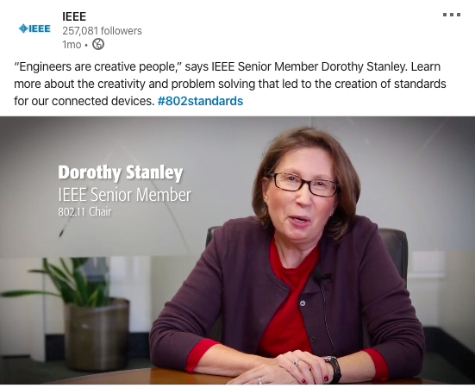
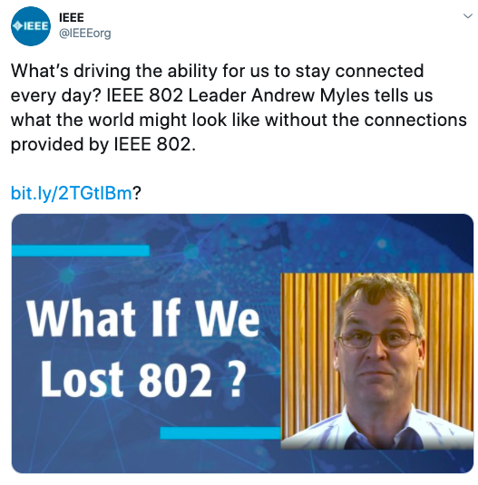
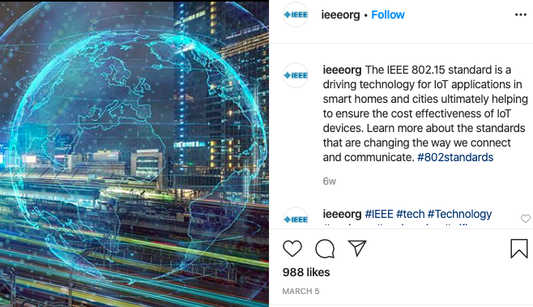
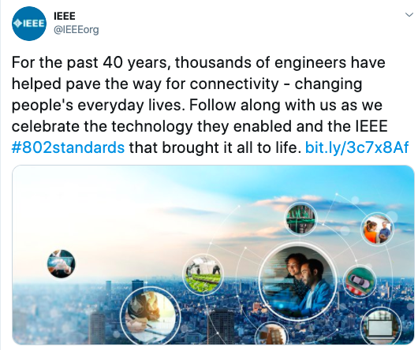
Highest Performing Social Posts
On LinkedIn and Facebook, video posts performed the highest. On Instagram and Twitter, graphic images were the highest performing. Posts containing videos still received high engagement on all channels.
Across channels, provoking messages about Wi-Fi and 802 received high engagement, for example, asking “What if we lost 802” and “A world without Wi-Fi?”
Simple and relatable posts performed well, for example, “Engineers are creative people.”
Posts that connected 802 to popular topics, such as IoT or smart cities performed well, allowing users to think about how 802 interacts with their daily lives.

Slide 32
China Social Performance
The IEEE China team translated an 802 Transmitter article, “The Global Impact of IEEE’s 802 Standards” and posted it on China social channels (Weibo and WeChat) resulting in a top performer for the region
Reach/Engagement: 1,211 *the average for articles in China is ~1,050*
How does this compare?
Out of the 13 articles/videos sent to the IEEE China team for translation from 2018-2020, this article ranks #5
Out of just articles (no videos), this ranks #3
Why is this important?
This article was posted the first week of March. Given the massive impact that coronavirus had in China, this is a huge success.
How does this align with previous insights?
Prior to this article, 5G and IEEE-related content (members, etc.) performed best
The data continues to tell us that the IEEE China audience has a heavy interest in IEEE-centric content and the future of networking.

Slide 33
TRANSMITTER PERFORMANCE

Slide 34
Transmitter Article Performance Snapshot
ARTICLE | VIEWS
3 Ways the World Would Be a Different Place Without IEEE’s Family of 802 Standard | 693
How Ethernet Has Enabled Today’s Hyper-Connected World | 517
Why the Development of Wireless Networks Is Important for Global IoT Growth | 496
How the Future of Wi-Fi Will Impact Our Workplaces and Lifestyles Worldwide | 307
** avg benchmark for Transmitter is 300-400 views for articles only. We know that videos perform best on social media vs on a landing page based on best practices. We shared our videos on both platforms and had the best performance on social.

Slide 35
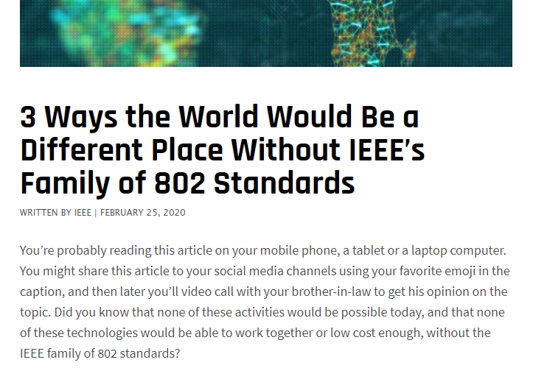
Highest Performing Transmitter Content
The highest performing article on Transmitter was 3 Ways the World Would Be a Different Place Without IEEE’s Family of 802 Standards.
One of the three ways was about remote work and how difficult it would be without 802. The data shows there was a large increase in traffic in April, a time when almost the entire world was working remotely. This proves our content was timely and relevant for our audience. The highest source of traffic was direct, meaning readers most likely came directly from the homepage or clicked on this article after reading another one.

Slide 36
Key Learnings + Highlights
Google Display Network paid advertising ( aka GDN) performed extremely well. GDN banners across the web and apps drove 46.29% of all traffic to the Transmitter 802 Standards page at an average Cost Per Click of just $0.14 per click.
802 video content garnered high engagement and gathered a following throughout the campaign. We saw an increase of views over time with over 450K views alone in the final two week period of the campaign (4/1-4/15) with a total of 750,294 views overall.
Our audience engaged the most with content that immediately asked a provoking question, such as what a world without Wi-Fi would look like, or content that established a link from 802 to popular industries and/or everyday life.
Media coverage resonated most when talking about the future applications of 802 and when discussing the various technologies 802 enables like Wi-Fi and Ethernet rather than the technical nuances of the standards. Examples included Wi-Fi sensing, Ethernet for autonomous vehicles, applications to the IoT, etc.
COVID-19 was at its peak during the majority of our campaign (April + March) yet we out performed all of our metrics. This was due to the fact that our existing content included topics like remote work and that we quickly made a shift in our campaign to highlight further relevance. This included changing the language of our organic, paid and website copy and our media pitching.

Slide 37
Appendix B
IEEE SA
Summary
Notes:
Applications Space Experts; hyper scale data centers, social media, mobile apps, streaming video, etc.
Future - gaming, augmented reality, virtual reality
Industry Experts from Google, Facebook, Verizon, ATT, Automotive OEMs….and so on

Slide 38
IEEE 802 ANNIVERSARY
IEEE SA Campaign Performance
Final Campaign Report

Slide 39
WEBPAGE: BY THE NUMBERS
 | As of 3/4 | As of 3/11 | As of 3/18 | As of 3/25 | As of 4/1 | As of 4/8 | As of 4/15
Page Views | 906 | 1,602 | 2,378 | 3,073 | 3,671 | 3,809 | 3,951
Avg Time on page | 2:27 | 2:23 | 02:14 | 02:15 | 02:24 | 02:26 | 02:31
Form Submissions | 5 | 8 | 11 | 14 | 21 | 24
Total Clicks | 374 | 671 | 1024 | 1,398 | 1,582 | 1,654 | 1,758
Click-Through rate | 41.28% | 41.89% | 43.06% | 45.49% | 43.09% | 43.42% | 44.50%

Slide 40
WEBSITE: USER JOURNEY
Where they came from:
Most users came from visiting the Standards website
Other users primarily came from Newsletters and Social Media
The rest came from direct links and other sources
What they did while here:
Most users visited the Standards homepage after visiting the 802 page
Nearly the same amount of users interacted with the 802 page and the associated bio page
The rest visited a variety of web pages across the Standards Association website
Where they dropped off:
Most users left the 802 page directly
A smaller subset of users left from the Standards homepage
The rest were a variety of web pages across the Standards Association website

Slide 41
SOCIAL MEDIA
2/26-3/6 | Facebook | Twitter | LinkedIn | Totals
Number of posts | 3 | 3 | 3 | 9
Engagement (Likes/Shares/ Comments) | 37 | 59 | 51 | 147
Engagement Rate | .02% (Industry Benchmark .09%) | .011% (Industry Benchmark .07%) | 1.93% (Industry Benchmark .204%) | N/A
Reach/ Impressions | 5,069 | 4,297 | 734 | 10,100
Additional Twitter statistics.

Slide 42
SOCIAL MEDIA
as of 3/18 | Facebook | Twitter | LinkedIn | Totals
Number of posts | 4 | 6 | 3 | 13
Engagement (Likes/Shares/ Comments) | 53 | 174 | 55 | 282
Engagement Rate | .03% (Industry Benchmark .09%) | .34% (Industry Benchmark .07%) | 2.07% (Industry Benchmark .204%) | N/A
Reach/ Impressions | 6,478 | 11,855 | 750 | 19,083
Additional Twitter statistics.

Slide 43
SOCIAL MEDIA
as of 3/25 | Facebook | Twitter | LinkedIn | Totals
Number of posts | 4 | 8 | 3 | 15
Engagement (Likes/Shares/ Comments) | 55 | 222 | 55 | 332
Engagement Rate | .03% (Industry Benchmark .09%) | .43% (Industry Benchmark .07%) | 2.07% (Industry Benchmark .204%) | N/A
Reach/ Impressions | 6,518 | 18,338 | 750 | 25,606

Slide 44
SOCIAL MEDIA
as of 4/1 | Facebook | Twitter | LinkedIn | Totals
Number of posts | 4 | 10 | 3 | 17
Engagement (Likes/Shares/ Comments) | 55 | 277 | 55 | 387
Engagement Rate | .03% (Industry Benchmark .09%) | .54% (Industry Benchmark .07%) | 2.07% (Industry Benchmark .204%) | N/A
Reach/ Impressions | 6,544 | 24,947 | 775 | 32,266

Slide 45
SOCIAL MEDIA
as of 4/8 | Facebook | Twitter | LinkedIn | Totals
Number of posts | 4 | 11 | 3 | 18
Engagement (Likes/Shares/ Comments) | 55 | 316 | 55 | 426
Engagement Rate | .03% (Industry Benchmark .09%) | .61% (Industry Benchmark .07%) | 2.07% (Industry Benchmark .204%) | N/A
Reach/ Impressions | 6,582 | 28,124 | 775 | 35,481

Slide 46
SOCIAL MEDIA
as of 4/15 | Facebook | Twitter | LinkedIn | Totals
Number of posts | 4 | 11 | 4 | 19
Engagement (Likes/Shares/ Comments) | 55 | 338 | 56 | 449
Engagement Rate | .03% (Industry Benchmark .09%) | .66% (Industry Benchmark .07%) | 2.03% (Industry Benchmark .204%) | N/A
Reach/ Impressions | 6,582 | 30,542 | 778 | 37,902

Slide 47
INTEREST FORM SUBMISSIONS AS OF 04/08-2020
Total Working Group Interest Form Submissions as of 04/08 (corrected) | 21
Number of Interest Form Submissions by Working Group | 1 802.1 Higher Layer LAN Protocols Working Group 4 802.3 Ethernet Working Group 5 802.11 Wireless LAN Working Group 6 802.15 Wireless Specialty Networks (WSN) Working Group 1 802.18 Radio Regulatory TAG 3 802.19 Wireless Coexistence Working Group 1 802.24 Vertical Applications TAG

Slide 48
INTEREST FORM SUBMISSIONS AS OF 04/15-2020
Total Working Group Interest Form Submissions as of 04/15 | 23
Number of Interest Form Submissions by Working Group | 2 802.1 Higher Layer LAN Protocols Working Group 4 802.3 Ethernet Working Group 6 802.11 Wireless LAN Working Group 6 802.15 Wireless Specialty Networks (WSN) Working Group 1 802.18 Radio Regulatory TAG 3 802.19 Wireless Coexistence Working Group 1 802.24 Vertical Applications TAG

Slide 49
INTEREST FORM SUBMISSIONS AS OF 05/04-2020
Total Working Group Interest Form Submissions as of 05/04 | 26
Number of Interest Form Submissions by Working Group | 3 802.1 Higher Layer LAN Protocols Working Group 5 802.3 Ethernet Working Group 6 802.11 Wireless LAN Working Group 7 802.15 Wireless Specialty Networks (WSN) Working Group 1 802.18 Radio Regulatory TAG 3 802.19 Wireless Coexistence Working Group 1 802.24 Vertical Applications TAG

Slide 50
THANK YOU

