Slide 1

Coalition for Content
Provenance and Authenticity
[ByungGook Lee / Dongseo Univ.]

Slide 2
IEEE 3079 Human Factors for Immersive Content Working Group
DCN: 3079-25-0048-00-0008
Title: Coalition for Content Provenance and Authenticity
Date Submitted: July 23, 2025
Authors or Source(s): ByungGook Lee (Dongseo Univ.)
Presented by ByungGook Lee (Dongseo Univ.)
Re: IEEE 3079 Session #33 in Budapest, Hungary
Abstract: Contribution report for IEEE 3079 session #33
Purpose: Reviewing report and confirm to motions in this session

Slide 3
IEEE 3079
Human Factors for Immersive Content Working Group
Beom-Ryeol Lee, lbr@etri.re.kr
Coalition for Content Provenance and Authenticity
Date: 2025-07-23
Author(s):
Name | Affiliation | Phone [optional] | Email [optional]
ByungGook Lee | Dongseo Univ. | +82 10 9331 1453 | lbg@dongseo.ac.kr
Hoon Jae Lee | Dongseo Univ. | +82 10 2801 3735 | hjlee@dongseo.ac.kr
Dae-Ki Kang | Dongseo Univ. | +82 10 7557 2944 | dkkang@dongseo.ac.kr

Slide 4
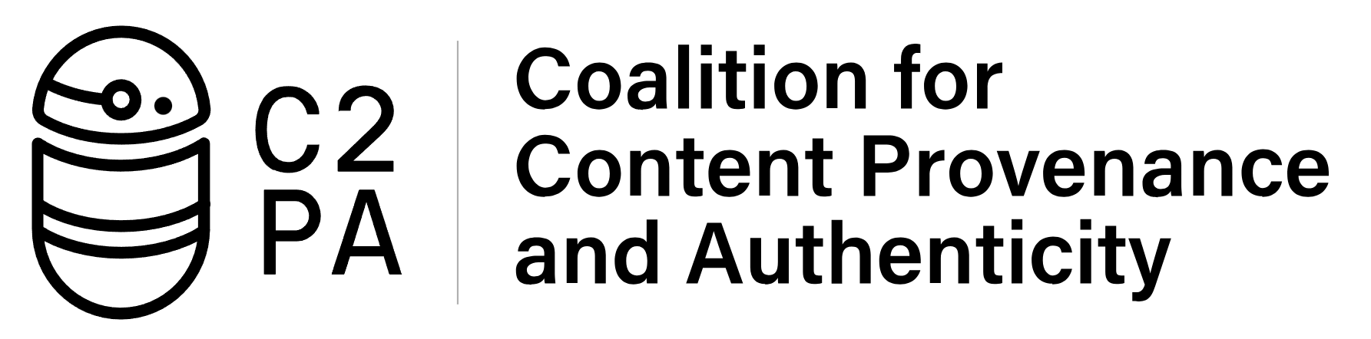
Coalition for Content
Provenance and Authenticity
The Coalition for Content Provenance and Authenticity is an initiative that addresses the prevalence of misleading information online through the development of technical standards for certifying the source and history (or provenance) of digital assets.
https://blog.witness.org/2021/12/witness-and-the-c2pa-harms-and-misuse-assessment-process/
https://www.slideshare.net/slideshow/c2pa-specifications-and-harms-and-misuse-assessment/250745426

Slide 5
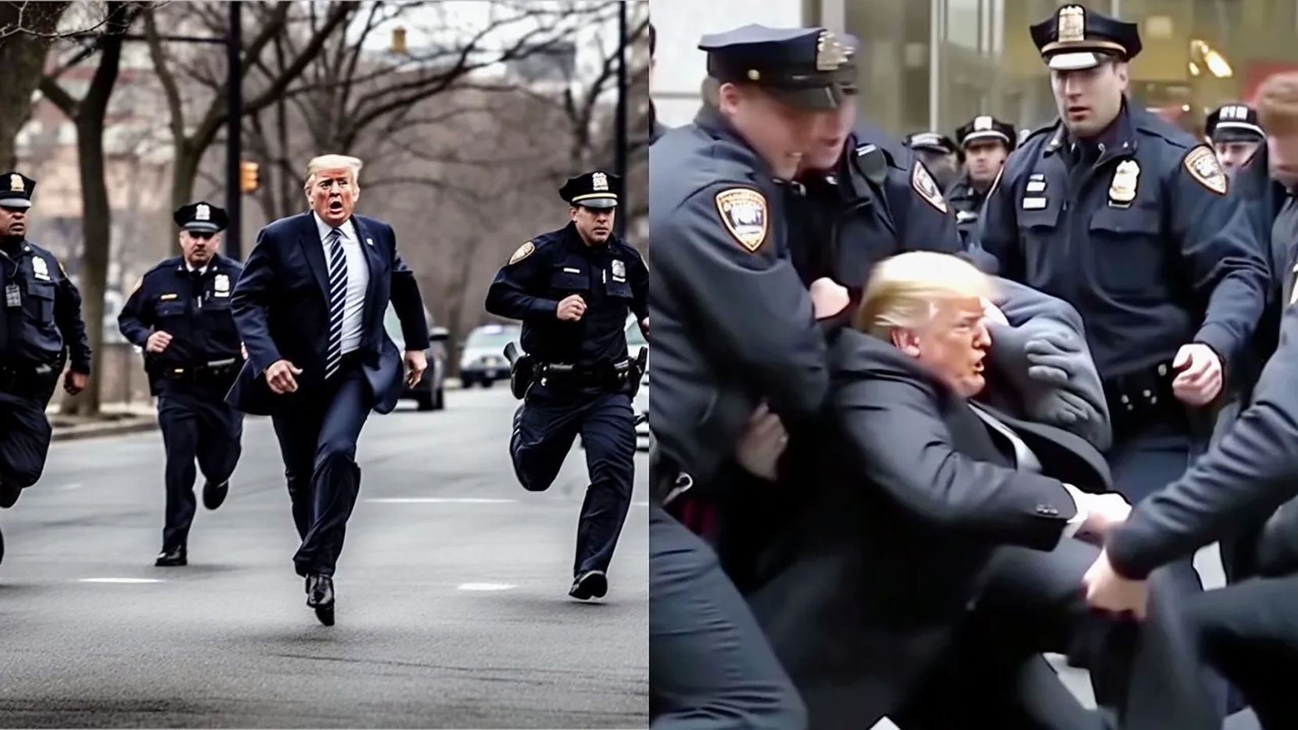
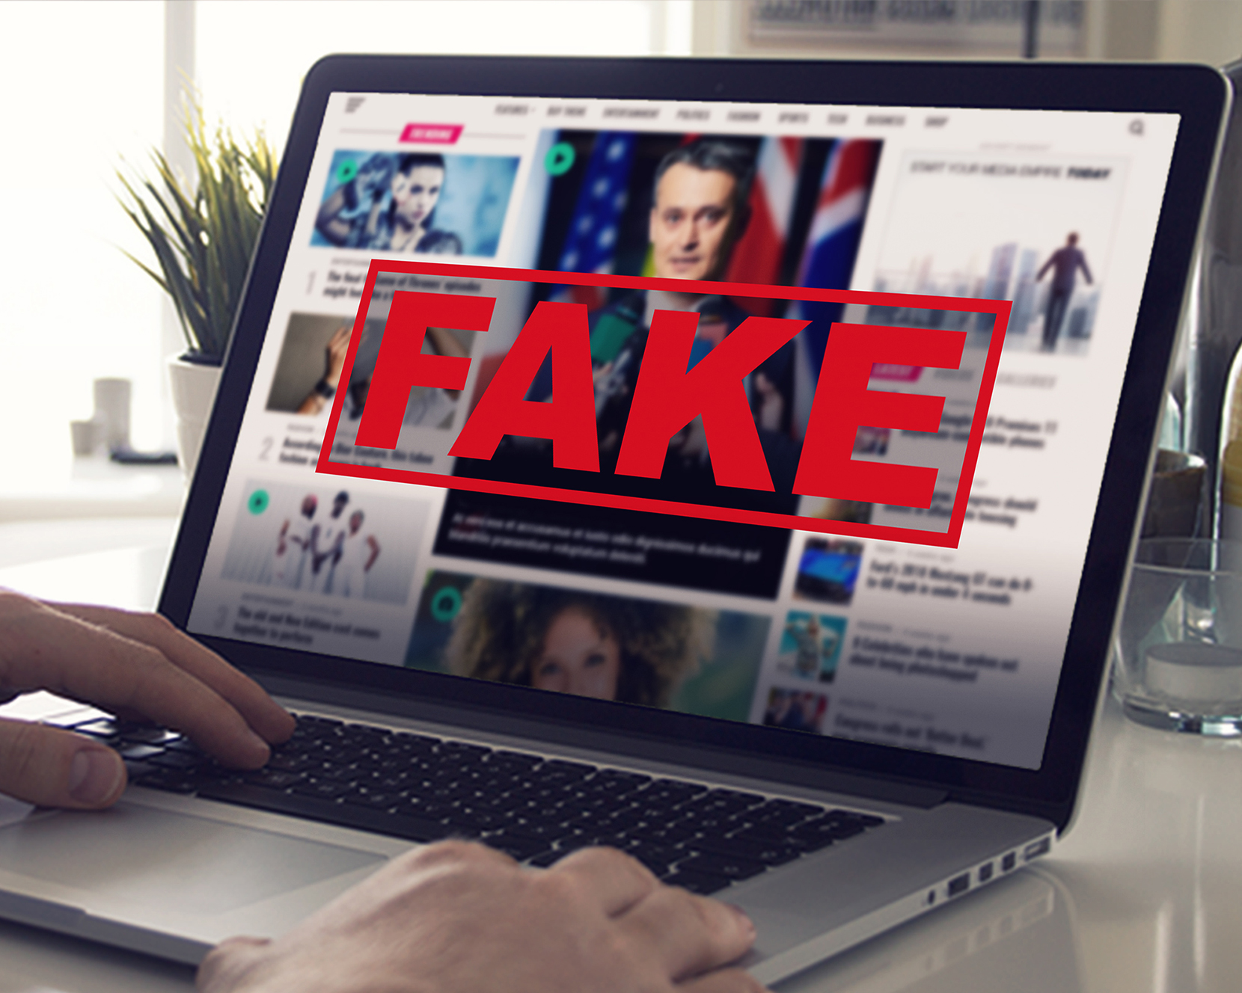
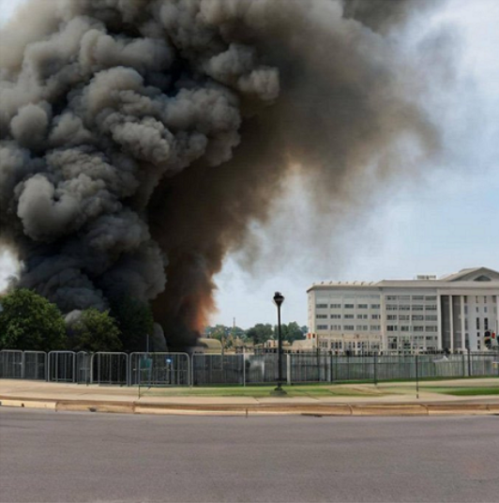
Coalition for Content
Provenance and Authenticity
In response to the spread of fake news, including widely circulated deepfake images of Trump in custody and a fabricated bombing of the Pentagon, the U.S. administration introduced a standard for watermarking AI-generated content through an executive order signed by President Joe Biden in October 2023. Currently, OpenAI, Microsoft, and Adobe are applying the Content Authenticity Initiative(CAI) as described above. Additionally, Meta is applying tags to AI-generated images on Instagram, Facebook, and Threads. Google uses a watermark based on DeepMind's SynthID that is difficult to remove because it is embedded in the image itself, not the metadata.
There is false information circulating about the arrest of former U.S. President Donald Trump,
as well as photos of the Pentagon bombing and images generated by AI.
https://mobislive.com/reportcontent/?content=1157 https://blog.naver.com/gptfrontier/223491301892
https://www.plagiarismtoday.com/2023/10/30/president-biden-signs-executive-order-calling-for-ai-watermarking/

Slide 6
Coalition for Content
Provenance and Authenticity(C2PA)
A group of influential technology and media companies has partnered to form the Coalition for Content Provenance and Authenticity(C2PA), a Joint Development Foundation project [https://www.jointdevelopment.org/] established to address the prevalence of disinformation, misinformation and online content fraud through developing technical standards for certifying the source and history or provenance of media content. Founding members Adobe, Arm, BBC, Intel, Microsoft and Truepic seek to establish a standardized provenance solution with the goal of combating misleading content.
C2PA member organizations will work together to develop content provenance specifications for common asset types and formats to enable publishers, creators and consumers to trace the origin and evolution of a piece of media, including images, videos, audio and documents. These technical specifications will include defining what information is associated with each type of asset, how that information is presented and stored, and how evidence of tampering can be identified.
https://www.yna.co.kr/view/RPR20210223008000353

Slide 7
Coalition for Content
Provenance and Authenticity(C2PA)
The formation of the C2PA brings together founding members of the Adobe-led Content Authenticity Initiative(CAI) [https://contentauthenticity.org/] and the Microsoft- and BBC-led Project Origin [https://www.originproject.info/], unifying technical specifications under a single entity. The CAI is building a system to provide provenance and history for digital media, giving creators a tool to claim authorship and empowering consumers to evaluate whether what they are seeing is trustworthy. Project Origin has its roots in the production and distribution of news. The effort has focused on tackling disinformation in the digital news ecosystem by attaching signals to a piece of content to demonstrate its integrity and making this information available to those using it. With the foundation of the C2PA, technical standards will be unified while these two entities continue to pursue adoption, prototyping and education within their respective communities.
https://www.yna.co.kr/view/RPR20210223008000353

Slide 8
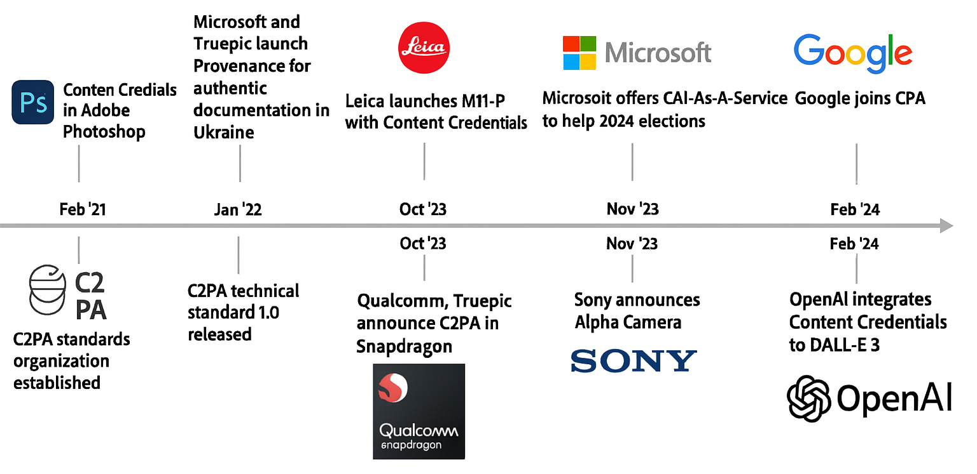
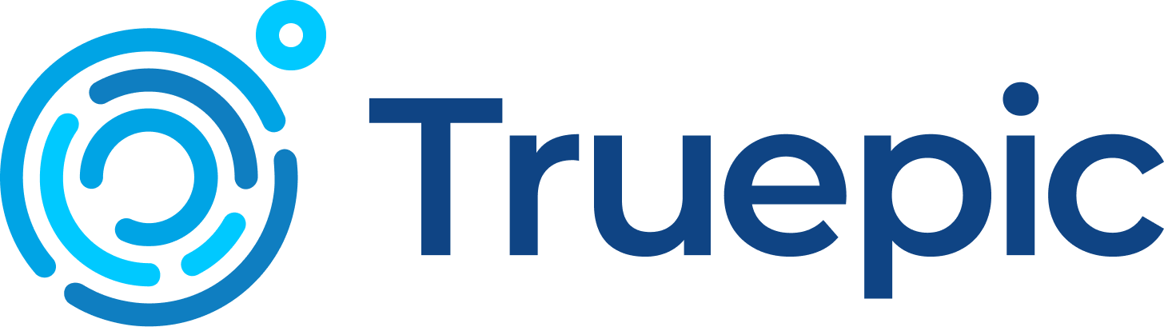
Timeline of Key C2PA Adoption Milestones
https://mys.mapyourshow.com/mys_shared/nab24/handouts/C2PA%20Summary.pdf

Slide 9
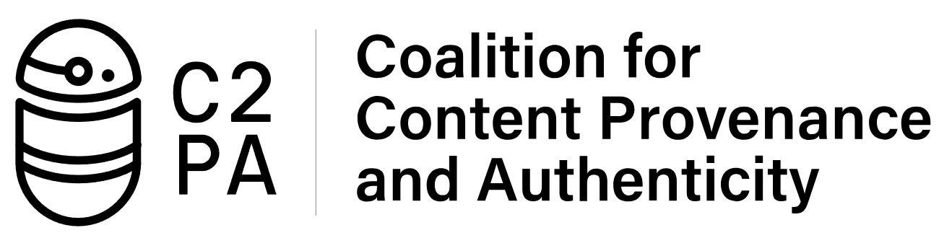
Coalition for Content
Provenance and Authenticity(C2PA)
C2PA
Standard
Implementors
Adobe, Microsoft, Intel, Truepic, ARM, Witness, Fastly, CLink...
In the software and hardware, for example a Truepic Camera, or Adobe's Photoshop
https://blog.witness.org/2021/12/witness-and-the-c2pa-harms-and-misuse-assessment-process/
https://www.slideshare.net/slideshow/c2pa-specifications-and-harms-and-misuse-assessment/250745426

Slide 10
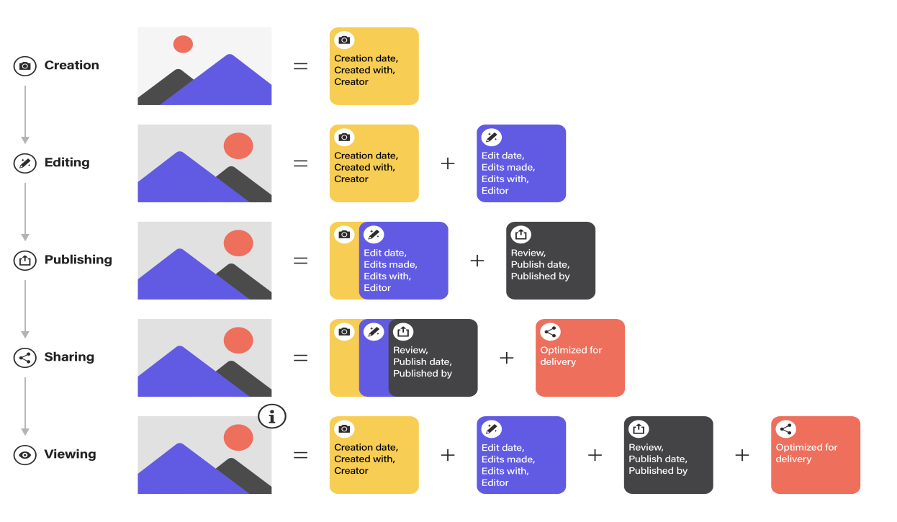
How Tamper-Evident Provenance Works
https://mys.mapyourshow.com/mys_shared/nab24/handouts/C2PA%20Summary.pdf

Slide 11
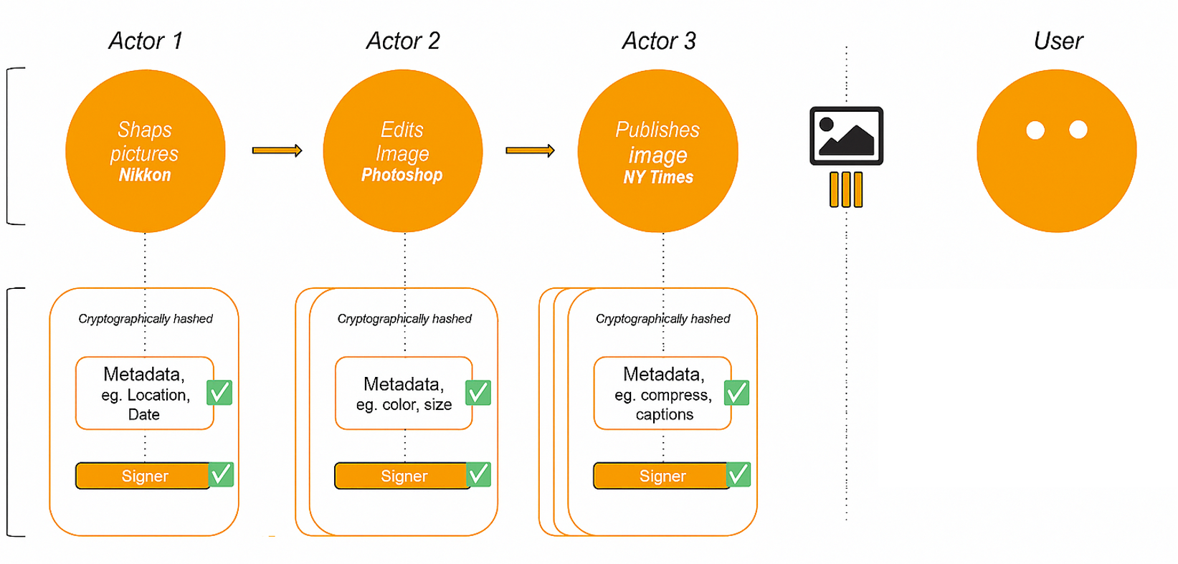
Provenance of digital assets across platforms
Content with provenance provides indicators of authenticity so that consumers can have awareness of who has altered content and what exactly has been changed.
https://blog.witness.org/2021/12/witness-and-the-c2pa-harms-and-misuse-assessment-process/
https://www.slideshare.net/slideshow/c2pa-specifications-and-harms-and-misuse-assessment/250745426

Slide 12
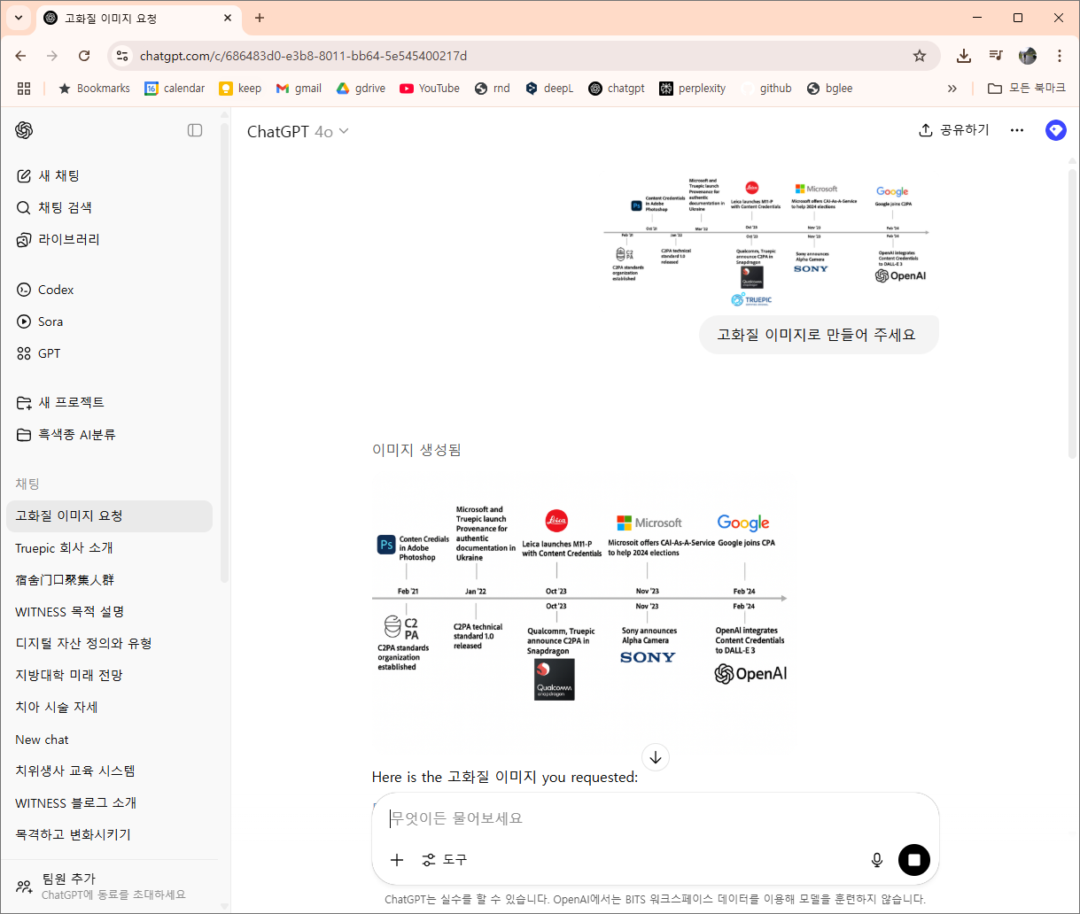
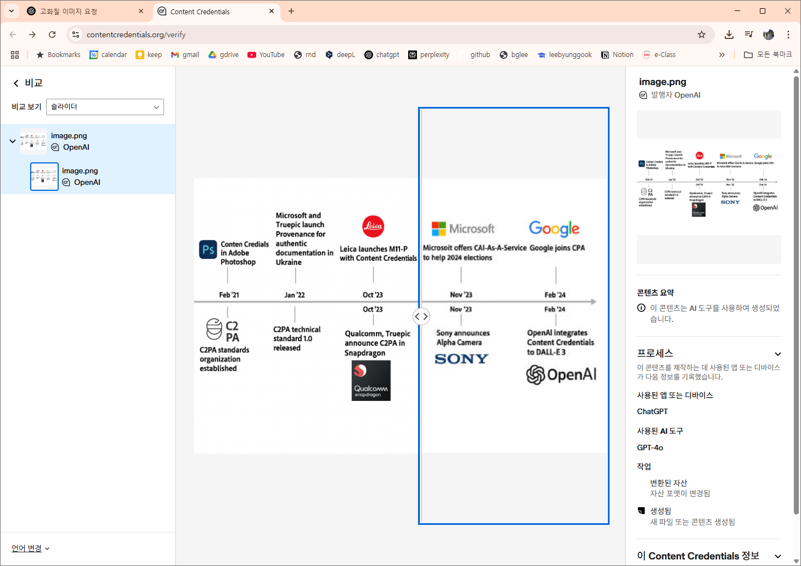
ChatGPT C2PA
https://chatgpt.com/c/686483d0-e3b8-8011-bb64-5e545400217d https://contentcredentials.org/verify

Slide 13
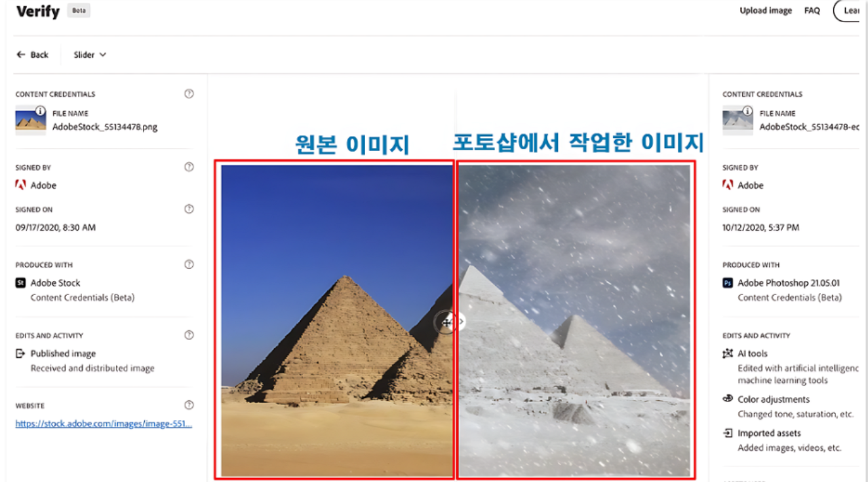
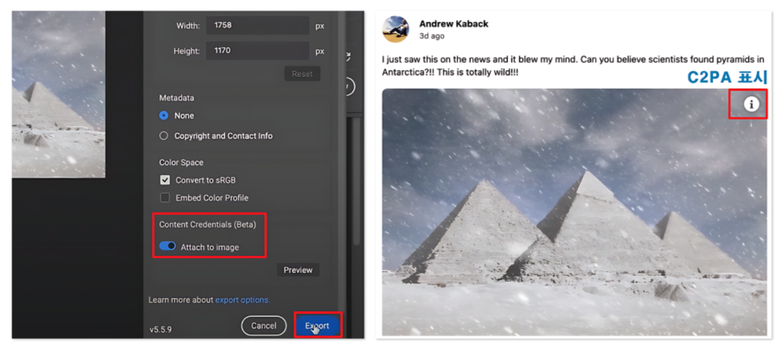
ChatGPT C2PA
If you save a Photoshop image with "Contents Credentials," such as the image on the left, it will be saved with a C2PA icon, like the one on the right. Clicking on the exclamation point icon will take you to a website where you can see where the image originated. There, you'll see a list of the image's history, showing where it came from. You can also compare the original image with the image you worked on in Photoshop.
https://blog.naver.com/gptfrontier/223491301892

Slide 14
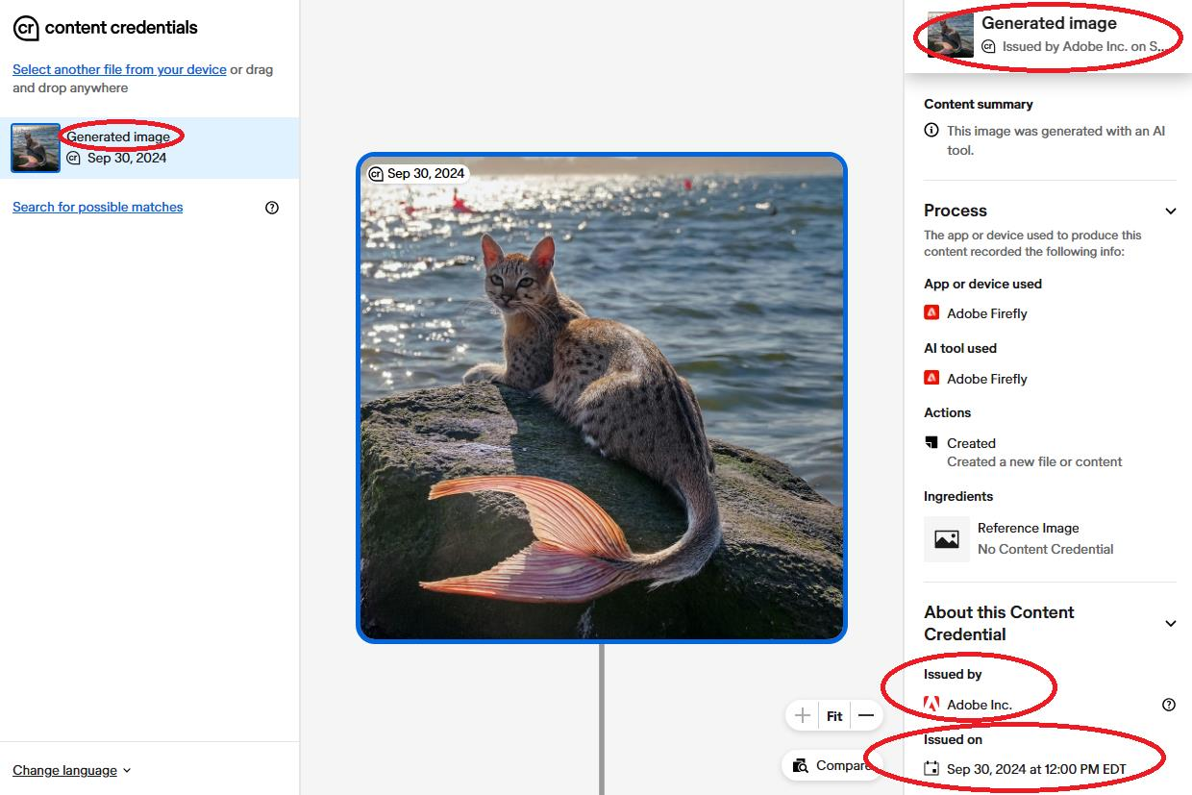
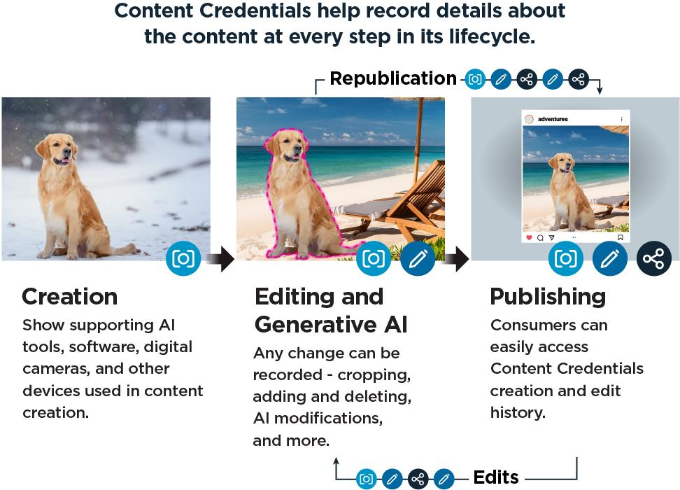
Adobe Firefly C2PA
Content Credentials lifecycle depicted. This can be from the point of capture (creation), to editing and generative AI use, to publishing (based on https://contentauthenticity.org/how-it-works).
Content Credentials can include details about whether an image was created using generative AI (screenshot from https://contentcredentials.org/verify).
https://media.defense.gov/2025/Jan/29/2003634788/-1/-1/0/CSI-CONTENT-CREDENTIALS.PDF

Slide 15
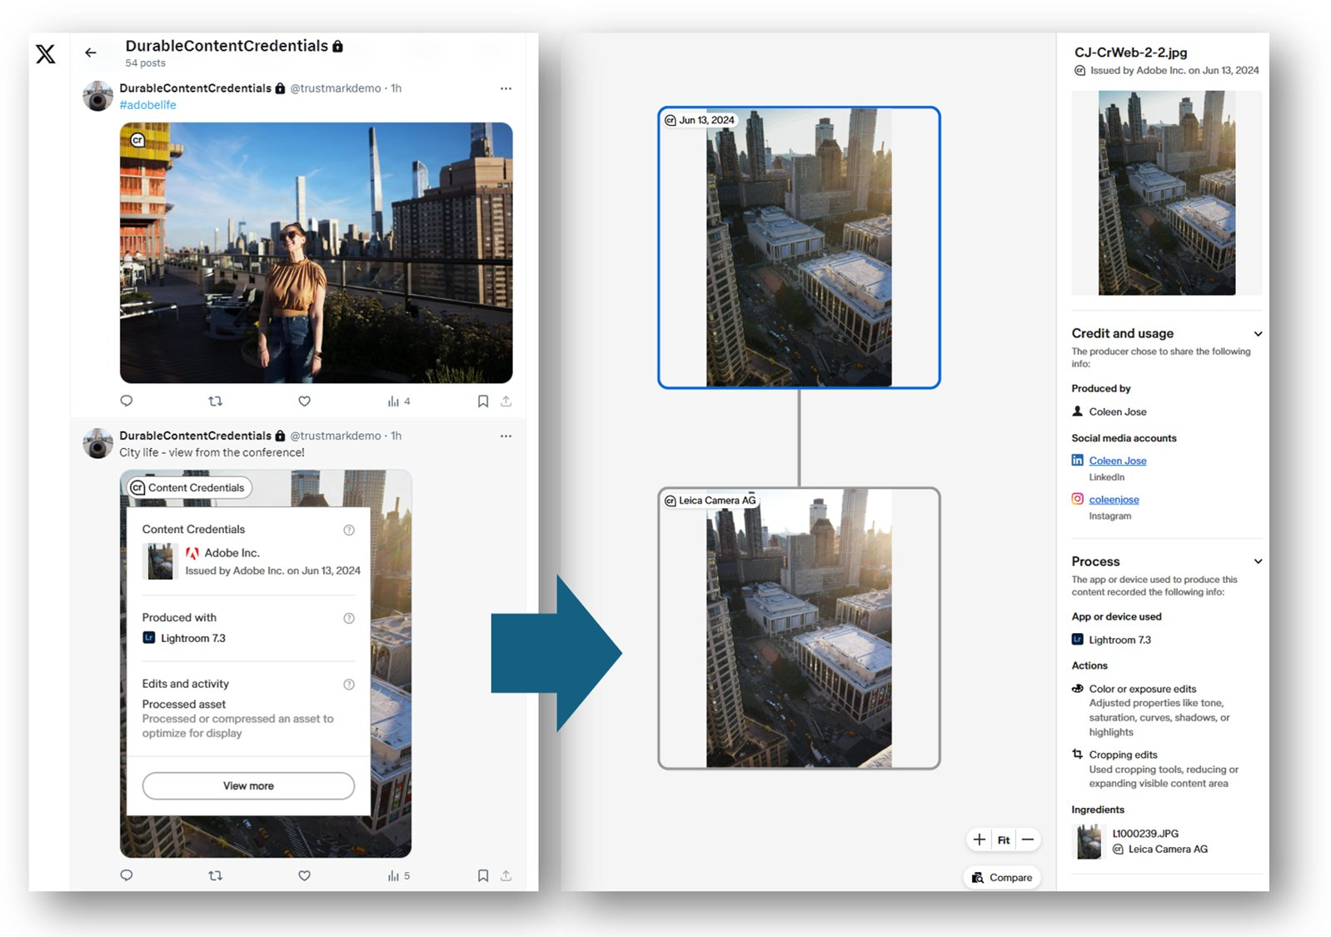
Content Authenticity Initiative on X
https://x.com/ContentAuth/status/1805672702763540909
https://contentauthenticity.org/blog/three-pillars-of-provenance

Slide 16
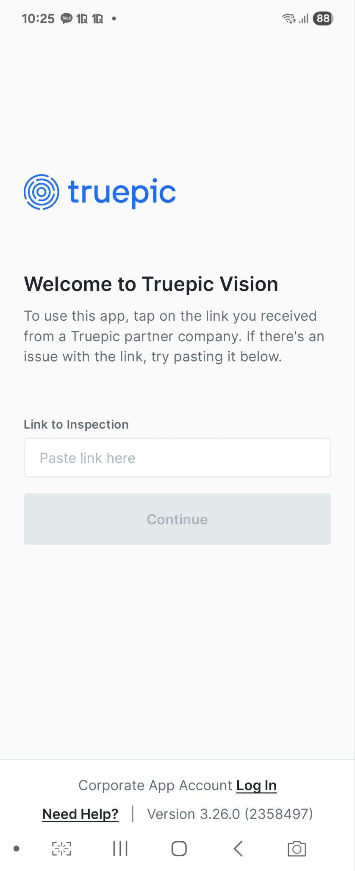
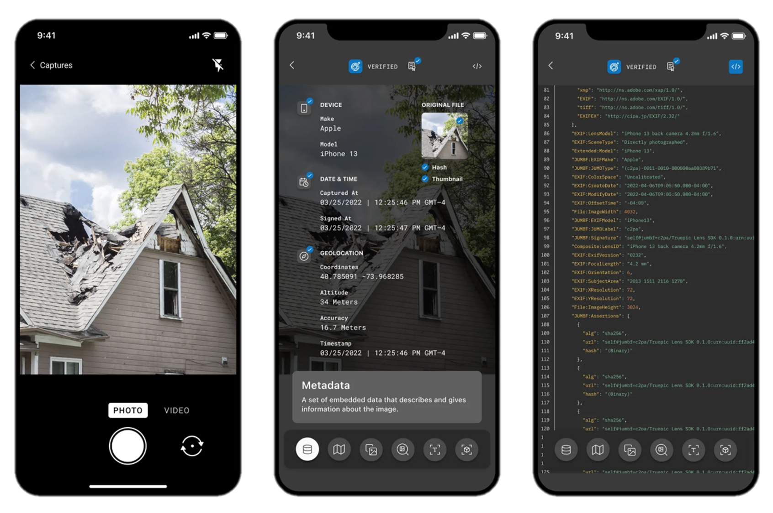
The Best Inventions of 2022 TIME
Truepic is an American technology company that develops tools for verifying the authenticity of digital content. Founded by Craig Stack and Jason Lyons in 2015, the company is headquartered in San Diego, California. Through its "Controlled Capture" technology, Truepic provides solutions that prove photos and videos have not been altered since they were taken. Truepic co-founded the Coalition for Content Provenance and Authenticity(C2PA) with Adobe, Microsoft, Sony, and others to establish standards for verifying the provenance and authenticity of digital content. Truepic is also a member of the Content Authenticity Initiative(CAI), which aims to increase transparency and trust in digital media.
https://time.com/collection/best-inventions-2022/6228166/truepic-lens/

Slide 17
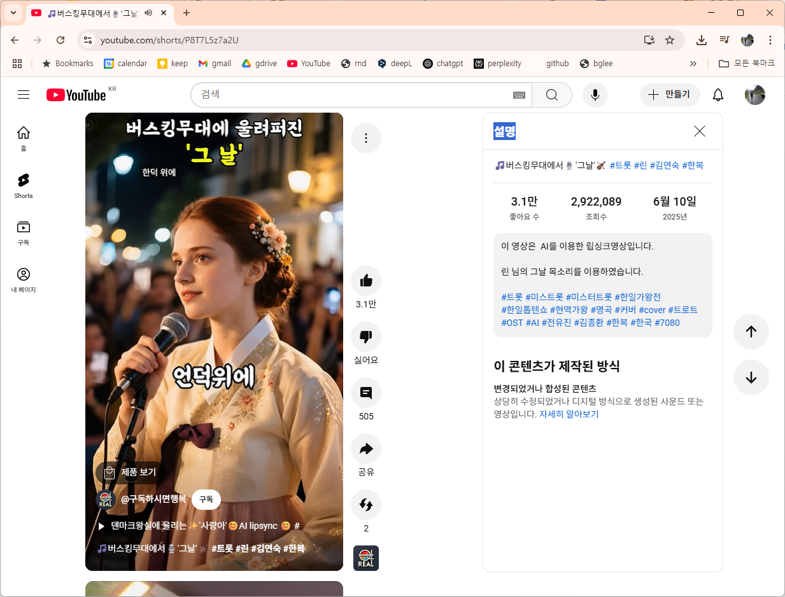
YouTube announced new content guidelines
In November 2023, YouTube announced new content guidelines requiring that AI-generated content, which could be misleading, be labeled as such. YouTube has long prohibited technologically manipulated media that poses a significant risk of misleading viewers.
Under the new rules, content creators must label videos containing "factual representations of fictional or manipulated content" to indicate the use of AI tools. It is especially important to label videos that falsely depict a person as having done or said something that didn't happen. This is particularly crucial for videos that cover sensitive topics such as elections, ongoing conflicts, public officials, and public health crises, as announced by YouTube PM VPs Jennifer Flannery O'Connor and Emily Moxley on YouTube's official blog.
YouTube Monetization Policy Update July 15: Full Breakdown of Inauthentic Content Rules for 2025
https://www.youtube.com/shorts/P8T7L5z7a2U
https://inews.zoombangla.com/youtube-monetization-policy-update-july-15/#google_vignette

Slide 18
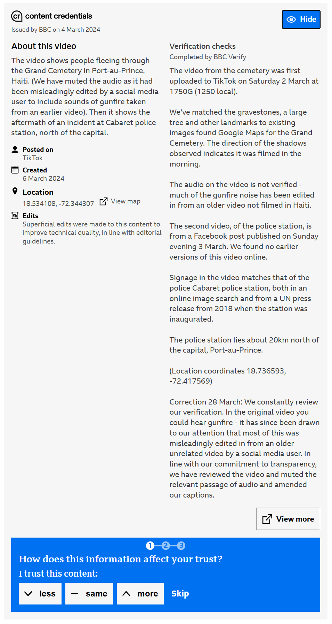
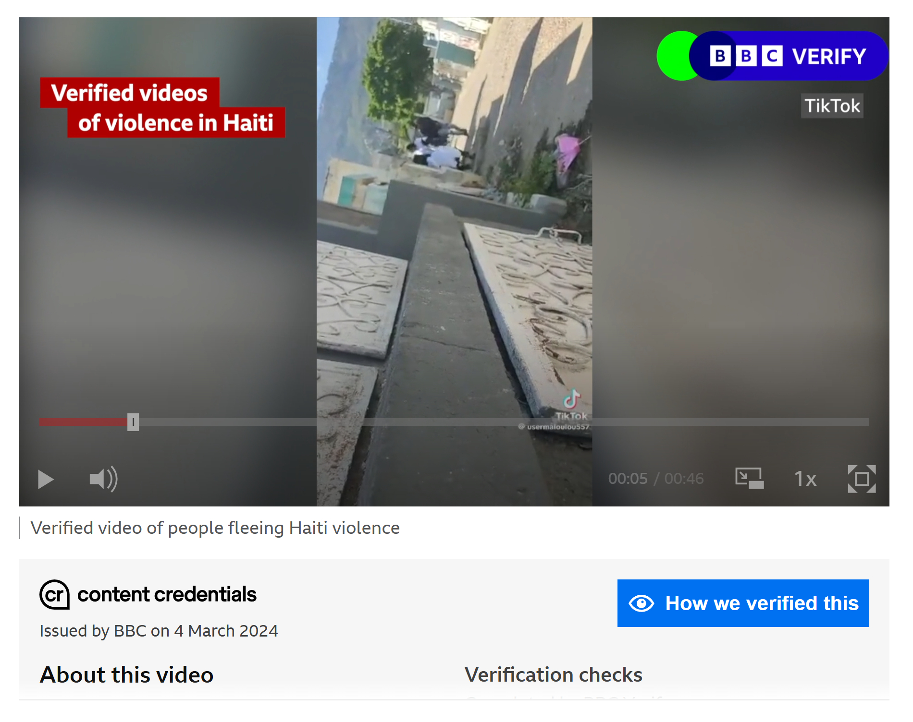
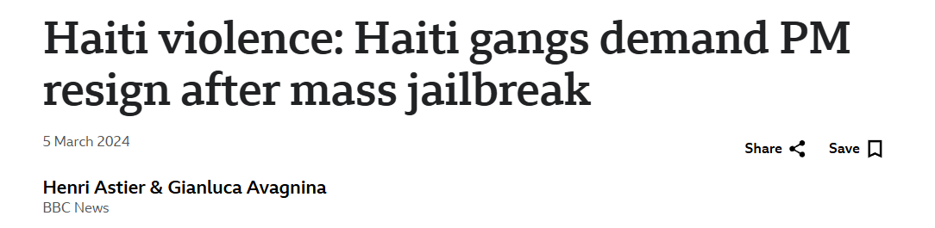
BBC Verify C2PA
Clicking the blue "How we verified this" button at the bottom right of the video in left figure details the process of proving content trust, as shown in right figure.
Figure is an example of the BBC issuing content credentials under the C2PA rules for a video embedded in the article "Haiti violence: Haiti gangs demand PM resign after mass jailbreak." The phrase "BBC Verify" is pinned in the top right corner of the video to indicate that the BBC has verified the content. This phrase remains visible throughout the video. Additionally, a box under the video states that the BBC issued this "Content Credential" on March 4, 2024. This informs users that the BBC is responsible for the content and emphasizes that it can be trusted.
https://www.kpf.or.kr/front/research/selfDetail.do?seq=599627&link_g_homepage=F
https://www.bbc.com/news/world-latin-america-68462851

Slide 19

WITNESS
The WITNESS blog(https://blog.witness.org/) is an online platform run by WITNESS, an international human rights organization. It shares information on how video and technology can be used to protect and promote human rights. The blog provides human rights activists, citizen journalists, and technologists with strategies and tools to document and respond to human rights violations through video recordings.
Human Rights Video Campaigns: WITNESS documents human rights abuses around the world and uses the footage to drive social change. For instance, we've covered AI-driven disinformation in Ghana's 2024 elections and the human rights impact of generative AI and deepfakes in the Philippines' 2025 elections.
The Intersection of Technology and Human Rights: We analyze the human rights implications of emerging technologies, including generative AI, deepfakes, and online verification tools. We also highlight community-based approaches to combat these technologies.
Video Archiving and Evidence: We provide guidance and examples on how to effectively preserve videos documenting human rights abuses and use them as legal evidence.
Training materials and toolkits: Provides a range of materials and toolkits to help human rights activists and citizens effectively advocate for human rights through video.
Founded in 1992 by musician Peter Gabriel, WITNESS is an international nonprofit human rights organization that works with human rights organizations in more than 80 countries around the world to document and respond to human rights abuses through video and technology.
https://en.wikipedia.org/wiki/Witness_%28organization%29?utm_source=chatgpt.com

Slide 20
WITNESS
Currently, WITNESS is assessing the potential harms, misuses, and abuses of the C2PA standard.
WITNESS's core mission is to empower citizens around the world to record human rights abuses on video and use the footage as evidence.
Ordinary citizens, activists, and victims use cell phones, cameras, and other devices to record incidents.
We provide guidelines to ensure that this footage can be used as legal evidence or as part of public discourse.
We educate people on creating and preserving trustworthy content.
WITNESS is a leader in advancing technologies and standards that verify the authenticity and provenance of footage.
We collaborate with the Content Authenticity Initiative (CAI).
The CAI leaves changes, history, and metadata on videos and images, making it transparent who made what modifications and when.
This prevents manipulation and improves the reliability of evidence.
We protect human rights through digital technology. To ensure that technology empowers human rights, we
We develop technologies and propose policies to counter emerging threats, such as deepfakes and AI manipulation.
We educate communities by providing training on digital security, truth in data, AI ethics, and more.
We engage in technology standardization work through global partnerships.
https://en.wikipedia.org/wiki/Witness_%28organization%29?utm_source=chatgpt.com

Slide 21
Human rights defender workflows
A human rights defender manages to capture footage /evidence of a war crime.
Human rights NGO assesses that it follows good evidence practice and that digital, physical and psycho-social security risks have been mitigated to the extent possible
Shares with relevant stakeholders in the justice and accountability processes...
News media could offer a 'safety seal' of its content and audience could verify provenance.
Published in news media that has C2PA enabled CMS(Contents Management System).
"Not embargoed"
C2PA enabled
CMS
C2PA enabled camera
C2PA enabled imaging or editing tool
Social media could verify that media comes from actual source and users could verify provenance.
'Original' video, with no alterations, including the verifiable metadata (manifests) that the activist wishes to disclose.
Information could be added for evidentiary value, or redacted for privacy and security
C2PA enabled
social media
Shared through C2PA enabled social media.
https://blog.witness.org/2021/12/witness-and-the-c2pa-harms-and-misuse-assessment-process/
https://www.slideshare.net/slideshow/c2pa-specifications-and-harms-and-misuse-assessment/250745426

Slide 22
Harm Modeling
Phase 1
Phase 2
Phase 3
Purposes, Use-cases, Users and Stakeholders
Harm, Misuse and Abuse Assessment
Mitigation strategies
The Harms, Misuse, and Abuse Assessment is an ongoing process that accompanies the design, development, implementation and use stages of the C2PA standard, and the process includes a multi-disciplinary and diverse range of stakeholders
https://blog.witness.org/2021/12/witness-and-the-c2pa-harms-and-misuse-assessment-process/
https://www.slideshare.net/slideshow/c2pa-specifications-and-harms-and-misuse-assessment/250745426

Slide 23
Potential harmsPotential harms
Reduction in options for anonymity and pseudonymity
Privacy loss
Attacks on journalistic freedom and independence Opportunity loss
Requiring participation in the use of technology or surveillance to take part in society
Differential pricing for goods and services Economic loss
Human rights activist inadvertently includes location in media assertion and is subsequently targeted (c.f. existing precedents of inadvertent release of metadata, most famously John McAfee or recurring cases in human rights)
An abuse of the C2PA system to enforce journalistic identity in laws in a jurisdiction or demand additional information on media posted on social media leads to a reduction of media diversity and suppression of speech.
Freedom of association, assembly and movement.
For example, algorithmic ranking: content creators forced to game algorithms with particular keywords, metadata to achieve visibility/to be ranked higher in a feed.
Marginalized communities or individuals unable or unwilling to access C2PA-enabled media may find their creative or journalistic work devalued in the marketplace.
https://blog.witness.org/2021/12/witness-and-the-c2pa-harms-and-misuse-assessment-process/
https://www.slideshare.net/slideshow/c2pa-specifications-and-harms-and-misuse-assessment/250745426

Slide 24
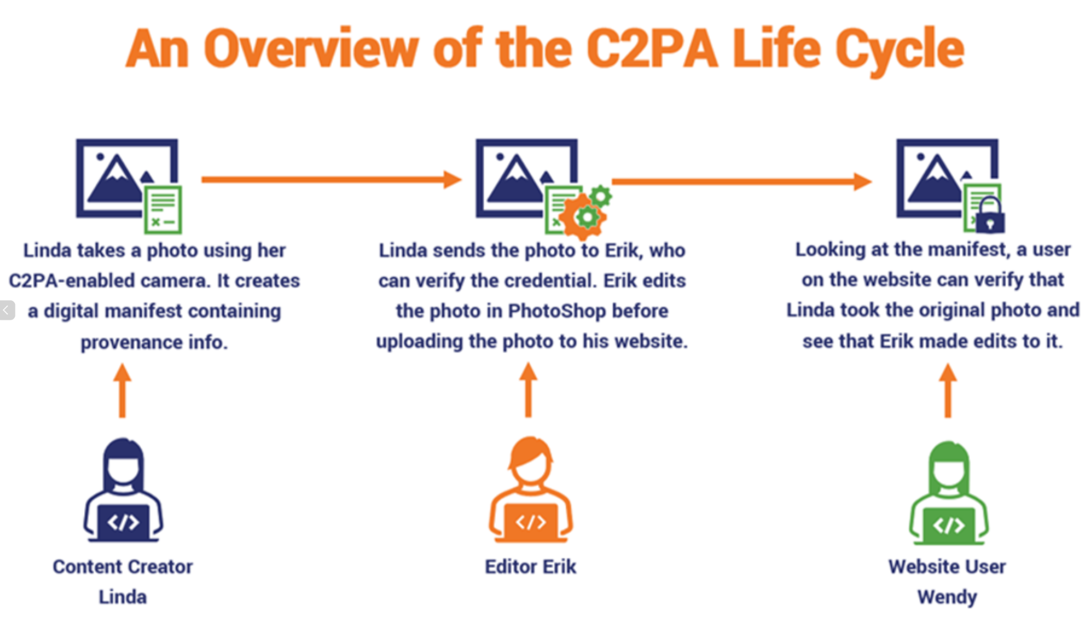
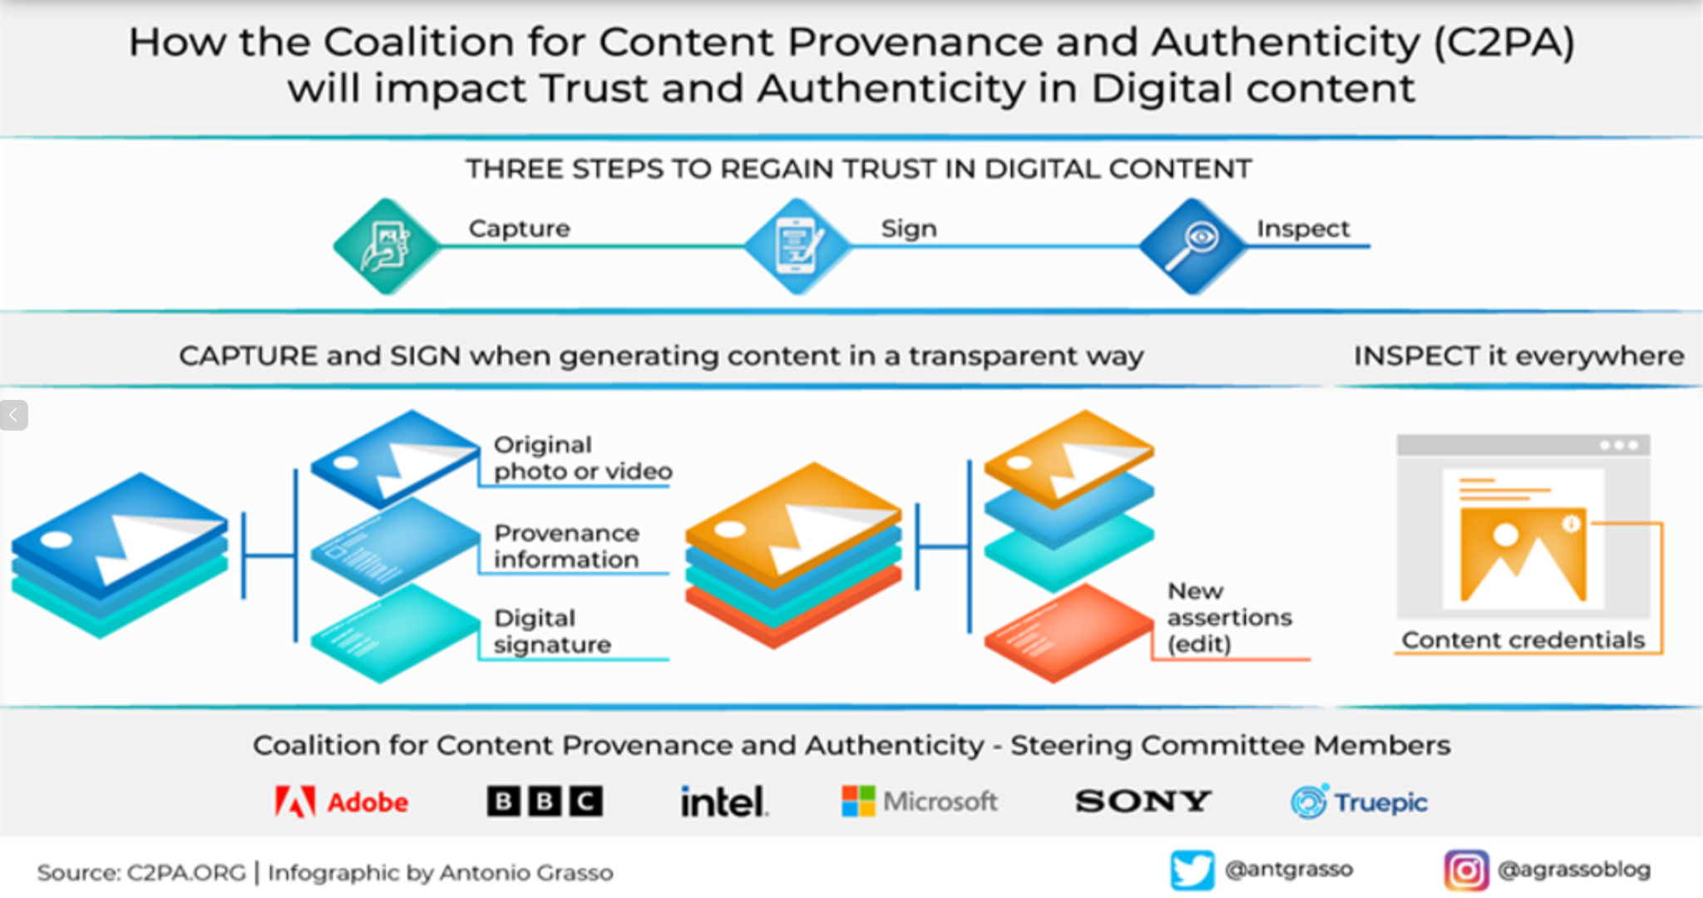
Coalition for Content
Provenance and Authenticity
The process begins with fingerprint and facial recognition. Then, it leverages the voice recognition and authentication features of devices such as Siri, Alexa, and Bixby to authenticate users and generate a unique digital signature. This signature is then embedded in the AI image or video creation process as metadata, in accordance with C2PA standards, to ensure the authenticity and provenance of the final content. Even if the content is leaked or shared externally, this ensures that the authenticity of the production process and AI generation can be verified at any time. These integrated solutions will strengthen the trustworthiness of AI-generated content going forward and align content management and verification with legal requirements and industry standards.
The Coalition for Content Provenance and Authenticity (C2PA) addresses the prevalence of misleading information online through the development of technical standards for certifying the source and history (or provenance) of media content. C2PA is a Joint Development Foundation project, formed through an alliance between Adobe, Arm, Intel, Microsoft and Truepic.
https://ko.shaip.com/blog/voice-recognition-overview-and-applications/ https://c2pa.org/

Slide 25
Coalition for Content
Provenance and Authenticity
1. Identifying AI-generated materials requires sophisticated technology. The best alternatives currently available are AI-based detection tools and watermarking, which are inconsistent, impermanent, and sometimes inaccurate. C2PA has emerged as an alternative.
2. C2PA is an open technology standard that enables publishers, companies, and others to embed metadata in media to identify its source and related information. C2PA is not only used for AI-generated images; camera manufacturers and news organizations have also adopted the standard to verify the origin and history of content.
3. Visit the OpenAI official website to learn more about C2PA in DALL-E 3. OpenAI states that "DALL-E 3 is equipped with the electronic watermark C2PA standard."
- Images generated with ChatGPT on the web and our API serving the DALL·E 3 model will now include C2PA metadata.(by Feb 12th)
- People can use sites like Content Credentials Verify to check if an image was generated by the underlying DALL·E 3 model through OpenAI’s tools.
- Metadata like C2PA is not a silver bullet to address issues of provenance. It can easily be removed either accidentally or intentionally. For example, most social media platforms today remove metadata from uploaded images, and actions like taking a screenshot can also remove it.
- Does text or voice generated by ChatGPT or OpenAI's API contain C2PA metadata? → Currently, only images generated with ChatGPT or our API serving the DALL·E 3 model will contain the C2PA metadata.
https://forest62590.tistory.com/123

Slide 26
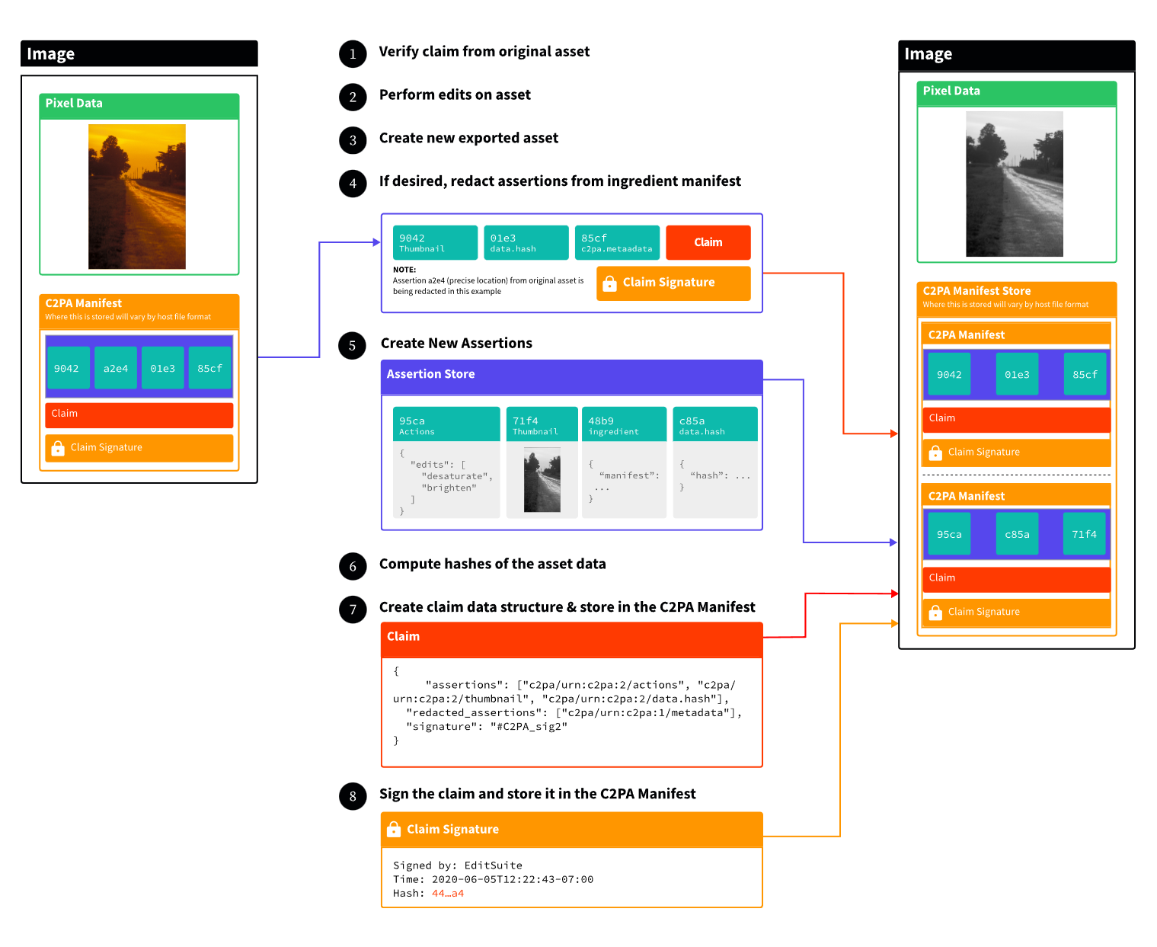
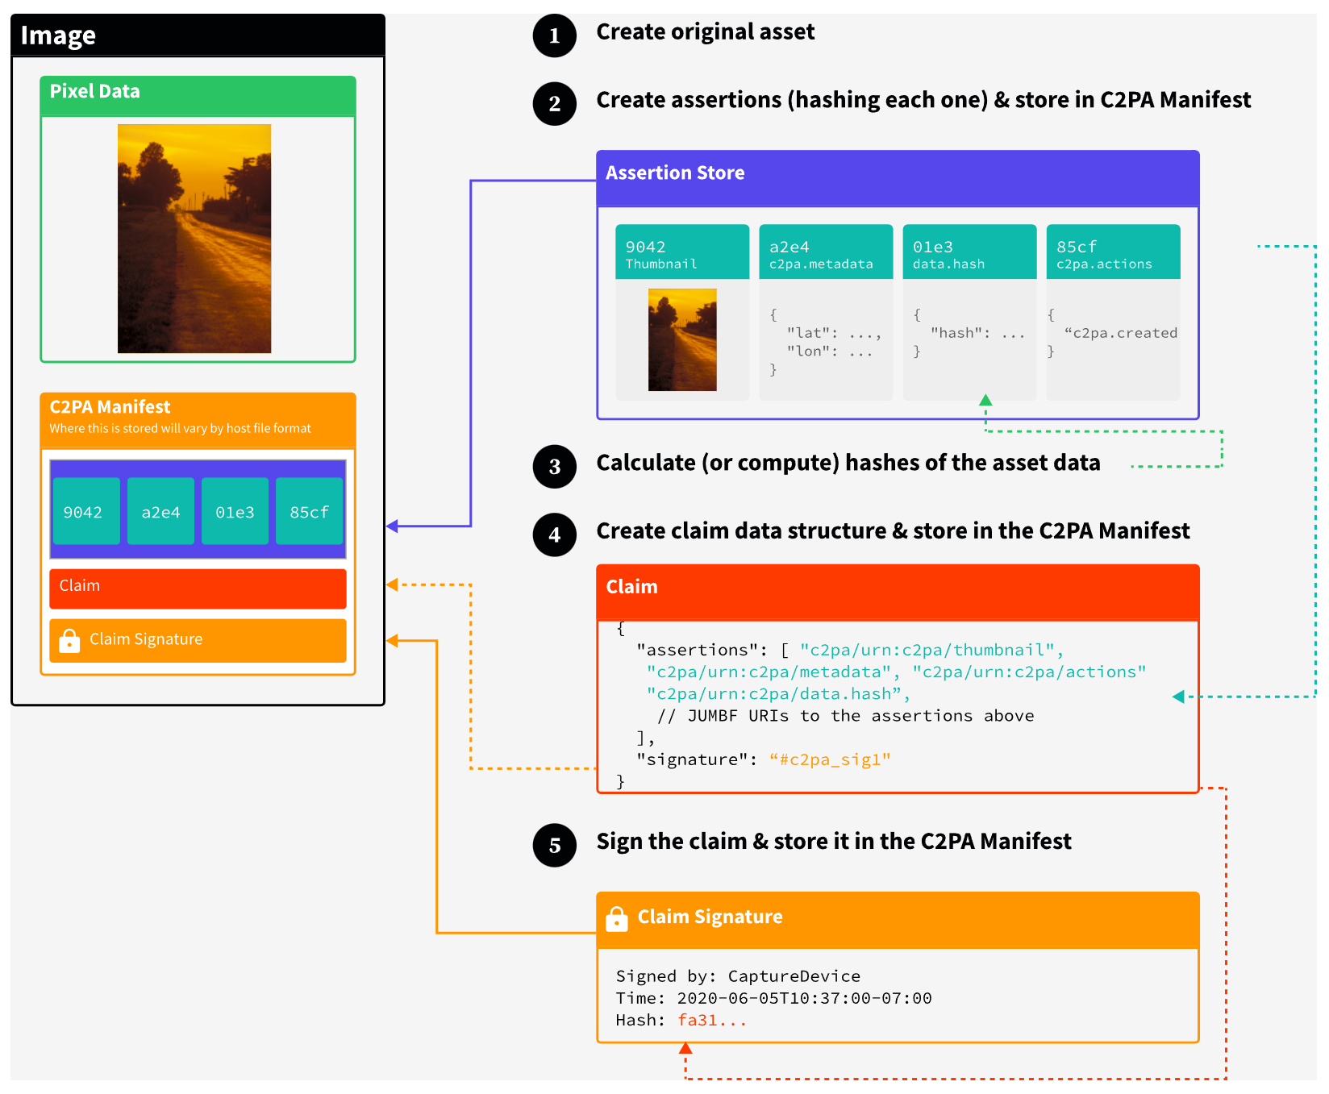
Examples of Claims
Figure 5. A single claim with assertions
Figure 6. Redacting assertions in a secondary claim
https://spec.c2pa.org/specifications/specifications/2.2/specs/C2PA_Specification.html#_overview

Slide 27
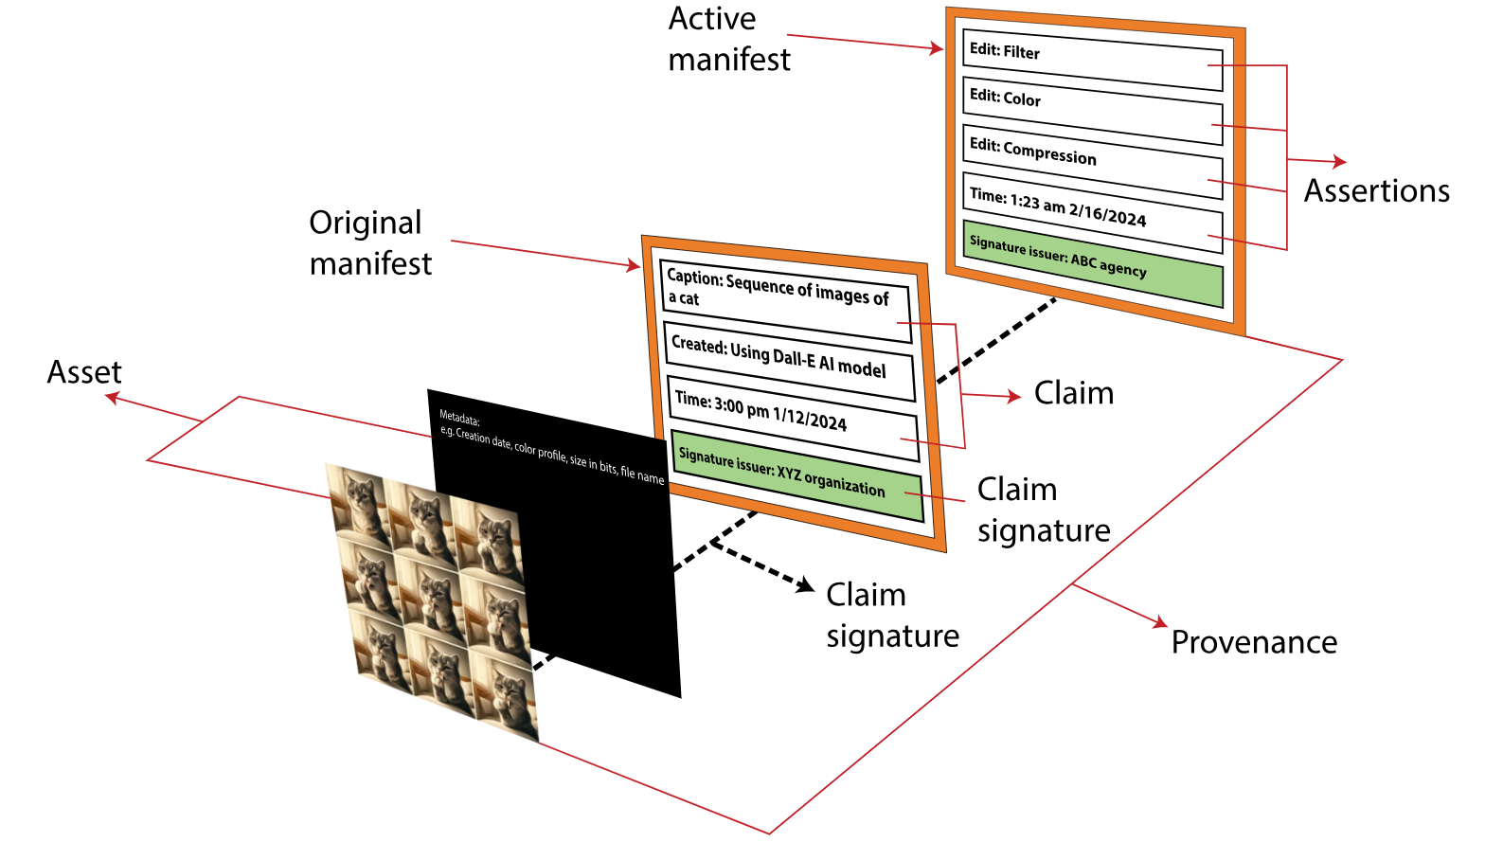
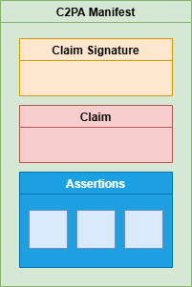
Insights into Coalition for Content
Provenance and Authenticity(C2PA)
Manifest: A small database attached to the asset which contains information about provenances such as claims, assertions, details of actor and such.
Actor: A non-human entity (hardware or software) that is participating in C2PA ecosystem. (There is a contradiction in the definition as of authoring this paper, the version 2.0 states that actors should only be non-human entities [4] while the definition of actor mentioned in glossary states both human and non-human [5]. For the sake of this paper, we will consider the latter definition.)
Signer: The actor whose credential’s private key is used to sign a claim on an asset.
Asset: The media file in question which could be an image, video, document, or audio.
Assertions: A data structure which represents a statement asserted by an actor concerning the asset. This data is a part of the C2PA manifest.
Claim: A digital signature which references assertions, redaction effects and other information necessary to represent content binding.
https://www.infosys.com/iki/techcompass/content-provenance-authenticity.html
https://www.infosys.com/iki/perspectives/mitigate-harms-synthetic-content.html

Slide 28
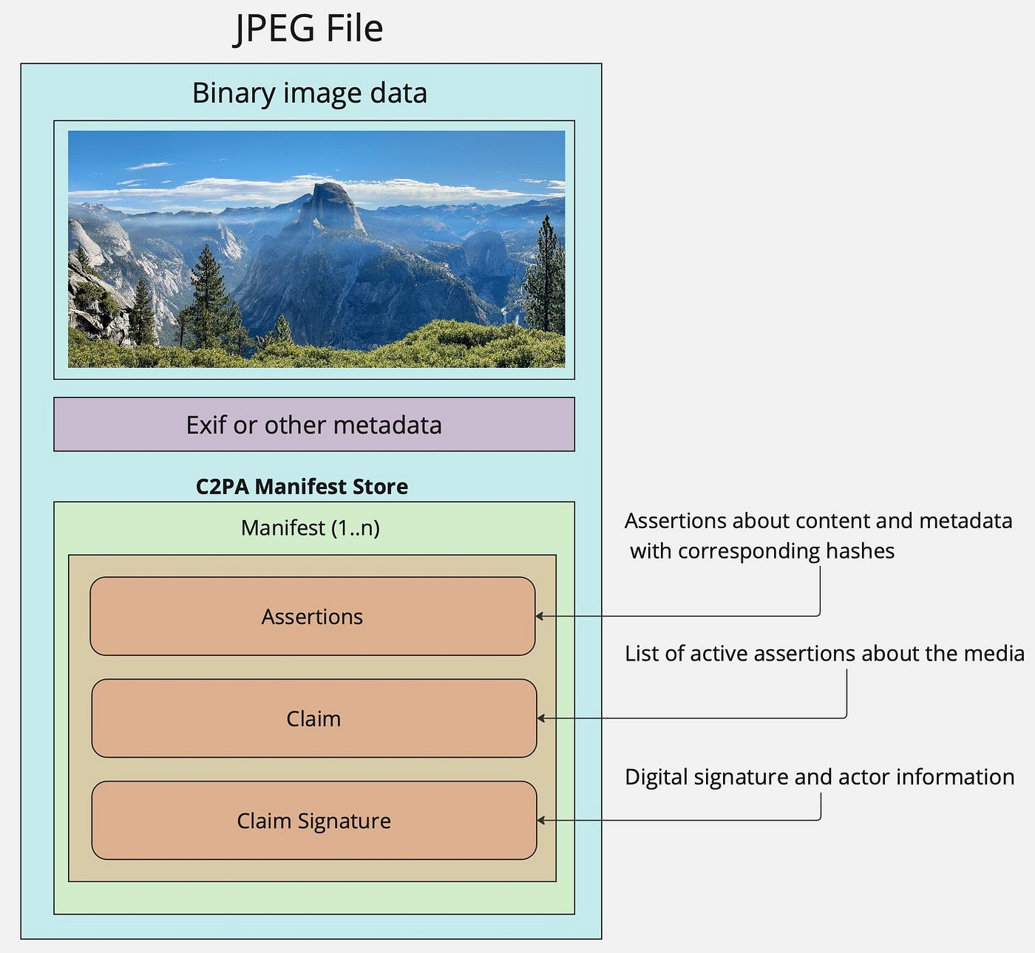
Insights into Coalition for Content
Provenance and Authenticity(C2PA)
Manifest: A small database attached to the asset which contains information about provenances such as claims, assertions, details of actor and such.
Actor: A non-human entity (hardware or software) that is participating in C2PA ecosystem. (There is a contradiction in the definition as of authoring this paper, the version 2.0 states that actors should only be non-human entities [4] while the definition of actor mentioned in glossary states both human and non-human [5]. For the sake of this paper, we will consider the latter definition.)
Signer: The actor whose credential’s private key is used to sign a claim on an asset.
Asset: The media file in question which could be an image, video, document, or audio.
Assertions: A data structure which represents a statement asserted by an actor concerning the asset. This data is a part of the C2PA manifest.
Claim: A digital signature which references assertions, redaction effects and other information necessary to represent content binding.
https://www.infosys.com/iki/techcompass/content-provenance-authenticity.html
https://medium.com/better-programming/verifying-the-origin-of-media-in-an-algorithmic-world-25bff92ab572

Slide 29
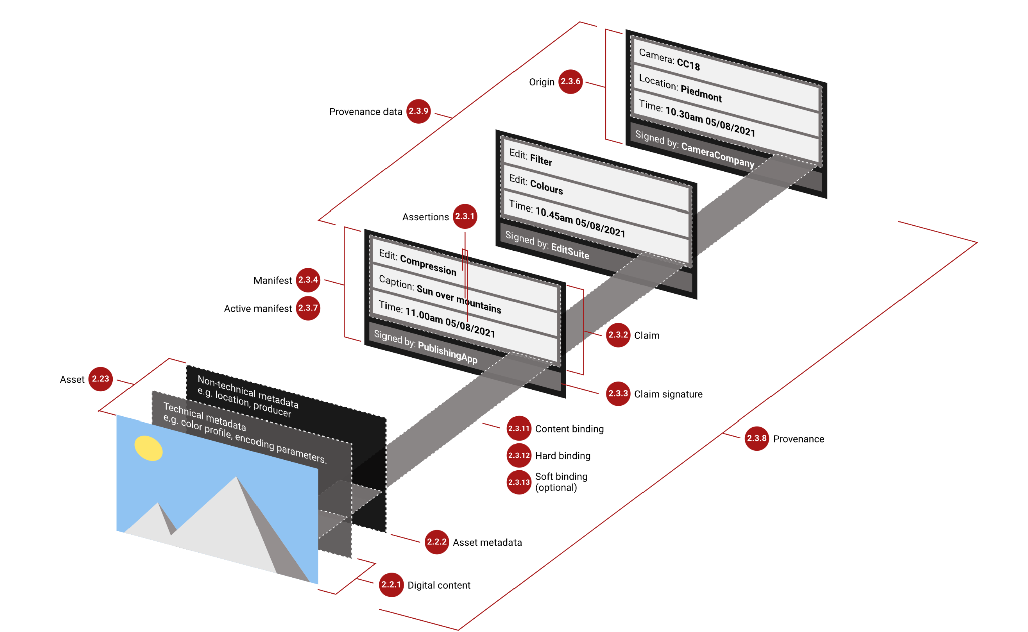
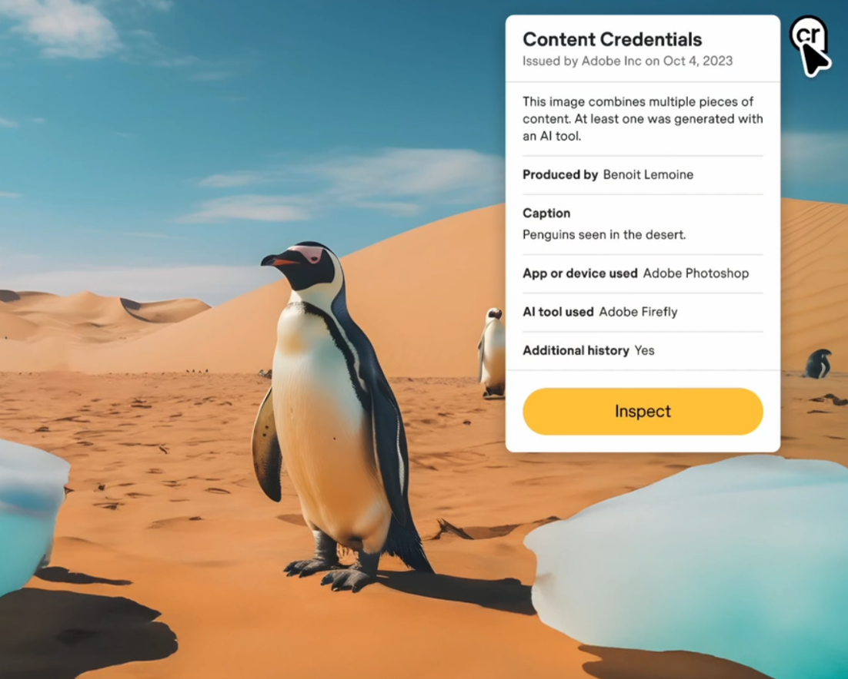
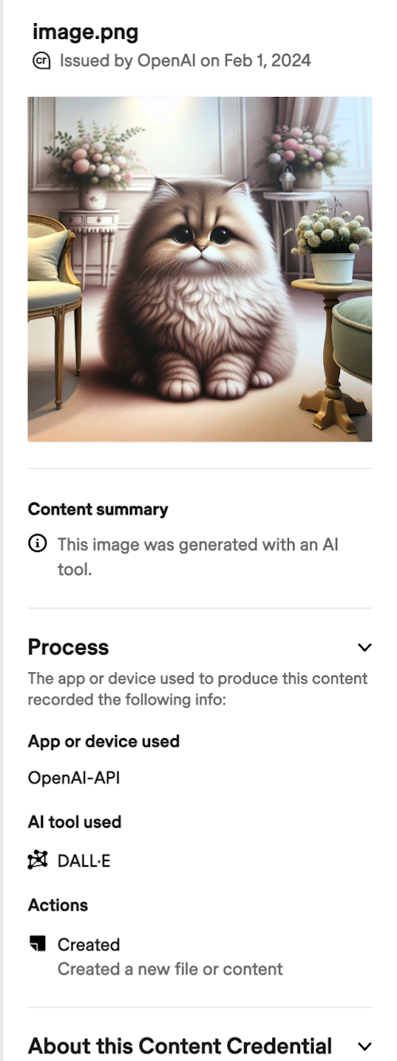
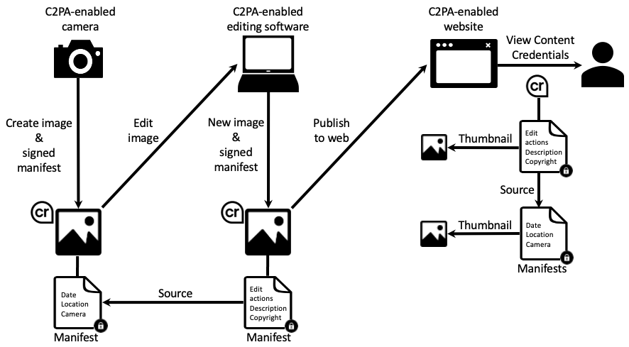
Insights into Coalition for Content
Provenance and Authenticity(C2PA)
Another important area that the C2PA looks to deliver on in 2024 is support for live video and audio content, in addition to the pre-recorded material that it supports today. It is important that even as events are taking place in real time, that users can be assured that they are seeing and hearing what is actually happening.
https://c2pa.org/specifications/specifications/2.2/specs/C2PA_Specification.html

Slide 30
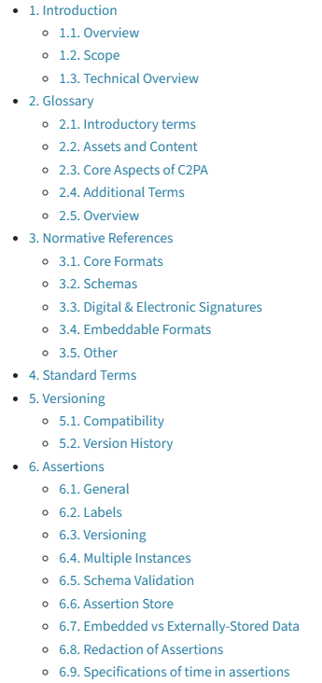
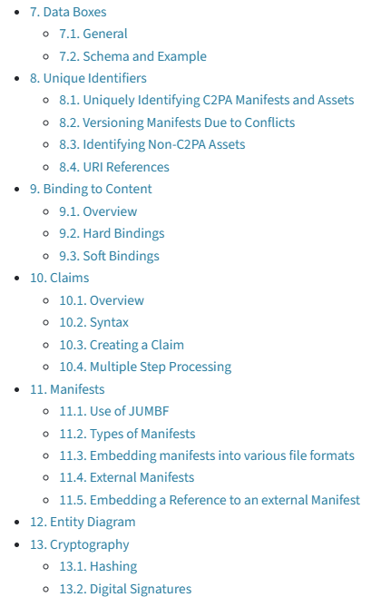
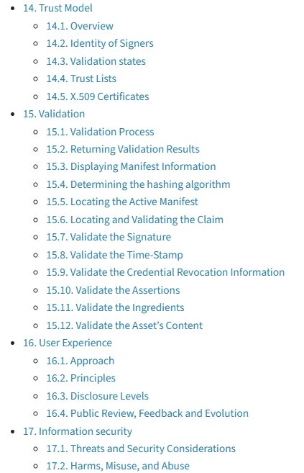
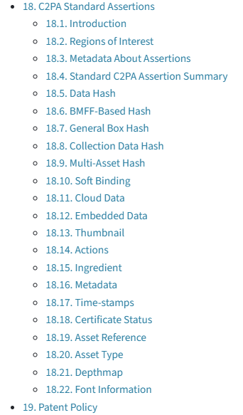
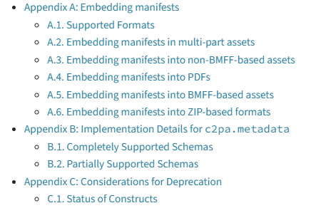
Coalition for Content
Provenance and Authenticity
https://spec.c2pa.org/specifications/specifications/2.2/specs/C2PA_Specification.html

Slide 31
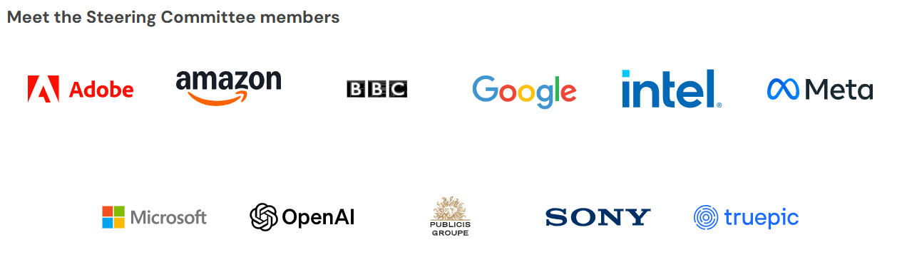
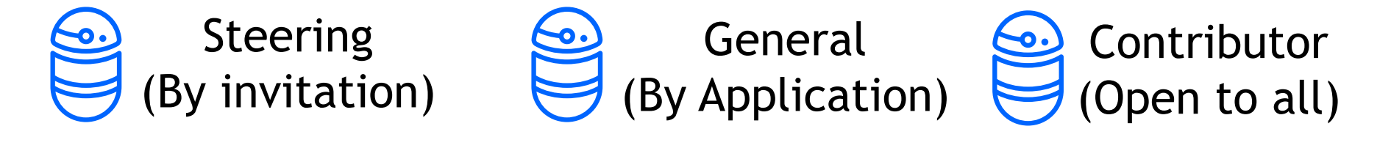
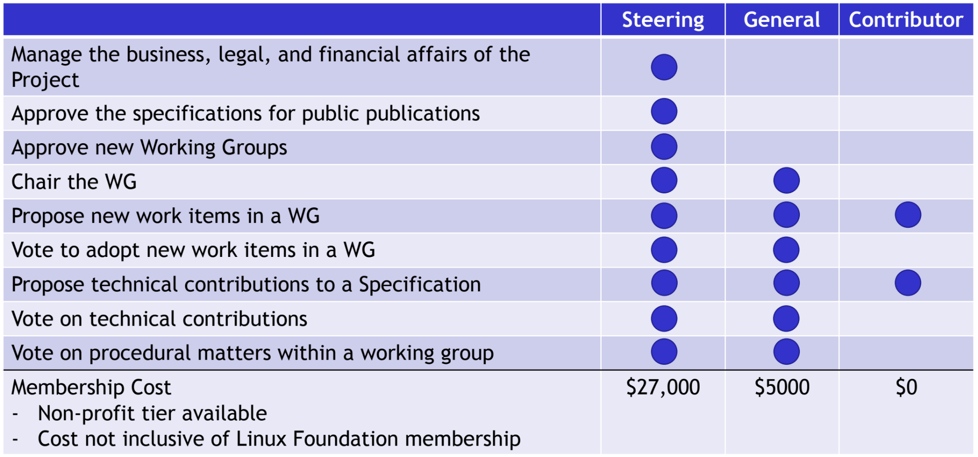

C2PA Membership
https://c2pa.org/ https://youtu.be/na9jBUC72VA?si=DBl4AxZcaQhsqrPZ https://c2pa.org/files/C2PA_Introduction_Deck.pdf

Slide 32
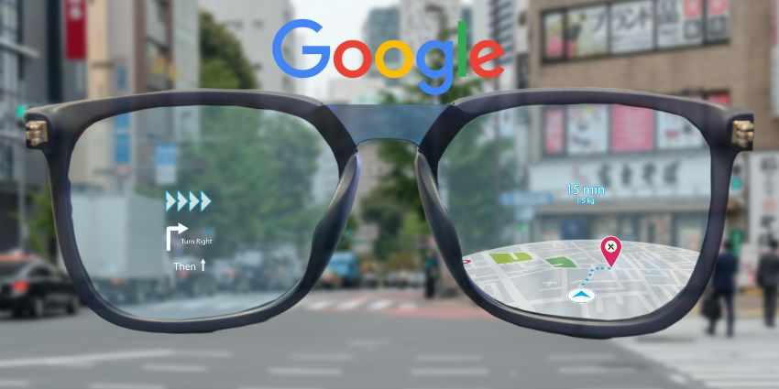
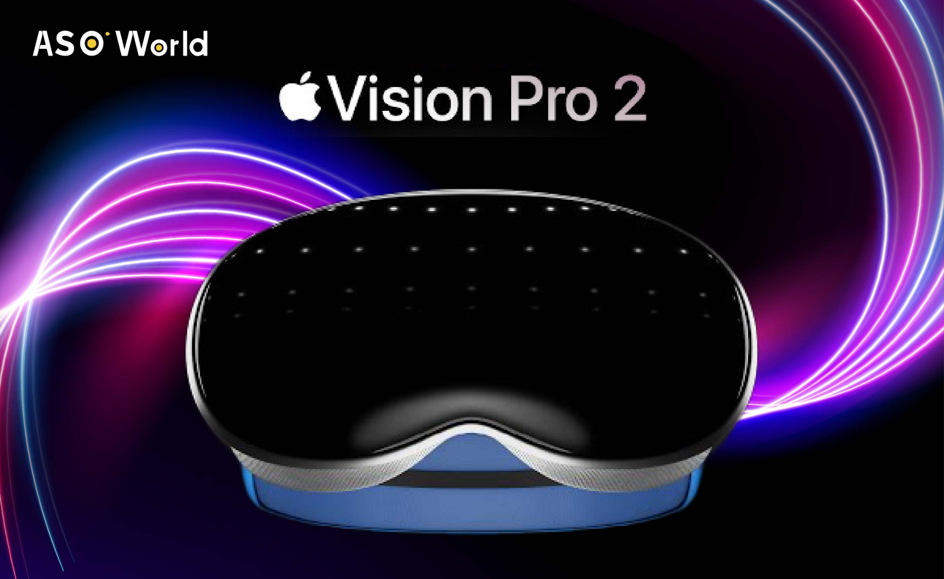
Smart Glasses
Initially, smart glasses technology focused on AR capabilities that simply superimposed visual information. Now, it is evolving into XR (extended reality), which blurs the line between the real and virtual worlds. When combined with AI, the possibilities of this technology expand exponentially. Traditional AR technology uses in-device sensors and cameras to recognize the user's location, field of view, and environment. Then, it overlays virtual graphics or data.
Generative AI goes beyond merely providing information; it interprets the user's behavior and context to actively respond. For instance, a device can analyze a situation using camera, microphone, and location data to offer relevant information or advice, even proactively. This provides an inherently different user experience than that of smartphones and traditional wearables, which rely on passive input.
Meta partnered with Ray-Ban to launch smart glasses that are fashionable and practical, and the market has responded positively.
Meta developed its AI model in-house to enable the glasses to respond quickly and to have advanced contextual awareness.
Apple's Vision Pro is a headset, not a pair of glasses, but it focuses on delivering an immersive XR experience.
Apple is reportedly working on a smaller, lighter version of the Vision Pro 2 and, in the long term, a glasses-based XR device.
Google, Microsoft, and Apple are all competing to dominate the next generation of computing platforms that converge AR, VR, and AI, albeit with different forms and approaches.
Google's prototype Android XR smart glasses, developed in collaboration with Samsung, are expected to launch in 2026.
The Apple Vision Pro 2 is expected to be released between late 2025 and spring 2026. The expected release date for Apple’s AR glasses is between 2026 and 2027. $500~$600
https://n.news.naver.com/article/025/0003444985?sid=105

Slide 33
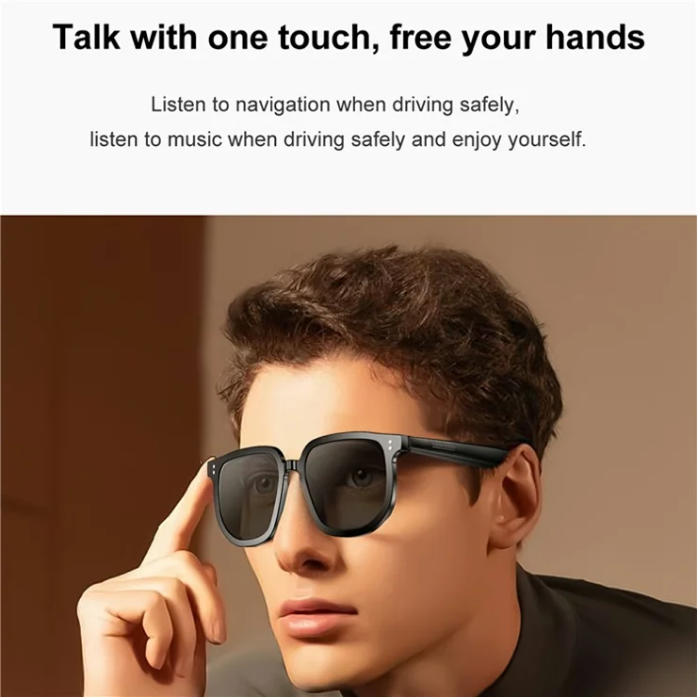
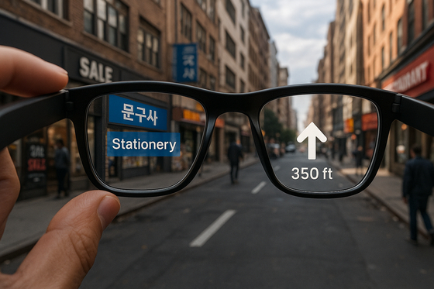
Smart Glasses
The biggest advantage of smart glasses is their hands-free interface. You can view information and give commands without using your hands, which is useful when your hands are busy, such as when you're driving, jogging, or cooking. The visual-centered presentation of information provides a more immersive and intuitive user experience than smartphones or smartwatches. Real-time translation, navigation, and checking notifications are more natural and seamless.
https://www.tvcmall.com/details/v1pro-smart-glasses-bluetooth-compatible-music-hands-free-calling-uv-protection-eyeglasses-sku6812002589a.html?srsltid=AfmBOorH34pKdtsut4YXYVWnkeZPj3rv6cZ3BdYs-V9RXcQ_o6OP1fIV https://www.joongang.co.kr/article/25340477

Slide 34
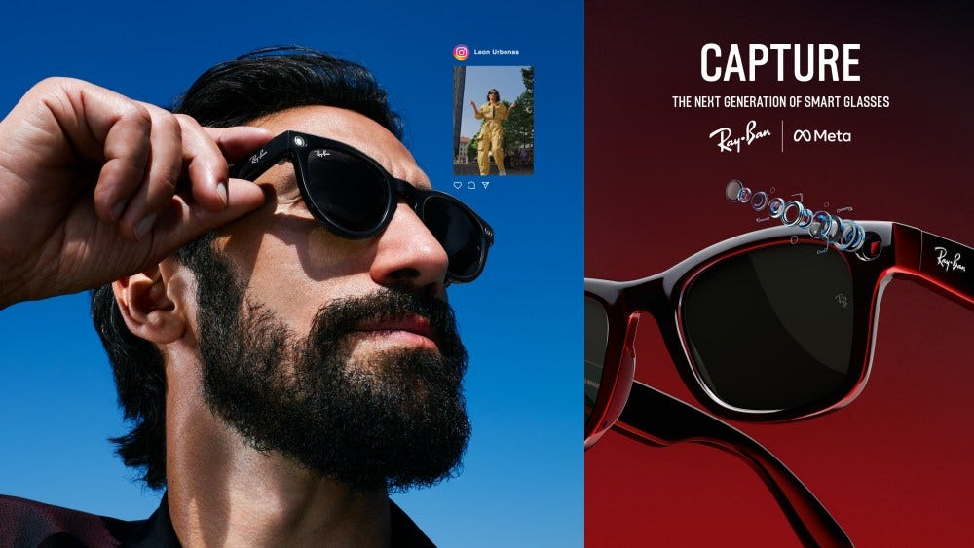

Smart Glasses
A second advantage is the “third eye” function made possible by AI. Smart glasses with generative AI, such as Gemini, recognize the wearer's gaze and provide contextualized information. For instance, if you look at a sign or poster in a foreign language, the glasses can automatically translate it into Korean. They can also scan your surroundings to recommend a popular restaurant or show you the current weather and nearby hazards. In an art gallery, you can stare at a painting and immediately access a description of the artist and work. These smart glasses are not just another pair of eyes; they are intelligent assistants that use your visual information to fill in the blanks in real time.
https://generativeai.pub/beyond-the-screen-metas-ai-powered-glasses-usher-in-a-new-era-c0aa55e821fa
https://www.kickstarter.com/projects/loomos/loomos-ai-glasses

Slide 35
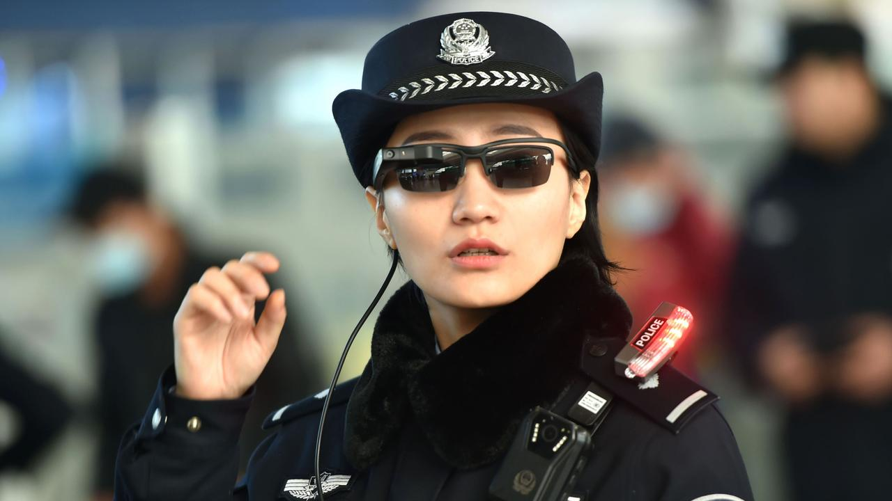
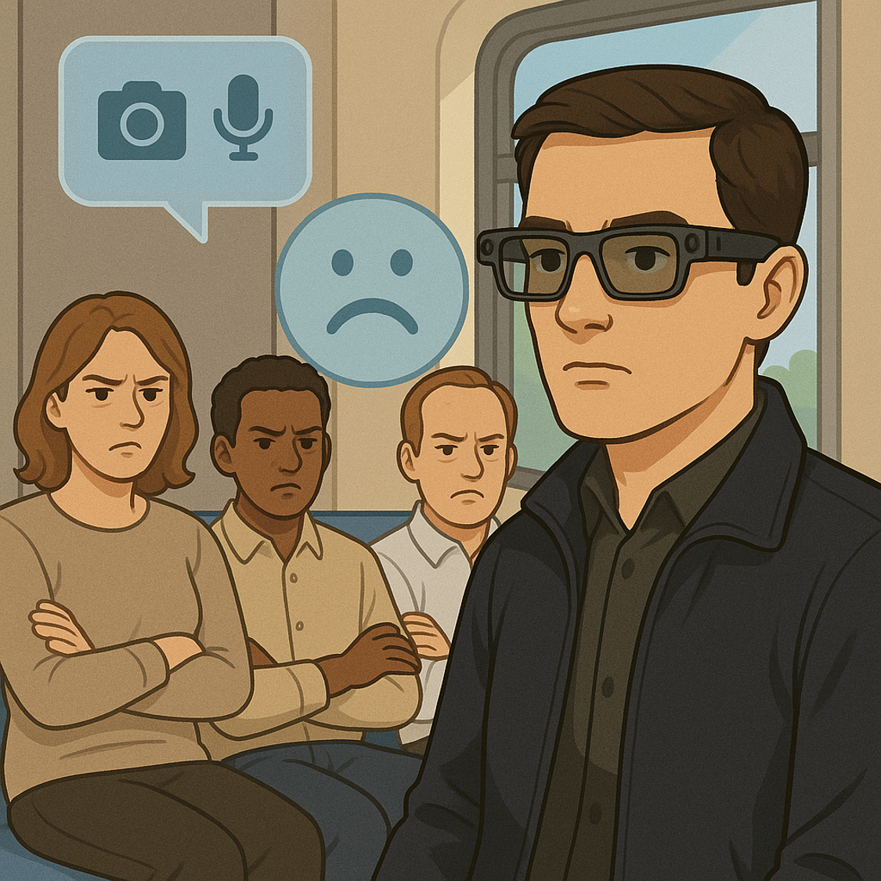
Smart Glasses
However, the downsides are obvious. First, battery life is still an issue. The continuous operation of the camera, sensor, display, and AI computation consumes a lot of power, making it difficult to achieve a level of endurance that allows for all-day use. Second, privacy concerns remain. Because the cameras and microphones are always on, it's possible to collect information about the people around you without their consent. This can lead to legal and social issues. Wearing smart glasses in public transportation, offices, meeting rooms, etc., may offend others and be perceived as a surveillance device. Third, the price is an issue. Due to the inclusion of high-performance AI, high-resolution displays, and a variety of sensors, the consumer price is higher than that of other wearable devices. There are also comfort issues.
https://www.kidsnews.com.au/technology/they-might-look-good-but-privacy-experts-warn-of-serious-harm/news-story/51dbdcb88d0977a0f302242f6a510485
https://generativeai.pub/beyond-the-screen-metas-ai-powered-glasses-usher-in-a-new-era-c0aa55e821fa

Slide 36
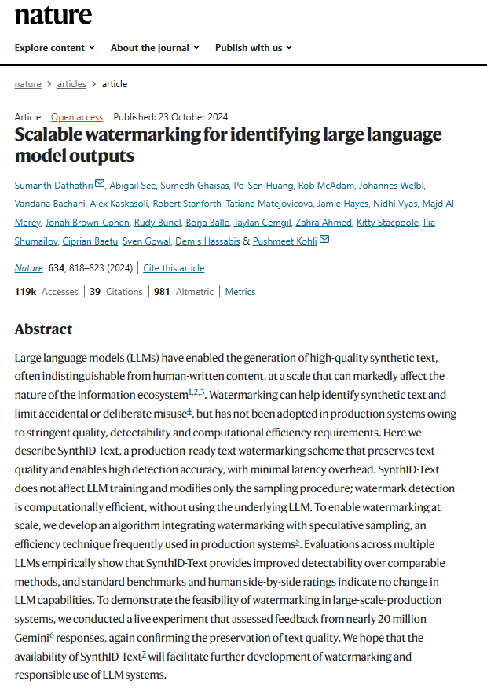
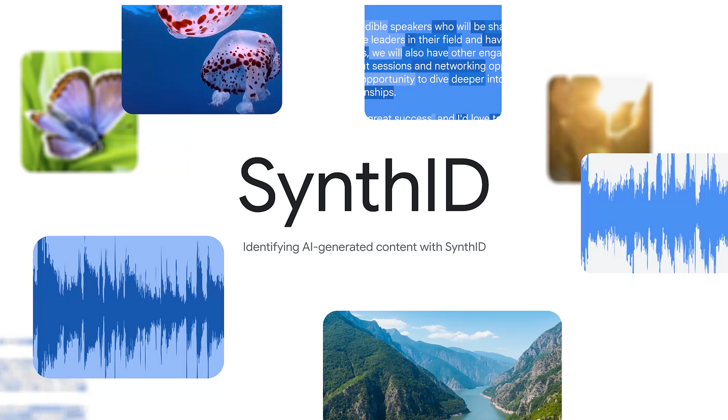


SynthID
https://www.nature.com/articles/s41586-024-08025-4
https://deepmind.google/science/synthid/ https://youtu.be/9btDaOcfIMY

Slide 37
Smart Glasses –
Personal Information Protection
Smart Glasses offer many benefits, including real-time information and the ability to take photos. However, they also raise serious privacy concerns of users and by standers. Serious privacy concerns exist for users and by standers. This article outlines privacy considerations for smart glasses. These Outlines how to protect your privacy from a technical perspective.
Data Encryption
- Encryption of Locally Stored Data and Data in Transit: Recorded Video, voice, and location Information such as recorded video, voice, and location are encrypted at the AES-256 level to prevent external leakage.
- End-to-End Encryption(E2EE) is applied. This is required when interfacing with the cloud Server.
Access Control
- Biometric authentication or PIN code.Based lock: This makes it impossible for anyone except the smart glasses wearer to access. Rights-based access control (RBAC): Restrict access by app and feature.
- It features a "Privacy Mode" that allows users to disable filming and recording features en masse when desired. This is useful for public and sensitive meetings.
Automatic Anonymization and Mosaicking.
- It automatically blurs sensitive elements, such as faces and license plates when taking videos or photos.
- De-identification function introduced after AI-based real-time face recognition..
- On-deviceDeveloped AI-based, real-time detection and automatic filtering technology for sensitive information.
Location information is minimally collected.
- Location information is only enabled when necessary and is kept turned off by default.It reduces collection frequency and precision to minimize privacy invasion.
- Reduced collection frequency and precision to minimize privacy invasion.
Notes:
스마트 글래스(Smart Glasses)는 실시간 정보 제공과 촬영 기능 등 다양한 이점을 제공하지만, 사용자 및 주변인의 개인정보 보호와
관련해 심각한 우려도 동반된다. 스마트 글래스에서 고려해야 할 개인정보 보호 방안을 기술적 관점에서 정리한 내용.
데이터 암호화
- 로컬 저장 데이터 및 전송 데이터 암호화: 촬영된 영상, 음성, 위치 정보 등을 AES-256 수준으로 암호화하여 외부 유출 방지.
- 엔드투엔드 암호화 (E2EE) 적용: 클라우드 서버와 연동 시 필수.
접근 제어
- 생체 인증 또는 PIN 코드 기반 잠금 기능: 스마트 글래스 착용자 외에는 접근이 불가능하도록 설정.
- 권한 기반 접근 제어(RBAC): 앱 및 기능별로 접근 권한을 제한.
- 사용자가 원할 때 촬영 및 녹음 기능 일괄 비활성화하는 "Privacy Mode" 탑재. 공공장소, 민감 회의 시 유용.
자동 익명화 및 모자이크 처리
- 영상이나 사진 촬영 시 얼굴, 차량번호판 등 민감한 요소 자동 블러 처리.
- AI 기반 실시간 얼굴 인식 후 비식별화 기능 도입.
- 온디바이스 AI 기반 실시간 민감 정보 감지 및 자동 필터링 기술 개발.
위치정보 최소 수집
- 위치정보는 필요한 경우에만 활성화하며, 기본은 꺼진 상태로 유지.
- 수집 주기 및 정밀도를 낮추어 프라이버시 침해 최소화.

Slide 38
Thank You

