Slide 1
MPEG-Immersive 3DoF+ Standard Work:
Related to 3DoF+ Call for Proposal
Presenter: Eun-Seok Ryu (esryu@gachon.ac.kr)
Jong-Beom Jeong, Dongmin Jang, Ju Hyeong Kim, SoonBin Lee, Eun-Seok Ryu
Multimedia Communications and Systems Lab. (MCSL)
http://mcsl.gachon.ac.kr
Department of Computer Engineering
Gachon University

Slide 2
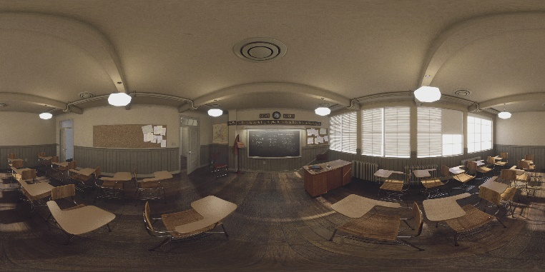
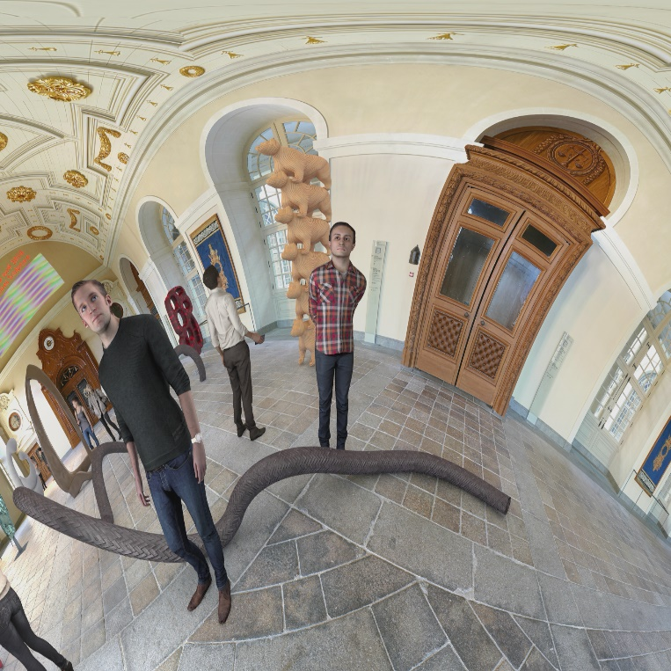
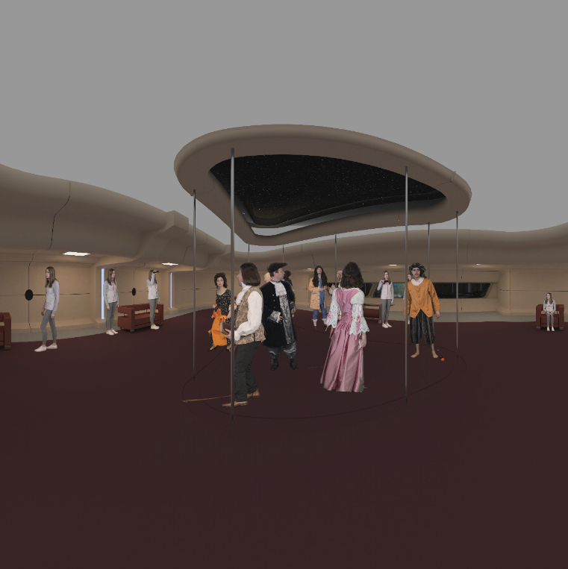
Test Materials for 3DoF+ - w17726
Philips
  ClassroomVideo
Technicolor
  TechnicolorMuseum
  TechnicolorHijack
Class A
ClassroomVideo (4096x2048), 360º x 180º FOV ERP,
30fps, 120frames, 15 source views
Class B
TechnicolorMuseum (2048x2048), 180º x 180º FOV ERP,
30fps, 300frames, 24 source views
Class C
TechnicolorHijack (4096x4096), 180º x 180º FOV ERP,
30fps, 300frames, 10 source views

Slide 3
Common Test Conditions (CTC) for 3DoF+ - w17726
Software
Software name | Location | Tag/branch
RVS | http://mpegx.int-evry.fr/software/MPEG/Explorations/3DoFplus/RVS | v2.0
ERP-WS-PSNR | http://mpegx.int-evry.fr/software/MPEG/Explorations/3DoFplus/ERP_WS-PSNR | 20180704
HDRTools | https://gitlab.com/standards/HDRTools/tree/0.18-dev | 0.18-dev
360Lib | https://jvet.hhi.fraunhofer.de/svn/svn_360Lib/branches/360Lib-5.1-dev | 5.1-dev
HM | https://hevc.hhi.fraunhofer.de/svn/svn_HEVCSoftware/tags/HM-16.16 | 16.16

Slide 4
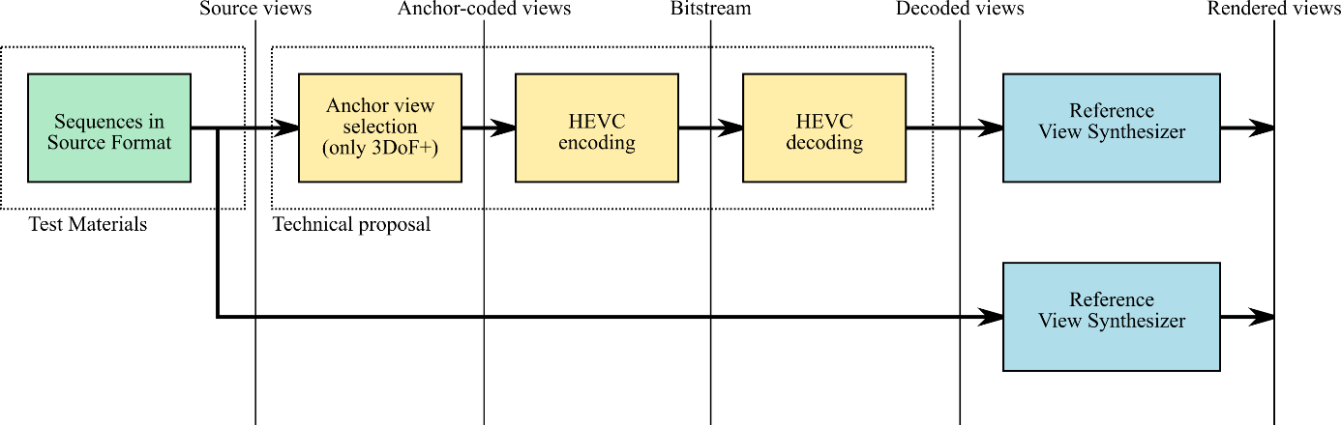
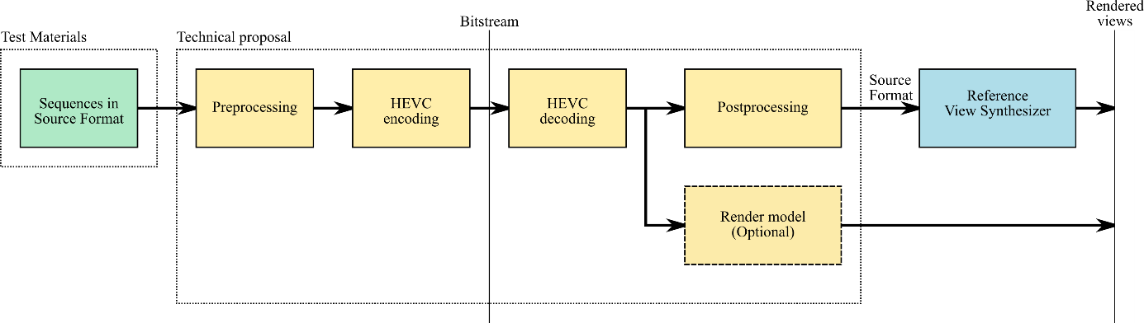
Common Test Conditions (CTC) for 3DoF+ - w17726
Anchor definition
Definition of the anchor
Technical proposal with pre- and post-processing

Slide 5
Common Test Conditions (CTC) for 3DoF+ - w17726
Quantization Parameter and class
 | QP1 | QP2 | QP3 | QP4 | QP5
Depth QP | 12 | 17 | 22 | 27 | 32
Texture QP | 22 | 27 | 32 | 37 | 42
QPs used for depth and texture
Test class | Sequence Name | No. of source views | No. of anchor-coded views | Anchor-coded views
A1 | ClassroomVideo | 15 | 15 | All
A2 | ClassroomVideo | 15 | 9 | v0, v7…v14
B1 | TechnicolorMuseum | 24 | 24 | All
B2 | TechnicolorMuseum | 24 | 8 | 0, 1, 4, 8, 11, 12, 13, 17
C1 | TechnicolorHijack | 10 | 10 | All
C2 | TechnicolorHijack | 10 | 5 | 1, 4, 5, 8, 9
Anchor-coded views per class

Slide 6
Common Test Conditions (CTC) for 3DoF+ - w17726
3DoF+ objective evaluation
Term | Description
Coded view position | The position of a source view which is coded by the anchor
Non coded source view position | The position of a source view which isn’t coded by the anchor
Intermediate view position | The position of a view which is out of any source view
Definitions for test class on 3DoF+
 | WS-PSNR
 | For the anchor RD curve | For the proponent’s RD curve
Coded BD rate | All frames Coded view & source view | All frames Proponent’s view & source view
Non-coded BD rate | All frames Non-coded source view & source view | All frames Proponent’s view & source view
Intermediate BD rate | All frames Intermediate view made by decoded views & same view made by all source views with 16-bit depth maps | All frames Proponent’s intermediate view & Same view made by all source views with 16-bit depth maps
Requirements for 3DoF+ objective evaluation

Slide 7



Reference View Synthesizer - w17759
Reference software for view synthesis of 3DoF+
Conceptual Diagram
Simple Example
Virtual View
View Blending
by dividing High Frequency and Low Frequency
Virtual View
View Blending
View & Depth
Synthesis
using Warping
View & Depth
Synthesis
using Warping
View & Depth
Synthesis
using Warping
View & Depth
Synthesis
using Warping
…
View & Depth
Synthesis
View & Depth
Synthesis
Texture & Depth
Texture & Depth
Texture & Depth
Texture & Depth
…
Input View 1
Input View 2
Input View 3
Input View 4
Input View L
Input View R

Slide 8
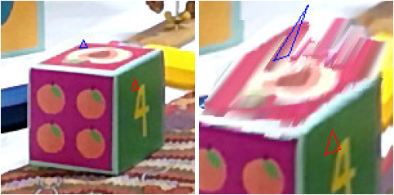
Reference View Synthesizer - w17759
3D Warping
  Pixel movement between viewpoints of the same world coordinate
  Input view is divided into triangles with the pixels centers as vertices
  Use affine transformation
  Being filled with interpolated colors after affine transformation
(a) Input view
(b) Obtained view after synthesizing view and depth

Slide 9







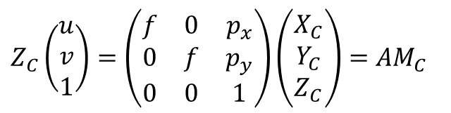






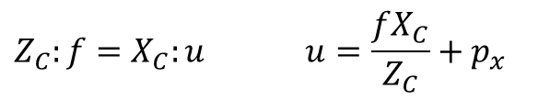





Reference View Synthesizer - w17759
View synthesis
$M_{Ci}$ = ($X_{Ci}$, $Y_{Ci}$, $Z_{Ci})$
$$Z_{C}:f=X_{C}:u u=\frac{fX_{C}}{Z_{C}}+p_{x}$$
M
$M_{Cs}$ = ($X_{Cs}$, $Y_{Cs}$, $Z_{Cs})$
Camera
$M_{W}$ = ($X_{W}$, $Y_{W}$, $Z_{W})$
World
$$v=\frac{fY_{C}}{Z_{C}}+p_{y}$$
$$m_{s}$$
$$m_{i}$$
Input view
Synthesis view
Considering principal point
Fig1. Camera and world cordinates of input and synthesis views
$$Z_{C}\left(\begin{matrix}u \\ v \\ 1\end{matrix}\right)=\left(\begin{matrix}f & 0 & p_{x} \\ 0 & f & p_{y} \\ 0 & 0 & 1\end{matrix}\right)\left(\begin{matrix}X_{C} \\ Y_{C} \\ Z_{C}\end{matrix}\right)=AM_{C}$$
Optical axis
$$\tilde{m}$$
$$M_{C}$$
Camera coordinate move by t and rotate by R
from world coordinate
$$X_{C}$$
$$Z_{C}$$
u
$M_{C}=$ $\tilde{m}A^{−1}$
$$M_{C}=RM_{w}+t$$
$$P$$
$$m$$
Image plane
$$\tilde{m}=ARM_{w}+At$$
f
$$(u,v)$$
$M_{w}={R_{i}}^{−1}{A_{i}}^{−1}\tilde{m_{i}}−{R_{i}}^{−1}t_{i}$ (Input view)
($p_{x}$, $p_{y})$
$$C$$
${R_{i}}^{−1}{A_{i}}^{−1}\tilde{m_{i}}−{R_{i}}^{−1}t_{i}=$ ${R_{s}}^{−1}{A_{s}}^{−1}\tilde{m_{s}}−{R_{s}}^{−1}t_{s}$
Fig2. Camera coordinate above the image plane
$$\tilde{m_{s}}={{A_{s}R_{s}R}_{i}}^{−1}{A_{i}}^{−1}\tilde{m_{i}}−A_{s}R_{s}{R_{i}}^{−1}t_{i}+A_{s}t_{s}$$

Slide 10
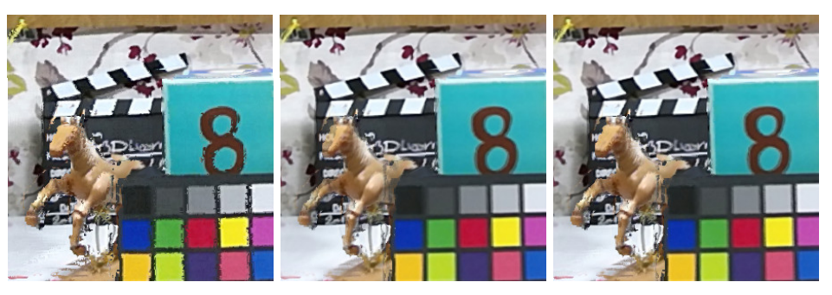



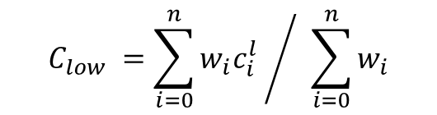
Reference View Synthesizer - w17759
Good quality : low depth and triangle with a regular shape
Taking the pixel with the maximal quality would give a sharper result
Taking the weighted mean is more resistant to errors
High and low frequencies are separated with a mean blur
Low frequencies are blended with the weighted mean
High frequencies are blended by choosing the pixel of highest weight
$$w_{i} ={\left(\frac{q_{i}}{d_{i}}\right)}^{α}$$
depth at pixel for synthesized view i
$$C_{low} ={\sum_{i=0}^{n}{w_{i}c_{i}^{l}} }/{ \sum_{i=0}^{n}{w_{i}}}$$
(a)
(b)
(c)
$$C_{high} ={argmax}_{c_{i}^{h}}(w_{i})$$
(a): Blending by argmax
(b): Weighted mean
(c): Multi-spectral blending: argmax - high frequencies
weighted mean - low frequencies
$c_{i}^{l} ,c_{i}^{h}$: color of the pixel in view i for
the low and high frequencies

Slide 11
Reference View Synthesizer - w17759
Architecture
Pipeline Object (Pipeline.cpp)
Initialize
Process
Pipeline::compute_views(int Frame)
Routine: Create Virtual View(Renderd View) to Write, For i = 1 to num_virtual_view
Parse
Configurations
Set Blending Method
Set Virtual Camera Parameters
Inpainting
Downscale
Write OutputFile
& OutMaskedFile
Type:
1)Simple
2)MultiSpec
CTC use (1)
RVS define as
Projector
Type:
1)Interpolation
2)Nearest
RVS only uses (2)
Using Manhattan
Not Main Interest
Downscale rasterized image
Routine: Load Image per Frame
Initialize
Image Buffer
Routine: Blend Virtual Views from Input Views, For i = 1 to num_input_view
Set Image
Params
Set Projection Type
Set Input Camera Parameters
Set Synthesis Method
Load Input
View Image
Synthesis
Type:
1)Perspective
2)Equirectangular
RVS define as
UnProjector
RVS only has Triangle Method
Compute Views
Blending

Slide 12
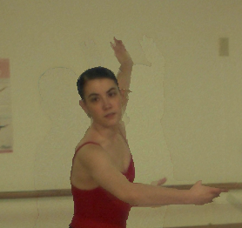
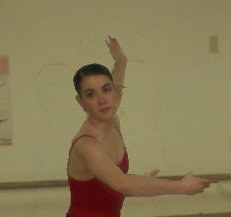
Fast Color Correction for View Synthesis - m43694
Fast color correction technique for view synthesis
Reduction of color artifacts in synthesized images
  Offset calculation
  Offset addition
SVS, no color correction (31.7 dB)
SVS, with color correction (32.6 dB)
Test sequence | PSNR [dB]
 | VSRS |  | SVS
 | No color correction | With color correction | No color correction | With color correction
Ballet | 31.45 | 31.96 | 31.72 | 32.55
Breakdancers | 31.89 | 31.89 | 32.09 | 32.16
Poznan_Fencing2 | 26.14 | 28.04 | 26.79 | 28.50
Soccer Linear | 34.80 | 34.80 | 34.92 | 34.94
BBB Butterfly | 32.06 | 32.06 | 33.94 | 33.91
BBB Flowers | 22.71 | 22.71 | 22.51 | 22.48
View Synthesis with Proposed Color Correction
(oc* – offset calculation)

Slide 13
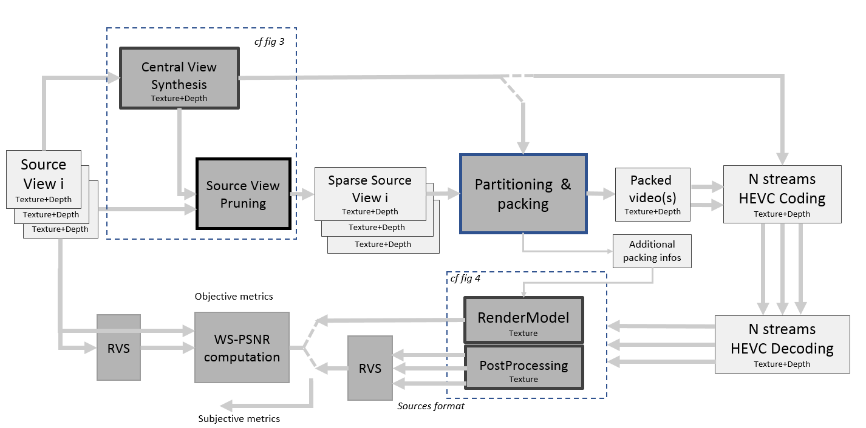
3DoF+ Software Platform Description - w17761
3DoF+ Software platform

Slide 14
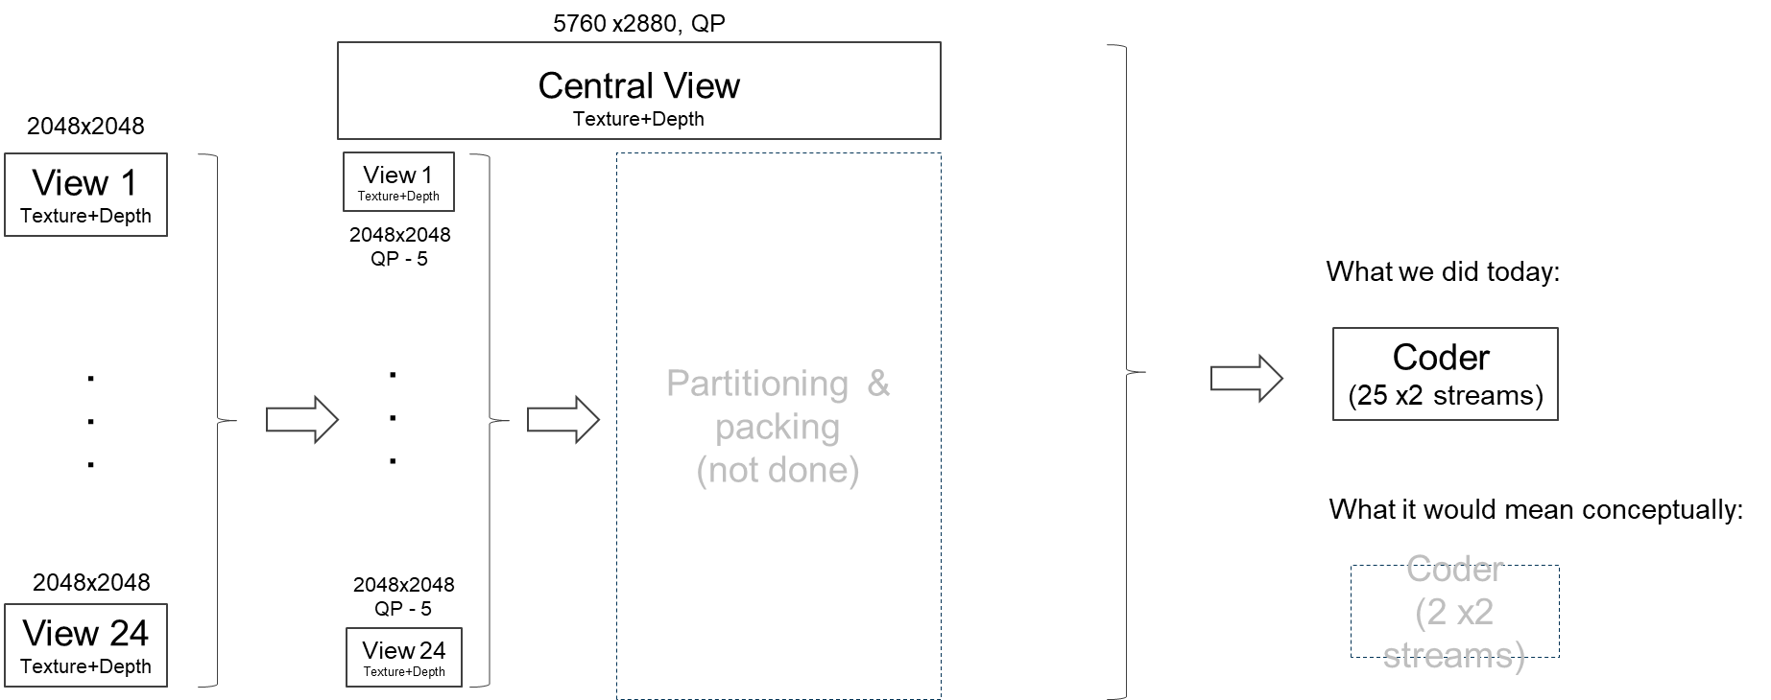
Outperforming 3DoF+ Anchors – m43504
Removing overlap between anchors reduces data
Send a central view and sparse views

Slide 15
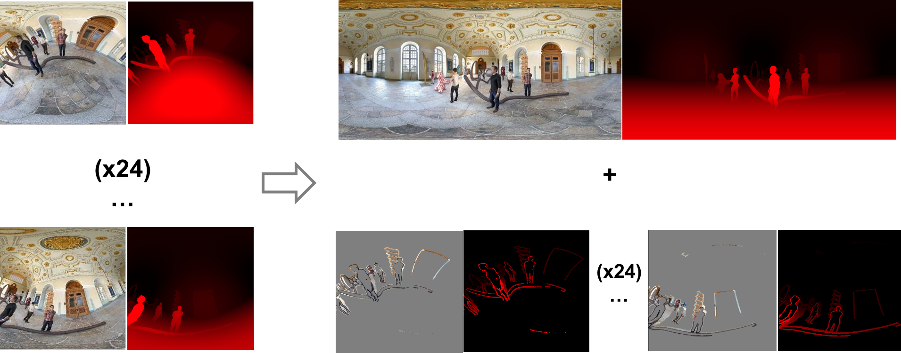
Outperforming 3DoF+ Anchors – m43504
1 central ERP + 24 semi ERP views

Slide 16
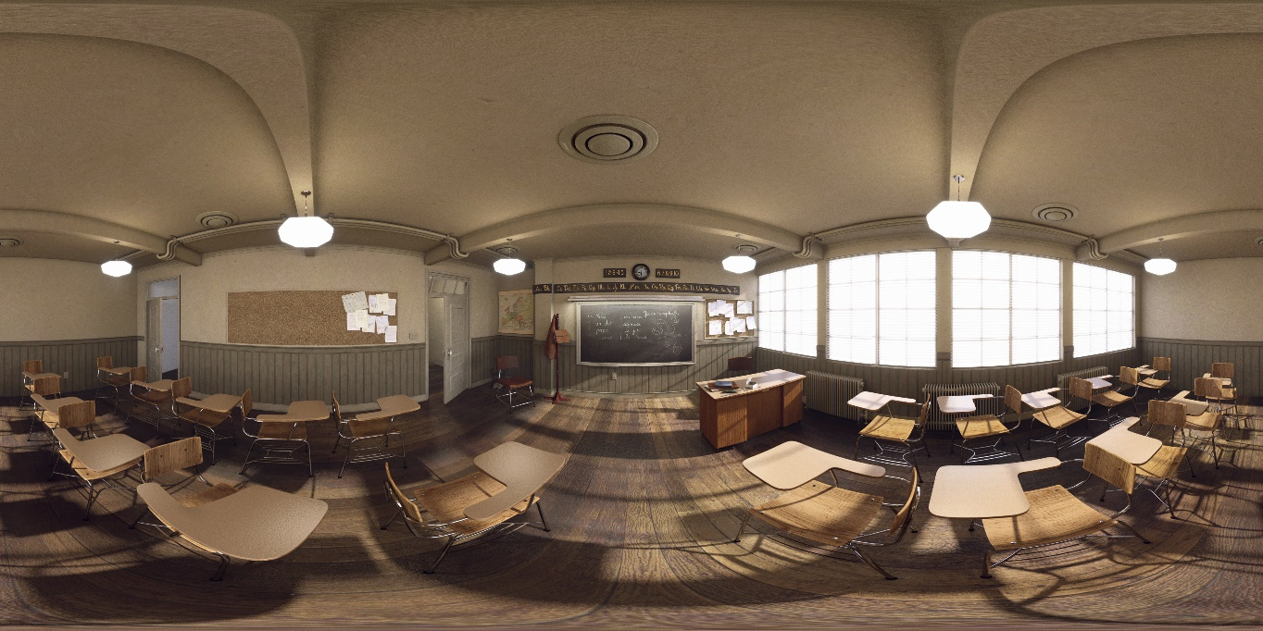
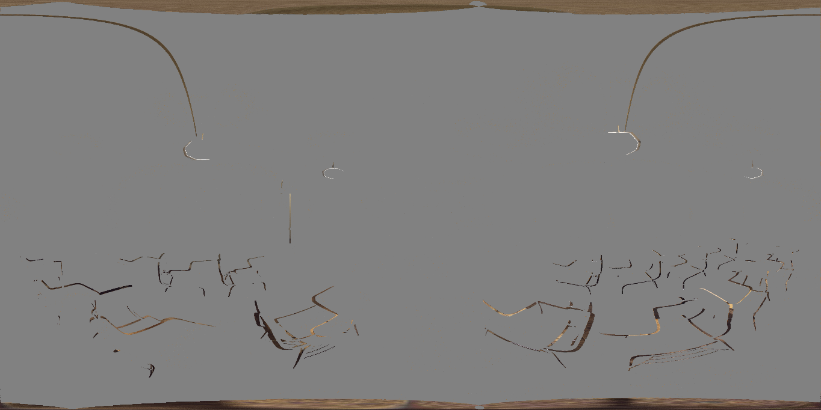
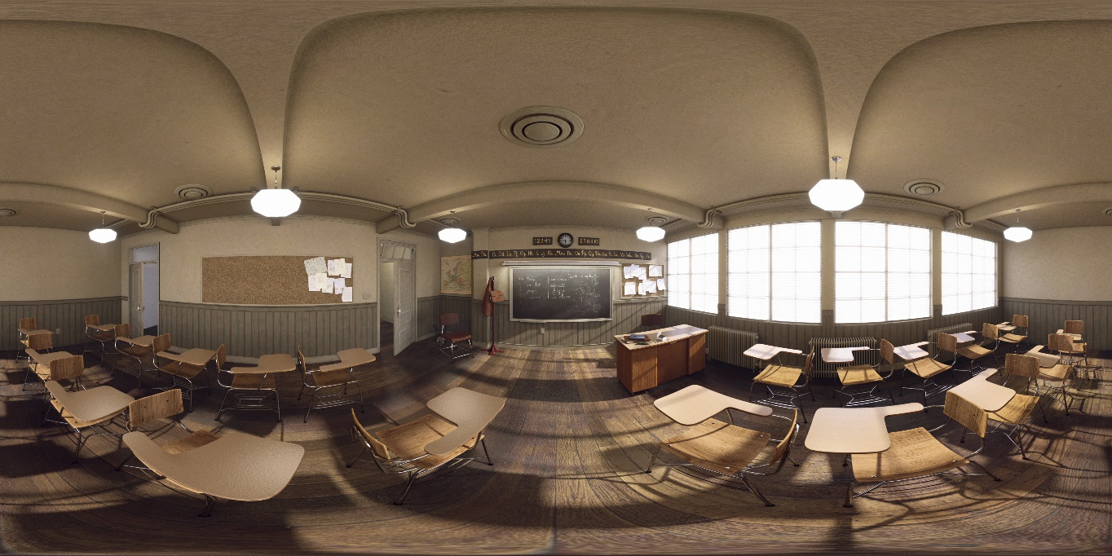
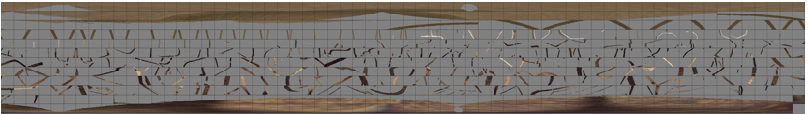





Source View Pruning & Packing
Based on m43504, build source view pruning module with RVS
Packing module divides the sparse views into small size blocks
If the block contains information more than threshold, it is added to packing view
Central View
Packing
Input View
Sparse View
Divide view into blocks
Source View Pruning
Remove redundancy
$$sv=iv −(iv∩cv)$$
v1
Pixel-by-pixel comparision
$M_{Wi}$ = ($X_{wi}$, $Y_{wi}$, $Z_{wi})$
s1
…
Add blocks which contain information more than threshold
$M_{Wc}$ = ($X_{wc}$, $Y_{wc}$, $Z_{wc})$
…
$$m_{s}$$
$$m_{i}$$
v14
Input View
Central View
s14

Slide 17
Source View Pruning & Reconstruction
Architecture
Source views
Anchor-coded views
Bitstream
Decoded views
Sequences in Source Format
Central & Source View Selection
HEVC
Encoding
HEVC
Decoding
Measure
WS-PSNR
with
Source Views
Source View Pruning
with RVS
HEVC
Encoding
HEVC
Decoding
Source View Reconstruction

Slide 18
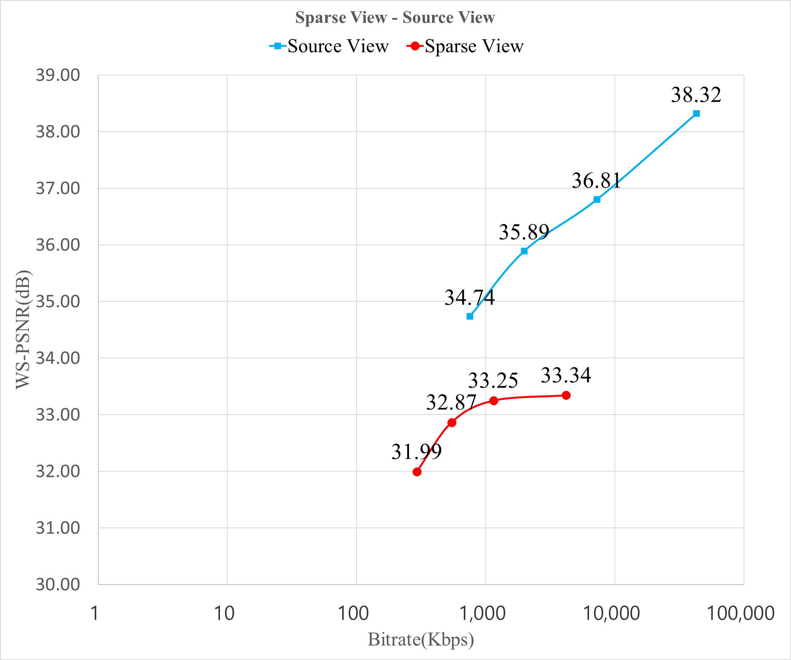
Source View Pruning & Reconstruction
RD-curve

Slide 19
Conclusion
Motivation
  3DoF+ requires high resolution, large amount of videos
  Multi-view video transmission needs multiple decoders
Proposed method
  Generate sparse view by removing overlap between views with RVS
  Divide sparse view into blocks and add them to packing view
  Reconstruct source view with central view and sparse views
Results
  Source view pruning saves bitrate with small loss of PSNR
  Packing reduces the size of view to transmit
Future work
  Color correction technique with illumination compensation
  Extensive experiment for optimal parameters

