Slide 1
[Orientation of IEEE 2888 WG for New Comers]
[Sangkwon Peter Jeong / JoyFun]

Slide 2
Compliance with IEEE Standards Policies and Procedures
Subclause 5.2.1 of the IEEE-SA Standards Board Bylaws states, "While participating in IEEE standards development activities, all participants...shall act in accordance with all applicable laws (nation-based and international), the IEEE Code of Ethics, and with IEEE Standards policies and procedures."
The contributor acknowledges and accepts that this contribution is subject to
The IEEE Standards copyright policy as stated in the IEEE-SA Standards Board Bylaws, section 7, http://standards.ieee.org/develop/policies/bylaws/sect6-7.html#7, and the IEEE-SA Standards Board Operations Manual, section 6.1, http://standards.ieee.org/develop/policies/opman/sect6.html
The IEEE Standards patent policy as stated in the IEEE-SA Standards Board Bylaws, section 6, http://standards.ieee.org/guides/bylaws/sect6-7.html#6, and the IEEE-SA Standards Board Operations Manual, section 6.3, http://standards.ieee.org/develop/policies/opman/sect6.html

Slide 3
IEEE 2888 Interfacing Cyber and Physical World Working Group Kyoungro Yoon, yoonk@konkuk.ac.kr
Orientation of IEEE 2888 WG for New Comers
Date: 2022-01-24
Author(s): Sangkwon Peter Jeong
Name | Affiliation | Phone | Email
Kyoungro Yoon | Konkuk University | +82 10 5177 3768 | yoonk@konkuk.ac.kr
Sangkwon Peter Jeong | JoyFun | +82 10 8667 7329 | ceo@joyfun.kr

Slide 4
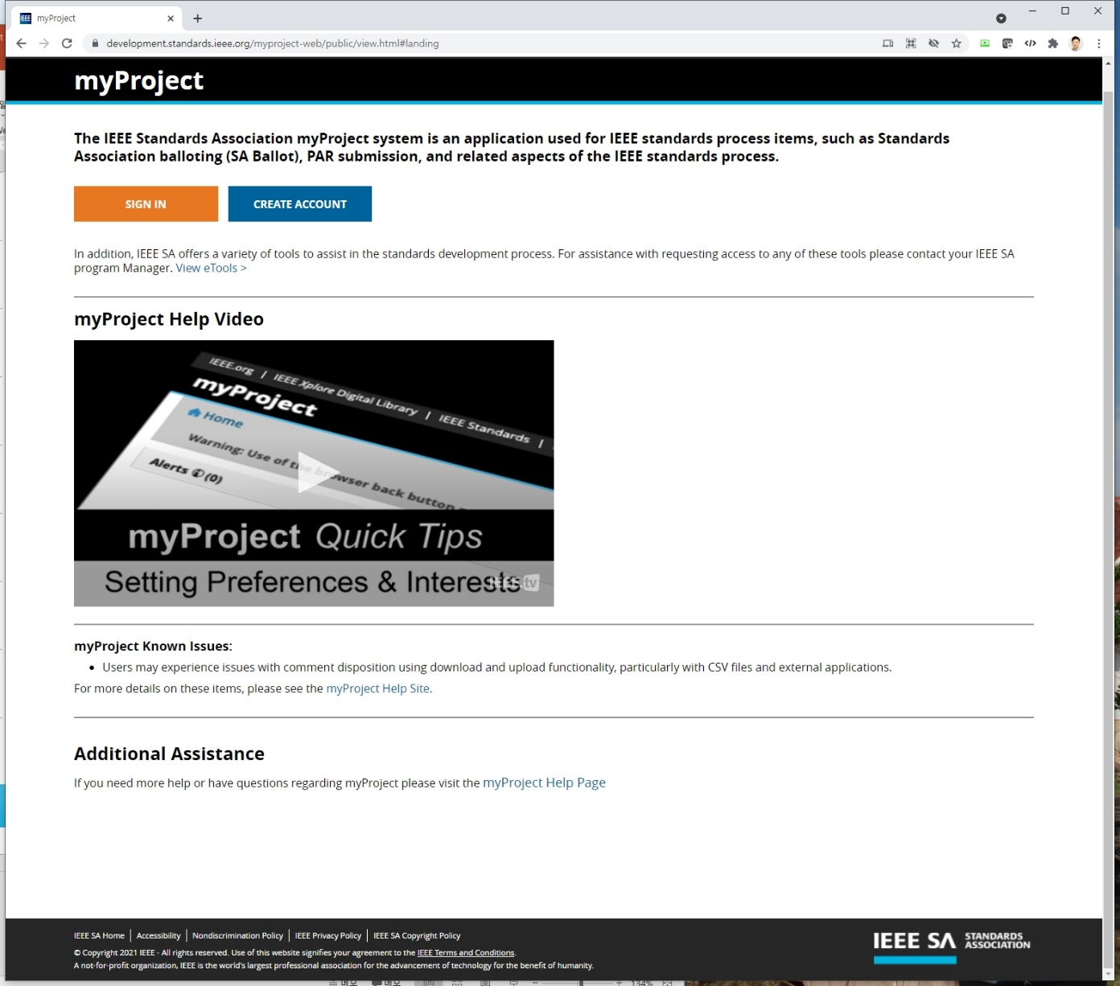
1. Interest Group
Click
URL: https://development.standards.ieee.org/

Slide 5
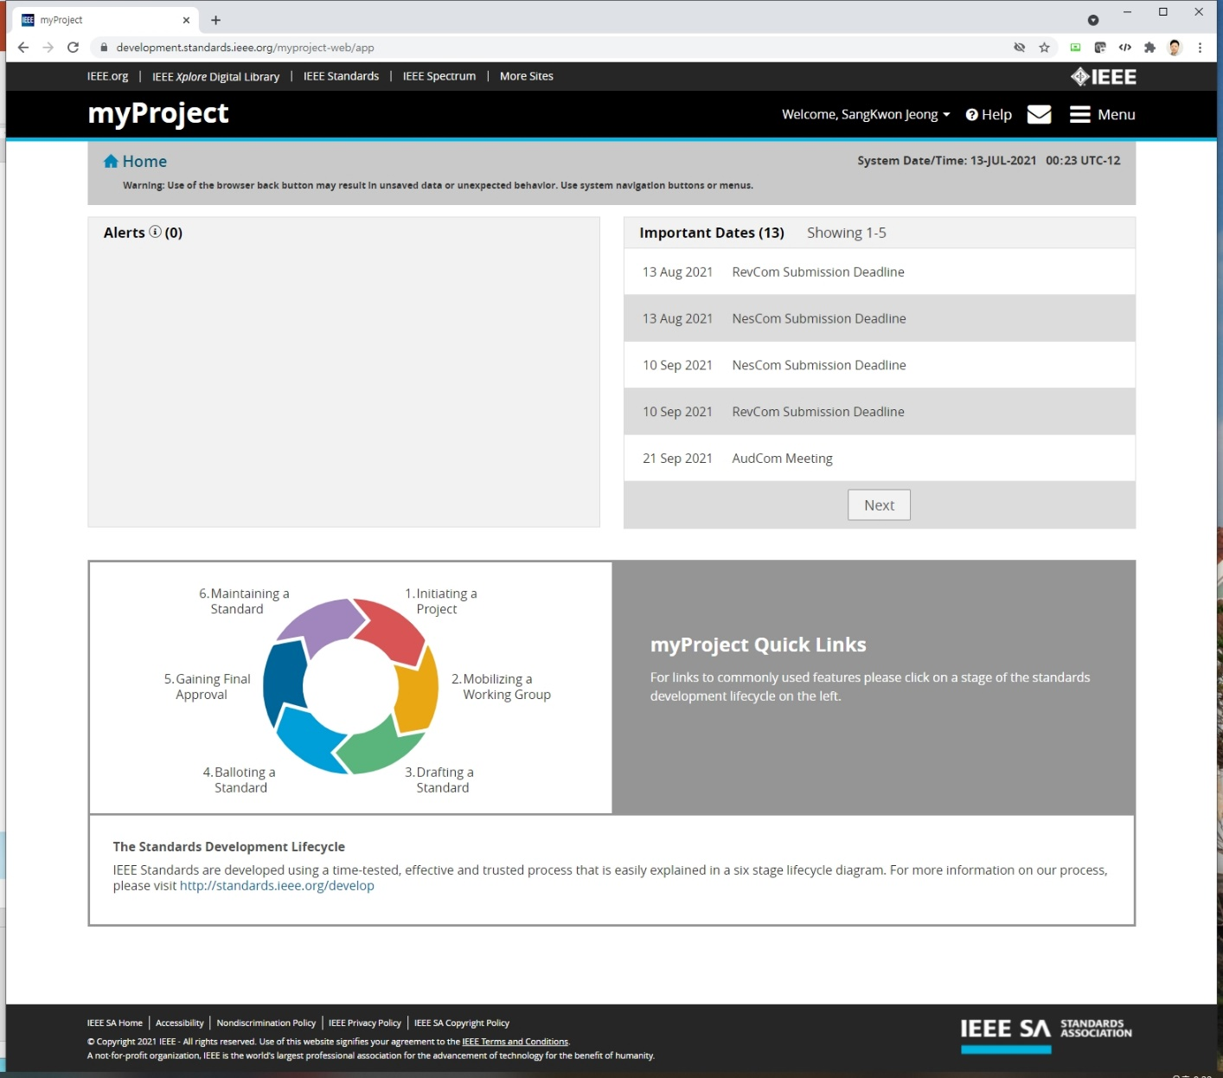
1. Interest Group
Click

Slide 6
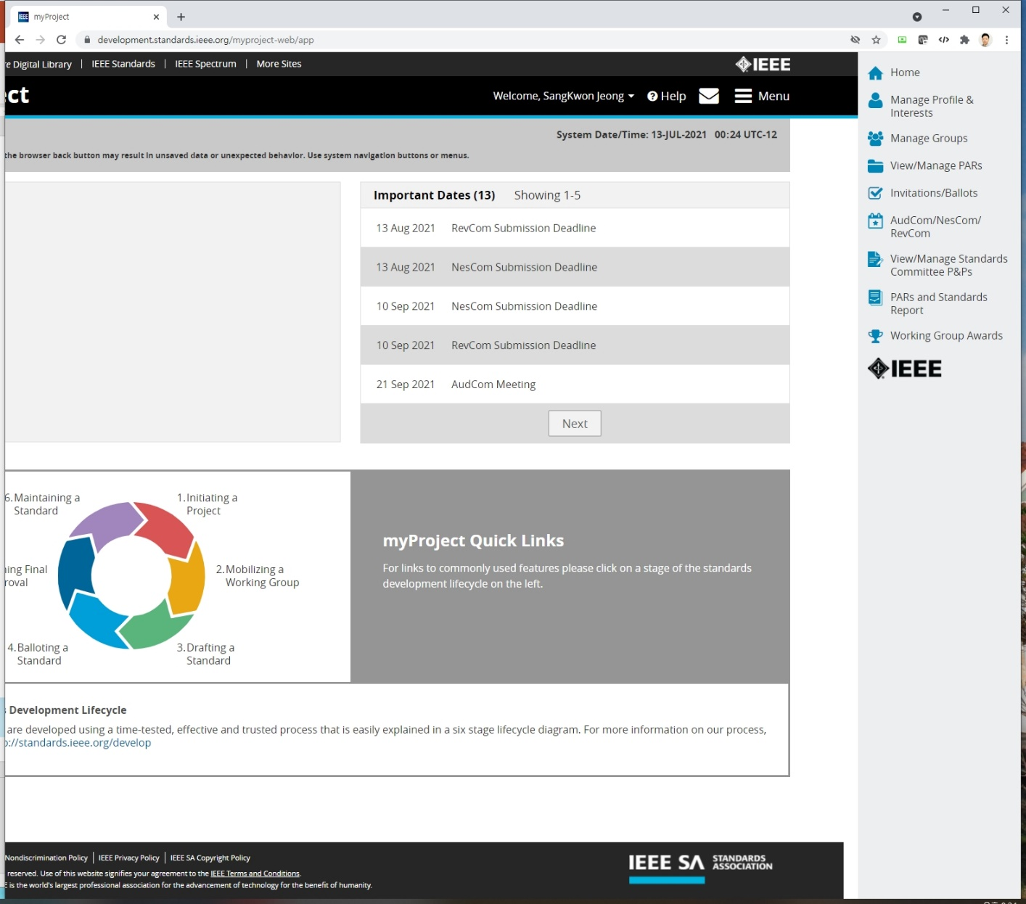
1. Interest Group
Click

Slide 7
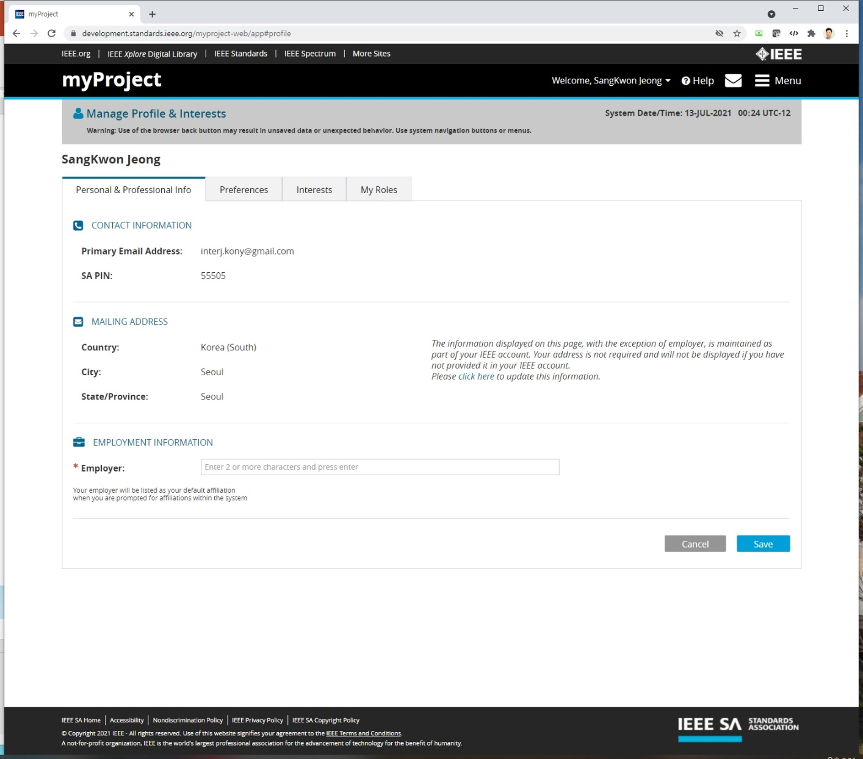
1. Interest Group
Click

Slide 8
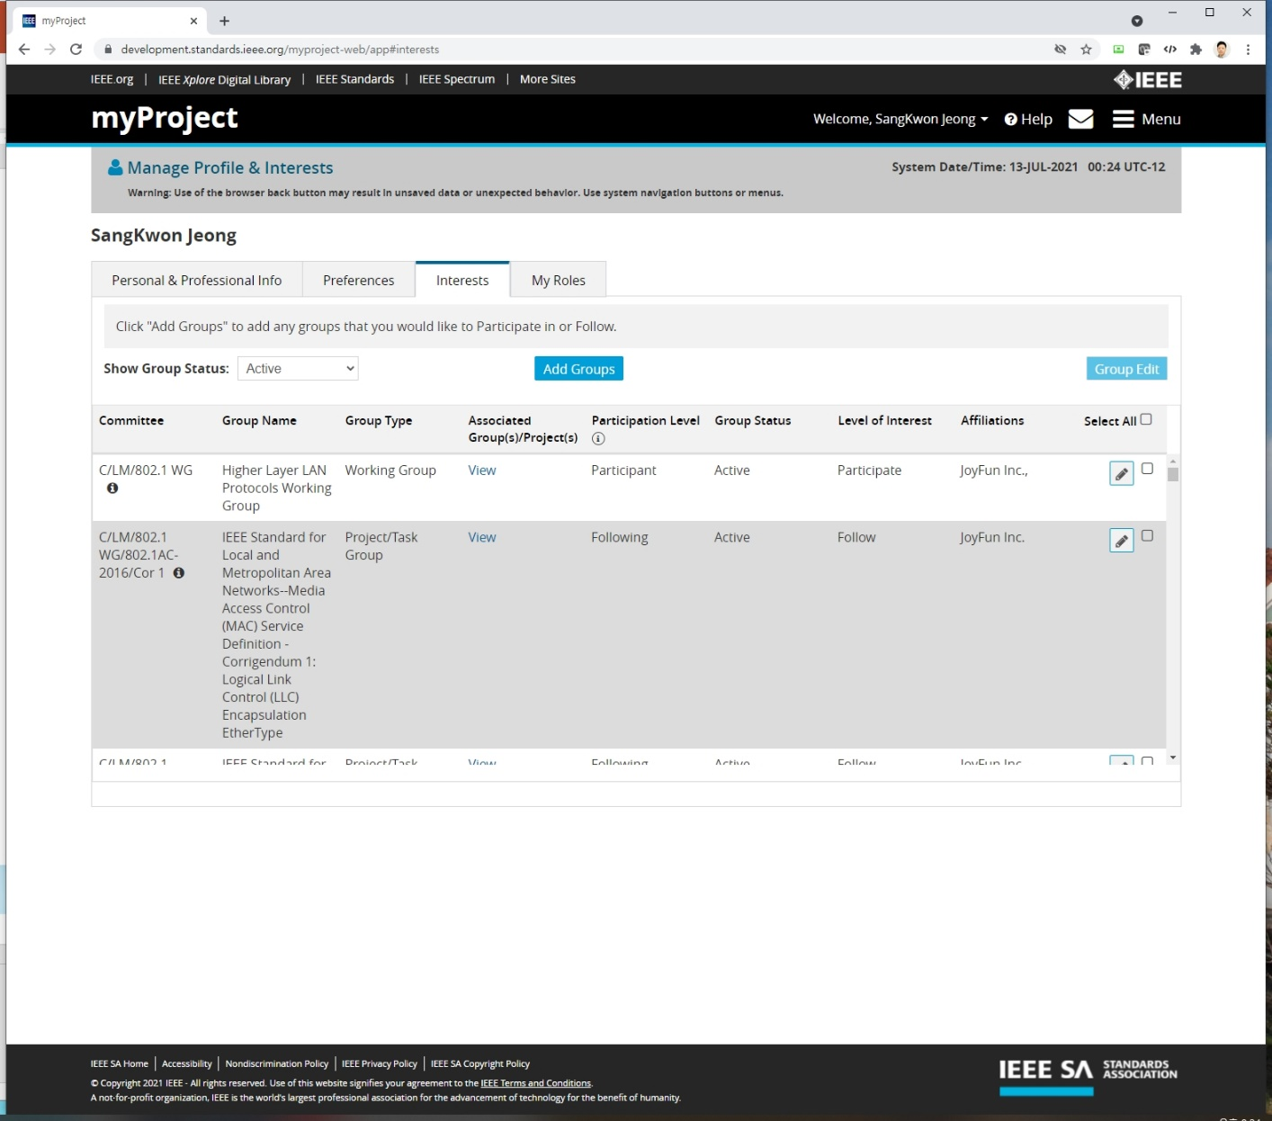
1. Interest Group
Click

Slide 9
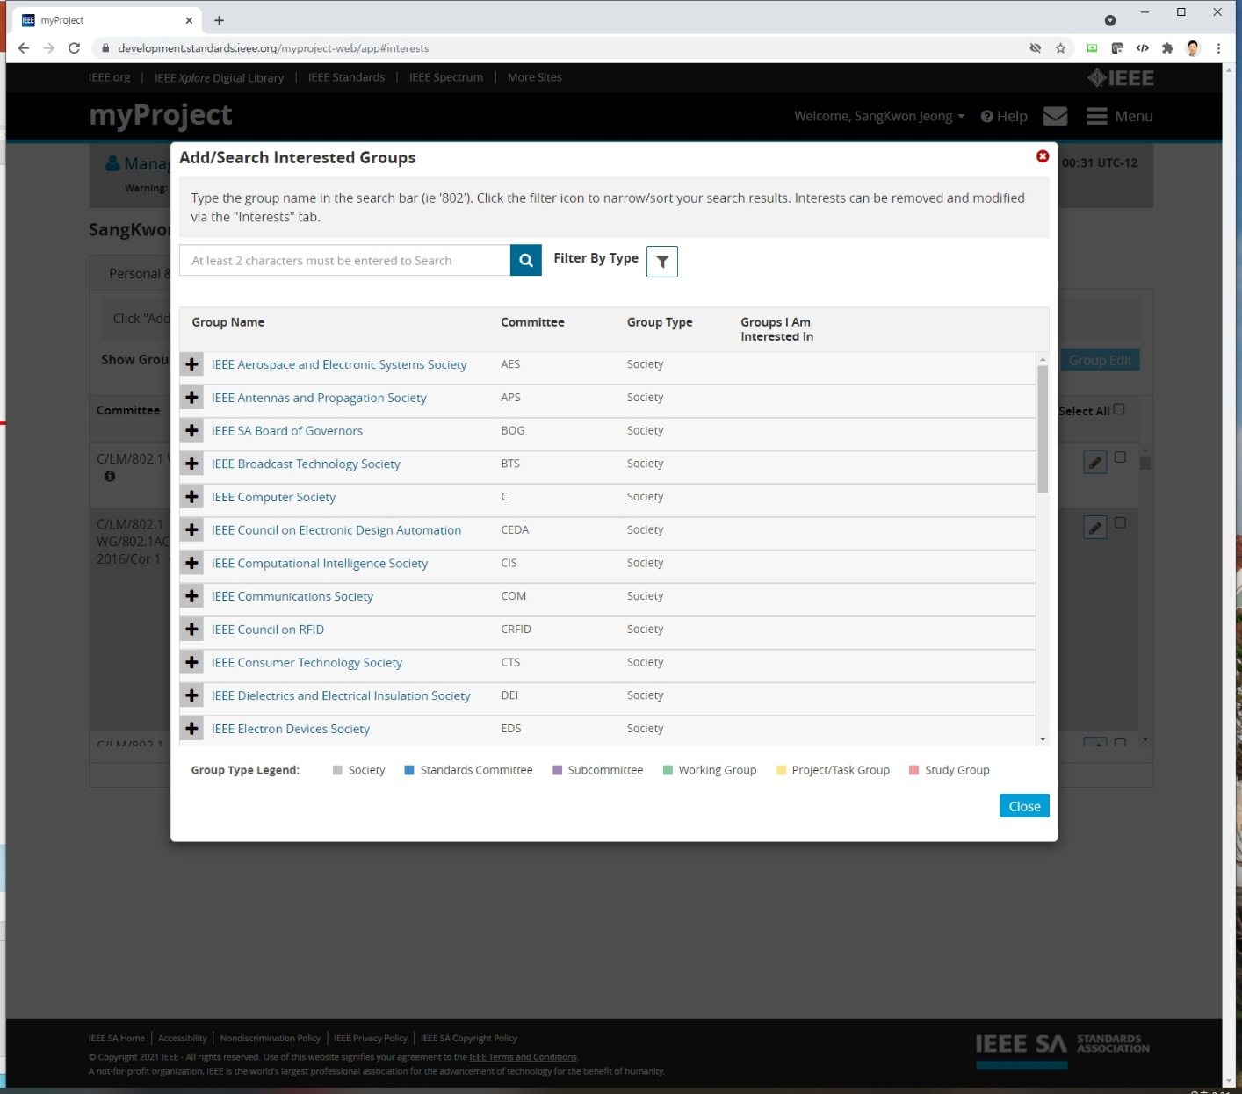
1. Interest Group
Click

Slide 10
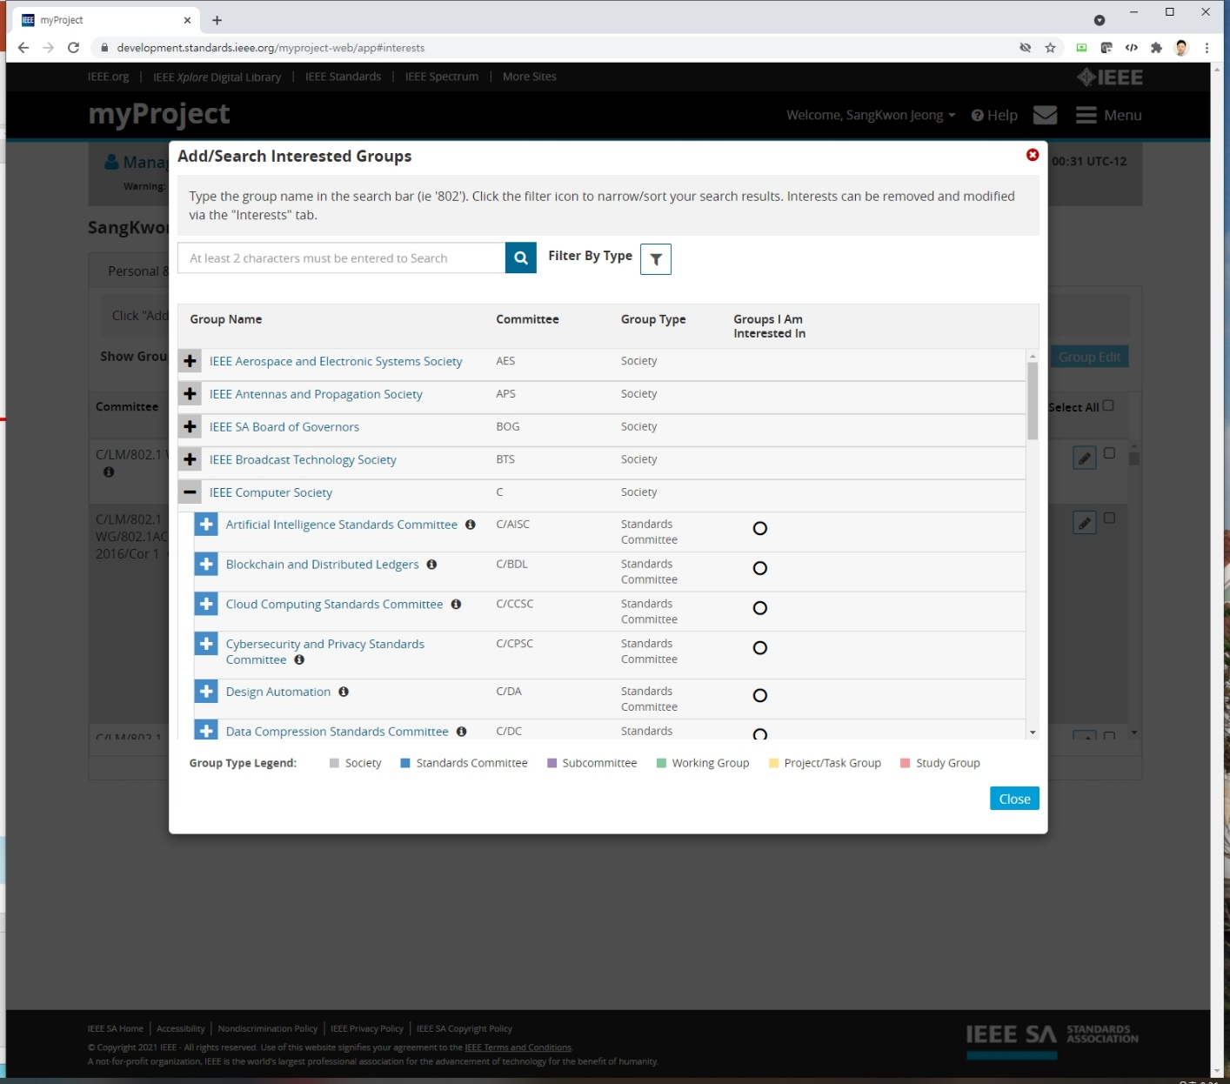
1. Interest Group

Slide 11
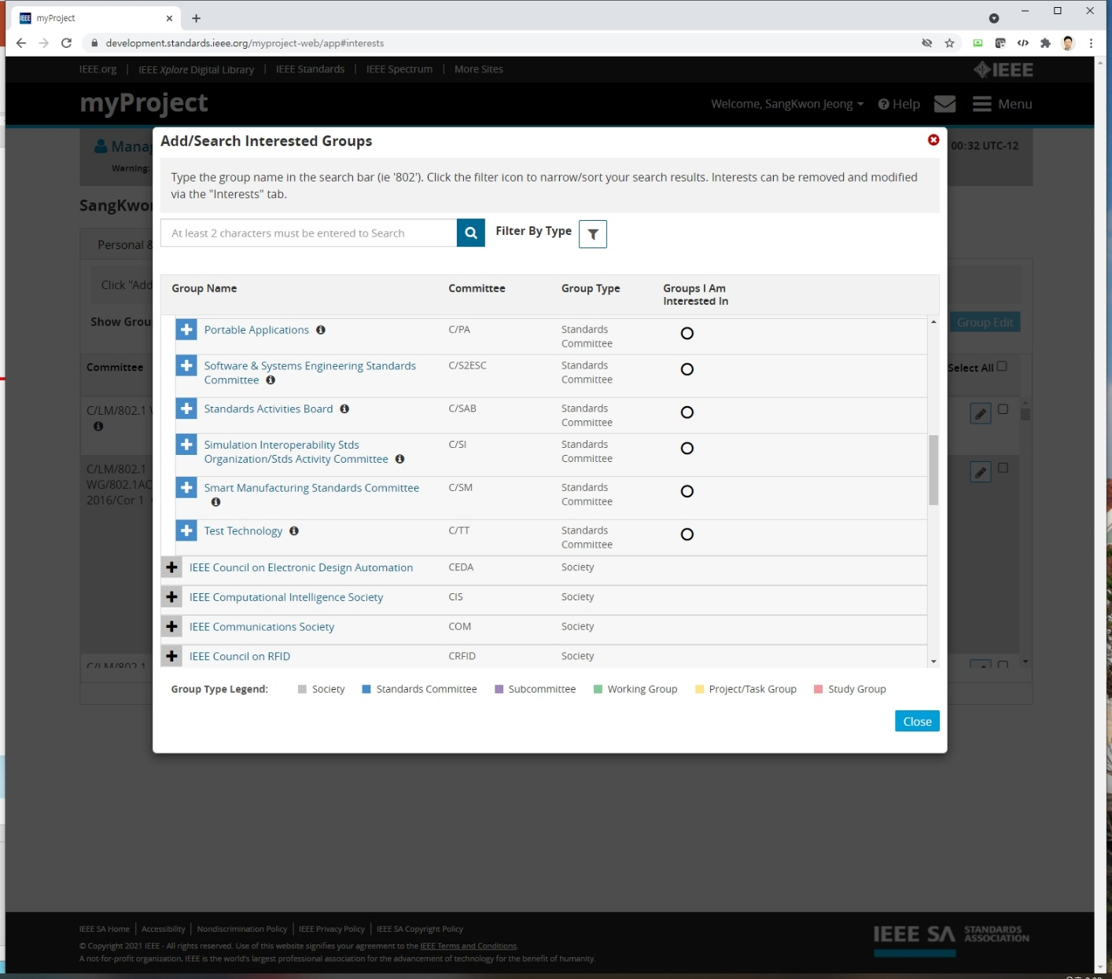
1. Interest Group
Click

Slide 12
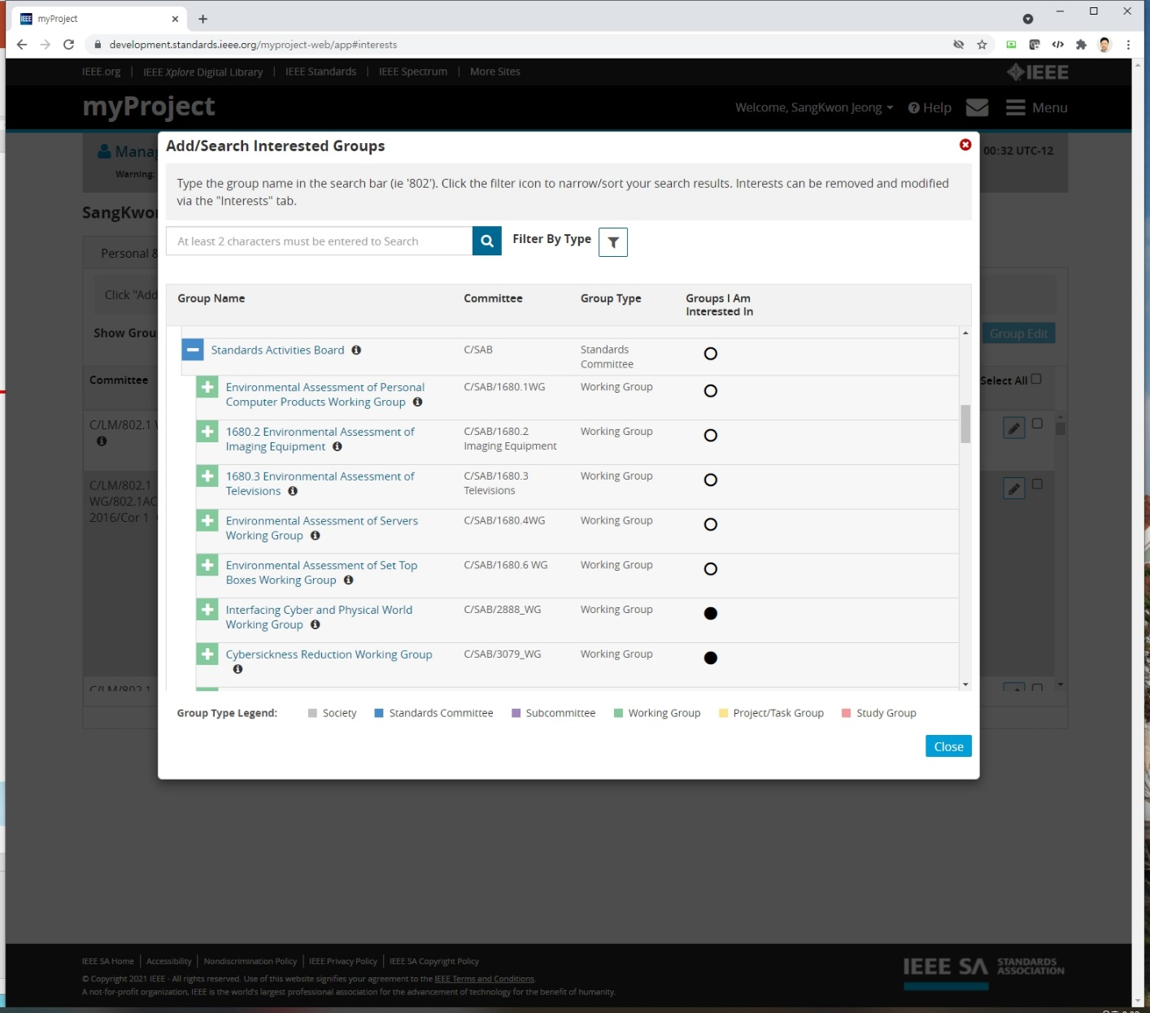
1. Interest Group

Slide 13
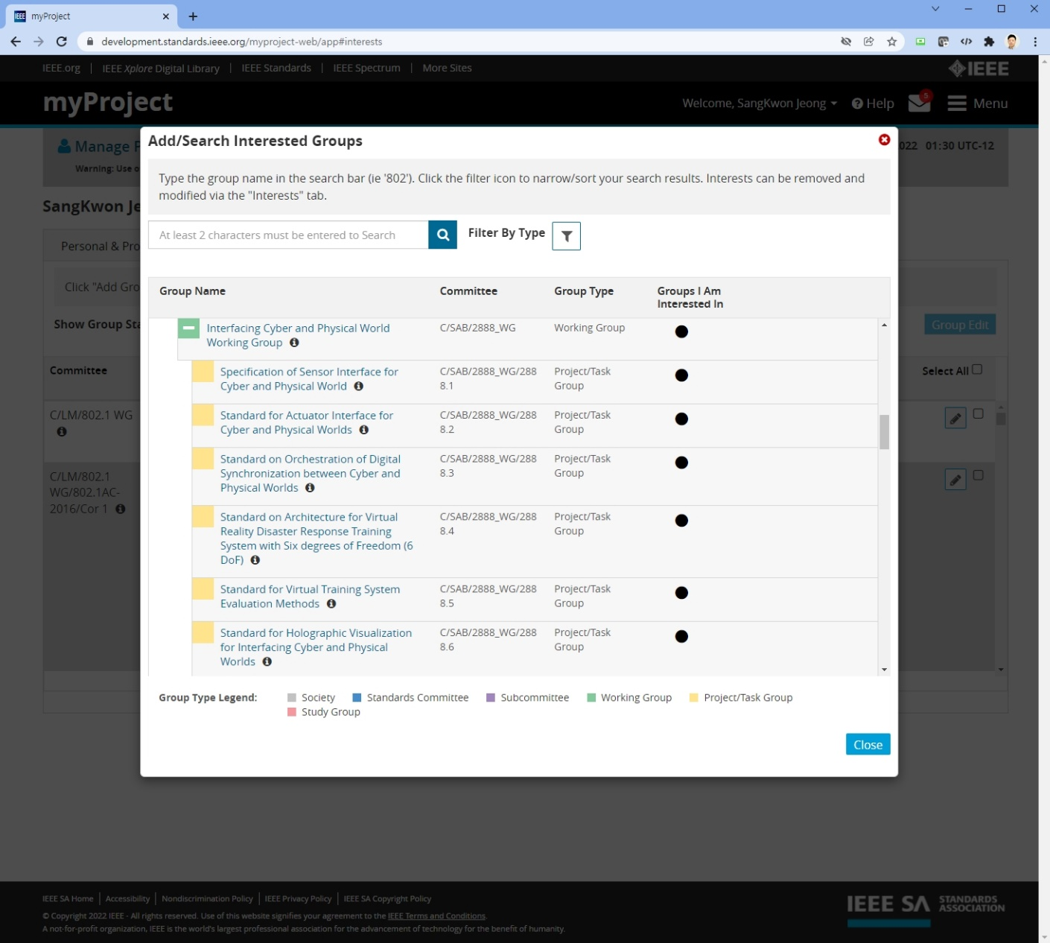
1. Interest Group
Click

Slide 14
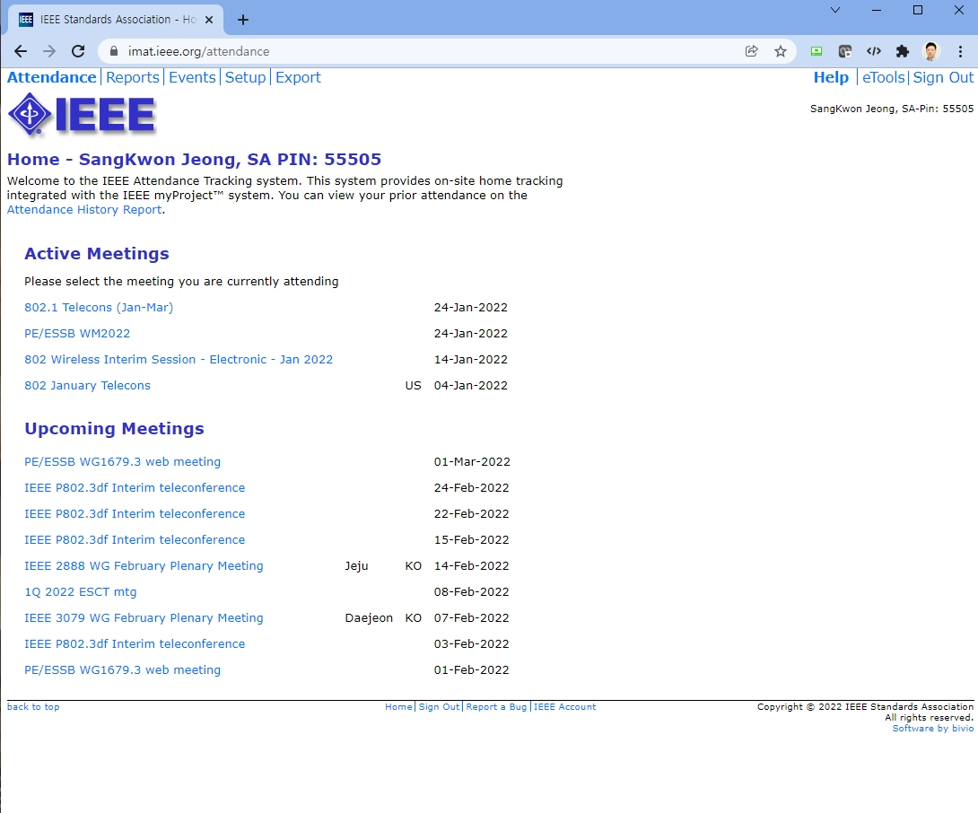
2. Attendance Tool – iMAT
URL: https://imat.ieee.org/attendance

Slide 15
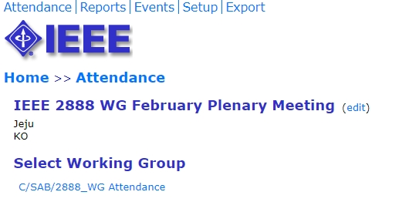
2. Attendance Tool – iMAT

Slide 16
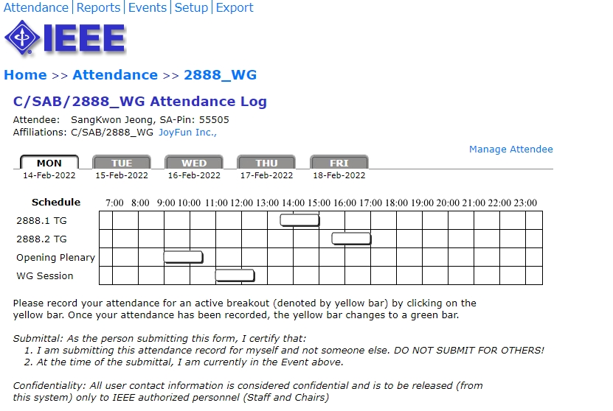
2. Attendance Tool – iMAT
change the yellow to green

Slide 17
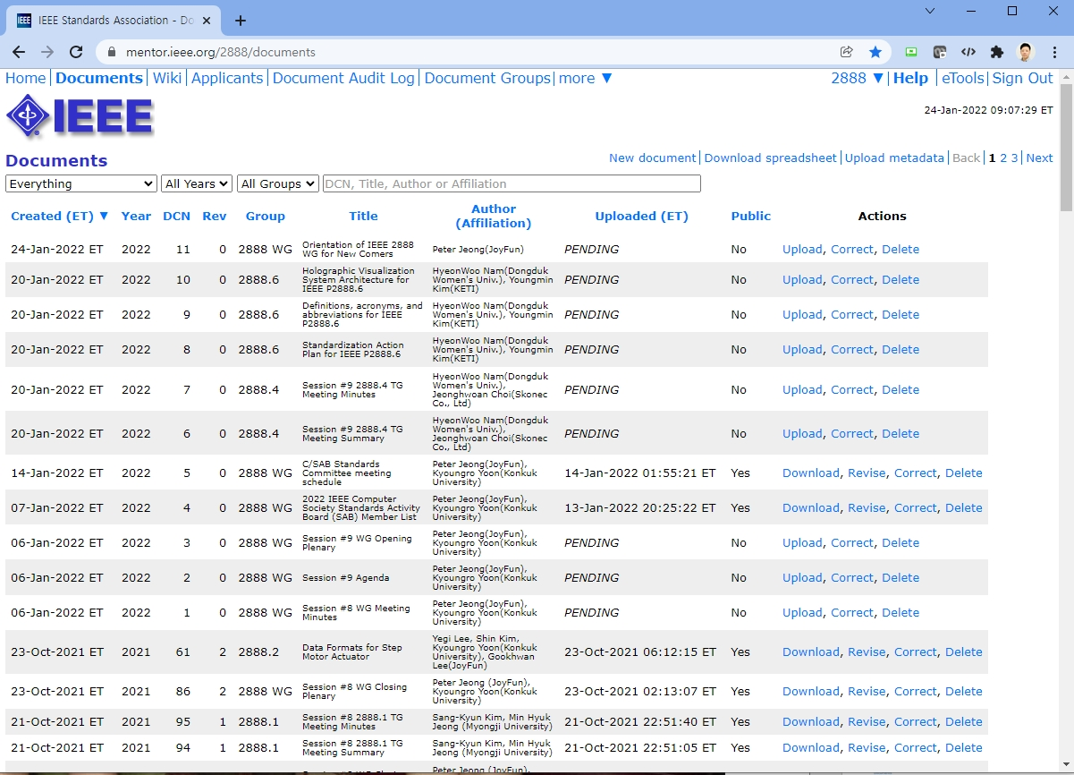
3. Input Contribution
URL: https://mentor.ieee.org/2888/documents
Click

Slide 18
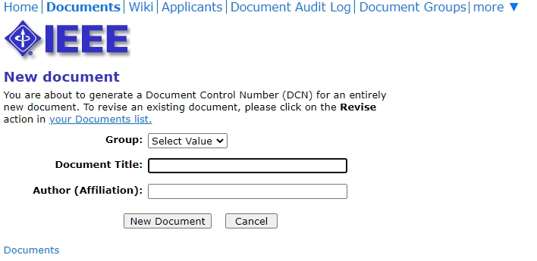
3. Input Contribution
Click

Slide 19
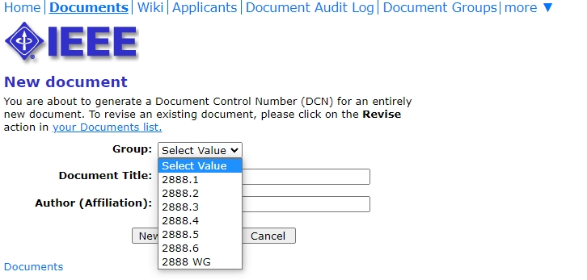
3. Input Contribution
Select One

Slide 20
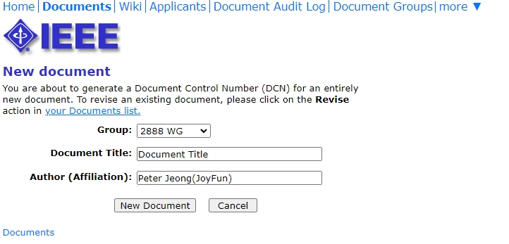
3. Input Contribution
Writing

Slide 21
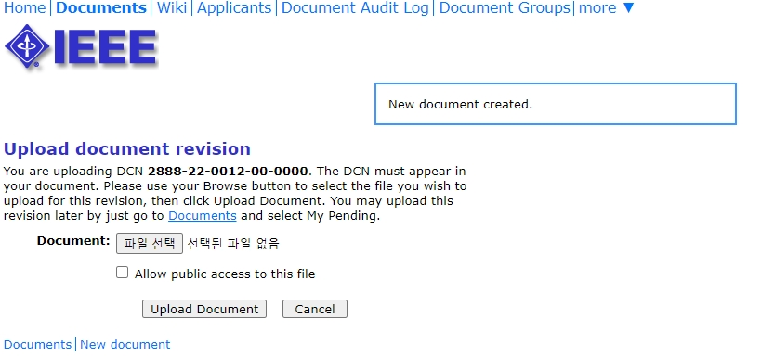
3. Input Contribution
① File Select
② Check
③ Upload

Slide 22
Document Numbering Convention
2888 - 22- XXXX – XX -XXXX
Number of the Project Number
Document Revision Number
Document order Number of the Year
Last 2 digits of Submitted Year
Name of Working Group

Slide 23
Thank You

