Slide 1
IEEE 802 OmniRAN EC SG Results and Outlook
Date: 2013-06-20
Authors:
Name | Affiliation | Phone | Email
Max Riegel | NSN | +49 173 293 8240 | maximilian.riegel@nsn.com
Notice: This document does not represent the agreed view of the OmniRAN EC SG. It represents only the views of the participants listed in the ‘Authors:’ field above. It is offered as a basis for discussion. It is not binding on the contributor, who reserve the right to add, amend or withdraw material contained herein.
Copyright policy: The contributor is familiar with the IEEE-SA Copyright Policy <http://standards.ieee.org/IPR/copyrightpolicy.html>.
Patent policy: The contributor is familiar with the IEEE-SA Patent Policy and Procedures: <http://standards.ieee.org/guides/bylaws/sect6-7.html#6> and <http://standards.ieee.org/guides/opman/sect6.html#6.3>.
Abstract
OmniRAN provides an abstraction of access networks based on IEEE 802 technologies to foster interoperability and integration into common control infrastructures. Networking functions and protocol attributes of the PHY and DL layers belong to IEEE 802.
Based on a few sample use cases gaps were determined in the existing IEEE 802 specifications and procedures.
Addressing the gaps would belong to the existing IEEE 802 WGs, however a common approach would be necessary to make the pieces fitting together.

Slide 2
IEEE 802 OmniRAN EC SG
Results and Outlook
OmniRAN within the scope of IEEE 802, gaps and potential ways forward

Slide 3
ToC
Access network functions within the scope of IEEE 802
Gaps to existing IEEE 802 standards (and procedures)
  Example use cases investigated for gap analysis
  Gap#1: Support for point-to-point links and link status indication in bridged access networks
  Gap#2: Network-ID and service indication in wired Ethernet
  Gap#3: Control interfaces for Software Defined Networking (SDN)
  Gap#4: Specification of IEEE 802 specific attributes for IETF protocols
Conclusion and potential ways forward

Slide 4
OmniRAN WITHIN
The SCOPE of IEEE 802
IEEE 802 OmniRAN Results and Outlook

Slide 5
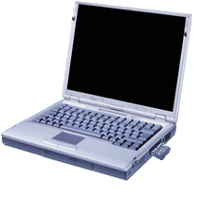
Access Networks enable the dynamic attachment of terminals to networks
Terminal
Access Network
Core
Services
Internet
Communication networks supporting dynamic attachment of terminals are usually structured into
  Access Network
    Distributed infrastructure for aggregation of multiple network access interfaces into a common interface
  Core
    Infrastructure for control and management of network access and end-to-end IP connectivity
  Services
    Infrastructure for providing services over IP connectivity

Slide 6
Functional decomposition of dynamic network access
Access Network
Core
Network advertisement
Pre-association signalling
Authentication, authorization and accounting client
L2 session establishment
  w/ QoS and Policy Enforcement
L2 mobility management inside access networks
Traffic forwarding to core based on L2 addresses
Subscription management
Terminal provisioning
Authentication, authorization and accounting server
IP address management
IP connectivity establishment to Internet and services
Policy & QoS management server (policy decision)
Mobility Anchor
Roaming support to other cores

Slide 7
Access Network Abstraction by OmniRAN
Terminal
Access Network
Core
Service
OmniRAN Architecture
R2
Terminal
Access Network
Core
R1
R3
OmniRAN provides a generic model of an access network based on IEEE 802 technologies
Application
Application
Transport
Transport
Network
Network
Network
Network
Data Link
Data Link
Data Link
Data Link
Scope of IEEE 802
Data Link
Data Link
Data Link
Data Link
Physical
Physical
Physical
Physical
Physical
Physical
Physical
Physical
Medium
Medium
Medium
Medium

Slide 8
Control plane for dynamic attachments of terminals to communication infrastructures
Terminal
Access Network
Core
Service
OmniRAN Architecture
R2
Terminal
Access Network
Core
R1
R3
Control Plane
Scanning
Network Selection
Association
Authentication
Host Configuration
Application
Access networks are dynamically controlled Layer 2 network infrastructures.
IEEE 802 deals with control functions in the PHY and DL layers.

Slide 9
Access Network Control Plane Functions
Access Network
ANQP
AAA
Policy
Configuration
DHCP
Application
Scanning
Network Selection
Association
Authentication
Authorization
Accounting
Host Configuration
Application
Policy Control
Application
Host Config Release
Disassociation
Accounting
Legend:
L2 Protocol
L2 Attributes
L2 Protocol
L3+ Attributes
L3+ Protocol
L2 Attributes
L3+ Protocol
L3+ Attributes

Slide 10
IEEE 802 Control Functions on R2 and R3
Access Network
ANQP
AAA
Policy
Configuration
DHCP
Application
Scanning
Network Selection
?
Association
Authentication
Authorization
Accounting
Host Configuration
Application
Policy Control
Application
Host Config Release
Disassociation
Accounting
IEEE 802 Access Technologies
IEEE 802 OmniRAN

Slide 11

Mapping of OmniRAN Reference Points to IEEE 802 Reference Model
Higher Layers
Higher Layers
Higher Layers Control
Higher Layers Control
R2 R3
R3
Current scope of IEEE 802
Data Link
Data Link
Data Link
Data Link
Data Link
Data Link
Physical
R1
Physical
Physical
Physical
Physical
Physical
Medium
Medium
Medium
Reference Points can be mapped onto the IEEE 802 Reference Model
  R1 represents the PHY and MAC layer functions between terminal and base station
    Completely covered by IEEE 802 specifications
  R2 represents the L2 control protocol functions between terminal and central entities for control and AAA.
  R3 represents the L1 & L2 control interface from a central control entity into the network elements
‘R2’ and ‘R3’ are build upon IEEE 802 specific attributes
  However IP based protocols are used to carry control information between network elements and core
  Effectively each of IEEE 802 network elements contains an IP communication stack on top of the IEEE 802 data path for the exchange of the control information.

Slide 12
Complete set of OmniRAN reference points
Terminal
R2
Access
Core
R1
R3
Internet
R4
R3
Access
Core
R3
Access
Authentication
Authentication
Authorization
Authorization
R5
Accounting
Accounting
Location
Location
CoA
CoA
Mobility
DataPath
Mobility
Access
R3
Core
Encapsulation
Encapsulation
Transport
Internet
Reference Points represent a bundle of functions between peer entities
  Similar to real network interfaces
Protocols may be IP-based, however attributes belong partly to IEEE 802

Slide 13
GAPs in IEEE 802
IEEE 802 OmniRAN Results and Outlook

Slide 14
Example use cases investigated for gap analysis
3GPP Trusted WLAN Access to EPC Use Case
ZigBee SEP2 Smart Grid Use Case
SDN-based OmniRAN Use Cases Summary

Slide 15
3GPP Trusted WLAN Access to EPC
TS 23.402 V11.6.0 (2013-03)
Support for non-seamless WLAN offload (NSWO) or single PDN connection selected by the network without IP address preservation
S2a bearer creation and deletion based on EAP and AAA signaling
Definition of a WLAN Access Network, a Trusted WLAN AAA Proxy (TWAP) and a Trusted WLAN Access Gateway (TWAG) providing the reference points SWw, Sta and S2a for the Trusted Non-3GPP WLAN Access
Reference Model:

Slide 16

3GPP Trusted WLAN Access to EPC
OmniRAN Reference Point mapping
R1 maps directly to the SWw reference point of 3GPP
R2 and R3 would provide specified interfaces for Trusted WLAN AAA Proxy and Trusted WLAN Access Gateway, which are not addressed by 3GPP by definition
3GPP does not provide details for direct Internet access.
Terminal
Access
R2
Core
R1
R3
Internet

Slide 17
3GPP Trusted WLAN Access to EPC
Gaps in IEEE 802 Bridged Networks
Setting up and maintaining a point-to-point link across a bridged infrastructure
  Initializing the point-to-point link under AAA based access control
  Maintaining the point-to-point link when STA roams to another AP
Link state signaling at the edge of the bridged infrastructure
  3GPP expects an trigger for setting up S2a context when link in IEEE 802 is established

Slide 18


ZigBee SEP2 Smart Grid Application
SEP2 Communication Infrastructure
SEP2 defines a Smart Energy Profile Network by which a variety of devices can communicate with the Energy Services Interface
The network consists of
  Local access infrastructure (HAN) with
    Network Access Server
    Network Authentication Server
  Application Trust Center
  Energy Services Interface
  to energy provider
Local access infrastructure can
be based on any technology
enabling IP connectivity to the
Application Trust Center and ESI.
ESI
Application
Trust Server
HAN
Network
Authentication
Server
Network
Access
Server

Slide 19
ZigBee SEP2 Smart Grid Application
OmniRAN Reference Point Mapping
OmniRAN is applicable to the local access infrastructure providing IP connectivity to ESI and Application Trust Server
HAN represents the functions contained in Access and Core function blocks of OmniRAN
R3 allows for easy integration of different link layer technologies with common Network Authentication Server and Network Access Server
R2 provides access authentication for any link technology represented by R1
HAN
Network
Authentication
Server
Application
Trust Server
ESI
Network
Access
Server
Access
R2
R3
Terminal
Access
Core
R1
R3

Slide 20
ZigBee SEP2 Smart Grid Application
Gaps to IEEE 802.3
ZigBee SEP2 requires support for network discovery and selection functions.
IEEE 802.3 explicitly mentioned in the SEP2 specification as technology candidate does not provide network advertisement, network discovery and network selection functions like the IEEE 802 wireless interfaces.

Slide 21
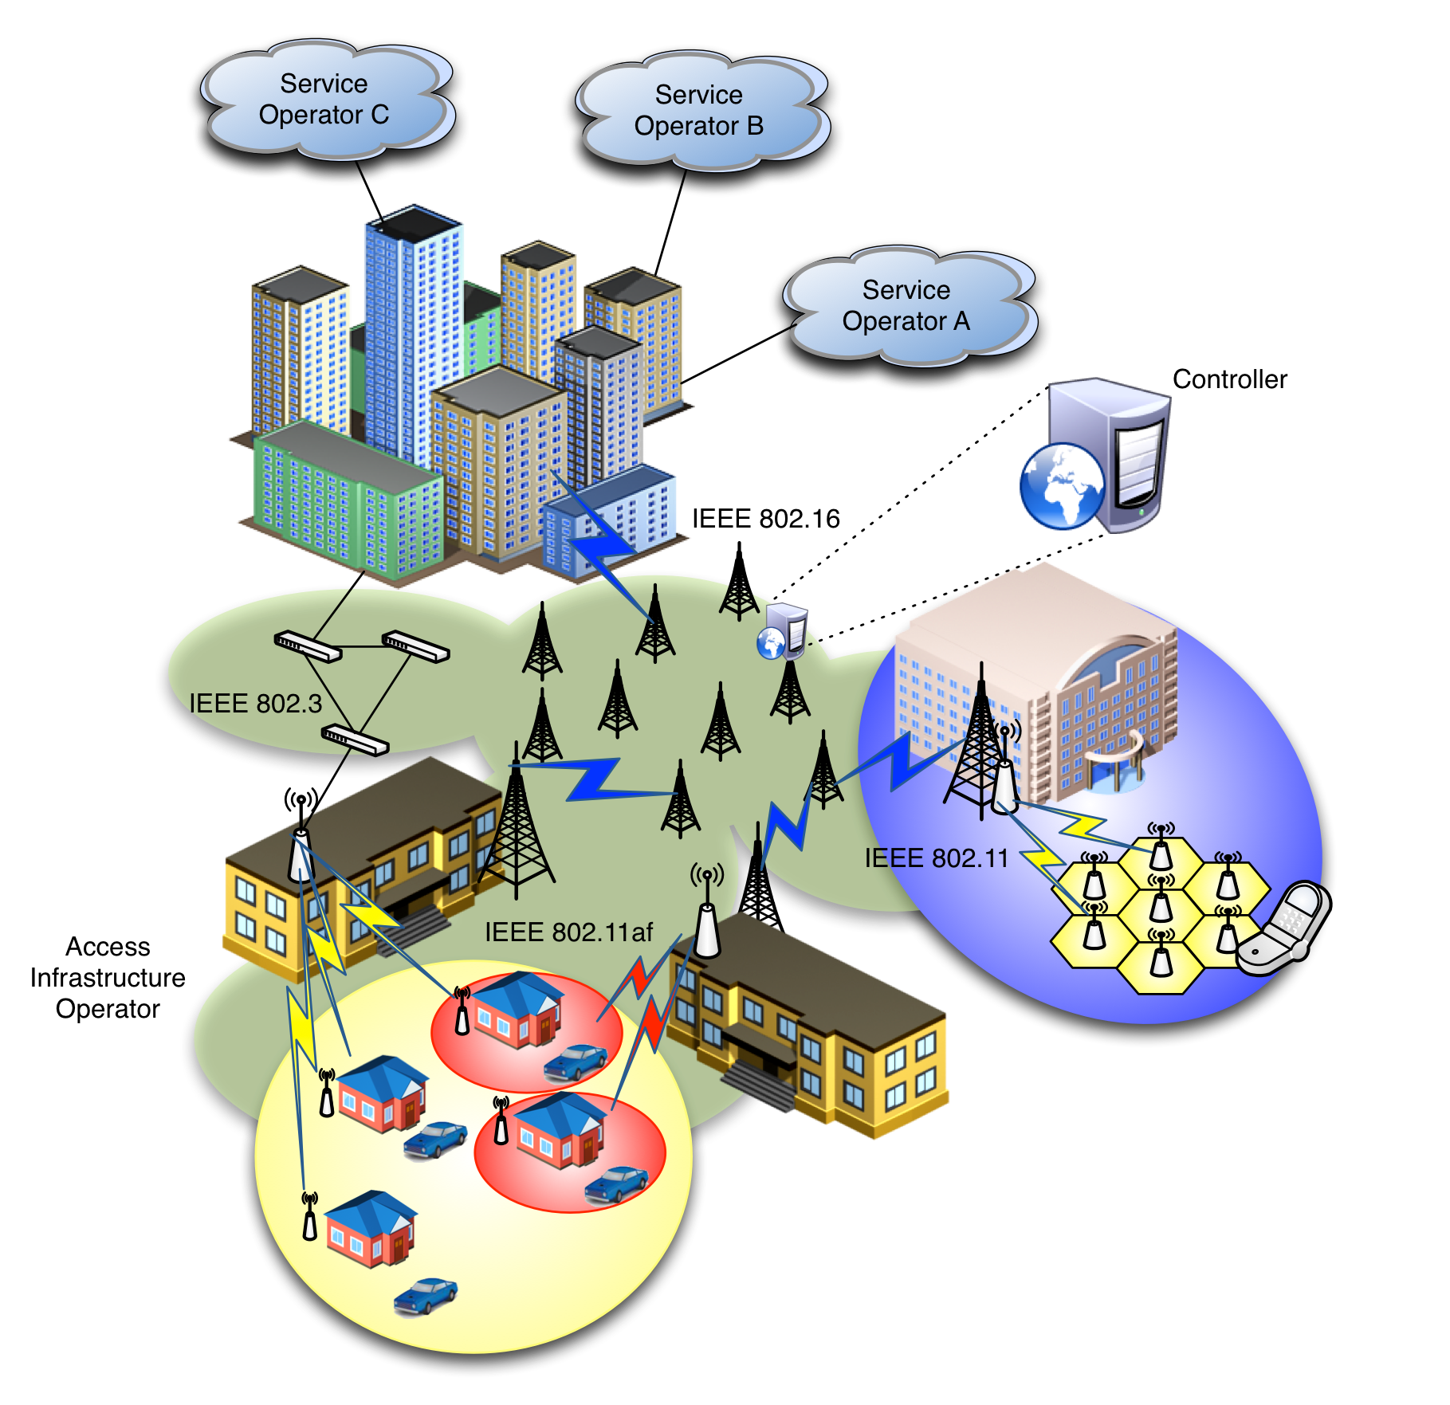
SDN-based OmniRAN Use Cases
Scenario
Centrally controlled configuration, from Core to Terminal, of heterogeneous IEEE 802 links
Dynamic creation of data paths with dynamic reconfiguration and mapping to the terminal at flow granularity
Clean separation of data and control planes

Slide 22

SDN-based OmniRAN Use Cases
Reference Point Mappings
Core
Operator A
Access 1
Access Abstraction
Backhaul
Terminal
Core
Operator B
Access 2
Internet
Access Abstraction
Access Abstraction
Multiple Cores sharing Access Network
Access Abstraction
Data and Control plane separation
Central control
SDN
Controller
Core
Operator C
Access 3
Access Abstraction
Access Network Operator
Core Operators
Data path
Control path

Slide 23
SDN-based OmniRAN Use Cases
Gaps to existing IEEE 802 technologies
Control of data forwarding plane, common to 802 technologies
  Southbound interface enabling the communication between the 802 technologies and the central controller (e.g. access abstraction)
  Clearly defined interfaces, SAPs and behaviors
  Ability to modify data path based on arbitrary but bounded selection parameters
    Packet classification mechanisms based on templates (á la OpenFlow)
    End-to-end packet flow and QoS
Radio configuration mechanism for access and backhaul links
  With defined metrics and reporting
Data plane management of the multiple-interface Terminal
  Notion of 802 logical interface facing L3
Generic 802 access authorization and attachment

Slide 24
Gaps to Handling IEEE 802 Attributes in IP Protocols
Handling of IEEE 802 specific attributes of IP protocols within the activities of IEEE P802:
  IEEE P802 has an established routine for defining the MIBs of IEEE 802 technologies
    Now completely in scope for IEEE 802
  No defined processes for defining other IEEE 802 related attributes in IP protocols
    e.g. AAA attributes are mainly done by IETF with some informal review by IEEE 802 WGs
Specification of IEEE 802 related attributes for IP protocols by IETF has many cumbersome issues.
Dedicated I-D to be submitted on the potential issues.
  Cooperation between IEEE 802 and IETF is currently reviewed and refined in [draft-iab-rfc4441rev-04.txt]
  IEEE 802 has to take care of all its attributes for IP protocols
    like done today for managed objects (MIBs)

Slide 25
Potential Ways forward
IEEE 802 OmniRAN Results and Outlook

Slide 26
Conclusion
OmniRAN provides an abstraction of access networks based on IEEE 802 technologies.
  Defining a common framework for deployment of IEEE 802 technologies for network access for various purposes
  Creating unified control interfaces to enable integration of various IEEE 802 access technologies into a common architecture and control infrastructure
  Supporting new developments for networking like SDN
OmniRAN Specification in the scope of IEEE 802 would consist of
  an normative part defining control attributes and referencing the DL SAP
  an informative part outlining the overall architecture
  an informative part proposing the usage of particular IP protocols and the mapping of the IEEE 802 attributes into the IP protocols.
Gaps in IEEE 802 technologies would have to be addressed by the individual WGs
Common framework necessary to align activities within the individual WGs
There are already a couple of ‘framework’ activities in IEEE 802
  Can OmniRAN be picky backed to one of the existing framework activities?

