Slide 1
IEEE 802 Scope of OmniRAN
Date: 2013-05-02
Authors:
Name | Affiliation | Phone | Email
Max Riegel | NSN | +49 173 293 8240 | maximilian.riegel@nsn.com
Notice: This document does not represent the agreed view of the OmniRAN EC SG. It represents only the views of the participants listed in the ‘Authors:’ field above. It is offered as a basis for discussion. It is not binding on the contributor, who reserve the right to add, amend or withdraw material contained herein.
Copyright policy: The contributor is familiar with the IEEE-SA Copyright Policy <http://standards.ieee.org/IPR/copyrightpolicy.html>.
Patent policy: The contributor is familiar with the IEEE-SA Patent Policy and Procedures: <http://standards.ieee.org/guides/bylaws/sect6-7.html#6> and <http://standards.ieee.org/guides/opman/sect6.html#6.3>.
Abstract
Access networks comprise functions which extend beyond the scope of IEEE 802.
The contribution provides different architectural views on access networks to define the functional pieces of access networks which fall into the scope of IEEE 802.

Slide 2
IEEE 802 Scope of OmniRAN
Architectural models and functional pieces of OmniRAN in the scope of IEEE 802

Slide 3
Motivation
IEEE 802 Scope of OmniRAN

Slide 4
How and where does OmniRAN fit?
(Informative figure IEEE 802-2001)
OmniRAN comprises the functions of access networks based on IEEE 802 technologies
As IEEE 802 access networks consist of the cooperation of multiple instances of IEEE 802 technologies with a single higher layer control and traffic forwarding function, there is no obvious place for OmniRAN in the IEEE 802-2001 informative figure.
  Like for other IEEE 802 standards, e.g. IEEE 802.21, IEEE 802.1X, …

Slide 5
Really helpful to describe and define OmniRAN scope within IEEE 802?
OmniRAN
R2, R3 R4
The amended figure 5 of 802rev-D1.6 puts OmniRAN into a single box of the higher layer end-point stack aside of the data path
  discussed in the Mar ‘13 Orlando session
The figure may not be completely wrong, however it provides not much guidance of functional pieces in scope of OmniRAN and relation to IP based protocols

Slide 6
IEEE 802 Architecture
IEEE 802 Scope of OmniRAN

Slide 7
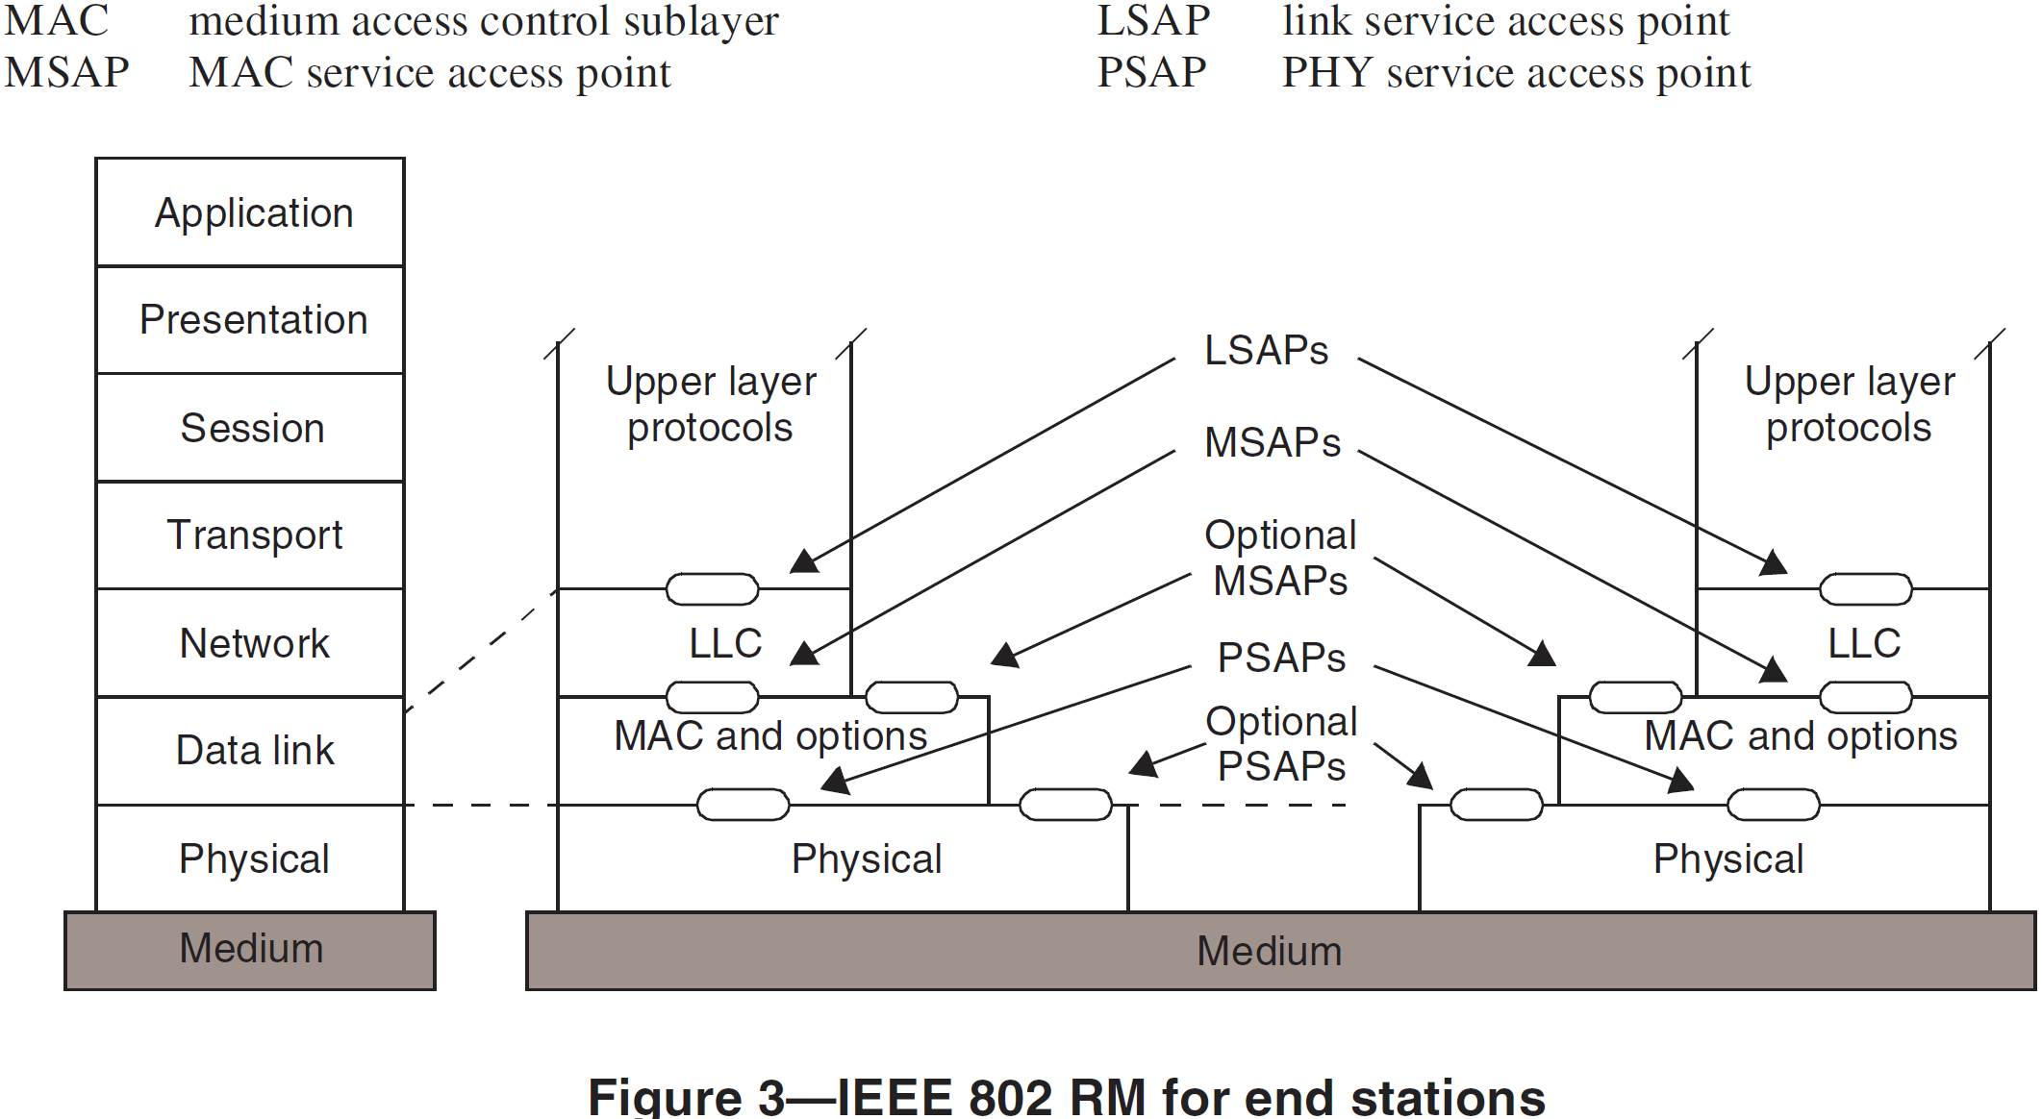
IEEE 802 Reference Model for End-Stations
(802rev-D1.6)
Reference Model within the 7 layer ISO-OSI model
Reference Model exposing specific IEEE 802 functions
IEEE 802 provides link layer connectivity to the overall communication architecture
It covers the Physical and the Data link layer of the ISO-OSI 7 layer model
Data link layer is represented in IEEE 802 by MAC and LLC sub-layers
Functionality above Data link layer is considered as ‘higher layer’.
The IEEE 802 connectivity stack is supplemented by a management plane and a plane representing IEEE 802.21 MIH.
MIH comprises a number of control SAPs into each of the layer of the IEEE 802 reference model
The network management model of IEEE 802 is aligned with the ITU TMN framework and provides the definition of managed objects for each of the layers of the IEEE 802 architecture
IEEE 802 allows for special purpose network management protocols when the usual network management approach with managed objects is not sufficient.

Slide 8
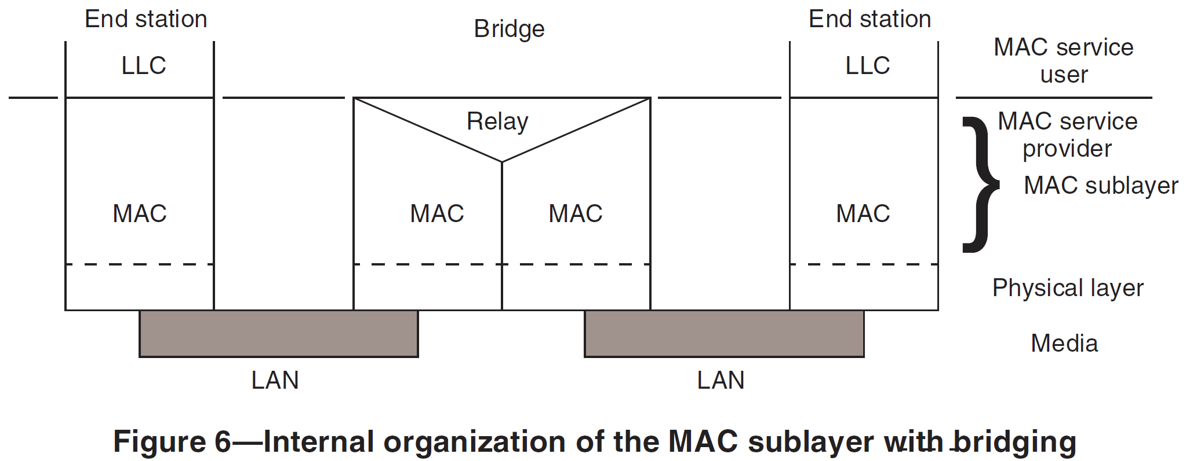
IEEE 802 Reference Model for Bridges
IEEE 802 provides a bridging model for interconnection of multiple network segments based on data link layer functionality
Different bridging protocols can handle the issues of various topologies including avoidance of data loops and establishment of ‘optimized’ filtering and forwarding decisions.
Bridging protocols have been extended to cope with multiple operational domains of an hierarchical provider structure.

Slide 9
Layered ACCESS NETWORK Architecture
IEEE 802 Scope of OmniRAN

Slide 10
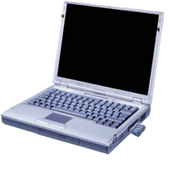
OmniRAN Architecture Partitioning for dynamic attachment of terminals to networks
Terminal
Access Network
Core
Network
Services
Internet
Communication networks supporting dynamic attachment of terminals are usually structured into
  Access Network
    Distributed infrastructure for aggregation of multiple network access interfaces into a common interface
  Core Network
    Infrastructure for control and management of network access and end-to-end IP connectivity
  Services
    Infrastructure for providing services on top of established IP connectivity

Slide 11
Functions for establishment of end-to-end Connectivity
Access Network
Core Network
Network advertisement
IEEE 802.xx PHY and MAC
Authentication, authorization and accounting client
L2 session establishment
  w/ QoS and Policy Enforcement
L2 mobility management inside and across access networks
Mobility Gateway
Traffic forwarding to core based on L2 addresses
Authentication, authorization and accounting server
IP address management
Policy & QoS management based on a SLA
Mobility among multiple access networks
IP connectivity establishment to Internet and services
Roaming via other core networks

Slide 12

Access Network Reference Model
Terminal
Access Network
Core
Network
Applic.
Applic.
Present.
Present.
Session
Session
Transport
Transport
Network
Network
Current scope of IEEE 802
Data Link
Data Link
Data Link
Data Link
Data Link
Data Link
Physical
Physical
Physical
Physical
Physical
Physical
Medium
Medium
Medium

Slide 13
OmniRAN Architecture WITHIN SCOPE of IEEE 802
IEEE 802 Scope of OmniRAN

Slide 14
OmniRAN Architecture and Reference Points
Terminal
R2
Access
Core
R1
R3
Internet
R4
R3
Access
Core
R3
Access
Authentication
Authentication
Authorization
Authorization
R5
Accounting
Accounting
Location
Location
CoA
CoA
Mobility
DataPath
Mobility
Access
R3
Core
Encapsulation
Encapsulation
Transport
Internet
Reference Points represent a bundle of protocols between peer entities
  - Similar to real network interfaces

Slide 15
OmniRAN Reference Points
R1: Access link, technology specific
R2: User & terminal authentication, subscription & terminal management
R3: Authorization, service management, user data connection, mobility support, accounting, location
R4: Inter-access network coordination and cooperation, fast inter-technology handover
R5: Inter-operator roaming control interface
All reference points may comprise a number of different protocols. However, only the protocols related to required functionality have to be present on the reference point.

Slide 16
Mapping of OmniRAN Reference Points to IEEE 802 Reference Model
Higher Layers
Higher Layers
R1
Higher Layers Control
Higher Layers Control
R2/R3 Control
R3 Control
R3 Data
Current scope of IEEE 802
Data Link
Data Link
Data Link
Data Link
Data Link
Data Link
Physical
R1
Physical
Physical
Physical
Physical
Physical
Medium
Medium
Medium
R1, R2, R3 Reference Points can be easily mapped into IEEE 802 Reference Model
  However IP based protocols to carry control information elements are out of scope of IEEE 802
  ‘R3 Data’ may define a special kind of Data Link SAP
  ‘R2’ and ‘R3 Control’ may comprise only definitions of attributes

Slide 17
Conclusion
IEEE 802 Scope of OmniRAN

Slide 18
Conclusion
OmniRAN Reference Points can be mapped into the IEEE 802 Reference Model
  R1 is completely covered by IEEE 802 specifications
  R2 and R3 are related to attributes for control of IEEE 802 functions and the definition of a DL SAP for the transport of user payload
  R4 is not considered by this contribution
    IEEE 802.21 may provide the solution for this OmniRAN reference point?
  R5 may be completely out of scope of IEEE 802
    However attributes of R3 may be copied over to R5
IP protocols used for OmniRAN are out of scope of IEEE 802
OmniRAN Specification in the scope of IEEE 802 would consist of
  an normative part defining control attributes and a DL SAP for the user payload
  an informative part outlining the overall architecture
  an informative part proposing the usage of particular IP protocols and the mapping of the IEEE 802 attributes into the IP protocols.
BTW: Approach looks quite similar to proposals on SDN

