Slide 1
802.24 Vertical Applications TAG
March 2018 Meeting
Rosemont, Illinois, USA

Slide 2
802.24 Overview
Officers
TAG Chair: Tim Godfrey
Secretary & TAG Vice Chair: Ben Rolfe
Task Groups
802.24.1 Smart Grid TG Tim Godfrey
802.24.2 IoT TG Chris DiMinico
28 Voting Members
Agenda: 24-18-0001-01-0000
Meetings for the Week
Tuesday PM2 24.1
Wednesday PM2 24.1
Manual attendance tracking for 802.1 & 802.3 members

Slide 3
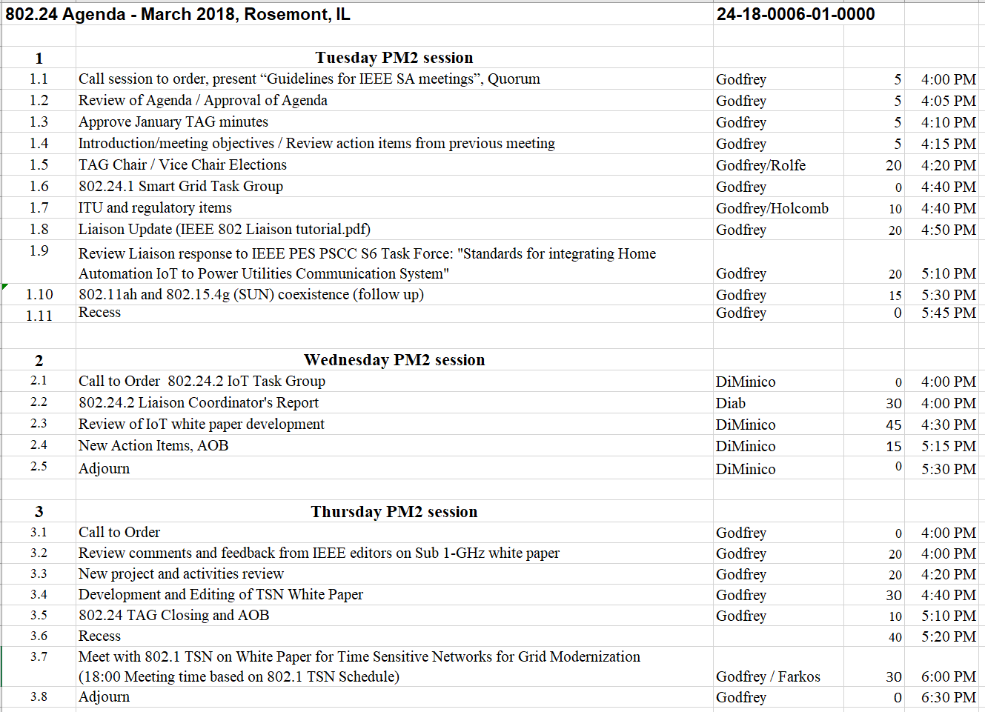
Agenda – 802.24-18-006r1

Slide 4
Guidelines for IEEE-SA Meetings
All IEEE-SA standards meetings shall be conducted in compliance with all applicable laws, including antitrust and competition laws.
Don’t discuss the interpretation, validity, or essentiality of patents/patent claims.
Don’t discuss specific license rates, terms, or conditions.
Relative costs, including licensing costs of essential patent claims, of different technical approaches may be discussed in standards development meetings.
Technical considerations remain primary focus
Don’t discuss or engage in the fixing of product prices, allocation of customers, or division of sales markets.
Don’t discuss the status or substance of ongoing or threatened litigation.
Don’t be silent if inappropriate topics are discussed… do formally object.
---------------------------------------------------------------
If you have questions, contact the IEEE-SA Standards Board Patent Committee Administrator at patcom@ieee.org or visit http://standards.ieee.org/about/sasb/patcom/index.html
See IEEE-SA Standards Board Operations Manual, clause 5.3.10 and “Promoting Competition and Innovation: What You Need to Know about the IEEE Standards Association's Antitrust and Competition Policy” for more details.
This slide set is available at https://development.standards.ieee.org/myproject/Public/mytools/mob/preparslides.ppt
IEEE 802 Executive Committee

Slide 5
Participation in IEEE 802 Meetings
Participation in any IEEE 802 meeting (Sponsor, Sponsor subgroup, Working Group, Working Group subgroup, etc.) is on an individual basis
• Participants in the IEEE standards development individual process shall act based on their qualifications and experience. (https://standards.ieee.org/develop/policies/bylaws/sb_bylaws.pdf section 5.2.1)
• IEEE 802 Working Group membership is by individual; “Working Group members shall participate in the consensus process in a manner consistent with their professional expert opinion as individuals, and not as organizational representatives”. (subclause 4.2.1 “Establishment”, of the IEEE 802 LMSC Working Group Policies and Procedures)
• Participants have an obligation to act and vote as an individual and not under the direction of any other individual or group. A Participant’s obligation to act and vote as an individual applies in all cases, regardless of any external commitments, agreements, contracts, or orders.
• Participants shall not direct the actions or votes of any other member of an IEEE 802 Working Group or retaliate against any other member for their actions or votes within IEEE 802 Working Group meetings, see https://standards.ieee.org/develop/policies/bylaws/sb_bylaws.pdf section 5.2.1.3 and the IEEE 802 LMSC Working Group Policies and Procedures, subclause 3.4.1 “Chair”, list item x.
By participating in IEEE 802 meetings, you accept these requirements. If you do not agree to these policies then you shall not participate.
(Latest revision of IEEE 802 LMSC Working Group Policies and Procedures: http://www.ieee802.org/devdocs.shtml )
Slide 5
IEEE 802 Executive Committee
Notes:
doc.: ec-16-0149-00-00EC
November 2016
Dorothy Stanley, HP Enterprise
Page 5

Slide 6
Administration
Attendance take on IMAT
Reciprocal rights for most WGs
Web page
http://www.ieee802.org/24
Mailing list
stds-802-24@listserv.ieee.org
802-24-voters@listserv.ieee.org (voters list)
Document archive
http://mentor.ieee.org/802.24/documents
IEEE 802 announcement reflector, stds-802-all@listserv.ieee.org
Send email to listserv@listserv.ieee.org with no subject and with the
following 2 lines appearing first in the body of the message
Subscribe stds-802-all
end

Slide 7
Monday: 802.24 TAG
Approve January minutes
24-18-0004r0
TAG Action Items from January:

Slide 8
802.24 TAG: Election of Officers
Procedure in 802.24 Operations Manual document 24-14-0007-00-0000
Announced Candidates
Tim Godfrey (Chair)
Ben Rolfe (Vice Chair)
Election of Chair
Vote: / /
Election of Vice Chair
Vote: / /

Slide 9
Coordination with Industry Connections:
Regularly examine (or liaison with) IC Committee to determine if we want to be involved with any existing IC activities.
Plan of action: Check in by email regularly (before plenary meetings) on status with the IC Committee
Ongoing Activity: IEEE 802 Network Enhancements Industry Connections Activity
Tuesday 7:30pm
New IC Activity at this meeting:
None known

Slide 10
Tuesday 802.24.1
Smart Grid TG

Slide 11
ITU and Radio Regulatory Items
For discussion

Slide 12
Liaison Update Request
Request from Jodi Haasz at IEEE to update active liaison relationships
Review document “IEEE 802 Liaison tutorial.pdf”

Slide 13
IEEE PSCC TF S6
January 2018 Study Report – "Standards for integrating Home Automation IoT to Power Utilities Communication Systems“
TAG comments from January meeting are posted
“IEEE 802.24 Jan 2018 Liaison Comments to PSCC-S6-Liaison.doc”
In 802.24 private area
Further review and edits today
Forward our final comments back to PSCC S6 following this session

Slide 14
802.15.4g and 802.11ah Coexistence
Review Current Status and any follow up

Slide 15
Wednesday 802.24.2 IoT TG

Slide 16
Tuesday: 802.24.2
802.24.2 Liaison Coordinator's Report
Wael Diab
IIC Liaison Report
Any new liaison requests
Request to explore liaison with Wi-Fi Alliance IoT Group.
802.24 will initiate the liaison request
Action Wael – draft a formal liaison statement with areas of collaboration and exchange.
Suggested: IoT Market Segment Task Group
Challenges – information exchange will need to be cleared of default confidentiality of WFA documents.

Slide 17
Liaison Update Request
Request from Jodi Haasz at IEEE to update active liaison relationships
Review document “IEEE 802 Liaison tutorial.pdf”

Slide 18
802.24.2
P2413 Liaison Report and Draft Review
Ludwig Winkel
Relationship to 24.2 IoT White Paper
Can be use to explain to the 802 community how 802 fits into the overall IoT architecture

Slide 19
802.24.2
Review and plan IoT white paper development
Chris DiMinico
Discussion on IoT White Paper Draft
Contributions towards IoT White Paper
Wi-Fi Alliance IoT Use Case Document Review

Slide 20
Thursday 802.24.1 Smart Grid TG

Slide 21
Sub 1 GHz White Paper
Comments and Questions from IEEE Editors prior to publication
Review “802.24 TAG white paper_edits.docx”
Questions from Catherine Berger

Slide 22
Future Opportunities Tracking
At plenary meetings – review upcoming needs and opportunities for 802.24 projects.

Slide 23
Future Opportunities Tracking (.1)
Are there any new utility industry activities or organizations that could benefit from a liaison to 802.24?

Slide 24
Future Opportunities Tracking (.2)
802.24 white paper on IoT and P2413?
Maybe more towards completion of P2413? What is the level of maturity?
Agnostic to underlying communications, but applicable to all 802 standards.
Highlight the relationship between P2413 and 802 standards.

Slide 25
Future Opportunities Tracking
802.15.12 ULI
Incorporating features from 802.15.9 RP which are currently used in utility networking into ULI standard
Some other areas of potential interest
ULI is still in early phase – when is the right time?
Develop use cases and examples of an integrated multi-802 network including 802.15
802.15.4s SMR – spectrum management resources
Can 802.24 provide an input with respect to Smart Grid or IoT?
IEC 65C WG 17 dealing with coexistence management and spectrum policy
ETSI TCRRS reconfigurable radio systems
ETSI TCERM WG 41 – defining a central coordination point to handle spectrum.
Sharing and increasing coexistence and providing better QoS
Notes for topics:
May be useful for dynamic radio management identified by utilities as import for future network deployments
4s resource management is defined, but not how they are used
White paper could cover how adaptation and resource management are accomplished.
Including use of metrics for management. Cross-standard application of metrics
Dynamic adaptability of 802.15.4 networks in the same spectrum as other 802 standards
Compare and contrast with link adaptation in other 802 standards

Slide 26
Other Future Opportunities
LPWAN
Amendment to 802.15.4, utilizing pieces for LPWAN
An 802-based alternative to proprietary LPWAN’s
See where IG-DEP goes.
Many use cases presented already covered by 802 standards
Potential application in utility networks for extremely hard to reach endpoints
Extremely low power use cases may be of interest to utility applications
Participation required to steer to useful work
Applying new bands and channel plans
802.15.4u and 802.15.4v completed. Add bands in various regions for existing 802.15.4 PHYs commonly used in smart grid.
802.15 FANE: OFDM –
Amendment for 802.15.4: Filling the blanks in the OFDM PHY.
802.15 SECN: Security
Action:
Late 2018: Plan update of first white paper to address latest amendments of 802.15.4

Slide 27
TSN Utility Use Cases
Further editing of first section describing utility use cases

Slide 28
Continue developing white paper
Condensing Text
Merge content related to time synchronization
Other text contributions from 802.1 TSN?
Review IETF DetNet use cases – incorporate others as appropriate

Slide 29
802.24 TAG closing
Action Items from this meeting
Plan TSN teleconference before July Plenary
Any New Business?
None

Slide 30
Joint Meeting with 802.1 TSN
Thursday, March 8, 18:00

