Slide 1
802.24 Vertical Applications TAG
Sept 2017 Meeting
Kona, Hi, USA

Slide 2
802.24 Overview
Officers
TAG Chair: Tim Godfrey
Secretary & TAG Vice Chair: Ben Rolfe
Task Groups
802.24.1 Smart Grid TG Tim Godfrey
802.24.2 IoT TG Chris DiMinico
36 Voting Members
Agenda: 24-17-0022-01-0000
Meetings for the Week
Monday PM2 24.1 Kona 3
Tuesday PM2 24.2 Kona 3

Slide 3
Agenda – 802.24-17-0022r0
802.24 Agenda - September 2017, Kona, Hi, USA |  | 24-17-0022-01-0000
1 | Monday PM2 session
1.1 | Call session to order, present “Guidelines for IEEE SA meetings”, Quorum | Rolfe | 5 | 4:00 PM
1.2 | Review of Agenda / Approval of Agenda | Rolfe | 5 | 4:05 PM
1.3 | Approve July TAG minutes 24-17-0018-00-0000 | Rolfe | 5 | 4:10 PM
1.4 | Introduction/meeting objectives / Review action items from previous meeting | Rolfe | 5 | 4:15 PM
1.5 | ITU and regulatory items | Rolfe/Lynch/Kennedy | 10 | 4:20 PM
1.6 | IEEE Smart Grid Advisory Group | Rolfe | 10 | 4:30 PM
1.7 | Review of contribution from Norm Finn | Rolfe | 30 | 4:40 PM
1.10 | Other business | Rolfe | 20 | 5:10 PM
1.11 | Recess | Rolfe | 0 | 5:30 PM
2 | Tuesday PM2 session
2.1 | Call to Order | Rolfe | 0 | 4:00 PM
2.2 | Liason Reports | Various | 30 | 4:00 PM
2.3 | Review Status of current whitepaper development | Rolfe | 15 | 4:30 PM
2.4 | New work product proposals | Rolfe | 30 | 4:45 PM
2.5 | Adjourn | Rolfe | 0 | 5:15 PM

Slide 4
Guidelines for IEEE-SA Meetings
All IEEE-SA standards meetings shall be conducted in compliance with all applicable laws, including antitrust and competition laws.
Don’t discuss the interpretation, validity, or essentiality of patents/patent claims.
Don’t discuss specific license rates, terms, or conditions.
Relative costs, including licensing costs of essential patent claims, of different technical approaches may be discussed in standards development meetings.
Technical considerations remain primary focus
Don’t discuss or engage in the fixing of product prices, allocation of customers, or division of sales markets.
Don’t discuss the status or substance of ongoing or threatened litigation.
Don’t be silent if inappropriate topics are discussed… do formally object.
---------------------------------------------------------------
If you have questions, contact the IEEE-SA Standards Board Patent Committee Administrator at patcom@ieee.org or visit http://standards.ieee.org/about/sasb/patcom/index.html
See IEEE-SA Standards Board Operations Manual, clause 5.3.10 and “Promoting Competition and Innovation: What You Need to Know about the IEEE Standards Association's Antitrust and Competition Policy” for more details.
This slide set is available at https://development.standards.ieee.org/myproject/Public/mytools/mob/preparslides.ppt

Slide 5
Moment of Silence
The chair presents the Guidelines for IEEE-SA Meetings
An opportunity is provided for attendees to respond.
No questions nor objections heard

Slide 6
Administration
Attendance take on IMAT
Reciprocal rights for most WGs
Web page
http://www.ieee802.org/24
Mailing list
stds-802-24@listserv.ieee.org
802-24-voters@listserv.ieee.org (voters list)
Document archive
http://mentor.ieee.org/802.24/documents
IEEE 802 announcement reflector, stds-802-all@listserv.ieee.org
Send email to listserv@listserv.ieee.org with no subject and with the
following 2 lines appearing first in the body of the message
Subscribe stds-802-all
end

Slide 7
Monday
1.1 | Call session to order, present “Guidelines for IEEE SA meetings”, Quorum
1.2 | Review of Agenda / Approval of Agenda
1.3 | Approve July TAG minutes 24-17-0018-00-0000
1.4 | Introduction/meeting objectives / Review action items from previous meeting
1.5 | ITU and regulatory items
1.6 | IEEE Smart Grid Advisory Group
1.7 | Review of contribution from Norm Finn
1.10 | Other business
1.11 | Recess

Slide 8
TAG Business
Approve Agenda
24-17-0022-01-0000
Moved by: Beecher; Second: Shah
Approved by unanimous consent
Approve July minutes
24-17-0018-00-0000
Moved by: Beecher; Second: Shah
Approved by unanimous consent

Slide 9
Regulatory Update
Presentation by Rich Kennedy on FCC NOI 17-104.
FCC stated goal is to promote flexible use of spectrum
Part of subject bands may be in use by utilities for smart grid applications now
802.11 advocates opening mid-band for general use by WiFi
802.15 notes there are RFID systems based on 802.15.4 using the mid band
Goal of 18 is to represent entire 802 view
Input requested: participate in 802.18 to shape 802 response
https://mentor.ieee.org/802.18/dcn/17/18-17-0118-00-0000-fcc-17-104-mid-band-spectrum-noi.pdf

Slide 10
TSN Whitepaper
Discussion of input from 802.1/Norm Finn
Action:
Clint to use input from Norm Finn to produce a “condensed” contribution for the whitepaper

Slide 11
Recess
Recessed at 16:53 Local Time

Slide 12
Tuesday 802.24.1
2 | Tuesday PM2 session
2.1 | Call to Order
2.2 | Liason Reports
2.3 | Review Status of current whitepaper development
2.4 | New work product proposals
2.5 | Adjourn

Slide 13
Liaison Reports
SEPA/SGIP – Matt Gillmore
PAP2 briefly “re-opened” to narrow band LTE
No other news

Slide 14
Review Status of current whitepaper development
PAP2 Wireless Matrix
No new input
TSN Whitepaper
See prior slide for action item

Slide 15
New work product proposals
From Berlin: Identified ongoing work in 802 to watch, status updates
802.15.12 ULI
802.15.4s SMR
802.22.3
802.15 IG DEP
LPWAN IG in 802.15
New bands and channel plans

Slide 16
Status of “watch” list
802.15.12 ULI
Incorporating features from 802.15.9 RP which are currently used in utility networking into ULI standard
Some other areas of potential interest
Still in proposal phase
802.15.4s SMR
Currently in sponsor ballot
May be useful for dynamic radio management identified by utilities as import for future network deployments
802.22.3 802.22 not meeting in Sept
802.15 IG DEP not meeting in Sept

Slide 17
Status of “watch” list
LPWAN IG in 802.15
Many use cases presented already covered by 802 standards
Potential application in utility networks for extremely hard to reach endpoints
Extremely low power use cases may be of interest to utility applications
Participation required to steer to useful work
New bands and channel plans
802.15.4u and 802.15.4v completed. Add bands in various regions for existing 802.15.4 PHYs commonly used in smart grid.

Slide 18
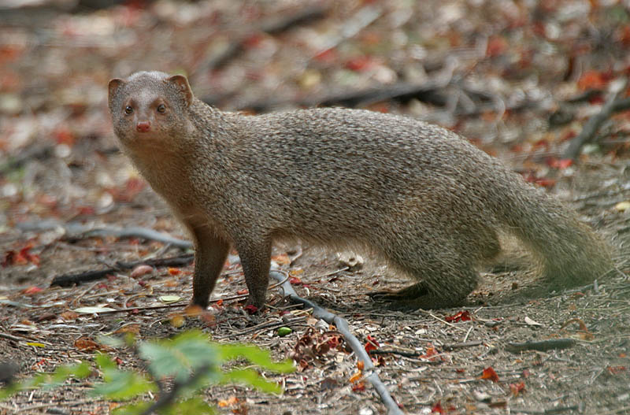
Adjourn
Motion to Adjourn
Moved by: Sturek Second: Shah
Adjourned at 16:26 Local Time

