Slide 1
802.24.1 Smart Grid TAG
Consolidated White Paper Presentation
Date: 2014-11-04
Authors:

Slide 2
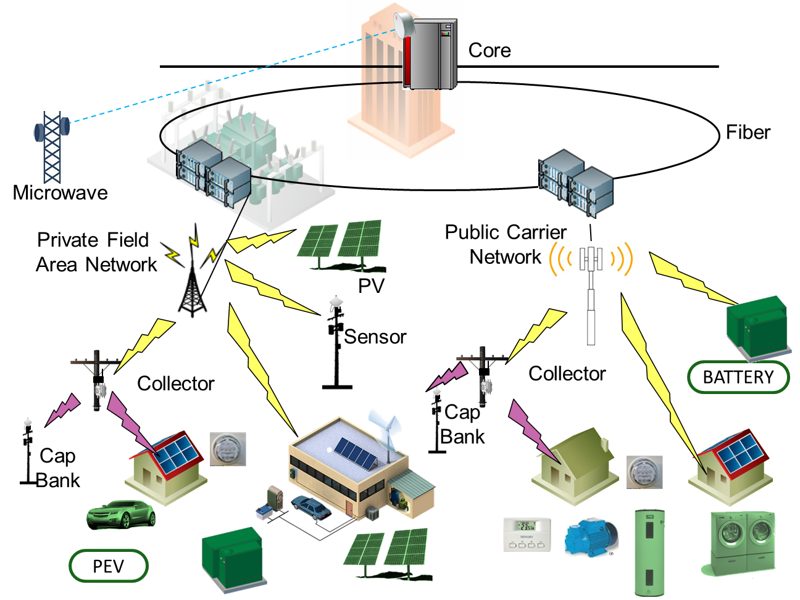
Key Standards for Integrated Grid Communications Networks
LAN
IEEE 802.3 Ethernet
IEEE 802.11 Wi-Fi
WAN
Ethernet 1000BASE-X
IEEE 802.16 WiMAX
IEEE 802.11 Mesh
FAN
RF Mesh: 802.15.4g WiSUN
IEEE 802.11ah
NAN
IEEE 802.11 Wi-Fi
IEEE 802.15.4 ZigBee
Devices

Slide 3
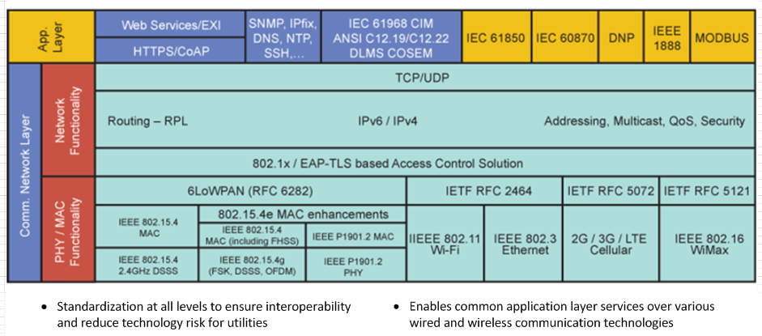
Examples of utility communications protocols
Re-Do and correct- make a slide like this

Slide 5
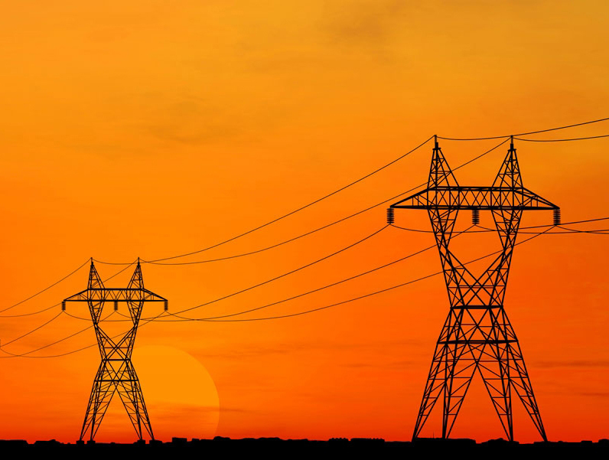

IEEE-SA Smart Grid

Slide 6
The Smart Grid = Electric Grid + Intelligence
Concern over the environment (CO2 emissions), scarcity of resources (fossil fuels), safety (nuclear plants) are precipitating a universal move to re-examine the Electric Gird.
The Smart Grid is defined as a radical evolution of the energy supply and consumption infrastructure that will provide providers and consumers with unprecedented levels of reliability and control while reducing the adverse environmental impact of energy generation and consumption.
A smart grid delivers electricity from suppliers to consumers using two-way digital technology to control appliances at consumers' homes to save energy, reduce cost and increase reliability and transparency.
Smart meters are part of a smart grid, but alone do not constitute a smart grid.
Notes:
Clarify the meaning of “intelligence” with a new bullet

Slide 7
Smart Grid
Smart Grid is defined as:
  Providing bidirectional communication of power quality, supply, and demand across the power grid to utilize electricity more dynamically resulting in increased energy efficiency and power grid reliability. This change is necessary to manage the increased variability caused by renewable resources, the increased peak demand created by energy intensive consumers such as electric vehicles, and to minimize the environmental impact of ever increasing aggregate demand for electrical power.
IEEE 802 networking technologies bring the following advantages to Smart Grid communications:
  Enterprise grade security compatibility
  Huge ecosystem (billions of products, hundreds of manufacturers)
  Long-term (20 year), battery-powered operation
  Continued operation during line fault events when using wireless media
  Wide choice of products across the spectrum of power versus performance
  Ability to be implemented in resource-constrained devices
  Ongoing development of standards to address changing environment and technology
  Wireless standards that operate in a licensed and license-exempt spectrum
  Offers a rich set of data rate/range/latency tradeoffs
  Common upper layer interface to seamlessly integrate into existing IT systems

Slide 8

SG Network Architecture
High level example of an AMI system
Detailed View:

Slide 9
Layering of M2M technology
Application Layer
Common Service Layer
Underlying Network Layer
IEEE 802 standards provide underlying networks with enhanced coverage and accessibility, quality of service, security (such as authentication and encryption), and reliability (high availability of network infrastructure).

Slide 10
Something on cyber security and IEEE 802

Slide 11
Example applications that take advantage of low power operation, (water, oil/gas, line sensors)
Example of “constrained” types of devices

Slide 12
Comparison with PLC – advantage of operation even if power line is damaged

Slide 13
Graphic / example of a mesh network

Slide 14
Examples of how higher layer protocols such as IEC 61850, 61968, DLMS/COSEM, can operate over IEEE 802 and take advantage of its features.

Slide 15
IEEE 802.11 standards hierarchy
IEEE
802.3
802.11
802.15
802.16
802.21
802.22
802.11a through 802.11z: Completed
Completed
Active: More Grid relevant
11ac
Higher rate in 5GHz band
11ad
Higher rate in 60GHz band
Active: Less Grid relevant
11ae
Prioritization of management frames
11af
TV White Space
11ah
915MHz Band operation (sub 1GHz)
11ai
Fast Initial Association
11aj
China Millimeter Wave Task Group
11ak
General Link (full bridging over WLAN) joint with 802.1
11aq
Pre-Association Discovery Task Group
11ax
High Efficiency WLAN (HEW)

Slide 16
802.11 – Spectrum / Rate view
.11ad
500MHz
1GHz
2GHz
5GHz
10GHz
60GHz
802.11ac
500Mbps
802.11n
802.11n
100Mbps
.11af
.11ah
802.11g
.11y
.11j
802.11a
.11p
10Mbps
802.11
802.11b
1Mbps

Slide 17
IEEE 802.15 standards hierarchy
IEEE
802.3
802.11
802.15
802.16
802.21
802.22
802.15.4
ZigBee
Completed
4e
Smart Utility Networks (WiSUN) AMI
4g
Active – More Grid relevant
4k
LECIM
Active – Less Grid relevant
4m
AMI for TV White Space
4n
4q
4r
Layer 2 Routing Task Group
Key Management
Protocol Task Group
802.15.9
802.15.10

Slide 18
802.15.4 PHY Overview (data rate vs frequency)
10Kbps
100Kbps
1Mbps
5GHz
O-QPSK
CSS
CSS
2GHz
4g 2FSK
4g 2FSK
4g 4FSK
4g O-QPSK
4g ODFM
4g 2FSK
4g 2FSK
4g 4FSK
1GHz
4g ODFM
BPSK DSSS
4g 2FSK
GFSK
4g 2FSK
O-QPSK, ASK
950
4g 4FSK
915
4g ODFM
BPSK DSSS
O-QPSK
868
4g O-QPSK
BPSK DSSS
O-QPSK, ASK
863
4g ODFM
780
O-QPSK, ASK
MPSK
500MHz
4g O-QPSK
4g 2FSK
4g 2FSK
4g 4FSK
4g 2FSK
4g ODFM

Slide 19
IEEE 802.16 standards hierarchy
IEEE
802.3
802.11
802.15
802.16
802.21
802.22
802.16-2012
WiMAX
16n
Completed – Grid Relevant
16p
Small Cell Backhaul
Completed – Less Relevant
16r
Multi-Tier Networks
WiMAX 2
16q
Active – Limited grid relevance
High Reliability
802.16.1
Machine to Machine
1a
1b
Performance Metrics
802.16.3

