Slide 1
IEEE 802.21 MEDIA INDEPENDENT HANDOVER
DCN: 21-1-0068-00-0000
Title: HMD based VR Tech Standard Activities
Date Submitted: November 13, 2018
Presented at IEEE 802.21 #88 Bangkok, Thailand
Authors or Source(s): Jeong, Sangkwon Peter (JoyFun)
Seo, Dong-Il Dillon (VoleR Creative)
Abstract: This document is to introduce some of the standard activities around the VR technology from various global standard organizations.

Slide 2
  IEEE 802.21 presentation release statements
This document has been prepared to assist the IEEE 802.21 Working Group. It is offered as a basis for discussion and is not binding on the contributing individual(s) or organization(s). The material in this document is subject to change in form and content after further study. The contributor(s) reserve(s) the right to add, amend or withdraw material contained herein.
The contributor grants a free, irrevocable license to the IEEE to incorporate material contained in this contribution, and any modifications thereof, in the creation of an IEEE Standards publication; to copyright in the IEEE’s name any IEEE Standards publication even though it may include portions of this contribution; and at the IEEE’s sole discretion to permit others to reproduce in whole or in part the resulting IEEE Standards publication. The contributor also acknowledges and accepts that this contribution may be made public by IEEE 802.21.
The contributor is familiar with IEEE patent policy, as stated in Section 6 of the IEEE-SA Standards Board bylaws <http://standards.ieee.org/guides/bylaws/sect6-7.html#6> and in Understanding Patent Issues During IEEE Standards Development http://standards.ieee.org/board/pat/faq.pdf>
  IEEE 802.21 presentation release statements
This document has been prepared to assist the IEEE 802.21 Working Group. It is offered as a basis for discussion and is not binding on the contributing individual(s) or organization(s). The material in this document is subject to change in form and content after further study. The contributor(s) reserve(s) the right to add, amend or withdraw material contained herein.
The contributor grants a free, irrevocable license to the IEEE to incorporate material contained in this contribution, and any modifications thereof, in the creation of an IEEE Standards publication; to copyright in the IEEE’s name any IEEE Standards publication even though it may include portions of this contribution; and at the IEEE’s sole discretion to permit others to reproduce in whole or in part the resulting IEEE Standards publication. The contributor also acknowledges and accepts that this contribution may be made public by IEEE 802.21.
The contributor is familiar with IEEE patent policy, as outlined in Section 6.3 of the IEEE-SA Standards Board Operations Manual <http://standards.ieee.org/guides/opman/sect6.html#6.3> and in Understanding Patent Issues During IEEE Standards Development http://standards.ieee.org/board/pat/guide.html>

Slide 3
IEEE 3079

Slide 4
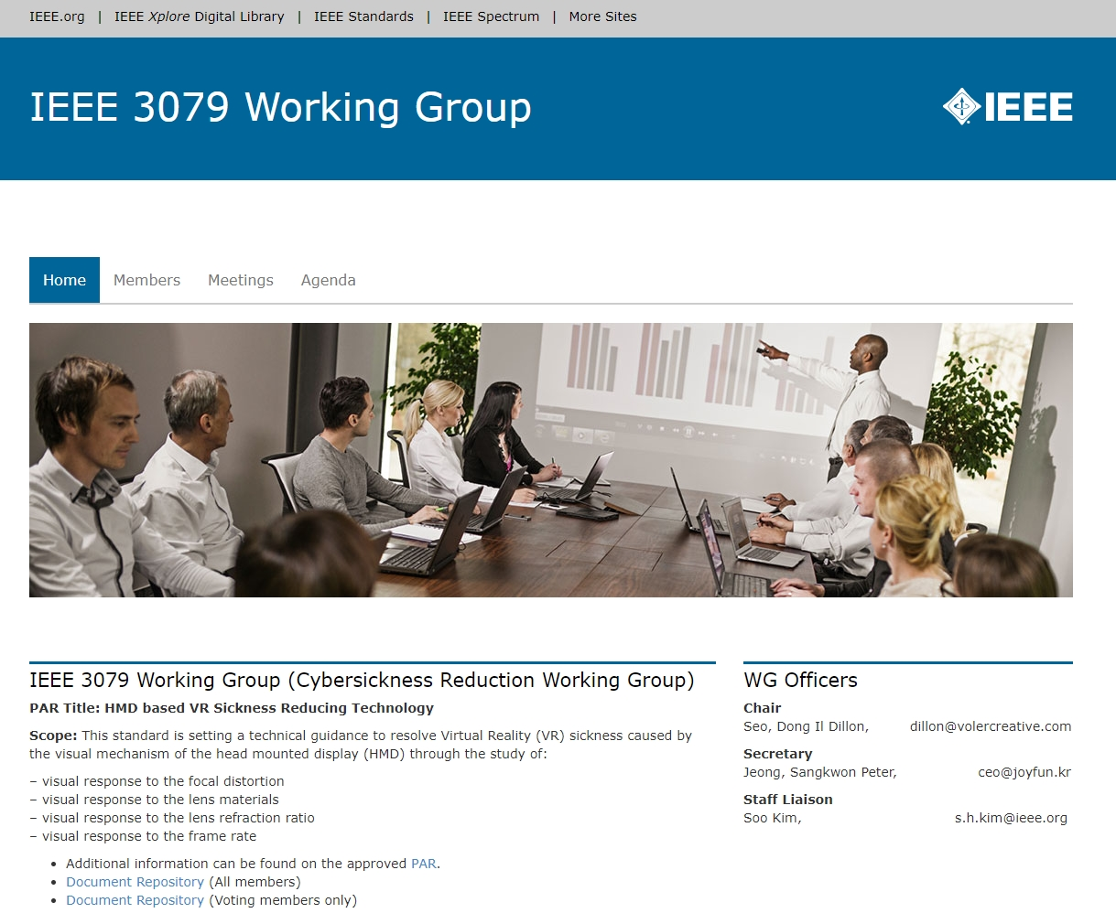
IEEE P3079
URL:
http://sites.ieee.org/sagroups-3079/

Slide 5
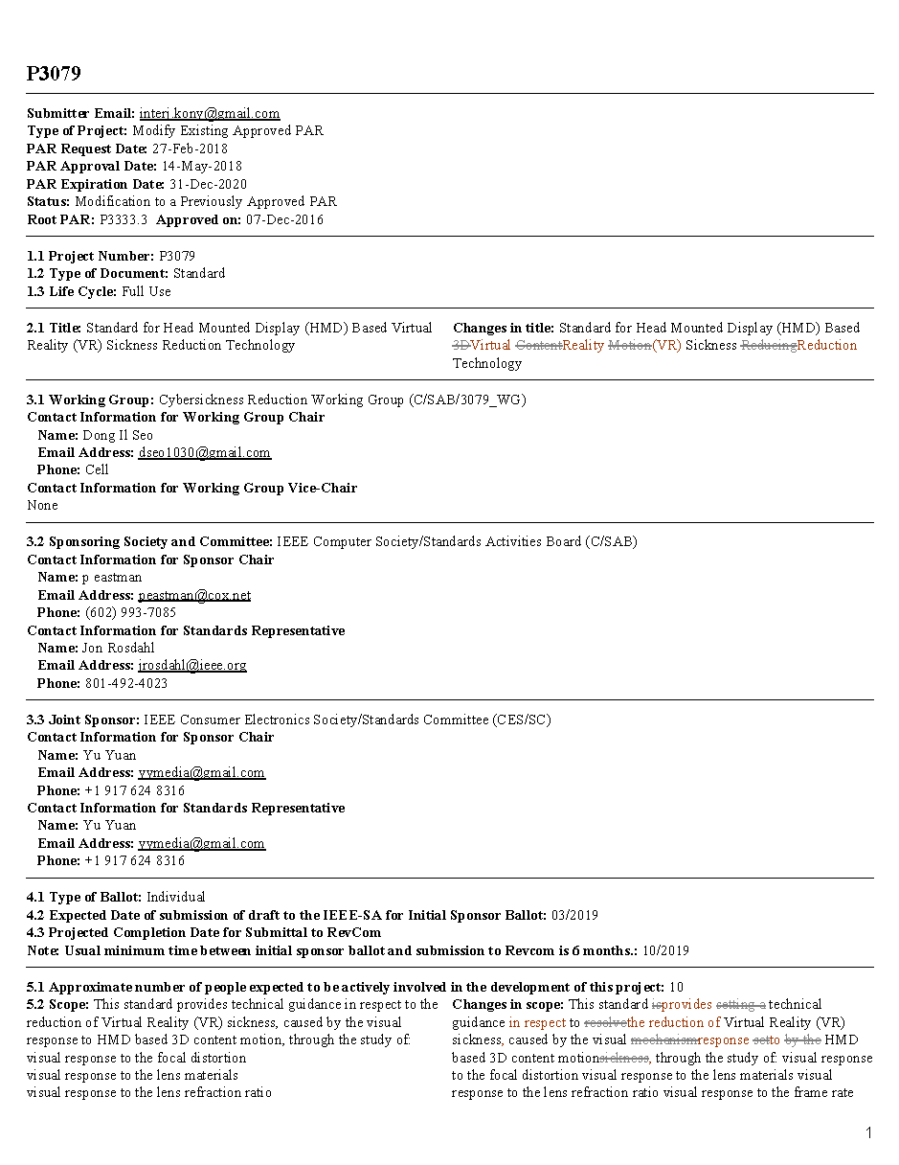
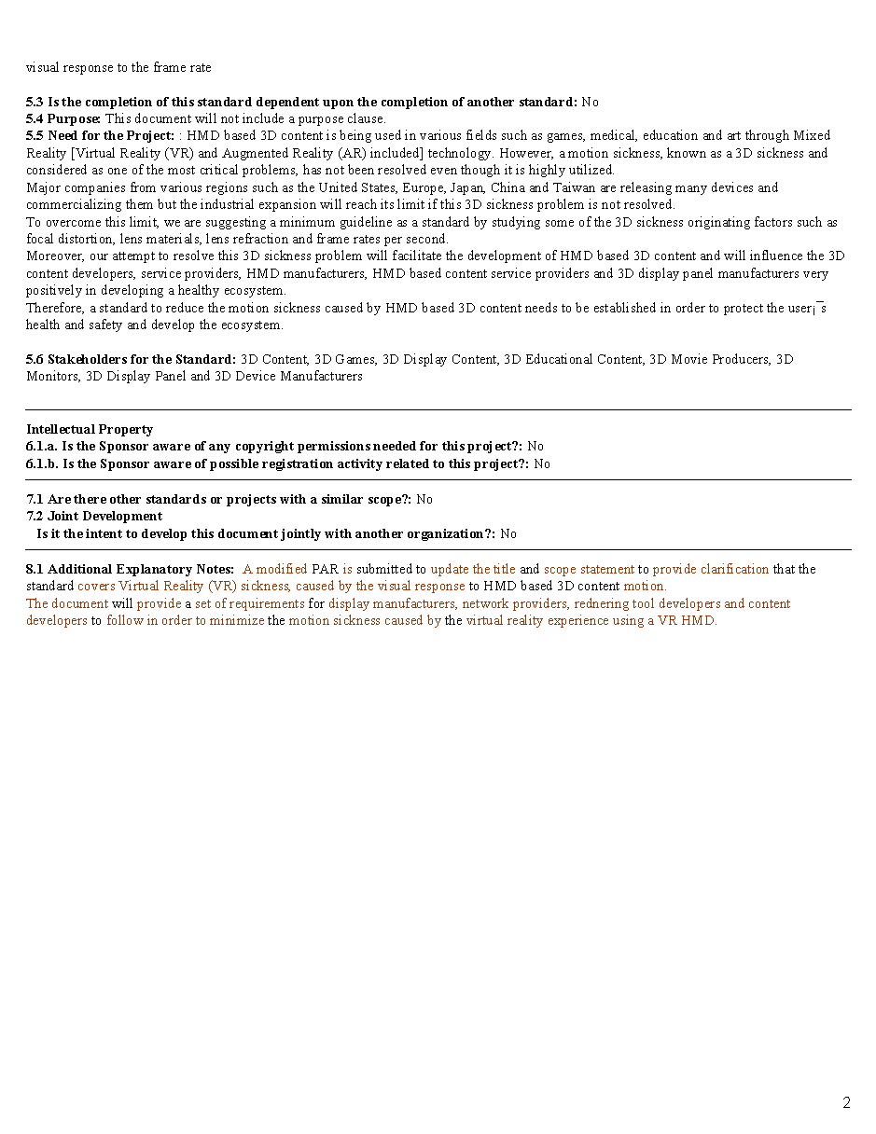
PAR
PAR Title: HMD Based VR Sickness Reduction Technology
WG Title: Cybersickness Reduction WG

Slide 6
Organization
IEEE 3079 TP (Technical Plenary)
TG number
Part of Task
TG 1
Analysis of Human Factors (Medical Research included)
TG 2
S/W & Content (Best Practice Guide)
TG 3
Network (Wired & Wireless Latency, Handover)
TG 4
Display (OLED, LCD, Display Board)
TG 5
Sensors (Latency, Accuracy)
TG 6
Lens (Materials, Refraction Ratio)
TP Members
Chairman & Vice-chairman of each TG

Slide 7
Development Timeline
PAR approved: 12/2016
Working Group 1st Letter Ballot: 06/2019 (20 days)
- Before July meeting
Working Group 2nd Letter Ballot: 09/2019 (20 days)
- Before October meeting
Open Sponsor Ballot Invitation: 10/2019 (30 days)
Start Sponsor Ballot: 11/2019 (30 days)
Start Recirculation 1st Ballot: 02/2020 (10 days)
Start Recirculation 2nd Ballot: 05/2020 (10 days)
Submit to RevCom: 07/2020
Publishing: 01/2021
Open Sponsor Ballot Invitation
Mandatory Editorial Coordination submission
WG 2nd
letter Ballot
WG Meeting to address comments
Ballot Resolution Telecon 1
Sent comments to the WG
Sent comment to the WG
Ballot Resolution Telecon1
WG 1st
letter Ballot
Start Sponsor
Ballot
Start Recirculation
1st Ballot
Start Recirculation
2nd Ballot
RevCom comment review
Submit to RevCom
SASB Approval
Publishing
06/2019
09/2019
11/2019
01/2020
03/2020
05/2020
07/2020
09/2020
01/2021
10/2019
12/2019
02/2020
04/2020
06/2020
08/2020

Slide 8
IEEE 2048 WG

Slide 9
IEEE 2048 Structure Standard for Virtual Reality and Augmented Reality
PAR Number | Project Type | Committee | Title | Scope | Approval Date | PAR Expiration | Status
P2048.1 | New | CES/SC/VRAR | Standard for Virtual Reality and Augmented Reality: Device Taxonomy and Definitions | This standard specifies the taxonomy and definitions for Virtual Reality (VR) and Augmented Reality (AR) devices. | 7-Dec-2016 | 31-Dec-2020 | WG Draft Development
P2048.2 | New | CES/SC/VRAR | Standard for Virtual Reality and Augmented Reality: Immersive Video Taxonomy and Quality Metrics | This standard specifies the taxonomy and quality metrics for immersive video. | 7-Dec-2016 | 31-Dec-2020 | WG Draft Development
P2048.3 | New | CES/SC/VRAR | Standard for Virtual Reality and Augmented Reality: Immersive Video File and Stream Formats | This standard specifies the formats of immersive video files and streams, and the functions and interactions enabled by the formats. | 7-Dec-2016 | 31-Dec-2020 | WG Draft Development
P2048.4 | New | CES/SC/VRAR | Standard for Virtual Reality and Augmented Reality: Person Identity | The standard specifies the requirements and methods for verifying a person's identify in virtual reality. | 7-Dec-2016 | 31-Dec-2020 | WG Draft Development
P2048.5 | New | CES/SC/VRAR | Standard for Virtual Reality and Augmented Reality: Environment Safety | This standard specifies recommendations for workstation and content consumption environment for Virtual Reality (VR), Augmented Reality (AR), Mixed Reality (MR) and all related devices where a digitalmore… | 7-Dec-2016 | 31-Dec-2020 | WG Draft Development
P2048.6 | New | CES/SC/VRAR | Standard for Virtual Reality and Augmented Reality: Immersive User Interface | This standard specifies the requirements and methods for enabling the immersive user interface in Virtual Reality (VR) applications, and the functions and interactions provided by the immersive user interface. | 23-Mar-2017 | 31-Dec-2021 | WG Draft Development
P2048.7 | New | CES/SC/VRAR | Standard for Virtual Reality and Augmented Reality: Map for Virtual Objects in the Real World | This standard specifies the requirements, systems, methods, testing and verification for Augmented Reality (AR) and Mixed Reality (MR) applications to create and use a map for virtual objects in the real world. | 23-Mar-2017 | 31-Dec-2021 | WG Draft Development
P2048.8 | New | CES/SC/VRAR | Standard for Virtual Reality and Augmented Reality: Interoperability between Virtual Objects and the Real World | This standard specifies the requirements, systems, methods, testing and verification for the interoperability between virtual objects and the real world in Augmented Reality (AR) and Mixed Reality (MR) applications. | 23-Mar-2017 | 31-Dec-2021 | WG Draft Development

Slide 10
IEEE 2048 Structure Standard for Virtual Reality and Augmented Reality
PAR Number | Project Type | Committee | Title | Scope | Approval Date | PAR Expiration | Status
P2048.9 | New | CES/SC/VRAR | Standard for Virtual Reality and Augmented Reality: Immersive Audio Taxonomy and Quality Metrics | This standard specifies the taxonomy and quality metrics for immersive audio. | 18-May-2017 | 31-Dec-2021 | WG Draft Development
P2048.10 | New | CES/SC/VRAR | Standard for Virtual Reality and Augmented Reality: Immersive Audio File and Stream Formats | This standard specifies the formats of immersive audio files and streams, and the functions and interactions enabled by the formats. | 18-May-2017 | 31-Dec-2021 | WG Draft Development
P2048.11 | New | CES/SC/VRAR | Standard for Virtual Reality and Augmented Reality: In-Vehicle Augmented Reality | This standard defines an overarching framework for Augmented Reality (AR) systems that assist drivers and/or passengers in vehicles. | 18-May-2017 | 31-Dec-2021 | WG Draft Development
P2048.12 | New | CES/SC/VRAR | Standard for Virtual Reality and Augmented Reality: Content Ratings and Descriptors | This standard defines the content ratings and descriptors for Virtual Reality (VR), Augmented Reality (AR) and Mixed Reality (MR). | 18-May-2017 | 31-Dec-2021 | WG Draft Development

Slide 11
Khronos Group

Slide 12

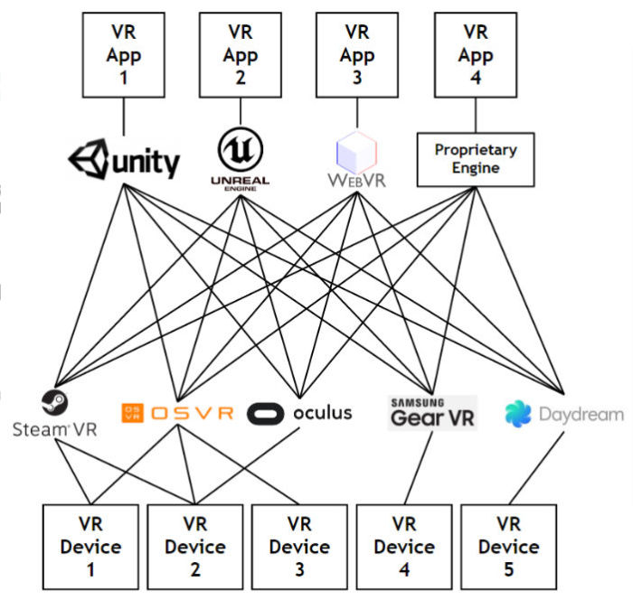
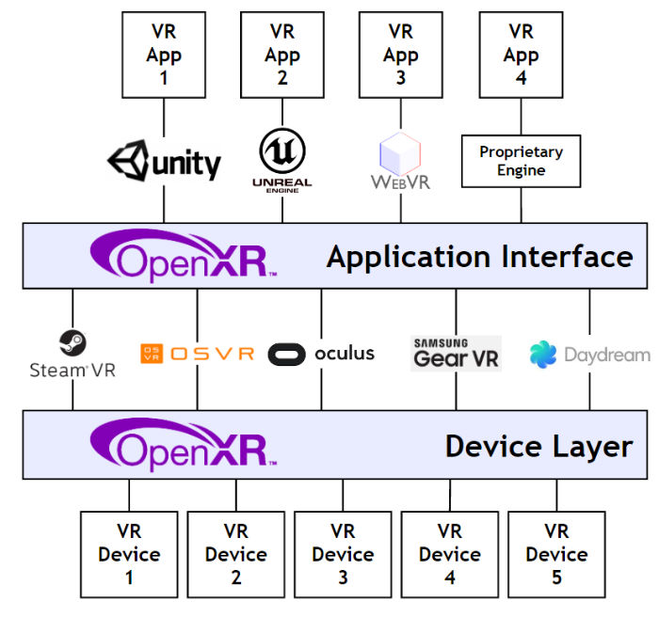
OpenXR
OpenXR - Cross-Platform, Portable, Virtual Reality
The OpenXR™ working group – previously known as the Khronos VR Initiative - is creating an open and royalty-free standard for VR and AR applications and devices.
The Problem
The Solution

Slide 13
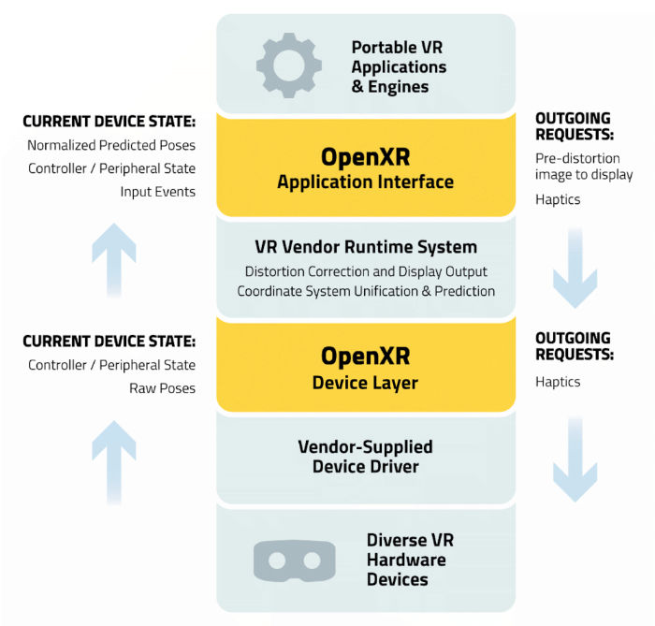
OpenXR Architecture
OpenXR defines two levels of API interfaces that a VR platform’s runtime can use to access the OpenXR ecosystem.
Apps and engines use standardized interfaces to interrogate and drive devices. Devices can self-integrate to a standardized driver interface.
Standardized hardware/software interfaces reduce fragmentation while leaving implementation details open to encourage industry innovation.

Slide 15
W3C

Slide 16
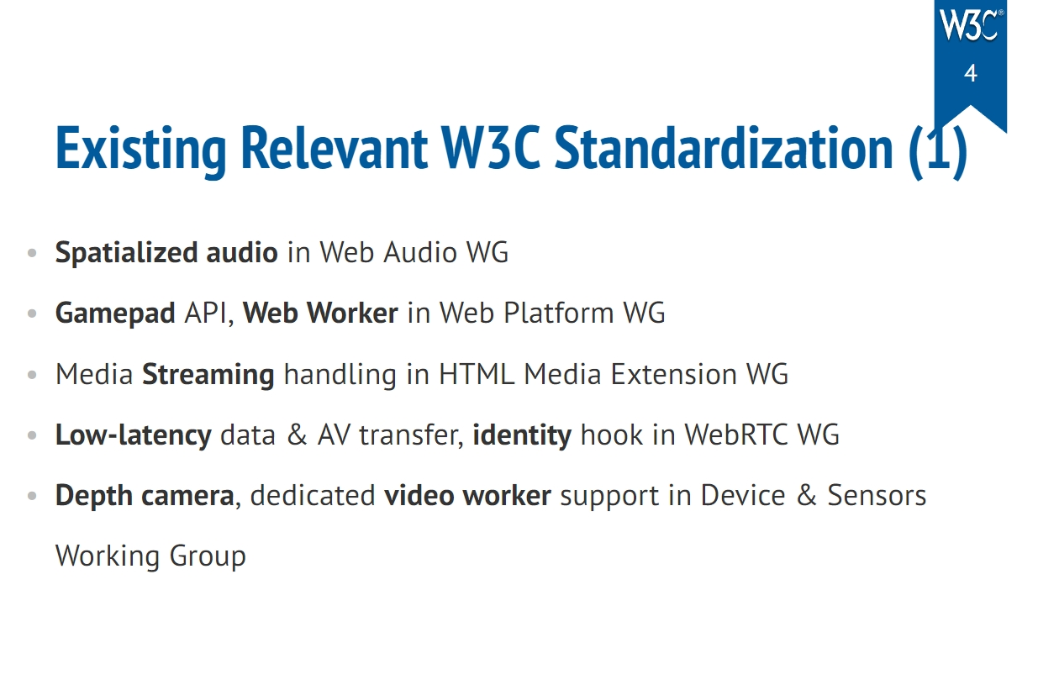
VR Standardization at W3C

Slide 17
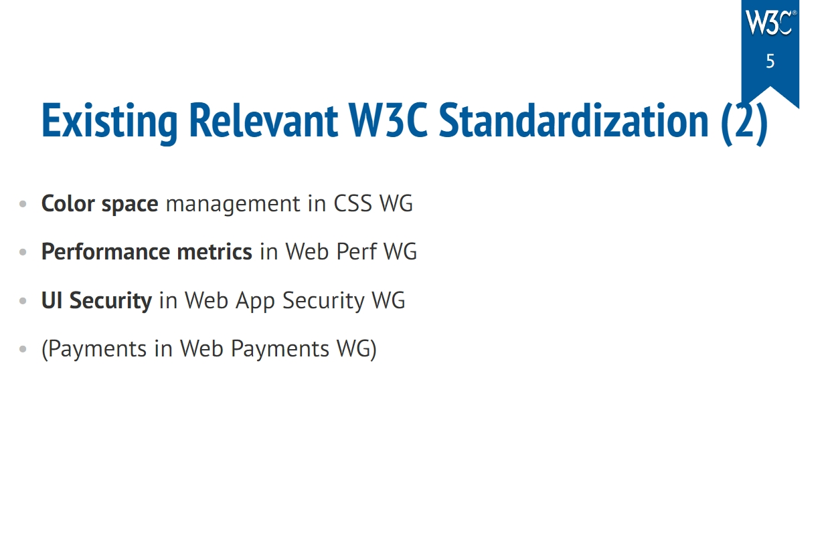
VR Standardization at W3C

Slide 18
ISO/IEC JTC1/SC24

Slide 19
ISO/IEC JTC1/SC24 Standard Spec
▸ISO/IEC 19777-1, 19777-2: X3D Language Bindings ECMAScript Ed.2, Java Ed.2 (Under Development)
▸ISO/IEC 19774-1, 19774-2: H-Anim Part 1 Architecture, Motion Data Animation (Published)
▸ISO/IEC 18039: Standard MAR Reference Mode (Published)
▸ISO/IEC 18038: Sensor representation in mixed and augmented reality(MAR) (Published)
▸ISO/IEC 18040: Live Actor and Entity Representation in Mixed and Augmented(MAR) (Published)
▸ISO/IEC 18520: Benchmarking of vision-based geometric registration and tracking methods for MAR (Published)
▸ISO/IEC 21858: Information model for mixed and augmented reality(MAR) contents (Published)

Slide 20
ITU-T SG 12

Slide 21
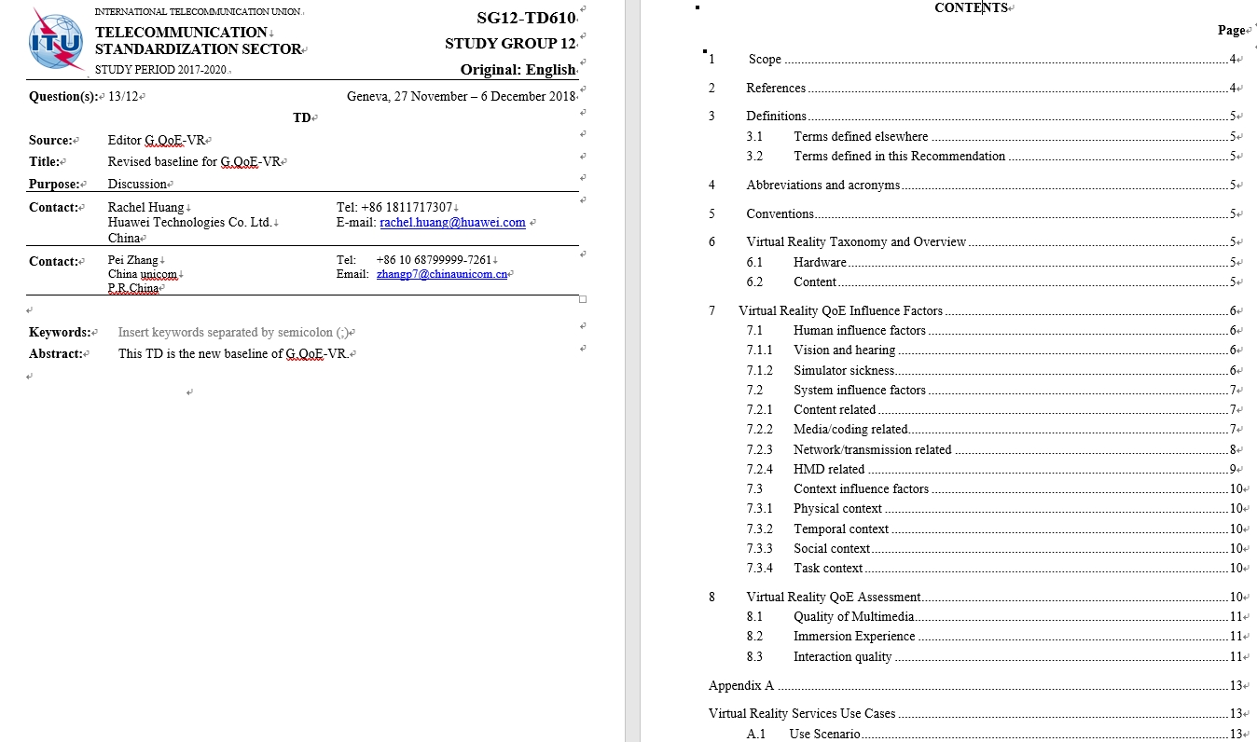
ITU-T SG12 QoE - VR
Status: Standard Document is under development
Issues
  Focusing on QoE without the understanding of VR content characteristics
  Dealing with irrelevant senses such as smell for VR QoE
  Missing MTP latency in the content

