Slide 1
2.4/5 GHz Spectrum Survey in San Jose, CA
Date: July 26, 2016
Authors:

Slide 2
Overview
Spectrum Snapshots
  Multiuse Space Near Downtown San Jose
    Used by multiple independent non-profit groups
  Single Family Dwelling in Residential Area
Brief Observations
Recommendations

Slide 3
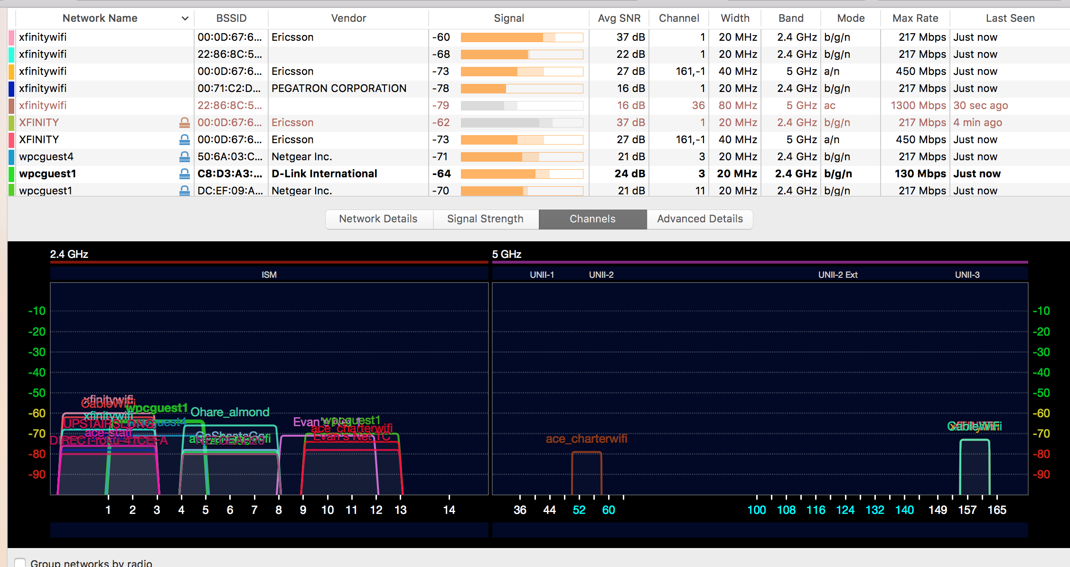
Multiuse Space: Atrium

Slide 4
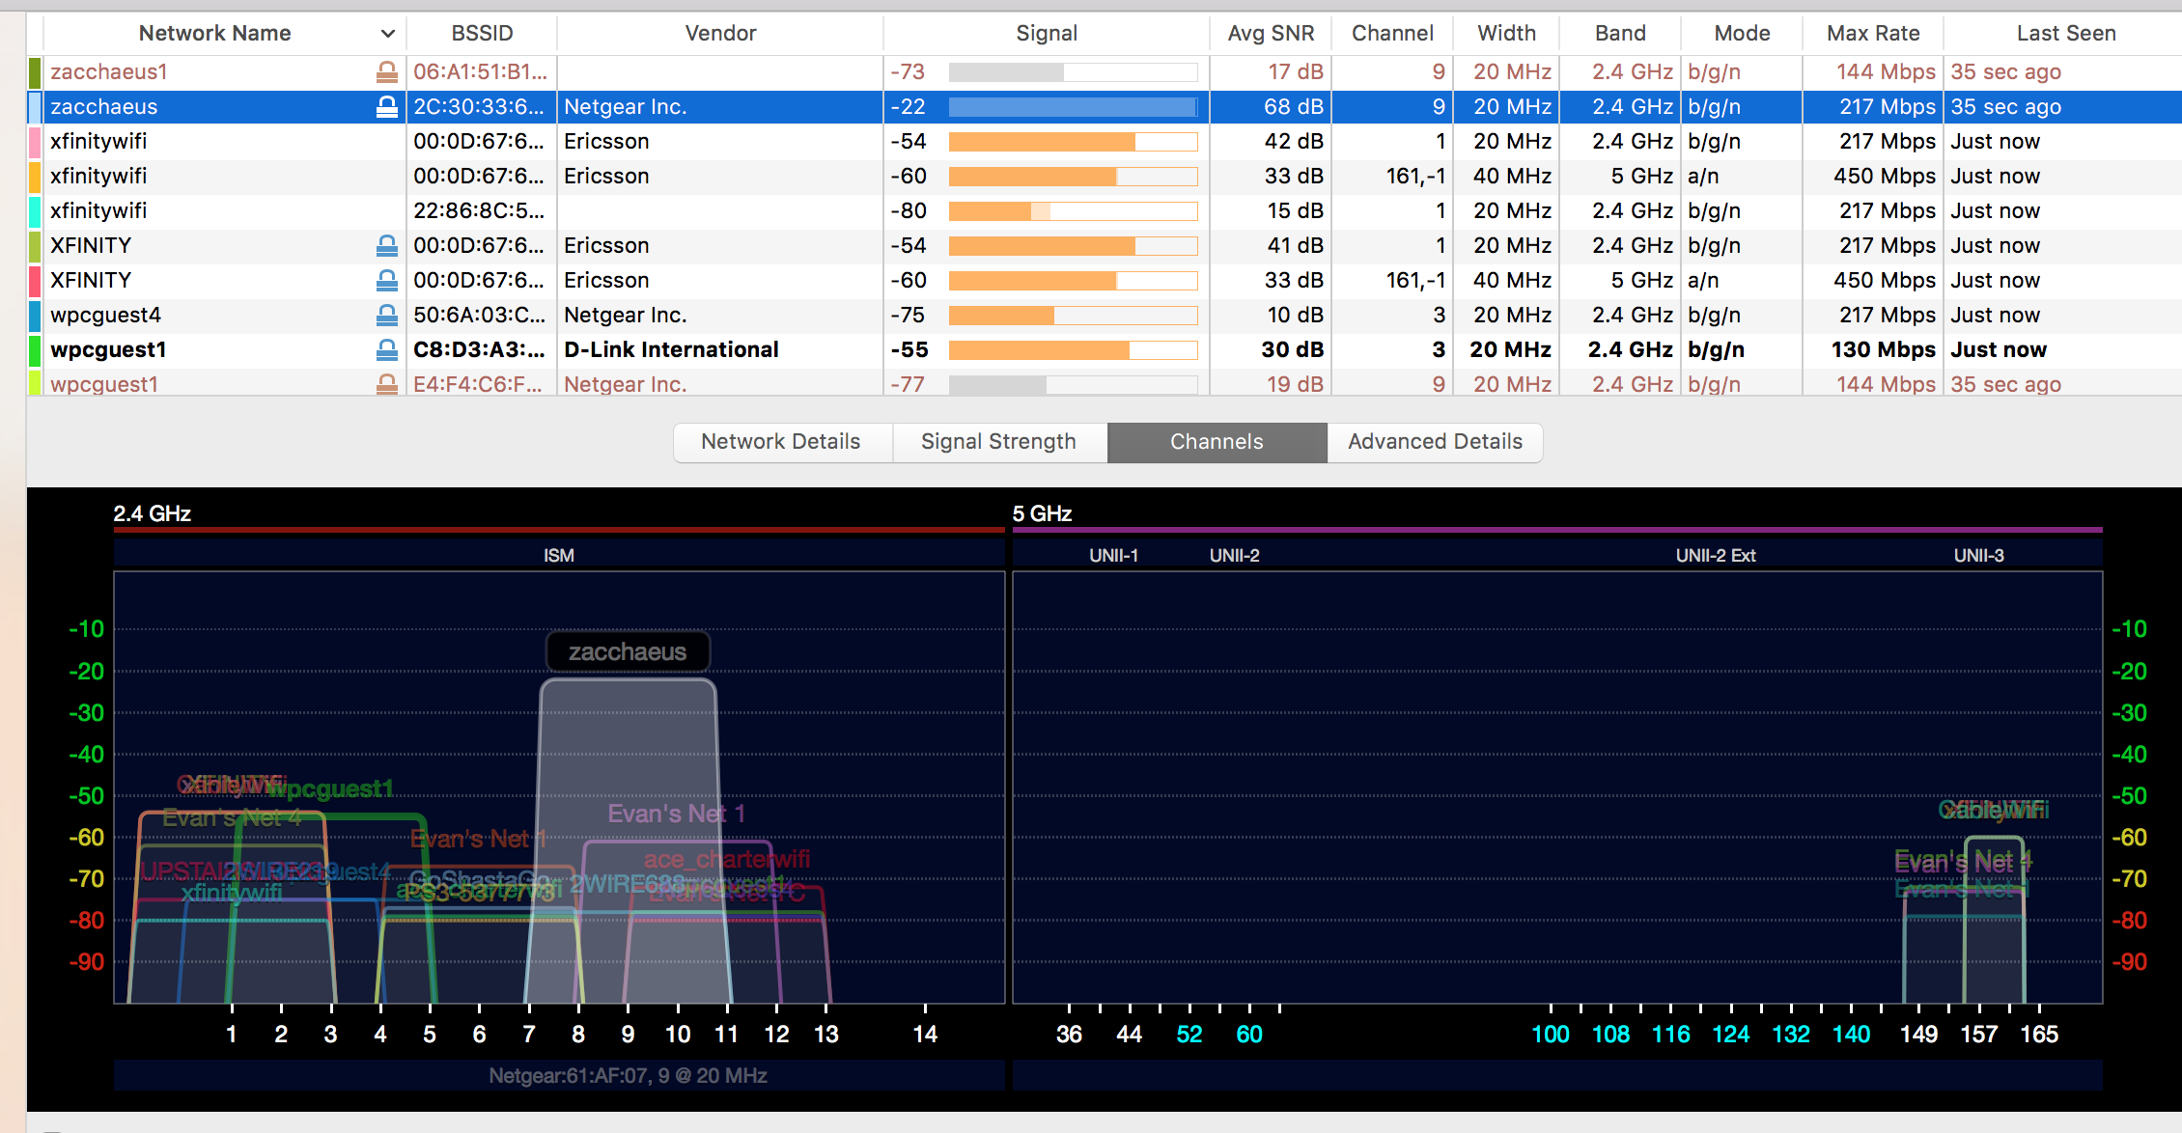
Multiuse Space: Side Door Lobby

Slide 5
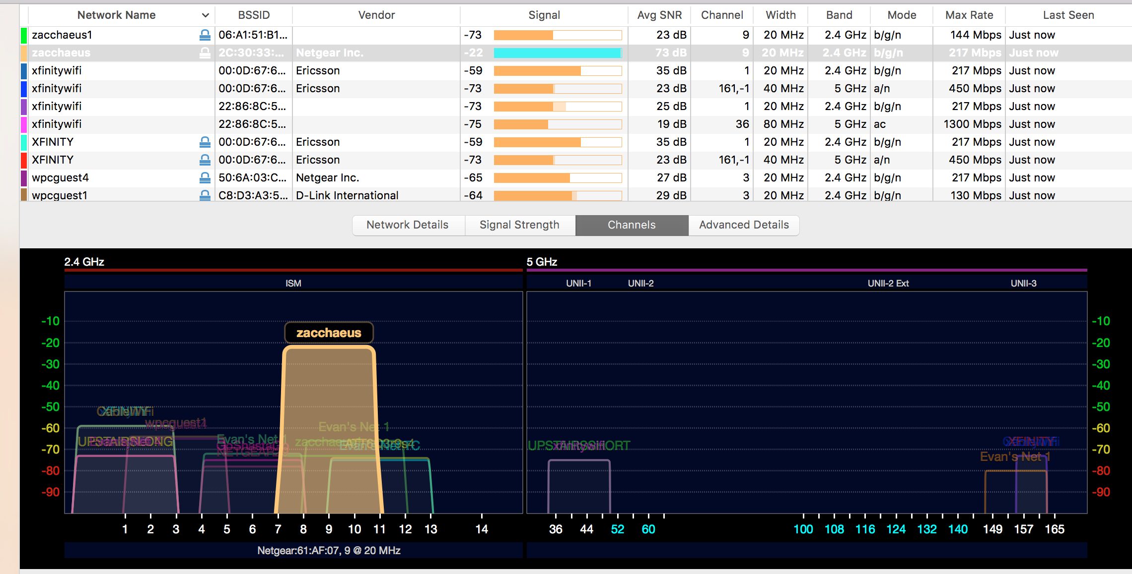
Multiuse Space: Office

Slide 6
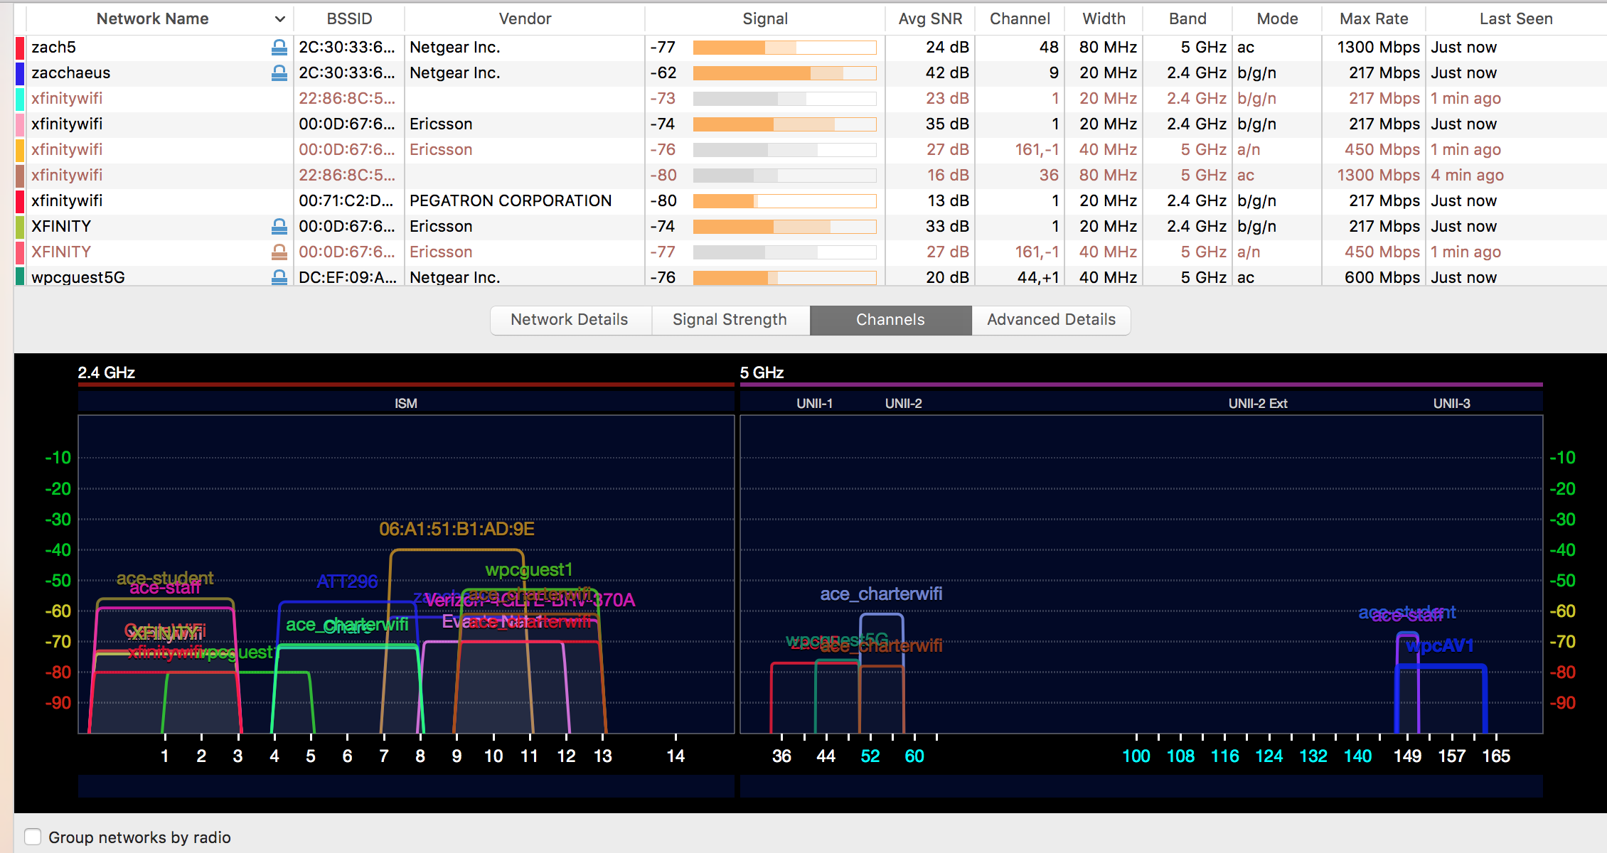
Multiuse Space: Meeting Space #1

Slide 7
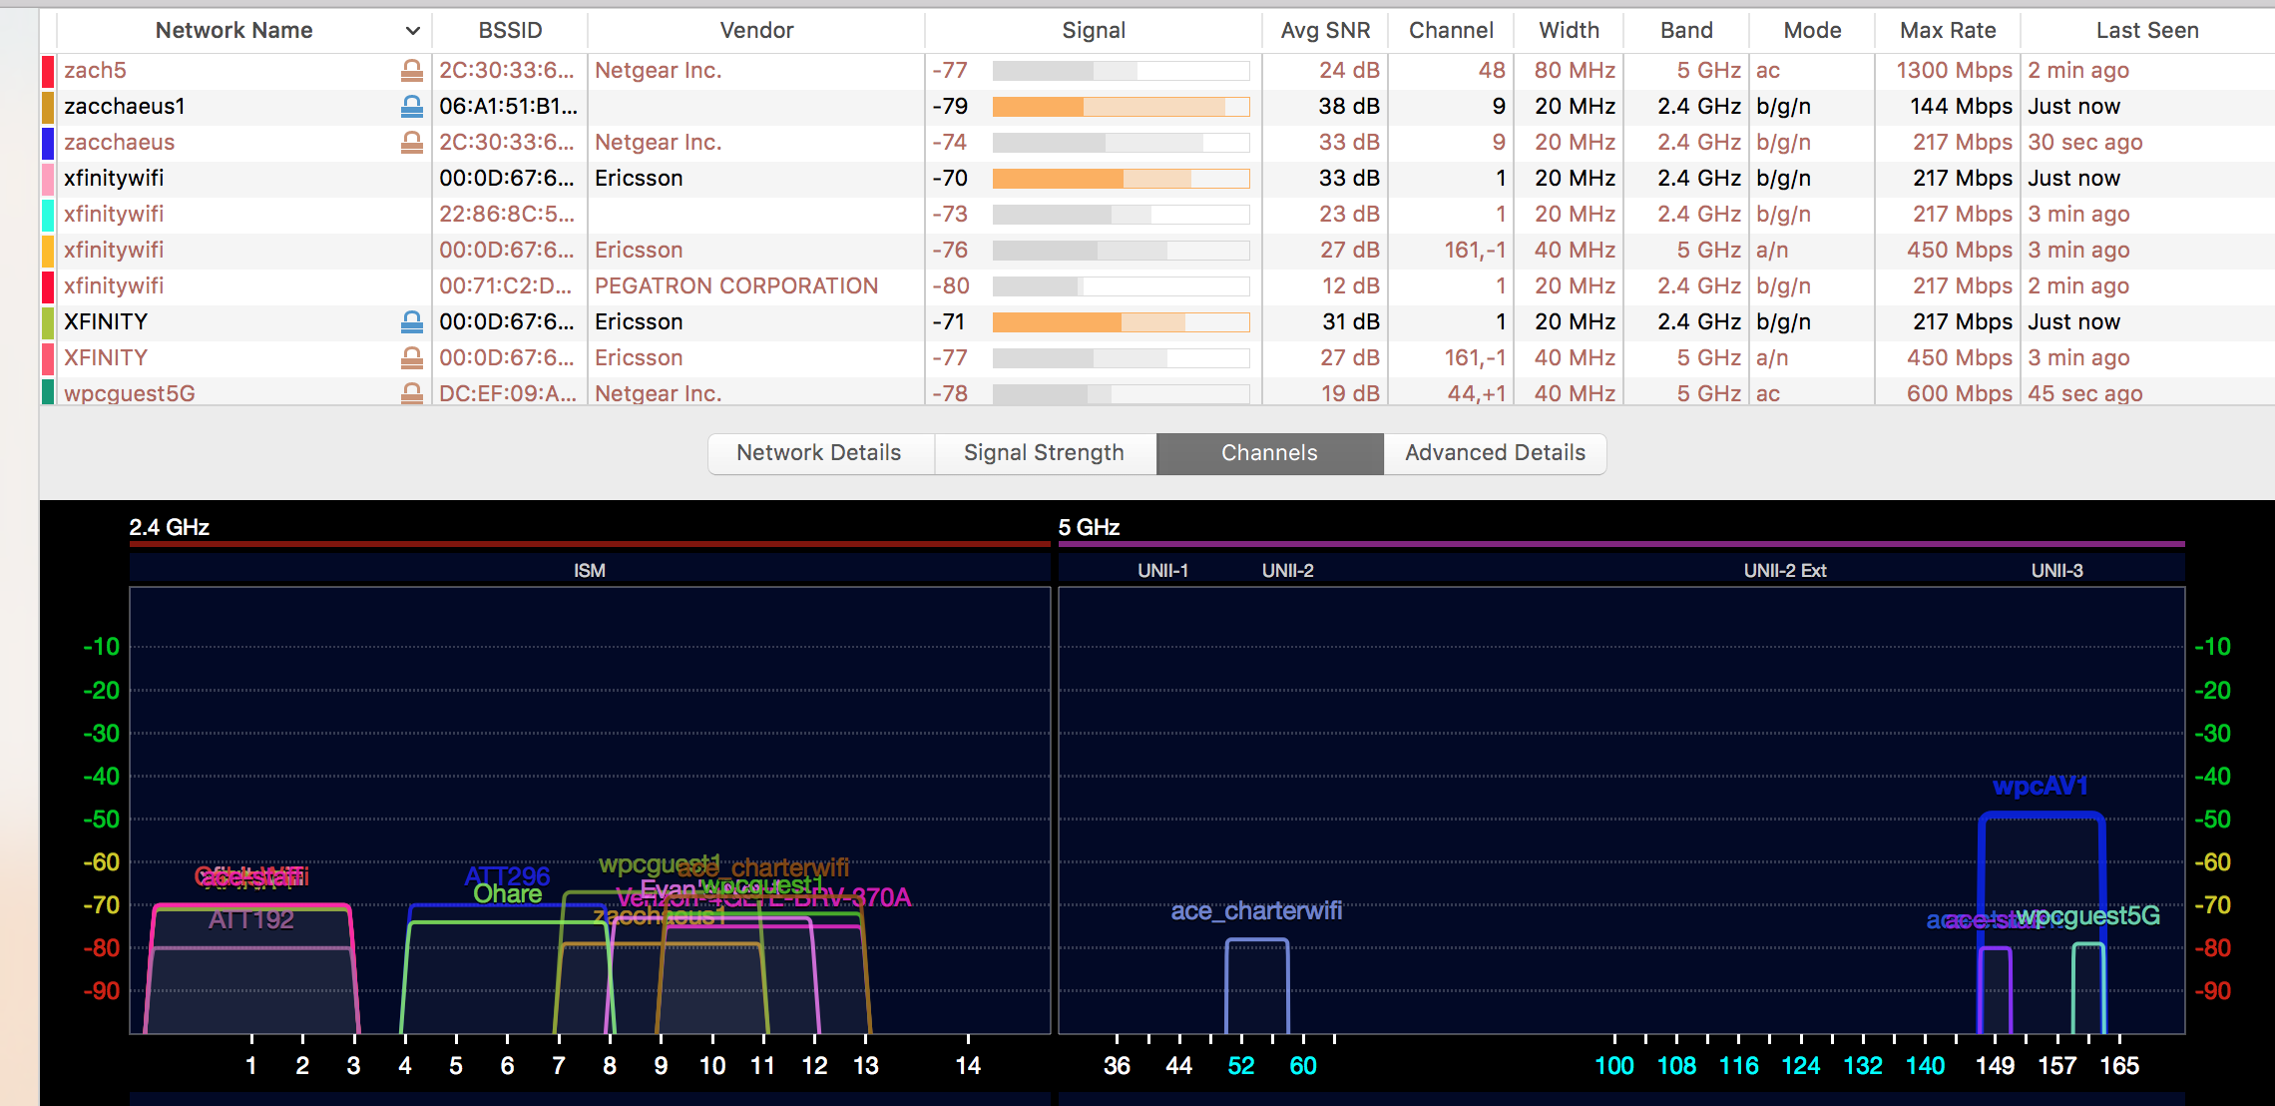
Multiuse Space: Auditorium, View 1

Slide 8
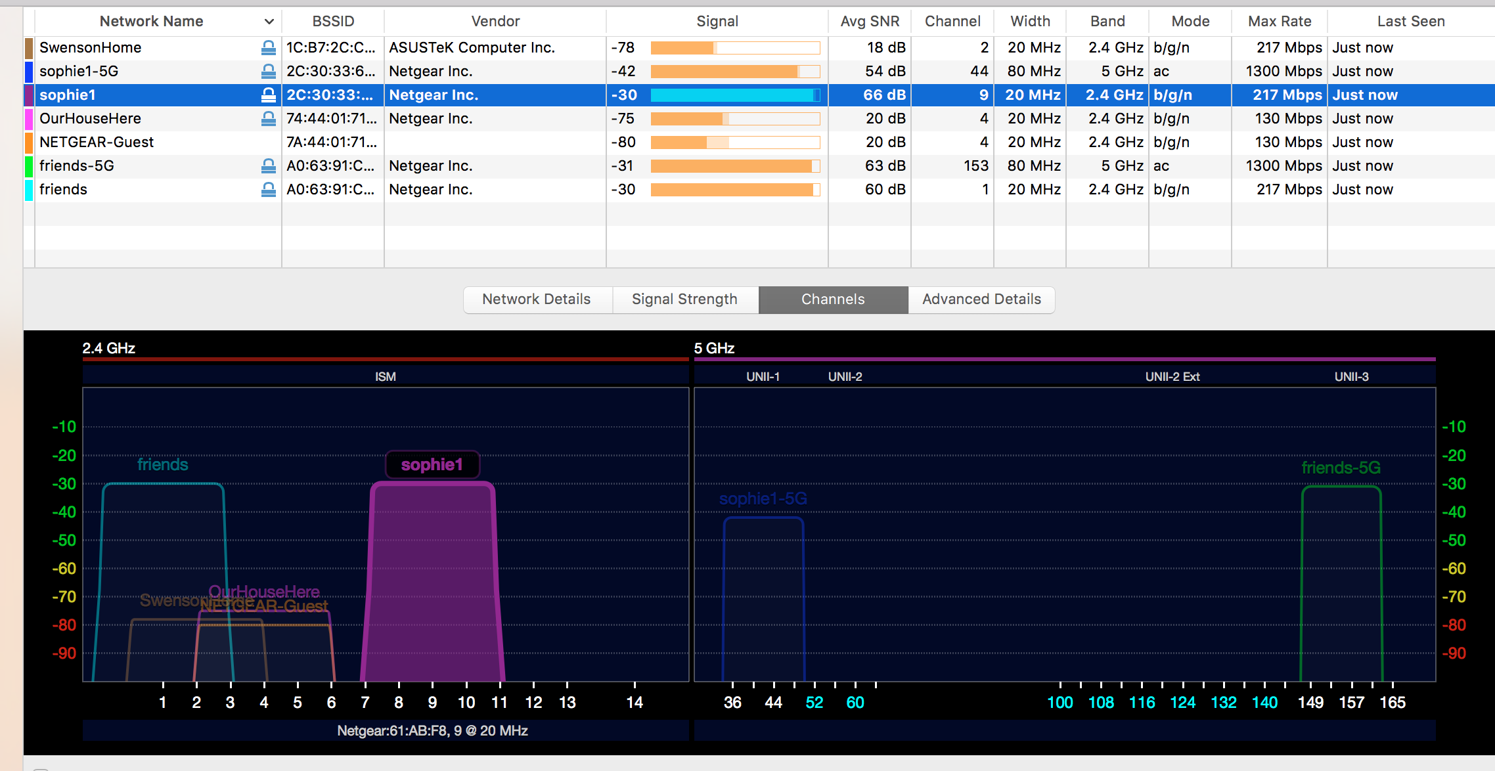
Residential Space: 1st Floor

Slide 9
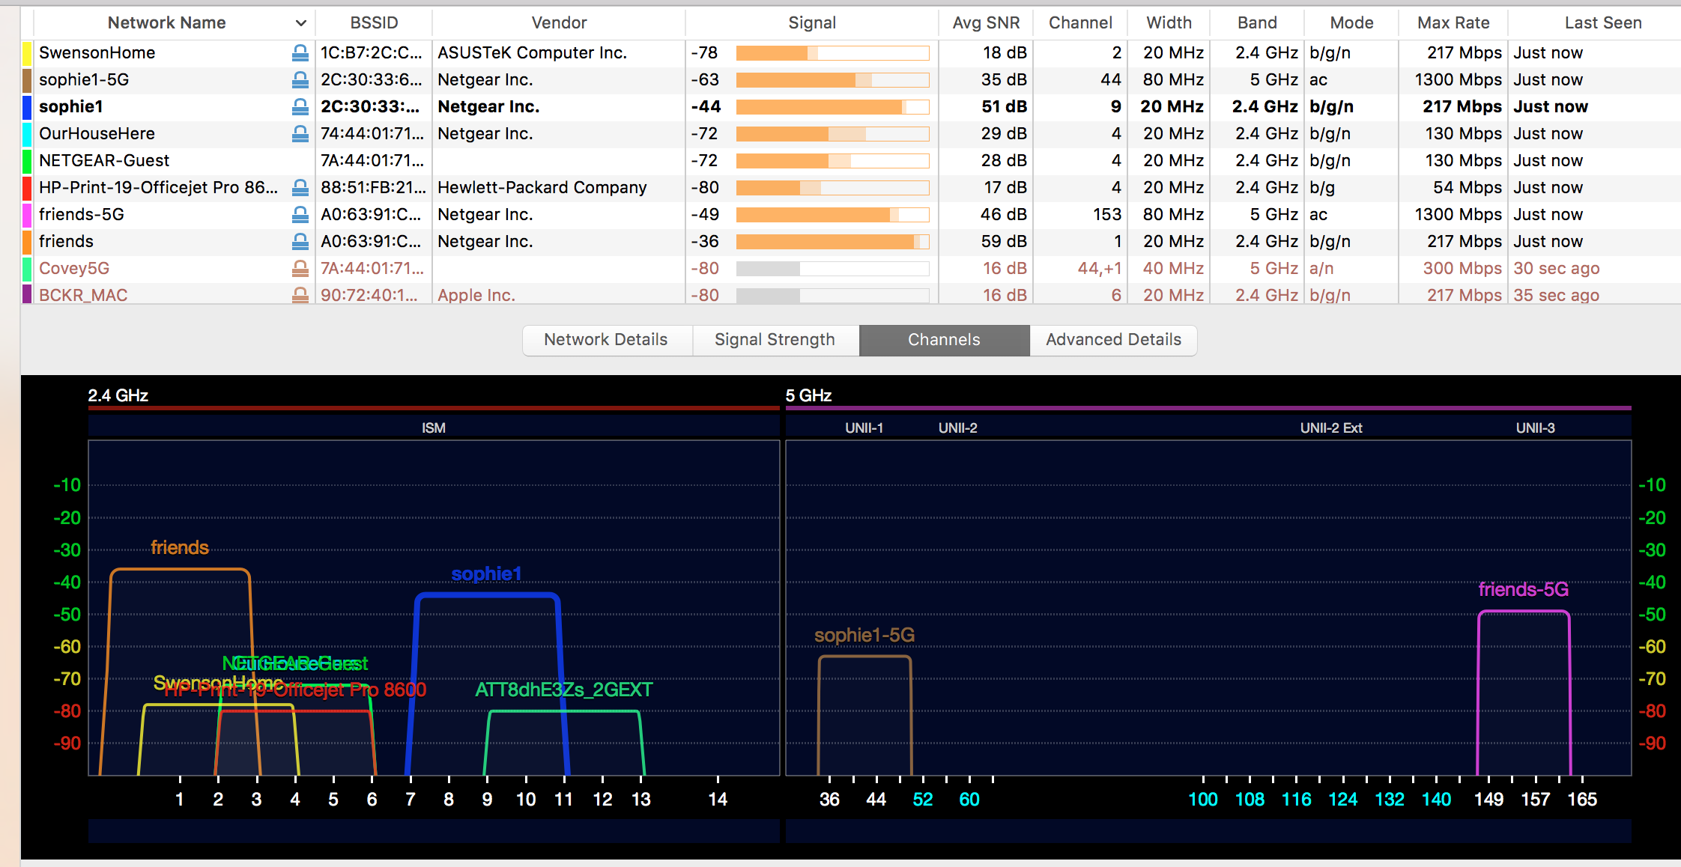
Residential Space: 2nd Floor

Slide 10
Observations
2.4 GHz channels show multiple overlapping users.
  The Multiuse Space is more densely occupied.
  Separation between residential properties reduces spectrum clutter.
5 GHz channels occupied at the band edges.
  The Multiuse Space is more densely occupied at the band edges.
  Separation between residential properties reduces spectrum clutter.
  No DFS channels in use.
  More growth in 5 GHz channels coming, which will increase the number of overlapping users at the band edges.

Slide 11
Recommendations
Messaging to international regulators
  Emphasize progress in resolving rules impediments (test waveforms, operational details, etc.)
  Emphasize rapid certification processes to improve time to market.
Crowding in 5 GHz band edges – market response
  Emphasize the shifting market at 5 GHz, where DFS capable APs/routers are moving from being a future prospect to being required for growth in the consumer Wi-Fi market.

