Slide 1
Project: IEEE P802.15 Working Group for Wireless Specialty Networks (WSN)
Submission Title: March 2024 Plenary TG4ab Meeting Slides
Date Submitted: 14 January 2024
Source: Benjamin A. Rolfe (Blind Creek Associates)
Contact:
Voice: +1 408 395 7207, E-Mail: ben.rolfe @ ieee.org
Re: Task Group 4ab: 802.15.4 UWB Next Generation
Abstract: Meeting Slides for the Wireless Interim Session, January 2024
Purpose: Continue project progress and continue the illusion of organizaation
Notice: This document has been prepared to assist the IEEE P802.15. It is offered as a basis for discussion and is not binding on the contributing individual(s) or organization(s). The material in this document is subject to change in form and content after further study. The contributor(s) reserve(s) the right to add, amend or withdraw material contained herein.
Release: The contributor acknowledges and accepts that this contribution becomes the property of IEEE and may be made publicly available by P802.15.

Slide 2
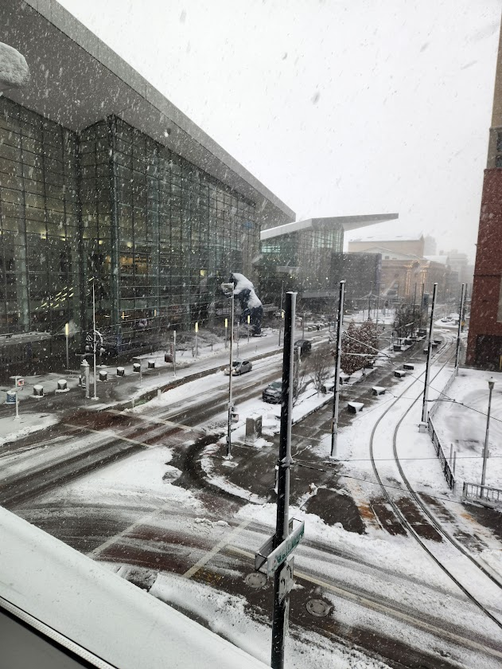
Task Group 15.4ab Next Generation UWB Amendment
March 2024 802 Plenary Session
Mixed Mode
Live from Denver, CO, USA

Slide 3
Meeting Preamble
Stuff you need to know before we get to the meeting content

Slide 4
Mixed Mode Logistics
Head table will project (one computer all day)
Local: queue to speak a microphone; remember remote attendees will hear you only if you use the microphone!
Remote attendees please queue via chat window
Local attendees when joining WebEx connect without audio!
In-room Webex with audio enabled will disrupt the meeting!
Presenters, both local and remote, will present via WebEx
For those Remote Attendees connecting to Webex, Configure Webex Audio to use “Music Mode”.
Makes sure “mute on entry” is set in WebEx
Please do not turn on video.

Slide 5
Hybrid Meeting Conduct: Other
In room breakouts:
We have the TG4ab Meeting rooms (physical and virtual) during our scheduled meeting times
We have a 2nd breakout room (physical and virtual) with coordination with WG chair
If leading a breakout – get with TC chair or VC for webex details
Keep in mind we have remote attendees in inconvenient time zones when able (use email reflector, etc)
We will do the best we can and keep learning as we go!

Slide 6
Time Management
We will need to stay within the allocated time to get through everything
If less than the allocated time is used in a time slot, we’ll start the next time slot (accumulate any unused time to the end of the meeting)
Accumulated time will be used to continue discussion where needed

Slide 7
Registration for 802 LMSC Plenaries and 802 Wireless Interims
This 802.15 meeting is part of the IEEE 802 plenary session
You must pay the registration fee in order to attend virtually or in person
If you have not already done so please register:
Session Information & Registration Website:
https://touchpoint.eventsair.com/2024-jan-ieee-802-wireless-interim-session/registration
If you do not intend to register for this session you must leave this meeting and, if you have logged attendance on IMAT, email the appropriate WG chair or vice chairs to have your attendance cancelled

Slide 8
Task Group Rules
Discussion: Everyone present is welcome
Straw polls: Everyone present may vote
Formal motions: WG voters
To make, second and vote
Patent policy for PAR activities applies
All the usual rules of conduct
Please identify yourself on first contact with name and affiliation

Slide 9
IEEE-SA Patent, Copyright, and Participation Policies
Consolidated Slide Set: https://www.ieee802.org/3/WG_tools/templates/policies_slides_12012023.pptx
See: https://grouper.ieee.org/groups/802/sapolicies.shtml
IEEE-SA Patent Slides for Standards Development Meetings (.pdf)
https://development.standards.ieee.org/myproject/Public/mytools/mob/slideset.pdf
IEEE-SA Standards Board Patent Committee (PatCom) home page
https://standards.ieee.org/content/ieee-standards/en/about/sasb/patcom/index.html
IEEE-SA Participation Policy meeting slide set - individual method (.pdf)
https://standards.ieee.org/content/dam/ieee-standards/standards/web/documents/other/Participant-Behavior-Individual-Method.pdf
Working Group Copyright Materials
https://standards.ieee.org/ipr/copyright-materials.html
https://standards.ieee.org/content/dam/ieee-standards/standards/web/documents/other/ieee-sa-copyright-policy-2019.pdf

Slide 10
Participants have a duty to inform the IEEE
Ways to inform IEEE
Cause an LOA to be submitted to the IEEE SA (patcom@ieee.org); or
Provide the chair of this group with the identity of the holder(s) of any and all such claims as soon as possible; or
Speak up now and respond to this Call for Potentially Essential Patents
If anyone in this meeting is personally aware of the holder of any patent claims that are potentially essential to implementation of the proposed standard(s) under consideration by this group and that are not already the subject of an Accepted Letter of Assurance, please respond at this time by providing relevant information to the WG Chair
Participants shall inform the IEEE (or cause the IEEE to be informed) of the identity of each holder of any potential Essential Patent Claims of which they are personally aware if the claims are owned or controlled by the participant or the entity the participant is from, employed by, or otherwise represents
Participants should inform the IEEE (or cause the IEEE to be informed) of the identity of any other holders of potential Essential Patent Claims
Early identification of holders of potential Essential Patent Claims is encouraged

Slide 11
Reminders
You are reminded NOW that all the 802 and IEEE rules you heard at the opening plenary apply to every meeting. This is your final reminder!
Meetings will start ON TIME as shown on the schedule – arrive early, finish nesting, get comfortable
Questions and discussions time may be limited: Use the email reflector to continue discussion!
Take advantage of coffee breaks and other ad hoc time as well as the reflector, and
Don’t forget about remote attendees!

Slide 12
Agenda
https://mentor.ieee.org/802.15/dcn/24/15-24-0128-02-04ab-tg4ab-agenda-march-2024.xlsx
(check mentor for latest version)

Slide 13
Agenda
Motion to approve agenda contained in document 15-24-0128-04.
Moved by David Xun Yang (Huawei)
Second by Clint Chaplin (SRA)
Discussion:

Slide 14
Approvals of Minutes
Motion to approve minutes contained in documents 15-24-0116 and 15-24-0140.
Moved by: David Xun Yang (Huawei)
Second by: Clint Chaplin (SRA)
Discussion:
TG4ab Conf Call Mins Jan 2024 through March 2024
https://mentor.ieee.org/802.15/dcn/24/15-24-0116-00-04ab-tg4ab-jan-interim-mins.docx
TG4ab January Wireless Interim Mins
https://mentor.ieee.org/802.15/dcn/24/15-24-0140-00-04ab-tg4ab-conf-call-mins-jan-to-mar-2024.docx

Slide 15
Session Objectives
Resolve collected comments
Complete the draft!
Commence WG Letter Ballot when:
We have a technically complete draft
We have a draft that is ready to ballot
We have completed WG pre-requirements

Slide 16
5.2.b Scope of the project (As approved):
This amendment enhances the Ultra Wideband (UWB) physical layers (PHYs) medium access control (MAC), and associated ranging techniques while retaining backward compatibility with enhanced ranging capable devices (ERDEVs). Areas of enhancement include:
additional coding, preamble and modulation schemes to additional coding, preamble and modulation schemes to support improved link budget and/or reduced air-time relative to IEEE Std 802.15.4 UWB;
additional channels and operating frequencies;
interference mitigation techniques to support greater device density and higher traffic use cases relative to the IEEE Std 802.15.4 UWB;
improvements to accuracy, precision and reliability and interoperability for high-integrity ranging; schemes to reduce complexity and power consumption;
definitions for tightly coupled hybrid operation with narrowband signaling to assist UWB;
enhanced native discovery and connection setup mechanisms;
sensing capabilities to support presence detection and environment mapping;
and mechanisms supporting low-power low-latency streaming as well as high data-rate streaming allowing at least 50 Mb/s of throughput.
Support for peer-to-peer, peer-to-multi-peer, and station-to-infrastructure protocols are in scope, as are infrastructure synchronization mechanisms. This amendment includes safeguards so that the high throughput data use cases do not cause significant disruption to low duty-cycle ranging use cases.
https://development.standards.ieee.org/myproject-web/app#viewpar/9081

Slide 17
Project Schedule (working baseline)
Proposed project schedule | Nov -22 | Dec-22 | Jan-23 | Feb-23 | Mar-23 | Apr-23 | May-23 | Jun-23 | Jul-23 | Aug-23 | Sep-23 | Oct-23 | Nov-23 | Dec-23 | Jan-24 | Feb-24 | Mar-24 | Apr-24 | May-24 | Jun-24 | Jul-24 | Aug-24 | Sep-24 | Oct-24 | Nov24 | Dec 24 | Jan 25 | Feb 25 | Mar 25 | Apr 25 | May 25 | June 25 | July 25
Integrate poposals/contributions into TFD
Develop draft from TFD
Draft 0
TG draft review and revision
Working group pre-ballot review
Pre-ballot review and comment resolution
First letter ballot
LB Comment Resolution
WG Recirculatoin
Comment resolution, 1st recirc
Conditional approval for SA ballot
WG Recirculatoin
Comment resolution, 2nd recirc and final recirc
First SA ballot
Comment resolution, first SA ballot
SA Resirculation
Comment resolution, SA recirculation
SA Resirculation
Comment resolution, 2nd SA recirc
Conditional or unconditional approval to RevCom
Optional 3rd SA recirc if needed
 |  |  |  |  |  |  |  |  |  |  |  |  |  |  |  |  |  |  |  |  |  |  |  |  |  |  |  |  |  |  |  |  |  |  |  |  |  | `
First letter ballot slipping to …
You are Here
Slide 17

Slide 18
Near Term Working Milestones
 | Original Schedule | Current Schedule
Call for proposals | November 2021
Cut-off for new features (high level feature set), PHY | May 2022
Cut-off for new features (high level feature set), MAC | July 2022
Draft 0 | Post-January 2023 | Post March July Sept 2023
TG draft review and revision complete | February - March 2023 | Mar-June 2023 Sept 2023 Oct 2023
Working group pre-ballot review commence | March – May 2023 (following March meeting) | July August Sept Start: Nov 2023 Close: 2 Jan 2024
Comment Resolution |  | Start: Jan 2024 Done: March 2024
First letter ballot | June 2023 (following meeting) | Oct Nov 2023 Jan 2024 Goal: March 2024
Initial LB comment resolution |  | Start: May 2024 Done: TBD
DONE
We are here
?
Heading towards
Current pace -> Start LB in May or later

Slide 19
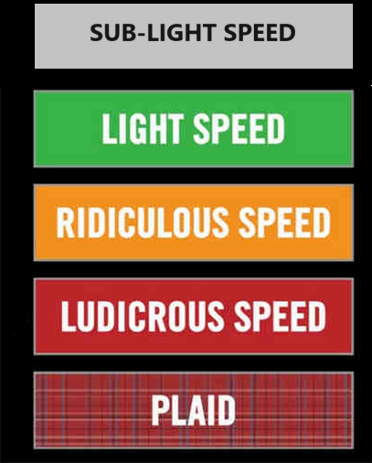
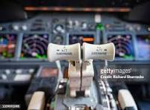
Comment resolution reports

Slide 20
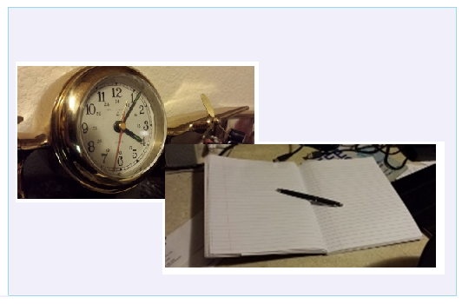
Editor’s Corner

Slide 21
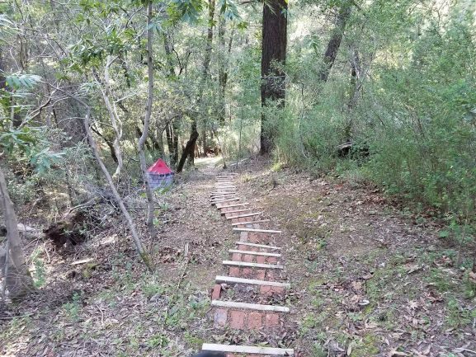
Next Steps

Slide 22
Completing the Draft
Goal: create a technically complete draft that is ready for balloting
Complete:
NO TBDs or implied TBDs (e.g. ??)
Sufficient detail to be understood and (maybe) implementable
Not perfect: that’s what balloting is for!
To get there: Identify and fill holes
Resolve comments with technically complete content and sufficient details for TE to execute
Approve changes to enable editor to create ballotable draft

Slide 23
Steps up to Letter Ballot: Summary
Complete draft, posted to drafts area
Comment resolutions documented and approved (TG motion)
TG technical editor has applied all resolutions
TEG Review:
WG chair assigns Technical Expert Group
TEG reviews for technical consistency with base standard
WG Technical Editor review
WGTE reviews for editorial consistency with base standard
Reference: https://mentor.ieee.org/802.15/dcn/23/15-23-0083-05-0mag-project-task-list.xlsx for tasks and OM xref

Slide 24
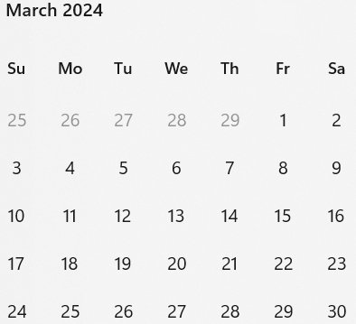
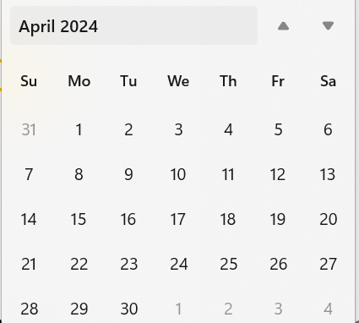
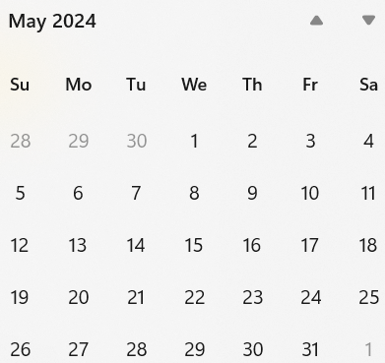
Call schedule, March thru May
Weekly on Tuesdays 2 hours split:
6am PT (1 hour)
3pm PT (1 hour)
Commencing 26-March-2024
April 30 (hour 1): Coexistence topics, Joint meeting with 802.11 CoEx SC

