Slide 1
Project: IEEE P802.15 Working Group for Wireless Specialty Networks
Submission Title: Performance Evaluation of Channel Coding under Various Channel Models in Some Classes of Coexistence in TG6ma
Date Submitted: 15 November 2023
Source: Kento Takabayashi¹, Takumi Kobayashi², Daisuke Anzai², Macro Hernandez^{3,4}, Ryuji Kohno^{3,4}
Company: (1) Toyo University (2) Nagoya Institute of Technology (3) CWC, University of Oulu (4) YRP International Alliance Institute
Address: (1) 2100 Kujirai, Kawagoe, Saitama, Japan 351-8585
Voice:[(1) +81-866-94-2104]
E-Mail:[takabayashi.kento.xp@gmail.com]
Re: In response to call for technical contributions
Abstract: Performance evaluations of error correcting codes for IEEE 802.15.6ma under some channel models is provided. In addition, we also consider coexistence with IEEE 802.15.4ab.
Purpose: Material for discussion in P802.15.6ma TG corresponding to comments in EC Meeting
Notice: This document has been prepared to assist the IEEE P802.15. It is offered as a basis for discussion and is not binding on the contributing individual(s) or organization(s). The material in this document is subject to change in form and content after further study. The contributor(s) reserve(s) the right to add, amend or withdraw material contained herein.
Release: The contributor acknowledges and accepts that this contribution becomes the property of IEEE and may be made publicly available by P802.15.

Slide 2
Performance Evaluation of Channel Coding under Various Channel Models in Some Classes of Coexistence in TG6ma
November 2023,
Hybrid Session ,
Hilton Hawaiian Village Waikiki - Honolulu, HI
Kento Takabayashi ⁽¹⁾, Takumi Kobayashi, Daisuke Anzai ⁽²⁾, Macro Hernandez, Ryuji Kohno^{(3,4)}
⁽¹⁾ Toyo University, ⁽²⁾ Nagoya Institute of Technology, ⁽³⁾ CWC, University of Oulu, ⁽⁴⁾ YRP-International Alliance Institute

Slide 3
Importance of QoS control
In WBAN systems, a wearable vital sign sensor node can include various types of sensors with different data rates, the allowable communication error ratio and delay
IEEE 802.15.6 based WBAN may deal with 8 levels of user priority data
Those data have a wide range of quality of service (QoS)
Therefore, optimal error control for input data is an important feature in sensor data transmission procedures
User priority | Traffic designation | Frame type
0 | Background (BK) | Data
1 | Best effort (BE) | Data
2 | Excellent effort (EE) | Data
3 | Video (VI) | Data
4 | Voice (VO) | Data
5 | Medical data or network control | Data or management
6 | High-priority medical data or network control | Data or management
7 | Emergency or medical implant event report | Data

Slide 4
Error control in current IEEE 802.15.6
IEEE 802.15.6 shall use a (63, 51) BCH code as an error correcting code in narrowband, UWB and HBC PHY
Only user priority 6 data in UWB-PHY may use a hybrid ARQ with a (126, 63) shortened BCH code
However, the error control scheme of the current IEEE 802.15.6 cannot deal with the QoS because of lack of flexibility
In IEEE 802.15.6ma, we indicate a concept of channel coding technique to deal with various types of QoS data as shown in a next figure

Slide 5
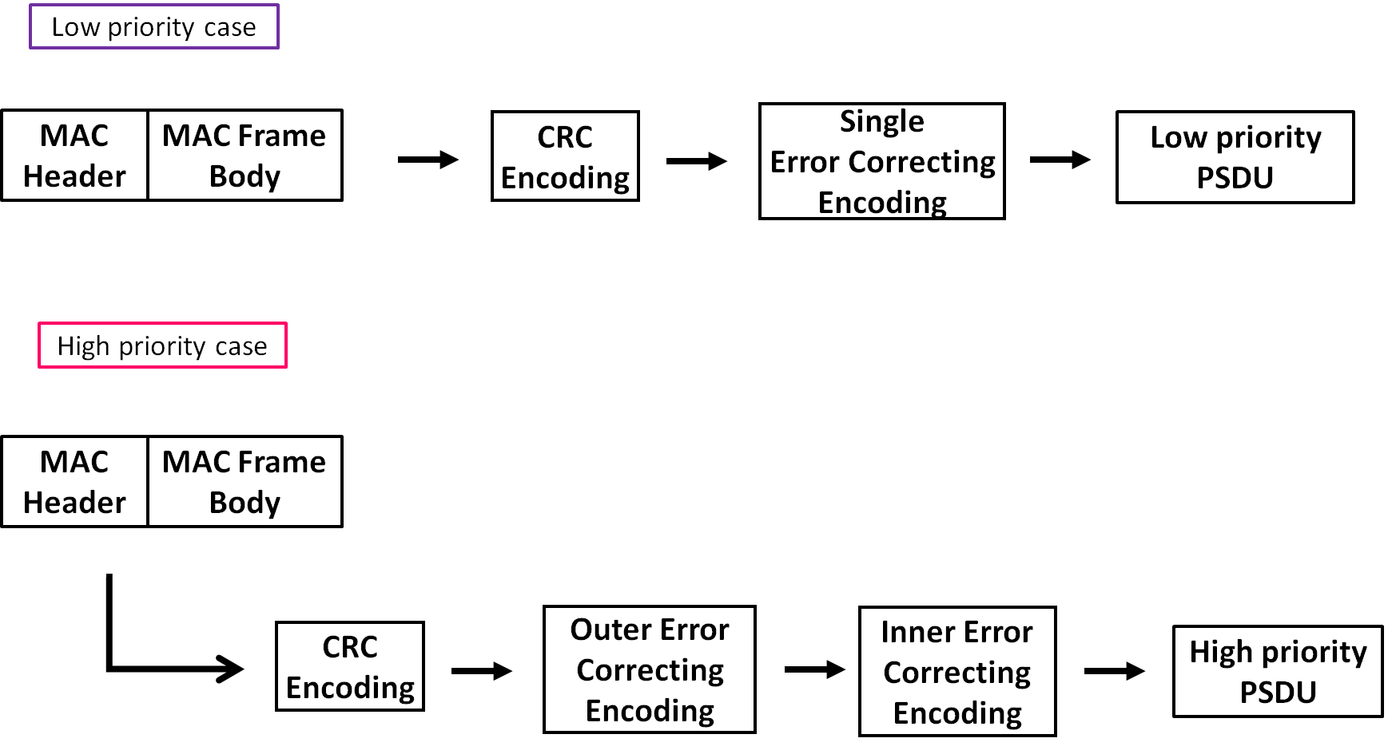
Concept of channel coding for PSDU
In a low priority QoS case, only a single error correcting code will be applied for PSDU
In a high priority QoS case, an outer and an inner error correcting codes will be serially applied for PSDU
MPDU is encoded by CRC-16-CCITT to detect bit errors

Slide 6
Table for Concept
User priority | Inner code | Outer code | HARQ
0 | 15.4ab LDPC or BCC (R=1/2) |  | -
1 | 15.4ab LDPC or BCC (R=1/2) |  | -
2 | 15.4ab LDPC or BCC (R=1/2) |  | -
3 | 15.4ab LDPC or BCC (R=1/2) |  | -
4 | 15.4ab LDPC or BCC (R=1/2) | (54, 46) shortened RS code | -
5 | 15.4ab LDPC or BCC (R=1/2) | (54, 38) shortened RS code | -
6 | 15.4ab LDPC or BCC (R=1/2) | (54, 28) shortened RS code | -
7 | 15.4ab LDPC or BCC (R=1/2) | (54, 14) shortened RS code | -
As an outer code, shortened Reed-Solomon (RS) codes with N=54 (original code length N=63) will be selected to correct burst errors due to interference from other WBANs and the coding rates are changed according to each QoS and channel condition
As an inner code, 15.4ab LDPC (K=324, 648, 972, R=1/2) or BCC will be selected for the coexistence of 15.6ma and 15.4ab
This updated concept table is considered as the first priority
Notes:
N=54 shortened Reed-Solomon codes has 324 bits code length (m=6, 54*6=324)
Hence, this code length matches the information bit length of 15.4ab LDPC codes in multiples
For low QoS case, original 15.6 BCH codes will be applied as a one idea
Coexistence class 0~7

Slide 7
Evaluations (Only RS)
Bit error ratio of (54,46), (54,38), (54,28), (54,14) shortened RS codes and no encoding were evaluated under an
AWGN channel and BPSK modulation
Performances were improved as the coding rate decreased

Slide 8
Evaluations (BCC and RS)
Inner code: BCC (R=1/2), soft decision Viterbi decoding
Outer code: (54,46), (54,38), (54,28), (54,14) shortened RS codes and no encoding
Performances were improved as the coding rate of the RS codes decreased
Low coding rate cases was able to correct a lot of bit errors
AWGN channel and BPSK modulation

Slide 9
Evaluations (LDPC and RS)
Inner code: LDPC (N=1296-bit, R=1/2)
Outer code: (54,46), (54,38), (54,28), (54,14) shortened RS codes and no encoding
There was almost no change in performance regardless of the coding rate of the RS code
Next slide adds another element to check the effectiveness of these combinations
AWGN channel and BPSK modulation

Slide 10
Evaluations (LDPC and RS)
Inner code: N=1296-bit (R=1/2) LDPC code
Outer code: (54,46), (54,38), (54,28), (54,14) shortened RS codes and no encoding
Performances were improved as the coding rate of the RS code decreased
Low coding rate cases could correct a lot of error and erasure
AWGN channel and BPSK modulation
Burst erasure occurs at 32.5% of the code length of the LDPC code (70 consecutive 6-bit erasures)

Slide 11
Considering Shadowing Case
The PDF of shadowing in path-loss is as follows:
$$g\left(y\right)=\frac{1}{\sqrt{2πσ_{s}^{2}}}\exp\left(−\frac{{\left(y−μ_{s}\right)}^{2}}{2σ_{s}^{2}}\right)$$
From the above, the voltage amplitude ratio follows a log-normal distribution, and the PDF is as follows:
$$f\left(x\right)=\frac{1}{\sqrt{2π{\left(\frac{σ_{s}}{a}\right)}^{2}}x}\exp\left(−\frac{{\left(\ln{x}−\frac{μ_{s}}{a}\right)}^{2}}{2{\left(\frac{σ_{s}}{a}\right)}^{2}}\right)$$
$μ_{s}$: mean of shadowing [dB]
$σ_{s}$: standard deviation of shadowing [dB]
$μ=\frac{μ_{s}}{a}$: mean of logarithmic amplitude ratio
$σ=\frac{σ_{s}}{a}$: standard deviation of logarithmic amplitude ratio
PDF of log-normal distribution ($μ=0, σ=0.31$)

Slide 12
Evaluation (Shadowing Case)
BPSK modulation
AWGN and Shadowing
・w/o coding
・Only RS
・Only LDPC
RS parameter
Code length: 324 bits
LDPC parameter
Code length: 1296 bits
Fading parameter
Variance: 2.69 [dB]

Slide 13
Summary of Concept Tables
Inner code: 15.4ab BCC and LDPC codes (R=1/2, K=324, 648, 972)
Outer code: Shortened RS code (N=54, K=46, 38, 28, 14, original code length N=63)
A hybrid ARQ shall not be utilized under coexistence environment class 0~6
Shortened RS codes outperform only half-rate LDPC code in the case of the shadowing channel and high SNR
We aim to evaluate the proposed combination in other practical channel models

Slide 14
Thank you for your attention ! ! !

Slide 15
Another evaluation
Inner code: N=1296-bit (R=1/2) LDPC code
Outer code: (54,46), (54,38), (54,28), (54,14) shortened RS codes and no encoding
Performances were improved as the coding rate of the RS code decreased
AWGN channel (SNR=10dB) and BPSK modulation, burst erasure occurs at 30~40% of the code length of the LDPC code (65-86 consecutive 6-bit erasures)

