Slide 1
UWB in ITS - ETSI TC ITS work item -
Date: 2023-07-07
Authors:

Slide 2
Abstract
This contribution presents an initial overview over the further development of the WI “UWB in ITS” in ETSI TC ITS WG2. The work item has bee created in April 2023. As a result a ETSI TR will be developed to present the possibilities of UWB technologies in a cooperative ITS system like ETSI ITS-G5. An initial draft version of TR 103 970 is available.

Slide 3
Introduction
UWB technologies have some unique characteristics for the use in vehicular environments which has resulted in the deployment of UWB in a broad range of vehicles.
Actually, these UWB based functionalities need not to be interoperable between different vehicles or manufacturers.
Typically, several UWB devices are already build into a car.
By extending the capability of these devices to be able to cooperate with other cars and objects a broad range of additional applications could be possible

Slide 4
Some existing UWB based vehicular use-cases
Secure keyless entry systems
In-cabin sensor application for child-left-behind application
Intrusion detection applications
Most of these applications don’t need to interoperate with other cars, persons or objects.

Slide 5
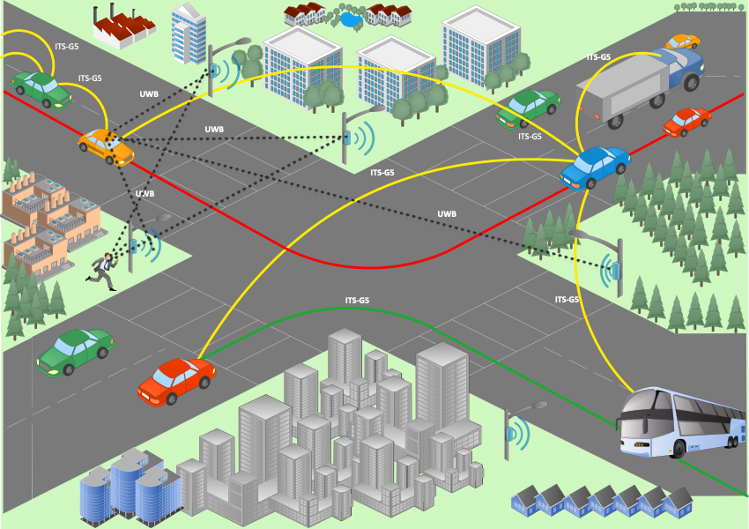
UWB in C-ITS
Example of using UWB in a C-ITS systems ETSI ITS-G5
Goal:
enhanced and secure cooperative positioning
Secure VRU clustering
Use of existing standardized cooperative messages as integral part of C-ITS
In some case UWB communication could be envisaged.

Slide 6
Spectrum regulatory considerations
New ECC Decision (06)04 allows the use of UWB in vehicles and fixed outdoor infrastructure for tracking purposes in the band 6.0 GHz to 8.5 GHz
Based on this decision a new CEPT Report 84 has been created on CEPT level and will be published soon.
CEPT Report 84 will be used by the EU commission to update the European UWB decision and thus make this new frame-work mandatory in the EU (harmonized regulation).
New WI has been started in CEPT/ECC with the goal of an UWB band extension up to 10.6 GHz (goal to keep existing application / rule categories).
Main issue in the band above 6.0 GhHz to 7.4 GHz is the coexistence with other wireless systems including RLAN and potentially IMT-2020 in the future

Slide 7
Conclusion
By integration of existing UWB devices into a cooperative ITS system synergetic effects can be exploited
Secure and trusted ranging operation can improve performance of C-ITS e.g. for:
Vulnerable Road User clustering and positioning (pedestrian, cyclist, motorbike)
Precise lane identification
Maneuver coordination for highly automated vehicles
Required: Move towards standardized ranging and positioning operation taking advantage of existing protocol and communication media like set of ETSI ITS standards

