Slide 1
Project: IEEE P802.15 Working Group for Wireless Speciality Networks (WSN)
Submission Title: Simulation Scenarios for the Assessment of Reflective Intelligent Surfaces in THz Backhaul Applications
Date Submitted: 9 July 2023
Source: Thomas Kürner, TU Braunschweig
Address Schleinitzstr. 22, D-38092 Braunschweig, Germany
Voice:+495313912416, FAX: +495313915192, E-Mail: t.kuerner@tu-braunschweig.de
Re: n/a
Abstract: This document provides information on simulation scenarios for the assessment of reflecting intelligent surfaces (IRS). IRS are seen as an enabler for NLOS backhaul connections using THz links as defined in IEEE Std 802.15.3d-2017. The work is carried out within the Horizon Europe 6G SNS Project TERRAMETA (TERahertz ReconfigurAble METAsurfaces for ultra-high rate wireless communications).
Purpose: Information of IEEE 802.15 SC THz
Notice: This document has been prepared to assist the IEEE P802.15. It is offered as a basis for discussion and is not binding on the contributing individual(s) or organization(s). The material in this document is subject to change in form and content after further study. The contributor(s) reserve(s) the right to add, amend or withdraw material contained herein.
Release: The contributor acknowledges and accepts that this contribution becomes the property of IEEE and may be made publicly available by P802.15.

Slide 2



TERRAMETA
Simulation Scenarios for the Assessment of Reflective Intelligent Surfaces in THz Backhaul Applications
Bo Kum Jung, Thomas Kürner – TU Braunschweig
This project has received funding from Horizon Europe, the European Union’s Framework Programme for Research and Innovation, under grant agreement 101097101. The project is supported by 6G SNS and its members (including top-up funding by UK Research and Innovation (UKRI) under the UK government’s Horizon Europe funding guarantee).
Views and opinions expressed are however those of the authors only and do not necessarily reflect those of the European Union, 6G SNS or UKRI. The European Union, 6G SNS or UKRI cannot be held responsible for them.

Slide 3
Motivation RIS in THz Backhaul Link
Backhaul link is a communication channel between core network and access node
THz backhaul link can provide high data rates, and reduce installation time and cost
Requirements
  High gain antenna
  LoS condition
  Specular reflection in specific case

Slide 4

Motivation RIS in THz Backhaul Link
RIS?
Any programmable surface that can manipulate electromagnetic waves
How can the use of RIS improve THz backhaul networks?
Signal

Slide 5
Agenda
RIS use cases in THz backhaul
Simulation scenario
Simulation tool
Conclusion and future aspects

Slide 6
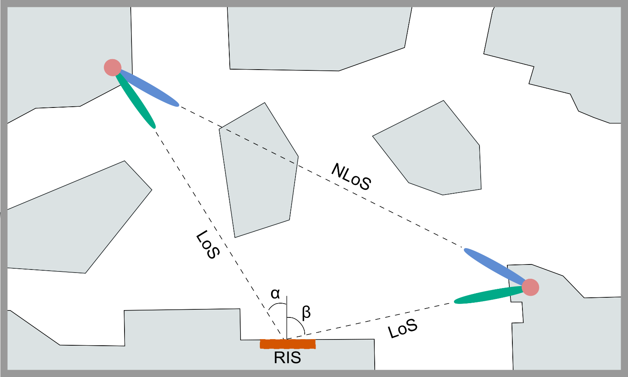
RIS Use Cases in THz Backhaul Links
Use case 1
More THz backhaul links
Non specular reflection
Freedom of placement
Use case 1

Slide 7
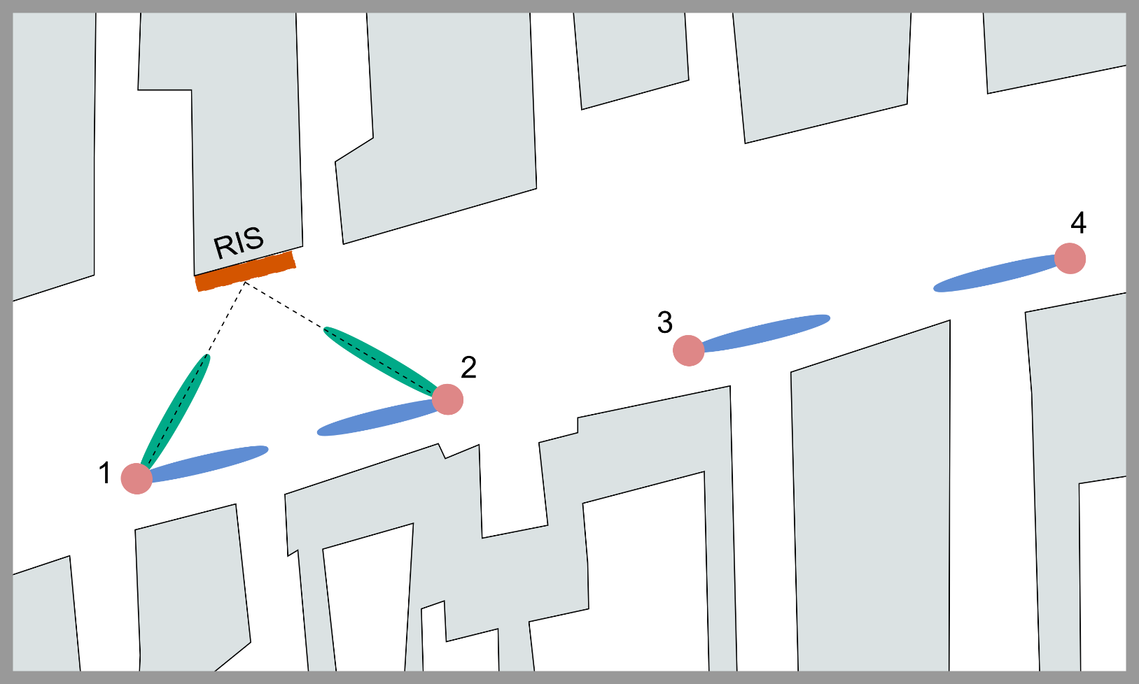
RIS Use Cases in THz Backhaul Links
Use case 2
Relaxing high interference
  High SINR
  Advanced MCS
  High data transmission
Street level deployment
  Lamp-site
  Artificial tree
Use case 2

Slide 8
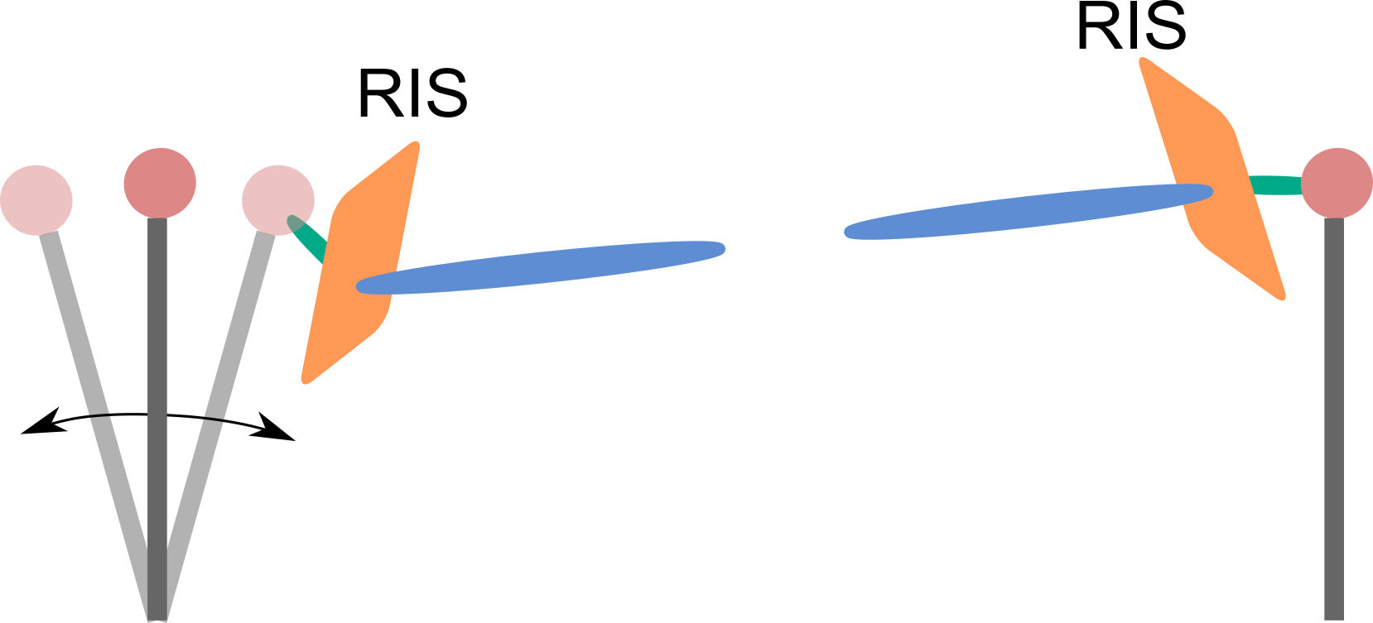
RIS Use Cases in THz Backhaul Links
Use case 3
Beam management
Antenna misalignment
  Wind
  Skilled manpower
Ease of control
  Geometrical change
Use case 3

Slide 9
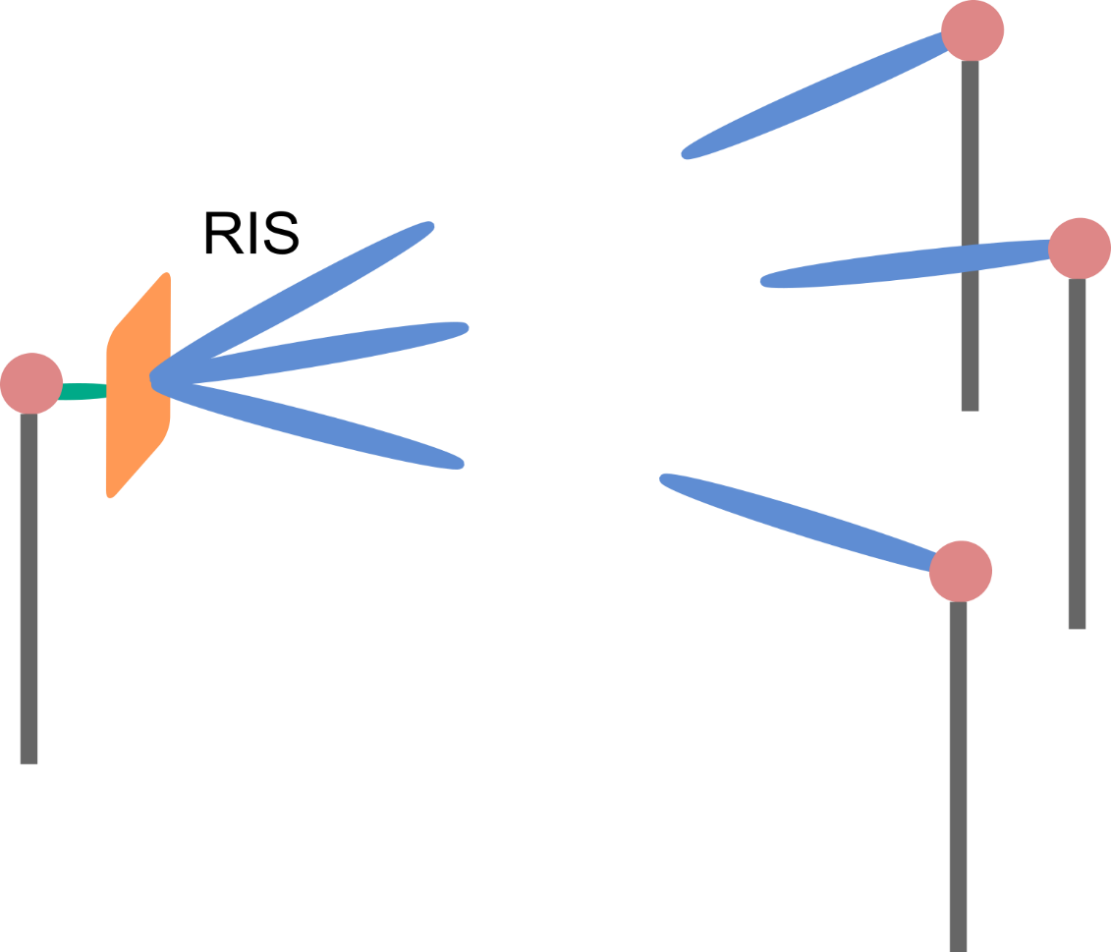
RIS Use Cases in THz Backhaul Links
Use case 4
Increase connectivity
  Time variant
  Spatial variant
Antenna reduction
  Cost
  Effort
Use case 4

Slide 10
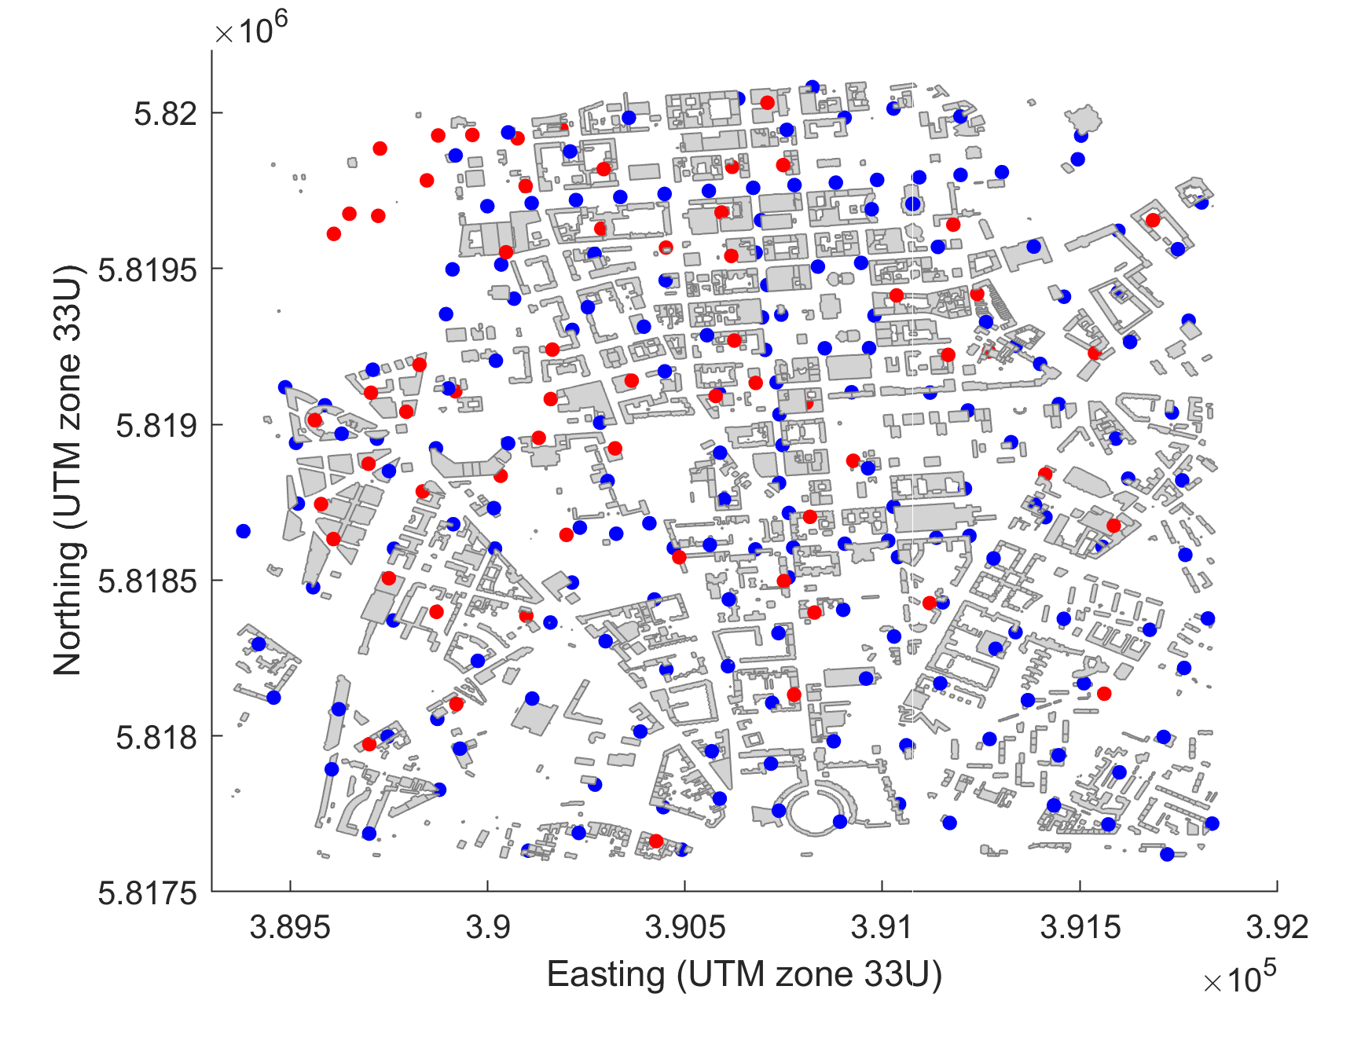
Simulation Scenario
Cell deployment scenario
City center of Berlin
  62 macro cell sites (red)
  176 small cell sites (blue)
50% of small cell sites
  Lamp-post sites 4m above the ground
50% of small cell sites
  1m above the rooftop of buldings

Slide 11
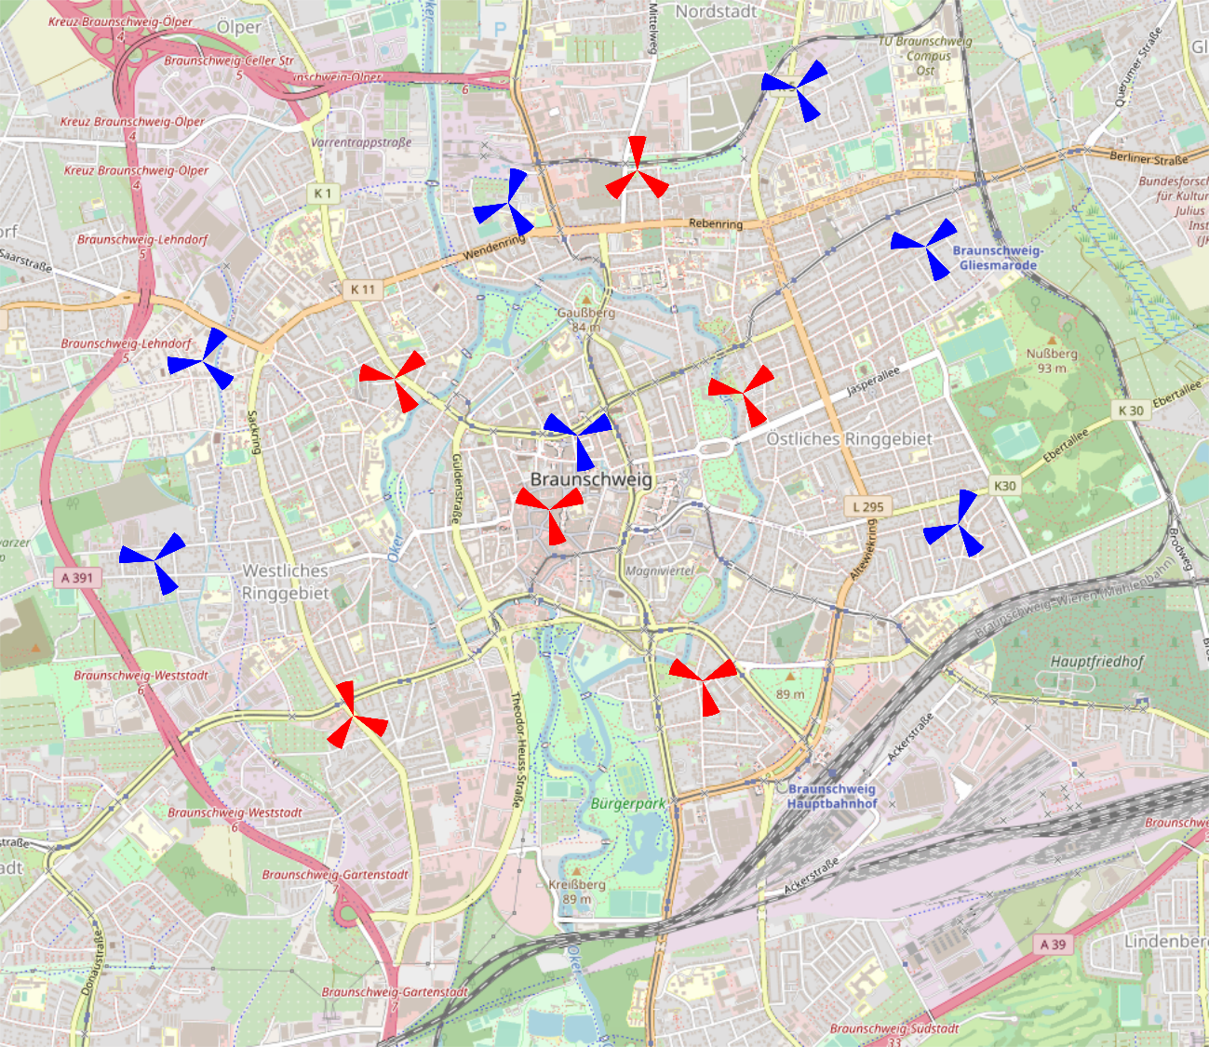
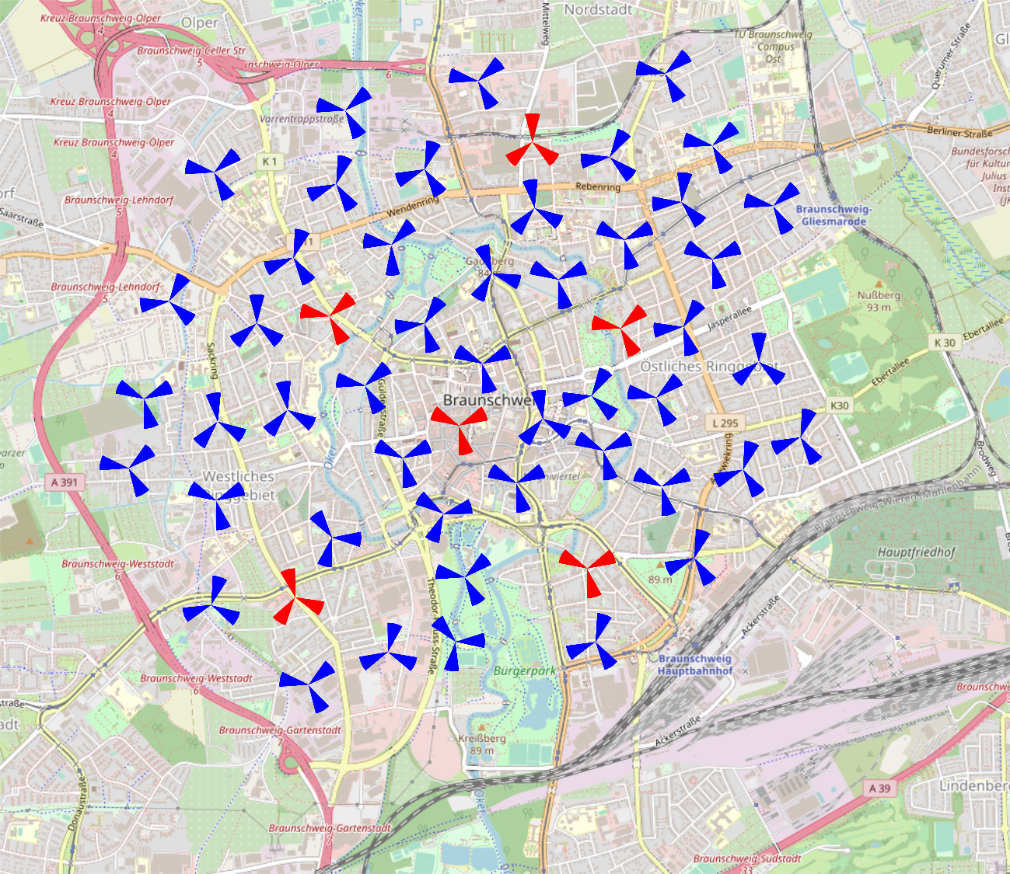
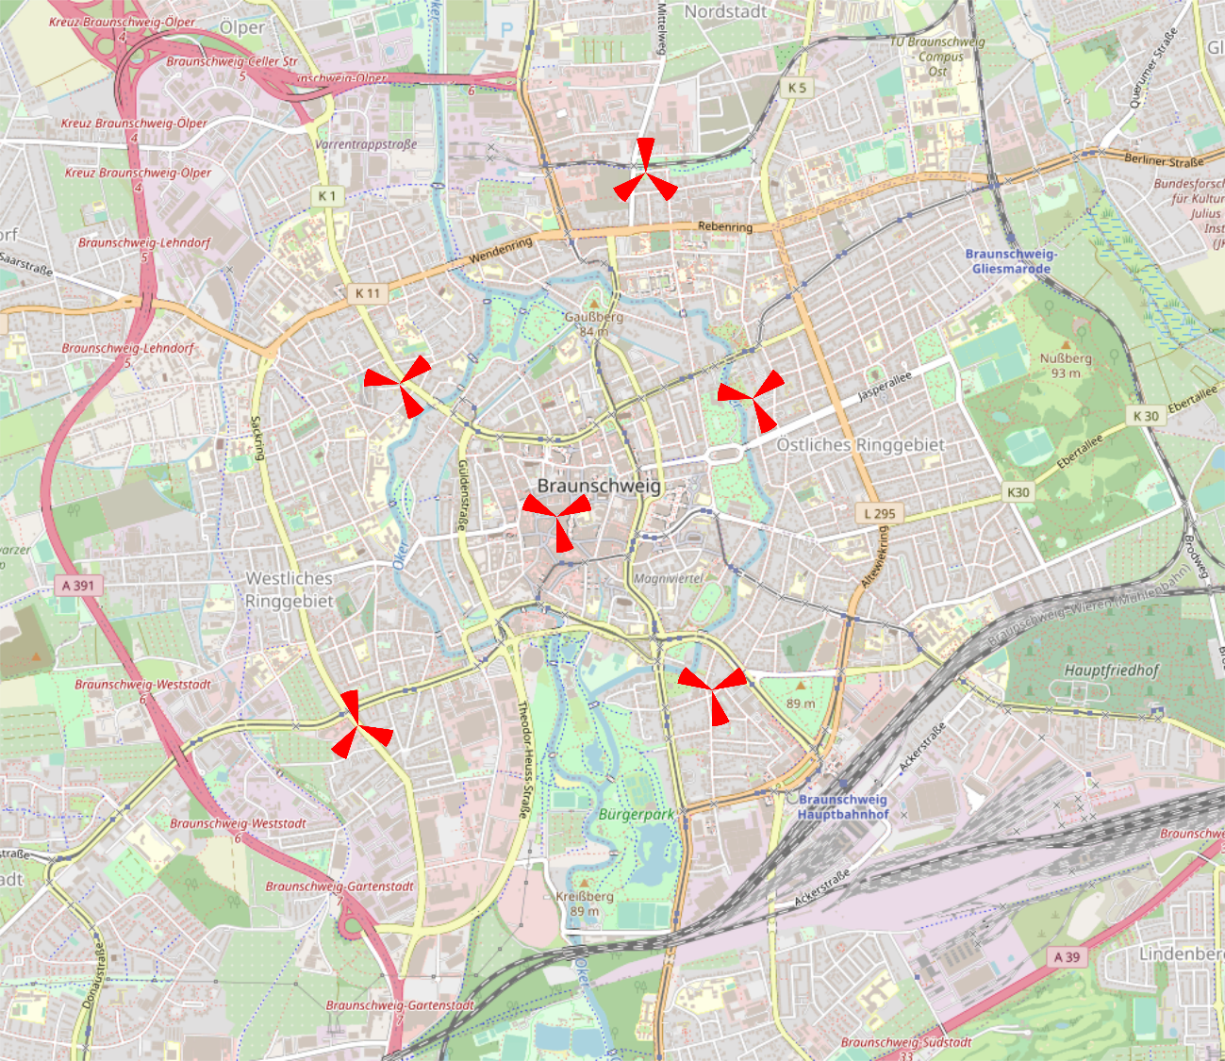
Simulation Scenario
Motivation of automatic planning algorithm for backhaul links
Planning THz backhaul links by hand is feasible
Planning THz backhaul links turns into non-deterministic polynomial problem
Reducing planning effort for backhaul links
Planning THz backhaul links by hand is feasible

Slide 12

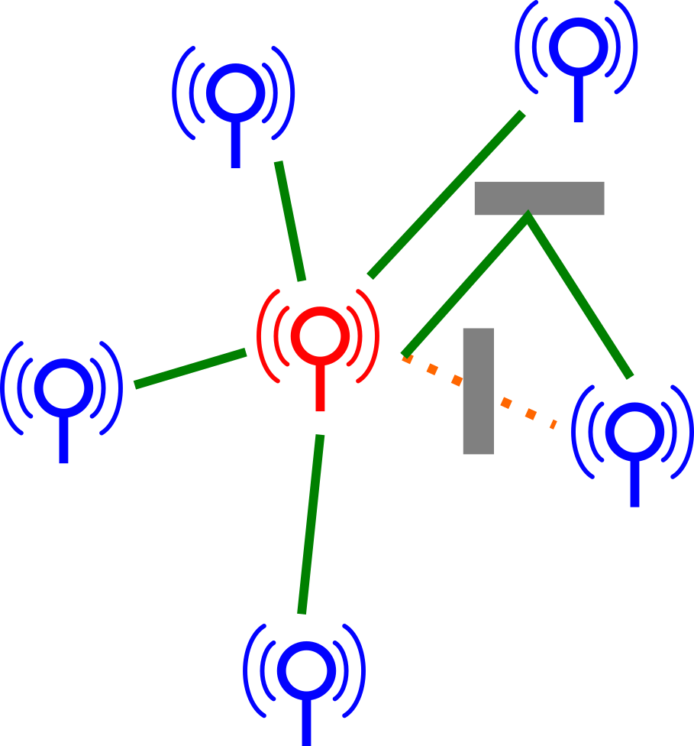
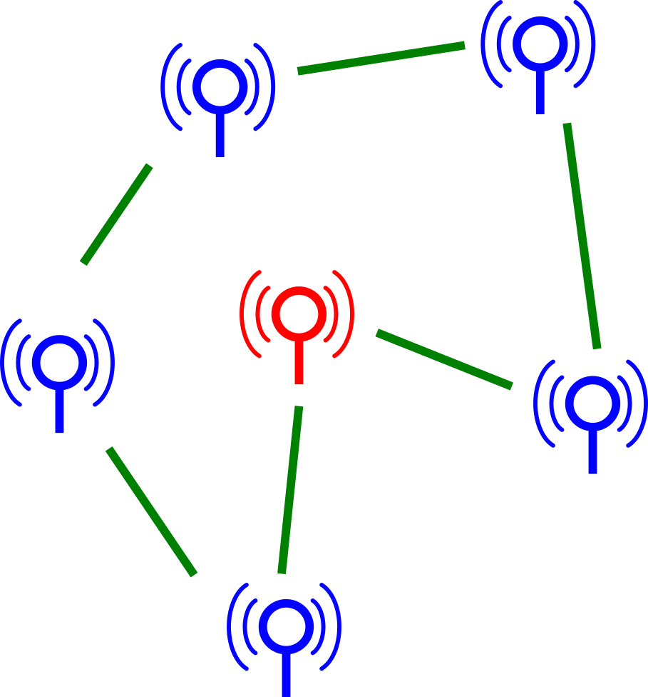
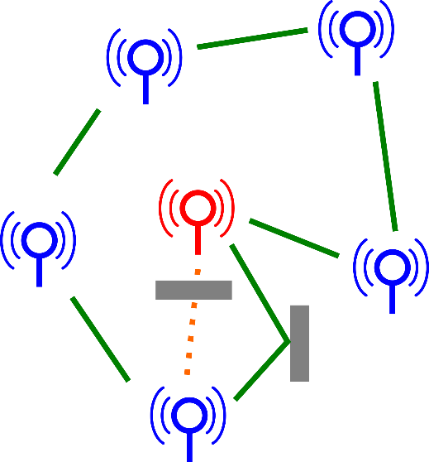
Simulation Scenario
Introduced automatic planning algorithm for backhaul links
Star topology
Ring topology
LoS
LoS & NLoS
LoS
LoS & NLoS
B. K. Jung, N. Dreyer, J. M. Eckhard and T. Kürner, "Simulation and Automatic Planning of 300 GHz Backhaul Links," 2019 44th International Conference on Infrared, Millimeter, and Terahertz Waves (IRMMW-THz), 2019, pp. 1-3, doi: 10.1109/IRMMW-THz.2019.8873734.
T. Kürner and B. K. Jung, "Automatic Planning of NLOS Backhaul Links at 300 GHz arranged in Star Topology," 2021 XXXIVth General Assembly and Scientific Symposium of the International Union of Radio Science (URSI GASS), 2021, pp. 1-3, doi: 10.23919/URSIGASS51995.2021.9560305.
B. K. Jung and T. K̈ürner, "Automatic Planning Algorithm of 300 GHz Backhaul Links Using Ring Topology," 2021 15th European Conference on Antennas and Propagation (EuCAP), 2021, pp. 1-5, doi: 10.23919/EuCAP51087.2021.9411010.
B. K. Jung and T. K̈ürner, "EuCAP2023_Simulation and Automatic Planning of NLoS Backhaul Links at 300 GHz using Ring Topology," 2023 17th European Conference on Antennas and Propagation (EuCAP), 2023, pp. 1-5.

Slide 13
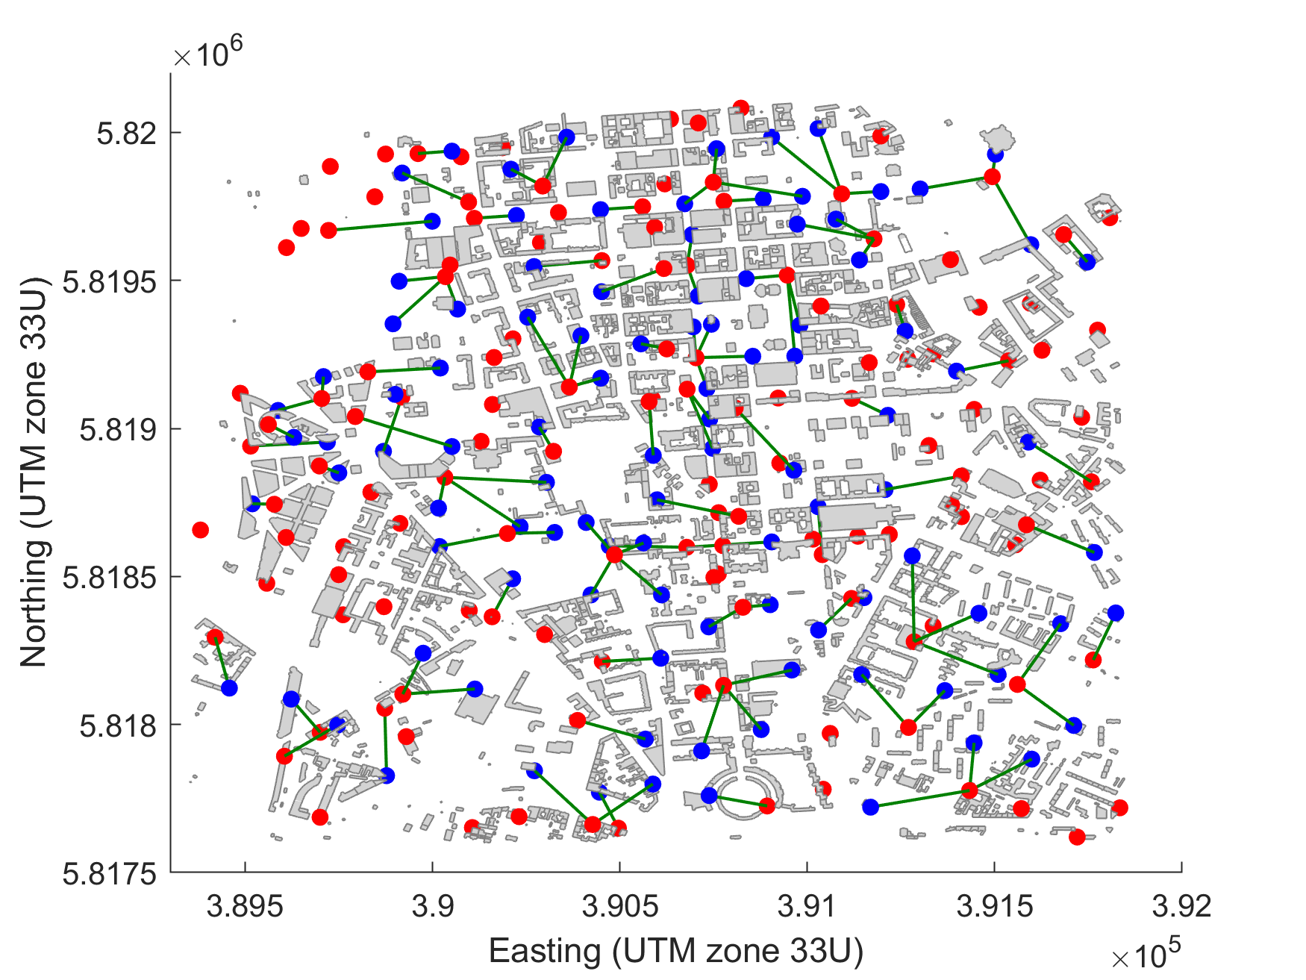
Simulation Scenario
Automatic planning algorithm for backhaul links
Star LoS
  300 m link distance
  4 deg angle margin
THz backhaul available at 104 out of 176 small cell sites

Slide 14
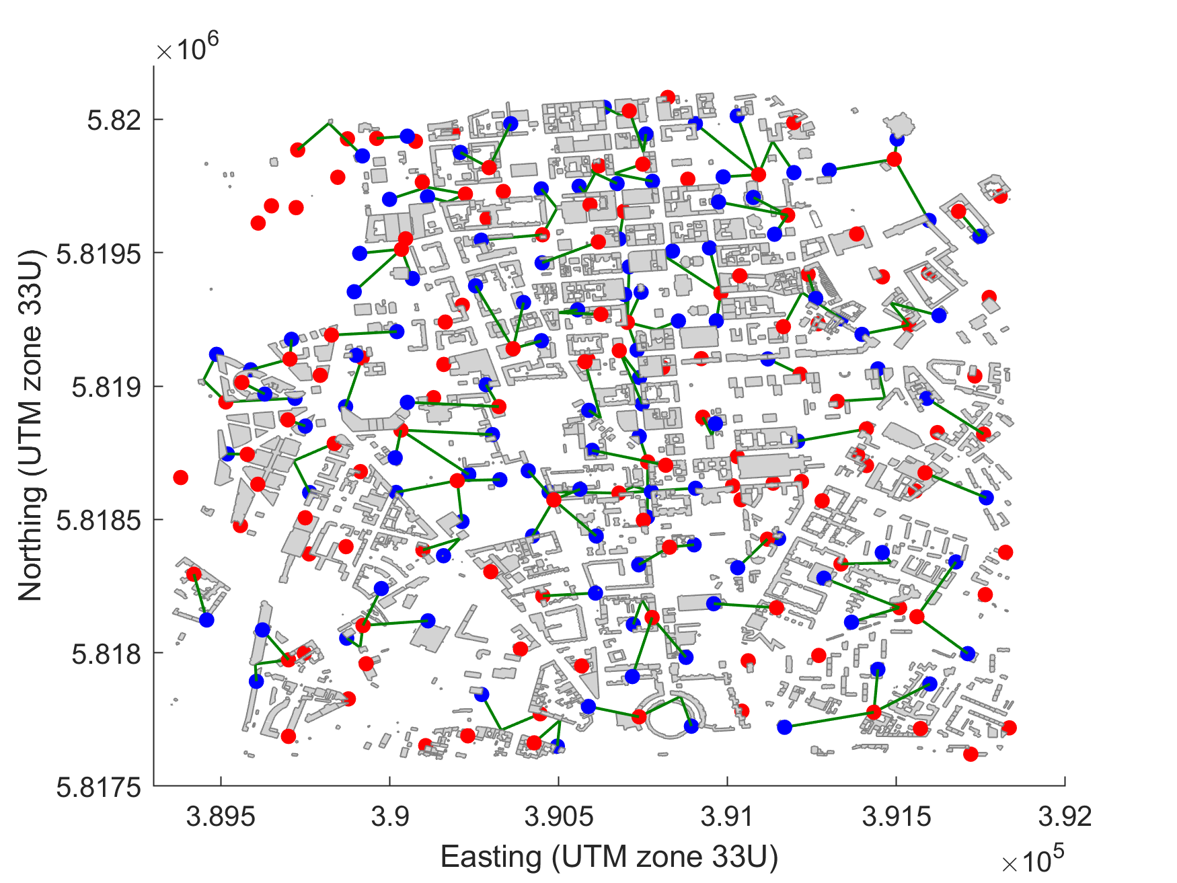
Simulation Scenario
Automatic planning algorithm for backhaul links
Star NLoS
  300 m link distance
  4 deg angle margin
THz backhaul available at 111 out of 176 small cell sites

Slide 15
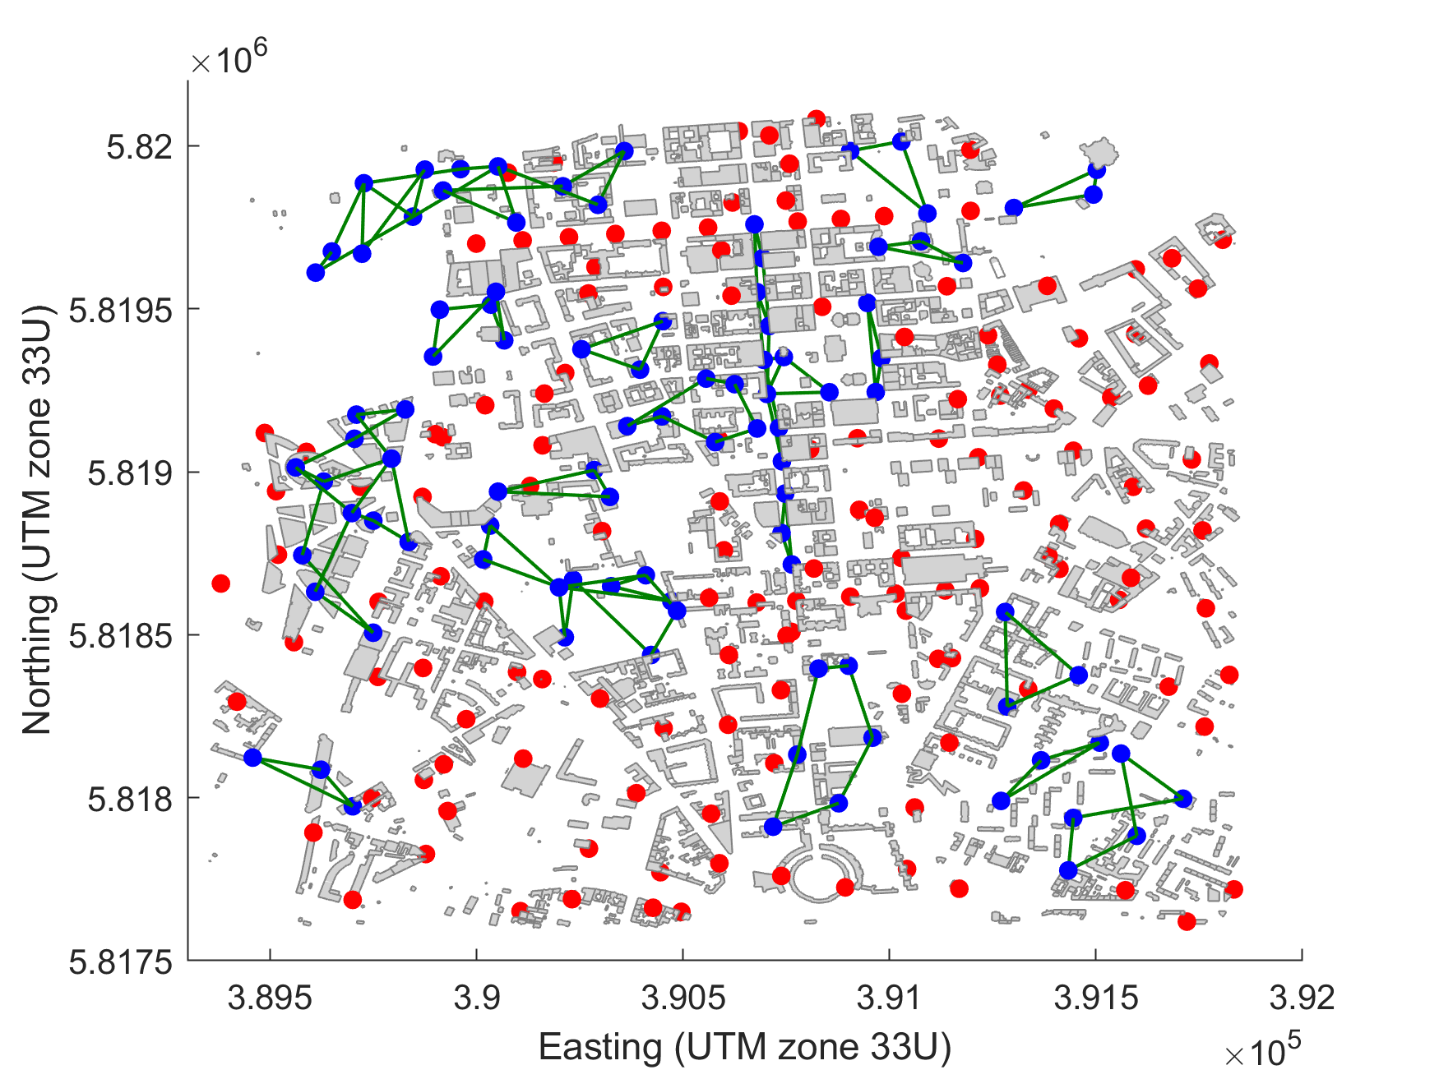
Simulation Scenario
Automatic planning algorithm for backhaul links
Ring LoS
  300 m link distance
  4 deg angle margin
  6 ring candidates
26 ring cluster
THz backhaul available at 71 out of 176 small cell sites

Slide 16
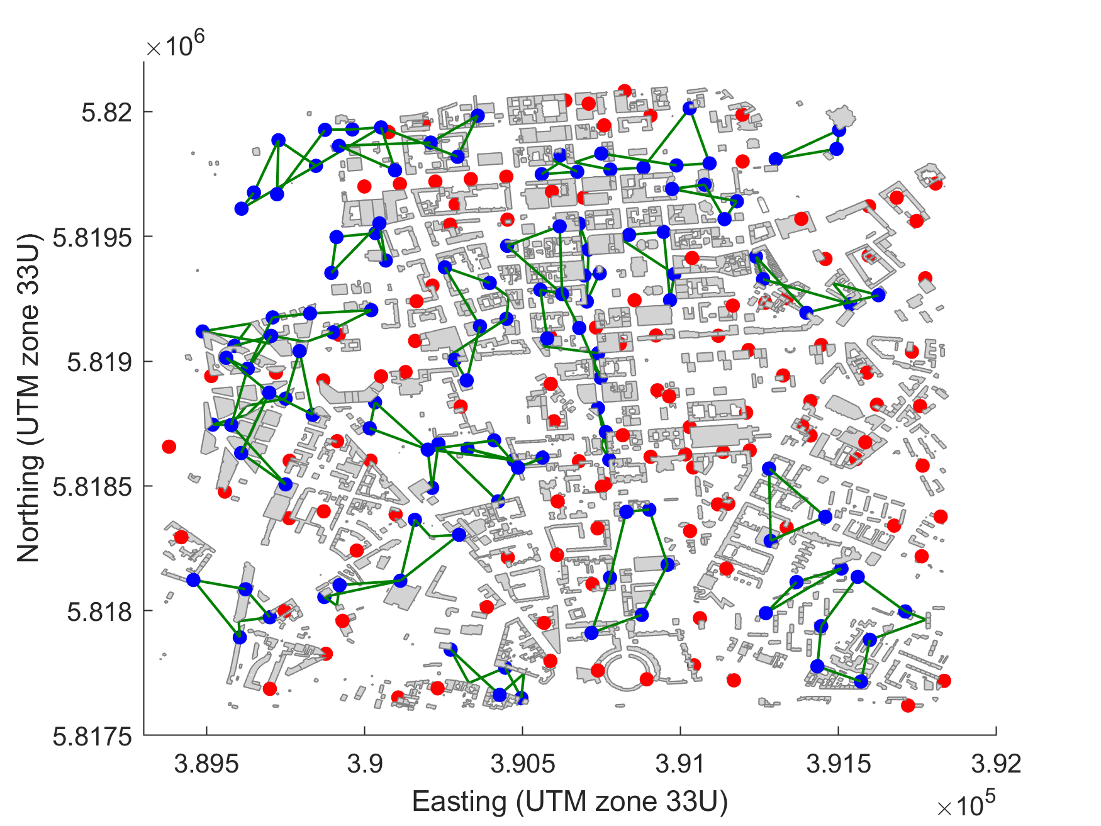
Simulation Scenario
Automatic planning algorithm for backhaul links
Ring NLoS
  300 m link distance
  4 deg angle margin
  6 ring candidates
30 ring cluster
THz backhaul available at 94 out of 176 small cell sites

Slide 17
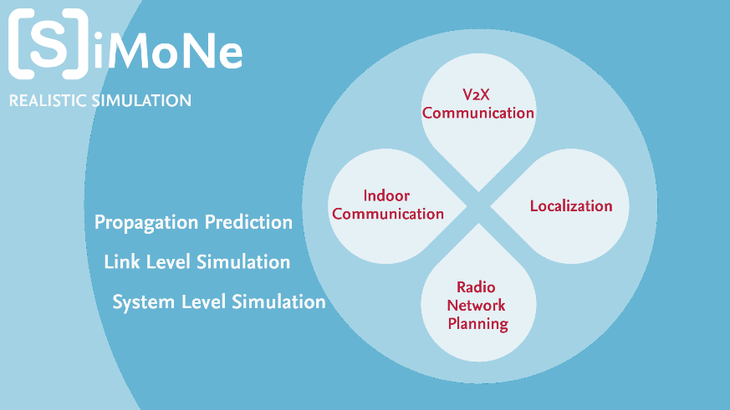
Simulation Tool
The Simulator for Mobile Networks - SiMoNe

Slide 18

Simulation Tool
Tool-chain for simulations
3D-Modelling Tool
Ray Tracer
System Level Simulator
Channel Information
Link Level Simulator

Slide 19
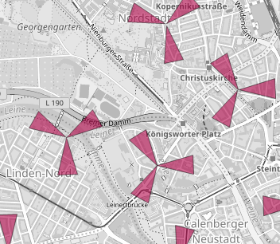
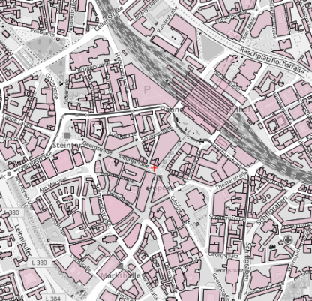
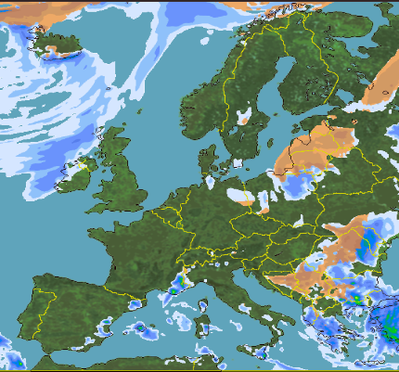
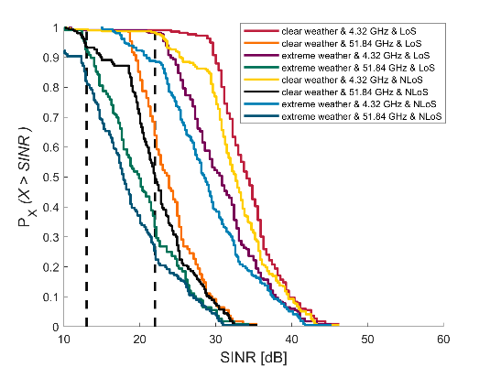
Simulation Tool
System level simulation
Network
Building Data
Weather condition
It models the functionality of overall mobile networks
Impact of weather conditions on the THz backhaul links is included for the assessment
Assessment of SINR values
      Achievable data rate
SINR

Slide 20
Simulation Tool
Link level simulation
Link Level Simulator models a bit transmission chain
Coordination and steering, signal plotting and KPI exports handled by central instances
Functionalities encapsulated in blocks and can be changed or extended
Coordinator
Bit Source
Encoder
Interleaver
Modulator
Ray-Tracing
Channel
Beam Steering
Bit Sink
Decoder
Deinterleaver
Detector
Sampling
RF Impairments
Signal Plotting
KPI Export

Slide 21
Conclusion & Future Aspects
Four RIS‘s use cases in THz backhaul links are identified
    Better connectivity
    Interference management
    Antenna alignment
    Beam splitting (antenna reduction)
Use cases of RIS will be assessed in THz backhaul networks planned with the automatic backhaul planning algorithm
The assessment will be completed exploiting an in-house developed simulation tool (SiMoNe) both at system and link level plane

Slide 22

Funding Acknowledgements
This project has received funding from Horizon Europe, the European Union’s Framework Programme for Research and Innovation, under grant agreement 101097101. The project is supported by 6G SNS and its members (including top-up funding by UK Research and Innovation (UKRI) under the UK government’s Horizon Europe funding guarantee)

Slide 23
Thank you for your attention!

