Slide 1
Project: IEEE P802.15 Working Group for Wireless Personal Area Networks (WPANs)
Submission Title: [Public advertisement for NBA-UWB MMS native discovery follow-up]
Date Submitted: [July, 2023]
Source: [Hongwon Lee, Insun Jang, Jinsoo Choi, HanGyu Cho(LG Electronics)]
Email: hongwon.lee@ lge.com
Re: []
Abstract: [Public initialization setup handshake and ranging session for NBA-UWB MMS]
Purpose: []
Notice: This document has been prepared to assist the IEEE P802.15. It is offered as a basis for discussion and is not binding on the contributing individual(s) or organization(s). The material in this document is subject to change in form and content after further study. The contributor(s) reserve(s) the right to add, amend or withdraw material contained herein.
Release: The contributor acknowledges and accepts that this contribution becomes the property of IEEE and may be made publicly available by P802.15.

Slide 2
PAR Objective | Proposed Solution (how addressed)
Safeguards so that the high throughput data use cases will not cause significant disruption to low duty-cycle ranging use cases
Interference mitigation techniques to support higher density and higher traffic use cases
Other coexistence improvement
Backward compatibility with enhanced ranging capable devices (ERDEVs)
Improved link budget and/or reduced air-time
Additional channels and operating frequencies
Improvements to accuracy / precision / reliability and interoperability for high-integrity ranging
Reduced complexity and power consumption
Hybrid operation with narrowband signaling to assist UWB
Enhanced native discovery and connection setup mechanisms | Public initialization setup handshake and ranging session for NBA-UWB MMS
Sensing capabilities to support presence detection and environment mapping
Low-power low-latency streaming
Higher data-rate streaming allowing at least 50 Mbit/s of throughput
Support for peer-to-peer, peer-to-multi-peer, and station-to-infrastructure protocols
Infrastructure synchronization mechanisms

Slide 3
Related Contributions
[1] Public advertisement for NBA-MMS UWB
H. Lee (LGE) et al., May. 2023
[2] NBA-MMS-UWB ranging text proposal for 15.4ab TFD
A. Krebs (Apple) et al., Nov. 2022
[3] NBA-MMS-UWB compressed psdu details
A. Krebs (Apple) et al., May 2023
[4] Compressed PSDU for One-to-Many Ranging using NBA-MMS
J. Jiang (Apple), et al., May. 2023

Slide 4
Background
Public(non-private) advertisement method is introduced in [1]
For public advertisement, following features are proposed
New Compressed PSDU message ID: PUBLIC-ADV-POLL, PUBLIC-ADV-RESP, PUBLIC-SOR
Packet format for PUBLIC-ADV-POLL, PUBLIC-ADV-RESP, PUBLIC-SOR
For public addresses of PULIBC-{ADV-POLL, ADV-RESP, SOR}, we have to consider compressed PSDU size
After initialization using PUBLIC-{ADV-POLL, ADV-RESP, SOR}, privacy protected addressing method for ranging session can be used to reuse POLL, RESP and REPORT messages
To use privacy protected address, IdentityReolvingKey is needed to generate hash value for public initialization

Slide 5
Agenda
Public addressing method for initialization setup handshake and session is described in detail
RPA_hash value generation for POLL, RESP and REPORT after public initialization is described in detail

Slide 6
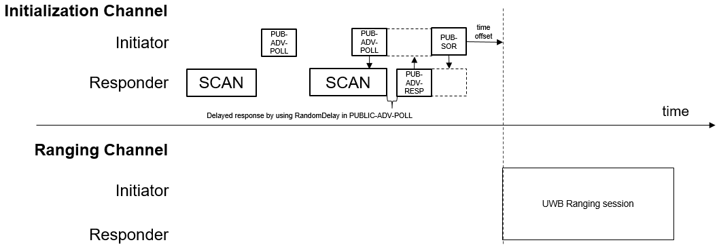
Recap: Public Native Discovery Concept [1]
In [1], Public Native Discovery Concept is introduced
PUBLIC-XXXs have different address field compared with ADV-POLL, ADV-RESP, ADV-CONF and SOR

Slide 7
Public advertisement address
For public advertisement address, extended address is too long to apply to compressed PSDU format. Therefore, shorten address should be applied
There is no PAN ID and related field such as PAN Coordinator field in compressed PSDU format, therefore it may be hard to apply 2 bytes short address from 15.4.
We are considering to apply 3 bytes for public advertisement address(AdvAddr) randomly generated by an initiator
AdvAddr may be used for advertising address of PUBLIC-ADV-POLL. The AdvAddr in PUBLIC-ADV-POLL may be used for destination address of PUBLIC-ADV-RESP and source address of PUBLIC-SOR

Slide 8
Responder’s address for public initialization
Extended address is too long to apply to compressed PSDU format. Therefore, shorten address should be applied for responder’s address for public purpose as well
We are considering to apply 3 bytes for responder’s address during initialization setup handshake
Responder’s 3 bytes address(RespAddr) may be assigned by a responder to reduce additional procedure to obtain address from an initiator
The RespAddr may be set for PUBLIC-ADV-RESP as source address
An initiator can use RespAddr obtained from PUBLIC-ADV-RESP as destination address for PUBLIC-SOR unless duplicated
In the most scenario, the chance of duplication is very low

Slide 9
Recap: Privacy Protected Addresses [3]
Static MAC address in message header has privacy
Resolvable Private Address (RPA) protects against tracking
IdentityResolvingKey[16] (IRK) is commonly known to PAN participants only
prand[3] transmitted in POLL/ADV-POLL every ranging block
hash[3] = AES-128-ECB(key=IRK[16], data=(0x000…[13] || prand[3])) every packet
Privacy Protected Addresses are used for ranging session
IRK is needed to use POLL/RESP/REPORT for public initialization
POLL and ADV-POLL
Other packets

Slide 10
Public IRK for public initialization
Public initialization means unknown devices are discovered each other and establish session setup through public initialization setup handshake
To use existing POLL, RESP and REPORT for public initialization, IdentityResolvingKey(IRK) to generate RPA_hash value is necessary
IRK is commonly known to PAN participants
It may be hard to assign or distribute same IRK among unknown devices for ranging session after public initialization
To generate IRK for public initialization, it may be good option to use the information which both an initiator and a responder know
AdvAddr and RespAddr exchanged through public initialization setup handshake may be used to generate same IRK for both the initiator and the responder.
IRK[16] may be simply generated by concatenating padding, AdvAddr and RespAddr
e.g. AdvAddr[3] = 62:EE:5B, RespAddr[3] = 3F:0A:F8, MSB zero-paded
IRK[16] = 0x0000000000000000000062EE5B3F0AF8

Slide 11
Public initialization and ranging session example
Random address, AdvAddr and RespAddr are used for public initialization setup handshake
For ranging session, IRK value is needed to generate RPA_hash to use POLL, RESP and REPORT
AdvAddr and RespAddr may be used to generate IRK
Initialization Channel
AdvAddr = 62:EE:5B
RespAddr = 3F:0A:F8
AdvAddr = 62:EE:5B
AdvAddr = 62:EE:5B
time
offset
Initiator
PUB-ADV-POLL
PUB-ADV-POLL
PUB-SOR
Initiator’s source address = 62:EE:5B
Initiator’s destination address to the responder = 3F:0A:F8
Responder
SCAN
SCAN
PUB-ADV-RESP
Responder’s source address = 3F:0A:F8
Responder’s destination address to the responder = 62:EE:5B
RespAddr = 3F:0A:F8
AdvAddr = 62:EE:5B
time
Ranging Channel
Address Field: hash + prand
Address Field: hash
Initiator
POLL
UWB RANGING
REPORT
Responder
RESP
REPORT
Address Field: hash
Address Field: hash

Slide 12
RPA_hash value generation and resolution example
Using IRK[16] generated using AdvAddr and RespAddr, RPA_hash value for POLL, RESP, REPORT can be generated
IRK[16] = 0x0000000000000000000062EE5B3F0AF8
prand = Random.new().bytes(3) = 0x2F0A73 ← generated by an initiator
hash[3] = AES-128-ECB(k, r) = AES-128-ECB(0x0000000000000000000062EE5B3F0AF8, 0x000000000000000000000000002F0A73) % 2^24 = 0xBF6200 ← lowermost of 0xF9DB8F01861F2D61971053FFF5BF6200
K = key, r = data
Resolution procedure is same as private session
hash and prand values are shared from POLL by an initiator
Using IRK[16] generated by a responder and prand, localhash can be generated
If hash == loalhash, it is resolved

Slide 13
Recap: One-To-Many Ranging [4]
Responder 1
Responder 2
For one-to-many case, first POLL message in access slot 0 should be broadcasted to responders in one-to-many ranging session
IRK for broadcasting message is necessary in this case

Slide 14
Public IRK for one-to-many public initialization
For one-to-many, there are not only unicast POLL but also broadcast POLL
For broadcast POLL, Group address which are known to whole responders participating in same ranging session is needed
GroupID like group address may be shared during public initialization setup handshake
GroupID represents a group of devices which are participating same ranging session
GroupID may be assigned by an initiator and included to PUBLIC-ADV-POLL to share. If GroupID is not included in PUBlC-ADV-POLL, it may be assigned as 0xFFFFFF
IRK[16] can be simply generated by concatenating AdvAddr and GroupID(MSBs zero padded)
e.g. AdvAddr[3] = 62:EE:5B, GroupID[3] = 98:2E:FF, MSBs zero-paded
IRK[16] = 0x0000000000000000000062EE5B982EFF

Slide 15
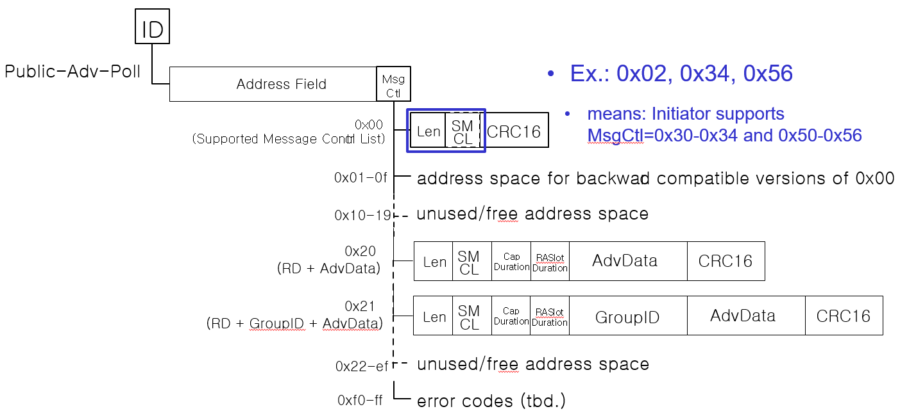
PUBLIC-ADV-POLL packet format with GroupID
GroupID may be 3-octets assigned by an initiator
GroupID shall be unique among other initiators around

Slide 16
Conclusion
Public addresses are proposed for public initialization setup handshake
For public initialization setup handshake, POLL/RESP/REPORT including RPA can be utilized by generating public IRK for ranging session
To generate public IRK, AdvAddr and RespAddr exchanged during handshake may be used for one-to-one ranging
To generate public IRK for one-to-many especially for broadcast POLL, GroupID may be shared through PUBLIC-ADV-POLL and used
Using these public IRKs, original POLL/RESP/REPORT messages for ranging session can be used after public initialization setup handshake

Slide 17
References
[1] H. Lee et al., “Public advertisement for NBA-UWB MMS native discovery”, 15-23-0249-02-04ab.
[2] A. Kreb et al., “NBA-MMS-UWB ranging text proposal for 15.4ab TFD”, 15-22-0381-02-04ab.
[3] A. Kreb et al., “NBA-MMS-UWB compressed psdu details”, 15-23-0258-01-04ab.
[4] J. Jiang et al.,” Compressed PSDU for One-to-Many Ranging using NBA-MMS”, 15-23-0260-02-04ab.

