Slide 1
Project: IEEE P802.15 Working Group for Wireless Personal Area Networks (WPANs)
Submission Title: Channel Impulse Response (CIR) Signal to Quantization Noise (SQNR) Analysis
Date Submitted: May 16, 2023
Source: Steve Shellhammer, Pooria Pakrooh, Bin Tian, and Koorosh Akhavan (Qualcomm)
E-Mail:{sshellha, ppakrooh, btian, kakhavan}@qti.qualcomm.com
Abstract: Here we provide simulation results of the signal to quantization noise level when scaling and quantizing the CIR for the CIR Report.
Notice: This document has been prepared to assist the IEEE P802.15. It is offered as a basis for discussion and is not binding on the authoring individual(s) or organization(s). The material in this document is subject to change in form and content after further study. The authors(s) reserve(s) the right to add, amend or withdraw material contained herein.

Slide 2
PAR Objective | Proposed Solution (how addressed)
Safeguards so that the high throughput data use cases will not cause significant disruption to low duty-cycle ranging use cases
Interference mitigation techniques to support higher density and higher traffic use cases
Other coexistence improvement
Backward compatibility with enhanced ranging capable devices (ERDEVs)
Improved link budget and/or reduced air-time
Additional channels and operating frequencies
Improvements to accuracy / precision / reliability and interoperability for high-integrity ranging
Reduced complexity and power consumption
Hybrid operation with narrowband signaling to assist UWB
Enhanced native discovery and connection setup mechanisms
Sensing capabilities to support presence detection and environment mapping | Here we look at the SQNR of the scaled and quantized CIR for the CIR Report
Low-power low-latency streaming
Higher data-rate streaming allowing at least 50 Mbit/s of throughput
Support for peer-to-peer, peer-to-multi-peer, and station-to-infrastructure protocols
Infrastructure synchronization mechanisms

Slide 3
Introduction
In [1] we described how scaling and quantization of the CIR values can be used to reduce the CIR report size while still maintaining a high signal to noise ratio
In [1] we proposed power-of-two scaling for ease of implementation
Here we describe our scaling and quantization simulation and provide SQNR distribution results
Before going into the simulation, we provide information about the distribution of the UWB Channel model taps

Slide 4
Tap CDF of UWB Channel Model
We set up the UWB Channel model code
We captured 5000 channel realizations for Channel Model 1
We wanted to understand the distribution of these channel model Taps so we could see how that would affect the CIR SQNR simulation
First, we scaled all the taps so that the largest absolute value of all the taps was unity
We dropped all zero value Taps since we are converting to dB
Then we plotted the cumulative distribution function (CDF) of all the taps, in dB

Slide 5
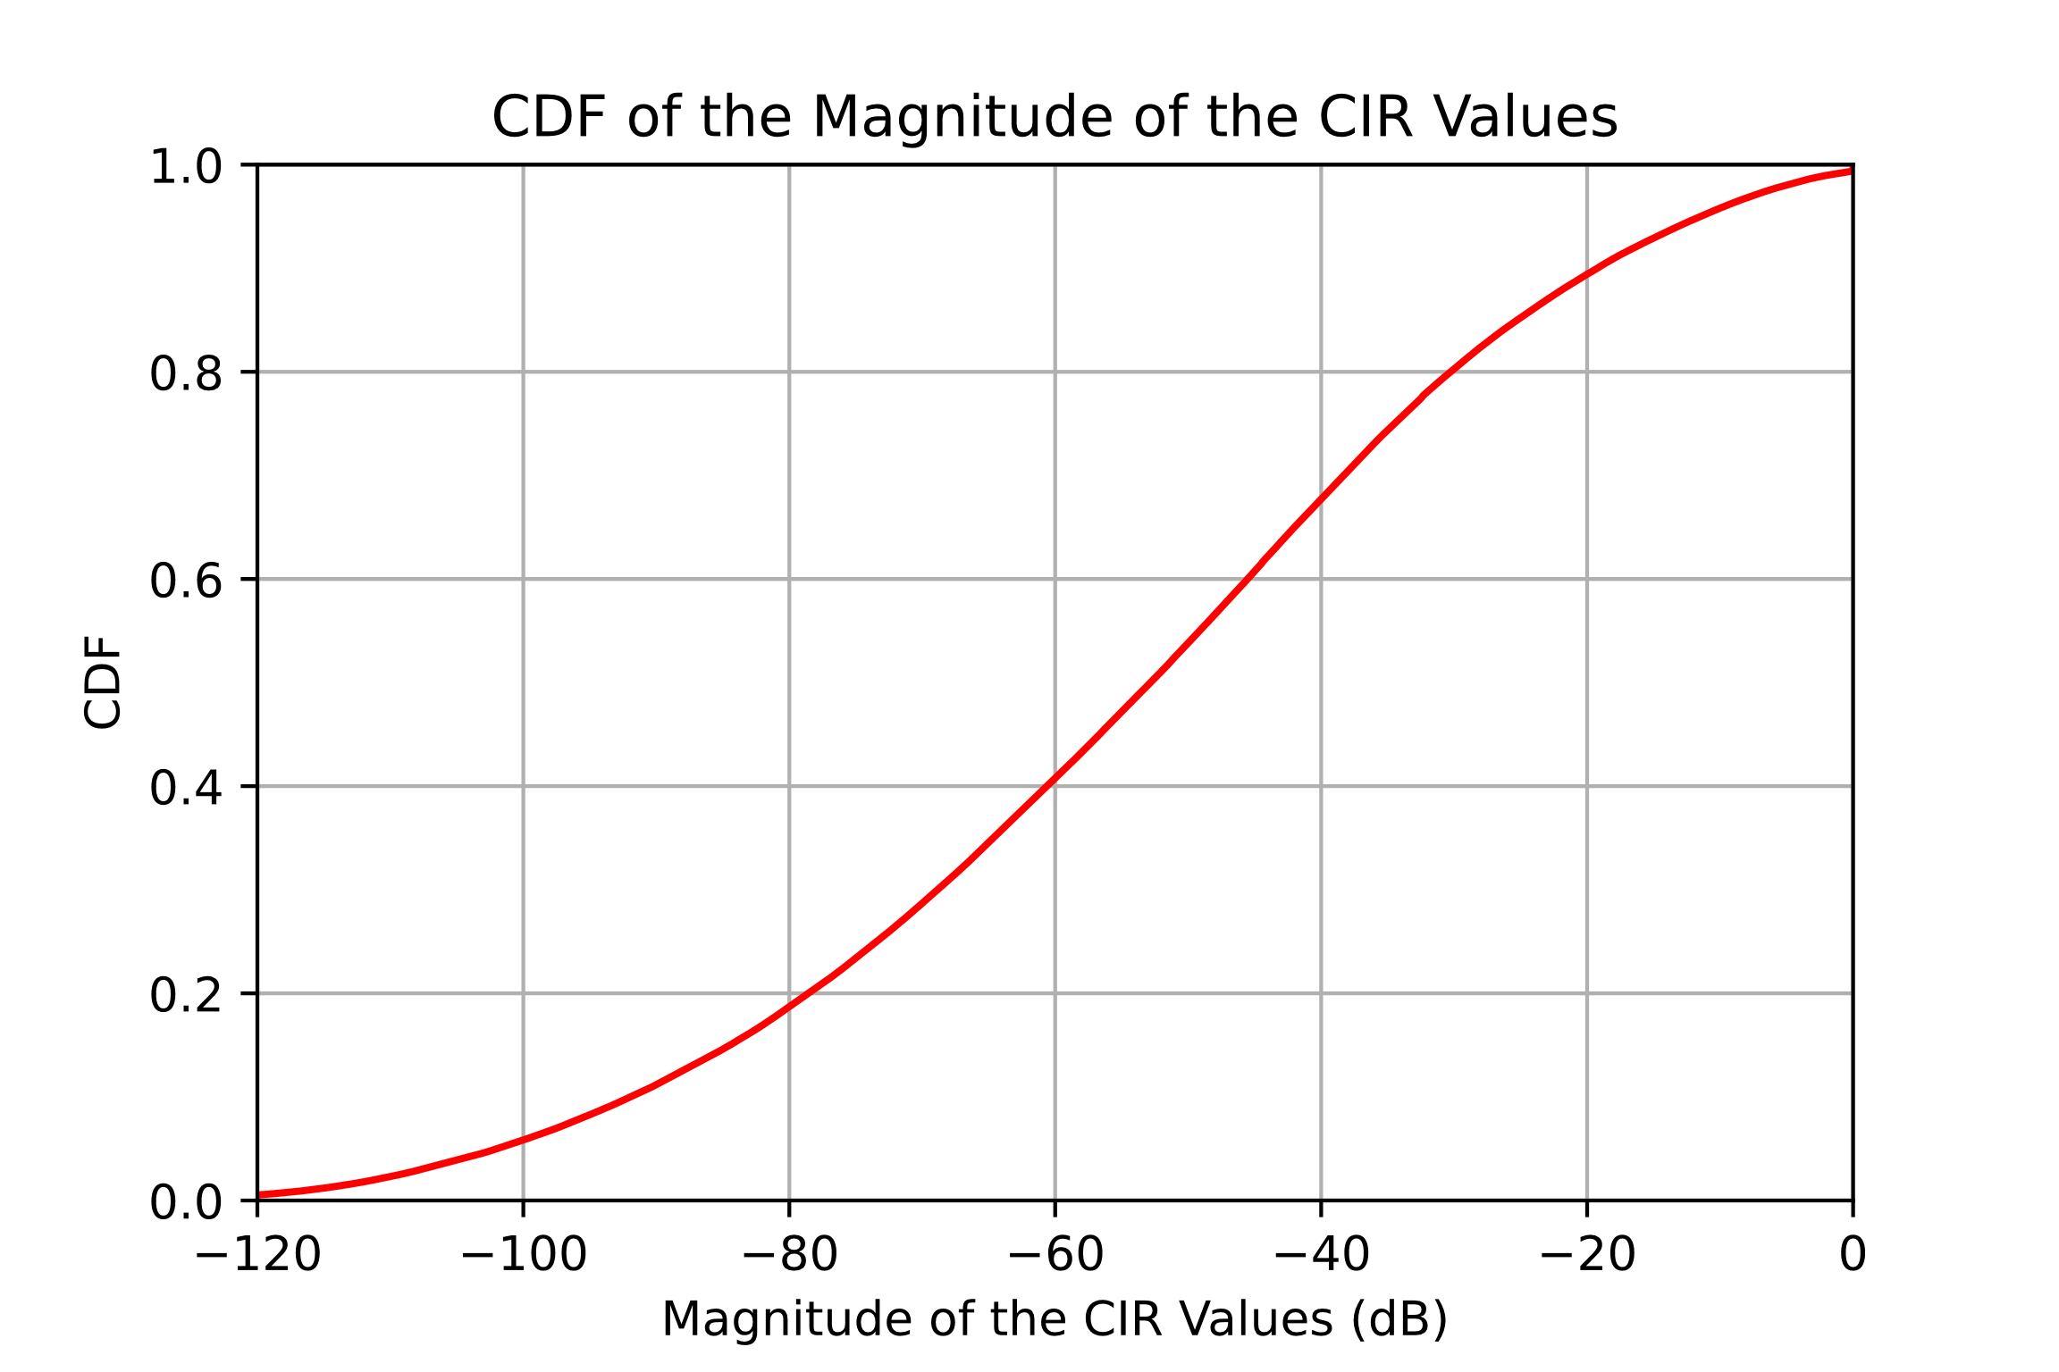
CDF of UWB Channel Model Taps
The channel models have an enormous dynamic range
This is different than CSI where the CSI values have a much lower dynamic range
The very small CIR taps are not relevant to RF Sensing

Slide 6
Simulation Description
Use UWB Channel Model 1
Select a Threshold
This was proposed in [2] and is included in the latest consensus UWB sensing document [3]
For each channel realization perform the following steps
Set a threshold and set all CIR Taps below that threshold to zero, since these CIR values are not relevant to RF Sensing
Perform power-of-two scaling and quantization as described in [1], for a specified Word Size
Calculate the SQNR for each of the CIR Taps (see next slide)
Perform this process for 5000 channel realization
Plot the SQNR for several Word Size values

Slide 7
SQNR
The following is the SQNR formula
The true CIR Tap is the complex value $z$
The scaled and quantized (and rescaled) CIR Tap is the complex value $\hat{z}$
$$SQNR=20 Log\left( \frac{\left|z\right|}{\left|z−\hat{z}\right|}\right)$$

Slide 8
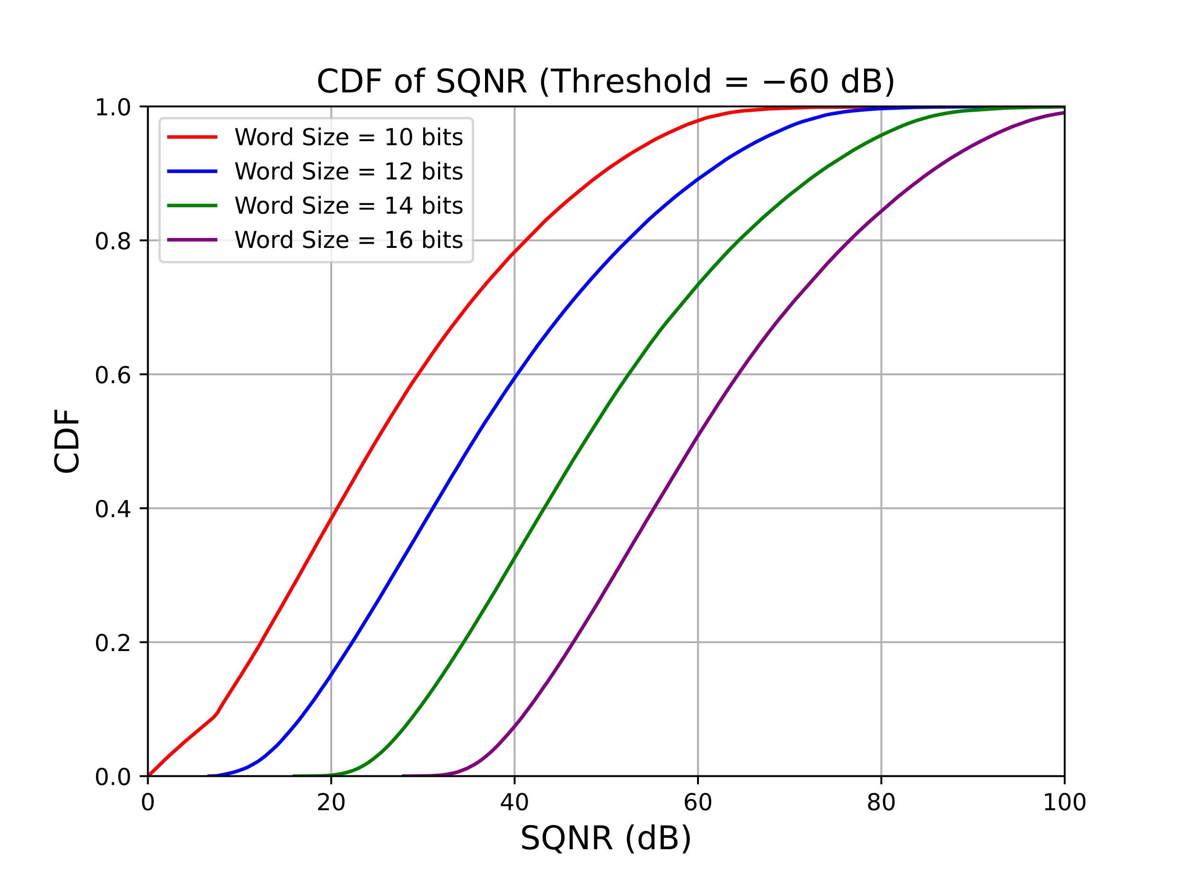
Threshold $=−60$ dB
Word Size of 10 bits may be too small
Word Size of 14 bits is probably sufficient

Slide 9
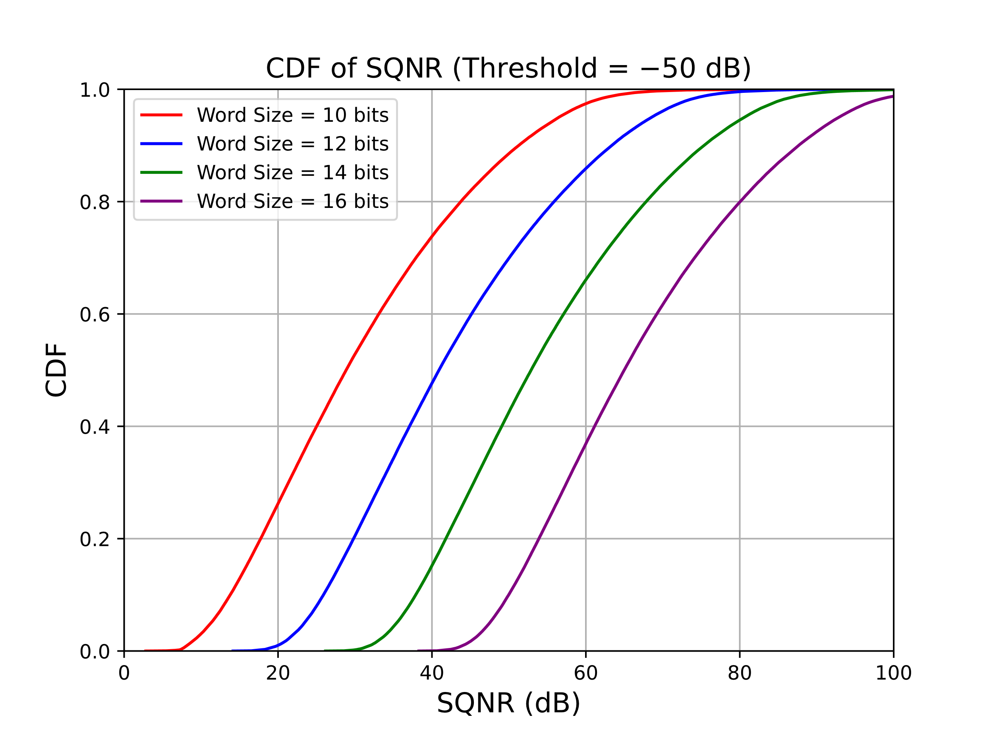
Threshold $=−50$ dB
Word Size of 12 bits is probably sufficient

Slide 10
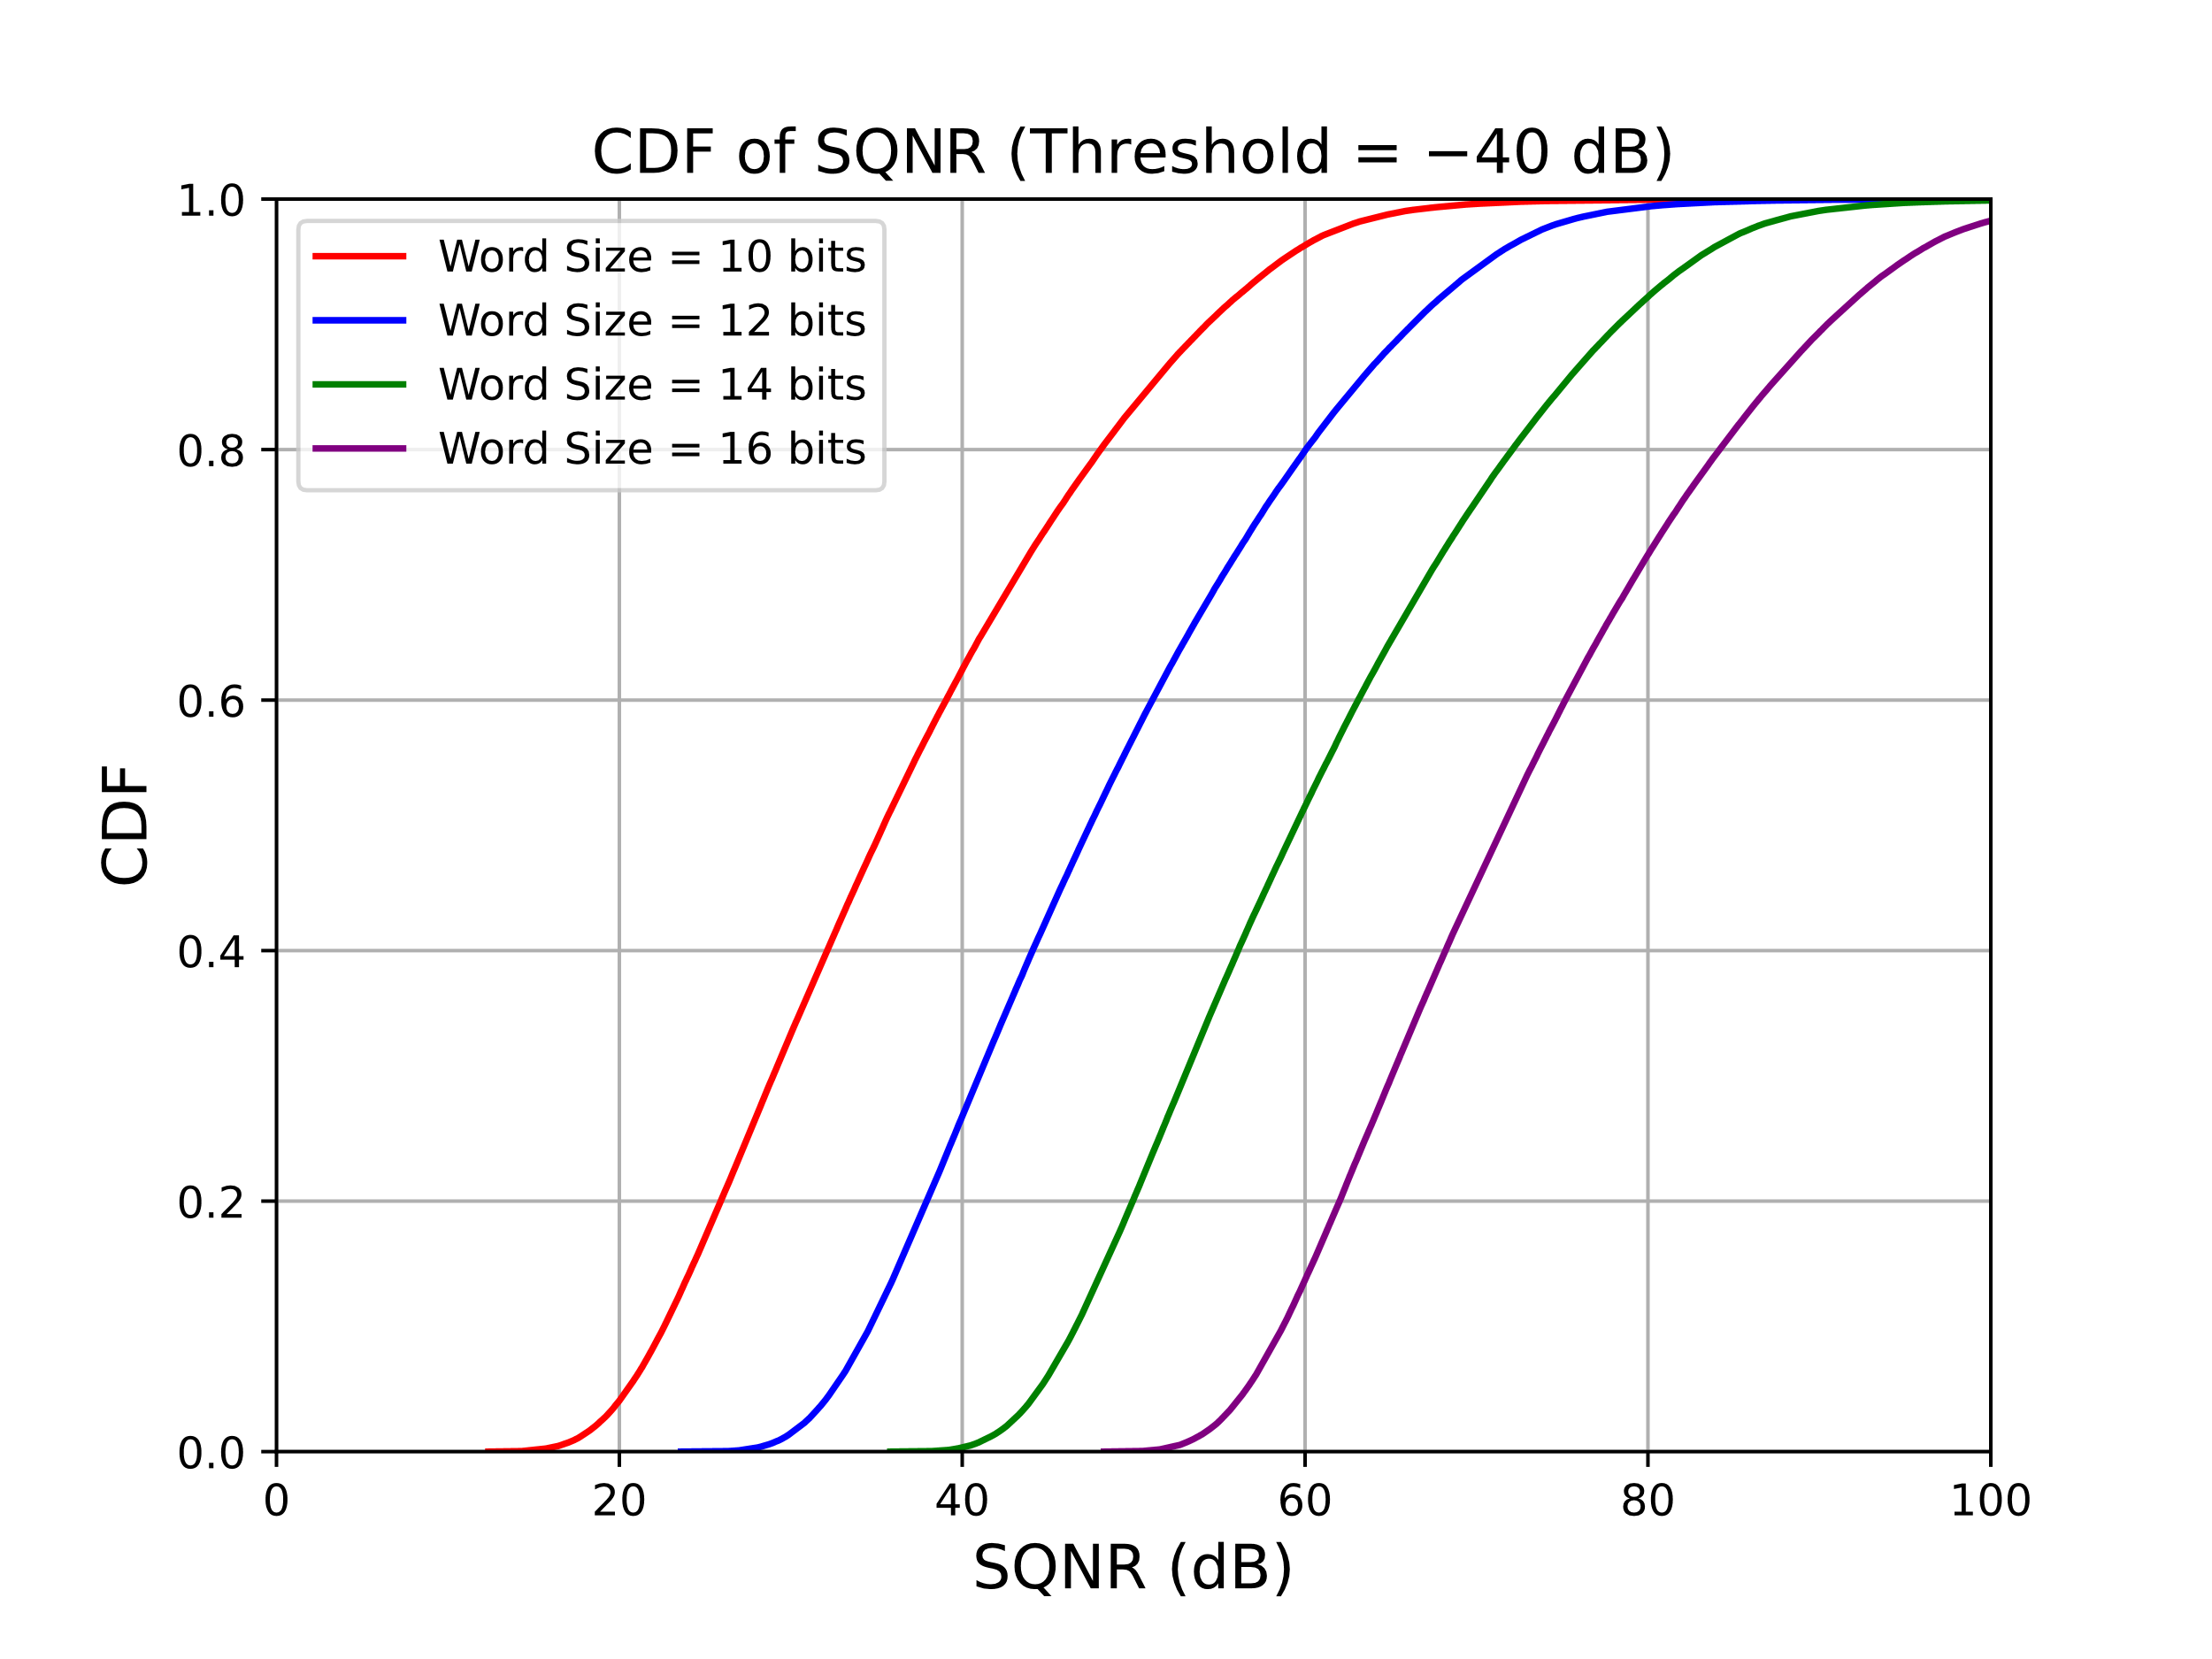
Threshold $=−40$ dB
Word Size of 10 bits is probably sufficient

Slide 11
Relative Strength of Reflected Signal
In [4] we looked at the Link Budget of RF Sensing and the relative signal level of the reflected signal depending upon the radar cross section of the object being sensed
We considered the following topology
$$d_{3}$$
Initiator/ Tx
Responder/Rx
$$d_{2}$$
$$d_{1}$$
Sensing packet
OTA CIR measurement report
Object being
sensed

Slide 12
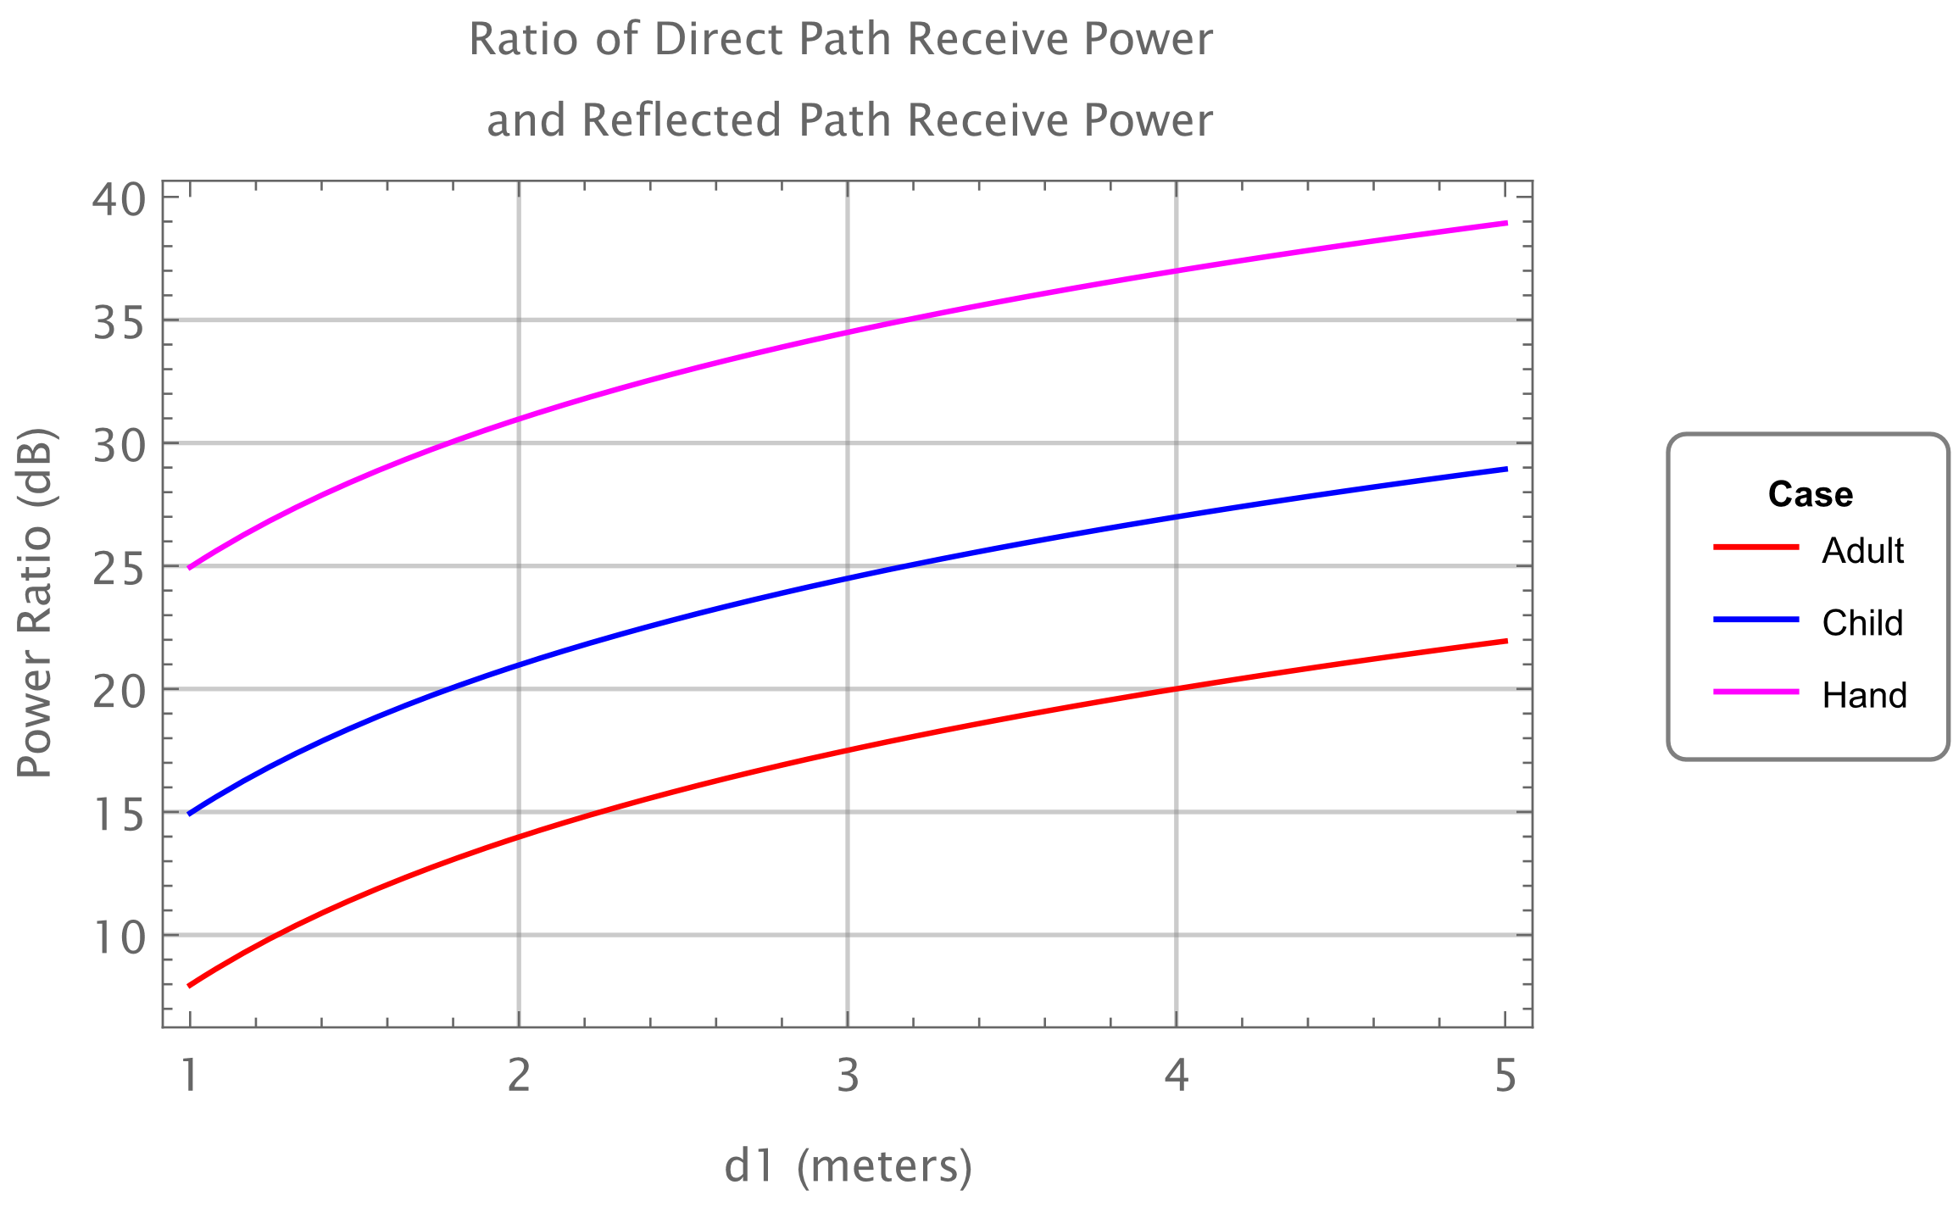
Ratio of Line-of-Sight Signal to Reflected Signal
From [4] we have: Ratio of RX power of direct signal and RX power of reflected signal:
Assuming $d1=d2=d$, Ratio Direct/Reflected received power increases according to $d^{2}$
We see that in most cases the reflected signal is within 40 dB of the line-of-sight signal. Hence in most cases the threshold will be set at or above $−40$dB.

Slide 13
Observations and Conclusions
Observations
When the threshold is set very low a larger Word Size is needed to ensure good SQNR
When the threshold is set higher a smaller Word Size can be used while still ensuring good SQNR
In most cases the threshold will be set at or above $−40$dB
Conclusions
It is possible to reduce the CIR report size
When the threshold is set higher a smaller Word Size is possible saving more CIR report size
The choice of the Word Size could be set by the Initiator

Slide 14
References
Steve Shellhammer, et. al., “CIR Scaling and Quantization,” IEEE 802.15-23/0121r0, March 2023
Xiliang Luo, Vinod Kristem and Moche Cohen, “Bitmap-based CIR Reporting for UWB Sensing,” IEEE 802.15-23/16r0, January 2023
Pooria Pakrooh, et. al., “Latest Consensus on UWB Sensing for 802.15.4ab,” IEEE 802.15-23/79r1, March 2023
Pooria Pakrooh, et. al., “Link budget analysis and CIR reporting for UWB RF sensing,” IEEE 802.15-22/66r2, January 2022

