Slide 1
Project: IEEE P802.15 Working Group for Wireless Personal Area Networks (WPANs)
Submission Title: Long Range extension of the 802.15.4-2020 OFDM PHY
Date Submitted: March 2022
Source: Thomas Almholt (Texas Instruments), Tomas Motos (Texas Instruments)
Contact:
Voice: +1 214 567 4516, E-Mail: talmholt@ti.com
Re: Wireless Next Generation, Long Range extension enhancements to 802.15.4-2020
Abstract: Enhancing OFDM with Long Range extension for increased link budget and reliability while remaining compliant with existing regulatory regulations worldwide. Adopters would experience significantly increased operating range over any existing SUN-OFDM PHY in the 802.15.4-2020.
Purpose: Stimulate thought and work towards adoption
Notice: This document has been prepared to assist the IEEE P802.15. It is offered as a basis for discussion and is not binding on the contributing individual(s) or organization(s). The material in this document is subject to change in form and content after further study. The contributor(s) reserve(s) the right to add, amend or withdraw material contained herein.
Release: The contributor acknowledges and accepts that this document becomes the property of IEEE and may be made publicly available by P802.15.
Notes:
Jul 12, 2010
Page 1
Need to add a note about TI patented technology

Slide 2
Interest Group OFDM-NG Next Generation SUN OFDM PHY’s
Hybrid Meeting
May 15th, 2023

Slide 3
Proposed Agenda
Opening and meeting preamble
Review document presented at March-23 Meeting
Motion at the end of week to create a Study Group
Create Study Group
Discuss suggestion expand scope to include
Include 6GHz operation
General SUN-PHY update (OQPSK, OFDM, FSK)
add support for SUN-OFDM MCS7
Next steps
Next meeting (Tuesday PM1)
Present detailed document prepared by TI for OFDM-LR
July Plenary
Any other Business

Slide 4
Interest Group Rules
Discussion: Everyone present is welcome
Straw polls: Everyone present may vote
Formal motions: WG voters
To make, second and vote
Patent policy for PAR activities applies
All the usual rules of conduct
Please identify yourself on first contact with name and affiliation

Slide 5
IEEE-SA Patent, Copyright, and Participation Policies
See: https://grouper.ieee.org/groups/802/sapolicies.shtml
IEEE-SA Patent Slides for Standards Development Meetings (.pdf)
https://development.standards.ieee.org/myproject/Public/mytools/mob/slideset.pdf
IEEE-SA Standards Board Patent Committee (PatCom) home page
https://standards.ieee.org/content/ieee-standards/en/about/sasb/patcom/index.html
IEEE-SA Participation Policy meeting slide set - individual method (.pdf)
https://standards.ieee.org/content/dam/ieee-standards/standards/web/documents/other/Participant-Behavior-Individual-Method.pdf
Working Group Copyright Materials
https://standards.ieee.org/ipr/copyright-materials.html
https://standards.ieee.org/content/dam/ieee-standards/standards/web/documents/other/ieee-sa-copyright-policy-2019.pdf

Slide 6
Participants have a duty to inform the IEEE
Participants shall inform the IEEE (or cause the IEEE to be informed) of the identity of each holder of any potential Essential Patent Claims of which they are personally aware if the claims are owned or controlled by the participant or the entity the participant is from, employed by, or otherwise represents
Participants should inform the IEEE (or cause the IEEE to be informed) of the identity of any other holders of potential Essential Patent Claims
Early identification of holders of potential Essential Patent Claims is encouraged

Slide 7
Ways to inform IEEE
Cause an LOA to be submitted to the IEEE SA (patcom@ieee.org); or
Provide the chair of this group with the identity of the holder(s) of any and all such claims as soon as possible; or
Speak up now and respond to this Call for Potentially Essential Patents
If anyone in this meeting is personally aware of the holder of any patent claims that are potentially essential to implementation of the proposed standard(s) under consideration by this group and that are not already the subject of an Accepted Letter of Assurance, please respond at this time by providing relevant information to the WG Chair
08 June 2021 – Slide 2

Slide 8
Other Guidelines for IEEE Working Group Meetings
All IEEE SA standards meetings shall be conducted in compliance with all applicable laws, including antitrust and competition laws.
Don’t discuss the interpretation, validity, or essentiality of patents/patent claims.
Don’t discuss specific license rates, terms, or conditions.
Relative costs of different technical approaches that include relative costs of patent licensing terms may be discussed in standards development meetings.
Technical considerations remain the primary focus.
Don’t discuss or engage in the fixing of product prices, allocation of customers, or division of sales markets.
Don’t discuss the status or substance of ongoing or threatened litigation.
Don’t be silent if inappropriate topics are discussed. Formally object to the discussion immediately.
---------------------------------------------------------------
For more details, see IEEE SA Standards Board Operations Manual, clause 5.3.10 and Antitrust and Competition Policy: What You Need to Know at http://standards.ieee.org/develop/policies/antitrust.pdf

Slide 12
IEEE SA Copyright Policy
By participating in this activity, you agree to comply with the IEEE Code of Ethics, all applicable laws, and all IEEE policies and procedures including, but not limited to, the IEEE SA Copyright Policy.
Previously Published material (copyright assertion indicated) shall not be presented/submitted to the Working Group nor incorporated into a Working Group draft unless permission is granted.
Prior to presentation or submission, you shall notify the Working Group Chair of previously Published material and should assist the Chair in obtaining copyright permission acceptable to IEEE SA.
For material that is not previously Published, IEEE is automatically granted a license to use any material that is presented or submitted.

Slide 13
IEEE SA Copyright Policy
The IEEE SA Copyright Policy is described in the IEEE SA Standards Board Bylaws and IEEE SA Standards Board Operations Manual
IEEE SA Copyright Policy, see Clause 7 of the IEEE SA Standards Board Bylaws https://standards.ieee.org/about/policies/bylaws/sect6-7.html#7 Clause 6.1 of the IEEE SA Standards Board Operations Manual https://standards.ieee.org/about/policies/opman/sect6.html
IEEE SA Copyright Permission
https://standards.ieee.org/content/dam/ieee-standards/standards/web/documents/other/permissionltrs.zip
IEEE SA Copyright FAQs
https://standards.ieee.org/faqs/copyrights/
IEEE SA Best Practices for IEEE Standards Development
http://standards.ieee.org/content/dam/ieee-standards/standards/web/documents/other/best_practices_for_ieee_standards_development_051215.pdf
Distribution of Draft Standards (see 6.1.3 of the SASB Operations Manual)
https://standards.ieee.org/about/policies/opman/sect6.html

Slide 14
Proposed Agenda
Opening and meeting preamble
Review document presented at March-23 Meeting
Motion at the end of week to create a Study Group
Create Study Group
Discuss suggestion expand scope to include
Include 6GHz operation
General SUN-PHY update (OQPSK, OFDM, FSK)
add support for SUN-OFDM MCS7
Next steps
Next meeting (Tuesday PM1)
Present detailed document prepared by TI for OFDM-LR
July Plenary
Any other Business

Slide 15
IEEE 802 Ground Rules
Respect … give it, get it
NO product pitches
NO corporate pitches
NO prices
NO restrictive notices – (no confidentially notices in email)
Presentations must be openly available

Slide 16
Proposed Agenda
Opening and meeting preamble
Review document presented at March-23 Meeting
Motion at the end of week to create a Study Group
Create Study Group
Discuss suggestion expand scope to include
General SUN-PHY update (OQPSK, OFDM, FSK)
add support for SUN-OFDM MCS7
Higher datarate SUN-FSK
6GHz operation (include a channel plan for 6GHz)
Next steps
Next meeting (Tuesday PM1)
Present detailed document prepared by TI for OFDM-LR
July Plenary
Any other Business

Slide 17
High level market needs
We see a market need for a new PHY with the following characteristics
Long range PHY to enable city wide simple star networks
Support dense networks with >10K nodes
Robust against interference and multipath fading
Power efficient for battery operated end node
Power constrained applications like flow meters, asset tracking and building automation.
World wide regulatory compliance including FCC 15.247 (digital modulation technique)
Simple low power, low system cost.
Industry Standards based solutions

Slide 18
New PHY goals
Long range PHY
Simplify regulation compliance testing with wide range of trade off between range and data rate.
Create long range PHY that does not require frequency hopping at the MAC level
Achieve greater than 150dB of link budget with 30dBm TX power for FCC
Requires -120dBm RX sensitivity or better
Support dense networks with enhanced co-channel and adjacent channel rejection
Efficient use of frequency spectrum
Optimized transmit current by using non-linear PA
The modulation must be constant envelop or specifically it must have 0dB Peak to Average Power Ratio (PAPR)

Slide 19
Project: IEEE P802.15 Working Group for Wireless Personal Area Networks (WPANs)
Submission Title: Proposal for new long range extension of the 802.15.4-2020 OFDM PHY
Date Submitted: March 2022
Source: Thomas Almholt (Texas Instruments), Tomas Motos (Texas Instruments)
Contact:
Voice: +1 214 567 4516, E-Mail: talmholt@ti.com
Re: Wireless Next Generation, Long Range extension enhancements to 802.15.4-2020
Abstract: Enhancing OFDM with Long Range extension for increased link budget and reliability while remaining compliant with existing regulatory regulations worldwide. Adopters would experience significantly increased operating range over any existing SUN-OFDM PHY in the 802.15.4-2020.
Purpose: Stimulate thought and work towards adoption
Notice: This document has been prepared to assist the IEEE P802.15. It is offered as a basis for discussion and is not binding on the contributing individual(s) or organization(s). The material in this document is subject to change in form and content after further study. The contributor(s) reserve(s) the right to add, amend or withdraw material contained herein.
Release: The contributor acknowledges and accepts that this document becomes the property of IEEE and may be made publicly available by P802.15. The proposed approach contains TI patent pending IP.

Slide 20
Study of existing IEEE PHY’s for long range application
We analyzed 5 IEEE derived Sub1GHz long range candidates based on the requirements presented in the marketing section of these slides.
It was found that each PHY would fail at least one of the test criteria and therefore made the PHY not able to solve the overall requirement.
Parameter | Zigbee R23 | LECIM DSSS | LECIM FSK | OQPSK 100kcps | OQPSK 1000kcps
RX Sensitivity [dBm] | -104 | -125 | ~115 | -120 | -110
Data rate [kbps] | 500 | 1.25 | 12.5 | 6.25 | 62.5
Occupied BW [kHz] | 600 | 1000 | 50 | 200 | 2000
Constant envelope modulation | Yes | No | Yes | Yes | Yes
Mobility and multipath resilient | No | Yes | No | No | No
Notes:
Make a matrix

Slide 21
Proposed scheme
Create a long range PHY by expanding existing SUN-OFDM modulation technique with high reuse of SUN-OFDM IP
Employ SC-OFDM techniques to reduce PAPR to 0dB and SC-OFDM technology provides high channel efficiency, co-channel interference tolerance / channel re-use
The proposed approach contains TI patent pending IP.
Notes:
Take a look at LeCM PHY’s and see what (FSK fast hopper), original LiCM (CDMA)
Add the blocker graph from Motos
Add FCC compliance plot

Slide 22
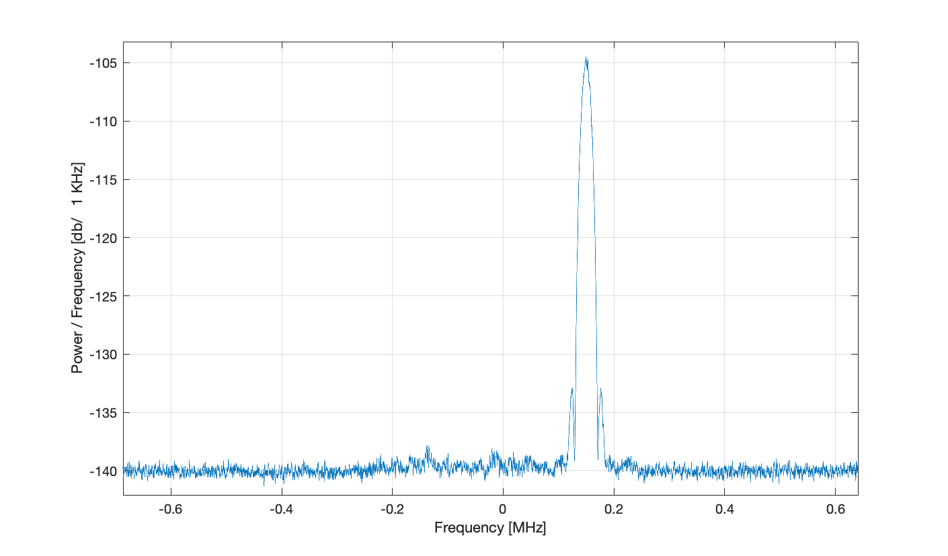
Proposed scheme
Technique is resilient to co-channel interference.
Simulations show ~ 30 dB of in-band Interferer (FSK 10 kbps) to Wanted ratio
Wanted Signal 3 dB over sensitivity
Unwanted Signal
Wanted Signal
Notes:
Take a look at LeCM PHY’s and see what (FSK fast hopper), original LiCM (CDMA)
Add the blocker graph from Motos
Add FCC compliance plot

Slide 23
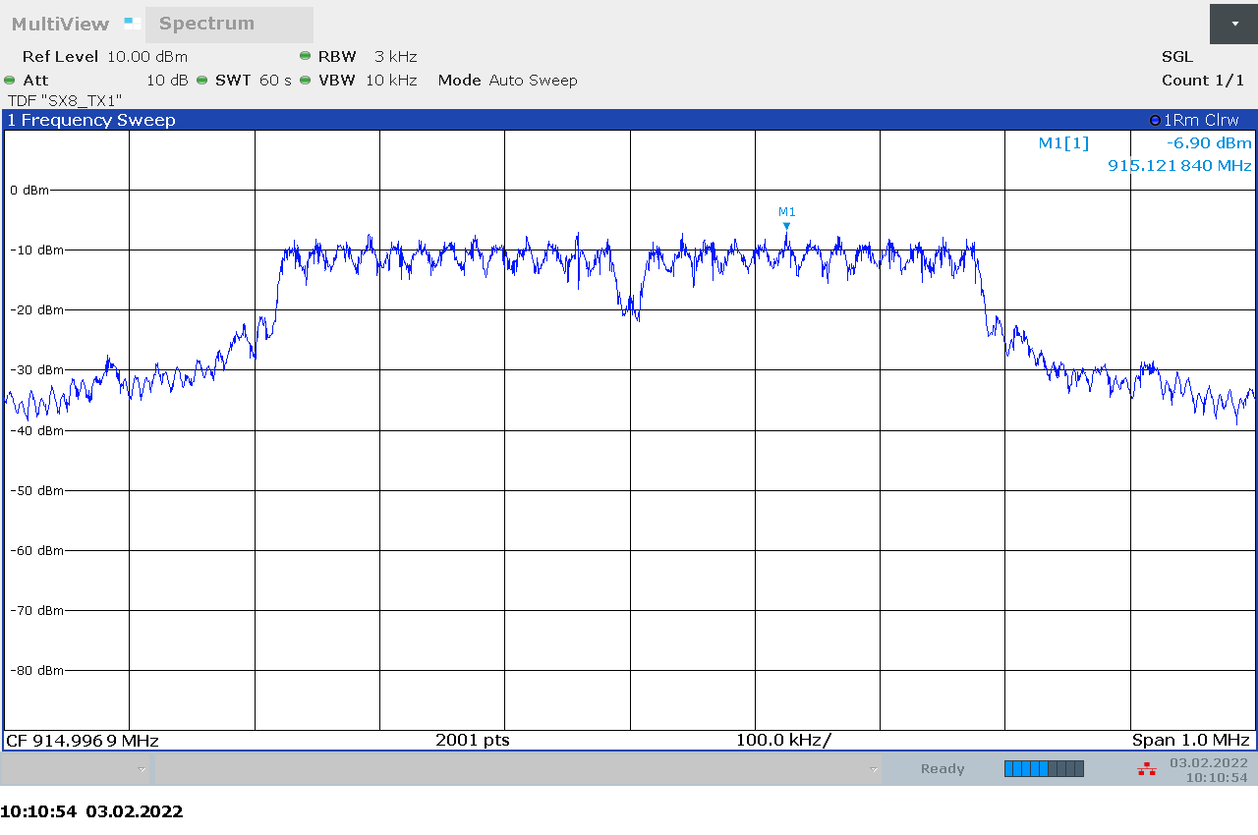
Proposed scheme
Adopt Option 1,2,3,4 schemes from SUN-OFDM to enable world wide compliance.
Option 3 and 4 would target Europe and Japan regulation
Option 2 would target FCC
Specifically for FCC compliance with 8dBm/3kHz at maximum TX power of 30dBm a symbol rate of 120us or faster must be selected.
Option 2 with 120us symbol rate showing occupied BW of 550KHz while tested per the FCC spectral density requirements
Notes:
Take a look at LeCM PHY’s and see what (FSK fast hopper), original LiCM (CDMA)
Add the blocker graph from Motos
Add FCC compliance plot

Slide 24
OFDM-LR data rate flexibility
To enable wide range of data rates, it is proposed to adopt 3 different symbol durations. This allows the system to retain its 0 PAPR characteristic while increasing the data rates
A minimum of 6 tones is required for the system to operate, therefore not all combinations are going to be possible for all predefined options of OFDM. See table below.
Notes:
Add data rate

Slide 25
RX sensitivity guidelines
Parameter | OFDM Option 1 | OFDM Option 2 | OFDM Option 3 | OFDM Option 4
Nominal bandwidth (kHz) | 1094 | 552 | 281 | 156
Channel spacing (kHz) | 1200 | 800 | 400 | 200
# Data tones | 52/26/12 | 26/12/6 | 12/6 | 6
120us (DSSS=8) | -124dBm | -124dBm | -124dBm | -124dBm
120us (DSSS=6) | -123dBm | -123dBm | -123dBm | -123dBm
120us (DSSS=4) | -122dBm | -122dBm | -122dBm | -122dBm
120us (DSSS=2) | -119dBm | -119dBm | -119dBm | -119dBm
60us (DSSS=8) | -121dBm | -121dBm | -121dBm | -
60us (DSSS=6) | -120dBm | -120dBm | -120dBm | -
60us (DSSS=4) | -119dBm | -119dBm | -119dBm | -
60us (DSSS=2) | -116dBm | -116dBm | -116dBm | -
30us (DSSS=8) | -118dBm | -118dBm | - | -
30us (DSSS=6) | -117dBm | -117dBm | - | -
30us (DSSS=4) | -116dBm | -116dBm | - | -
30us (DSSS=2) | -113dBm | -113dBm | - | -
Notes:
Flip the DSSS

Slide 26
Proposed solution provides:
This solution provide high link budget, while still being FCC 15.247 digital spread spectrum compliant (500kHz OCBW)
SC-OFDM technology provides high channel efficiency, co-channel interference tolerance / channel re-use
0dB PAPR for high efficiency analog design and low power

Slide 27
Proposed solution provides:
Call for participation
Email to the working group email reflector
Look for feedback on topics below.
Should we make this TG a Long Range only or all SUN PHY’s
General SUN-PHY update (OQPSK, OFDM, FSK)
OFDM-LR
add support for SUN-OFDM MCS7
Add 64 QAM
Higher datarate SUN-FSK
Addition data rate for Japan
400, 600kbps (up to 1MHz channels)
SUN-OQPSK?
200ksps?
6GHz operation (include a channel plan for 6GHz)

Slide 28
Proposed Agenda Tuesday PM1
Opening and meeting preamble
Review notes from
Update workgroup on synchronization technique for OFDM-LR
Call for participation
Asking for presentation to the IG at July meeting
Any other Business
Adjourn

Slide 29
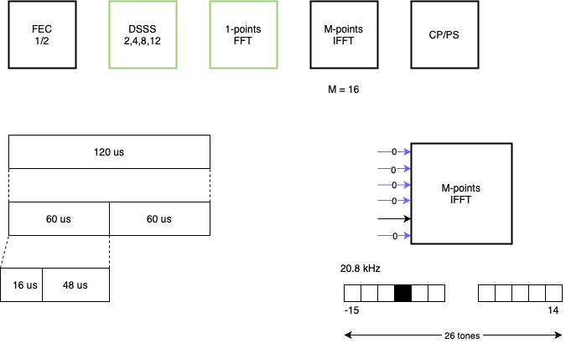
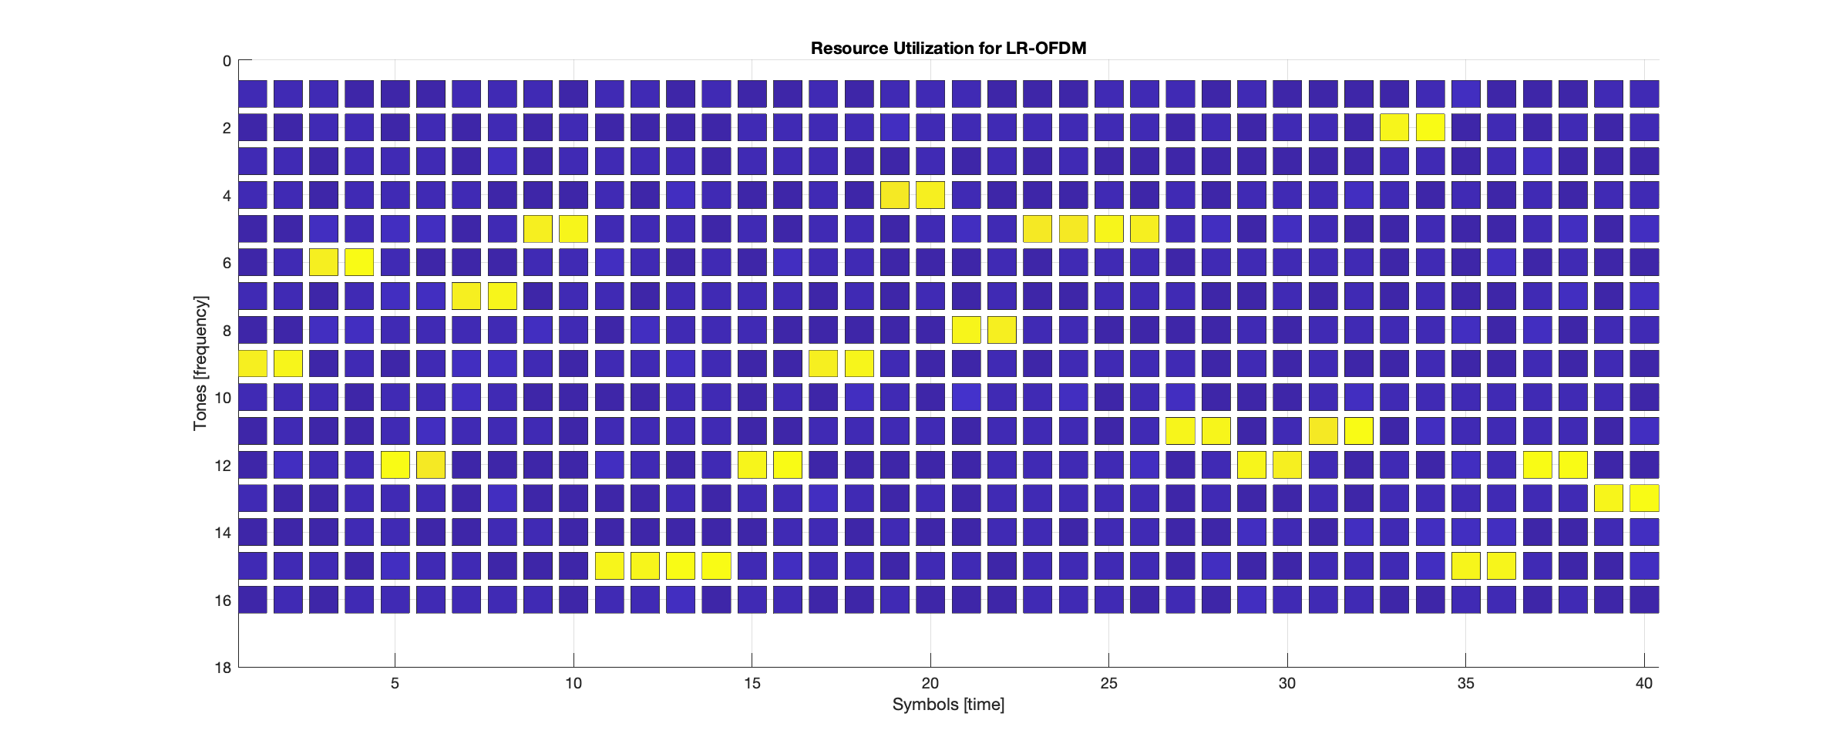
LR-OFDM Recap
LR OFDM = FEC + DSSS + DBPSK
FEC : Convolutional code with K=7
DSSS : Redundancy and Differential Encoding
DBPSK : Differential BPSK modulation
Two consecutive symbols are always sent in the same OFDM tone
The basic symbol duration in SUN OFDM is 120 us
The basic symbol duration in LR-OFDM is 60 us, but two consecutive symbols are always sent in the same tone

Slide 30
LR-OFDM Synchronization for 2kbps
16 + 64 + 64 DBPSK symbols (1 symbol DBPSK = 120 us)
Total duration of 144 symbols, 17.28 ms
Equivalent of 4.32 information bytes @ 2 kbps
Synchronization sequence sent in one single tone
Three pre-defined advertiser tones (-12,-2,12)
Only one of them is used for a given TX
These tones are used for devices wanting to connect to the network
Preamble | SW | SW

Slide 31
Text for call for participation
Additional improvement to the SUN-OFDM specification with special focus on long range communication in highly congested environment.
Data rates of 1 - 50kbps
RX Sensitivity of approximately -120dBm @ 1% PER 64 bytes (payload)
Consider collision mitigation techniques
Compliant to FCC 15.247 “digital modulation techniques”
Focus on symmetrical communication
Additional higher data rate options for SUN-OFDM and improved robustness
Introduction of 64 QAM to the SUN-OFDM specification
Improve performance low data option of existing SUN-OFDM (maybe improving synch)
Additional extension to the SUN-FSK specification

Slide 32
Adjourned Thanks

