Slide 1
IEEE 15-17-0436-00-007a
Project: IEEE P802.15 Working Group for Wireless Personal Area Networks (WPANs)
Submission Title: 15.7m OWC TG Closing Report July 2017
Date Submitted: July 13, 2017
Source: Yeong Min Jang Company: Kookmin University
Address
Voice:, FAX:, E-Mail: yjang@kookmin.ac.kr
Re:
Abstract:
Purpose:
Notice: This document has been prepared to assist the IEEE P802.15. It is offered as a basis for discussion and is not binding on the contributing individual(s) or organization(s). The material in this document is subject to change in form and content after further study. The contributor(s) reserve(s) the right to add, amend or withdraw material contained herein.
Release: The contributor acknowledges and accepts that this contribution becomes the property of IEEE and may be made publicly available by P802.15.

Slide 2
IEEE 15-17-0436-00-007a
Background
TG7m conducted a task group letter ballot review of draft D3
Draft D1 was issued at the end of October, 2016.
There were 826 technical comments and 251 editorial comments.
Draft D2 was issued at end of March, 2017.
For D2, there were 362 technical comments and 36 editorial comments.
Draft D3 was issued at the middle of June, 2016.
For D3, there were 407 technical comments and 41 editorial comments. There are 2 postponed technical comments.

Slide 3
IEEE 15-17-0436-00-007a
Status of comments at the end of July Meeting
Resolved technical comments carried over from May meeting
Resolved comments resolution for D3 document
Discussion about dimming issue for PHY IV, PHY V and PHY VI.
Discussion about the tutorial and merging text for PHY VI

Slide 4
IEEE 15-17-0436-00-007a
15.7m OWC TG suggestions:
Do not make a comment that request to replace whole subsection with the other document. Instead, explain which part should be changed to what sentence and why explicitly.
Hold ad-hoc meeting in Korea to show real device demos, give tutorials for each other

Slide 5
IEEE 15-17-0436-00-007a
Plans for Sept. meeting
4 August : Deadline for modified text/figures/tables based on the comment resolution against D3
Missing deadline of acceptable input may result in the committee imposing a penalty or removing text during the Sept. meeting.
25 August : Release Draft D4
1 Sept. : Deadline for comments against D4
8 Sept. : Deadline for comment resolutions
Comments against D4 will be resolved during the Sept. meeting. The text is maturing so we expect fewer comments and hopefully we can get them all resolved during the Sept. meeting.
Requesting 12 sessions

Slide 6
IEEE 15-17-0436-00-007a
Updated Milestone and Schedule
2017
Q1 | January | February | March
 | Continue comment resolution against D1 Prepare draft D2 | Comment resolution to delete against unnecessary parts of D1 | Finish comment resolution against D1 Prepare draft D2
Q2 | April | May | June
 | Release Draft D2 | D2 comment resolution Prepare D3 | Release D3
Q3 | July | August | September
 | D3 comment resolution | Release D4 | D4 comment resolution Request (conditional) approval for Letter Ballot
Q4 | October | November | December
 | Release D5 Letter Ballot 1 for D5 | LB1 comment resolution | Release D6

Slide 7
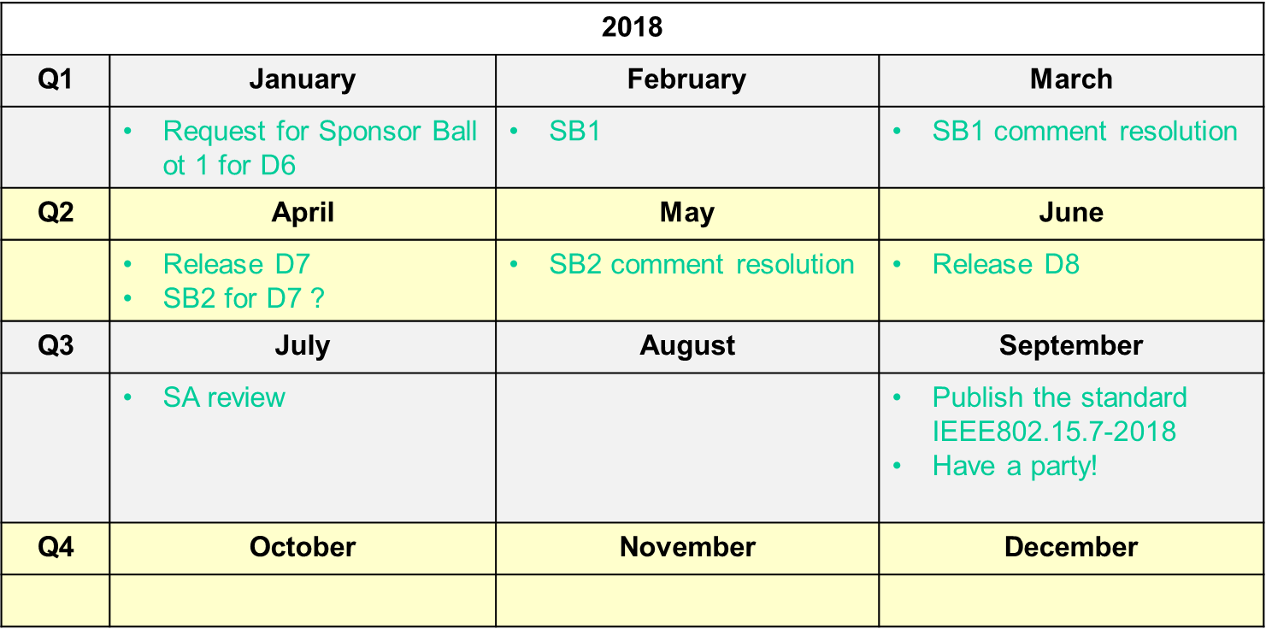
IEEE 15-17-0436-00-007a
Updated Milestone and Schedule

