Slide 1
Project: IEEE P802.15 Working Group for Wireless Personal Area Networks (WPANs)
Submission Title: [New elements of Section 6 in TG3d Applications Requirements Document]
Date Submitted: [19 February 2015]
Source: [Akifumi Kasamatsu, Iwao Hosako, and Hiroyo Ogawa]
Company: NICT
Address [4-2-1, Nukuikita, Koganei, 184-8795, Tokyo, Japan]
Voice:[+ 81 42 327 6876], FAX: [], E-Mail:[kasa@nict.go.jp]
Re: []
Abstract: [The aim of this contribution is to provide the new elements for Section 6 of Applications Requirements Document.]
Purpose: [Discussion on the possible use of 300-GHz band for the mobile fronhaul link between BBU (Baseband Unit) and RRH (Remote Radio Head).]
Notice: This document has been prepared to assist the IEEE P802.15. It is offered as a basis for discussion and is not binding on the contributing individual(s) or organization(s). The material in this document is subject to change in form and content after further study. The contributor(s) reserve(s) the right to add, amend or withdraw material contained herein.
Release: The contributor acknowledges and accepts that this contribution becomes the property of IEEE and may be made publicly available by P802.15.

Slide 2
Summary of Discussion
The previous contribution proposed the Radio over Fiber (RoF) link for mobile fronthaul to connect Baseband Unit (BBU) and Remote Radio Head (RRH) [1]. However, because 802.15.3d provides a standard for wireless devices, NICT proposes to use 802.15.3d devices to interface the specifications of radio base stations with 300-GHz wireless link.
The specification of radio base stations is known as a Common Public Radio Interface (CPRI) [1] which specifies the key internal interface of radio base stations between the Radio Equipment Control (REC) and the Radio Equipment (RE). The current specified maximum bit rate of CPRI is limited to 10 Gbps, however, 5G mobile systems will offer higher data rates greater than 10 Gbps to the mobile terminals [3], the capacity of the mobile fronthaul link has to be increased to satisfy with the technical requirements of 5G mobile systems.
The new application architecture for mobile fronthaul using 300-GHz band and 802.15.3d devices is shown in the next page. The detailed document of the new section 6 including a frequency band planning [4] will be provided at Berlin meeting.

Slide 3
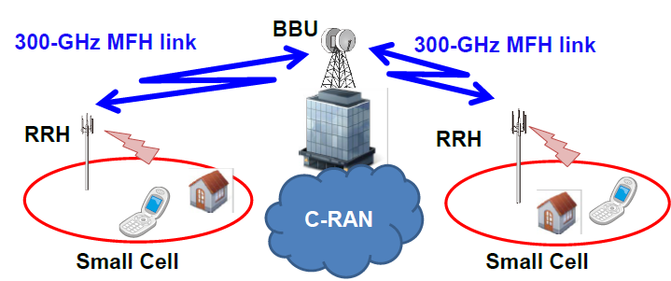
Mobile fronhaul using 300-GHz band

Slide 4
References
[1] Proposed modification of TG3d Applications Requirements Document (ARD), IEEE P802.15-14-0549-003d.
[2] Common Public Radio Interface (CPRI); Interface Specification, CPRI Specification V6.0 (2013-08-30).
[3] Mobile Communications Systems for 2020 and beyond, ARIB 2020 and Beyond Ad Hoc Group White Paper, Version 1.0.0, October 2014.
[4] Operational frequency bands for TG3d devices, IEEE 802.15-15-0052-01-003d.

