Slide 1
Project: IEEE P802.15 Working Group for Wireless Personal Area Networks (WPANs)
Submission Title: Optical interconnection of data center
Date Submitted: 19 March, 2013
Source: Akifumi Kasamatsu, Tokuhiko Sekine and Hiroyo Ogawa
National Institute of Information and Communications Technology
4-2-1, Nukuikita, Koganei, 184-8795, Tokyo, Japan
Voice: +81 42 327 6508, FAX: +81 42 327 6941, E-Mail: hosako@nict.go.jp
Nobuhiko Shibagaki and Hiroshi Hanyu, Hitachi Limited
Voice: +81 42 323 1111(ext 3559), Fax:042-327-7775, nobuhiko.shibagaki.qr@hitachi.com
Re: n/a
Abstract: The data rate of optical interconnection known as InfiniBand are presented as information for future terahertz communication systems.
Purpose: Informing 802.15IGTHz on data rate of optical interconnection used in data center
Notice: This document has been prepared to assist the IEEE P802.15. It is offered as a basis for discussion and is not binding on the contributing individual(s) or organization(s). The material in this document is subject to change in form and content after further study. The contributor(s) reserve(s) the right to add, amend or withdraw material contained herein.
Release: The contributor acknowledges and accepts that this contribution becomes the property of IEEE and may be made publicly available by P802.15.

Slide 2
Optical Interconnection of Data Center
Akifumi Kasamatsu*, Tokuhiko Sekine*, Hiroyo Ogawa*, Nobuhiko Shibagaki** and Hiroshi Hanyu**
*National Institute of Information and Communications Technology (NICT), Japan
**Hitachi Limited, Japan

Slide 3
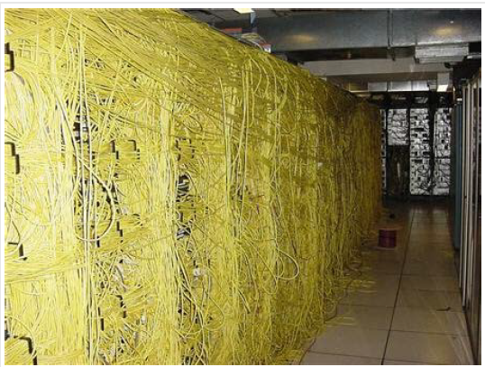
Wall of Ethernet Cable in a Server-Farm-Room
http://www.thebuzzmedia.com/the-super-internet-wall-of-ethernet-cable/

Slide 4
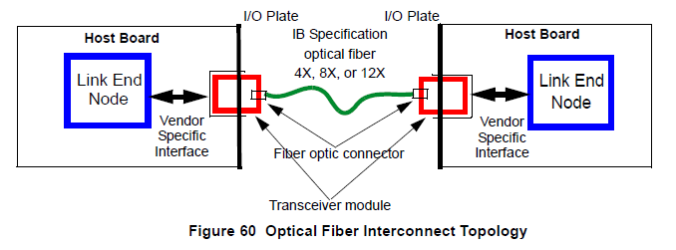
Optical Interconnection
Ref: InfiniBandTM Architecture Specification Volume 2

Slide 5
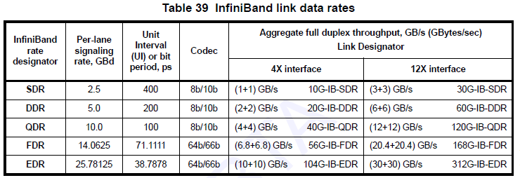
InfiniBand Link Data Rates
Ref: InfiniBandTM Architecture Specification Volume 2

