Slide 1
Data Forwarding within TXOP for XR Use Cases
Date: 2024-04-08
Name | Affiliations | Address | Phone | email
Seongho Byeon | Samsung Electronics |  |  | sh.byeon@samsung.com
Jack Jonghyo Lee
Jaheon Gu
Jinho Choi
Jonghoe Koo
Mingyu Lee
Taeyoung Ha
Youngwan So

Slide 2
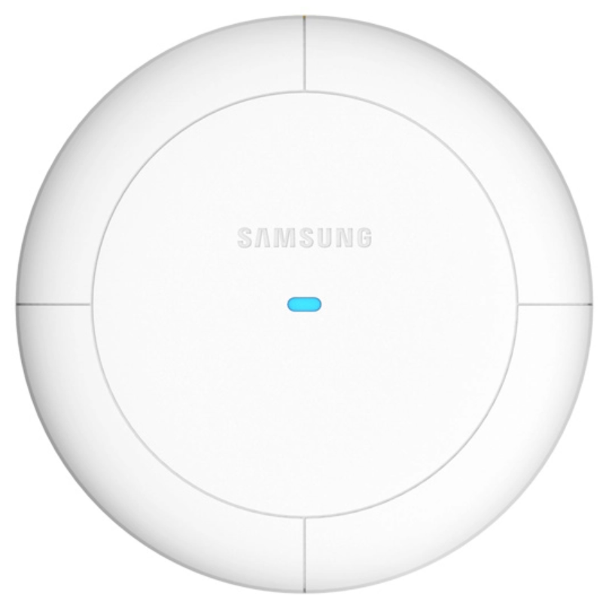
Introduction
Emerging XR use-cases
Need to support low End-to-End (E2E) latency
Encompassing the case where the two devices (i.e., remote device like VR glass and XR headset, and device for computation offloading such as laptop or smartphone) are connected through the same AP
XR compute offloading over wireless links is a key capability to scale the adoption of XR devices [1]
In such two-hop topology, sensing data or render data flows between two STAs via AP, requiring minimal control and contention overhead
AP
STA B
STA A

Slide 3
Introduction
Emerging XR use-cases
A proxy SCS mechanism is proposed to improve E2E QoS for the above use cases [2-4]
Due to size, thermal, cost and power constraint, XR devices may leverage a different device for computation, however, the compute device may not have the latest Wi-Fi technology and cannot exercise advanced Wi-Fi features
Introducing a new concept of procedure to set up the QoS, proxy SCS, between two devices within BSS, to enable the AP to deliver the proper E2E QoS for the traffic between STA A and STA B via the AP
➔ In this contribution, we would like to discuss the way of effectively supporting data forwarding between the two established STAs through proxy SCS or other QoS providing methods within TXOP

Slide 4
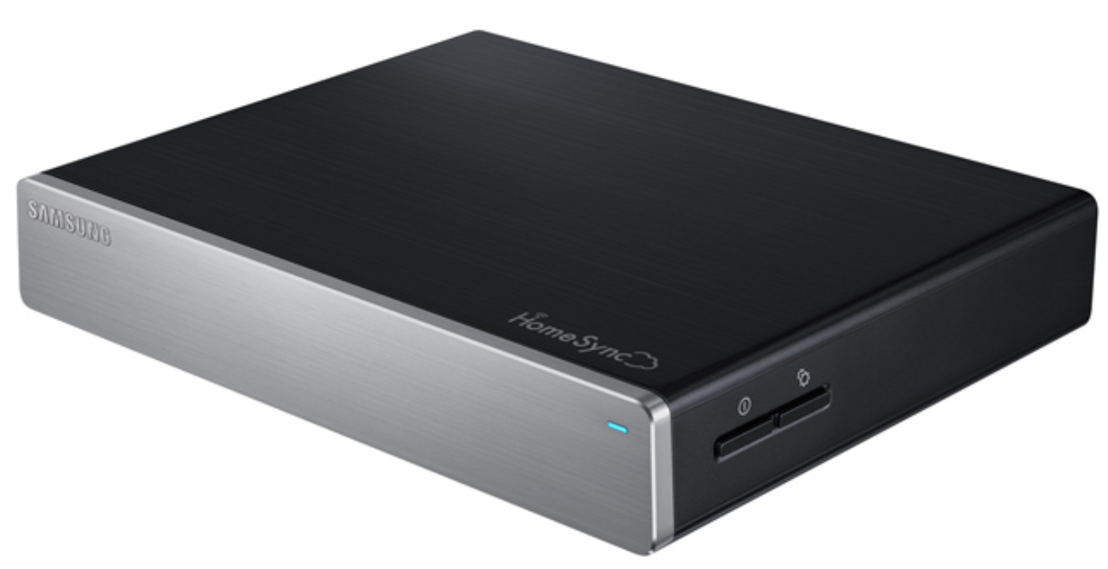
Introduction
Various cases where data forwarding is actually needed in the local network
Smartphone
Laptop
Home Cloud Server
AP
Smart Display
MR device
Smart IoT Hub

Slide 5
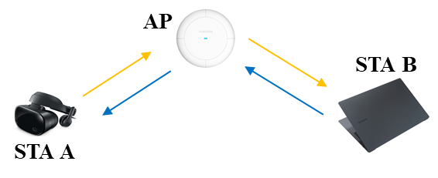
Problem Statement
Data forwarding within TXOP for low latency proxy traffic
Method for using legacy protocols to effectively support data forwarding
Normal EDCA
After participating in contention, STA A(B) transmits data within its TXOP
The AP also needs to win the contention, and then, transmits the corresponding data to STA B(A) depending on scheduling policy
The time overhead required for transmission and reception is large, and the latency is dependent on the AP's scheduling policy
Reverse Direction Grant (RDG)
STA A(B) sends one piece of data to the AP, after initiating TXOP
Then, the AP becomes TXOP holder and is able to continuously send data to STA B(A)
After a single session of data forwarding, there is no way for STA A(B) to get the TXOP back in order to transmit the next data to STA B(A) via the AP, nor is there any guarantee that the AP will forward the data
No large-scale industry adoption of RDG

Slide 6
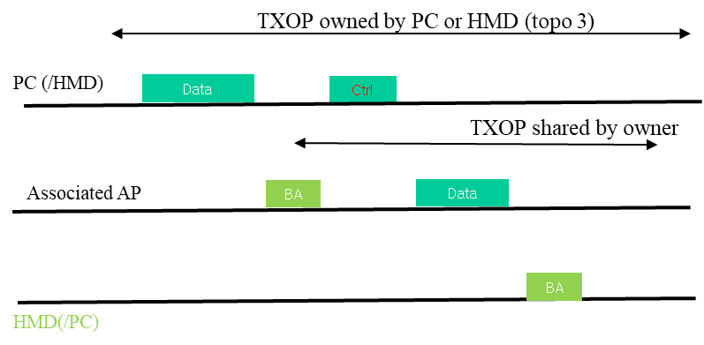
Problem Statement
Data forwarding within TXOP for low latency proxy traffic
TXOP Sharing in IEEE 802.11 be
Only the AP can share its TXOP using MU-RTS TXS Trigger Frame
The latency is dependent on the AP's scheduling policy
Large control overhead for frequent assigning and switching DL/UL for data forwarding
TXOP optimization proposal [1]
TXOP optimization method is proposed to improve overall QoS by reducing E2E latency, allowing any STA to share TXOP with minimal overhead for forwarding traffic to fit in TXOP
TXOP sharing for forwarding to reduce contention latency for TXOP responder for co-related flow

Slide 7
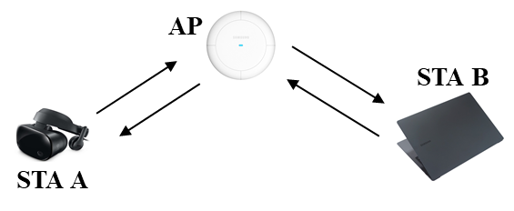
Data Forwarding within TXOP
Data forwarding (DF) supporting E2E QoS
Assumptions
C1. STA A and STA B are associated within the same BSS or the same multi-BSS
C2. Both STA A and STA B may not hear each other
[NOTE] The specific type of control frames are TBD
Upon completing the forwarding of QoS Data n (including retransmission) within the TXOP, the TXOP is handed over back to STA B, automatically
TXOP initiator informs other STAs that it finishes TXOP, if the remaining TXOP is not sufficient for the next QoS data transmission and forwarding
QoS data A-MPDU 1
…
DF-RSP
BA
DF-End
DF-End
AP
SIFS
BA
…
BA
STB A
QoS data A-MPDU 1
SIFS
SIFS
QoS data A-MPDU 2
SIFS
DF-ICF
…
DF-Fin
STA B
SIFS
SIFS
SIFS
SIFS
SIFS
Since the time required for data forwarding cannot be accurately predicted, the TXOP might be set as long as possible within the range allowed by the AP (TBD)
TXOP
Example: STA B initiates TXOP and transfers frame(s) to STA A via the AP

Slide 8
Conclusion
In this presentation, we propose a straightforward enhancement to the baseline TXOP sharing mechanism in order to facilitate two-hop data forwarding
This allows the AP to provide proper E2E QoS for low latency traffic between two STAs, particularly for emerging XR use-cases in the local network

Slide 9
References
[1] 11-23/1387r1 TXOP sharing extensions for XR use-cases (Dibakar Das, Intel)
[2] 11-23/0073r0 Thoughts on Proxy SCS (Guagang Huang, Huawei)
[3] 11-23/1958r0 Proxy QoS management for XR use cases (Guoqing Li, Meta)
[4] 01-24/1885r1 End-to-end QoS with SCS (Duncan Ho, Qualcomm)

