Slide 1
EMLSR Secondary Channel Operation
Date: 2024-03-12
Authors:

Slide 2
Background
In current deployments, APs typically support a larger BW than STAs:
  Ex: 802.11ax APs shall support 160 MHz, while non-AP STAs shall only support up to 80 MHz
  Utilizing upper 80 MHz (secondary channel) will improve the QoS for STA
802.11ax defines a mechanism to support secondary channels: SST+TWT
  HE STAs are scheduled on the secondary channels using SST
  SST lacks wide adoption
Proposal: leverage EMLSR to support STA operation on the secondary channel
  EMLSR will be widely supported in EHT → enables switching channels/bands based on ICF
  EMLSR is more flexible than TWT
  New name for this operational mode is EMLSR Secondary Channel (EMLSR-SC)

Slide 3
Basic Idea (1)
ICF informs EMLSR-SC STAs to switch channel to the secondary channel
Immediate response (IR) indicates that STA switched channels, and is ready for DL/UL operation
AP synchronizes DL/UL exchange – no misalignments between AP and STAs
Reuse all existing EMLSR rules

Slide 4
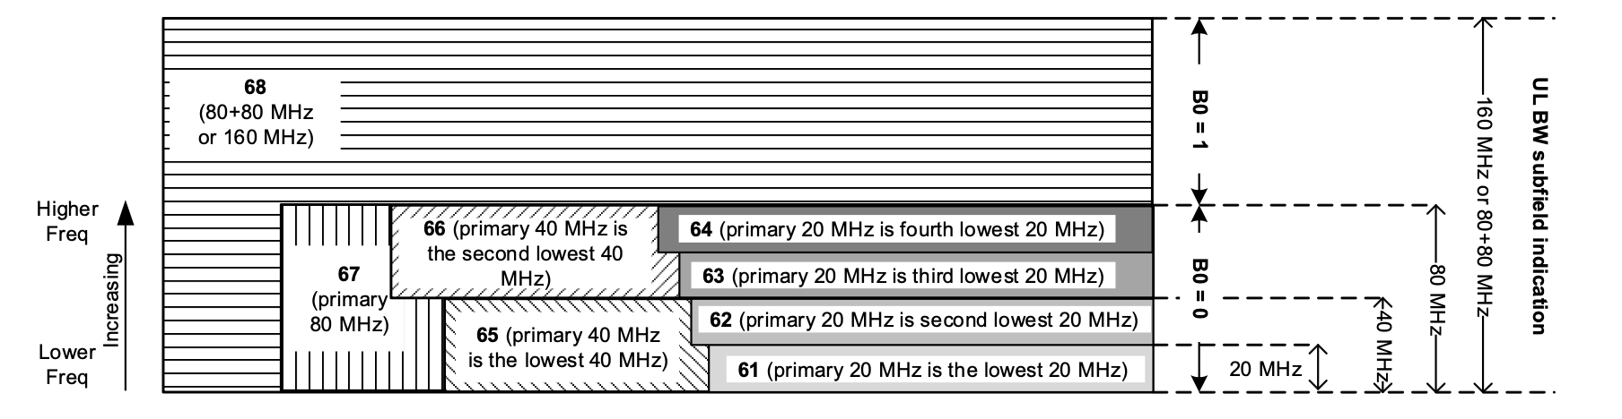
Basic Idea (2)
Use MU-RTS to inform EMLSR-SC STA to switch to secondary channel:
  User Info Field can be used to indicate RU index for secondary channel
  Ex: Set RU index = 67 and B0 = 1 ➞ tells STA to switch to S80
EMLSR-SC STA can use CTS (or BSR) to indicate channel switch is complete:
  Ex: CTS is transmitted only on S80

Slide 5
EMLSR-SC: DL MU Sequence (1)
AP transmits data to STA1 – STA4 in DL MU PPDU using either OFDMA or MU MIMO
STA1 – STA4 send IR in UL TB PPDU

Slide 6
EMLSR-SC: UL MU Sequence
Trigger frame initiates TX from STA using TB PPDU format:
  STAs transmit using their allocated RU

Slide 7
EMLSR-SC: Sounding Sequence
DL Sounding will be transmitted on full BW for both STA1 and STA2:
  Each STA must support mixed BW and partial BW sounding feedback (STA1 on P80, STA2 on S80)

Slide 8
Supported BW of Operation
To simplify AP design, we propose to limit minimum BW for EMLSR-SC STAs to 80 MHz:
  For 160 MHz AP, STA may operate on either P80 or S80
  For 320 MHz AP, STA may operate on either P80, S80, Lower 80MHz of S160, Upper 80 MHz of S160, P160 or S160
To enable MU transmissions, more than one STA may share the primary or secondary channels
Operating Band | AP BW Configuration | STA BW Configuration | Number of Total Channels
5 GHz | 160 MHz | 80 MHz | 2
6 GHz | 160 MHz | 80 MHz | 2
 | 320 MHz | 80 MHz | 4
 |  | 160 MHz | 2

Slide 9
Support of Both EMLSR and EMLSR-SC
An AP may have associated STAs that either support EMLSR-only, EMSLR-SC-only, or both EMLSR and EMLSR-SC
When an ICF sent by AP is received,
  EMLSR-only STAs need to listen on multiple band and switch operating band
  EMLSR-SC-only STAs need to only listen on single band and switch channels between primary and secondary channels
  EMLSR + EMLSR-SC STAs need to listen on multiple bands: (1) Switch operating band for EMLSR operation, or (2) Switch channels between primary and secondary channels for EMLSR-SC operation

Slide 10
EMLSR-SC Operation
Existing EMLSR protocol can be used for EMLSR-SC operation:
  Modify RU index setting of MU-RTS to allow CTS on secondary channels
  Add Capability bit to indicate support for 80 MHz only EMLSR-SC STA
  Make mixed BW support and partial BW sounding feedback conditional mandatory for EMLSR-SC
  Disallow non-TB sounding procedure for EMLSR-SC operation
  Disallow 802.11ac BF poll
In addition, a Coex protocol is needed to enable EMLSR and EMLSR-SC operations in the same BSS

Slide 11
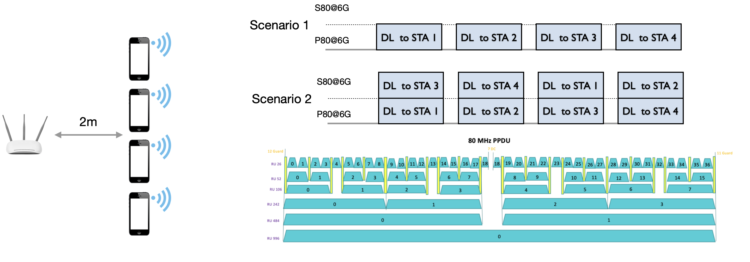
Simulation Results (1)
Assumptions:
  802.11ax HE BSS operation
  Four 80 MHz HE STAs are associated with a 160 MHz BSS HE AP
Scenario 1:
  Disable secondary 80 MHz operation
  AP schedules each STA using round robin on the primary 80 MHz channel
Scenario 2:
  Enable secondary 80 MHz operation
  AP schedules STA using round robin on both primary and secondary 80 MHz channels
Compare the system performance of Scenarios 1 and 2

Slide 12
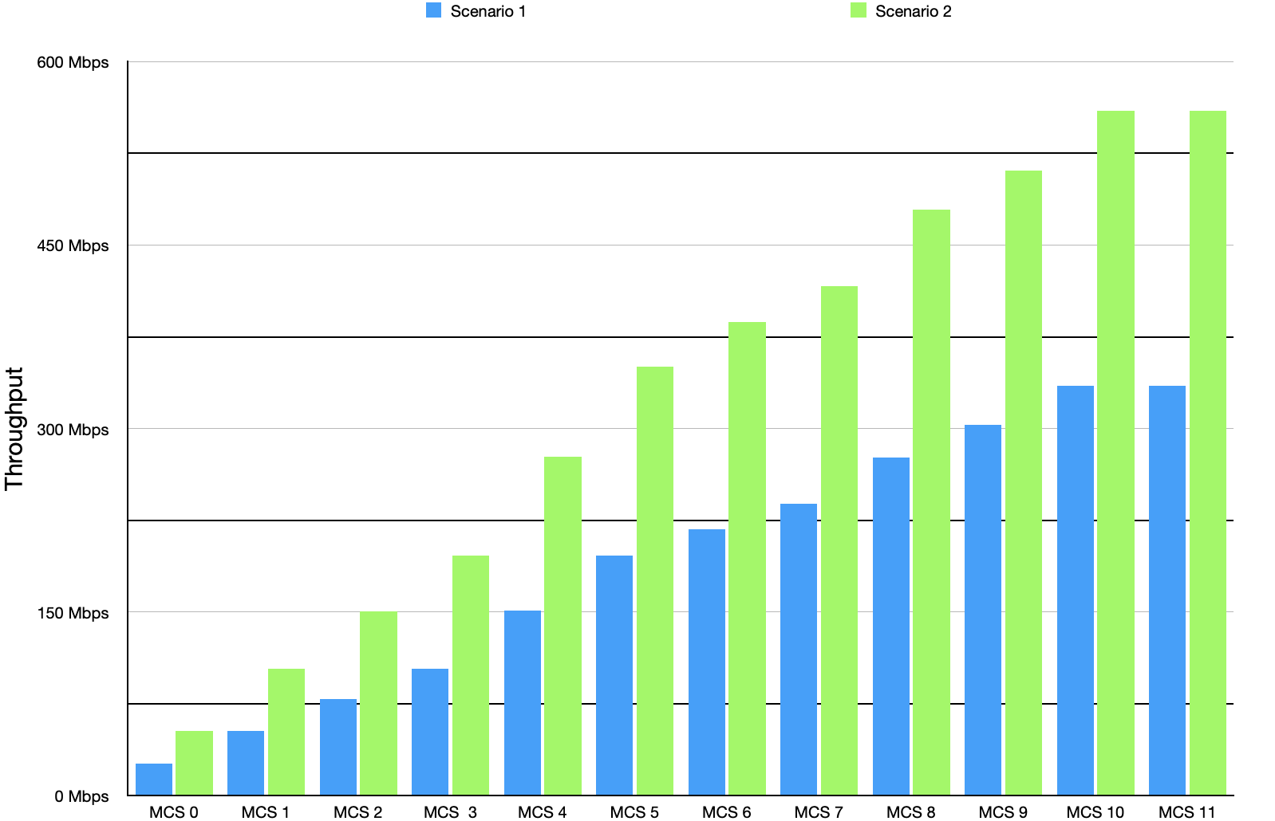
Simulation Results (2)
Key simulation configuration:
  AMSDU Aggregation: off
  64 BA window
  RTS: off
  Rate adaptation: off
  Nss = 1, GI=1.6us
Scenario 2 significantly outperforms Scenario 1:
  Enabling secondary 80 MHz channel significantly improves the throughput
  For MCS 11, Scenario 2 provides a 79% throughput gain over Scenario 1

Slide 13
Straw Poll 1
Do you agree that the 802.11bn TG shall define a secondary channel mechanism that leverages the existing 802.11be EMLSR protocol as discussed in this presentation?
  Name of the mechanism is TBD, use EMLSR-SC as a reference for discussion purpose
Yes
No
Abstain

Slide 14
Straw Poll 2
Do you agree that an 802.11bn STA that supports EMLSR-SC operation shall be able to support the EMLSR operation?
Yes
No
Abstain

Slide 15
Straw Poll 3
Do you agree that a Coex mechanism should be defined to enable the coexistence of the EMLSR-only, EMLSR-SC-only, and EMLSR + EMLSR-SC STAs to operate in the same BSS?
Yes
No
Abstain

