Slide 1
Server-Managed Secure Transaction with AMP Devices
Date: 2024-3-6
Authors:

Slide 2
Summary
A brief review of the basic secure transaction model for AMP devices proposed in IEEE 802.11-24/0178r0.
Why we need to enhance the basic secure transaction model?
Proposed implementation for a server-managed secure transaction model for AMP devices, which is compatible with the basic secure transaction model.
Notes:
https://unit42.paloaltonetworks.com/iot-threat-report-2020/

Slide 3
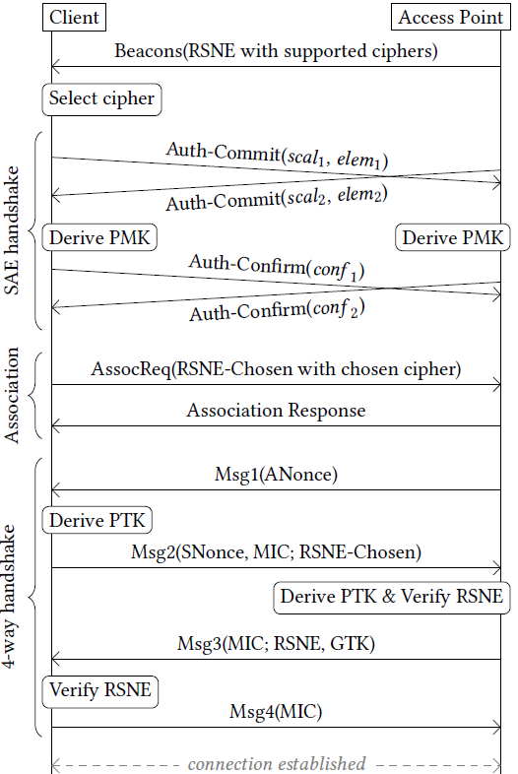
What is a suitable communication model for AMP devices?
If an ambient device follows the conventional Wi-Fi MAC (maintaining a secure link for layered networking)
It will take 10+ frames to establish a secure association.
The ambient device needs to have sufficient power to maintain the secure association and low power operating mode (e.g., TSF timer).
Questions
Do AMP devices have sufficient power for such overhead?
Current layered networking model has been designed to support multiple applications and large-volume data exchange. Do AMP devices need this?
Arguments
Layered networking model over conventional Wi-Fi MAC is not the best fit for AMP devices that are often designed for a single application.
Compact transaction-based communication model, as described here, may be better.
Notes:
https://unit42.paloaltonetworks.com/iot-threat-report-2020/

Slide 4
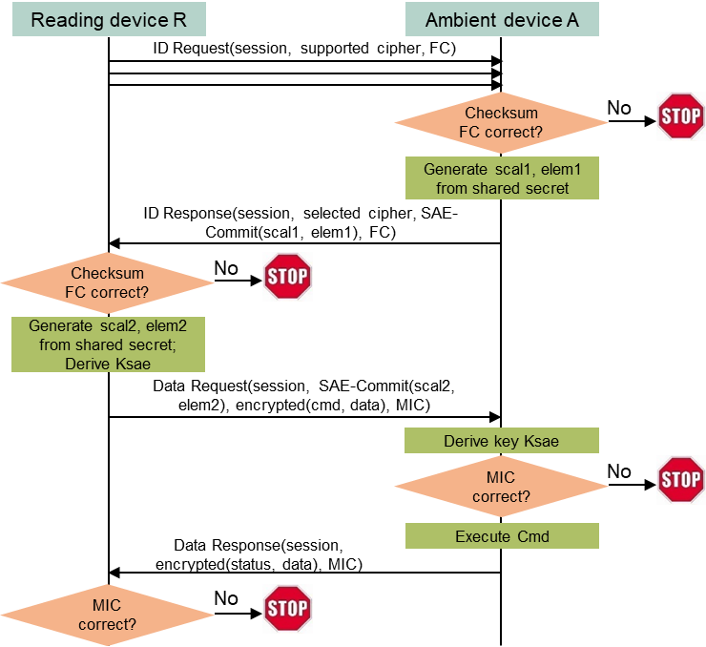
The basic secure transaction model for AMP devices
Assumptions
AMP devices typically support one application (function).
AMP devices do not have large data volume to exchange at each transaction.
AMP devices do not need to maintain association and/or low power mode (they can simply power off or lose the power after communication).
Initial ideas
A simple Request (by regular STA) + Response (by AMP device) transaction model.
Integrated security based on a shared secret between the requester (regular STA) and the respondent (AMP device).
Absolutely minimize exchanged messages during the aforementioned secure data transaction.
Solution
Only 4 message exchanges are needed to finish secure transaction.
Notes:
https://unit42.paloaltonetworks.com/iot-threat-report-2020/

Slide 5
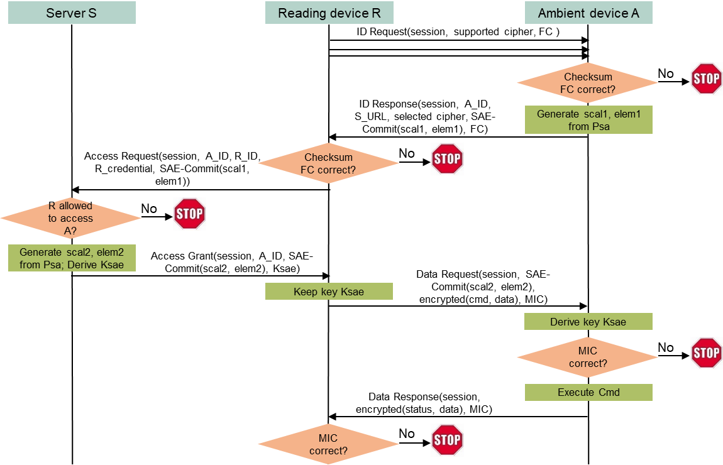
A server-managed secure transaction model for AMP devices
Use case: an entity owning many deployed AMP devices may want to dynamically allow/disallow reading devices to access deployed AMP devices.
Example: a contractor’s reading device may need the access, and the access right should be removed after finishing the contract.
Shared secret between a reading device and an AMP device is no longer suitable.
It is impractical to maintain and update identifiers and shared secrets for different reading devices on every AMP device, especially deployed AMP devices.
Solution: let a server manage access rights for deployed AMP devices.
Notes:
https://unit42.paloaltonetworks.com/iot-threat-report-2020/

Slide 6
Implementation
A user’s reading device R sends an ID_Request message to an ambient device A.
A provides its ID (A_ID), a server S’s URL (S_URL), SAE-Commit(scalar1, element1) in an ID_Response message to R, where SAE-Commit is generated based on a secret Psa between S and A.
R connects to S over a secure connection such as TLS, submitting A_ID, SAE-Commit(scalar1, element1), along with its identifier (R_ID) and credential (R_credential).
If R is allowed to access A, S generates SAE-Commit(scalar2, element2), derives a key Ksae based on Psa, then send them to R. R cannot find Psa from Ksae.
R sends a Data_Request to A, with SAE-Commit(scalar2, element2) and command/data encrypted by Ksae.
A derives Ksae. After verifying the MIC in Data Request, it carries out the instruction and sends a Data Response with the response data encrypted using Ksae to R. R verifies the MIC in Data_Response then decrypts the response data.
Notes:
https://unit42.paloaltonetworks.com/iot-threat-report-2020/

Slide 7
Conclusions
A server-managed secure transaction model can dynamically control the user device’s access to AMP devices without any update on AMP devices.
Only four messages with AMP devices are needed for the user device to finish a secure transaction, the same as the basic secure transaction model for AMP devices.
Compatible with the basic model. A reading device can find which model to follow from the ID_Response message (with or without server URL).
Notes:
https://unit42.paloaltonetworks.com/iot-threat-report-2020/

