Slide 1
UEQM – Further Details
Date: 2024-03-11
Authors:
Name | Affiliations | Address | Phone | email
Ron Porat | Broadcom |  |  | ron.porat@broadcom.com
Qijia Liu | Broadcom

Slide 2
Introduction
[1]-[4] introduced the topic of UEQM
UEQM provides gain but the number of combinations is potentially very large which complicates implementation and link adaptation.
Our goal in this presentation is to find the sweet spot between the number of combinations and performance.
We focus on two aspects:
What should be the maximum QAM difference between the strongest and weakest streams
How many UEQM combinations should we support
We further focus on 2 and 3 spatial streams

Slide 3
Simulation Assumptions
SVD based Tx beamforming
MIMO Configs: 2x2, 3x3, 4x4
80MHz
DNLOS, BLOS, 500 channel realizations for each MIMO config
MCS0-13 on all streams
Including RF impairments
Gain numbers based on RvR simulation, which uses genie rate selection per channel realization at each SNR point

Slide 4
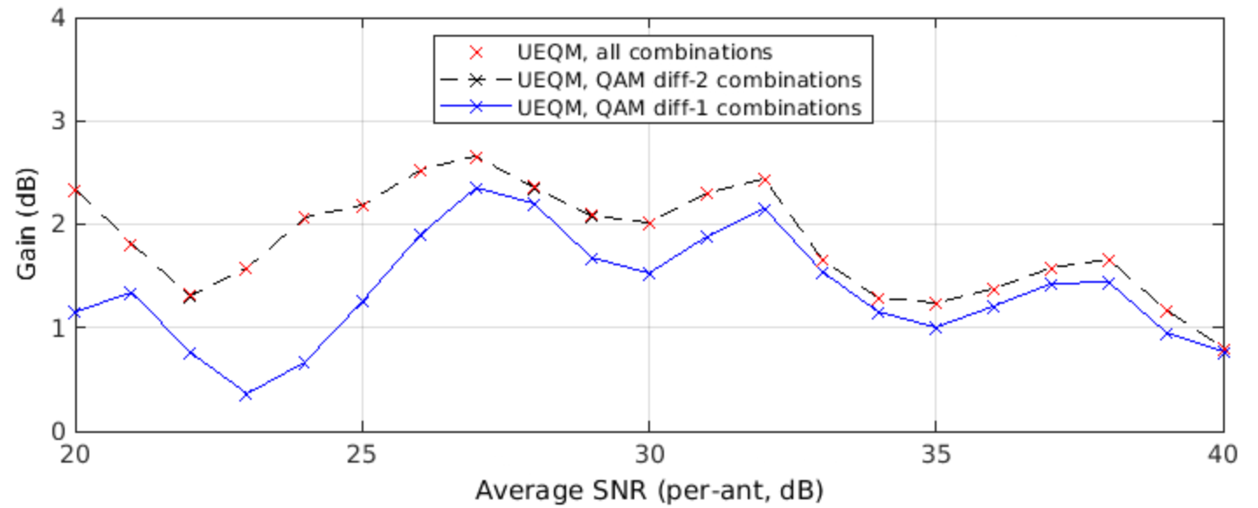
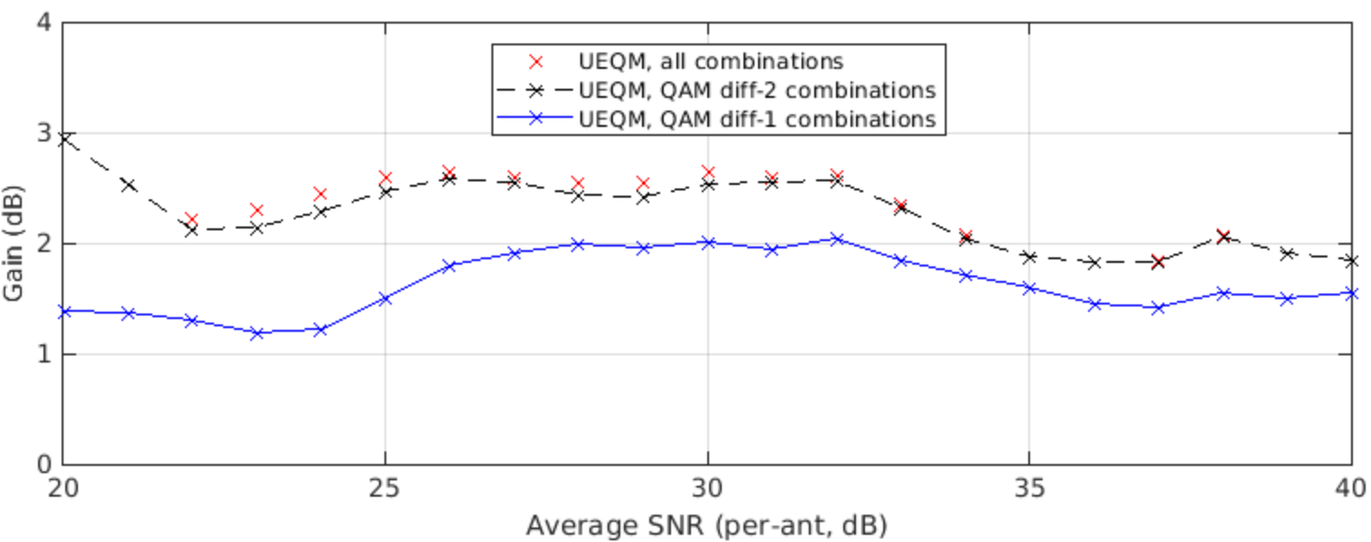
Optimal UEQM combinations for Nss=2
80MHz 2x2 DNLOS TXBF
 | Mod[stream] |  | combinations
 | 0 | 1 | all | diff-2 | diff-1
0 | x | x | ✓ | ✓ | ✓
1 | x | x-1 | ✓ | ✓ | ✓
2 | x | x-2 | ✓ | ✓
3 | x | x-3 | ✓
4 | x | x-4 | ✓
Up to QAM diff-2 recommended in order to achieve full potential gains with limited complexity
80MHz 2x2 BLOS TXBF

Slide 5
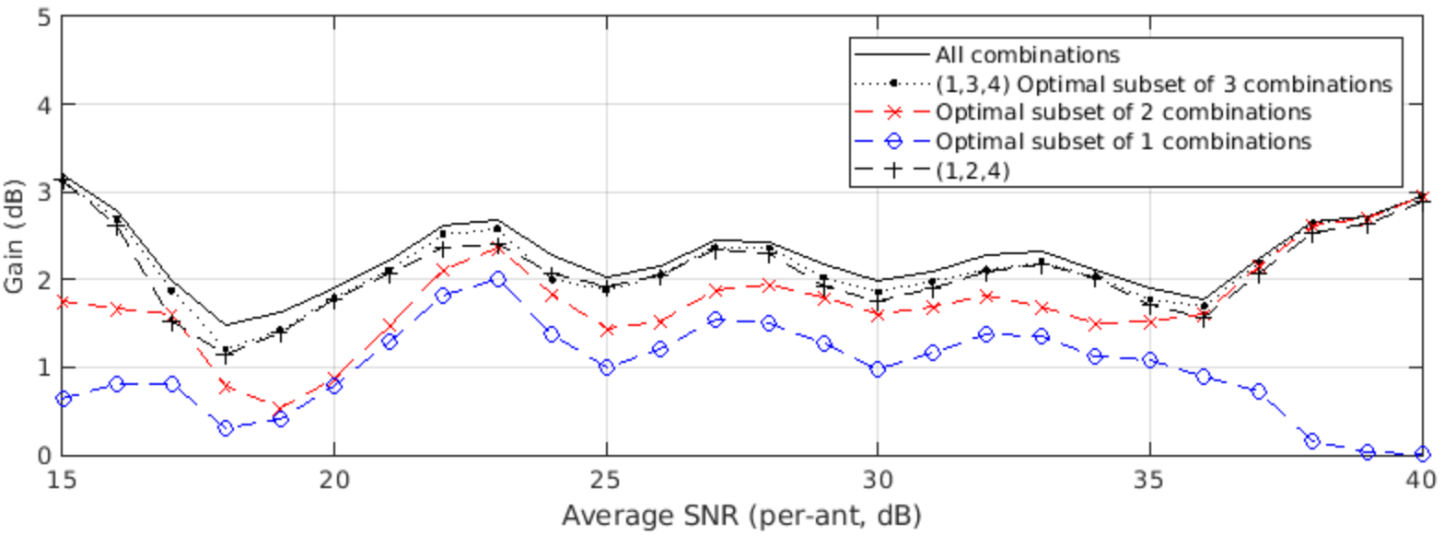
Optimal UEQM combinations for Nss=3 in 4x4
80MHz DNLOS 4x4 Nss=3 TXBF
 | Mod[stream] |  |  | # UEQM combinations
 | 0 | 1 | 2 | 1 | 2 | 3
0 | x | x | x | ✓ | ✓ | ✓
1 | x | x | x-1 |  |  | ✓
2 | x | x-1 | x-1 | ✓ | ✓ | ✓
3 | x | x | x-2
4 | x | x-1 | x-2 |  | ✓ | ✓
5 | x | x-2 | x-2
80MHz BLOS 4x4 Nss=3 TXBF
 | Mod[stream] |  |  | # UEQM combinations
 | 0 | 1 | 2 | 1 | 2 | 3
0 | x | x | x | ✓ | ✓ | ✓
1 | x | x | x-1 |  | ✓ | ✓
2 | x | x-1 | x-1 | ✓
3 | x | x | x-2 |  | ✓ | ✓
4 | x | x-1 | x-2 |  |  | ✓
5 | x | x-2 | x-2
-

Slide 6
Discussion
Metric for best Nss=3 UEQM combination subsets: max average goodput gain percentage in SNR [20,30]dB (see Appendix for switching point between Nss=3 and Nss=4)
Compared with “all combinations” (UEQM with QAM diff-3 and 4), limiting to QAM diff-2 is close to optimal.
Selecting only l or 2 UEQM combinations results in sub-optimal performance.
Out of the 5 possible diff-2 combinations for Nss=3, combinations (1,3,4) or (1,2,4) provide good performance.

Slide 7
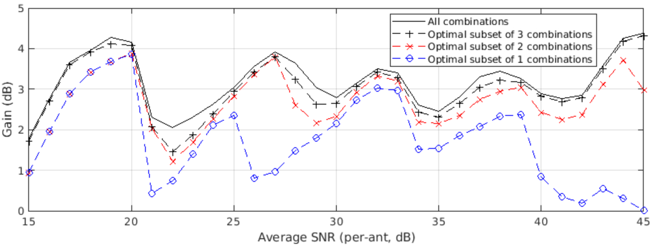
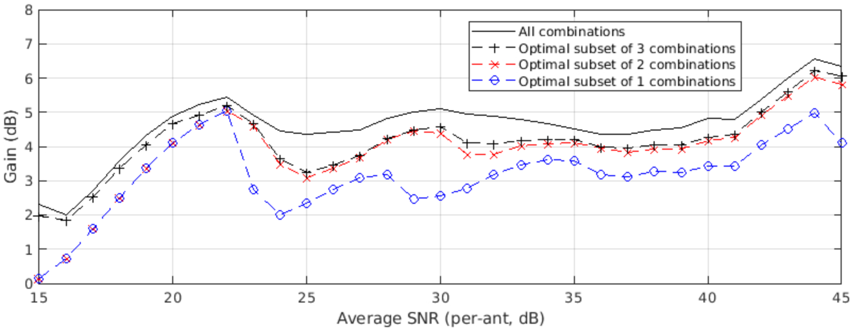
Optimal UEQM combinations for Nss=3 in 3x3
80MHz DNLOS 3x3 Nss=3 TXBF
 | Mod[stream] |  |  | # UEQM combinations
 | 0 | 1 | 2 | 1 | 2 | 3
0 | x | x | x | ✓ | ✓ | ✓
1 | x | x | x-1 |  |  | ✓
2 | x | x-1 | x-1
3 | x | x | x-2 | ✓ | ✓ | ✓
4 | x | x-1 | x-2 |  | ✓ | ✓
5 | x | x-2 | x-2
80MHz BLOS 3x3 Nss=3 TXBF
 | Mod[stream] |  |  | # UEQM combinations
 | 0 | 1 | 2 | 1 | 2 | 3
0 | x | x | x | ✓ | ✓ | ✓
1 | x | x | x-1 |  |  | ✓
2 | x | x-1 | x-1
3 | x | x | x-2 | ✓ | ✓ | ✓
4 | x | x-1 | x-2 |  | ✓ | ✓
5 | x | x-2 | x-2

Slide 8
Discussion
Extended Nss=3 SNR range in 3x3: max average goodput gain percentage in SNR [15,50]dB
In summary combination (1,3,4) is the best for Nss=3, considering 3x3 and 4x4

Slide 9
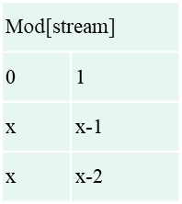
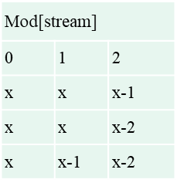
Conclusions
It is possible to achieve almost all the gains of UEQM with up to 3 combinations and with a limitation to a difference of up to 2 levels of QAM between the strongest and weakest streams
Recommend that 11bn adopts the following options for UEQM:
Nss=2 Nss=3

Slide 10
References
[1] 11-24-0117-01 Improved Tx Beamforming with UEQM
[2] 11-24-0016-01-00bn-uhr-mimo-rvr-enhancement-with-unequal-modulation
[3] 11-24-0113-01-00bn-unequal-modulation-in-mimo-txbf-in-11bn
[4] 11-24-0176-01-00bn-unequal-modulation-over-spatial-streams

Slide 11
SP #1
Do you agree to add to the 11bn SFD :
UEQM is limited to the following combinations:
Nss=2 Nss=3

Slide 12
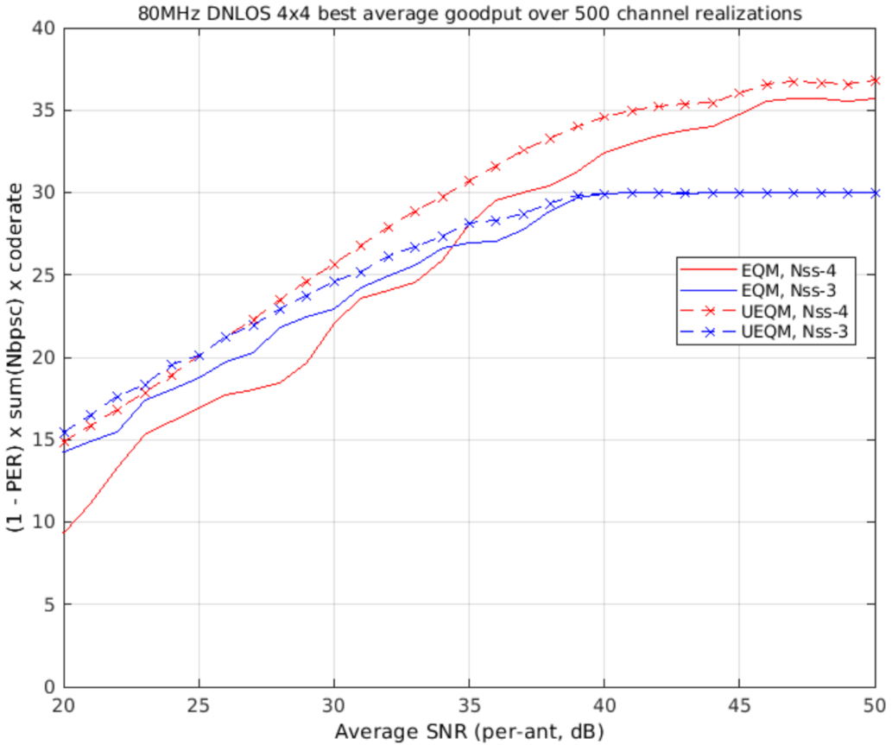
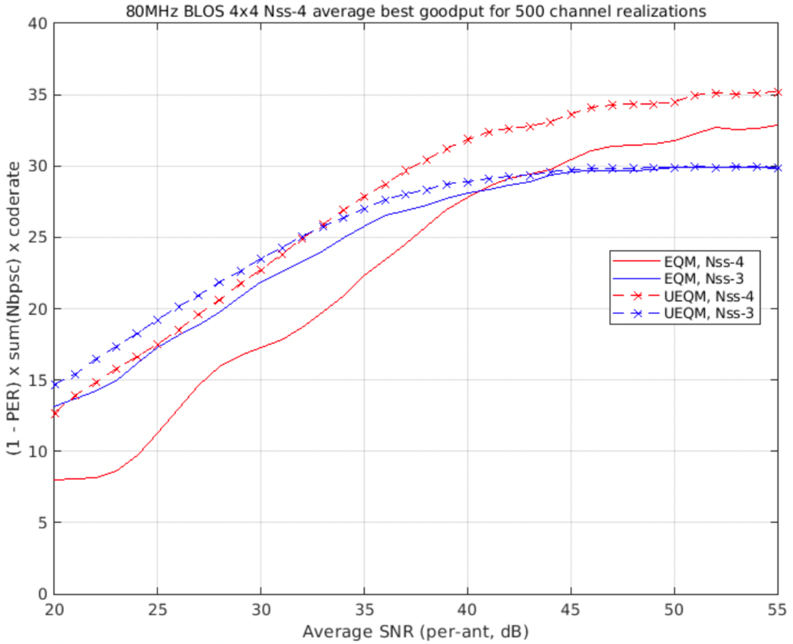
Appendix - Nss=3 and Nss=4 Link Adaptation
To help decide the SNR range for Nss=3, we show the Nss=3 to Nss=4 transition SNRs with 4x4 antenna configs and TXBF
Nss=4 transition SNR (dB) | DNLOS | BLOS
EQM | 34 | 41
UEQM | 26 | 33
80MHz DNLOS 4x4 Nss=4 TXBF
80MHz BLOS 4x4 Nss=4 TXBF

