Slide 1
Pilot Design Considerations for dRU
Date: 2024-03-xx
Authors:
Name | Affiliations | Address | Phone | Email
Lin Yang | Qualcomm
Bin Tian
Youhan Kim
Qifan Chen
Notes:
September 2012

Slide 2
Overview
Pilot design for dRU has been discussed in previous contributions [1]-[3]
Pilot locations need to be defined carefully to harvest frequency diversity
For dRU, we assume same number of pilots as in rRU
dRU phase tracking may be better because of pilot spreading over wide BW
As previous contributions showed pilot placement is important
In this contribution we highlight our view of dRU pilot design

Slide 3
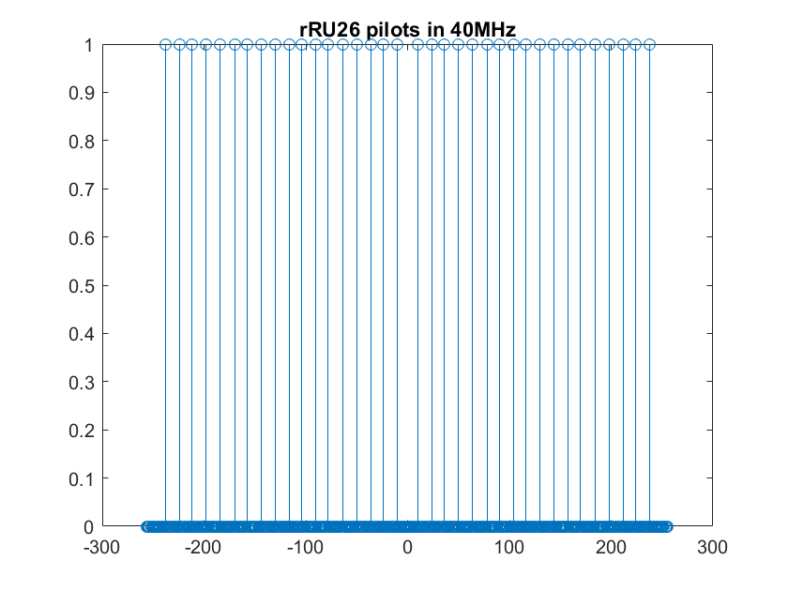
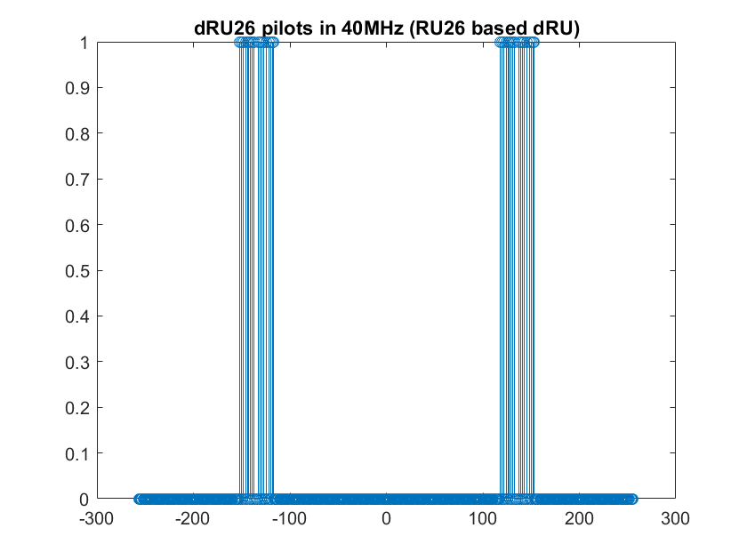
Issue of Re-using Relative Pilot Locations in rRU
If the pilot tones were mapped according to its relative location within the corresponding rRU, pilots in different dRUs with same size would squeeze into N local area (N is # of pilot for that RU size)
Because in the existing rRU tone plan, relative pilot tone locations in each RU are almost the same for different RUs with same RU size
As such, pilots in dRU26 are squeezed into two local areas, similarly other dRU sizes
In case there is interference/spurs in any of the two local areas, every RU26 STA in OFDMA suffers the hit

Slide 4
High Level Thoughts on dRU Pilot Tone Location Design
Preferred dRU pilot location property
Tones next to DC or edges are not allowed for pilots to avoid impairment impact
Within each dRU pilots should be separated enough for frequency diversity
Across different RUs, pilots are not clustered together so to be robust to interference and spur
Prefer evenly or near-evenly distributed pilot tones for dRU
Following hierarchical structure as rRU pilots
dRU tone plan also follows hierarchical structure

Slide 5
Hierarchical Pilot Structure for dRU
RU26 based pilot design, pilot locations of entire BW depends on dRU26 pilots
Optimization only needs to be done on dRU26 pilots while taking larger RU sizes’ design goals into consideration
Decimate for larger RU sizes
Essentially P52 = 2*P26, P106 = ½*(2*P52), P242 = 2*P106, P484 = 2*P242
Since different dRU size has different tone mapping spacing/pattern, joint optimization may lead to a set of evenly or near-evenly distributed pilot tones over entire spreading BW, ready to use by all RUs with various of RU sizes in given spreading BW
Guarantee good pilot tone separation for any dRU scheduling combinations

Slide 6
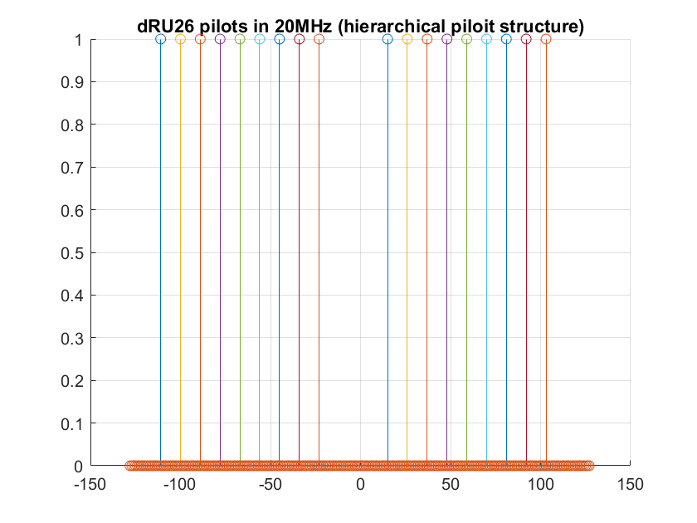
Example Hierarchical Pilots for dRU in 20MHz
dRU tone plan is still under discussion. Use one of example [4,5]
Following hierarchical structure with globally optimized pilot tones
Pilot tone separation is 11 11 11 … perfect even distribution!
Enough separation of pilots for any combination of dRUs: comparable to rRU
Within each dRU: pilots separation of 126 tones for any dRU26 to harvest frequency diversity
Relative Pilot Tone Indices for dRU in 20MHz (start tone index is 1) Hierarchical Structure
dRU26, i=1:9 | dP26-1 | dP26-2 | dP26-3 | dP26-4 | dP26-5 | dP26-6 | dP26-7 | dP26-8 | dP26-9
 | (2,15) | (4,17) | (3,16) | (5,18) | (6,20) | (8,21) | (10,23) | (9,22) | (11,25)
dRU52, i=1:4 | dP52-1 |  | dP52-2 |  |  | dP52-3 |  | dP52-4
 | sort([dP26_1 dP26_2]) |  | sort([dP26_3 dP26_4]) |  |  | sort([dP26_6 dP26_7]) |  | sort([dP26_8 dP26_9])
dRU106, i=2 | dP106-1 |  |  |  |  | dP106-2
 | sort([dP52_1([1,3]) dP52_2([2,4])]) |  |  |  |  | sort([dP52_3([1,3]) dP52_4([2,4])])
Evenly distributed pilot tones for all dRU26 in 20MHz

Slide 7
Summary
We proposed hierarchical pilot structure for dRU, in which pilot locations are optimized globally and systematically
dRU26’s pilot tones are the base set for lager dRU’s pilots
Evenly or near-evenly distributed over entire BW
Within each dRU, large pilots separation ensures frequency diversity
Across different RUs, guarantee of enough separation of pilots for any combination of dRUs
dRU tone mapping is a new tone plan. So defining new pilot locations for dRU adds little complexity

Slide 8
References
[1] 11-23-1115-00-0uhr-cfo-impact-and-pilot-design-for-dru
[2] 11-23-1447-00-0uhr-cfo-impact-and-pilot-design-for-dru-follow-up
[3] 11-23-1511-01-0uhr-pilot-tone-allocation-and-other-considerations-of-tone-distributed-rus-for-uhr
[4] 11-23-2021-00-00bn-principle-and-methodology-for-dru-tone-plan-design
[4] 11-24-0468-00-00bn-DRU-Tone-Plan-for-11bn

Slide 9
Straw Poll #1
Do you agree to add the following text to the TGbn SFD?
11bn supports hierarchical pilot structure for dRU

