Slide 1
DPWiFi for IEEE802.11bn WMANs
Date: 2024-04-11
Authors:

Slide 2
Abstract
TWI’s proposed “DPWiFi” IEEE802.11bn PHY/ MAC, particularly relevant to Wireless Metropolitan Area Networks (“WMANs”), represents Breakthrough wireless enabling Disruptive radios forming Revolutionary networks to deliver Transformative Broadband worldwide in the not too distant future

Slide 3
Proposed DPWiFi IEEE802.11bn PHY/ MAC Specification
32 IEEE802.11be concurrent, cochannel EHT RF streams
32x32 MIMO Dynamic Polarization Multiplexing
32x32 MIMO Tx/Rx DLOS/ nLOS/ NLOS Beam Forming/ Steering
Propagation Channel Impairment Mitigation
AP/ Client Rx Interference Cancellation
AP Tx Multi-beaming
Client Rx Multipath Recombination
90D/ 10U TDMA MAC
5-7 GHz UNII Operation

Slide 4
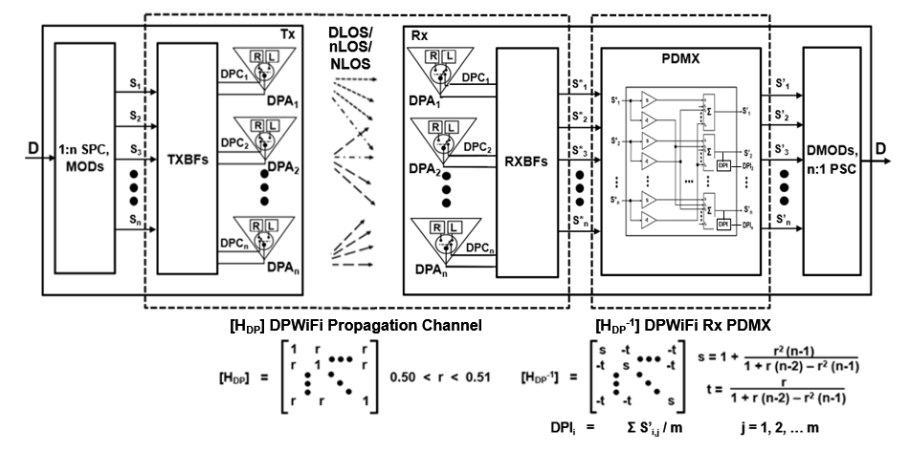
Breakthrough DPWiFi Technology
The WMAN DP propagation channel [H_{DP}] is an n-dimensional “Polarization Space” The upper bound for n, if it exists, greatly exceeds 32
The [H_{DP}] channel transfer function is non-singular, deterministic, scalar and uniform
I.e., h_{ij} = 1, i = j; h_{ij} = 0 ≤ r < 1 , i ≠ j
The Propagation Channel Dynamic Polarization Index (ChDPI) “r” varies with [H_{DP}] impairments
DPWiFi DLOS, nLOS and NLOS links are subject to [H_{DP}] “depolarization”
(i.e., induced Rx angular polarization rotation wrt Tx-established orthogonality baseline)
DLOS links experience atmospheric fog, rain, etc. of up to 5º [H_{DP}] depolarization
nLOS links obstructed/ diffracted by foliage or structures face up to 15º depolarization
NLOS links reflected by structures or vehicles depolarize by up to 45º

Slide 5
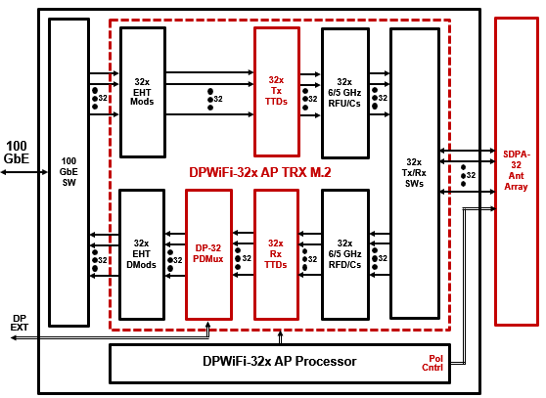
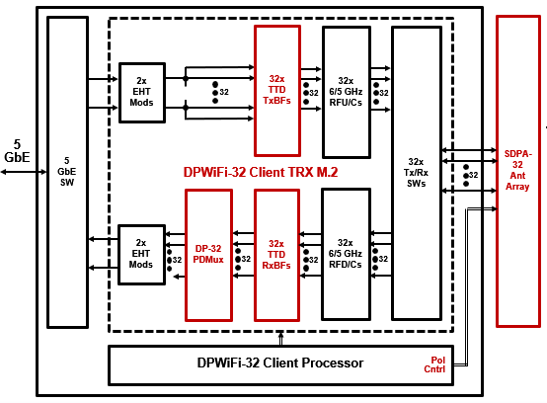
Breakthrough DPWiFi Chipsets

Slide 6
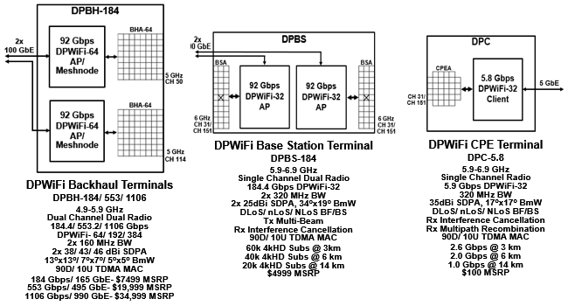
Disruptive DPWiFi APs and Clients
DPWiFi Backhaul (“DPBH”): High Directivity 184/ 553/ 1106 Gbps AP/ Meshnode
DPWiFi Base Station (“DPBS”): Wide Coverage 184 Gbps AP
DPWiFi CPE (“DPC”): High Directivity 5.8 Gbps Client

Slide 7
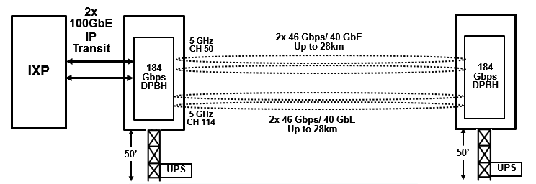
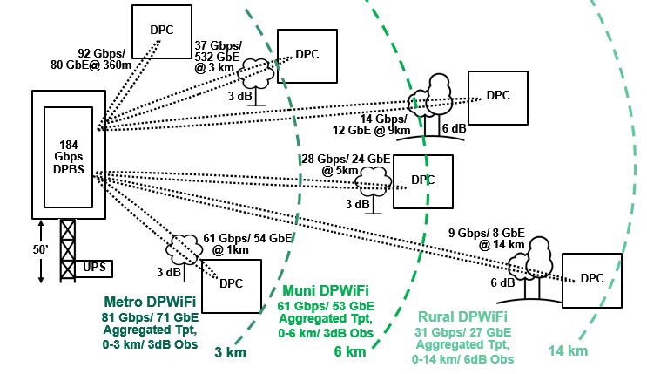
Revolutionary DPWiFi Networks
DPWiFi Backhaul
One DPBH Backhaul link transports 184/ 553/ 1106 Gbps beyond 25 km
DPWiFi Distribution
“Metropolitan DPWiFi” for densest population cities
“Municipal DPWiFi” for sparser population cities
“Rural DPWiFi” for lightly populated regions
One DPWiFi Distribution network supplies dedicated 4kHD to
60k subscribers within 3 km, or
40k subscribers within 6 km, or
20k subscribers within 14 km

Slide 8
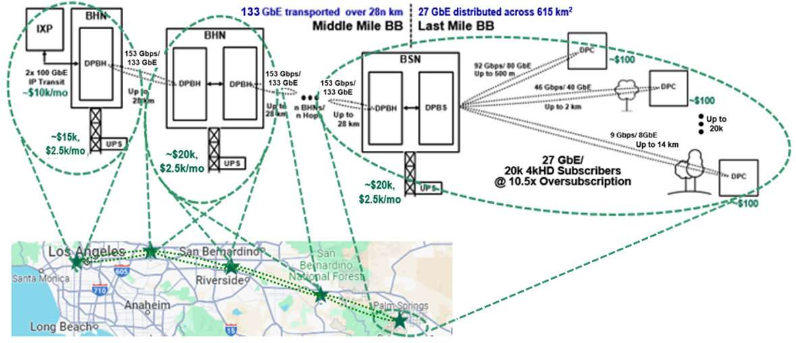
Transformative “Fixed WiFi Access” Rural WMANs
Rural “FWiFiA”: 184 Gbps Base Station/ Up to 20k Subscribers up to 14 km away
Rural DPWiFi 90% Gross Margin BLOWS UP today’s Exurban FWA Business Model

Slide 9
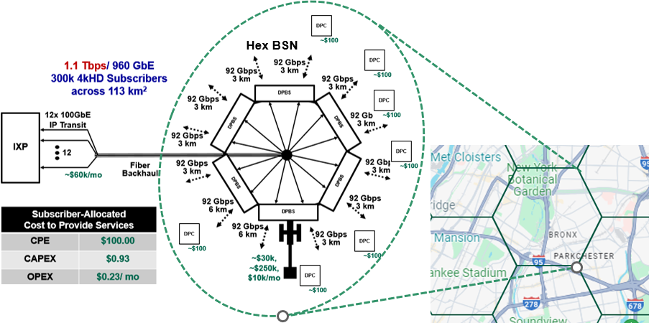
Transformative Fixed WiFi Access Urban WMANs
Metro FWiFiA: 1.1 Tbps Base Station/ Up to 300k Subscribers per 3km radius city cell
Metro DPWiFi 97% Gross Margin BLOWS UP today’s Urban FWA Business Model

Slide 10
What’s to Become of DPWiFi WMANs?
There are ~1.4B Fixed Broadband (“FBB”) connections worldwide today
~ 72.8% Fiber (FTTx)
~ 16.0% Cable (Mostly USA-CN DOCSIS)
~ 8.7% Copper (DSL, ADSL, VDSL)
More About that North American Fixed Wireless Access
~3k WISPs are vying to BB-connect ~12k communities (500-50k residents) with $50-100/mo HD And achieve a 1 – 5% penetration of ~60% (~80M households) of the USA-Canada population
$10/mo 60/60/24/7 Dedicated 4kHD Rural FWiFiA would capture practically ALL those households
This means ~80M DPWiFi CPEs ultimately deployed, or ~40M DPCs sold annually For a $800M SoC/ $4B CPE annual business in as little as 3 years
Fixed WiFi Access will completely upend the above Global Broadband Order
Global FBB incumbent NWOs will overbuild their own urban networks with Metro/ Muni FWiFiA
Those same incumbents then expand into the neighboring countryside with Rural FWiFiA
All those FWiFiA networks combine to offer $10/mo 60/60/24/7 4kHD to up to 2B global subs by 2029 And don’t forget many subs will also drive connected cars by then, accounting for ~ 500M more connections
This means ~2.5B DPWiFi CPEs deployed, or ~1.25B DPCs sold yearly Or a $25B SoC/ $125B CPE yearly business by 2030
DPWiFi WMANs will Displace Legacy Fixed Broadband!

Slide 11
References
1. 23/1606r1-UHRSG Dynamic Polarization Multiplexing and Beamforming WLANs Carlos A Rios (Terabit Wireless Internet), 13-Sep-2023
23/1756r3-TGbn MIMO Dynamic Polarization and Beamforming: Proposed IEEE802.11bn PHY Carlos A Rios (Terabit Wireless Internet), 16-Nov-2023
24/0041r12-TGbn DPWiFi MATLAB Validation Carlos A Rios (Terabit Wireless Internet), 02-Feb-2024

