Slide 1
Impact of Tx EVM on MIMO
Detection – Follow Up
Date: 2024-02-22
Authors:
Name | Affiliations | Address | Phone | email
Genadiy Tsodik | Huawei |  |  | Genadiy.tsodik@huawei.com
Rani Keren
Shimi Shilo
Doron Ezri
Yoav Levinbook
Oded Redlich

Slide 2
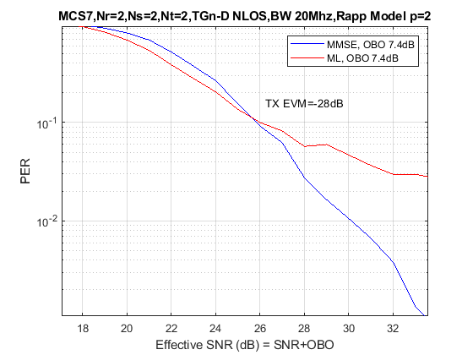
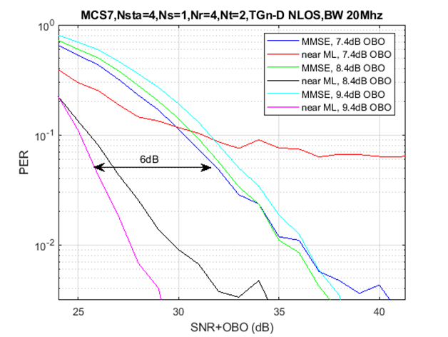

Recap
In [1] we presented the impact of Tx EVM
on nonlinear MIMO detection
We explained that the theoretical gain of nonlinear
detection can not be achieved when Tx EVM is
a dominant noise contributor
In particular, we showed that in this case the
optimal detector coincides with linear detection
which implies that linear detection outperforms
nonlinear near-ML detection
We also showed that improving Tx EVM
resolves the issue and achieves the theoretical
gain of nonlinear detection
In this contribution we address some questions that
were raised during the discussion and provide further thoughts on this topic
MMSE outperforms ML!
$${\tilde{s}}_{ML}=\underset{s∈\text{QA}{\text{M}}^{M}}{argmin}{\left\|H^{−1}y−s\right\|}^{2}$$

Slide 3
Optimal Detector
As derived in [1], when transmitted signal has additional noise component produced by Tx EVM the noise at the receiver is colored
It implies an optimal detector for this scenario which includes whitening stage with inverse Cholesky of the noise covariance
It also means that in presence of Tx EVM performance is always degraded and transmit noise become a limiting factor (whitening can not compensate Tx EVM impact) – we show the simulation results in the next slide

Slide 4
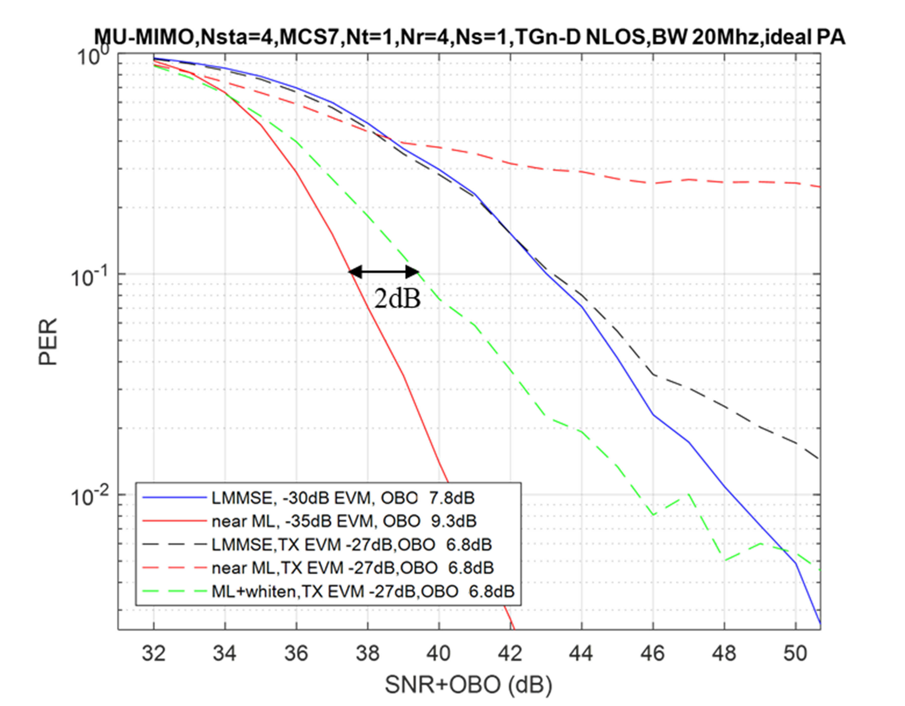
Optimal Detector vs Tx EVM Improvement
We can see on the figure below that bad Tx EVM may significantly degrade the performance of both linear and non-linear detector
We compare the best performance that can be achieved with improved Tx EVM when applying near-ML and MMSE to the optimal near-ML + whitening detectors
We can see that improving Tx EVM
yields gain of 2dB compared to optimal
detection with a whitening stage (of
course the latter requires a higher
complexity at the receiver)
Whitening in this simulation is based
on genie transmitter noise covariance

Slide 5
Impact of Tx EVM with different MCS
We also examined the impact of Tx EVM on the performance of different modulations and coding rates
Simulation parameters:
  TGn-D channel
  Modulation and coding rate: MCS4, MCS5, MCS8, MCS9
  4 STAs
  Nss = 1 per STA
  Nrx_Ant = 4
  PA Model – Rapp, p = 2
  Detector – MMSE and near-ML (with no whitening)
  OBO – we show two results for each type of detector:
    The minimum OBO that ensures standard Tx EVM requirement is met
    The OBO that implies best performance at PER = 10%

Slide 6
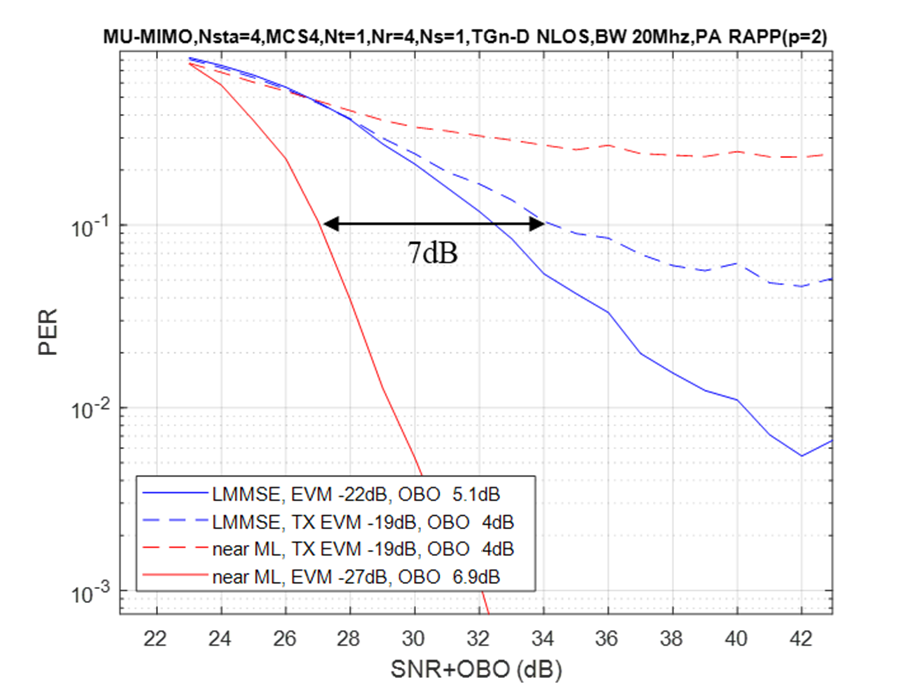
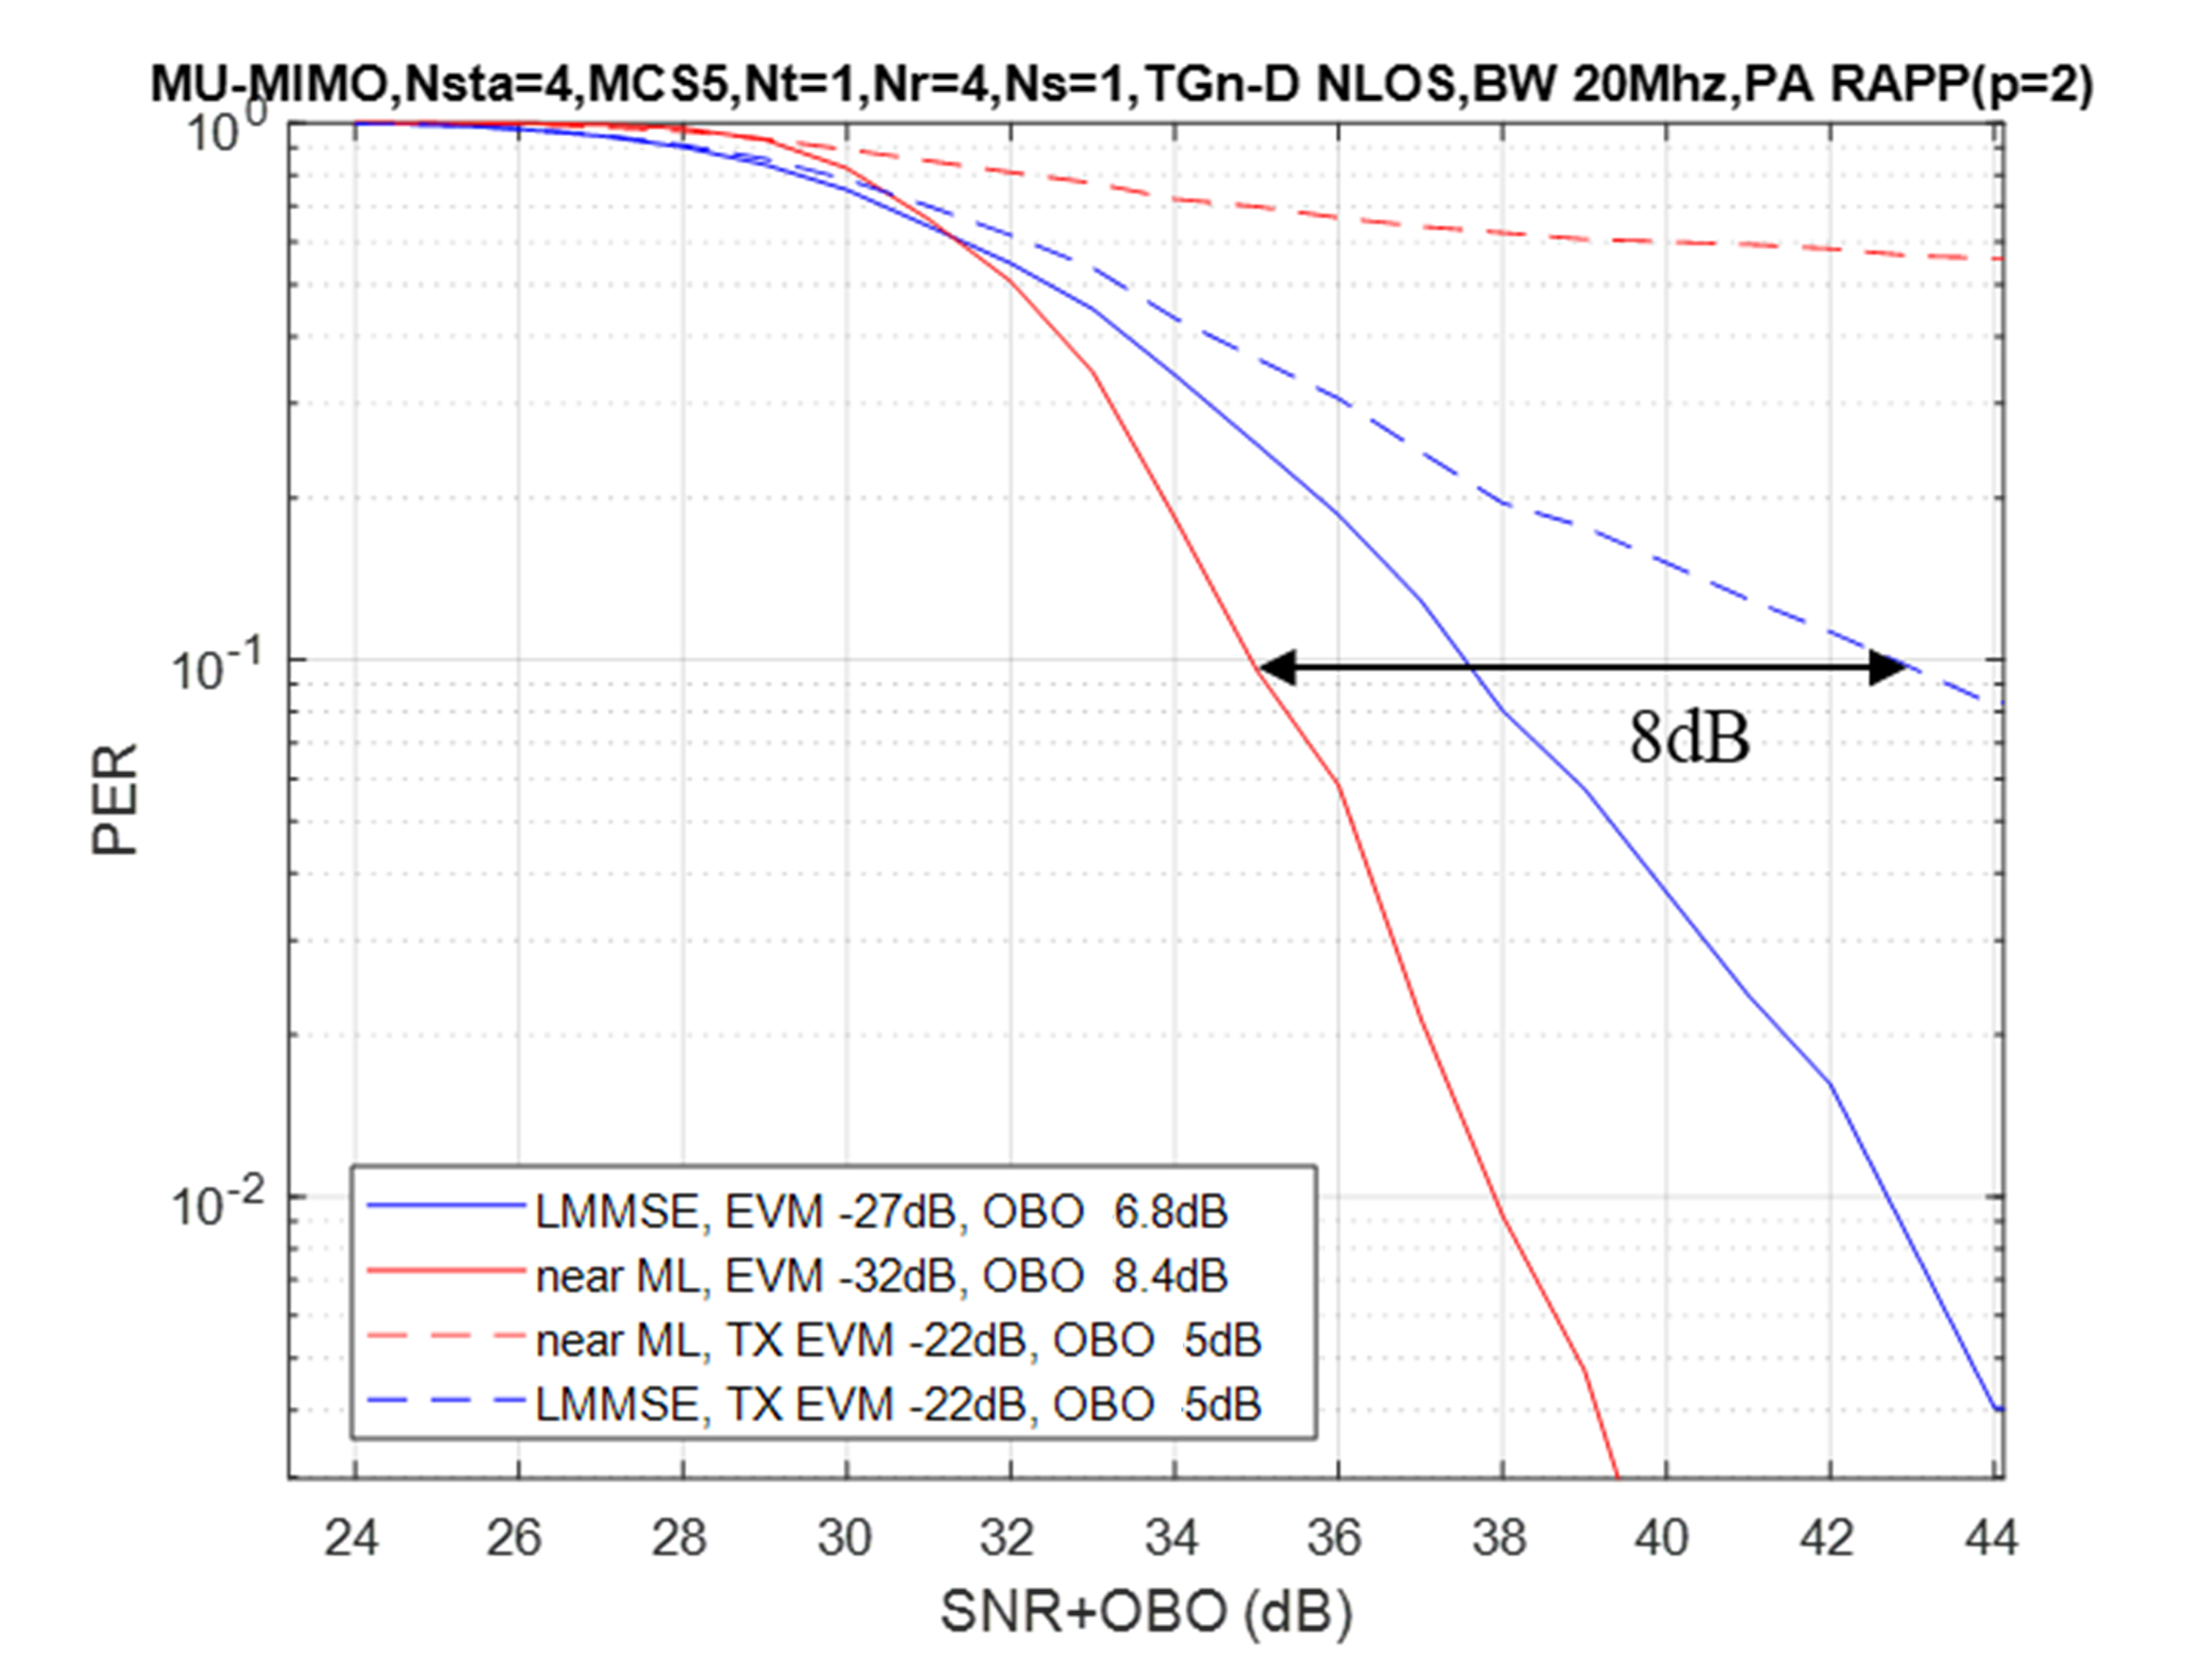
Mid MCS
We can see that the best detection with improved Tx EVM is better then the best detection at standard Tx EVM by up to 8dB
The improved Tx EVM implies better performance for both MMSE and near-ML detection, while nonlinear detection yields a significant gain compared to MMSE detection

Slide 7
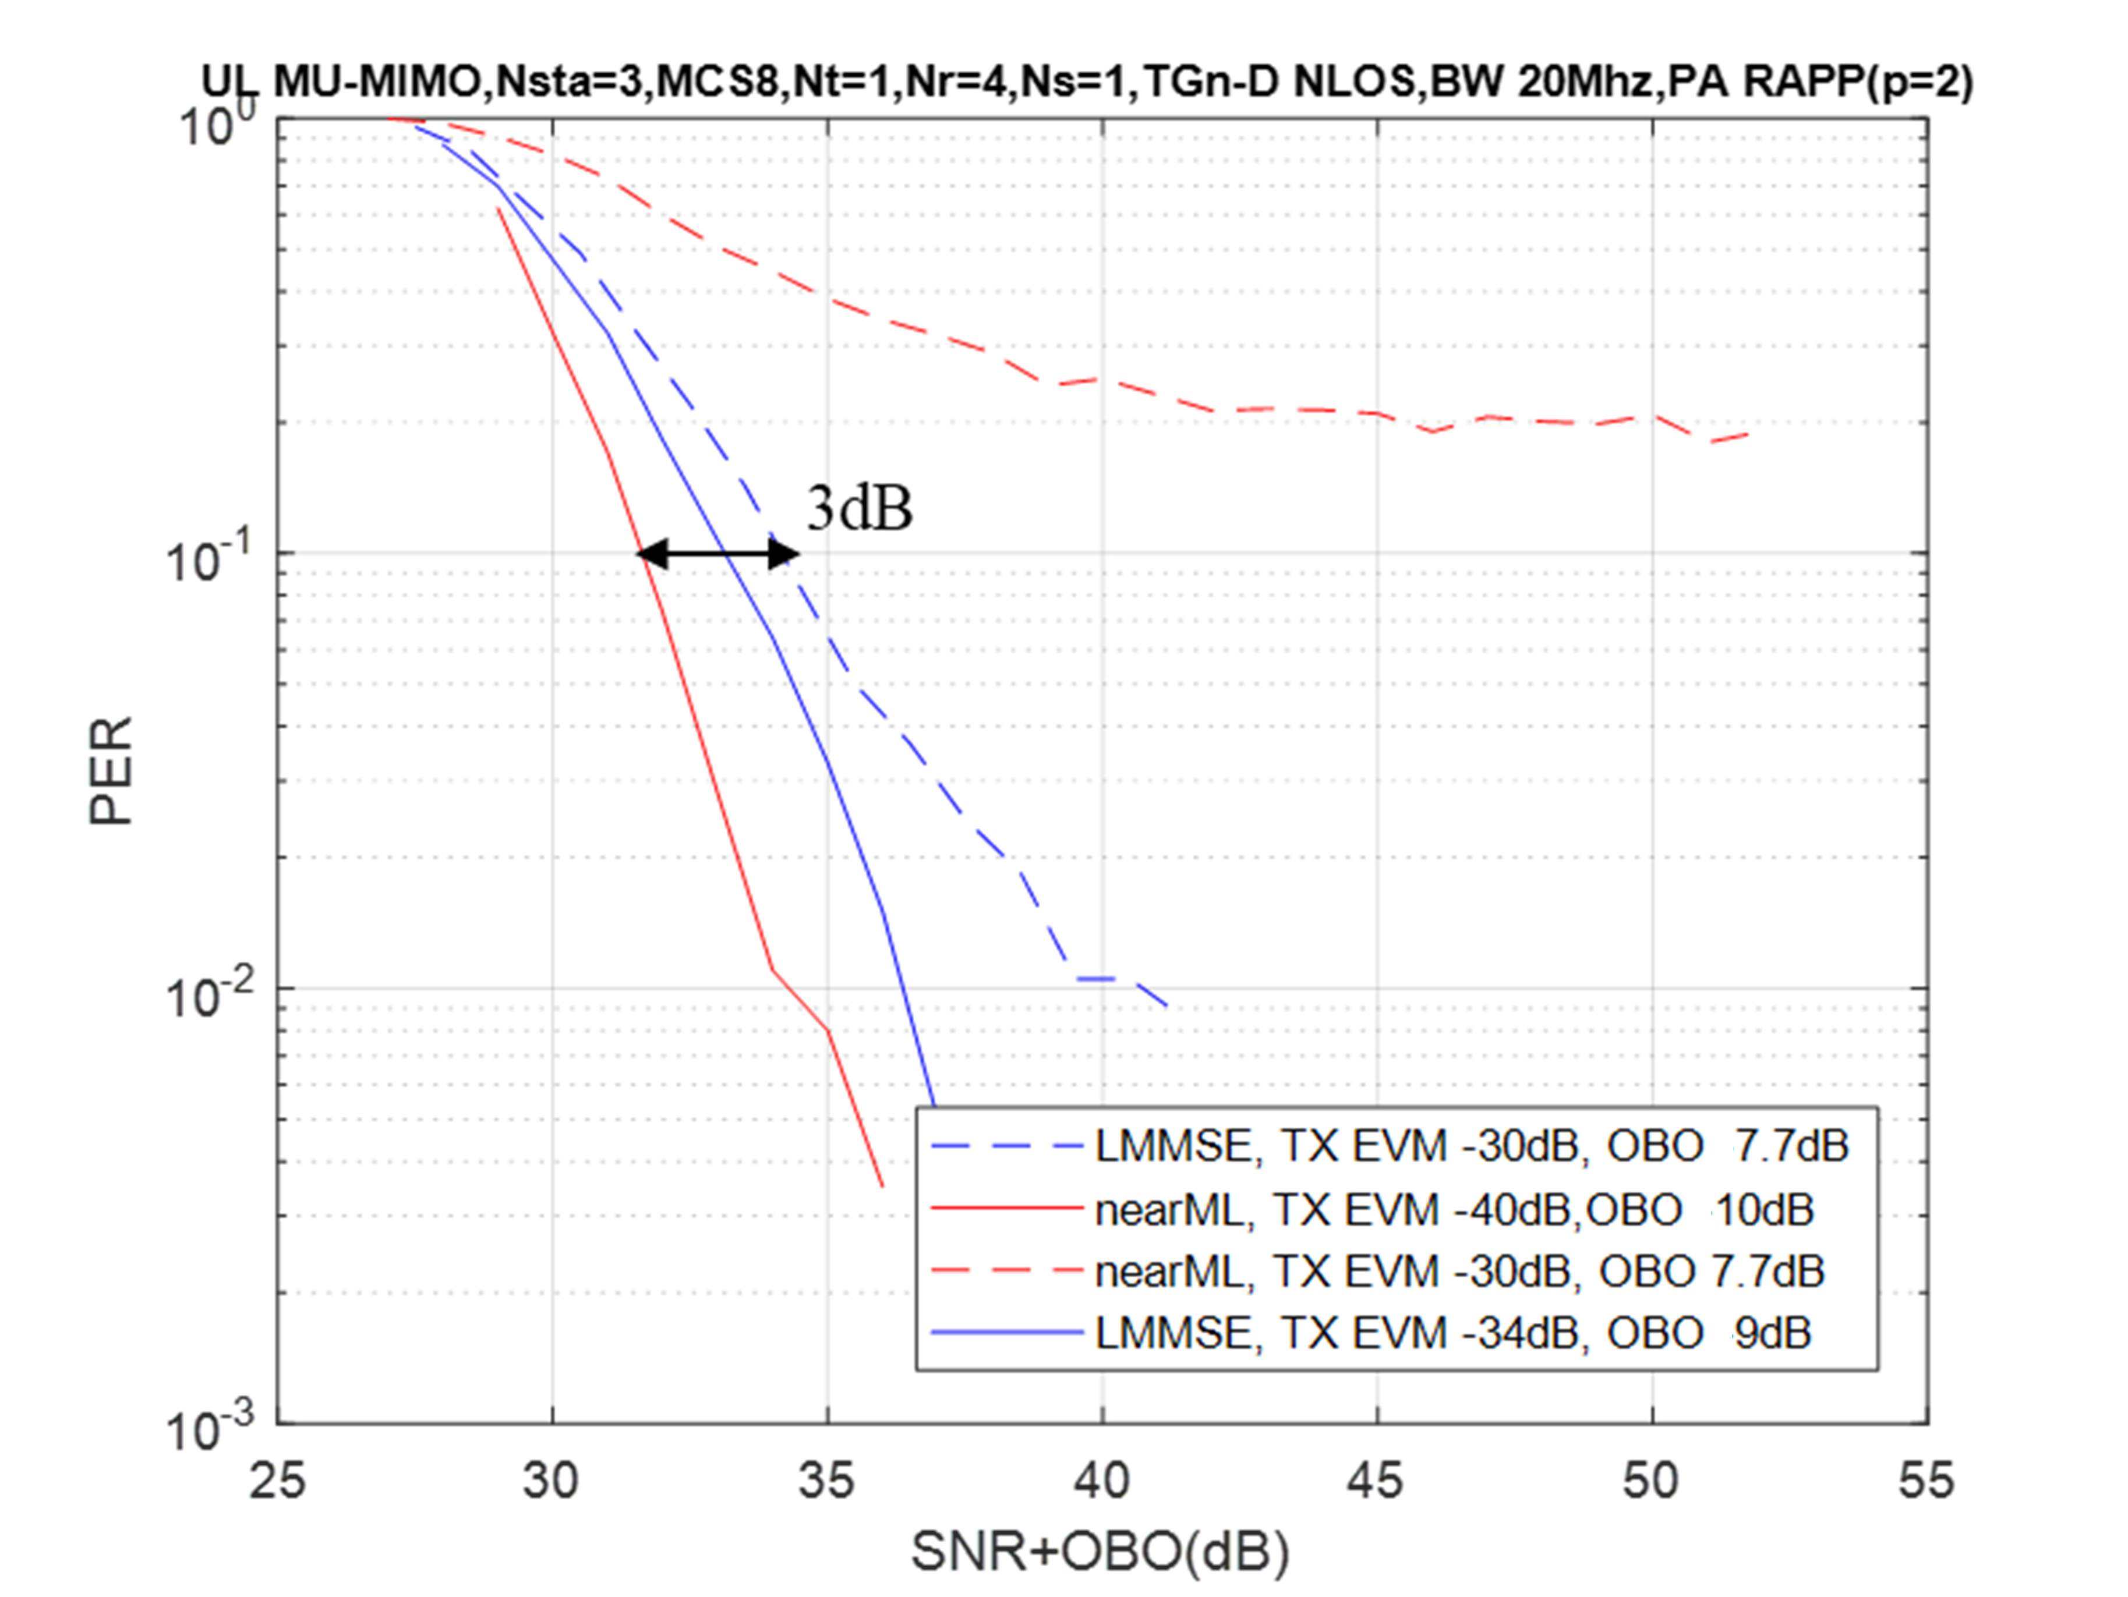
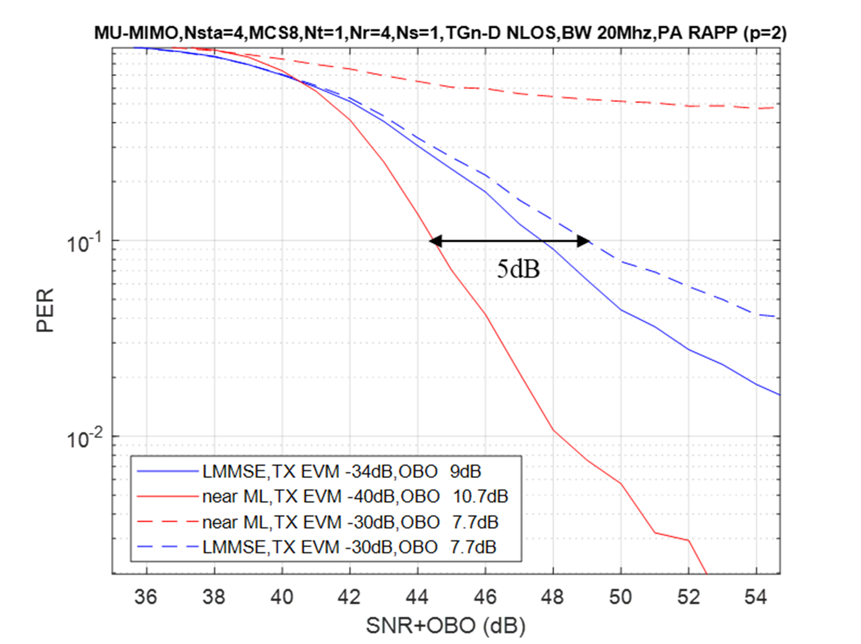
High MCS – MCS8
We can see similar behavior at high MCS – where both detectors provide significant improvement with better Tx EVM, while the near-ML detector also yields a significant gain compared with the MMSE detector

Slide 8
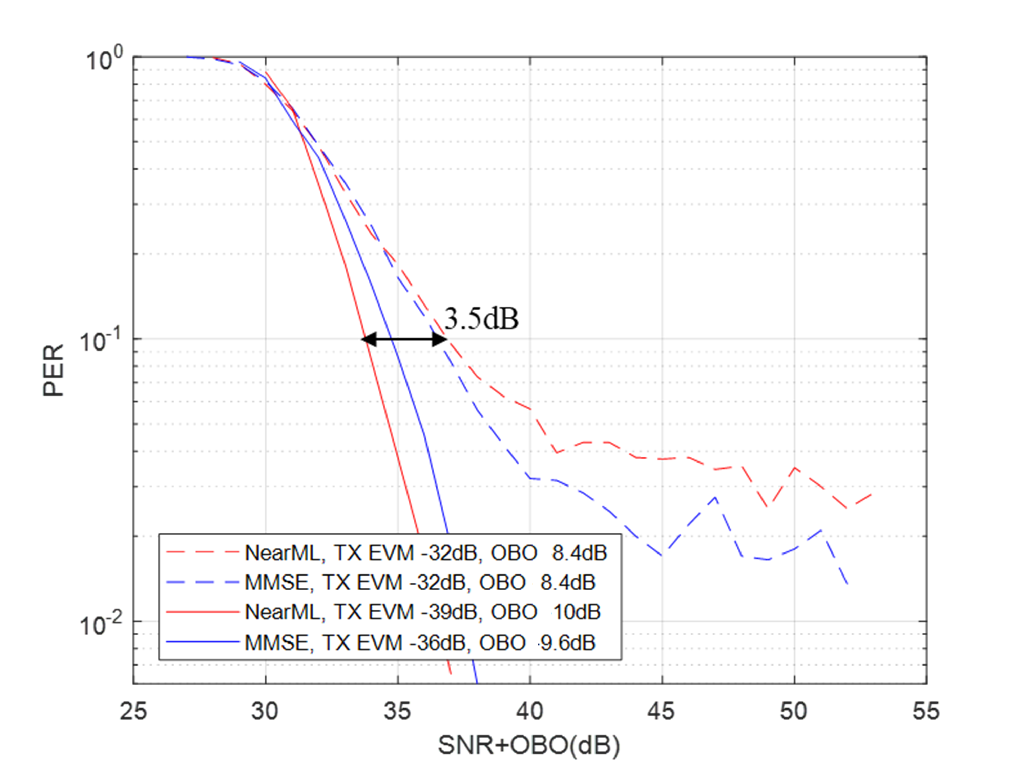
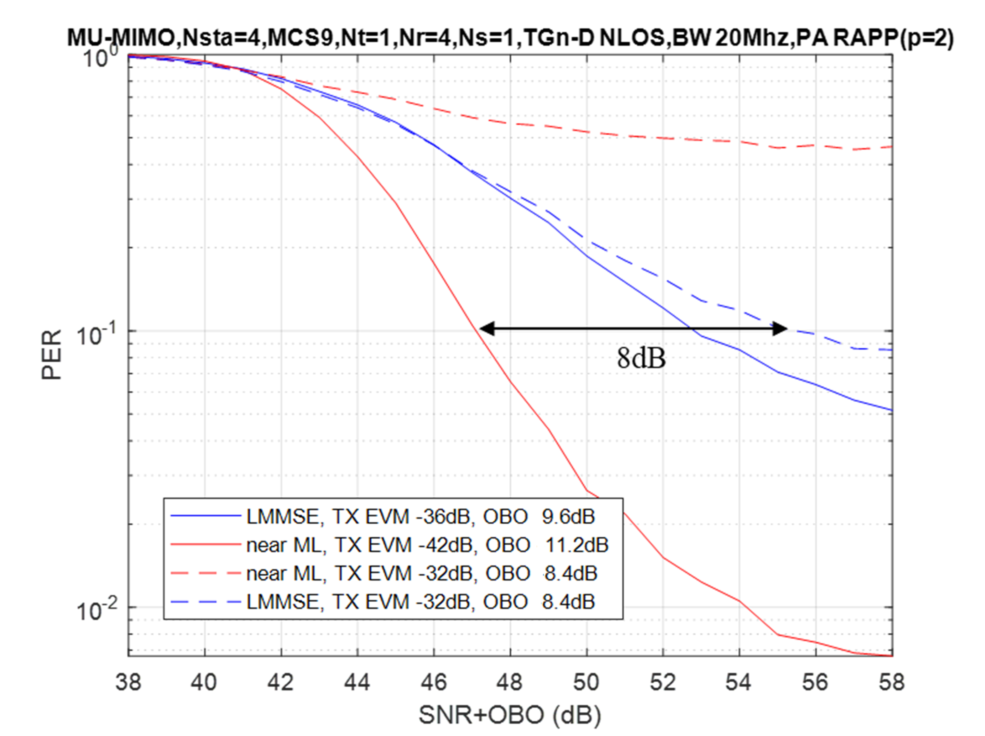
High MCS – MCS9
MCS9 behaves similar to MCS8, where with full rank MIMO there is a much higher gain

Slide 9
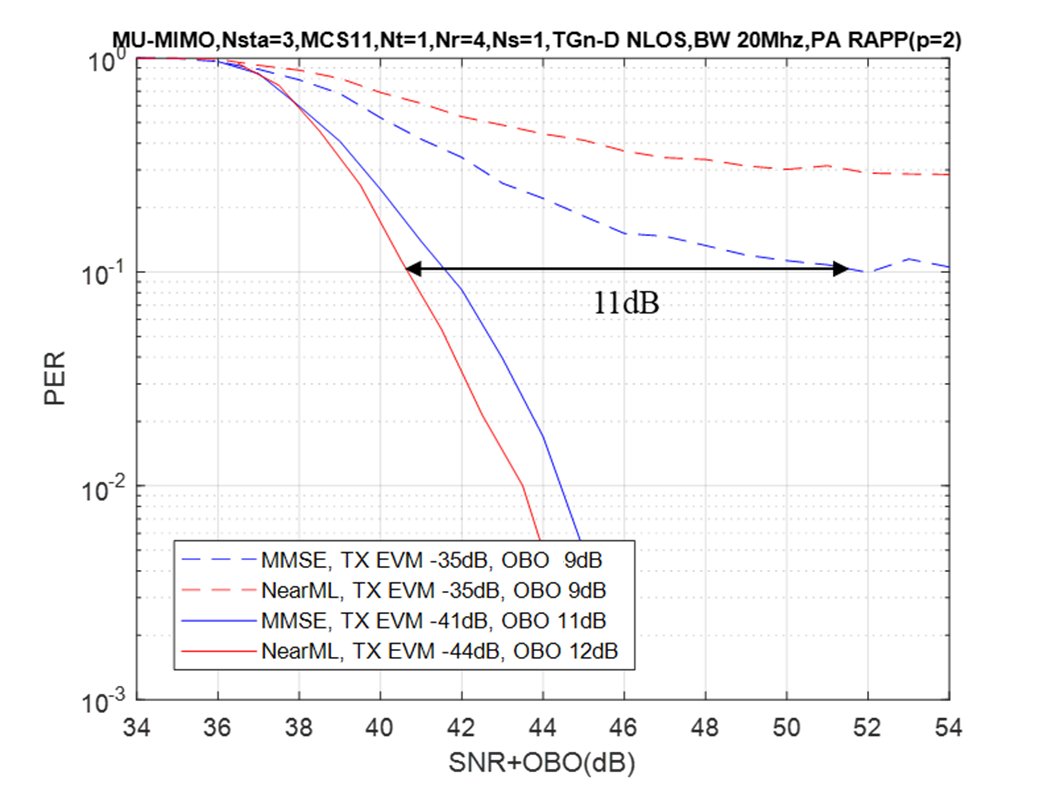
Very High MCS
We also simulated MIMO with MCS11 to study the impact of Tx EVM when SNR is very high and the theoretical gap between linear and nonlinear detector is smaller
We can see that the gain of near-ML detection is smaller (~1dB), however we still achieve significant gain of 11dB compared to standard Tx EVM

Slide 10
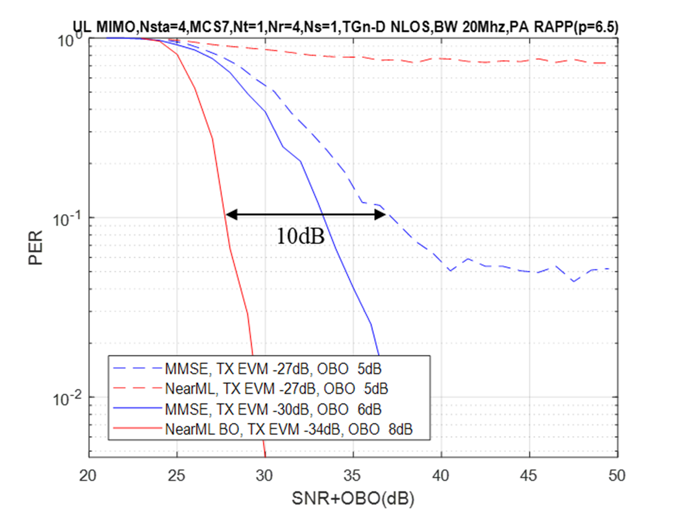
More Linear PA: Rapp with P = 6.5
A more linear PA enables lower BO while yielding the same Tx EVM, which means that near-ML may achieve its optimal performance at a lower BO level
The gain of near-ML detection remains large and similar to the gain of 6dB that was observed with p = 2, while the gain between the best performing detector with standard and improved Tx EVM is 10dB

Slide 11
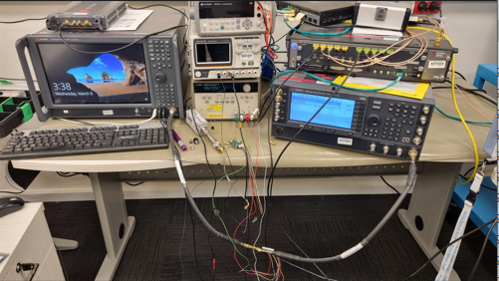
Volterra based PA model
As an alternative to the Rapp model, we also used a Volterra based PA model to incorporate the transmit signal impairments applied to the simulation. The Volterra model has the following advantages over the Rapp model:
  It is capable of incorporating the PA memory effects that are combined with the nonlinear effects
  It is a general model that can be tuned to accurately represent the behavior of a specific PA
The Volterra model parameters were fitted
to true recordings of output signal samples
generated by a practical PA
The PA recordings were extracted by a lab
setup that includes signal generation and
sampling instruments

Slide 12
Volterra based PA model
We can see on the figure below that the gain of the best detection with improved Tx EVM compared to the best detection with standard Tx EVM is ~4.5dB
4.5dB

Slide 13
Summary
We showed that improved Tx EVM has a significant impact on MIMO performance especially when non-linear detection is applied
We can see impressive gain achieved with improved Tx EVM, both with different modulation and coding rates and also with a more realistic (more linear) PA model
We also explained and showed that improved Tx EVM leads to better performance with a nonlinear detectors without a whitening stage than the optimal detector (using a whitening stage) while later also requires higher complexity
Based on [1] and the results presented here we may consider modifying/extending standard Tx EVM requirements to improve MIMO performance and allow better adjustment to detector type applied at the receiver

Slide 14
Reference
[1] 11-23-1944-01-00bn-impact-of-tx-evm-on-mimo-detection

