Slide 1
NB simulation results comparison
Author:
Name | Affiliation | Address | Email
Menzo Wentink | Qualcomm | Utrecht, The Netherlands | mwentink qti qualcomm
Carlos Aldana | Meta | 1 Hacker Way, Menlo Park, CA 94025 | caldana@meta.com

Slide 2
Introduction
NB technology is discussed in both Bluetooth and 802.15.4ab
  In Europe, NB is allowed to transmit at 14 dBm with 10 dBm/MHz
  In Europe, VLP using 802.11 technology is allowed to transmit at 14 dBm but has much lower PSD
    For 80/160/320 MHz, the PSD values are -5/-8/-11 dBm/MHz, respectively
These slides contain a comparison of simulation results presented in the IEEE 802.11 coexistence study group as well as a strawpoll
10 dBm/MHz
NB
80 MHz
802.11
-5 dBm/MHz
-8 dBm/MHz
160 MHz
802.11
-11 dBm/MHz
320 MHz 802.11

Slide 3
From 11-23-0877-00-coex
no LBT
LBT

Slide 4
From 11-23-1622-00-coex
no LBT
LBT

Slide 5
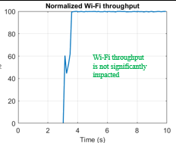
From 11-23-1503-00-coex
582 ms
no LBT

Slide 6
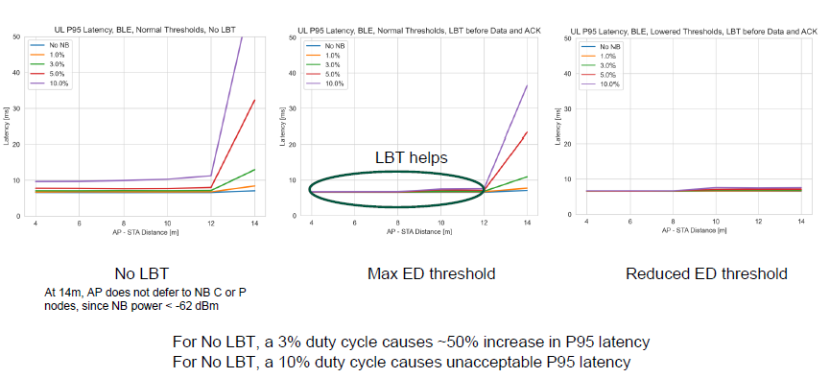
From 11-23-1259-01-coex
no-LBT: high P95 latency
LBT:
low P95 latency

Slide 7
From 11-23-1279-00-coex
NBFH / NBFH in 300 MHz
no LBT
LBT
no LBT
LBT

Slide 8
From 11-23-1279-00-coex
NB-UWB / NBFH in 40 MHz
no LBT
LBT
no LBT
LBT

Slide 9
From 11-24-0122-00-coex
NBFH / Wi-Fi
no LBT
LBT
glitch
no LBT
LBT

Slide 10
From 11-24-0122-00-coex
NBFH / Wi-Fi
no LBT
LBT
no LBT
LBT

Slide 11
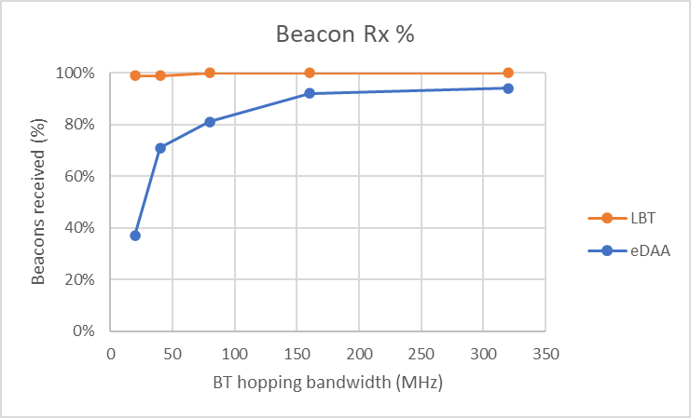
From 11-23-1622-00-coex
NBFH / Wi-Fi
LBT
no LBT
Corroborated in 11-23-1503-00-coex
nb_broadcast_edaa_r2303a-e
nb_broadcast_lbt_r2303a-e

Slide 12
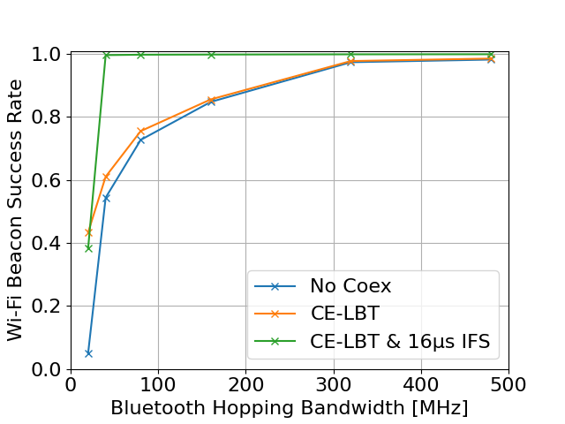
From 11-23-1999-00-coex
NBFH / Wi-Fi
LBT
no LBT

Slide 13
Conclusions

Slide 14
Conclusions
These simulation results illustrate that NB without LBT can cause major interference to Wi-Fi
  DAA (i.e. no-LBT) will have a very long response time before evacuating a Wi-Fi channel
    Wi-Fi may experience significant latency
  DAA will typically not defer for Wi-Fi Beacons, Broadcast (BC) and Multicast (MC)
    this may cause significant Beacon/BC/MC loss
    Wi-Fi may be impacted at the connection level because of this
To ensure better co-existence with 802.11, recommendation is for NB to adopt a mandatory coexistence mechanism to enable shared use of the spectrum and adequate performance for both 802.11 and NB. The mandatory coexistence mechanism should consist of one or more of LBT or other techniques.

Slide 15
Strawpoll
802.11 Coex SC recommends that 802.15.4ab adopts a mandatory coexistence mechanism to enable shared use of the spectrum and adequate performance between 802.11 and 802.15.4ab. This mandatory coex mechanism should consist of one or more of LBT or other techniques.
Y/N/A

Slide 16
Appendix: simulation details

Slide 17
From 11-23-1259-01-coex (Meta)
Effect of no-LBT NB on 802.11

Slide 18
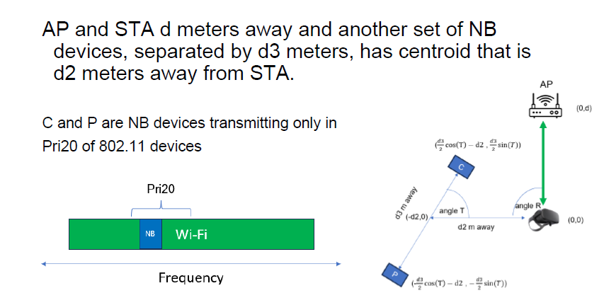
Scenario

Slide 19
From 11-23-0877-00-coex (Apple)
eDAA ramp-up time

Slide 20
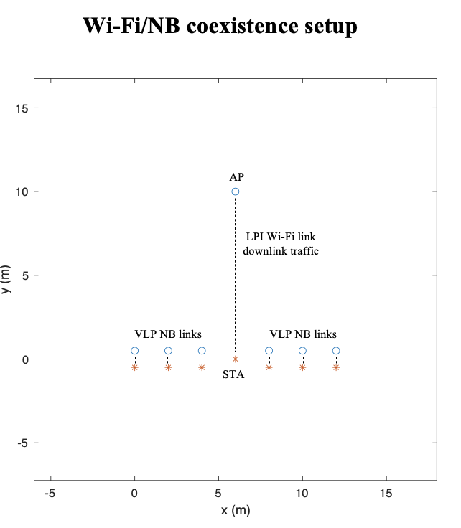
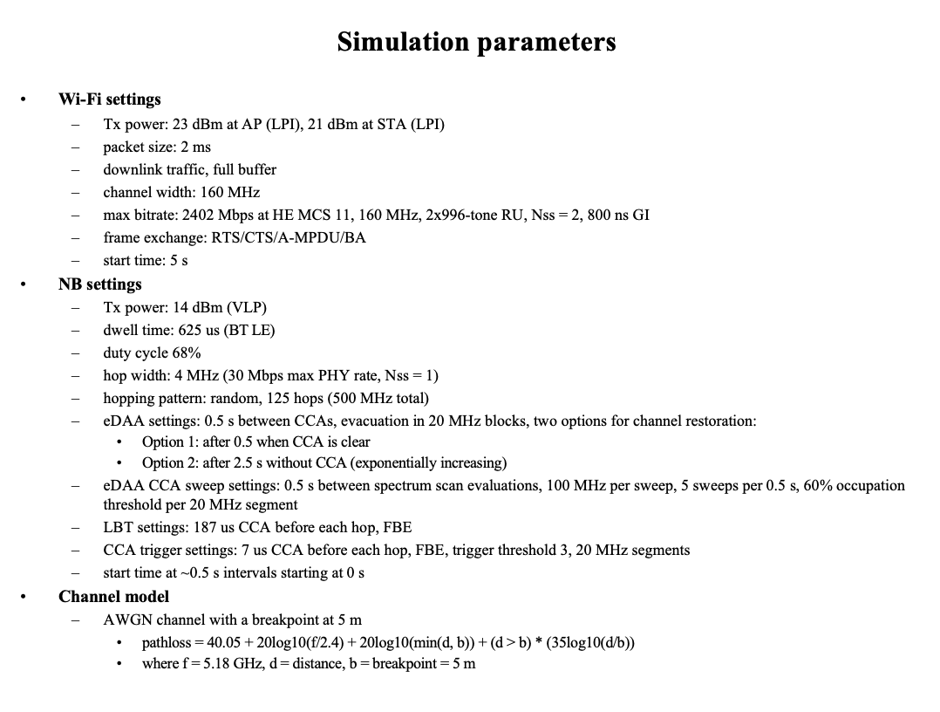
11-23-0453-00-coex-nb-overview – Slide 14 / 15
slide from 802.11-23/877r0 (Apple)
  More realistic PHY
    WIFI Rate - 20Mbps at HE MCS7, 160 MHz, 2x996-tone RU, Nss = 1, 800 ns GI
    NB Settings - EDR3M 3-DH1 (3Mbps max PHY rate Nss=1) – Well know Technology
      500 Hops
  Change the band to UNII-5

Slide 21
From 11-23-1622-00-coex (Qualcomm)
eDAA

Slide 22
Wi-Fi / NBFH simulation parameters – Beacon Rx
slide from 802.11-231622r0 (Qualcomm)
Wi-Fi settings
  Tx power: 23 dBm at AP (LPI), 21 dBm at STA (LPI)
  packet type: Beacons only (300 us, 20 MHz)
  beacon period: 100 ms (10 beacons/s)
  PHY rate: 6 Mbps OFDM
NBFH settings
  Tx power: 14 dBm (VLP)
  dwell time: 463 us
    150 us IFS, 313 us Tx, 68% duty cycle per link
    300 us IFS, 163 us Tx, 35% duty cycle per link
  hop width: 2 MHz (15 Mbps max PHY rate, Nss = 1)
  hopping pattern: random, 10 to 160 hops in 20 to 320 MHz, respectively
  eDAA settings: 0.125 s between CCA evaluations, 1.25 s before possible release (eDAA 125)
  CCA trigger settings: 7 us CCA before each hop, FBE, trigger thresholds 3+3/24, 20 MHz segments
    the values 3+3/24 indicate a threshold of 3, then a bump of 3 (to 6) for extra hysteresis, and 24 is the max value
  staggered startup during first 0.5 s
  bi-directional traffic with two peripherals
  isochronous audio, 1, 2 or 4 CIG events (tries) per ISO cycle (CIG 1, CIG 2, CIG 4)
Channel model
  AWGN channel with a breakpoint at 5 m
    pathloss = 40.05 + 20log10(f/2.4) + 20log10(min(d, b)) + (d > b) * (35log10(d/b))
    where f = 5.18 GHz, d = distance, b = breakpoint = 5 m

Slide 23
Wi-Fi / NBFH topology – Beacon Rx
slide from 802.11-231622r0 (Qualcomm)
AP
LPI Wi-Fi link
downlink traffic
VLP NBFH links
VLP NBFH links
STA
nb_broadcast_edaa_r2102a-e
nb_broadcast_lbt_r2102a-e

Slide 24
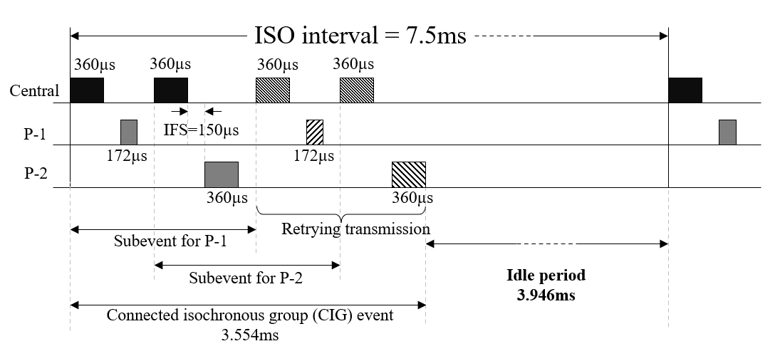
BT isochronous audio illustration
slide from 802.11-231622r0 (Qualcomm)
‘CIG 1’ – 1 try (0 retries), 17% duty cycle
‘CIG 2’ – 2 tries (1 retry), 34% duty cycle
‘CIG 4’ – 4 tries (3 retries), 68% duty cycle

Slide 25
From 11-23-1503-00-coex (Intel)
Beacon Rx %

Slide 26
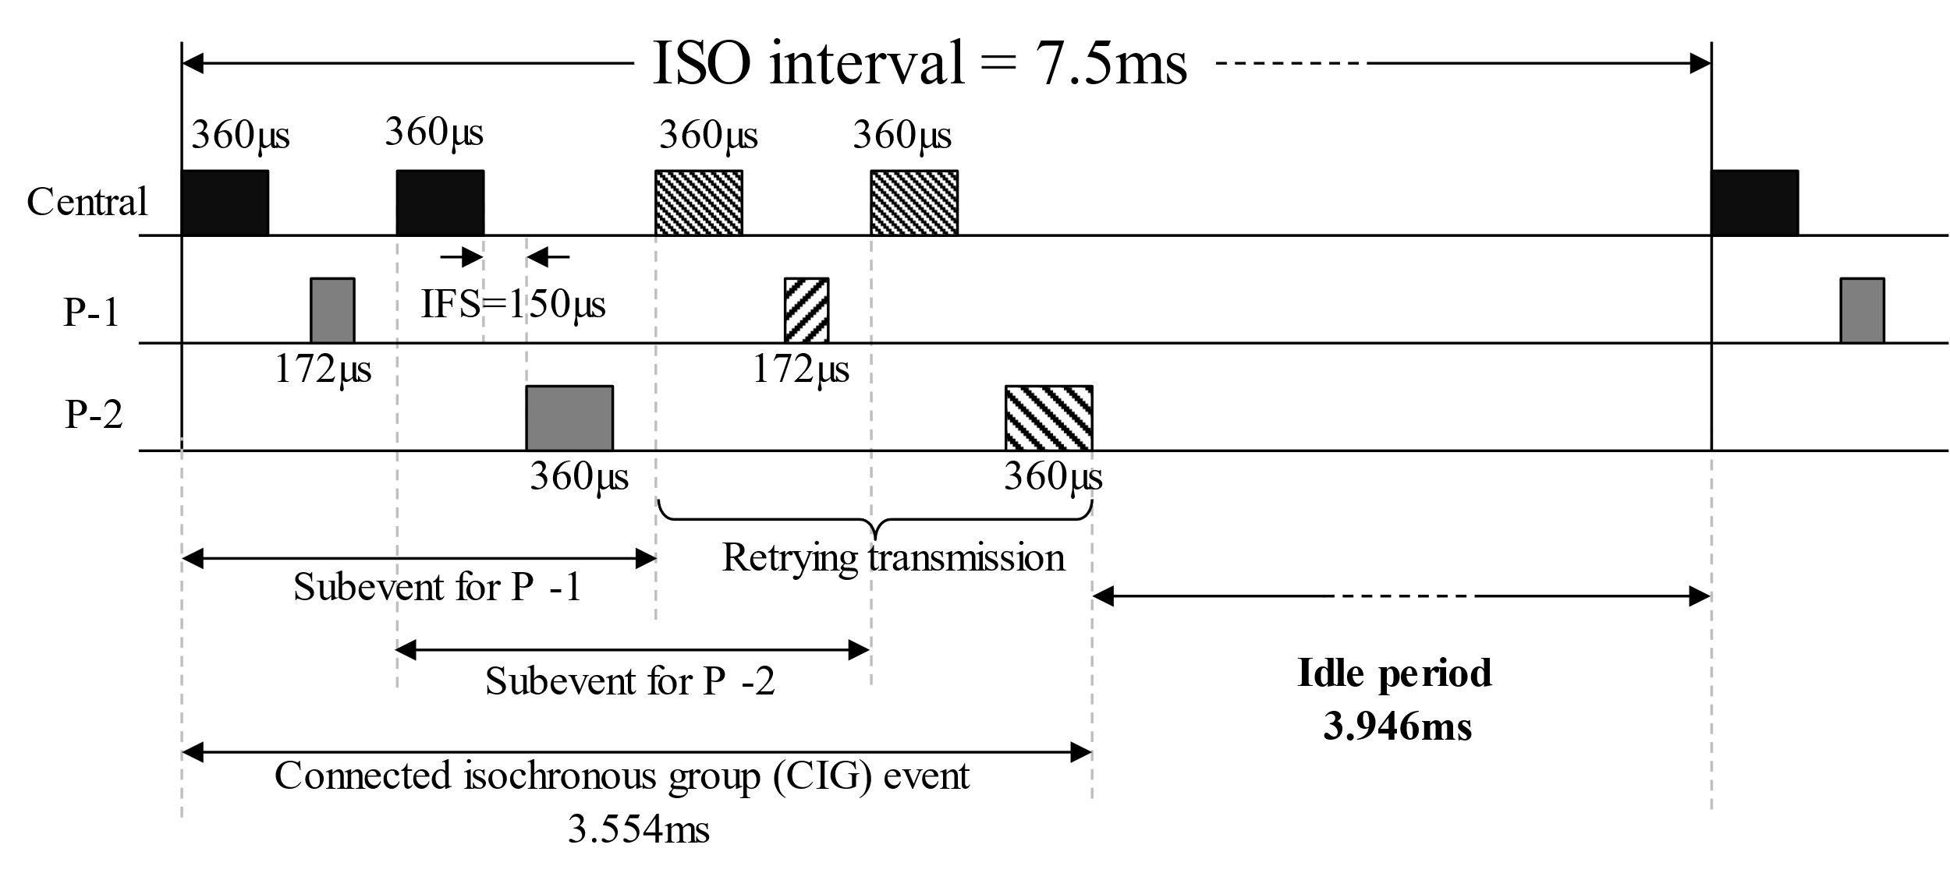
Simulation setup
slide from 1503r3 (Intel)
Bluetooth:
Low Energy (LE) 2M PHY
Gaming audio: 2 earbuds
  1 earbud contains mic
  1 earbud has inertial measurement unit (IMU) sensor
Tx power: 14 dBm
ISO interval = 7.5ms
Max latency = 15ms (2×ISO)
Number of subevents, NSE = 2
1 main TX + 3 retry opportunities
  Total 4 attempts
Number of channels = 80 (each channel 2MHz wide)
Total hopping BW = 160MHz
Bi-directional traffic
Wi-Fi:
1 AP, 1STA
Tx power: 20 dBm at AP/STA
MCS11
Single stream
One directional traffic
Traffic load: Full buffer or 60% constant bit rate, or, beacon-only
TXOP duration ≈ 5ms
Bandwidth = 80MHz
Transmission starts at time=3s
Wi-Fi
80MHz
Bluetooth
Overlap
160MHz
Channel model:
AWGN channel with a breakpoint at 5 m
pathloss = 40.05 + 20log10(f/2.4) + 20log10(min(d, b)) + (d > b) * (35log10(d/b))
where f = 5.18 GHz, d = distance, b = breakpoint = 5 m

Slide 27
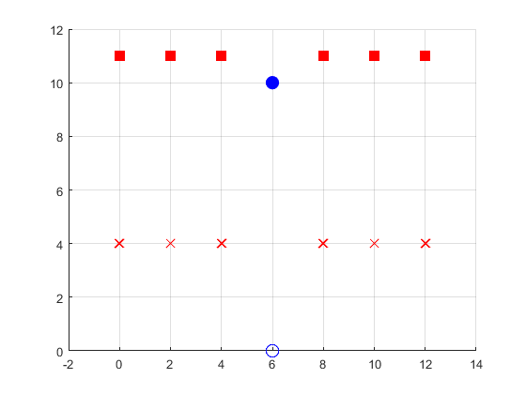
Wi-Fi + Multiple Bluetooth
slide from 1503r3 (Intel)
Bluetooth central
Wi-Fi AP
meters
Bluetooth peripheral with 2 earbuds
Wi-Fi STA
meters

Slide 28
References

Slide 29
References
  11-24-0122-00-coex-bluetooth-isochronous-audio-with-lbt (IEEE Panama, January 2024)
  11-24-0007-00-coex-proposal-for-bluetooth-and-wi-fi-coexistence-in-5-and-6ghz (IEEE Panama, January 2024)
  11-23-1259-01-coex-effect-of-no-lbt-nb-on-802-11-devices (November 2023)
  11-23-1999-00-coex-ieee-802-11-beacons-and-bluetooth-coexistence-simulations (IEEE Atlanta, September 2023)
  11-23-1622-00-coex-nbfh-coexistence-with-wi-fi (IEEE Atlanta, September 2023)
  11-23-1503-00-coex-bluetooth-wi-fi-coexistence-channel-access-simulation-study (IEEE Atlanta, September 2023)
  11-23-1279-00-coex-nb-with-lbt (IEEE Berlin, July 2023)
  11-23-0877-00-coex-narrow-coex-studies (IEEE Orlando, May 2023)
  11-23-0455-00-coex-wi-fi-deferral-for-nb-signals (IEEE Atlanta, March 2023)
  11-23-0454-00-coex-impact-of-bt-on-wlan-performance (IEEE Atlanta, March 2023)
  11-23-0453-00-coex-nb-overview (IEEE Atlanta, March 2023)
  BT SIG Bluetooth_Wifi_coex_LBTvsEDAA_intel_aug2023
  BRAN(21)109h004r2_EN_303_687_NB_Proposals_for_DAA_Optimisation
  BRAN(21)109h007_NB_coexistence_with_WB_in_6_GHz
  ETSI EN 300 328 (2.4 GHz)
  ETSI EN 301 893 (5 GHz)
  ETSI EN 303 687 (6 GHz)

