Slide 1
DPWiFi MATLAB Validation
Date: 2024-01-17
Authors:

Slide 2
Abstract
During last November’s plenary TWI proposed “Dynamic Polarization MIMO Multiplexing and Beamforming” as a candidate PHY for the nascent TGbn standard. TWI has since MATLAB-modelled “DPWiFi” for the Fixed Wireless Access application, and key findings are summarized herein.

Slide 3
Why DPWiFi for TGbn?
The P802.11bn PAR states that the defining TGbn Ultra High Reliability MAC/ PHY requires one operating mode exhibiting at least 25% higher throughput than the TGbe Extremely High Throughput MAC/PHY.
In a DLOS channel, EHT maximum Data Rate (MCS13, 320 MHz, 800 ns GI, 1 Stream) corresponds to 2.882 Gbps, while the proposed DPWiFi peak Data Rate (MCS13, 320 MHz, 800 ns GI, 32 Streams) clocks 92.224 Gbps. DPWiFi DLOS operation delivers 3200% higher throughput than TGbe.

Slide 4
Proposed DPWiFi PHY
32 IEEE802.11be concurrent, cochannel RF streams
32x32 MIMO Dynamic Polarization Multiplexing (“DP-32”)
32x32 MIMO Tx/Rx DLOS/ nLOS/ NLOS Beamforming/Beamsteering
AP MU-MIMO Tx Multi-beaming
Client MU-MIMO Rx Interference Cancellation
Client MU-MIMO Rx NLOS Multipath Recombination
5-7 GHz UNII Operation
4096 QAM 5/6
320 MHz BW
92.2 Gbps Peak Data Rate
80 GbE P2P Throughput over a 28 km Free-Space Range
27 GbE PMP Throughput across a 79 km² Foliage-obstructed Area

Slide 5
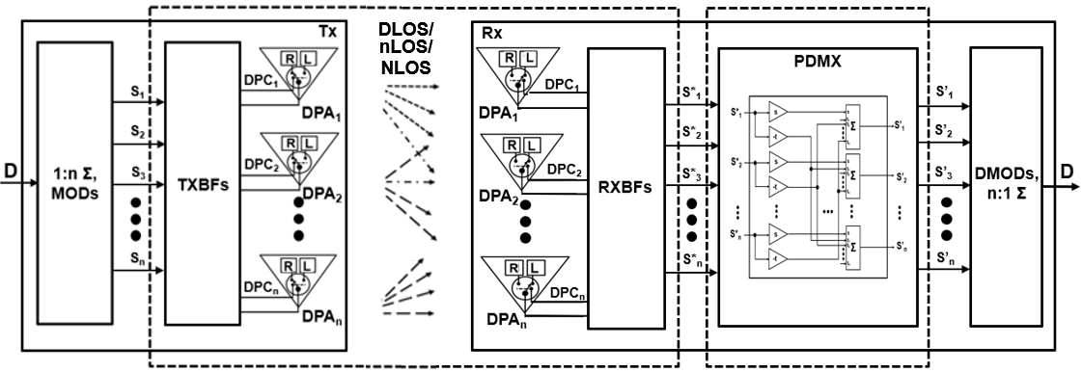
Proposed DPWiFi TRX Architecture
1
[H_{DP}] DPWiFi Propagation Channel
[H_{DP}⁻¹] DPWiFi Rx PDMX
Post-Honolulu refinements

Slide 6
DPWiFi for Fixed Wireless Access
Fixed WiFi Access Propagation Channel
FWA propagation channel [H_{DP}] is an n-dimensional “Polarization Space”, with an n upper bound >> 32 32 x 32 DPWiFi (“DPWiFi-32”) delivers unprecedented and unrivaled 80 GbE P2P and 27 GbE PMP FWA Throughput
[H_{DP}] is non-singular, deterministic and scalar (i.e., h_{ij} = 1, i = j; h_{ij} = r, i ≠ j), r variable with [H_{DP}] impairments
FWA comprises DLOS, nLOS and NLOS links, all susceptible to [H_{DP}] “depolarization” degradation Channel Depolarization (“ChDp”, º) is propagation-induced angular Rx signal polarization rotation wrt the Tx-impressed baseline
Direct Line of Sight TRXs experiencing atmospheric fog, rain, etc. encounter up to 5º [H_{DP}] depolarization
near Line of Sight TRXs partially obstructed by foliage, landscape or structures face up to 15º [H_{DP}] depolarization
Non Line of Sight TRX channels enduring reflection/diffraction by landscape, structures or vehicles depolarize by up to 45º
ChDp rapidly overwhelms the Rx PDMux, precluding full MIMO co-channel interference cancellation
Already severe depolarization consequences further magnify with increasing DPWiFi MCS and MIMO order
DPWiFi MUST incorporate comprehensive propagation channel depolarization mitigation for Fixed Wireless Access
“Adaptive DPWiFi” Fixed Wireless Access:
FWA (Open Loop) Channel Sounding
FWA AP broadcasts “Training Packets (T)” every ~1ms to all associated STAs
Each FWA STA processes T, estimates ChDp, determines its [H_{DP}], computes [H_{DP}⁻¹] and reconfigures its Rx PDMux to match
FWA TRX DPWiFi TRX as Honolulu-proposed, plus FWA Channel Sounding

Slide 7
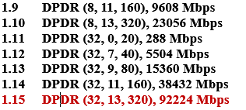
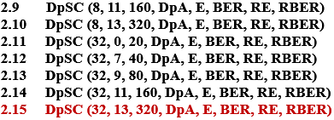
DPWiFi TRX Validation Plan
Note: See corresponding Validation Test results following

Slide 8
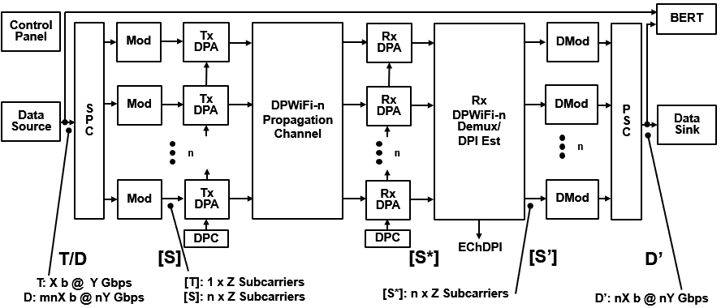
DPWiFi TRX MATLAB Model
Data Source Generates
1x Training Packet/
1x Data Packet
SPC/Modulators Synthesize
1x Training Stream/
32x Symbol Streams
Tx DPAs Walsh-Polarize
1x Training Stream/
32x Symbol Streams
DPWiFi Channel MIMO-Multiplexes
1x Training Stream/
32x Symbol Streams
Rx DPAs De-correlate
32x M-M Training Streams/
32x M-M Symbol Streams
Rx DPDMux Estimates Channel DPI/
Recovers 32x Symbol Streams
Demodulators/PSC Recover 1x Data Packet
Data Sink Accepts 1x Data Packet

Slide 9
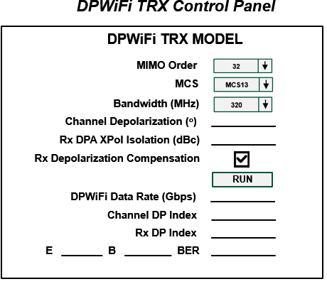
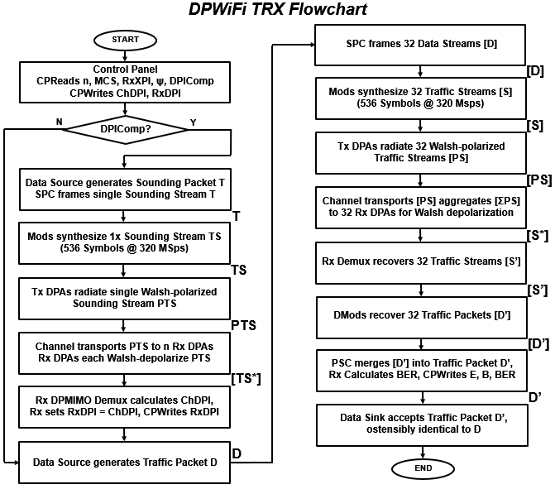
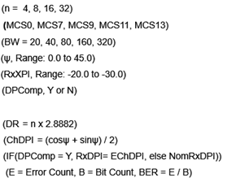
DPWiFi TRX MATLAB Model Detail

Slide 10
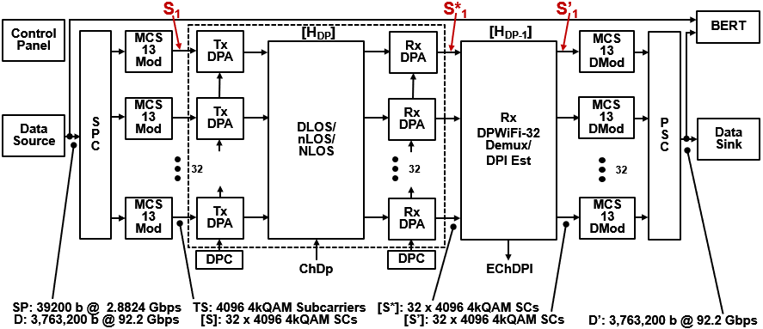
DPWiFi TRX Validation
TWI is currently executing the entire DPWiFi TRX Validation Plan of Slide 6
However, the key “Will DPWiFi work for FWA?” question has already been settled:
Validation Plan items 1.15 and 2.15 comprise the most extreme DPWiFi-for-FWA corner case
That is, if DPWiFi-32 320 MHz MCS13 works subjected to the full range of channel impairments, then ALL OTHER DPWiFi MIMO order, bandwidth and MCS combinations will ALSO work
TWI HAS completed items 1.15/2.15 DP-32 320 MHz MCS13 MATLAB modeling, as summarized below
DPWiFi-32 320 MHz MCS13 TRX MATLAB Simulink Model

Slide 11
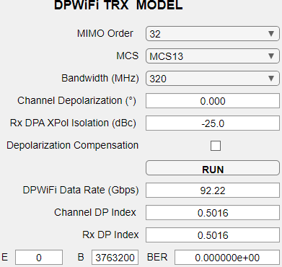
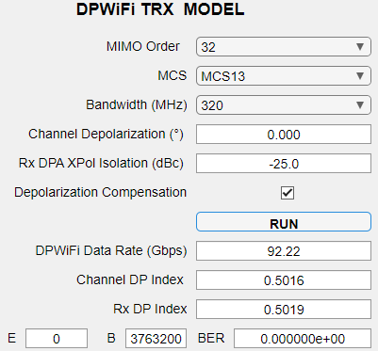
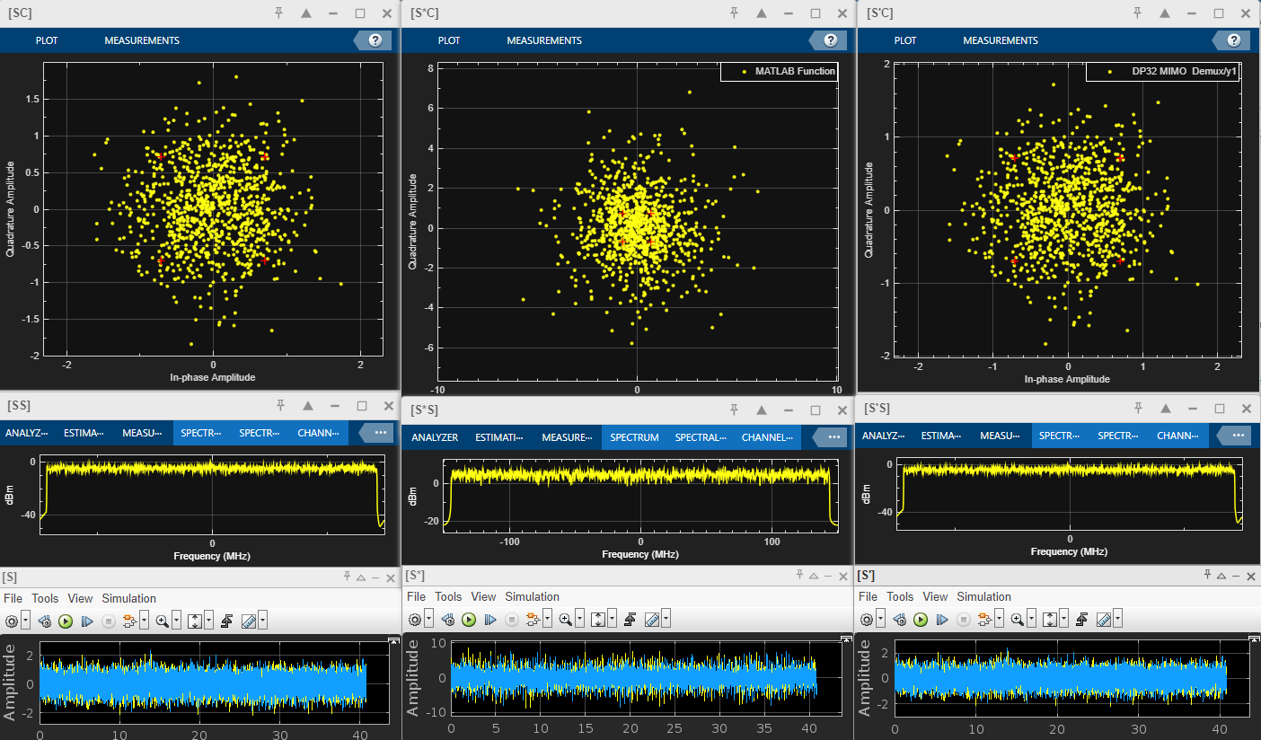
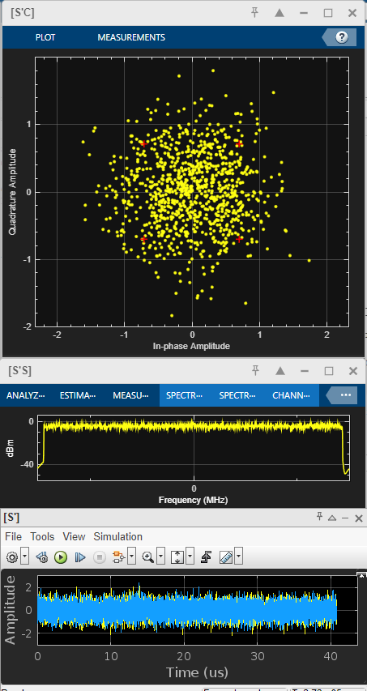
DPWiFi TRX Modeling
1. DPWiFi TRX Simulations
1.1 DPWiFi-32 320 MHz MCS13, ChDp = 0.0º

Slide 12
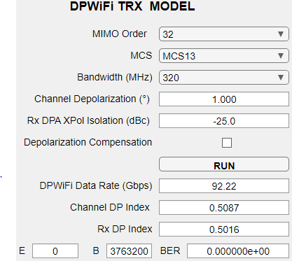
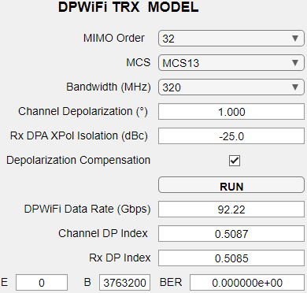
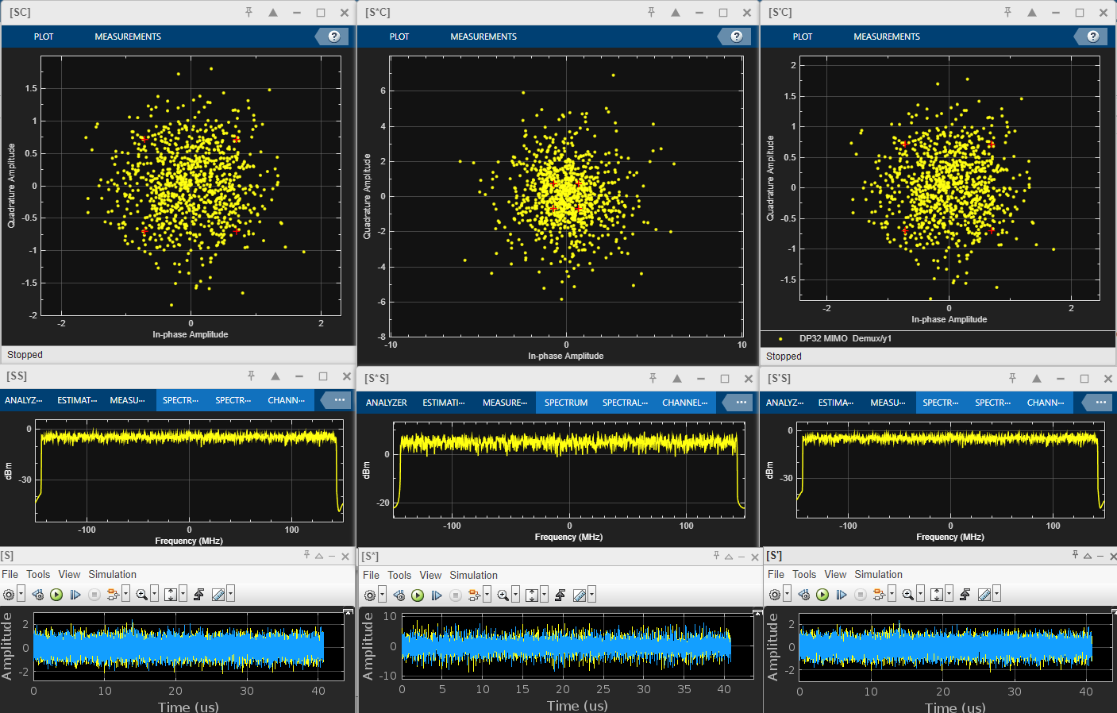
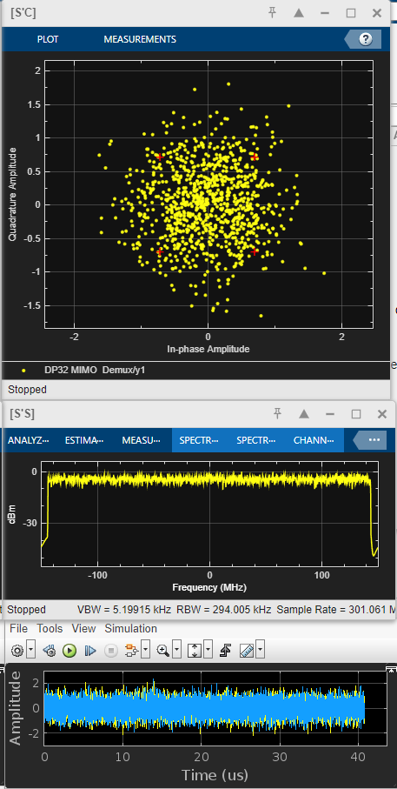
DPWiFi TRX Modeling
1.2 DPWiFi-32 320 MHz MCS13, ChDp = 1.0º

Slide 13
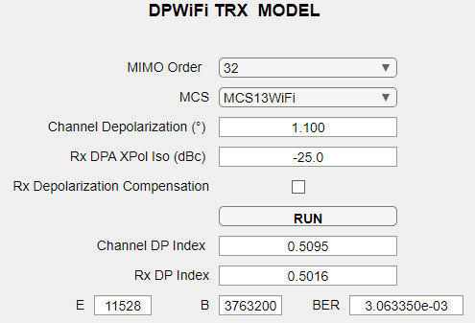
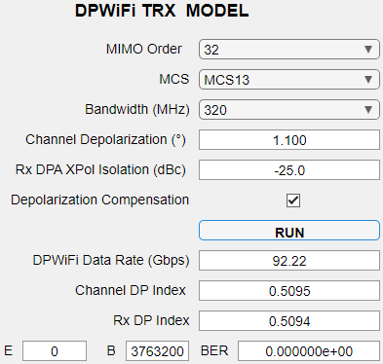
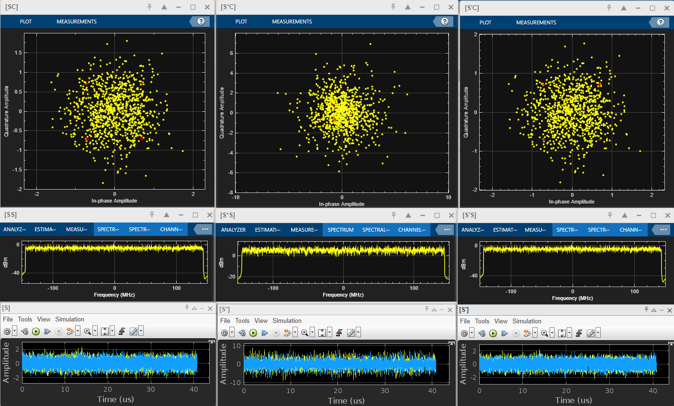
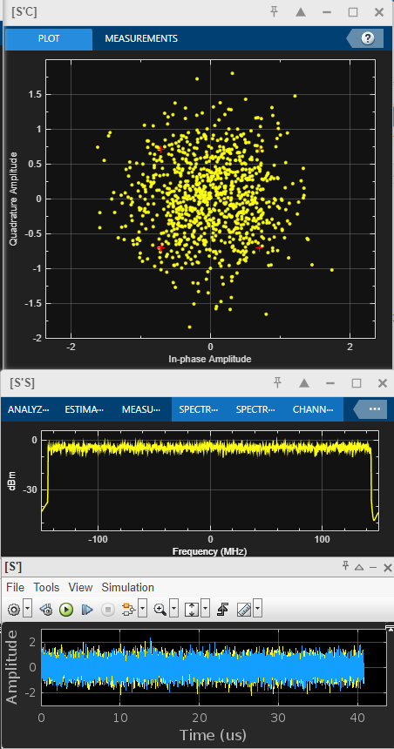
DPWiFi TRX Modeling
1.3 DPWiFi-32 320 MHz MCS13, ChDp = 1.1º

Slide 14
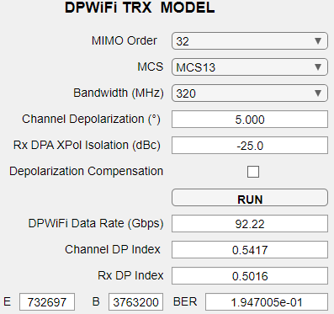
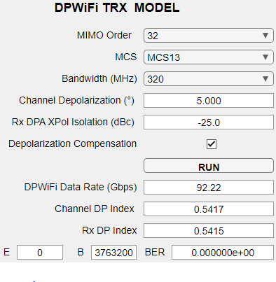
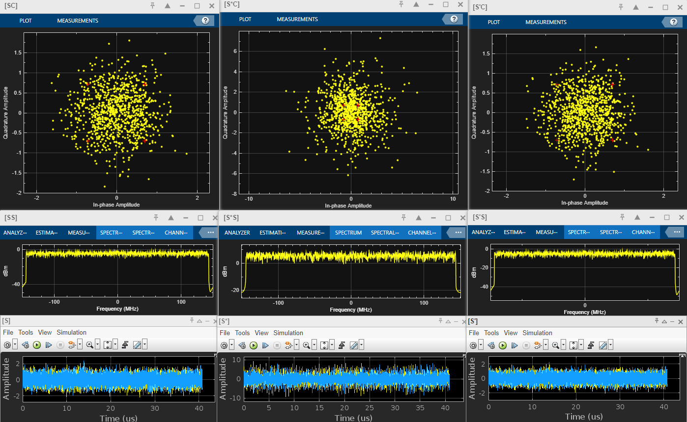
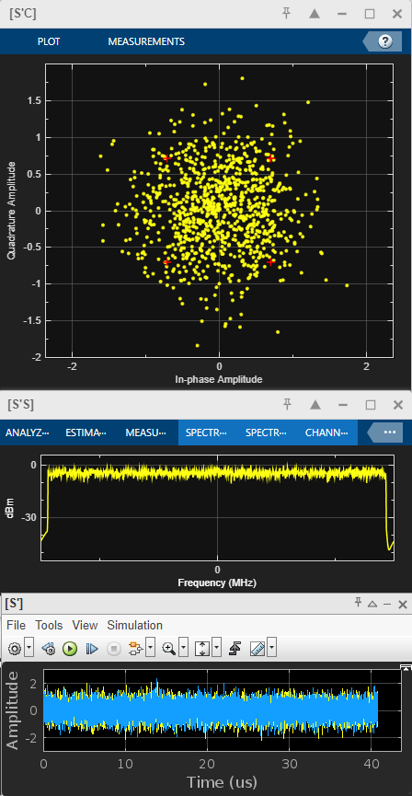
DPWiFi TRX Modeling
1.4 DPWiFi-32 320MHz MCS13, ChDp = 5.0º

Slide 15
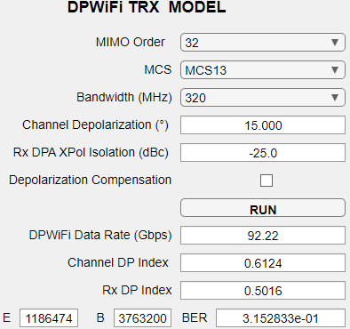
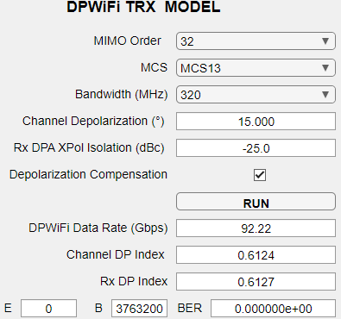
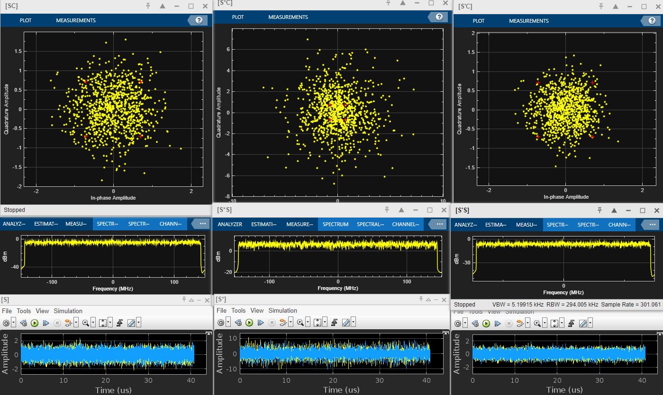
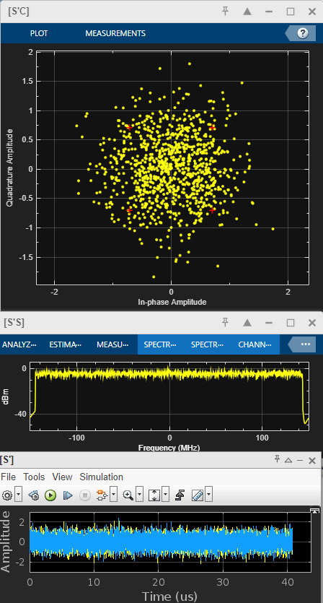
DPWiFi TRX Modeling
1.5 DPWiFi-32 320 MHz MCS13, ChDp = 15.0º

Slide 16
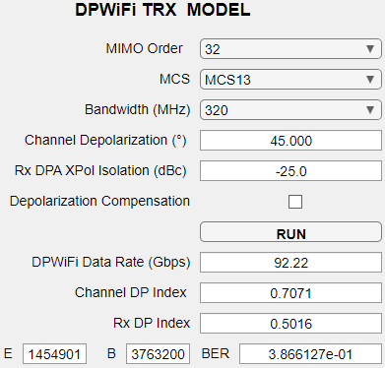
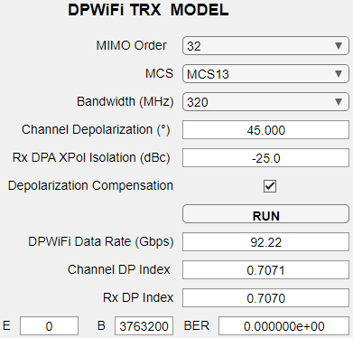
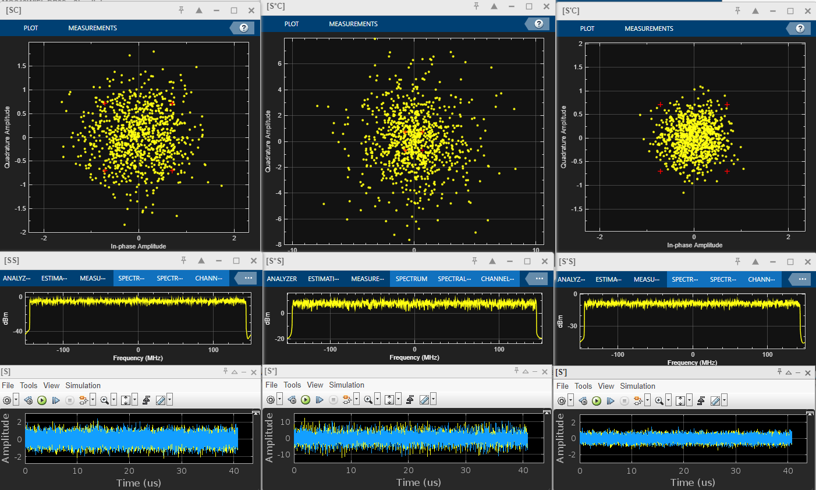
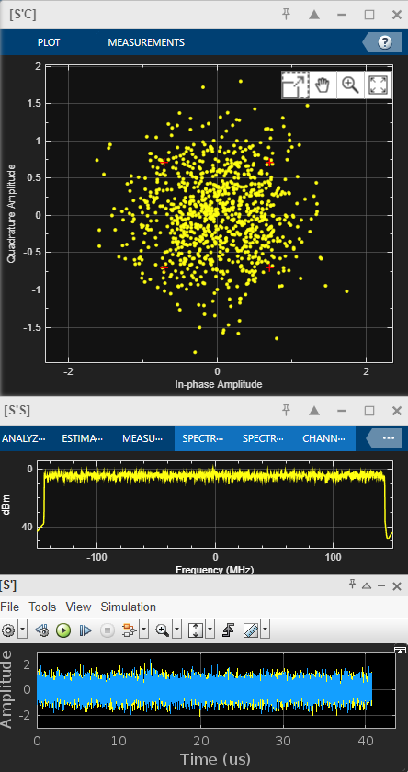
DPWiFi TRX Modeling
1.6 DPWiFi-32 320 MHz MCS13, ChDp = 45.0º

Slide 17
DPWiFi TRX Modeling Observations, Analysis and Conclusions
DPWiFi TRX Modeling- Salient Observations
DPWiFi TRX Modeling- Analysis 3.1 DPWiFi is extraordinarily sensitive to propagation channel depolarization, as even slight fog would crash an FWA link 3.2 Adaptive DPWiFi, however, fully mitigates any amount of channel depolarization
4. DPWiFi TRX Modeling- Conclusions Adaptive DPWiFi (henceforth just “DPWiFi”) is both an extraordinarily powerful and robust Fixed Wireless Access solution
DPWiFi TRX Performance in Impaired Propagation Channels DPWiFi-32 320 MHz MCS12 vs Channel Depolarization
Channel Impairment Depolarization Angle | None 0.0º | Heavy Mist 1.0º | Slight Fog 1.1º | Heavy Rain 5.0º | Rain + Foliage 15.0º | Orthogonal Reflection 45.0º
Channel DP Index | 0.5016 | 0.5087 | 0.5095 | 0.5417 | 0.6124 | 0.7071
Uncompensated TRX BER | 0.000 | 0.000 | 0.003 | 0.195 | 0.315 | 0.376
Compensate TRX BER | 0.000 | 0.000 | 0.000 | 0.000 | 0.000 | 0.000

Slide 18
DPWiFi MATLAB Validation Summary
Granted comprehensive DPWiFi TRX modeling results still pending, fully completed corner-case MATLAB simulations (results presented herein) have nevertheless decisively validated TWI claims of extraordinary, unprecedented DPWiFi TRX performance in Fixed Wireless Access applications.
DPWiFi thereby fully merits unqualified, enthusiastic endorsement for adoption as a TGbn PHY.

Slide 19
References
1. 23/1606r1-UHRSG Dynamic Polarization Multiplexing and Beamforming WLANs Carlos A Rios (Terabit Wireless Internet), 13-Sep-2023
23/1756r3-TGbn MIMO Dynamic Polarization and Beamforming: Proposed IEEE802.11bn PHY Carlos A Rios (Terabit Wireless Internet), 16-Nov-2023

