Slide 1
DPWiFi MATLAB Validation
Date: 2024-01-16
Authors:

Slide 2
Abstract
During last November’s plenary TWI proposed “Dynamic Polarization MIMO Multiplexing and Beamforming” as a candidate PHY for the nascent TGbn standard. TWI has since MATLAB-modelled “DPWiFi” for the Fixed Wireless Access application, and key findings are summarized herein.

Slide 3
Proposed DPWiFi PHY
32 IEEE802.11be concurrent, cochannel RF streams
  32x32 MIMO Dynamic Polarization Multiplexing (“DP-32”)
  32x32 MIMO Tx/Rx DLOS/ nLOS/ NLOS Beamforming/Beamsteering
  AP MU-MIMO Tx Multi-beaming
  Client MU-MIMO Rx Interference Cancellation
  Client MU-MIMO Rx NLOS Multipath Recombination
  5-7 GHz UNII Operation
  4096 QAM 5/6
  320 MHz BW
  92.2 Gbps Peak Data Rate
  80 GbE P2P Throughput over a 28 km Free-Space Range
  27 GbE PMP Throughput across a 79 km² Foliage-obstructed Area

Slide 4
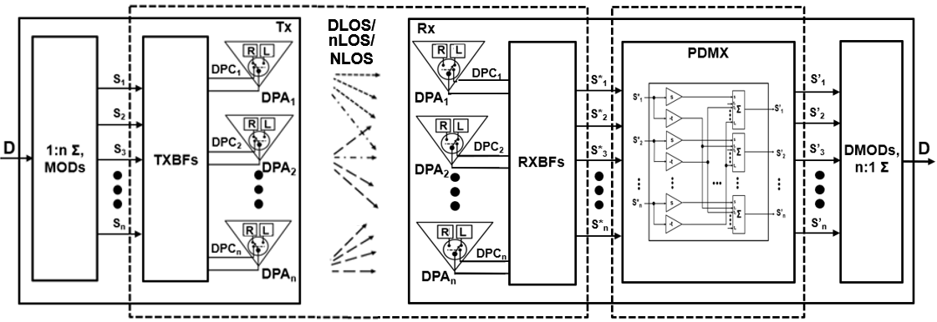



Proposed DPWiFi TRX Architecture
1
[H_{DP}] DPWiFi Propagation Channel
[H_{DP}⁻¹] DPWiFi Rx PDMX
Post-Honolulu refinements

Slide 5
DPWiFi for Fixed Wireless Access
Fixed WiFi Access Propagation Channel
  FWA propagation channel [H_{DP}] is an n-dimensional “Polarization Space”, with an n upper bound >> 32
  32 x 32 DPWiFi (“DPWiFi-32”) delivers unprecedented and unrivaled 80 GbE P2P and 27 GbE PMP FWA Throughput
  [H_{DP}] is non-singular, deterministic and scalar (i.e., h_{ij} = 1, i = j; h_{ij} = r, i ≠ j), r variable with [H_{DP}] impairments
  FWA comprises DLOS, nLOS and NLOS links, all susceptible to [H_{DP}] “depolarization” degradation
  Channel Depolarization (“ChDp”, º) is propagation-induced angular Rx signal polarization rotation wrt the Tx-impressed baseline
    Direct Line of Sight TRXs experiencing atmospheric fog, rain, etc. encounter up to 5º [H_{DP}] depolarization
    near Line of Sight TRXs partially obstructed by foliage, landscape or structures face up to 15º [H_{DP}] depolarization
    Non Line of Sight TRX channels enduring reflection/diffraction by landscape, structures or vehicles depolarize by up to 45º
  ChDp rapidly overwhelms the Rx PDMux, precluding full MIMO co-channel interference cancellation
    Already severe depolarization consequences further magnify with increasing DPWiFi MCS and MIMO order
    DPWiFi MUST incorporate comprehensive propagation channel depolarization mitigation for Fixed Wireless Access
“Adaptive DPWiFi” Fixed Wireless Access:
  FWA (Open Loop) Channel Sounding
    FWA AP broadcasts “Training Packets (T)” every ~1ms to all associated STAs
    Each FWA STA processes T, estimates ChDp, determines its [H_{DP}], computes [H_{DP}⁻¹] and reconfigures its Rx PDMux to match
  FWA TRX
  DPWiFi TRX as Honolulu-proposed, plus FWA Channel Sounding

Slide 6
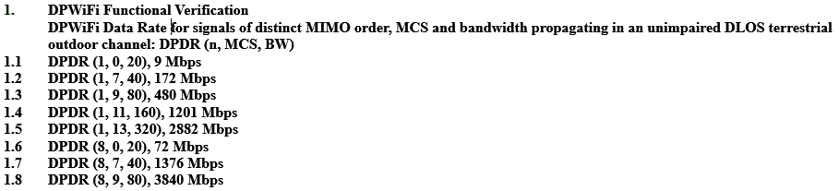
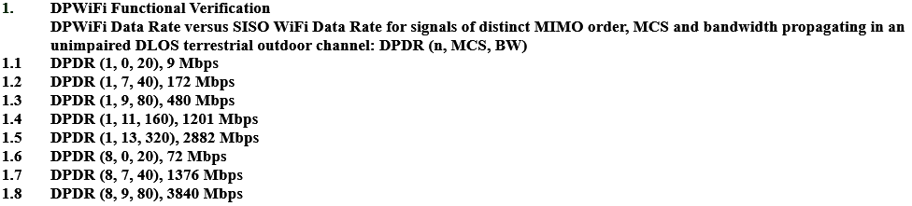
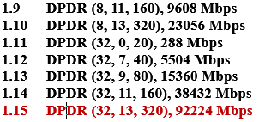
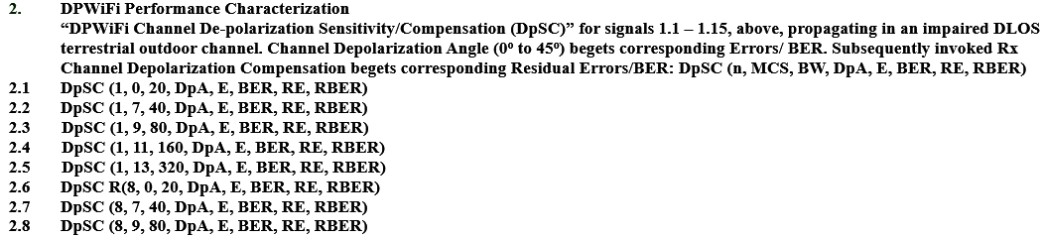
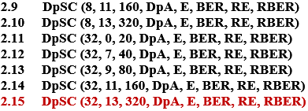
DPWiFi TRX Validation Plan
Note: See corresponding Validation Test results following

Slide 7
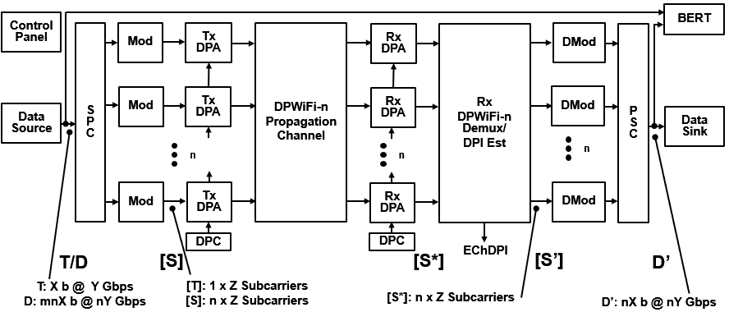
DPWiFi TRX MATLAB Model
Data Source
Generates
1x Training Packet/
1x Data Packet
SPC/Modulators
Synthesize
1x Training Stream/
32x Symbol Streams
Tx DPAs
Walsh-Polarize
1x Training Stream/
32x Symbol Streams
DPWiFi Channel
MIMO-Multiplexes
1x Training Stream/
32x Symbol Streams
Rx DPAs
De-correlate
32x M-M Training Streams/
32x M-M Symbol Streams
Rx DPDMux
Estimates Channel DPI/
Recovers 32x
Symbol Streams
Demodulators/PSC
Recover 1x
Data Packet
Data Sink
Accepts 1x
Data Packet

Slide 8
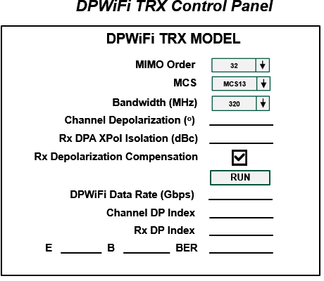
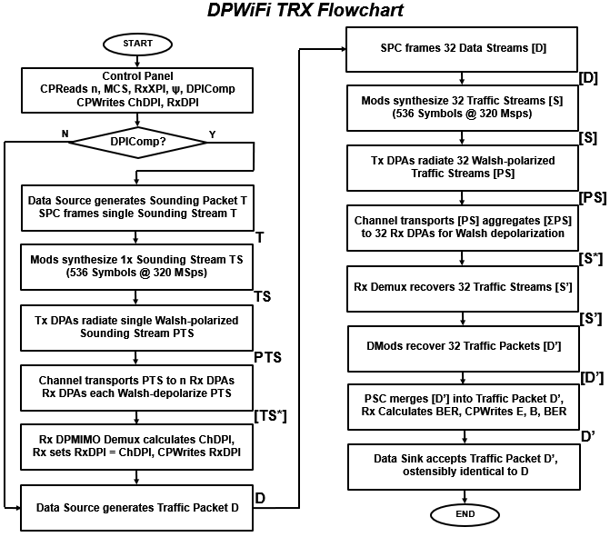
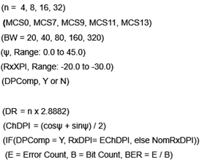
DPWiFi TRX MATLAB Model Detail

Slide 9
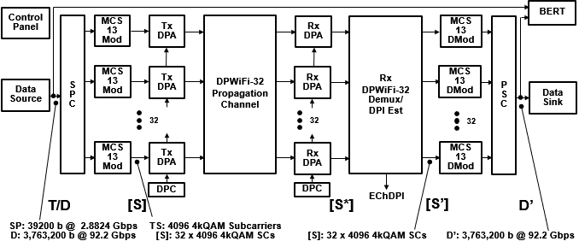
DPWiFi TRX Validation
TWI is currently executing the entire DPWiFi TRX Validation Plan of Slide 6
However, the key “Will DPWiFi work for FWA?” question has already been settled:
  Validation Plan items 1.15 and 2.15 comprise the most extreme DPWiFi-for-FWA corner case
    That is, if DPWiFi-32 320 MHz MCS13 works subjected to the full range of channel impairments, then
    ALL OTHER DPWiFi MIMO order, bandwidth and MCS combinations will ALSO work
    TWI HAS completed items 1.15/2.15 DP-32 320 MHz MCS13 MATLAB modeling, as summarized following
DPWiFi TRX MATLAB Simulink Model

Slide 10
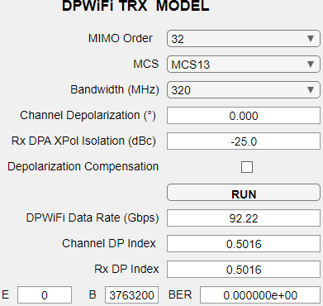
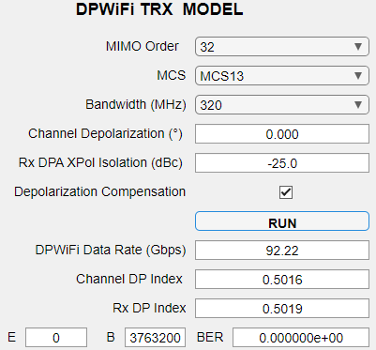
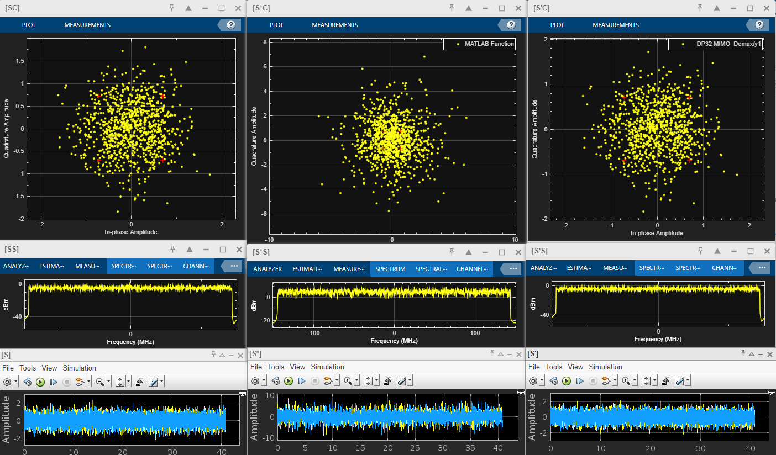
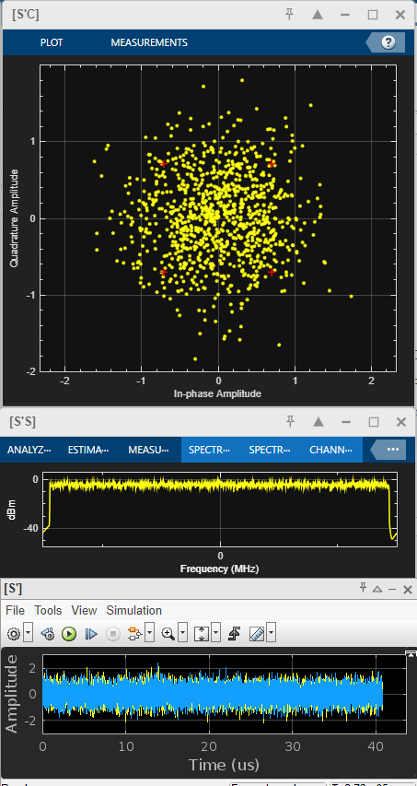
DPWiFi TRX Modeling
1. DPWiFi TRX Simulations
1.1 DPWiFi-32 320 MHz MCS13, ChDp = 0.0º

Slide 11
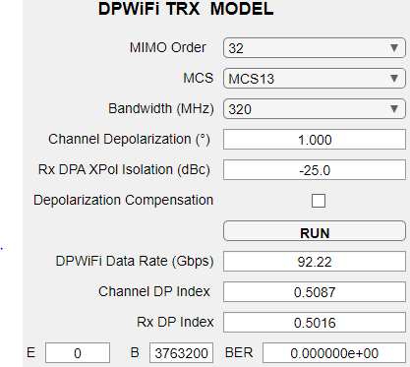
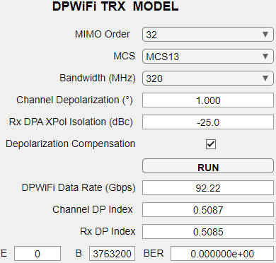
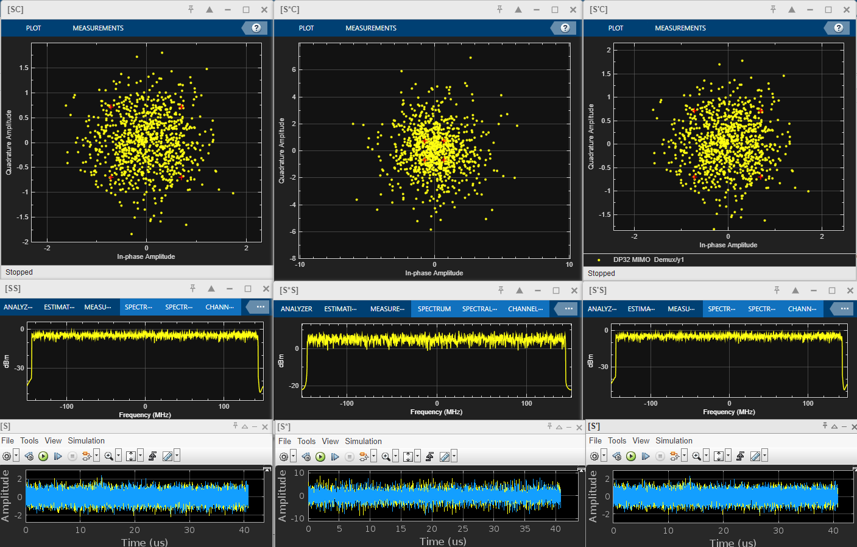
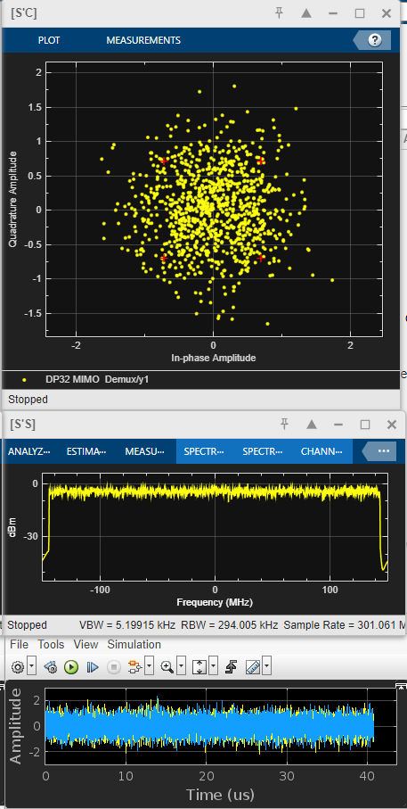
DPWiFi TRX Modeling
1.2 DPWiFi-32 320 MHz MCS13, ChDp = 1.0º

Slide 12
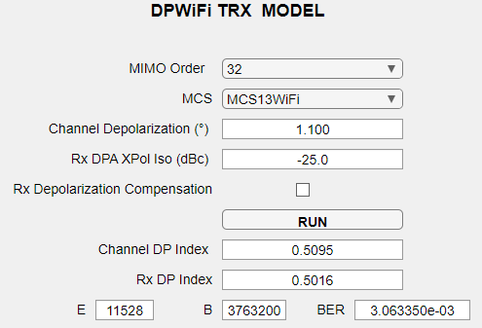
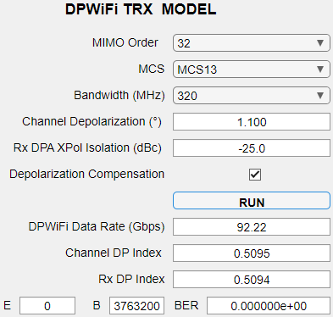
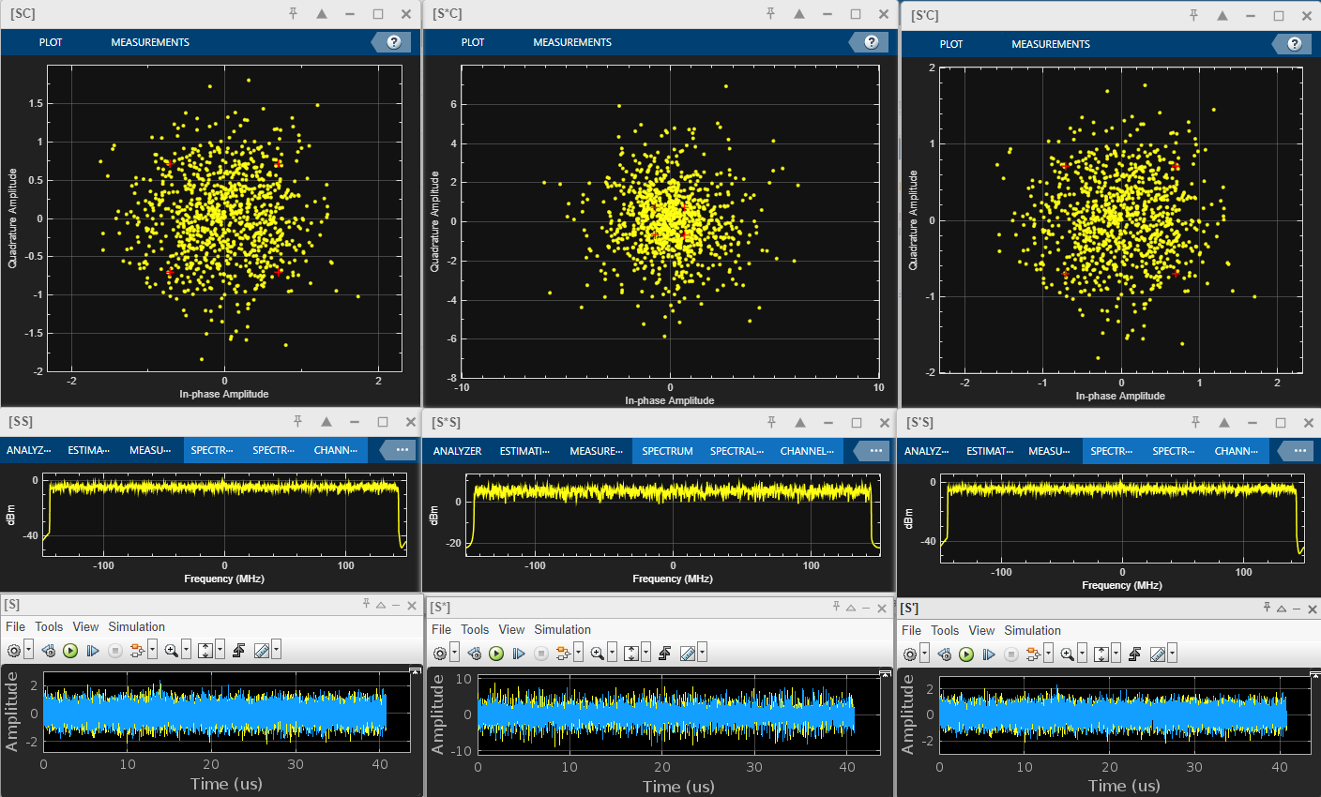
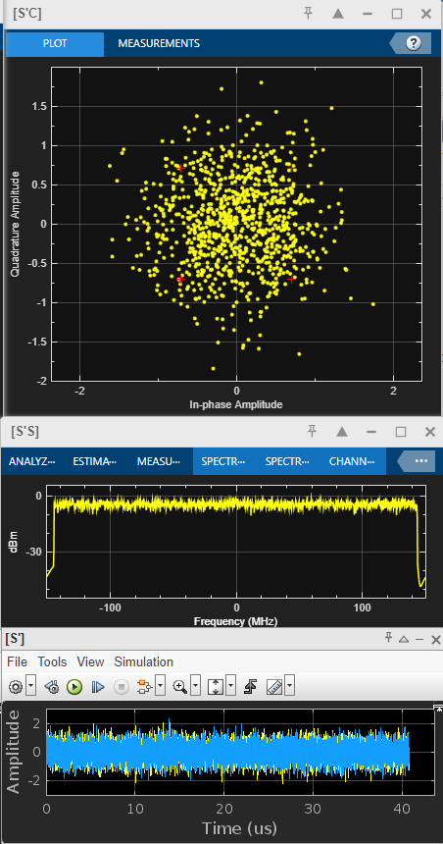
DPWiFi TRX Modeling
1.3 DPWiFi-32 320 MHz MCS13, ChDp = 1.1º

Slide 13
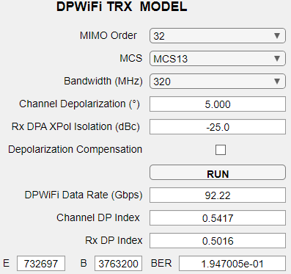
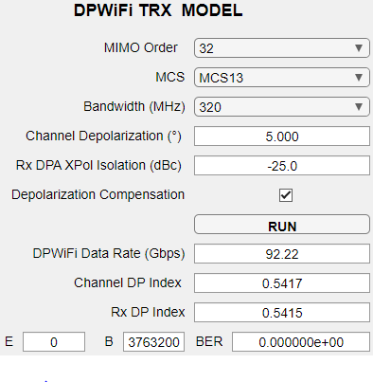
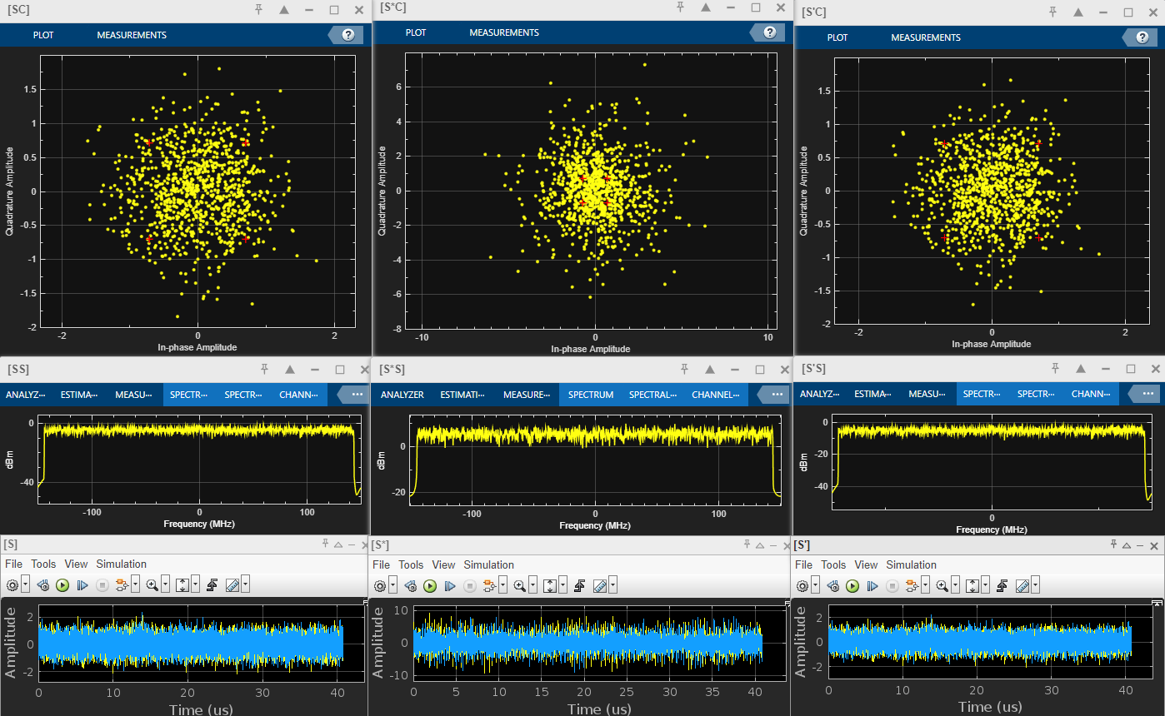
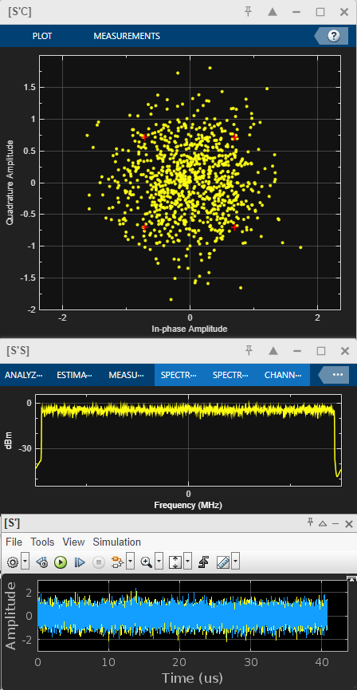
DPWiFi TRX Modeling
1.4 DPWiFi-32 320MHz MCS13, ChDp = 5.0º

Slide 14
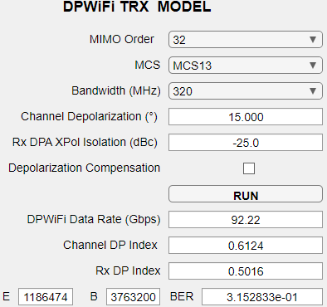
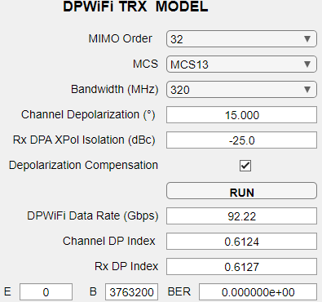
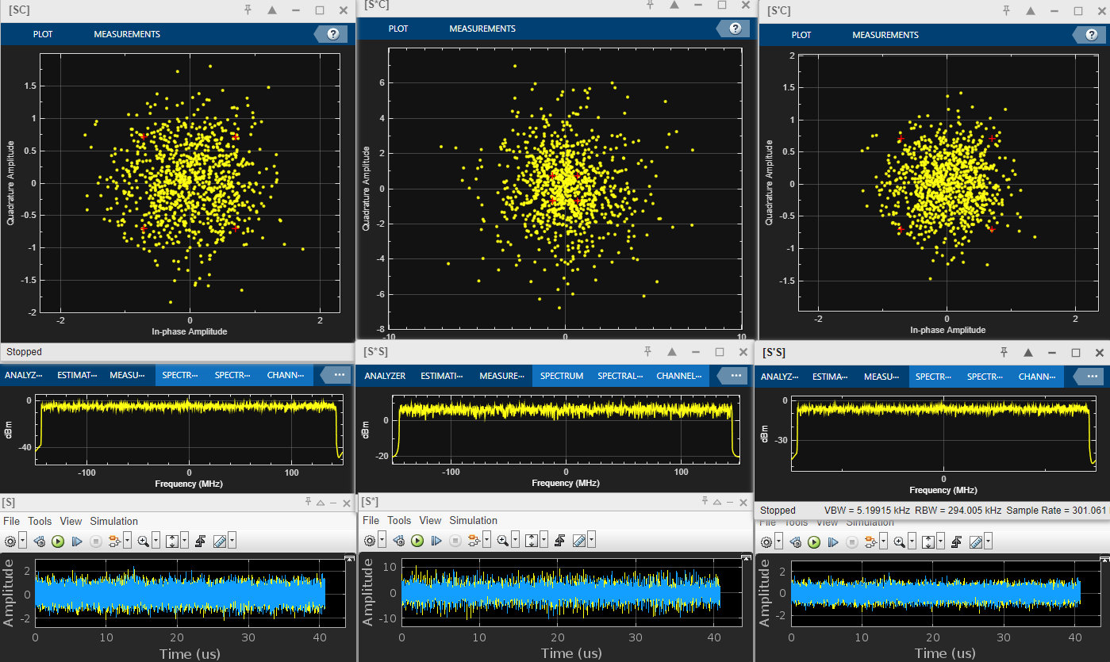
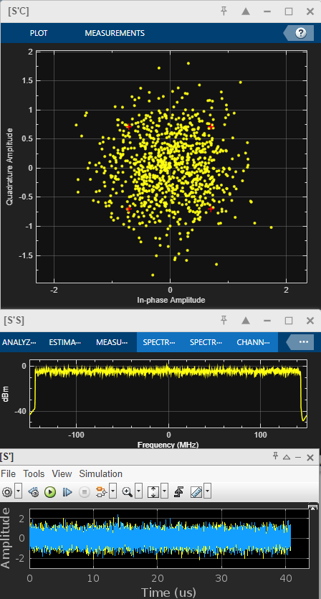
DPWiFi TRX Modeling
1.5 DPWiFi-32 320 MHz MCS13, ChDp = 15.0º

Slide 15
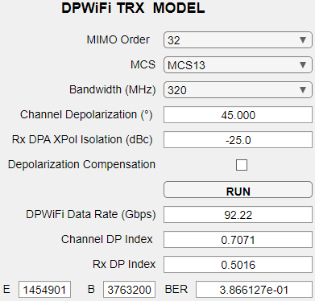
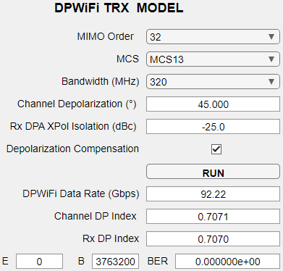
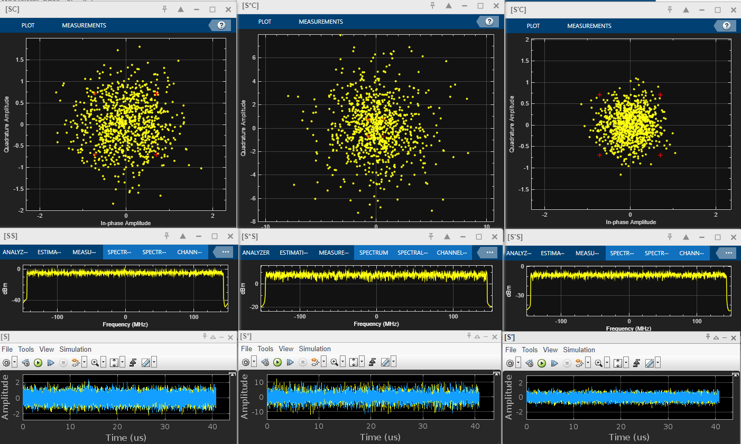
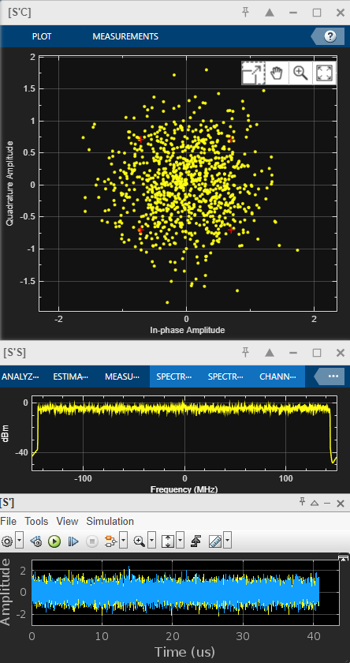
DPWiFi TRX Modeling
1.6 DPWiFi-32 320 MHz MCS13, ChDp = 45.0º

Slide 16
DPWiFi TRX Modeling Observations, Analysis and Conclusions
DPWiFi TRX Modeling Salient Observations
DPWiFi TRX Modeling Analysis
3.1 DPWiFi is extraordinarily sensitive to propagation channel depolarization, as even slight fog would crash FWA links
3.2 Adaptive DPWiFi, however, fully mitigates any amount of channel depolarization
4. DPWiFi TRX Modeling Conclusions
Adaptive DPWiFi (henceforth just “DPWiFi”) is both an extraordinarily powerful and robust Fixed Wireless Access solution
DPWiFi TRX Performance in Impaired Propagation Channels DPWiFi-32 320 MHz MCS12 vs Channel Depolarization
Channel Impairment Depolarization Angle | None 0.0º | Slight Fog 1.0º | Slight Fog 1.1º | Heavy Rain 5.0º | Rain + Foliage 15.0º | Orthogonal Reflection 45.0º
Channel DP Index | 0.5016 | 0.5087 | 0.5095 | 0.5417 | 0.6124 | 0.7071
Uncompensated TRX BER | 0.000 | 0.000 | 0.003 | 0.195 | 0.315 | 0.376
Compensate TRX BER | 0.000 | 0.000 | 0.000 | 0.000 | 0.000 | 0.000

Slide 17
DPWiFi MATLAB Validation Summary
Granted comprehensive DPWiFi TRX modeling results are still pending, completed corner-case MATLAB simulations (results presented herein) have nevertheless decisively validated TWI claims of extraordinary, unprecedented DPWiFi TRX performance in the Fixed Wireless Access application.
DPWiFi thereby fully merits unqualified, enthusiastic endorsement for adoption as a TGbn PHY.

