Slide 1
Light Communication for UHR
Date: 2023-01-17
Authors:
Name | Affiliations | Address | Phone | email
Volker Jungnickel | Fraunhofer HHI |  |  | volker.jungnickel@hhi.fraunhofer.de
Kai Lennert Bober | Fraunhofer HHI |  |  | kai.lennert.bober@hhi.fraunhofer.de
Matthias Wendt | Signify |  |  | matthias.wendt@signify.com
Nancy Lee | Signify |  |  | nancy.lee@signify.com
Sang-Kyu Lim | ETRI |  |  | sklim@etri.re.kr

Slide 2
Outline
Introduction
  Status of UHR
Light Communication
  Use cases in future IoT
LC for UHR
  High bandwidth
  Low power PHY
  Distributed deployment
  Precise positioning
  Technology demos
Summary
  Straw polls

Slide 3
Introduction
This contribution looks at future steps for Light Communication (LC) beyond 802.11bb. The objective is to integrate LC with 802.11 mainstream, and to be commonly used besides RF. We review next generation ultra-high reliability (UHR) WLAN project and the use cases and recent research for next generation LC. Besides wider bandwidth, a distributed architecture is proposed enabling higher reliability, lower latency and precise positioning. By adding theses features, future LC maybe a win-win situation for UHR.

Slide 4
UHR Use Cases and Requirements
Use cases
  Metaverse, AR/VR, Wearables [1]
  Cloud VR [2]
  Device sharing [3]
  Enterprise/business [4][5]
  Residential and home networking [6][7]
Requirements
  Improve Wi-Fi quality of experience [3]
  Enable higher data rates
    1 Gbps/user in 2025 and 2 Gbps/user in 2030 [8]
    10 Gbit/client [3]
    peak throughput of 100 Gbit/s [9]
  Reduce latency [9][10] in dense environments [11]
  Reduce power consumption [7][10][12][13]

Slide 5
Challenges for UHR based on RF
Ultra High Reliability (UHR) = cable-like QoS over wireless links
  this does not necessarily mean higher data rates
  applications want to get rid of cables and enjoy similar properties
  UHR means: zero packet loss, apps ask also for: lower latency/jitter, TSN support
UHR is a true challenge in randomly shared spectrum
  RF going through walls makes interference unpredictable
Interference from other technologies (Bluetooth, ZigBee, UWB)
  Coexistence is handled in 802.11 by CSMA/CA
    listen-before-talk concept creates an unreliable link, inherently
    coexistence could also be realized with advanced techniques
      dynamic spectrum sharing, ML/AI
Interference from other APs
  Multi-AP interference is handled in 802.11 by CSMA/CA, too
  Might need a distributed architecture with central intelligence

Slide 6
Sub-7 GHz
Further evolution of sub-7 GHz technology
  16 spatial streams, HARQ, wider BW, full duplex [8]
Deterministic channel access
  Operation in lightly licensed spectrum [14]
Multi-AP
  Multi-AP coordination [3, 11][13][15]
  C-OFDMA [16], SINR-aware spatial reuse [15], joint transmission [17]
    exploit macro diversity, interference-aware scheduling, convert interference into useful signal
  Well known from 4G/5G but potentially complex → select a simple yet effective scheme
Cloud-based network layout [12]
  Multi-AP techniques need centralized control (e.g., spectrum broker, central unit)
  Implementation behind WAN uplink (DSL, cable, PON) in operators central office [18]

Slide 7
mm-wave
PROs
  New spectrum brings most remarkable benefits [11]
    sufficient bandwidth, more frequency reuse → reduced congestion [11]
    enable 10 Gbps/client with 2 SS [3], multiple P2P links [3][19]
    reuse sub-7 GHz PHY [19][20][21]
  Mobility can be reached by MLO with sub-7 GHz bands [20][21]
    combine mm-wave with fiber-to-the-room (FttR) technologies in buildings [20]
CONs
  Can neither guarantee high reliability nor low latency [22]
    mm-wave depends on free line-of-sight
    beam scanning and tracking needs too much time
    possibly power-consuming
    higher CFO and phase noise at higher frequencies [23]
Similar features can be reached with Light Communication
  Spotty coverage, low power, reduced costs per bit
  Beamforming is not required, few sectors maybe enough
  CFO, Doppler, phase noise are all less relevant compared to mm-wave

Slide 8
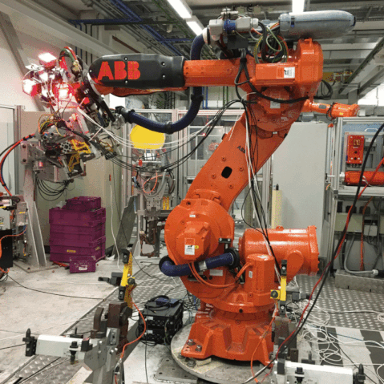
Light Communication
Key facts
Unique Selling Points
Mobile communication by using light
Bidirectional, high-speed
Useful complement to RF
Higher capacity/area in small “hotspots”
  1…10 Mbps/m² (RF)
  100+ Mbps/m² (LC)
Higher QoS: guaranteed delivery at low latency
Robust against jamming, enhanced privacy
RF is already mature and established in the market
LC to add new value to RF
Important synergies, both indoors and outdoors
  offloading, resilience against weather effects
RF systems take new opportunities by adding LC
Complement RF by LC

Slide 9
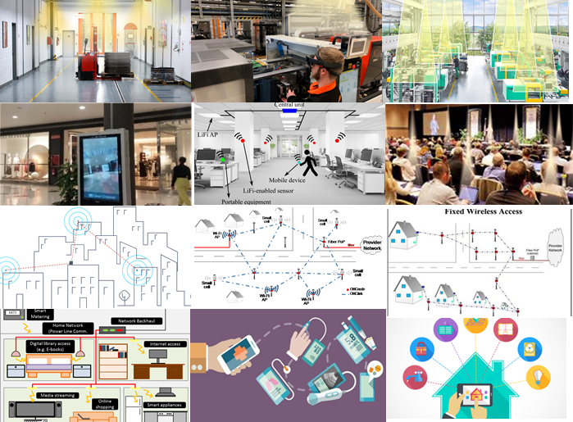
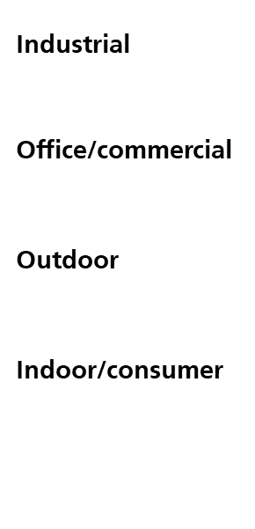
LC Use Cases in Future IoT
Future IoT
imaging sensors, video
reliable transmission at 100 Mbit/s/device
high density of devices
latency/jitter constraints
Great variety of use cases
EU H2020 IA ELIOT (Enhance Lighting for the Internet of Things, 2019-2022, www.eliot-h2020.eu/)
Create a new mass market
Use cases actually need networked LC, aka LiFi

Slide 10
Opportunities and Challenges of LC for UHR
Light Communication is fundamentally more reliable than RF
  Coexistence with other radio technologies is not an issue
    LC does not interfere with RF
  Interference from other APs is not an issue
    LC does not pass through walls
Need for CSMA/CA is naturally reduced
  The two fundamental interference problems of RF do not exist when using LC
    coexistence with other LC technologies, other LC AP signals are shielded by walls
LC needs distributed deployment with centralized control
  LC propagates similar to lighting
    communication is possible only inside illuminated area
    coverage of one room needs multiple LC optical antennas
    connected to AP by wired technologies (Ethernet, PLC, POF)
  use multiple LC optical antennas for reliable transmissions
    if line-of-sight to one LC optical antenna is blocked
    use other LC optical antenna(s) in the same room

Slide 11
LC in Industrial Applications [24, 25]
Large coverage area, high spatial reuse
  Distributed LC optical antennas with overlapping coverage areas [24, 25]
  Mobile devices move freely underneath them
  Parallel transmissions are centrally coordinated
    Spatial diversity: Multiple OFEs to one device (soft handoff)
    Spatial multiplexing: Multiple OFEs to multiple, well separated devices

Slide 12
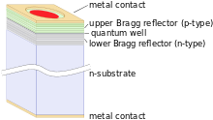
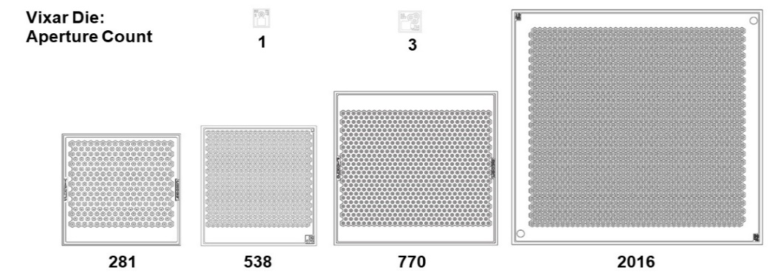
Higher Bandwidth [28]
TGbb specifies light modulation up to 336 MHz
  hardly achievable with common high-power LEDs
Arrays of vertical cavity surface emitting laser (VCSEL)
  originally developed for LIDAR applications
  consist of hundreds of VCSELs in 2D array
  optical behavior like LED (large area transmitter, i.e., eye safe)
  can be modulated at higher speed
Optical frontend design using VCSELs is a challenge
  high currents modulated at very high speed
  several amps on/off in few 100 ps
  VCSEL sub-arrays with individual drive circuit
Sources:
Wikipedia,
VIXAR
few mW
10 W
3 W
4 W
2 W

Slide 13
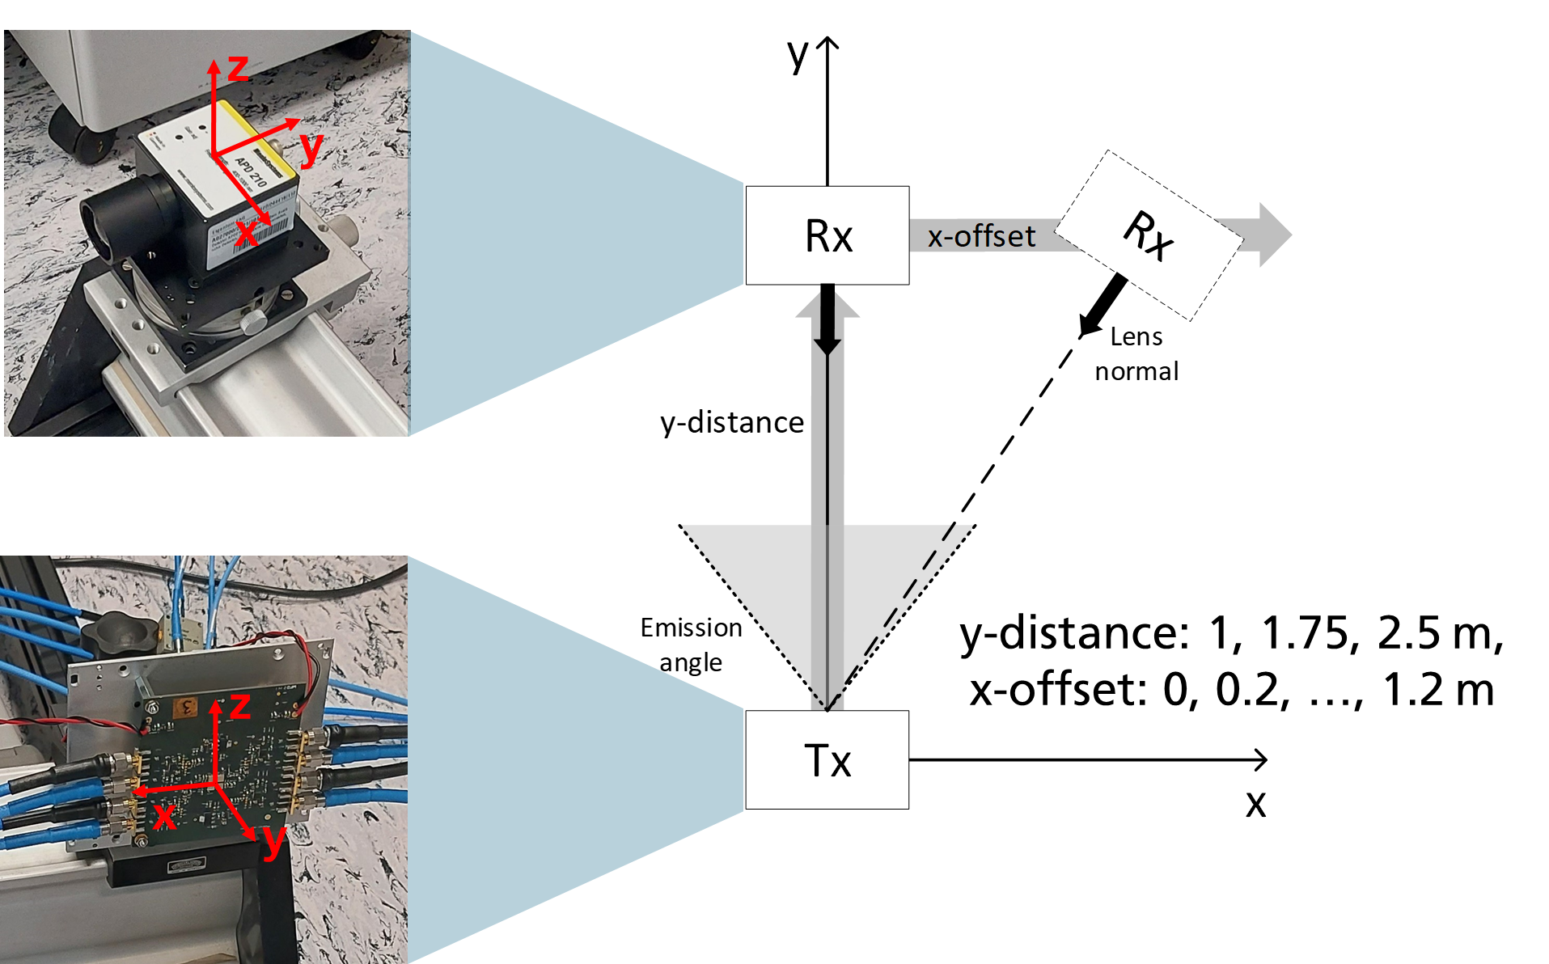
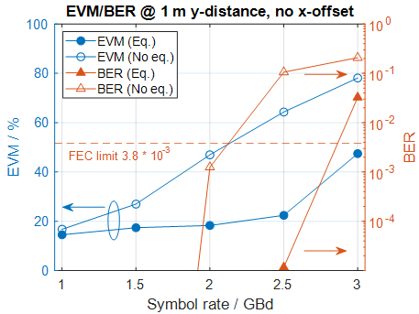
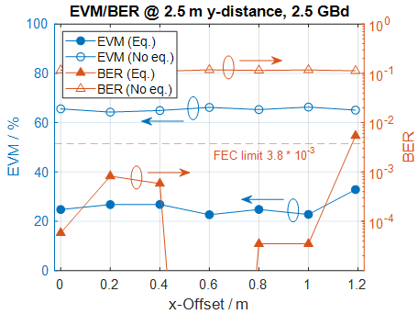
2.5 Gbaud in Large Coverage Area [29]
On-Off-Keying (OOK) w/o and with frequency-domain equalization (FDE)
  TX with 4 VCSEL arrays (Lexar, HHI), RX: commercial APD210 (Thorlabs)
3 m² area coverage at 2.5 GBaud
  error free with FDE, up to x-offset 1 m at 2.5 m y-distance
  3 m² area coverage
  reduced power/sector with dynamic optical antenna selection
LC bandwidth becomes similar to mm-wave
Y-distance: 1, 1.75, 2.5 m
X-offset: 0, 0.2, …, 1.2 m

Slide 14
Distributed Deployment: Low-power PHY
Narrow
field-of-view
Home/office
  focus is on higher data rate
  LOS blockage can be tolerated
  narrow beams → high received power, but no resilience
UHR needs overlapping coverage areas
  enables higher reliability
  spatial diversity to overcome LOS blockage
  wide, overlapping beams → lower received power, but more resilient
Distributed architecture needs low-power PHY.
Block-
age
Wide
field-of-view

Slide 15
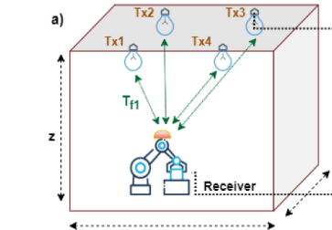
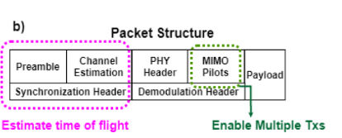
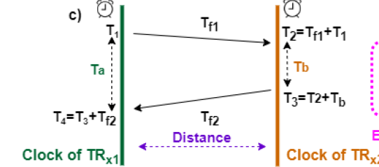
Precise Positioning [40-43]
Positioning/sensing integrated with wireless communication
  is immediately possible with D-MIMO
Time of flight (ToF) based
  combined ranging from multiple TXs (a)
  using ITU-T G.9991 PHY in PoC (b)
ToF is obtained from coarse and fine timing
  Coarse → framing sequence
  Fine → phase vs. frequency from MIMO channel estimation sequences
  Roundtrip ToF avoids synchronization between mobile and ceiling units (c)
Centimeter precision is demonstrated
  100 MHz_{3-dB} bandwidth
  relatively high SNR (~30 dB)
  few cm 3D error (after careful calibration)

Slide 16
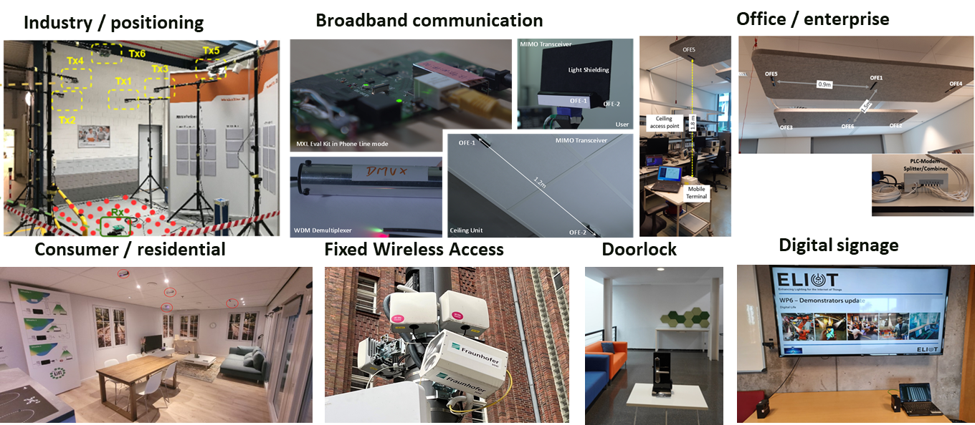
LC Technology Demos
The 10-partner cooperate/academic EU H2020 project “Enhance Lighting for the Internet of Things” (ELIoT, 2018-2022) tested LC in a great variety of applications.
various new videos on YouTube channel of ELIoT [44]
https://www.youtube.com/watch?v=xdeqhdoxP5A&list=PLbzbmwhsF7bR-W98sQ-9mSOnlhS3tjiWE
press release [45]

Slide 17
Summary
P802.11bb paved the way for LC into 802.11
  TGbb mostly defined adaptation to the optical medium (link level)
  LC needs more work concerning the MAC (system level)
LC needs further market development
  New use cases in future IoT (video traffic from sensors/machines to the cloud)
  New features needed: higher bandwidth, distributed architecture, low power, positioning
LC is similarly capable like 60 GHz, but maybe simpler and more powerful
  several GHz bandwidth/optical channel with VCSEL array TX
  channelization in the wavelength domain enables sheer unlimited capacity
  LC already uses same PHY like sub-7 GHz, numerology can be adapted to higher BW
Next steps for LC have significant overlap with UHR
  LC needs may be covered by contributing to the mainstream
  LC should be further developed as part of the 802.11 UHR project to augment RF

Slide 18
Straw poll
Would you support that 802.11 develops Light Communication further?
Y / N / A =

Slide 19
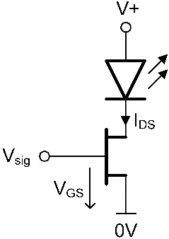
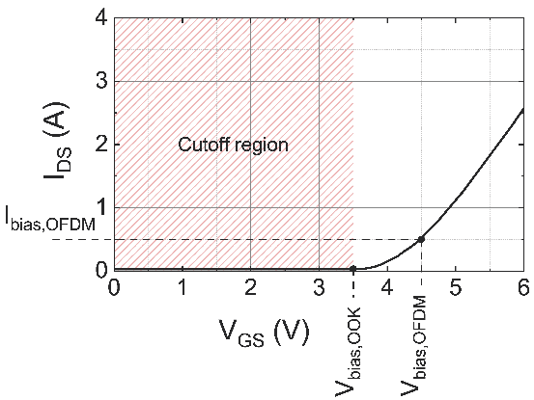
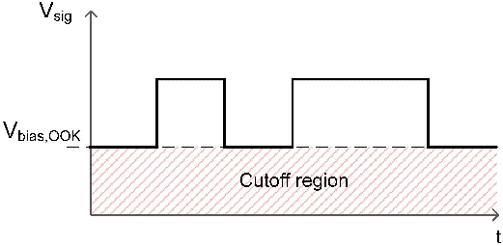
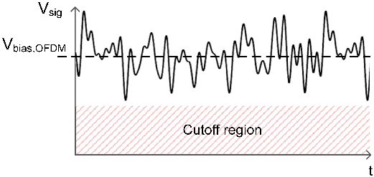
Low-power PHY [26]
OFDM
High spectral efficiency, higher bit rate
Adaptive to channel conditions
Class A/AB PA with good linearity
Modulation around constant bias
PA operating in resistive mode
OOK (On-Off-Keying) with FDE
Lower spectral efficiency, more robust
Switching amplifier is sufficient
→ PA avoids resistive mode: 10x more efficient
Tx amplifier power usage
OOK
OFDM
Shift of IFFT from TX to RX converts OFDM into OOK/FDE (frequency-domain equalization) [27].

Slide 20
Distributed architecture
Centralized WLAN
  mobile units (MU) connected via
  remote units (RUs) and
  fronthaul to
  central unit (CU)
  CU functionality is inside AP
  lower protocol functions shifted to RU
    functional split inside PHY/MAC
    needs open interface
  fronthaul transport vianalog vs. Ethernet
  Needs tight time synchronization (e.g. 802.1AS)
CU
fronthaul
RU
MU
Figure from IEEE P802.15.13_D10 [30]

Slide 21
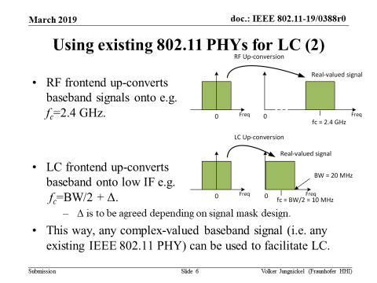
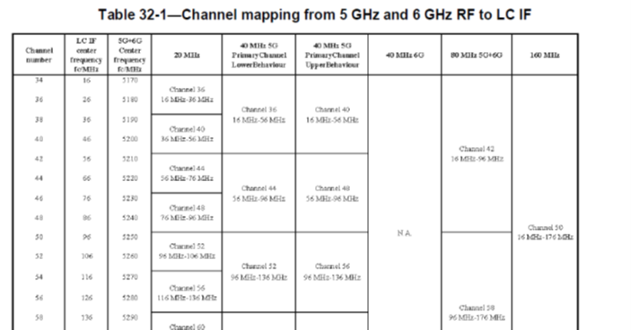
Status of LC in 802.11 [31]
TGbb D5.0 in 1st SA ballot recirc
defines usage of 800-1000 nm band
  transparent to 802.11 PHY and MAC [32]
  up/down-conversion, direct conversion [33, 34]
  channel mapping from 5 and 6 GHz to LC [35]
  multiple TX and multiple RX chains [36, 37]
  LC repetition for hidden terminal problem [38]
only 5 lines of MAC text

Slide 22
Status of LC in 802.11 (2)
802.11bb is currently very limited to LC medium adaptation
  802.11bb reuses whole 802.11 PHY and MAC
  distributed LC architecture needs major changes in 802.11 MAC

Slide 23
Distributed MIMO in IEEE P802.15.13_D10 [39]
Deterministic MAC
  fixed slot size
  beacon with variable delay (delay info in header)
  contention-based access period (CAP)
  contention-free access period (CFP)
Periodic channel estimation
  member estimates channel to nearby OFEs
  members provide compressed channel feedback
    power and delay of LOS path
  central coordinator knows relevant subset of OFEs
    schedules TXOPs in space/time, accordingly
  Status of P802.15.13
  SA ballot finished in November 2022
    D10 is on RevCom Agenda in January
  TSN suitability is discussed btw. 802.1/802.15
    overview presentation in 15-23/00xxry

Slide 24
References
[1] Chunyu Hu, “802.11bx: Enabling Metaverse -- Metaverse, AR/VR, and Wearables,” IEEE 802.11-22/0779r0
[2] Ross Jian Yu et al., “Cloud VR Use Case and Requirements,” IEEE 802.11-22/0952r0
[3] L. Cariou et al., “Next 802.11 generation after 11be,” IEEE 802.11-22/0046r1
[4] Brian Hart et al., “A perspective on proposed Ultra-High Reliability (UHR) features for enterprise use cases,” IEEE 802.11-22/1280r1
[5] Akira Kishida et al., “Use Cases for Wi-Fi Business Solutions in UHR,” IEEE 802.11-22/1493r1
[6] James Yee et al., “Multi AP Coordination and Residential Wi-Fi,” IEEE 802.11-22/1512r0
[7] Amelia Andersdotter et al., “Ultra-High Reliability (UHR) requirements for home-networking use cases,” IEEE 802.11- 22/1790r0
[8] Xiaofei Wang et al, “Thoughts on Next-Gen WLAN”, IEEE 802.11-22/0694r0
[9] Ming Gan et al., “Look ahead to next generation”, IEEE 802.11-22/0030r1
[10] Akira Kishida et al., “Considerations on UHR PAR”, IEEE 802.11-22/1919r2
[11] Laurent Cariou et al., “802.11 Gen8 Study Group”, IEEE 802.11-22/0729r1
[12] Rolf de Vegt, “Beyond ‘be’, IEEE 802.11-22/0059r0
[13] Lilli Hervieu, „A perspective on UHR features for operator residential deployments”, IEEE 802-11-22/1809r0
[14] Rolf de Vegt, “UHR Operation in Lightly Licensed Spectrum,” IEEE 802.11-22/1969r0
[15] Sigurd Schelstraete, “Views on UHR,” IEEE 802-11-22/1566r0
[16] Sigurd Schelstraete, “C-OFDMA throughput analysis in various mesh backhaul scenarios,” IEEE 802.11-22/1567r0
[17] Ron Porat, “Joiunt transmission for UHR – A refresher and new results,” IEEE 802.11-22/2188r0
[18] John M. Cioffi et al., "Cellular Subscriber Lines (CSL): A Wireless-Wireline Physically Converged Architecture," in IEEE Trans. Commun., vol. 68, no. 12, pp. 7289-7310, Dec. 2020.

Slide 25
References (2)
[19] Jinsoo Choi et al., “Discussion on next generation Wi-Fi”, IEEE 802.11-22/0685r0.
[20] Ming Gan et al., “Next generation SG formation,” IEEE 802.11-22/1083r1
[21] Laurent Cariou, “Some questions to answer for UHR PAR,” IEEE 802.11-22/1595r1
[22] Xiaofei Wang, “Thoughts on UHR features,” IEEE 802-11-22/1924r0
[23] Myeongjin Kim, “Thoughts on High frequency bands,” IEEE 802.11-22/1395r0
[24] Lennert Bober “Performance Evaluation of a Coordinated Visible Light Communication Network“ M.S. thesis, TU Berlin, 2018.
[25] Lennert Bober, et al., "Distributed Multiuser MIMO for LiFi in Industrial Wireless Applications," J. Lightwave Technol. 39, 3420-3433 (2021)
[26] Malte Hinrichs et al., "A Physical Layer for Low Power Optical Wireless Communications," in IEEE Transactions on Green Communications and Networking, vol. 5, no. 1, pp. 4-17, March 2021
[27] David Falconer et al., "Frequency domain equalization for single-carrier broadband wireless systems," in IEEE Communications Magazine, vol. 40, no. 4, pp. 58-66, April 2002
[28] Volker Jungnickel et al., “Laser-based LiFi for 6G: Potential and Applications,” The 9th Laser Display and Lighting Conference 2020 (LDC), Pacifico Yokohama, Japan.
[29] Malte Hinrichs et al. "Demonstration of 1.75 Gbit/s VCSEL-based Non-Directed Optical Wireless Communications with OOK and FDE," ECOC 2022, We5.52.
[30] IEEE P802.15.13_D10: IEEE Draft Standard for Multi-Gigabit per Second Optical Wireless Communications (OWC), with Ranges up to 200 meters, for both stationary and mobile devices
[31] IEEE P802.11bb_D5: IEEE Draft Standard for Information Technology--Telecommunications and Information Exchange Between Systems Local and Metropolitan Area Networks--Specific Requirements - Part 11: Wireless LAN Medium Access Control (MAC) and Physical Layer (PHY) Specifications Amendment 7: Light Communications.

Slide 26
References (3)
[32] Volker Jungnickel et al., “Proposed way forward on TGbb PHY,” IEEE 902.11-19/0388r0.
[33] Nikola Serafimovski et al., “Common-mode mandatory PHY”, IEEE 802.11-19/1625r4.
[34] Volker Jungnickel, “Resolution of CID 32 in CC against D2.1,”, IEEE 802.11-22/1115r0.
[35] Volker Jungnickel, “Channel mapping table from 5 and 6 GHz to LC IF,” IEEE 802.11-22/1088r4.
[36] Volker Jungnickel, “Draft text for multiple transmitters and receivers,” IEEE 802.11-21/1864r1.
[37] Robert Stacey, “LC MIMO,“, IEEE 802.11-22/2081r2.
[38] Chong Han, “Relayed CCA mechanism,” IEEE 802.11-20/1966r0.
[39] Kai Lennert Bober et al., "The IEEE 802.15.13 Standard for Optical Wireless Communications in Industry 4.0," IECON 2022 – 48th Annual Conf. of the IEEE Industrial Electronics Society.
[40] S. M. Kouhini et al., "LiFi Positioning for Industry 4.0," in IEEE Journal of Selected Topics in Quantum Electronics, vol. 27, no. 6, pp. 1-15, Nov.-Dec. 2021.
[41] S. M. Kouhini, et al. "LiFi based Positioning for Indoor Scenarios," 2021 17th International Symposium on Wireless Communication Systems (ISWCS), 2021.
[42] S. M. Kouhini, et al. "Object Tracking in an Indoor Scenario: Potential for Centimeter Accuracy with LiFi," 2022 13th International Symposium on Communication Systems, Networks and Digital Signal Processing (CSNDSP), 2022, pp. 806-811.
[43] Z. Ma et al., "LiFi Positioning and Optimization in an Indoor Factory Environment," IECON 2022 – 48th Annual Conference of the IEEE Industrial Electronics Society, 2022.
[44] ELIOT youtube channel: https://www.youtube.com/watch?v=xdeqhdoxP5A&list=PLbzbmwhsF7bR-W98sQ-9mSOnlhS3tjiWE
[]45] ELIOT final press release: https://idw-online.de

