Slide 1
Adaptive Contention Window Size for Back-Off Time in Distributed Coordinate Function (DCF)
Date: 2021-07-20
Authors:

Slide 2
Abstract
In this contribution, we propose a method to enhance the performance of the multi-link distribution coordinate function (DCF) for STR and non-STR modes by selecting the back-off time from adaptive contention window size. The aim of this selection to reduce the collision occurrence probability and provide better network perform

Slide 3
Introduction
In IEEE802.11 standards, the active stations in contention-based Distributed Coordination Function (DCF) contend for channel resource access using Carrier Sense Multiple Access with Collision Avoidance (CSMA/CA) where a station will sense the channel and automatically send a data frame if the channel is idle for a time longer than a DIFS interval. otherwise, it defers the transmission for a random back-off time.
If the source station did not receive the Acknowledgement (ACK) frame from the destination for a period longer than SIFS, it will assume that there is a collision and schedule retransmission for a random back-off time.

Slide 4
Introduction
The Contention Window (CW) is determining the value of the back-off timer.
After each time the station experiences collision, the back-off period will be doubled to reduce the probability of collision occurs between multiple simultaneous stations transmission. This method is called Binary Exponential Back-off (BEB).
The multi-link DCF operation in MLD discuss for both STR and non-STR mode in [1-9]

Slide 5
Problem statement
The collision occurrence is degradation the network performance:
Problem1: In conventional BEB, the previous range of the CW is included and there is a chance of choosing the back of time from the previous CW range. Thus , the collision probability still exists.
Problem2: After successful transmission, all stations that succeeded in transmitting are returned to use the CWmin simultaneously and this leads to an increase the collision probability for stations that succeeded in transmitting

Slide 6
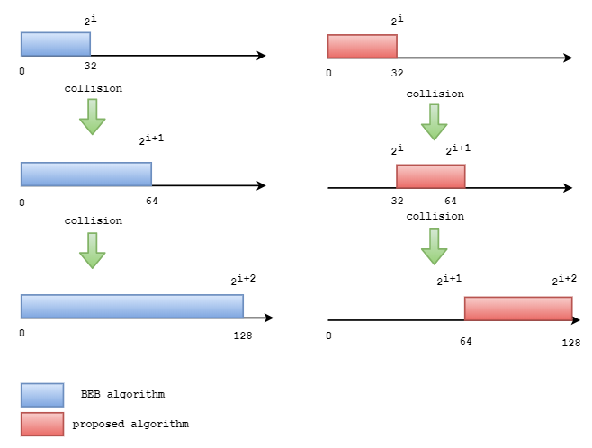
Problem1 proposed Solution :
In the collision occurrence case, we propose to exclude the overlap range of the previous CW when choosing the back-off timer.

Slide 7
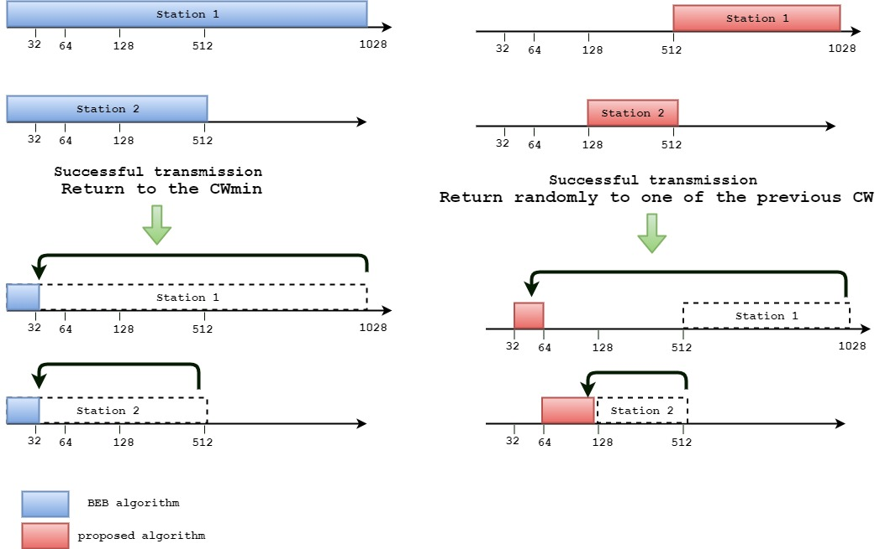
Problem2 proposed Solution :
When stations transmitting successfully, we proposed that each station return randomly to one of the previous CW using pseudorandom operation.

Slide 8
Summary
•We propose to reconsider determine back-off timer using CW by excluding the previous range.
•When stations successful transmission, we propose to each station return the CW randomly to one of the previous CW instead CWmin.

Slide 9
Straw Poll # 1
Do you agree that the CW size should exclude the previous CW range when a transmission fails, or collision accured?
Yes
No
Abstain

Slide 10
Straw Poll # 2
Do you agree that when the station successfully transmitted, the CW should be return randomly to one of the previous CW sizes instead of return to the CWmin?
Yes
No
Abstain

Slide 11
References
July 2021
[1] Sanghyun Kim et al. (WILUS Inc, SK Telecom), Contention Window Value Management for STR MLD, July: IEEE 802.11-21/1156r1, 2020.
[2] Duncan Ho et al. (Qualcomm), MLA: Sync PPDUs, March: IEEE 802.11-21/0026r7, 2020.
[3] Insun Jang et al. (LG Electronics), Channel Access for Multi-link Operation, July: IEEE 802.11-21/1144r6, 2019.
[4] Sunghyun Hwang et al. (ETRI, Korea National University of Transportation, and Yonsei Univ), Consideration on Multi-link Operation, July: IEEE 802.11-21/1181r1, 2019.
[5] Yunbo Li et al. (Huawei), Discussion about single and multiple primary links in synchronous multi-link, November: IEEE 802.11-21/1993r1, 2019.
[6] Sharan Naribole et al. (Samsung), Multi-link TXOP Aggregation Considerations, September: IEEE 802.11-21/1505r2, 2019.
[7] Zhou Lan et al. (Broadcom), MLO a-synchronize and synchronize operation discussions, January: IEEE 802.11-21/291r1, 2020.
[8] Liwen Chu et al. (NXP), Multiple Link Operation Follow Up, January: IEEE 802.11-21/0487r5, 2020.
[9] Dmitry Akhmetov et al. (Intel), Discussion on methods for synchronous ML operations , August: IEEE 802.11-21/993r5, 2020.
Abdelrahman Abushattal (Vestel), et al

