Slide 1
Wi-Fi sensing: Usages, requirements, technical feasibility and standards gaps
Date: 2019-07-15
Authors:
Name | Affiliation | Address | Phone | Email
Claudio da Silva | Intel Corporation | USA |  | Claudio.da.Silva@intel.com
Carlos Cordeiro |  |  |  | Carlos.Cordeiro@intel.com
Bahar Sadeghi |  |  |  | Bahareh.Sadeghi@intel.com
Cheng Chen |  |  |  | Cheng.Chen@intel.com
Artyom Lomayev |  |  |  | Artyom.Lomayev@intel.com

Slide 2
Introduction
This presentation introduces the application of Wi-Fi radio signals to sense (changes to) the environment where these signals propagate
This is hereby referred to as Wi-Fi sensing
This presentation covers:
  Definition and key applications
  Why and how to use Wi-Fi for sensing
  Use cases and requirements
  Technical feasibility
  The need for standard support
  Conclusion and proposed next steps

Slide 3
Wi-Fi sensing: what is it and what can it be used for
Wi-Fi sensing is the use, by a Wi-Fi sensing capable STA(s), of received Wi-Fi signals to detect feature(s) of an intended target(s) in a given environment
  Features = motion, presence or proximity, gesture, people counting, geometry, velocity, etc.
  Target = object, human, animal, etc.
  Environment = Within a few centimeters/meters of a device, room, house/enterprise, etc.
Wi-Fi sensing does not assume that the intended target carries a device with Wi-Fi functionality
The STA that transmits a Wi-Fi signal may or may not be the same as the STA that performs the Wi-Fi sensing function

Slide 4
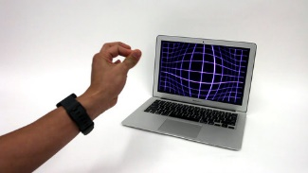
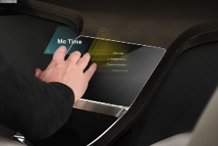

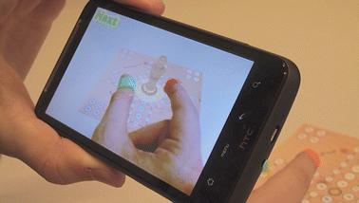
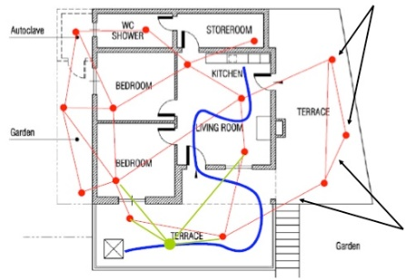
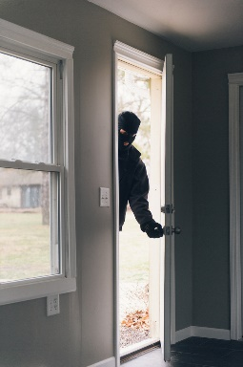
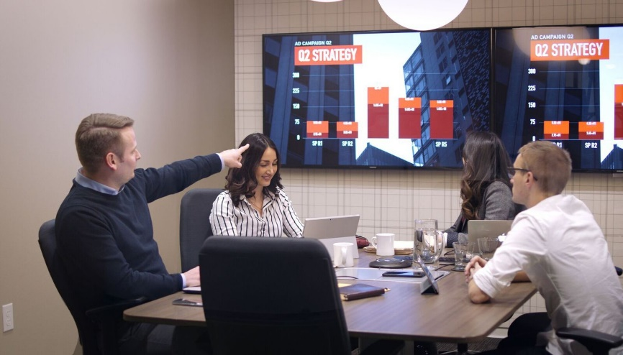
Wi-Fi sensing: Examples of applications
Gesture recognition (new form of UI):
Presence detection:
Wake on approach, walk away lock
PC
Automotive
Phone/Tablet
Room sensing and presence detection:
Target (e.g., people) counting and activity detection:
Augmenting APs/relays with sensing capabilities
Home security
Smart meeting rooms

Slide 5
Why use Wi-Fi for such applications?
Wi-Fi is ubiquitous in homes and enterprises – comes “for free”
Expand the use of Wi-Fi to applications beyond just communication – increase stickiness
Wi-Fi can overcome drawbacks from alternative technologies
  Camera: field of view, privacy, power consumption
  Ultrasonic/laser: objects can block
For some important applications, use of existing Wi-Fi signals is sufficient; for other applications and/or to improve performance, as discussed later in the presentation, standard support is needed.

Slide 6
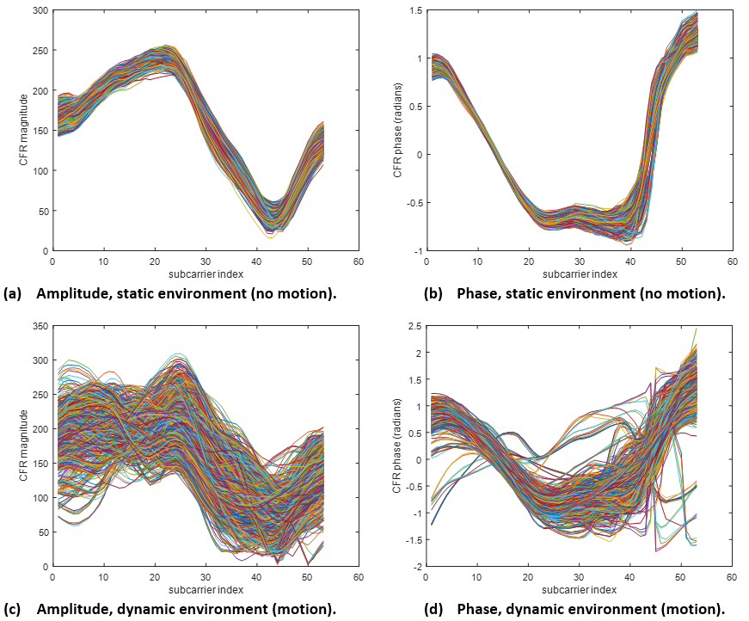
How to use Wi-Fi for such applications?
Figures show the amplitude and phase of channel estimates obtained with multiple PPDUs over time (~3 minutes). Each curve corresponds to one PPDU. Top row: no motion. Bottom row: motion in the room (one person randomly walking).
Technical principle behind Wi-Fi sensing is to track channel estimates obtained when decoding multiple Wi-Fi packets over time, and detect variations that indicate an event of interest.
Detection of some features require ML, but many can be achieved without it

Slide 7
Examples of use cases and requirements
Category | Market segments (devices) | Description | Accuracy (space/time) requirement
Presence/Motion detection | Enterprise, Home (PC, phone, AP) | Detect human presence and/or motion Wake on approach / walk away lock Wake on entry / walk away sleep Auto connect to display | Low/High (use case dependent)
Gesture recognition (Coarse/Far-field) | Enterprise, Home (PC, phone, wearable, cars) | Detect specific large movements/gestures, e.g., hand waving (may require AI/ML) Automotive, UI, gaming, VR/AR, machine interaction | Low/High (use case dependent)
Gesture Recognition (Fine/Near-field) | Enterprise, Home (PC, phone, wearable, cars) | Detect specific small movements/gestures, e.g., using fingers (may require AI/ML) Automotive, UI, gaming, VR/AR, machine interaction | High
Health care | Home (AP, smart home IoT client) | Detect biometric (HR/ ECG / etc.) abnormalities Elderly care | Low/High (use case dependent)
Room sensing (home automation, monitoring, etc.) | Enterprise, Home (AP, smart home IoT client) | Detect multiple targets, how many, activities, dimensions, etc. Does not necessarily require AI/ML Apps: gaming, smart home, home security | Low/High (use case dependent)

Slide 8
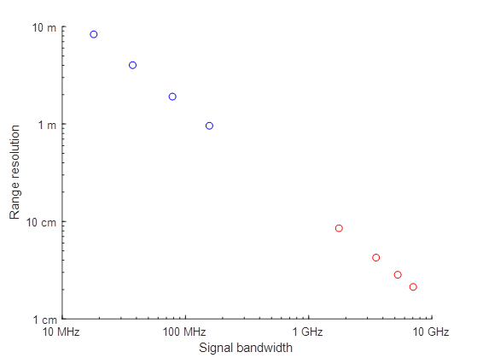


Different use cases require different resolutions
Low resolution sensing
e.g., human presence/ motion detection
2.4 GHz (IEEE 802.11 b/g/n/ax)
5 GHz (IEEE 802.11 a/n/ac/ax)
Accuracy resolution
High resolution sensing
e.g., gesture recognition
60 GHz (IEEE 802.11 ad/ay)
Note: In addition to accuracy resolution, 60 GHz provides higher angular resolution

Slide 9
Measuring Wi-Fi sensing performance
Wi-Fi sensing performance is not measured by typical communication system metrics such as link throughput or link latency
Instead, performance is measured by metrics such as the following:
  Sensing range: the maximum distance from sensing device to the target.
  Field of View (FOV): the angle through which the sensing device can perform sensing and detection, i.e., the FOV indicates the coverage area of a sensing device.
  Probability of detection: specified in terms of probability of correctness for aspects like:
    gesture detection where a pre-defined set of gestures and/or motions are to be identified
    presence detection
    a specific body activity detection like breathing
    distinguishing human target from non-human target or animal target
  Expected Latency: expected time taken to complete the related Wi-Fi sensing process.
  Expected number of simultaneous targets

Slide 10
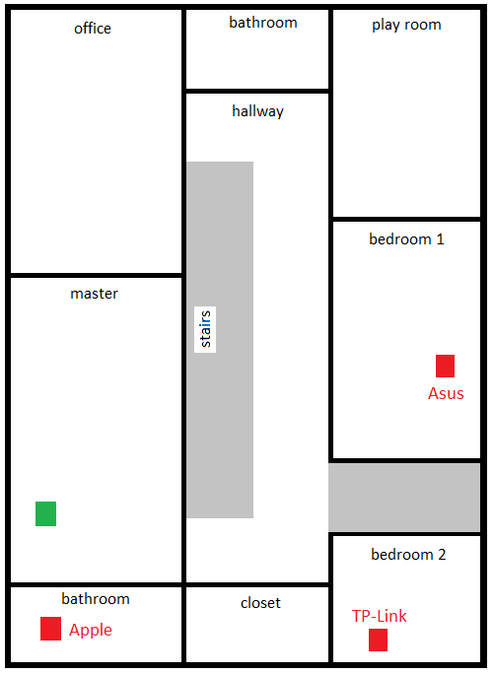
Technical feasibility
To assess the technical feasibility of Wi-Fi sensing, we have performed an extensive measurement campaign
  Main focus was on the presence detection use case (see slides 4 & 7)
Set up:
  All measurements were made on 5 GHz, channel 36
  Home environment with Wi-Fi networks operating co-channel
  One 2 antenna client laptop operating in sniffer mode: sensing device
  3 APs:
    AP 1: 3 antenna AP using 11n
    AP 2: 3 antenna AP using 11ac
    AP 3: 4 antenna AP using 11ac
  APs 1, 2 and 3 are commercially available, brand name APs with chipsets coming from three different vendors
  All devices remain stationary during all experiments
AP 3
Laptop
AP 1
AP 2

Slide 11
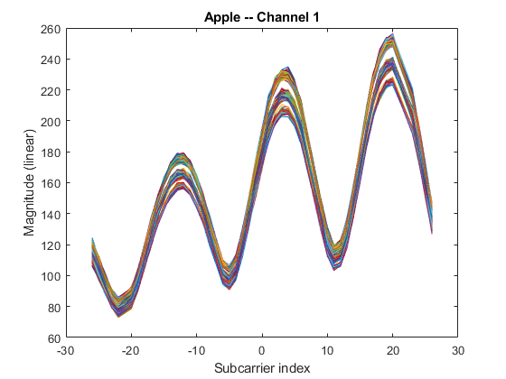
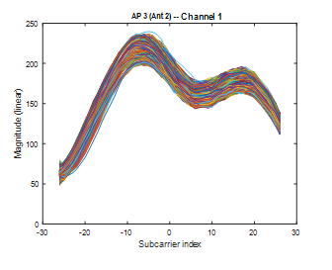
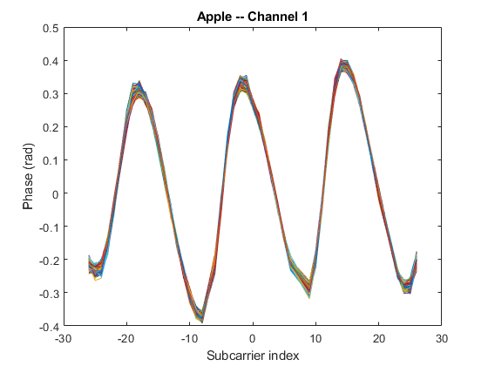
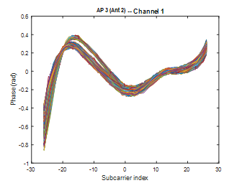
Measurement results: no motion
AP 1
AP 2
AP 3
AP 1
AP 2
AP 3 (Ant 2)
AP 1
AP 2

Slide 12
Technical approach
Phase 1: Measurement capture and conditioning
To test feasibility, we have implemented a simple algorithm that relies solely on AP spatial diversity in a given deployment
Algorithm makes use of channel estimates
  Mag/phase across the sub carriers to reveal the multipath environment
Algorithm has 3 phases (see right)
  Measurement capture
  Motion detection
  Presence detection
Phase 2: Motion detection
Phase 3: Presence detection
Likelihood TX₁
Likelihood TX₂
Likelihood TX_{N}

Slide 13
Technical approach: illustrative example
Raw data
E metric
Likelihood
Thresholding
AP 1
AP 1
AP 2
AP 1
AP 2
AP 3
AP 3

Slide 14
Movement in the same room as AP 2
AP 1
AP 2
AP 3
Take away:
Curves corresponding to AP 2 go up/down. All others (AP 1 and AP 3) remain pretty much constant.
Both phase and amplitude metrics show the expected behavior.

Slide 15
Movement in the hallway
AP 1
AP 2
AP 3
Take away:
All three links show variations, but ones corresponding to AP 2 and AP 3 are more pronounced.
Phase and amplitude metrics show expected behavior.

Slide 16
Movement close to the RX
AP 1
AP 2
AP 3
Take away:
All six links show noticeable change, as expected, for both amplitude and phase.
Motion “close” to the receiver results in largest variations in measurements from all transmitters

Slide 17
Movement in the same room as RX, but ~3m away from it
AP 1
AP 2
AP 3
Take away:
All six links show change, both for magnitude and phase. However, “amount” of change is much smaller than when motion is closer to the RX (see previous slide).

Slide 18
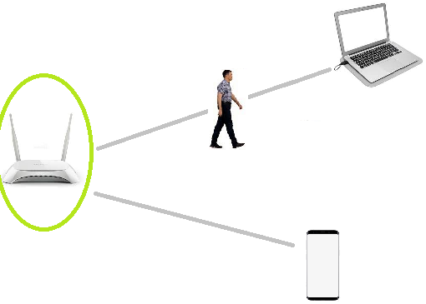
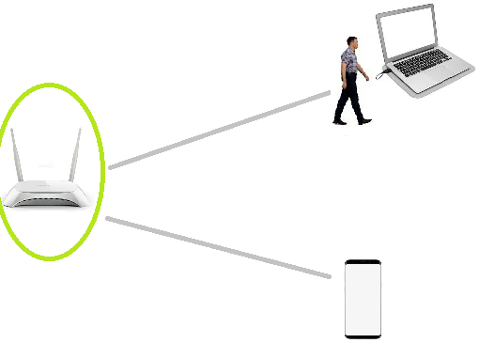
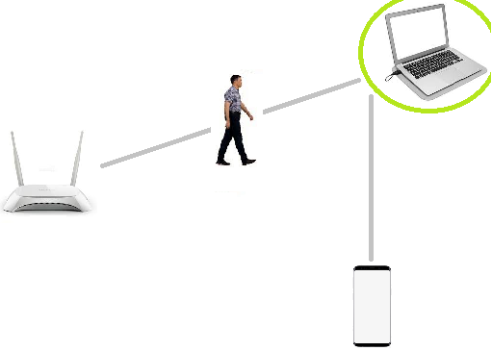
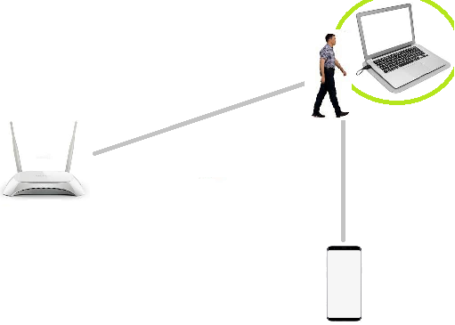
The need for cooperation
July 2019
Motion, upper link
In each of the two examples, the position of devices and person is the same.
However, different sensing results may be obtained depending on which device assumes the sensing receiver role.
Sensing accuracy for certain applications is increased with multiple sensing receivers, and larger number of Wi-Fi transmitters
Sensing receiver is the AP
Motion, upper link
Sensing receiver is the laptop
Motion, upper link
Proximity, laptop
Carlos Cordeiro (Intel)

Slide 19
Summary results: presence detection
ROC show probability of detection (PD) > 95% when using 2 APs, with a probability of false alarm (PFA) < 30%
Sensing ranges between 0.8-1m
Curves may shift with changes in environment (e.g. # APs, people, objects), algorithms (e.g. ML), optimizations, and “cleaner” channel estimates
More elaborate algorithms can definitely achieve higher PD with lower PFA, but this was not the focus of this study
This demonstrates that it is possible to use Wi-Fi (in 5 GHz) to detect presence
The more curves can be pushed to the top left-hand corner, the better. However, the operating point is determined by KPI(s) and complexity/performance trade-off.

Slide 20
The need for standard changes
Measurement campaign revealed that unless standard support is present, a number of important use cases cannot be addressed. Some of the reasons are:
  Our measurements have indicated that performance is much better if the measurement is taken “closer” to the target object – requires cooperation among multiple STAs
  Transmitters often change transmission characteristics (e.g., #antennas, BW, #SS) dynamically, which makes measurements very difficult to be made reliable – requires negotiation between STAs on timing and configuration of measurements
  If the receiver does not know ahead of time how many spatial streams (or antennas), BW, etc., are used by the transmitter to transmit a PPDU, measurements become unreliable and performance is, therefore, significantly degraded – requires negotiation between STAs
  Some environments have a single (or very few) APs, but may have multiple non-AP STAs that can assist in sensing – requires cooperation between AP and non-AP STAs
Therefore, standard support is necessary for cases including, but not limited to:
  Cooperation: allow a STA to request other STA(s) to perform sensing on its behalf
  Negotiation: negotiate timing and transmission configuration for STAs to perform sensing
  Group sensing: enable exchange of information among devices to setup and/or optimize a Wi-Fi sensing procedure/protocol – will enable much higher accuracies
  For use cases that may make use of multiple non-AP STAs and/or APs, synchronization and/or scheduling mechanisms would be useful for more reliable measurements

Slide 21
Conclusion and proposed next steps
July 2019
There is much interest in the industry on Wi-Fi sensing
  Depending on the use case of interest, some efforts are focused on 2.4/5 GHz, some are focused on 60 GHz, and some are focused on all the Wi-Fi bands
In this presentation we have shown that it is technically feasible for Wi-Fi to support many sensing use cases and their requirements
We plan to continue studying this subject in more detail (different algorithms, more measurements, other use cases) and bring a follow up presentation at the next 802.11 meeting in September
At that time and depending on the conclusions, we plan to make a recommendation to the 802.11 WG on how to proceed on this topic
Carlos Cordeiro (Intel)

