Slide 1
A Future For Unlicensed Spectrum
Date: 2018-06-04
Authors:

Slide 2
Introduction
Regardless of everything we do to develop new, better, faster wireless technologies, the available spectrum has a hard limit
We can continue to go higher in frequency, but there are shortcomings in range, power requirements and cost
Technology breakthroughs are always possible, but infrequent
Where is the better answer: Unused and underused spectrum
Regulator recognition of this is key
All references to unlicensed, which is an FCC term, also refers to license exempt, as used elsewhere
Whitepaper with additional information
  https://www.dropbox.com/s/g950142cqlghh3d/Multiband%20White%20Space%20Spectrum%20Access%20.pdf?dl=0
Agenda

Slide 3
Background
DARPA Project XG tried to take advantage of unused spectrum
  www.daml.org/meetings/2005/04/pi/DARPA_XG.pdf
  Sensing across a range of frequencies could locate unused segments for a specific location and time, i.e. White Spaces
  Perfect identification of unused spectrum is required, and very difficult using only sensing
In 2006, the FCC looked at this WRT the TV bands
  The digital transition could make a lot of spectrum available for unlicensed use
  However, the decision to auction the 600 MHz band severely limited the number of available channels

Slide 4
TV White Spaces
To take advantage of this FCC R&O (FCC 06-156), IEEE 802 developed two new standards
  802.11af for Local Area Networks (WLAN)
  802.22 for Regional Area Networks (WRAN)
The key to the success of TVWS as a consumer technology was low cost based on Wi-Fi economies of scale, as semiconductor companies count on large markets to commit to silicon development
Unfortunately, with places like New York, Los Angeles and Chicago with one or fewer TVWS channels available, interest in developing silicon waned
TVWS – R.I.P. (at least for WLANs)
However, it is being used to provide low-cost rural Internet access

Slide 5
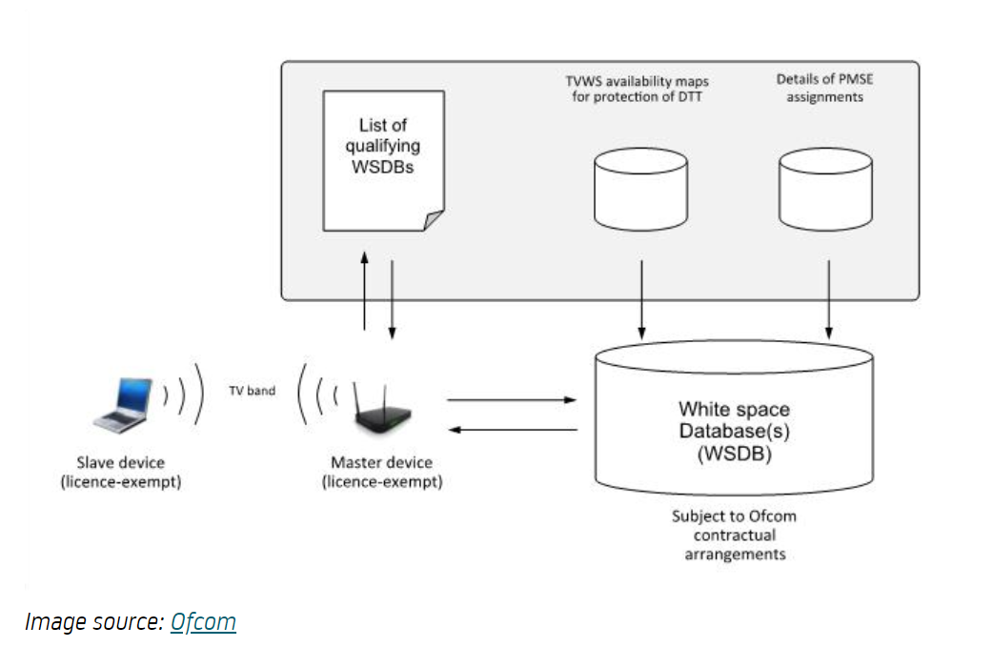
[TV]WS Database Basics

Slide 6
Device Authorization by Database
(Based on Operation in the TV Bands)
The database contains all of the licensed devices, with parameters for calculating their protection contours
The master device has regulatory certification for operation in White Space, and operates with database protection contours
  Its transmit power, along with the contour parameters calculate its specific protection contour
An unlicensed slave device in range of the master device, associates with the master, and asks for permission to operate
The master checks the list of qualifying devices and authenticates if and only if the device is qualified, and provides the operating parameters that will protect the licensed devices
The master checks with the database periodically to ensure there has been no change that would require a channel change

Slide 7
Rethinking White Spaces
The limited expectations for TVWS resulted in a loss of interest in all White Spaces
Based on location and time, there are still vast amounts of White Space, but with technical challenges
  Meeting technical and regulatory challenges has always been an IEEE 802 focus
  The key to rethinking White Spaces is identifying the challenges and meeting them
So what are the challenges?
  Technical: Efficient operation across a wide range of frequencies
  Regulatory: Getting help from regulators to enable use of all White Spaces

Slide 8
Addressing the Technical Challenges
Today’s low cost technologies cannot efficiently address a wide range of frequencies
Radio components such as PAs, LNAs, and antennas are optimized for relatively narrow frequency ranges
Different frequency bands can have different regulatory limits on bandwidth, power, etc.
Breaking the radio out into a separate module can support multiple bands with today’s technologies
  Immediately applicable for last-mile wireless
Technology advances can address WLAN with Wi-Fi-like economies of scale

Slide 9
Basic Architecture & Application

Slide 10
Radio Module Features
Band specific radio, PA, LNA and antenna
  Bandwidth selected for efficiency/cost of RF components
  Selectable efficiency
    For cost reduction – wider bandwidth coverage with a single module at lower efficiency
Memory device with regulatory database information relative to the specific band
  Pre-programmed
  Internet updateable
  Contains MAC parameters for the specific band
Communicates with MAC module
  MAC setup
  Periodic regulatory updates from the Internet
  Checks for energy on white space channels and reports to central database
Optional additional radio for In-Service Monitoring (ISM)

Slide 11
MAC Module Features
Standard 802.11 or 802.22 MAC
Regulatory controls
  Interface with Radio module
    to get MAC parameters for the specific band
    to provide updates to database memory
  Interface with the database via the Internet
    to get database updates
    to relay detected database errors, inaccuracies

Slide 12
Much Work Needed
Only the basic concepts are addressed here
Separation of the radio module will require standards work
To make this workable for low-cost WLAN use, advances are needed
  Frequency adjustable antennas need to be made practical for this application
  Wide-range, efficient approach to LNA, PA design, e.g. multiple selectable components

Slide 13
Addressing the Regulatory Challenges
Far more daunting are the regulatory challenges
  Regulators hesitant to upset the status quo, i.e. fixed allocation of spectrum with traditional protections against interference
  Incumbents resist any sharing, no matter how effective technology is in protecting them from interference
  Incumbents who have paid for spectrum do not want to deal with “freeloaders”
TVWS database proven effective
CBRS database being tested; 6 GHz band sharing will most likely need a database
AI can significantly add to protection of incumbents and effective sharing
IEEE 802.18 will take up this effort

Slide 14
Spectrum Management Future
The spectrum map on the following slide looks very complex, but it is only an extremely small slice of the real map
Digging deeper we see that what is shown does not represent any specific location or any specific time of day
  A nearly infinite set of maps would be needed to show the available spectrum at any location in the U.S.
This problem is the perfect example of how AI can manage the unmanageable
If we are to avoid a spectrum deadlock in the next 20 years, we must change the way it is managed and start now

Slide 15
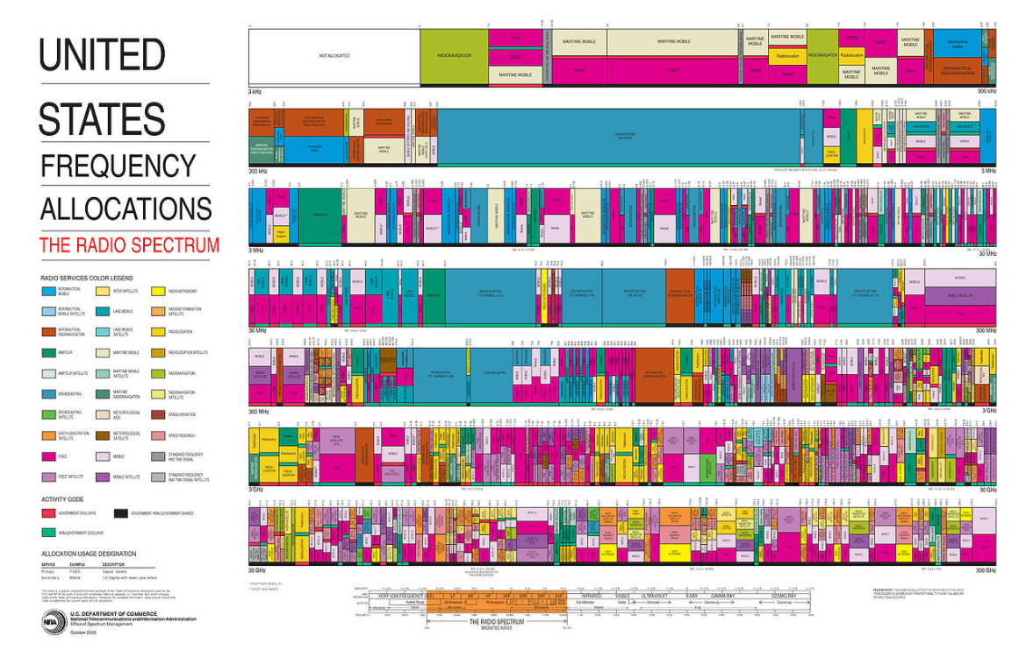
The U.S. Spectrum Map

Slide 16
Straw Poll
Do you believe that a group or groups within IEEE 802 should investigate the feasibility of Multi-band White Space?
  YES
  NO
  More information required to make a decision?

Slide 17
Straw Poll
Which group(s) should do this work?
  802.11?
  802.22?
  Both

Slide 18
Straw Poll
Should IEEE 802 advocate for an AI managed database for spectrum management?
  YES
  NO
  More information required to make a decision?

Slide 19
Questions?

Slide 20
References
FCC
  https://www.fcc.gov/general/white-space
Ofcom
  https://www.ofcom.org.uk/consultations-and-statements/category-1/white-space-coexistence
Microsoft
  http://whitespaces.microsoftspectrum.com/
My documents
  https://www.linkedin.com/pulse/multi-band-white-space-spectrum-access-rich-kennedy/
  https://mentor.ieee.org/802.18/dcn/18/18-18-0060-02-0000-a-future-for-unlicensed-spectrum.pptx

