Slide 1
802.11 for Next Generation V2X Communication
Date: 2018-03-06
Authors:

Slide 3
Abstract
03/06/2018
802.11p is matured and robust for Dedicated Short Range Communications (DSRC).
WLAN standard has evolved after 11p, with many matured technologies (e.g. LDPC, STBC etc).
Leverage the evolution of the 802.11 technologies to future proof 11p/DSRC for new applications for vehicle-to-everything (V2X).
Propose: start a study group to explore a long term roadmap for V2X.

Slide 4
Outline
Review existing technologies
Potential roadmap for new vehicle-to-everything (V2X) applications
Possible next steps

Slide 5
I. Review: 802.11p (WAVE)
802.11p Overview:
Used in rapidly varying communication environments, where the interval of the communication exchanges may be in very short, e.g., on the order of 10s or 100s of milli-seconds.
“V2X” applications: communication between vehicles (V2V), between vehicle and the roadside infrastructure (V2I), or between vehicle to anything on or on the side of the road, while operating at speeds up to a minimum of 200 km/h for communication ranges up to 1 km.

Slide 6
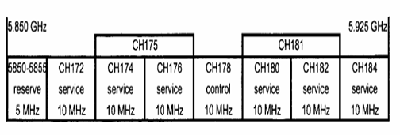
802.11p Channelization
5.9 GHz band in USA (5.850 – 5.925 GHz), i.e., U- U-NII-4; and in Europe (5.855 – 5.925 GHz)
FCC:
Ch. 172: Collision Avoidance Safety
Ch. 184: Public Safety

Slide 7
802.11p PHY/MAC
PHY (BW=10MHz): 2x down clock of 11a
BCC, 1SS
GI=1.6us
3/4.5/6/9/12/18/24/27 Mbps
More stringent ACI/AACI requirements
MAC:
Outside the Context of a BSS (OCB) Transmissions
Timing Advertisement
Limited Frame sizes

Slide 8
Simulation for C2C Safety Applications
Simulation settings:
DSRC 10MHz, 1Tx-1Rx-1SS
V2V radio channel models [1] (and Appendix)
LENGTH: 300B for DSRC safety applications
Rate: QPSK-1/2 for DSRC safety applications
Comparison:
11p with BCC
11ac down-clocked by 2x (DC2x), with LDPC

Slide 9
802.11p robust for DSRC applications
https://www.amazon.com/Kangaroos-Cootie-Catcher-Valentines-28-Count/dp/B078J4HKSY/ref=pd_sim_201_1?_encoding=UTF8&pd_rd_i=B078J4HKSY&pd_rd_r=265NWKPXDMSHPE04A739&pd_rd_w=5pOjD&pd_rd_wg=zk1EZ&psc=1&refRID=265NWKPXDMSHPE
1dB

Slide 10
802.11p robust for DSRC applications
https://www.amazon.com/Kangaroos-Cootie-Catcher-Valentines-28-Count/dp/B078J4HKSY/ref=pd_sim_201_1?_encoding=UTF8&pd_rd_i=B078J4HKSY&pd_rd_r=265NWKPXDMSHPE04A739&pd_rd_w=5pOjD&pd_rd_wg=zk1EZ&psc=1&refRID=265NWKPXDMSHPE
1dB

Slide 11
Comparing other Technologies
802.11p:
Based on 802.11a: robust performance for short packets.
Products ready with actual deployments, extensive interop tests and field trials.
Adopted or being considered by some regions.
Cellular-V2X (C-V2X):
Reusing LTE UL frame structure (Rel 14): require tight frequency and timing synchronizations
Longer symbol and GI durations
Leveraging more recent PHY technologies: e.g. more advanced coding.
Less mature than 802.11p: no extensive field trials/testing so far.
802.11n/ac/ah/ax standards have proven and matured technologies for V2X applications requiring longer packet sizes, higher throughput, larger Doppler and longer range, etc.
A new 802.11 amendment to leverage evolution of 802.11 to future proof 11p/DSRC for V2X applications?

Slide 12
802.11p/V2X Use Cases
V2X:
Collision avoidance: V2V communication can “reduce, mitigate, or prevent 81% of light-vehicle crashes by unimpaired drivers” – US DOT
Traveler information,
Toll collection,
Commercial vehicle operations,
Transit operations,
Traffic management.
Assisted automated driving
Services to Motorists
connecting the vehicle to the Internet, e.g., Email, Internet access and social applications like IM, etc
Connecting devices in and out of vehicles
Complementary to wireless broadband access service

Slide 13
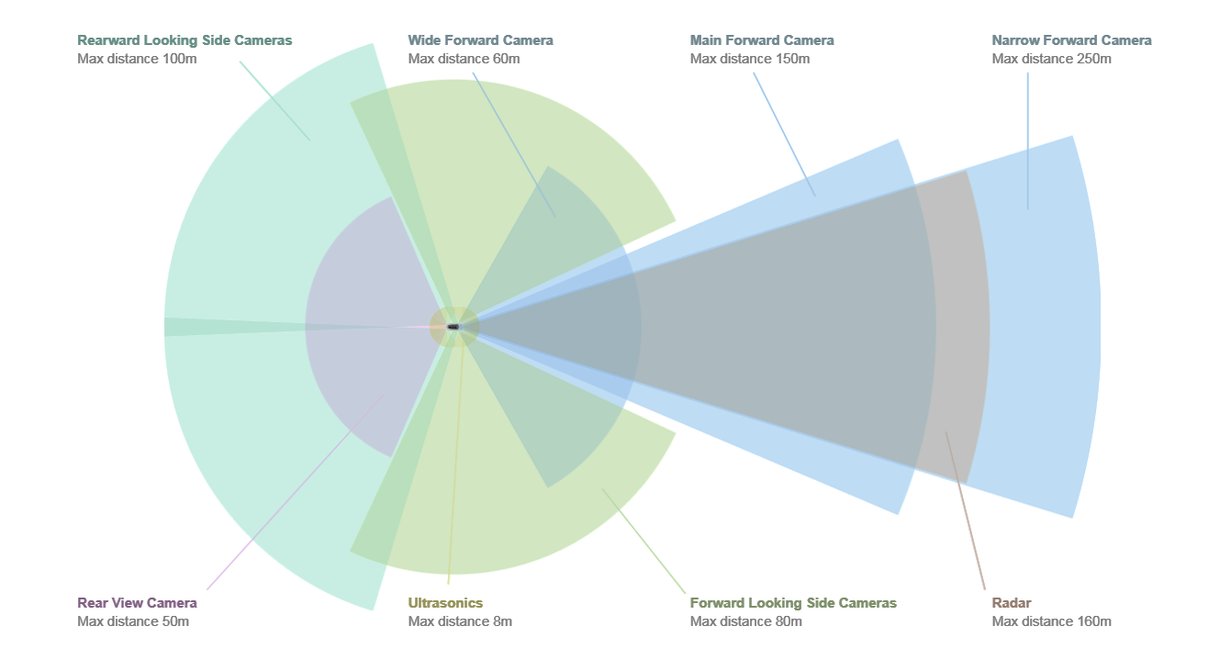
Range Illustration
802.11p

Slide 14
II. Direction for a long term roadmap
“11p is good enough for DSRC” does not mean we should stop its roadmap for future proof:
802.11 PHY has evolved after 802.11p amendments, with proven technologies, e.g. advanced coding, varying symbol/GI durations, higher data rates, longer range and better high Doppler performance.
It is natural to adopt some recent 802.11 technologies for new V2X applications, e.g. for higher throughput applications, and/or better reliability/efficiency.
Backward compatible with 802.11p.
New design requirements from existing field trials may also be addressed.
Other industry forum also considering 11p extension [2]

Slide 15
Example-1: OFDM Numerology Study
To study the most appropriate OFDM numerology for V2X scenario.
Example: Tone spacing, GI durations/Options.
May leverage outcomes from 11p field trials.

Slide 16
Example-2: Advanced PHY Technologies
To study the usage of more advanced PHY technologies in amendments after 802.11p, some examples:
LDPC Coding (11n and after – deployed in products today)
STBC (11n and after – deployed in products today)
MIMO (11n and after – deployed in products today)
Range Extension (11ax)
DCM (11ax)
Mid-amble (11ax Draft2.0): especially if LDPC is used.
Better not have any optional feature—OCB based traffic

Slide 17
Performance example
Simulation settings:
DSRC 10MHz, 1Rx-1SS
V2V radio channel models [1] (and Appendix)
LENGTH: 1KB for higher throughput applications
Rate: 64QAM-2/3 for higher throughput applications
Comparison:
11p with BCC
11ac down-clocked by 2x (DC2x), with LDPC, STBC (with 2 Tx and normalized power), mid-amble with period 4 symbols (just an example)

Slide 18
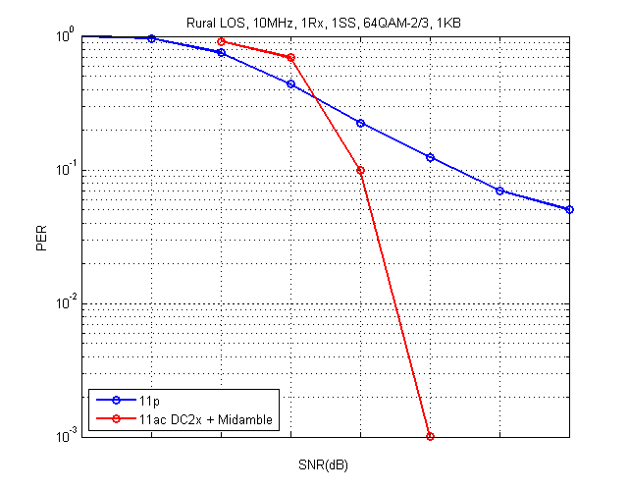
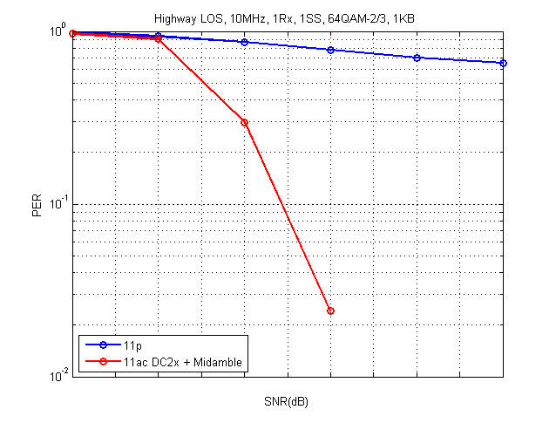
Potential Improvement for high-throughput Applications
Rural LOS
Highway LOS
1dB

Slide 19
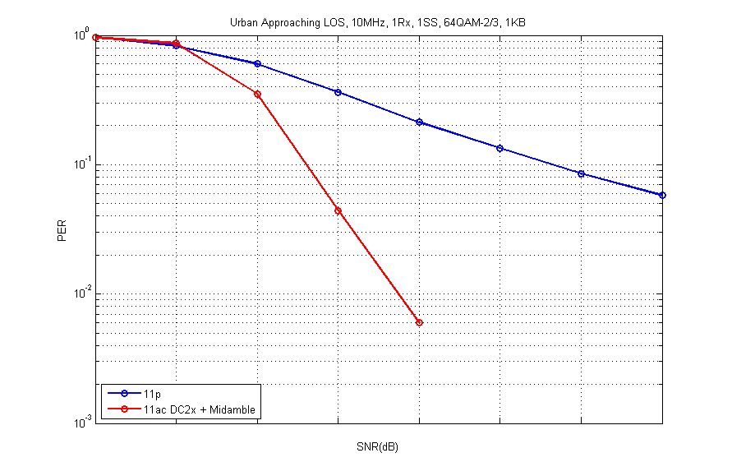
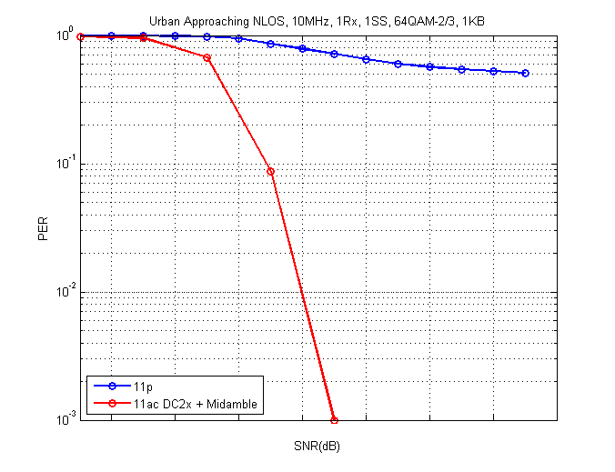
Potential Improvement for high-throughput Applications
Urban Approaching NLOS
Urban Approaching LOS
1dB

Slide 20
Example 3: Possible MAC Direction
Coex between 11p and the new PHY in V2V and V2I scenarios.
Frame Compression
Collision Reduction in (Urban) dense scenario
Congestion control

Slide 21
Possible Design Goals
New use cases
Higher Reliability: improved sensitivity under high Doppler outdoor multi-path channels.
Longer Range
Better PHY/MAC efficiency/higher throughput:
Reduce the effective PPDU length, therefore reduce packet collisions in busy urban roads, and improve performance under high Doppler.
Backward compatible with 11p.
Others?

Slide 22
III. Possible Next Steps
While 802.11p performs well in safety applications, it is not a reason to stop its evolution.
While LTE C-V2X claims their roadmap of evolution along with 3GPP is an advantage over 802.11p for “future proof”, 802.11 standards has also evolved.
Advantageous for 11p/DSRC to have a long term evolution roadmap to future proofing, with backward compatibility with 11p.
A possible 802.11 amendment? --Scope (open for discussion):
More reliable V2X communications with higher throughput
At least one mode that achieves longer range than 802.11p amendment, in the same high Doppler environment.
Same 5.9GHz band as 802.11p amendment.
A new SG?
PAR/CSD, use cases, channel models, technology feasibilities
Timeline: may be shortened by leveraging PHY and MAC technologies already in existing 802.11 amendments.

Slide 23
Conclusion
Two Main Messages:
802.11p is matured and robust for DSRC applications.
Develop a long-term evolution roadmap to future proof 11p/WLAN for V2X, while maintaining backward compatibility to 11p.
May leverage WLAN standards recent evolvement with other matured PHY/MAC technologies for higher throughput, longer range etc.
Call for Next Steps – study group

Slide 24
References
Kahn, Malik, “IEEE 802.11 Regulatory SC DSRC Coexistence Tiger Team V2V Radio Channel Models,” IEEE 802.11-14/0259r0.
Jérôme Härri (EURECOM), Matthias Alles (CREONICS), Friedbert Berens (FBConsulting), “ IEEE 802.11p Extension Roadmap,” Car 2 Car COM/ARCH, 11/29/2017.

Slide 25
Strawpoll
Do you support the formation of a new 802.11 Study Group to develop PAR and CSD for next generation WAVE technologies?

Slide 26
Appendix: C2C channels

Slide 27
Scenario Descriptions
Rural LOS: Intended primarily as a reference result, this channel applies in very open environments where other vehicles, buildings and large fences are absent.
Highway LOS: Two cars following each other on Multilane inter-region roadways such as Autobahns. Signs, overpasses, hill-sides and other traffic present.
Slide 27

Slide 28
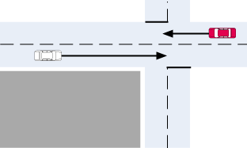
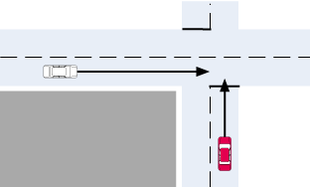
Scenario Descriptions
Urban Approaching LOS: Two vehicles approaching each other in an Urban setting with buildings nearby.
Street Crossing NLOS (Urban Approaching NLOS): Two vehicles approaching an Urban blind intersection with other traffic present. Buildings/fences present on all corners.
Slide 28

Slide 29
Channel Model Values
 | Tap1 | Tap2 | Tap3 |  | Units
Power | 0 | -14 | -17 |  | dB
Delay | 0 | 83 | 183 |  | ns
Doppler | 0 | 90 | -54 |  | Km/h
 | Tap1 | Tap2 | Tap3 | Tap4 | Units
Power | 0 | -10 | -15 | -20 | dB
Delay | 0 | 100 | 167 | 500 | ns
Doppler | 0 | 126 | -90 | 162 | Km/h
Table 1: Rural LOS Parameters
Table 2: Highway LOS Parameters
 | Tap1 | Tap2 | Tap3 | Tap4 | Units
Power | 0 | -8 | -10 | -15 | dB
Delay | 0 | 117 | 183 | 333 | ns
Doppler | 0 | 43 | -29 | 90 | Km/h
 | Tap1 | Tap2 | Tap3 | Tap4 | Units
Power | 0 | -3 | -5 | -10 | dB
Delay | 0 | 267 | 400 | 533 | ns
Doppler | 0 | 54 | -18 | 108 | Km/h
Table 3: Urban Approaching LOS Parameters
Table 4: Street Crossing NLOS Parameters

