Slide 1
LiFi: Concept, Use-cases and Progress
Date: 2016-05-10
Authors:

Slide 2
Abstract
The exponential demand for wireless communications, estimated at over 70% CAGR, is set to continue. The electromagnetic spectrum is becoming increasingly crowded and alternative, unlicensed mediums are being explored.
Light offers a completely unlicensed and very well understood medium for wireless communications. The use of light to provide high speed, bidirectional and networked wireless communications is named LiFi.

Slide 3
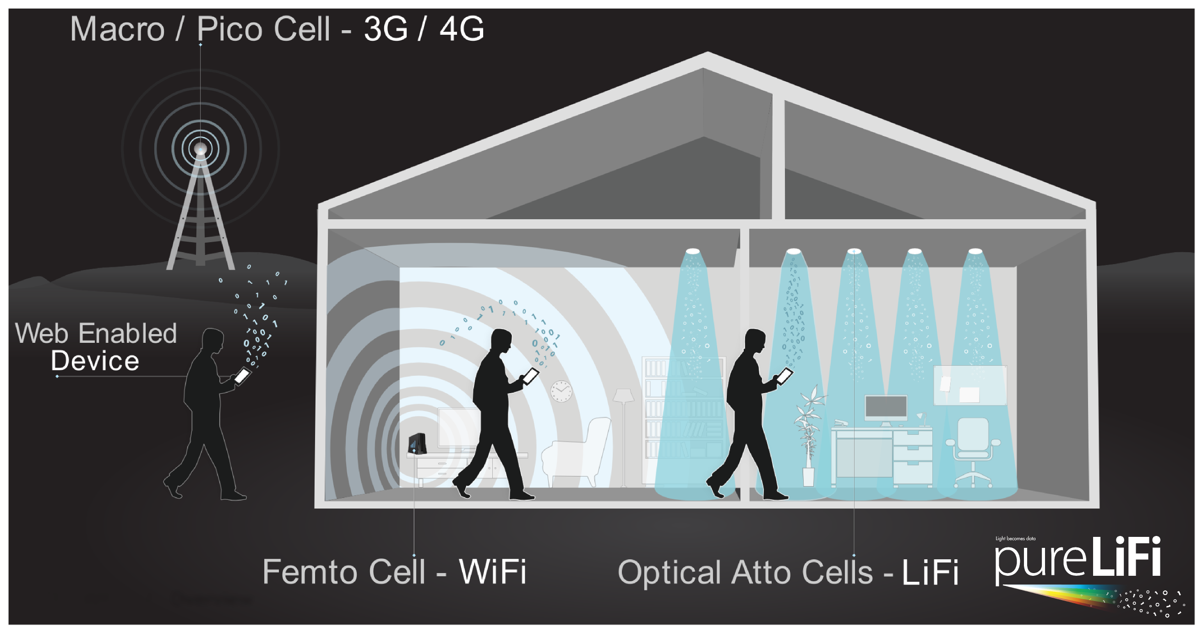
What is LiFi?

Slide 4

LiFi: Competitive Advantages
Security
Safety
Localization
Data density
No Regulatory Constraints – Globally Unlicensed

Slide 5
Capacity
There are capacity bounds defined by Shannon’s Theory
OWC Channel not a Gaussian (non-negative, real-valued signal with an Average Power Constraint), but can be modeled to be similar
There is an upper bound (You/Kahn 2002)
  DCO-OFDM + Good Coding
  Improved waveform
    U-OFDM
    ACO-OFDM

Slide 6
Capacity
There are capacity bounds defined by Shannon’s Theory
OWC Channel not a Gaussian (non-negative, real-valued signal with an Average Power Constraint), but can be modeled to be similar
There is an upper bound (You/Kahn 2002)
  DCO-OFDM + Good Coding
  Improved waveform
    U-OFDM
    ACO-OFDM

Slide 7
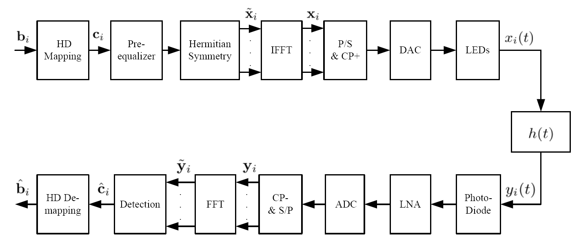
Optical OFDM
Sym.
Map
No Up-conversion
Sym.
DE-Map
TIA

Slide 8
No Up-Conversion = Baseband Modulation
Incoherent Modulation
The Baseband signal is modulated by changing the Intensity of the Light
The Baseband signal is detected by measuring Directly Detecting the light intensity
“Morris Code” 2.0
Wavelength Division Multiplexing to utilize the entire Light Spectrum

Slide 9

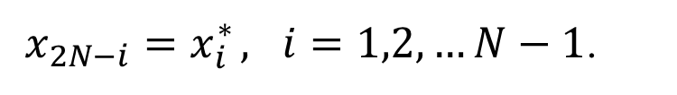
DC-biased Optical-OFDM
$x_{2N−i}=x_{i}^{∗} , i=1,2,…N−1$.
$$x_{0}^{}$$
is the DC biased

Slide 10
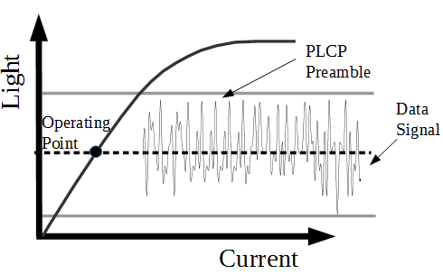
DC-biased Optical-OFDM

Slide 11
Unipolar Optical-OFDM

Slide 12
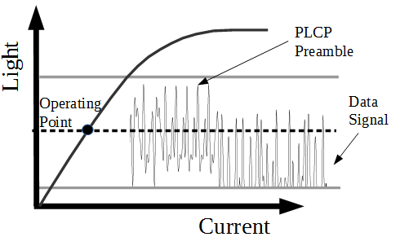
Unipolar Optical-OFDM

Slide 13
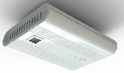
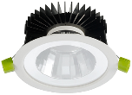
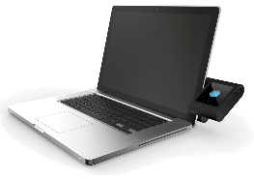
The Architecture
Gateway
DHCP Server
Switch
Power & Data

Slide 14
Energy Efficiency
Computational Efficiency
  Proposed protocols have similar computational complexity to existing communication protocols such as 802.11 g/n/ac PHYs
  Detailed specifications for a proposal can be found:
    https://mentor.ieee.org/802.15/dcn/16/15-16-0363-00-007a-text-input-lifi-low-bandwidth-phy-and-mac-d0.docx
    https://mentor.ieee.org/802.15/dcn/16/15-16-0356-01-007a-text-input-for-high-bandwidth-phy.zip
Availability of Energy
  Lighting is already present and consuming power
Electromagnetic Radiated power
  Smaller wavelength of light means it requires more energy to achieve the same distance

Slide 15
IR vs. VLC
Time has changed the key factors for this technology:
  Components
  Constraints
  Use-cases
Technology
  High power devices can be produced with VL (regulation/health&safety)
  IR receiver technology is more developed today
  Optical OFDM
  Networking (Handover & Multiple Access)

Slide 16
Security
Cyber
  Use of existing 802.1x capabilities
Physical
  Light signals power degrades quicker than any other RF signal.
  Confined, clearly visible coverage area
  Intuitive

Slide 17
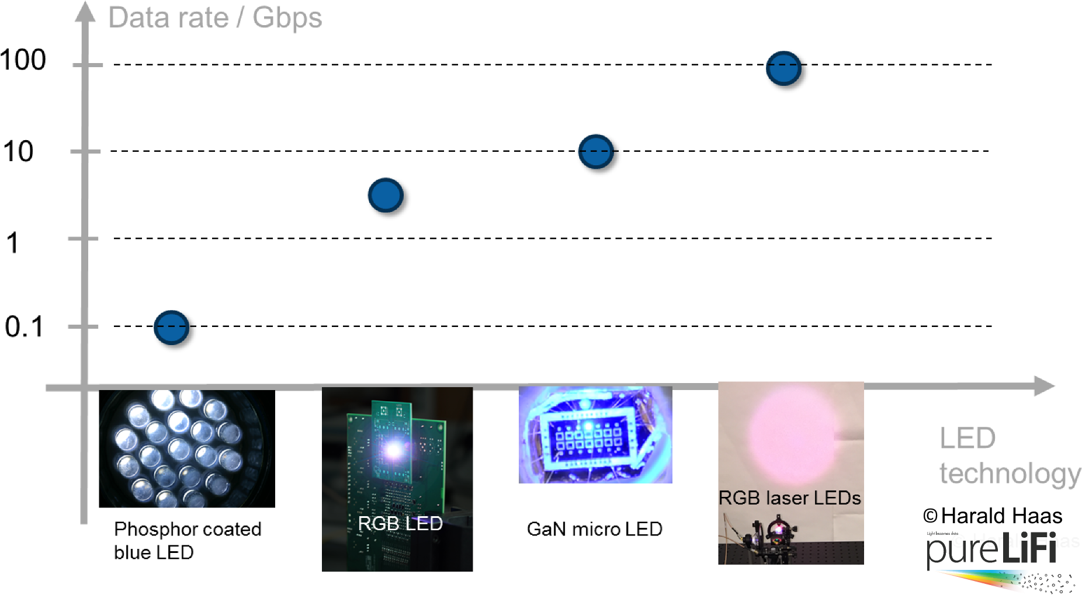
Emitter Technology

Slide 18
Receiver Technology
Data Rate / Gbps
100
Research
10
1
0.1
Solar-cells
PIN Photo-Diode
(PD)
Avalanche PD
(APD)
Single-photon APD
(SPAD)

Slide 19
Impact of LiFi on CRI & Lifetime of LEDs
“Provided adequate thermal management is used, the average drive current dictates the emitted light quality (CRI, CCT and chromaticity) but not the instantaneous drive current. Hence to preserve the expected light quality of LEDs used for LiFi, the modulating signal must be balanced.”
  W. O. Popoola, “Impact of VLC on Light Emission Quality of White LEDs,” Journal of Lightwave Technology, Vol. 34, No. 10, May15, 2016.

Slide 20
802.11 vs. LiFi
 | 802.11 | LiFi
Medium | RF | Light
Signal Modulation | Coherent | IM/DD
Duplex | Half (Full ?) | Full
Hidden Node | Rarely Occurs | By Design CSMA/CA does not work

Slide 21
Co-existence

Slide 22

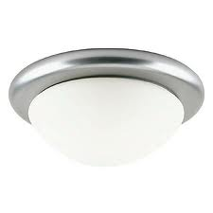

Co-existence
Network
VLC offloading WLAN and/or cellular traffic in a 3-tier HetNet
RF for uplink
Data aggregation in RF and/or optical
Seamless connectivity in a mobile multiuser access scenario
Gigabit applications while supporting:
Illumination functionality
  Color tunable
  Dimmable
High quality lighting
  CCR
  CRI
Router and WiFi AP
RF
Optical
User 1
Cell 1
Cell 2
Handover

Slide 23
Co-existence

Slide 24
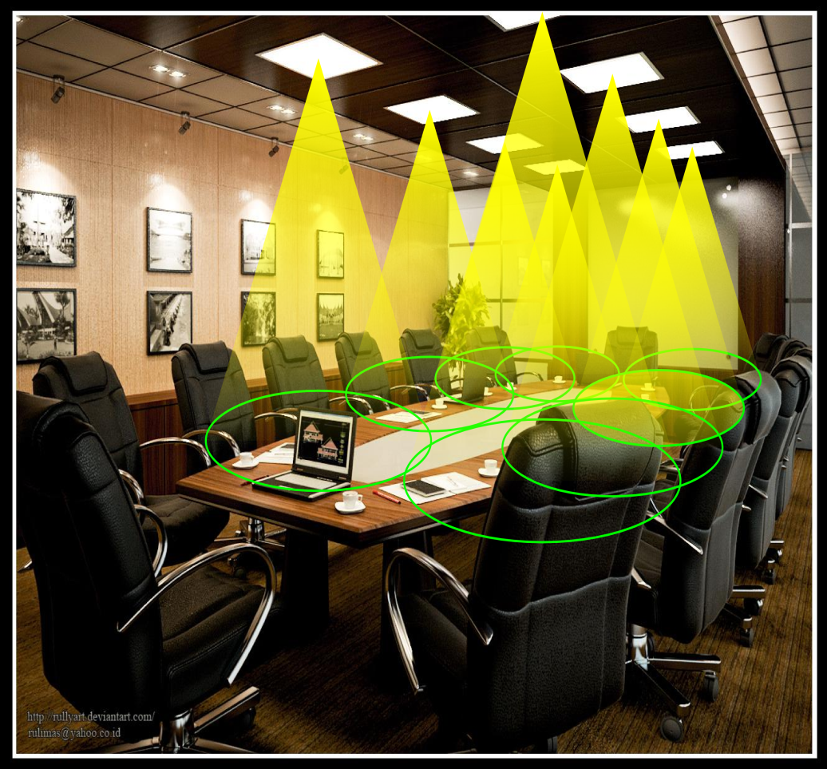
The LiFi Optical Atto-cell Network
Cellular network in a room: optical atto-cell network.
Each light functions as a base station covering a very small area (typically 1-10 m²).
Inherent properties of light reduce interference:
  No signals outside the room
  Easy beamforming with optics
  Enhanced security

Slide 25
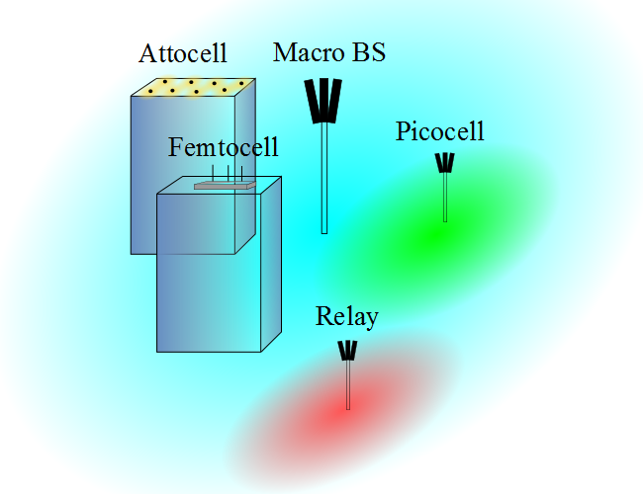
Het. Nets = Small Cells
I. Stefan, H. Burchardt, and H. Haas, “Area spectral efficiency performance comparison between VLC and RF femtocell networks,” ICC, 2013.

Slide 26
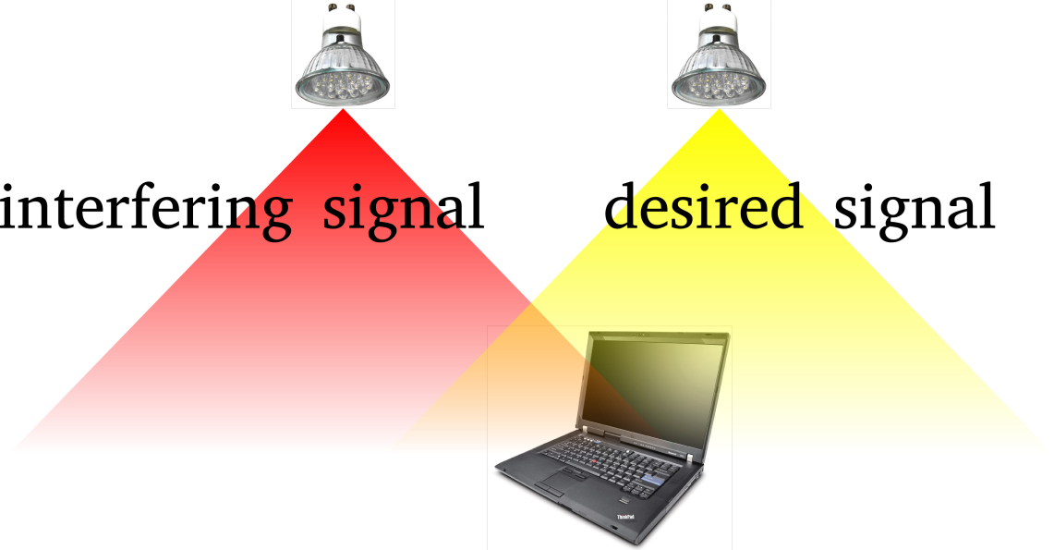
Interference Coordination in VLC
Spectrum reuse leads to co-channel interference (CCI).
Interference coordination techniques in OW:
  Traditional static resource partitioning [2]
  Busy-burst-signalling-based interference-aware resource allocation [3]
  Fractional frequency reuse [4].
[2] G. W. Marsh, J. M. Kahn, “Channel Reuse Strategies for Indoor Infrared Wireless Communications,” IEEE Trans. on Commun., 1997.
[3] B. Ghimire and H. Haas, “Self Organising Interference Coordination in Optical Wireless Networks,” in EURASIP Journal on Wireless Communications and Networking, 2012.
[4] C. Chen, et. al., “ Fractional frequency reuse in optical wireless networks,” in PIMRC, 2013.

Slide 27
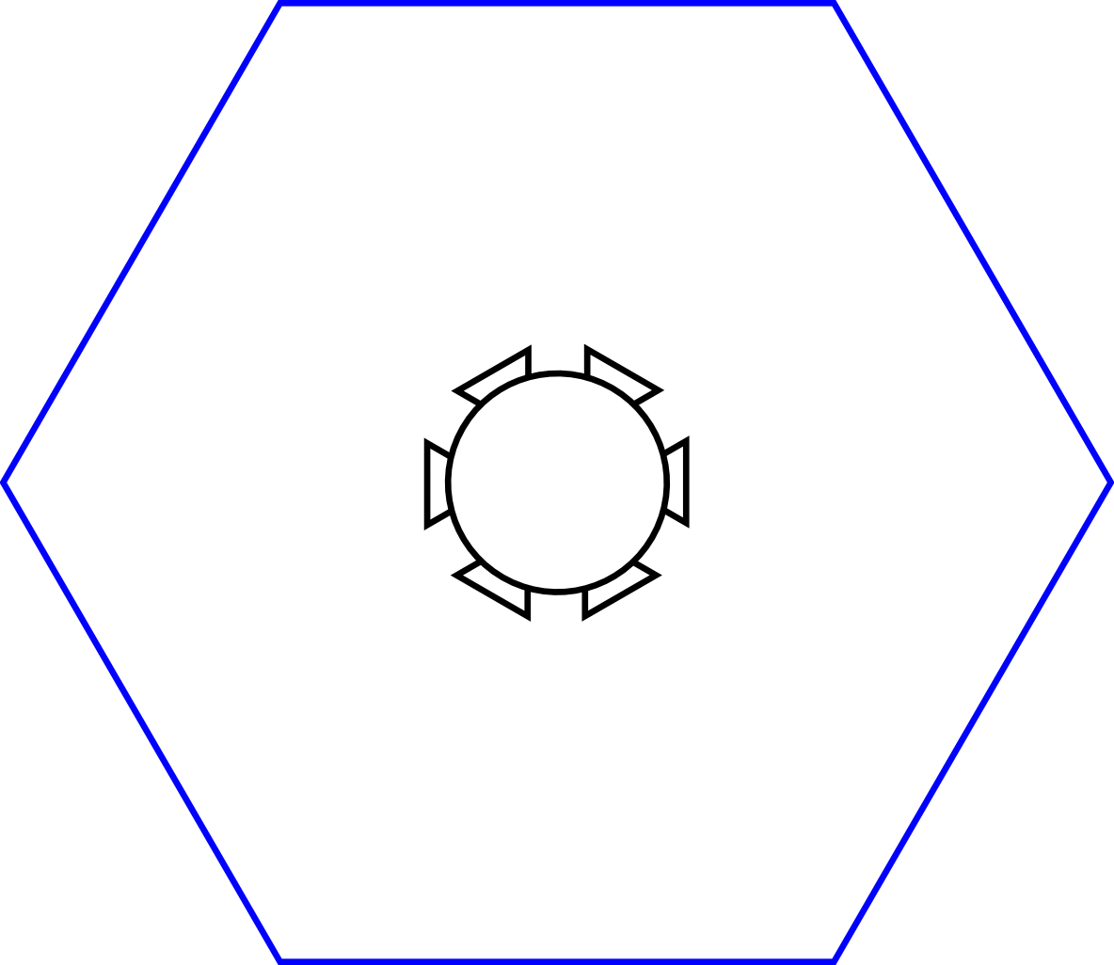
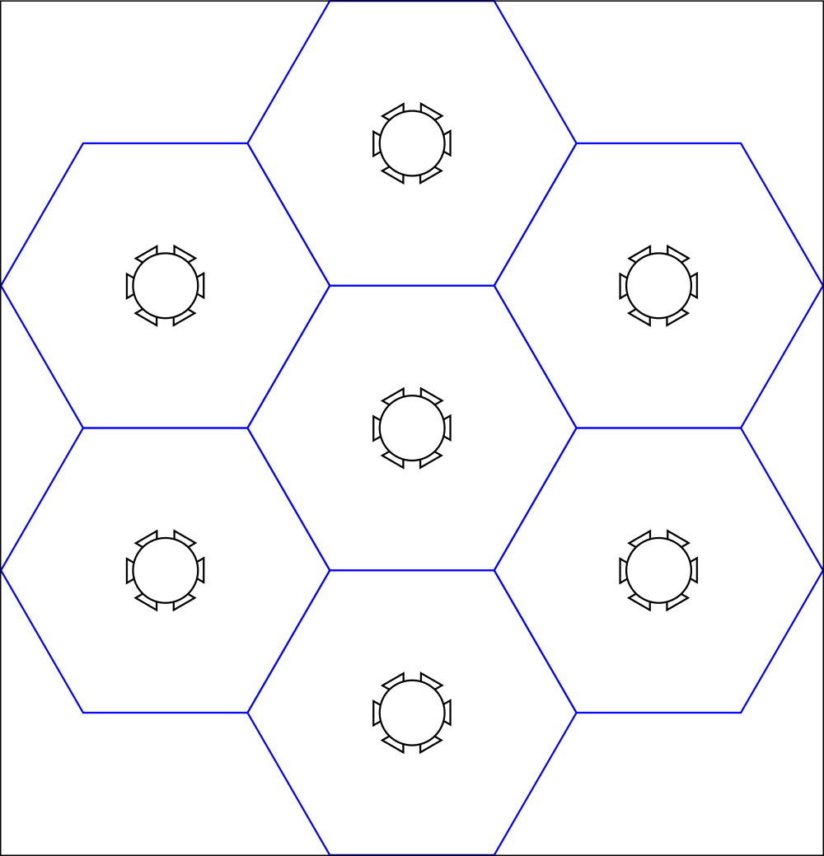
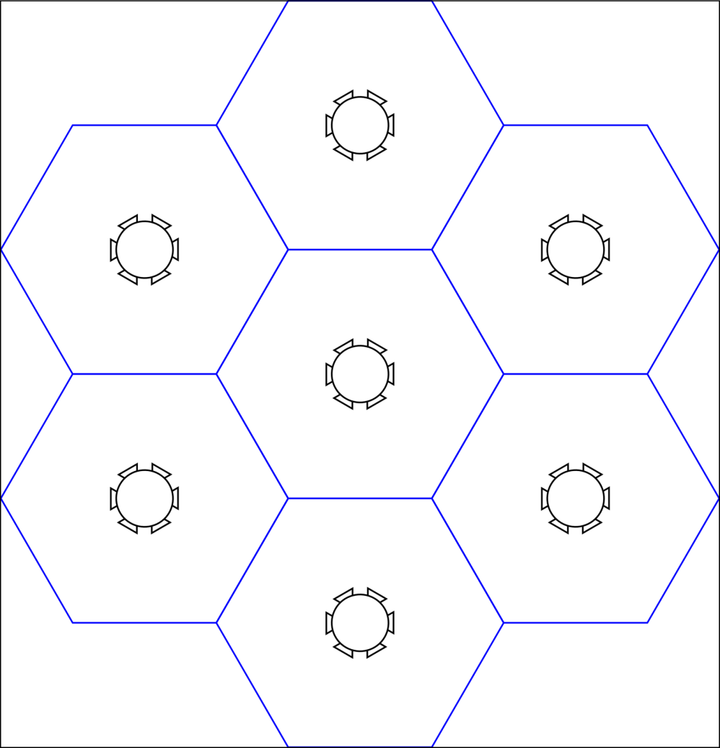
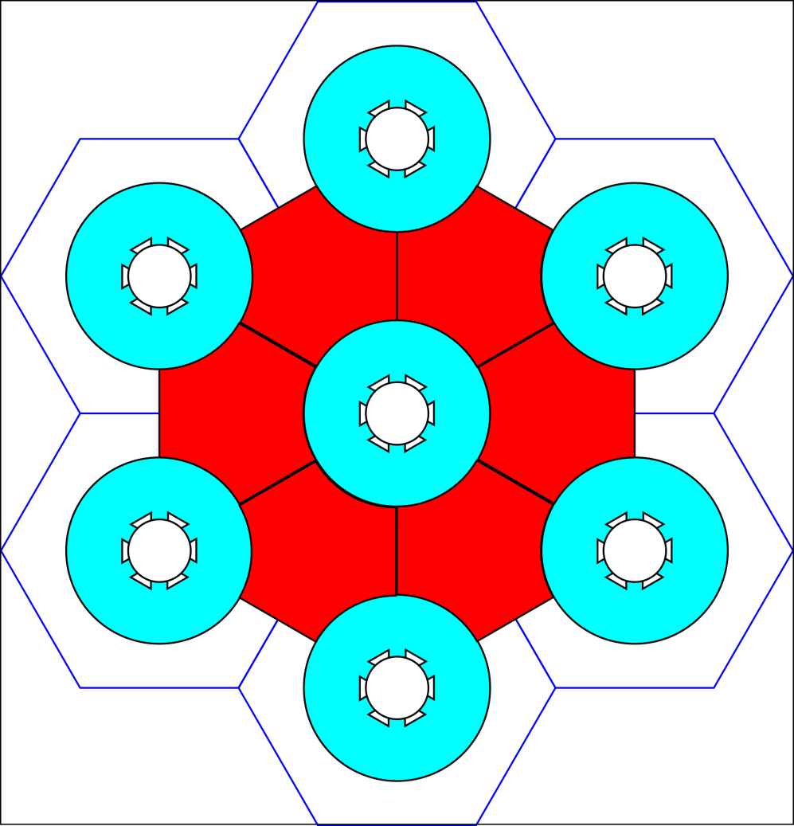
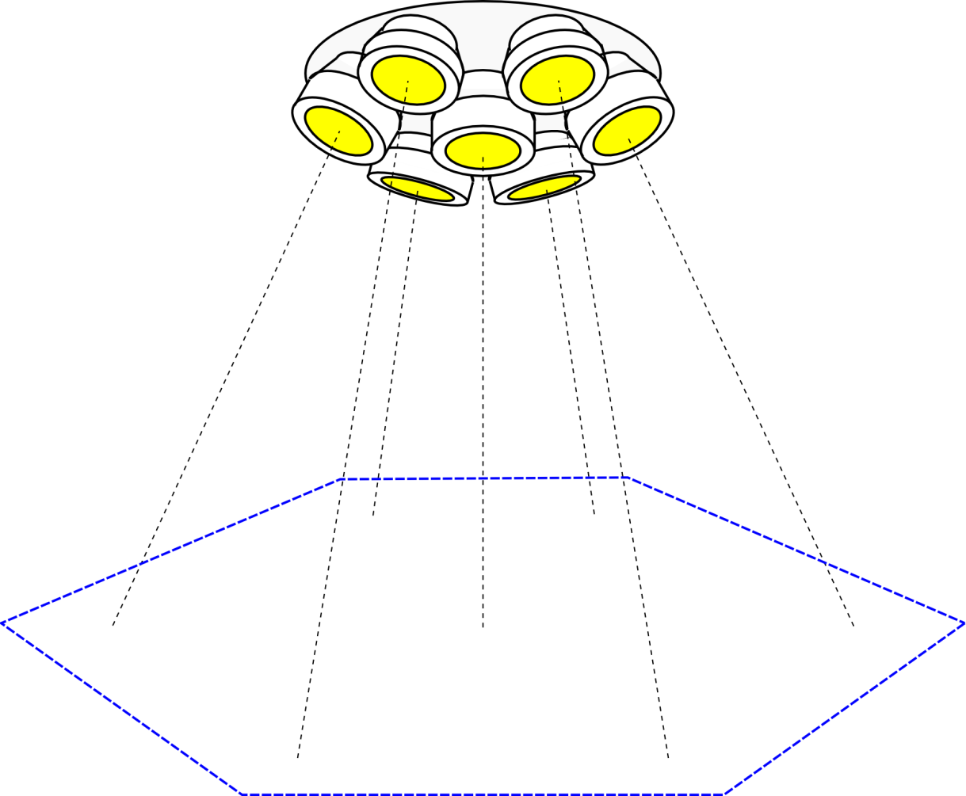
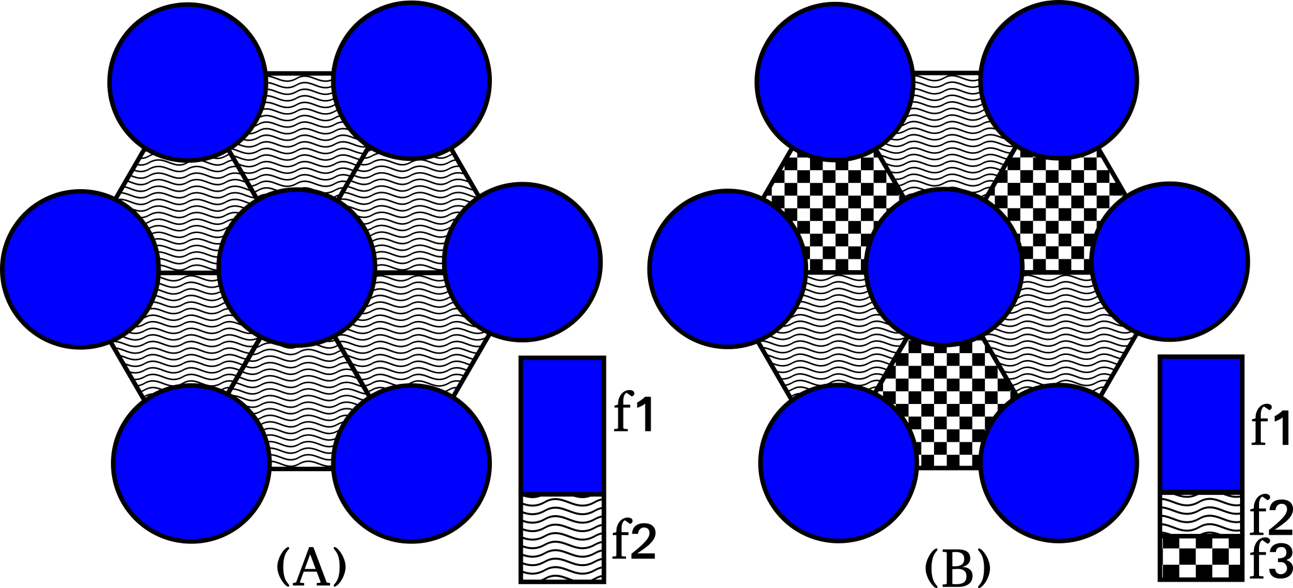
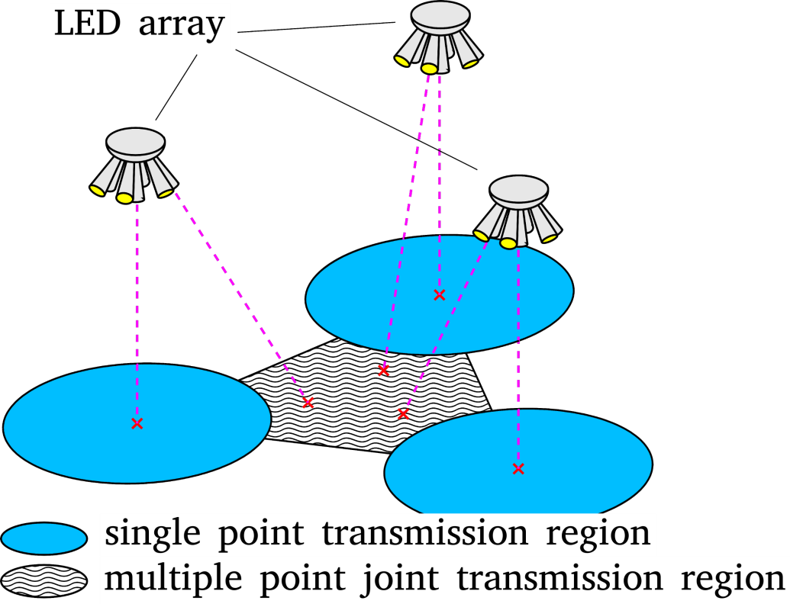
Joint Transmission in VLC
LED array design:
VLC Downlink network:
Transmission region division:
Frequency plan:

Slide 28
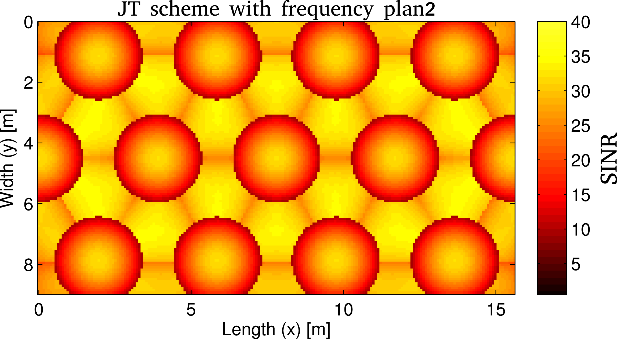
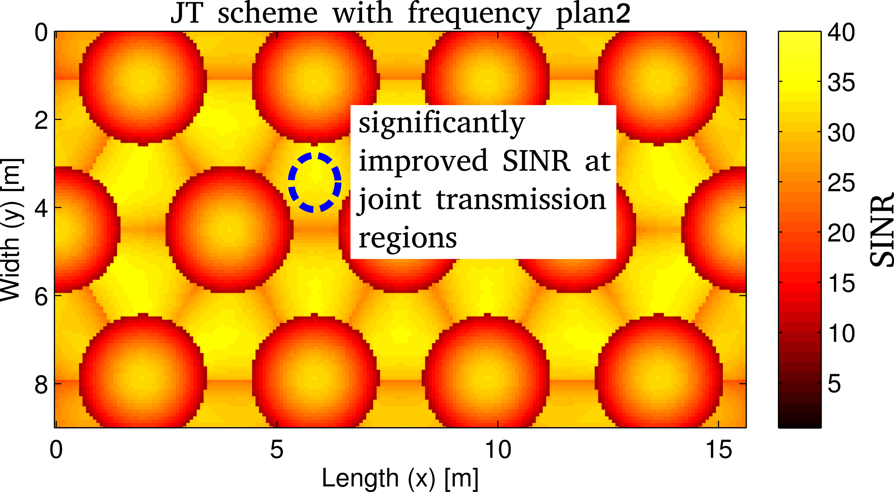
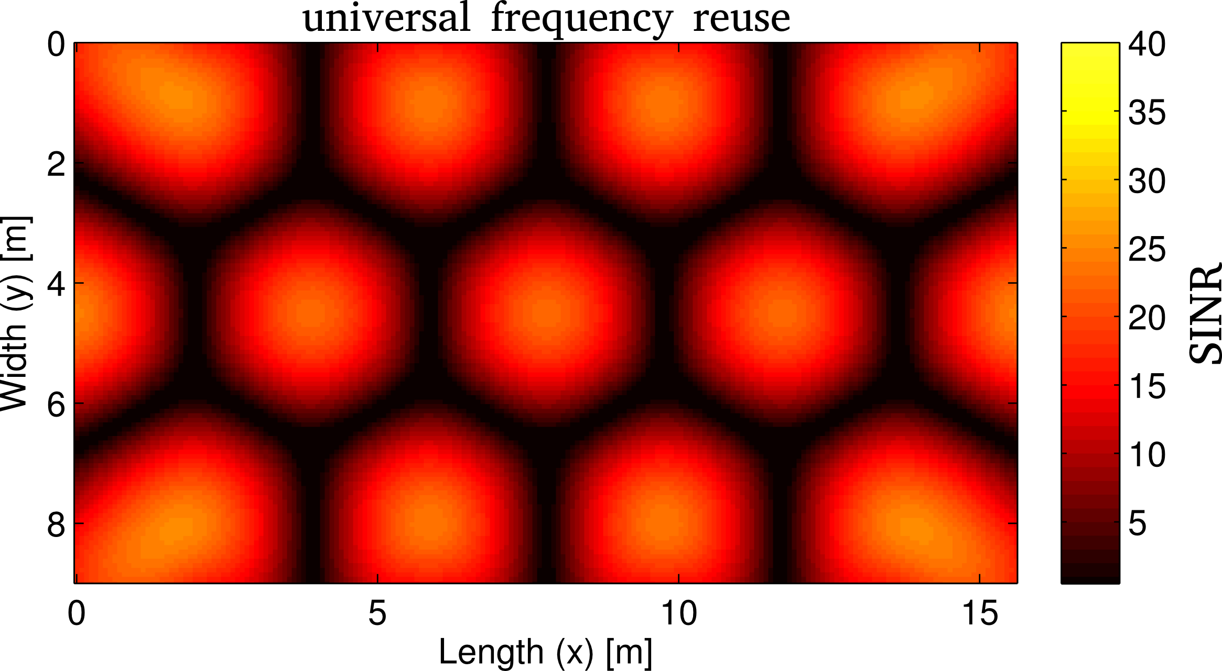
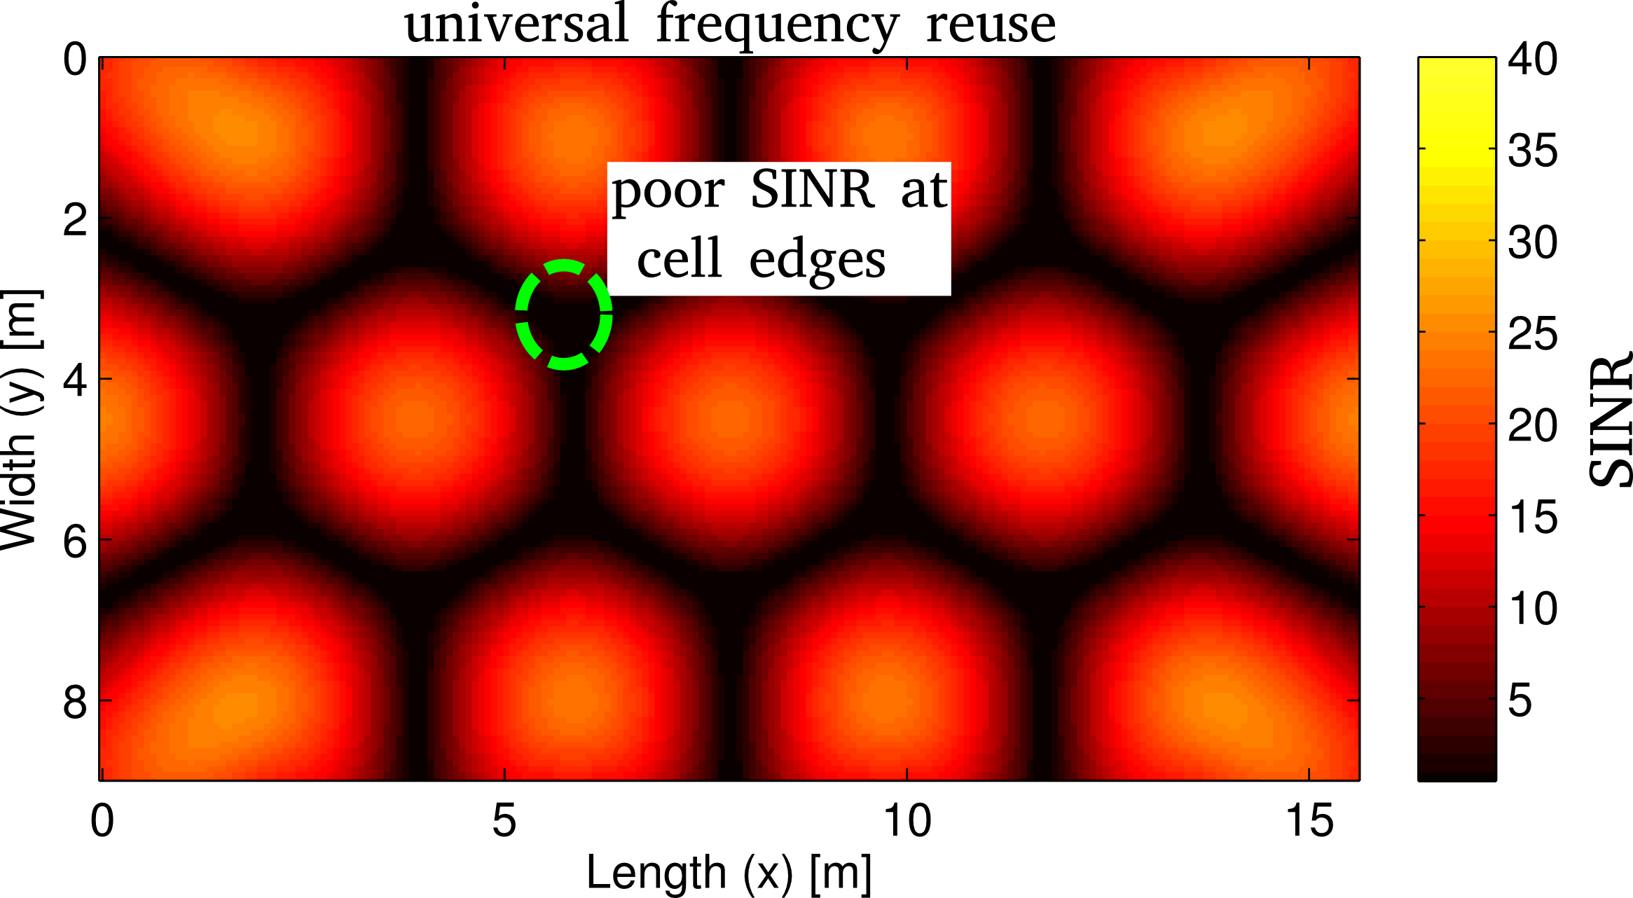
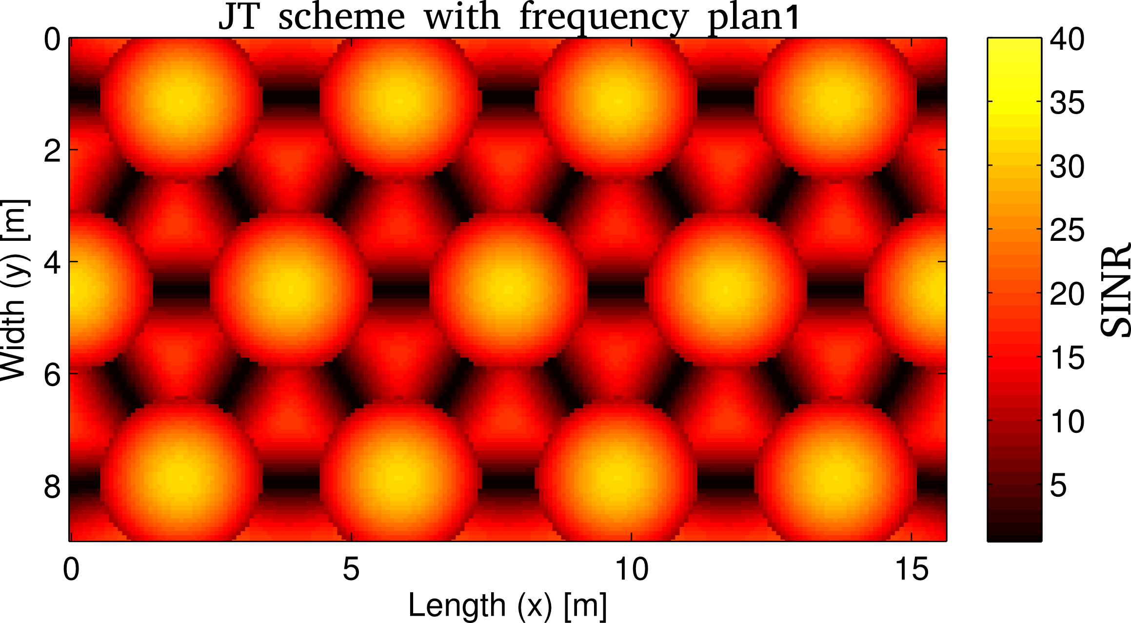
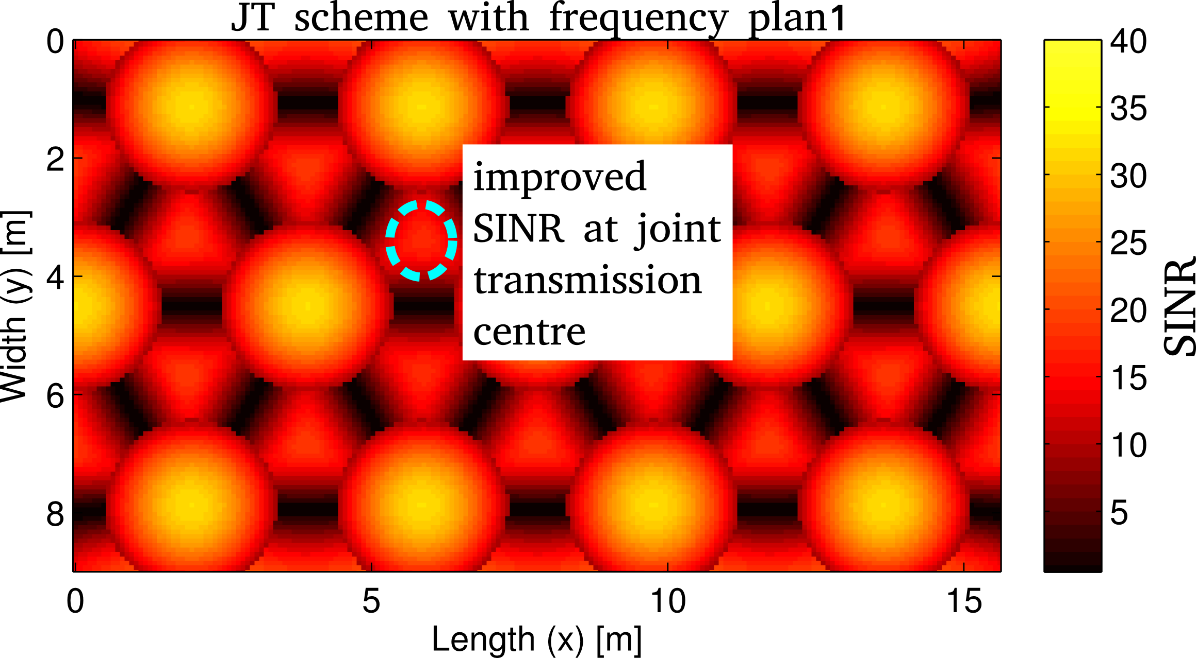
Simulation Results
Signal to Interference plus Noise Ratio (SINR):

Slide 29
References
I. Stefan, H. Burchardt, and H. Haas, “Area spectral efficiency performance comparison between VLC and RF femtocell networks,” ICC, 2013.
G. W. Marsh, J. M. Kahn, “Channel Reuse Strategies for Indoor Infrared Wireless Communications,” IEEE Trans. on Commun., 1997.
B. Ghimire and H. Haas, “Self Organising Interference Coordination in Optical Wireless Networks,” in EURASIP Journal on Wireless Communications and Networking, 2012.
C. Chen, et. al., “ Fractional frequency reuse in optical wireless networks,” in PIMRC, 2013.
H. Haas, L. Yin, Y. Wang, and C. Chen, "What is LiFi?," in Journal of Lightwave Technology , vol.PP, no.99, 2016
C. Chen, D. A. Basnayaka, and H. Haas, "Downlink Perormance of Optical Attocell Networks," in IEEE Journal of Lightwave Technologies, vol. 34, no. 1, pp. 137-156, Jan. 2016.
Dobroslav Tsonev, Stefan Videv, and Harald Haas, "Towards a 100 Gb/s visible light wireless access network," Opt. Express 23, 1627-1637 (2015)
M. Ayyash, H. Elgala, A. Khreishah, V. Jungnickel, T. Little, S. Shao, M. Rahaim, D. Schulz, Coexistence of WiFi and LiFi towards 5G: Concepts, Opportunities, and Challenges, IEEE Communiations Magazine, Optical Communications Series, vol. 54, no. 2, pp. 64-71, February 2016.
Yunlu Wang and Harald Haas, “Dynamic Load Balancing with Handover in Hybrid Li-Fi and RF Networks”, Journal of Lightwave Technology, vol. 33, no. 22, pp.4671-4682, 2015.

