Slide 1
Low-Power Wake-Up Receiver (LP-WUR) for 802.11
Date: 2015-11-10
Authors:

Slide 2
Abstract
This presentation introduces a low-power wake-up receiver (LP-WUR) design that enables low power consumption and low latency for 802.11.

Slide 3
Problem: Escaping the Duty-Cycle Trap
With duty-cycled operation, low power consumption and low latency are conflicting goals
To increase battery life, a device needs to sleep more → increased latency
To receive data with low latency, a device needs to sleep less → shorter battery life
Low latency
(but short battery life)
Goal
Sleep less
battery
life
Sleep more
Long battery life
(but long latency)
latency

Slide 4
Problem: Internet-of-Things (IoT) Use Case
Today without LP-WUR
User cannot access the IoT device while the IoT device is off to save power
Internet
Waits until IoT device wakes up
(worst case = 1 hour)
Access Point
Access Point
command
User
Configuration change command
(e.g. collect data every 10 min)
IoT device
ON
OFF
(wakes up every 1 hour)

Slide 5
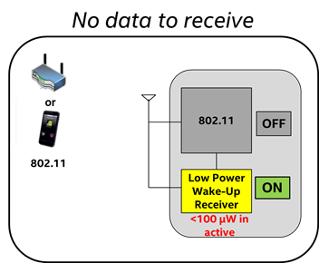
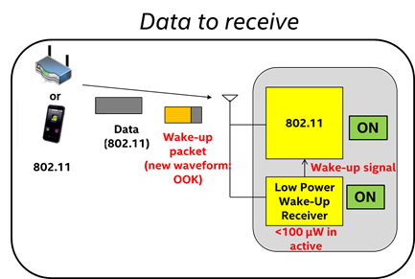
Solution: Low-Power Wake-Up Receiver (LP-WUR) as Companion Radio for 802.11
Comm. Subsystem = Main radio (802.11) + LP-WUR
Main radio (802.11): for user data transmission and reception
Main radio is off unless there is something to transmit
LP-WUR wakes up the main radio when there is a packet to receive
User data is transmitted and received by the main radio
LP-WUR: not for user data; serves as a simple “wake-up” receiver for the main radio
LP-WUR is a simple receiver (doesn’t have a transmitter)
Active while the main radio is off
Target power consumption < 100 µW in the active state
Simple modulation scheme such as On-Off-Keying (OOK)
Narrow bandwidth (e.g. < 5 MHz)
Target transmission range: LP-WUR = Today’s 802.11

Slide 6
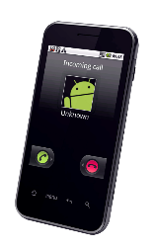
Design and Operation of LP-WUR
Transmission range
or
Data
Packet
802.11 = LP-WUR
Transmitter
Receiver
802.11
802.11
802.11
802.11
ON
OFF
OFF
+
ON
802.11
Wake-up Packet
Wake-up signal
LP-WUR
ON
Wake-up Packet
Extremely low power receiver design (< 100 uW)
- Small and simple OOK demodulator
802.11 preamble for coexistence
Use L-SIG to protect the packet
This is for 3rd party legacy stations
This is not decoded by LP-WUR
(L-SIG: legacy SIGNAL field)
Payload modulated with On-Off Keying (OOK)
Payload = [Wakeup preamble | MAC header (Receiver address) | Frame body | FCS]
OOK modulation can be done using OFDM transmitter with modification (OFDM: orthogonal frequency division multiplexing; FCS: frame check sequence)

Slide 7
IoT Use Case
Proposed scheme using LP-WUR
User can access the IoT device with low latency and the IoT device can have long battery life
Internet
Access Point
Access Point
command
Wake-up Packet
User
Configuration change command
(e.g. collect data every 10 min)
IoT Device
OFF
ON
(wakes up every 1 hour)

Slide 8
LP-WUR Designs from University and Industry
Publications | Frequency (GHz) | Modulation | Power (µW) | Sensitivity (dBm) | Rate (kbps) | Tech CMOS (nm) | Active area (mm²)
CICC [2007] – UC Berkeley | 1.9 | OOK | 65 | -50 | 40 | 90 | 0.16
ISSCC [2008] – UC Berkeley | 2 | OOK | 52 | -72 | 100 | 90 | 0.1
VLSI[2014] – Panasonic | 0.925 | OOK/FSK* | 45.5 | -87 | 50 | 65 | 1.27
JSSC[2014] - IMEC | 0.78-0.915 | OOK | 123 | -86 | 10 | 90 | 1.27
*) FSK: frequency-shift keying
References:
CICC [2007] : N. Pletcher, S. Gambini, and J. Rabaey, “A 65μW, 1.9 GHz RF to Digital Baseband Wakeup Receiver for Wireless Sensor Nodes,” IEEE Custom Integration Circuits Conference (CICC), 2007.
ISSCC [2008]: N. Pletcher, S. Gambini, and J. Rabaey, “A 2 GHz 52 μW Wake-Up Receiver with -72 dBm Sensitivity Using Uncertain-IF Architecture,” IEEE International Solid-State Circuits Conference, 2008.
VLSI [2014]: T. Abe, and et. al., “An Ultra-Low-Power 2-step Wake-Up Receiver for IEEE 802.15.4g Wireless Sensor Networks”, Symposium on VLSI Circuits Digest of Technical Papers,” 2014.
JSSC[2014]: X. Huang, and et. al., “A 780-950 MHz, 64-146 μW Power-Scalable Synchronized-Switching OOK Receiver for Wireless Event-Driven Applications,” IEEE Journal of Solid-State Circuits, Vol.49, No.5, May 2014.

Slide 9
Usage Model 1: Quick Message/Incoming Call Notification Scenario
(1) Without LP-WUR
(2) With LP-WUR
Internet
Internet
AP buffers data until the client wakes up
message
or
message
message
message
+
Wake-up packet
Sleep/wake periodically
or
or
Sleep until wake-up packet is received
802.11
Main radio needs to wake up periodically to receive a notification within a latency requirement
802.11+LP-WUR
Wake-up upon reception of wake-up packet and receive message

Slide 10
Usage Model 2: Quick Status Query/Report, Configuration Change Scenario
(1) Without LP-WUR
(2) With LP-WUR
Internet
AP buffers data until the IOT device wakes up
Internet
Status query command
Configuration change command
Status query command
or
Configuration change command
Status query command
or
AP
AP
Status query command
+
Status report
Wake-up packet
Sleep/wake periodically
Sleep
IOT device
802.11
IOT device
802.11+LP-WUR

Slide 11
Comparisons: Legacy 802.11 Power Save Modes versus LP-WUR
Scenario: data packet interval > polling interval (=latency requirement)
Legacy 802.11 power save modes
Proposed LP-WUR
2mS
(U-APSD: unscheduled automatic power save delivery)
Notes:
(1) PS-Poll: STA wakes up periodically to receive beacon frames to see if there is data to receive
(2) U-APSD: STA wakes up periodically and transmits a trigger frame to see if there is data to receive
(3) Target Wake Time (TWT): AP/STA schedules a next target wake time during the current packet exchange
(4) Proposed LP-WUR: doesn’t need to receive beacons nor transmit triggering frames nor schedule TWT
(5) Proposed LP-WUR with scheduling: consumes even less power by waking up at scheduled times (e.g. TWT)

Slide 12
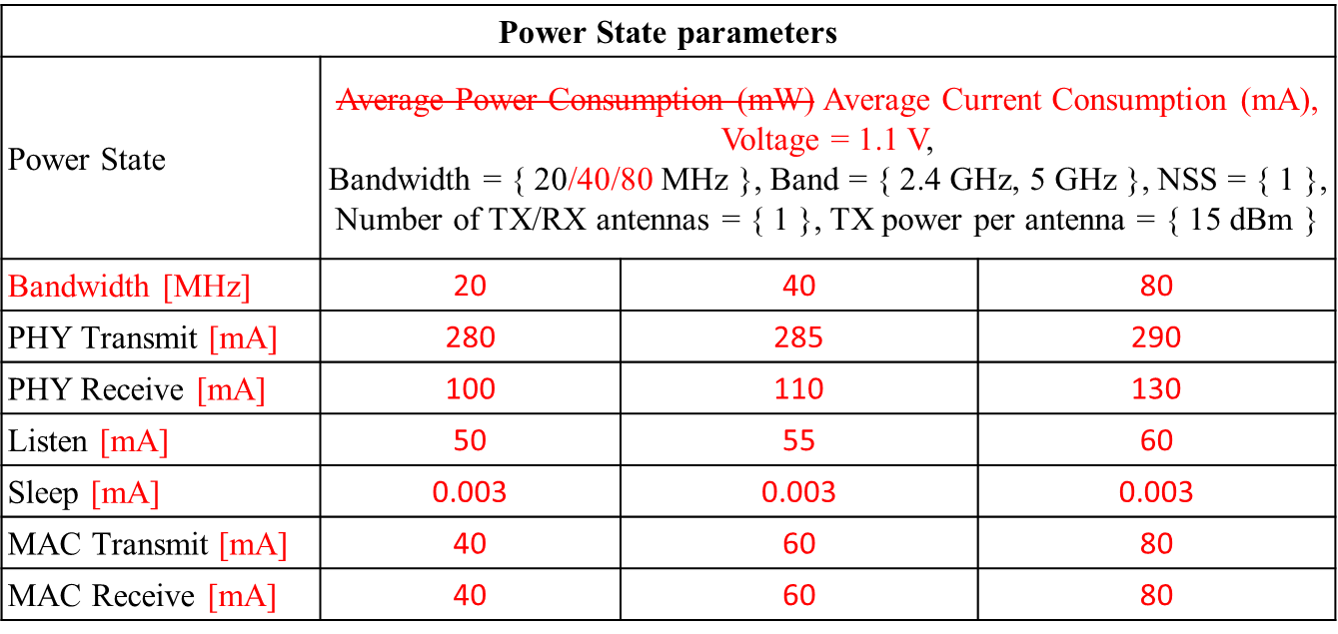
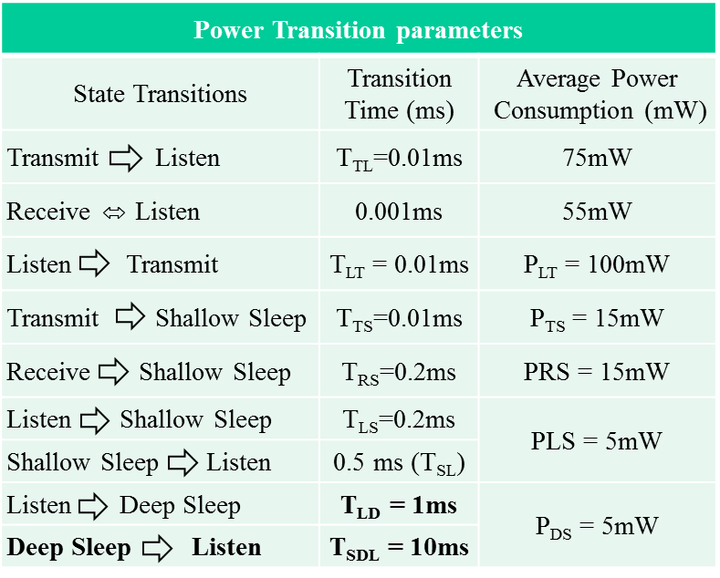
TGax Power Consumption Model
Doc. 11-14/1444r2 [C. Yu, MediaTek]
Doc. 11-15/1100r2 [C. Ghosh, Intel]

Slide 13
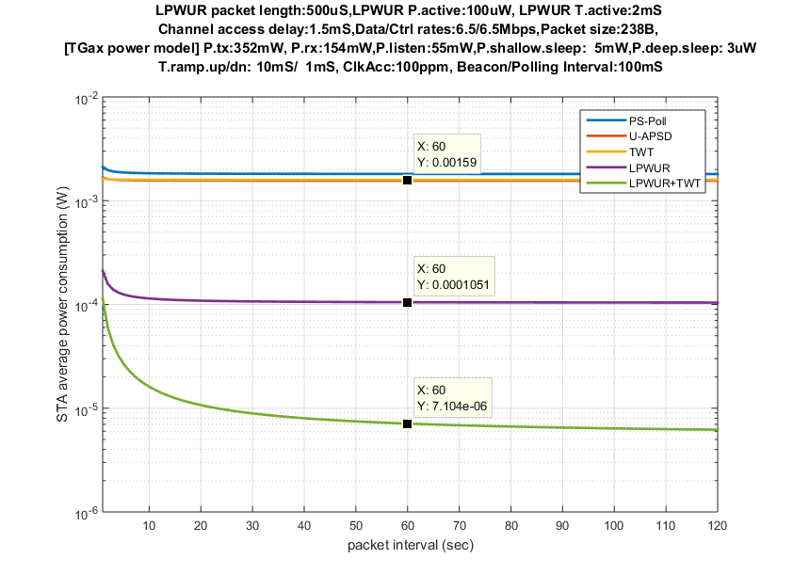
Comparison Using TGax Power Consumption Model
Latency requirement: 100mS
Parameters | Values
Wake-up packet length | 500 µS
LP-WUR power consumption in active state | 100 µW
LP-WUR active time duration | 2 mS
Channel access delay | 1.5 mS
802.11 PHY rate (data/control) | 6.5 Mbps
Data packet size | 238 bytes
Beacon/polling interval | 100 mS
Legacy power save modes
1.6 mW
~15x
LP-WUR always on
~224x
105 µW
LP-WUR duty-cycled
(2 mS active every 100 mS)
7 µW

Slide 14
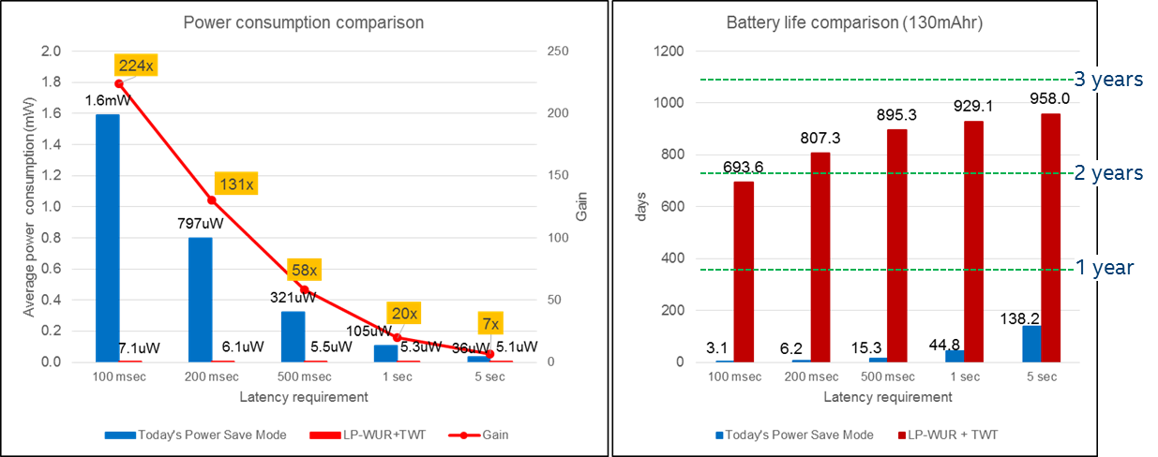
Comparison Summary
LP-WUR shows significant power saving over legacy power save modes
Power saving gain : 7x (@5sec latency)~224x (@100mS latency)
LP-WUR enables a long battery life and low latency with a small battery

Slide 15
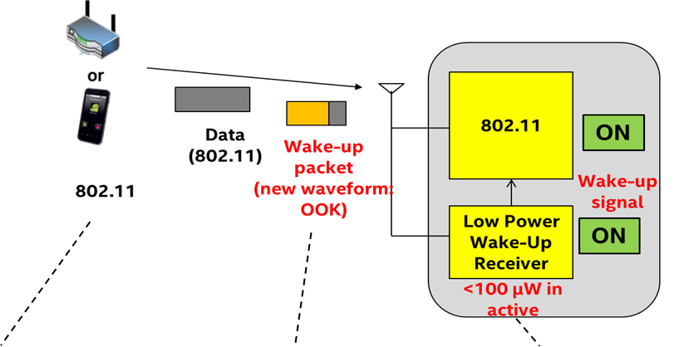
Overview of LP-WUR for 802.11
[Wake-up packet transmitter]
(1) Transmit a wake-up packet
[Wake-up packet design]
(1) Designed to coexist with 802.11
(2) Simple modulation scheme (OOK) for low power receiver design
(3) New packet format design
[LP-WUR receiver design]
Small and simple OOK demodulator – only decodes OOK modulated payload
Active power consumption < 100 uW
Meet 802.11 receiver performance requirements: e.g. minimum sensitivity = -82dBm (MCS0), PER<=10%

Slide 16
Comparison between LP-WUR and LRLP
 | LP-WUR | LRLP (long-range low-power)
User data transmission and reception | LP-WUR wakes up the 802.11 radio when it receives a wake-up packet User data is transmitted and received by the 802.11 radio | User data is transmitted and received by a new LRLP PHY/MAC
Metrics | Average power consumption Latency | Data transmission rate Peak/average power consumption Transmission range

Slide 17
Summary
Today’s 802.11 makes trade-offs between low power consumption and low latency
The proposed LP-WUR technique can enable low power consumption and low latency at the same time
A simple modulation scheme such as OOK can enable a low power receiver design
Our study shows significant gain can be achieved using LP-WUR over legacy 802.11 power save modes

Slide 18
Straw Poll
Do you support the basic concept of the LP-WUR technique in this presentation for standardization in the 802.11WG?
Y: 65
N: 1
A: 51

