Slide 1
Regulatory frame work for the expansion of 802.11ac to 6-10GHz
Date: 2015-07-13
Authors:
Notes:
July 2007

Slide 2
Abstract
This document addresses synergies of using 6-10.5GHz as an extension frequency band for 802.11ac with the main focus onto the regulatory situation.
Based on this situation some proposals will be made.

Slide 3
This Presentation
Related IEEE presentations
Regulation Overview
EU-US-Canada
Why 6-10GHz complements 11ac
11ac needs additional capacity
11ac use cases need peer-to-peer at short range
6-10GHz is a low risk extension of spatial capacity for 11ac
  6-10GHz has propagation characteristics similar to 11ac
  6-10GHz can reuse the same antenna
  6-10GHz can probably reuse much of the same RFIC and BB die

Slide 4
Related presentations

Slide 5
Related documents 12/0375, 12/0653, 12/0929, 12/1143, 12/0096r0, 11/743r0 and 11/385r1
https://mentor.ieee.org/802.11/dcn/12/11-12-0375-00-0wng-6-10ghz-extensions-to-802-11ac-part3.ppt
https://mentor.ieee.org/802.11/dcn/12/11-12-1143-00-0wng-6-10ghz-rate-range-and-link-budget.ppt
https://mentor.ieee.org/802.11/dcn/12/11-12-0929-00-0wng-expansion-of-802-11ac-to-6-10ghz.ppt
https://mentor.ieee.org/802.11/dcn/12/11-12-0653-00-0wng-compatibility-of-6-10ghz-extensions-with-the-802-11ac-phy.ppt
https://mentor.ieee.org/802.11/dcn/12/11-12-0096-00-0wng-6-10ghz-extensions-to-802-11ac-part2.ppt
https://mentor.ieee.org/802.11/dcn/11/11-11-0743-00-0wng-6-9ghz-extensions-to-802-11.ppt
https://mentor.ieee.org/802.11/dcn/11/11-11-0385-01-0wng-ultrwideband-spectrum-for-802-11.ppt

Slide 6
Regulation overview

Slide 7
European UWB activities and worldwide UWB harmonization needs
Basis UWB requirements
 | Europe | United States | Canada
Regulation | EC DEC 2014/702/EU | FCC Part 15.500 | RSS 220
Bandwidth | >50 MHz@-13 dB | fractional bandwidth equal to or greater than 0.20, or bandwidth equal to or greater than 500 MHz, regardless of the fractional bandwidth @ -10 dB | 10 dB bandwidth of at least 500 MHz or a -10 dB fractional bandwidth greater than 0.2. Details in Annex of RSS220
Operating frequency bands | Based on specific regulation (application) | >960 MHz with 8 subclasses | >960 MHz with 8 subclasses
Additional signal limitation | No | at any point in time; modulation on / off | No
Measurement requirement | Mean power: with 1ms and RBW: 1 MHz Peak power with RBW: 50 MHz → If not: correction: 20log(RBW/50)
 | harmonized measurement document: ETSI TS 103 883 Planned: ETSI EN 303 883 | FCC Part 15.521 & 15.523 | RSS – 220 Annex
Additional Regulation | No wideband rules | Wideband rule: FCC Part 15.250: 5925-7250 MHz, BW > 50MHz, No „at any point in time“ rule | Wide band rule RSS 210: not on board aircraft or satellites; not be used for toys; a fixed outdoor infrastructure is not permitted, except for operation on board ships or land vehicles.
Doc.-no. ERMTGUWB(15)000017r2

Slide 8
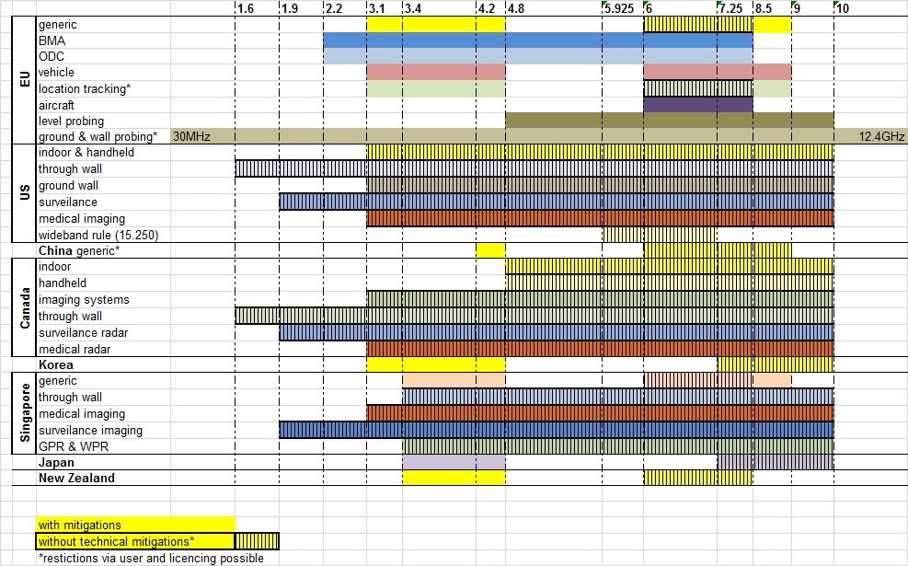
Frequency Allocation for EU-US-Canada-Singapore-China

Slide 9
Current Global Status For UWB
Problems:
→ no certification process defined in many countries
→ if defined, rules vary for:
  frequency ranges
  application restrictions (e.g. vehicle, tracking, medical)
  user restrictions (e.g. public, professional, government)
  environment restrictions (indoor & outdoor)
  mitigation techniques
  receiver requirements (new in EC 2016/2017; RE-D: 2014/53/EU)
  signal definitions
  conformance testing procedure
  ETSI prepared a first version for a common UWB testing document (ETSI TS 103 883)
  ETSI TS 103 883 will be transferred into ETSI EN 303 883 (first draft available)
Minimum BW requirement
modulation requirement (on/off) during “test”

Slide 10
Identified issues with 11ac in 6GHz to 10GHz
US regulation for UWB (FCC Part 15.500):
  defines a minimum bandwidth of 500MHz
  Hopping as part of the modulation
    “at any point in time rule”
    For hopping systems the basic bandwidth has to be larger than 500MHz
    No direct reuse of 11ac signals with bandwidth up to 160MHz
US wideband regulation (FCC part 15.250), 5925MHz to 7250MHz)
  Allows for 50MHz bandwidth as basic hopping bandwidth
  No “at any point in time rule”
  But only 1325MHz frequency band available

Slide 11
Extension of 11ac into 6GHz to 10.5GHz

Slide 12
11ac as basis for an extension
Existing 802.11ac/ad PHY + MAC provides most of the hooks
  In Europe the basic 11ac system with BW > 50MHz could be used in an UWB mode in the band 6GHz to 8.5GHz (9.0GHz)
  Updated US regulation (“at any point in time” rule) or use of wideband rules FCC part 15.250
  → simple hopping system with 20MHz to 160MHz single hop-bandwidth would be possible
  → Possible TX power increase due to averaging with 10 step hopping up to 10dB!

Slide 13
Possible frequency plans with existing FCC rules
FCC part 15.500: at least five 500MHz channels are available in 6-9GHz
  Mean power of -41,3 dBm/MHz mean, 0dBm peak/50MHz
  Up to 8 in some countries
  Allows k=4 frequency reuse for high user density
FCC Part 15.250: 1325MHz available under wideband rules.
  Mean power of -41,3 dBm/MHz mean, 0dBm peak/50MHz
  8 160MHz channels or 1 8-hop 160MHz channel (9dB power increase)
  Up to 16 step hopping possible with 80MHz base system

Slide 14
Possible frequency plans with updated FCC rules
Updated FCC part 15.500:
  Remove “at any point in time rule”
  Change minimum bandwidth to 50MHz (see EU regulation)
possible 11ac+ System in the band 6GHz to 10,6GHz
  Mean power of -41,3 dBm/MHz mean, 0dBm peak/50MHz
  28 160MHz channels or 3 8-hop 160MHz channel (9dB power increase)
  Up to 57 step hopping possible with 80MHz base system
  Hopping system with 20MHz base system possible → up to 230 hopping frequencies
  E.g. 16 step hopping with 20MHz → 320MHz bandwidth 12dB power increase.
  Increased sharing capability by orthogonal hopping codes

Slide 15
Conclusion
Existing FCC regulation would already allow a 16 hop 80MHz based system with 12dB power increase using wideband rules
An optimized FCC regulation with
  No “any point in time rule” and
  Minimum bandwidth > 50MHz
  Similar to EU rules
→ would allow for a flexible usage model for the band 6GHz to 10,6GHz
  Lower UWB band would be available in the US (3.1GHz to 6GHz) providing additional resources for high speed and ultra high density 802.11 systems

Slide 16
Acknowledgement
This work was partly supported by the European Commission under the Horizon2020 frame work Programm (H2020) by the project HIGHTS (Grant Agreement Number: 636573).
For more information related to the HIGHTS project please refer to Annex 2 of this presentation

Slide 17
Annex 1
(Slides from older IEEE presentations, thanks to Jim Lansford)

Slide 18
How is this useful for 802.11?
802.11ac will become VERY successful
  Expected to dominate WLAN chipset sales by 2014
5GHz channels for infrastructure are limited
Peer-to-peer connectivity is expected to grow dramatically
  Wi-Fi Direct applications such as remote display, file/photo/video sharing, and docking…these are bandwidth intensive
Mobile platforms will ship hundreds of millions of 11ac chipsets per year
  Will create additional demand for capacity
6-10GHz would provide dramatic increase in spatial capacity for peer-to-peer applications without impacting infrastructure capacity

Slide 19
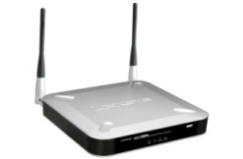

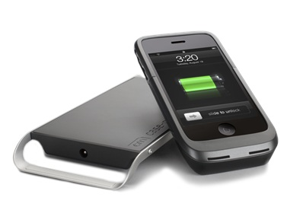


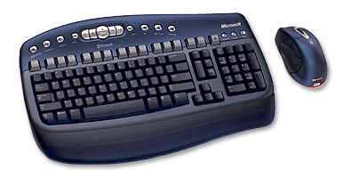
Use Case – Mobile Wireless Docking
Simultaneous internet and wireless docking with wireless display
Internet access
(11ac)
Office / Desktop
(6-10GHz)
Home /Entertainment
(6-10GHz)
Optional wireless charging
Meeting room
(6-10GHz)
Optional wireless keyboard/mouse
(Bluetooth or low-power Wi-Fi)

Slide 20
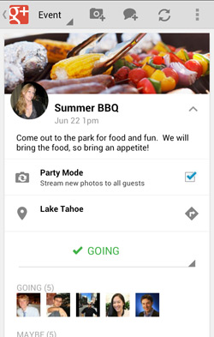

Use case: Peer-to-peer sharing
Galaxy S III: AllShare, GroupCast, ShareShot
Android “Party Mode”

Slide 21
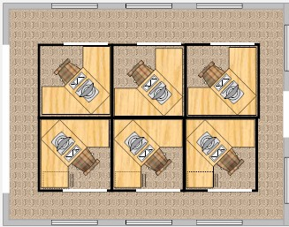
Cube farms: Use 5-6Ghz for infrastructure, 6-10GHz for P2P
2.5 m
At 320Mb/s at 8.2GHz, radius of coverage is ~2 meters with SISO OFDM
In a 10x10 foot space, this provides an aggregate spatial capacity of 5.12Gb/s
Minimum of 4 channels is required
  Could be shared band
Peer to peer apps can operate without interfering with infrastructure WLAN
Small cells yield highest spatial capacity in users per square meter
SISO OFDM UWB has a coverage area just larger than an average cubicle
Channel reuse can optimize capacity with minimum interference

Slide 22
6-10GHz is a low risk extension to 802.11ac for peer-to-peer
Can share common antenna
  No packaging issues
Similar RF chains, some of which can be shared
Propagation characteristics are similar to 802.11ac
  No more directional than 5-6GHz
  Does not need an antenna array
BUT range is limited
  About 1Gbps at 2 meters (500MHz channel, 1x2 MRC)
Low power: <400mW for a complete PHY+MAC
  Doesn’t include sharing of RF, Analog, and digital with 802.11ac

Slide 23

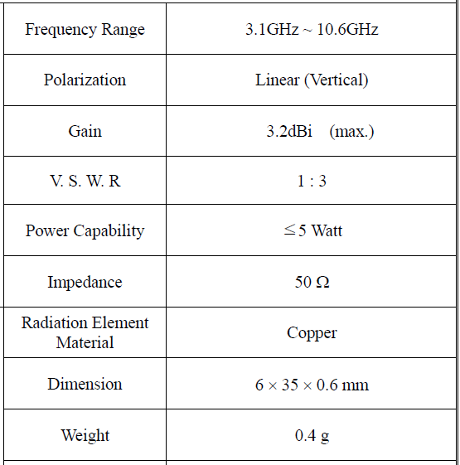
Common antenna
6mm
Numerous inexpensive antennas are already commercially available that cover 3 to 10GHz
Extension to cover 2-10GHz not expected to be difficult
35mm
Microstrip antenna

Slide 24
Annex 2
(Overview EU H2020 Project HIGHTS)

Slide 25
Project Goals and Description
Dr. Stefano Severi, Project Coordinator

Slide 26











HIGHTS Consortium
“The consortium is very strong, with high quality participants covering a wide range of expertise in the relevant areas to the project. The consortium demonstrates a very good complementarity among the participants”.

Slide 27
What do they expect from us?
HIGHTS will be known for what?

Slide 28
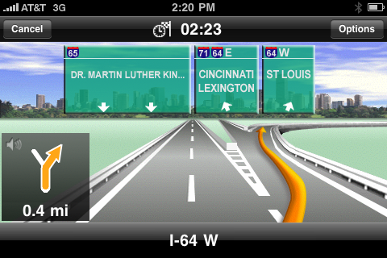
High precision positioning
HIGHTS aims at providing down to 0.25m positioning precision

Slide 29
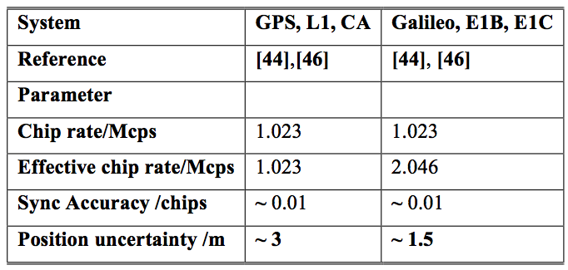
High precision positioning
HIGHTS is committed to realize a high precision location estimation solution (down to 0.25m precision) by regrouping state-of-the-art GNSS and various ranging technologies, cooperative communications and advanced fusion/consolidation of positioning information. This concept is sound and well described in the proposal.

Slide 30

High precision positioning
Even if the precision level achieved for the beginning will not be as high as targeted (e.g. only ~0.5m) it would still represent a significant progress from the current state-of-the-art and would enable the implementation of some new applications such as C-ACC and Platooning.

Slide 31
Is really and solely positioning our work?
What’s the “magic” behind the 25 cm?

Slide 32
HIGHTS Pyramid
High precision
Positioning
Implementation
& Integration
Sensing
Ranging
Communication

Slide 33
Which type of positioning?
New concepts along the way…
Cooperative Positioning
Ego Positioning

Slide 34
How to evaluate HIGHTS outcomes beyond the 25 cm target?

Slide 35

Impact
HIGHTS is positioned as ‘Lab-to-Market’
HIGHTS is expected to have a significant impact in the field at various levels. The expected impact is relevant to all the categories listed in the present Call (improved safety, efficiency, flexibility and sustainability).

Slide 36
Addressing Mass Production and Standardization
It is very convincing that the proposed project will strengthen the competitiveness and growth of companies.
In particular, the project will transfer to the market, through both the standardization process and the industrial consensus building process, a novel, high-precision and cost-effective cooperative positioning solution with focus on ITS. It will also enable the European and global market through these innovative technologies and provide great impulse to the standardization activities (in particular in Europe via the ETSI), the regulation definition and the industrial consensus building (via the External Member Group) in the long term.

