Slide 1
Over-the-air testing of 802.11 equipped devices.
Reverberation chambers as OTA test environments, improvement potential of 802.11 OTA testing and 802.11 vs. other wireless technologies
Date: 2015-03-09
Authors:

Slide 2
Abstract
Over-the-air testing of wireless devices aims at testing the final system performance of a complete device including the antennas. As such, the tests are rather complex and requires specialized equipment such as testing chambers.
This document aims at presenting the current status of OTA testing of 802.11 equipped devices. There are a number of issues related to OTA testing that needs to be addressed to improve testing capabilities and results.

Slide 3
Contents
Introduction to OTA testing
Reverberation chambers for OTA testing
Issues related to 802.11 OTA testing
OTA testing of cellular system
Proposed ways forward

Slide 4
Bluetest experience
Customers require testing of 802.11 equipped devices.
Testing scenarios not well enough defined.
Repeatability issues.
CSMA/CA
OTA testing of 802.11 equipped devices is often done in a non-controlled environment.
Effects like antenna correlation vital to MIMO capability and needs to be tested in a well defined environment.

Slide 5
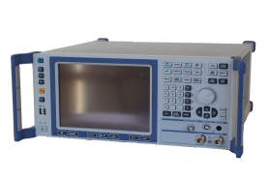
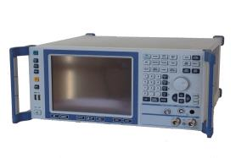
Over-the-air testing of wireless units
Conductive testing
  The Device Under Test (DUT) is connected via cables to the measurement instrument
  Easy test set-up but limitations in what can be measured
  Antenna performance including matching between front end and antenna not included in measurement
Over The Air (OTA) testing
  The DUT is connected via radio waves, “Over The Air”, to the test instrument
  A controlled radio environment shielded from interfering radio equipment is used
  Aims at measuring the actual performance of the device the way it is intended to be used
  Becomes more critical in testing MIMO devices.
DUT
DUT
Shielded environment

Slide 6
Over-the-air testing of wireless units
The Bluetest experience
Used for testing:
Total radiated power (Tx antenna test)
Total Isotropic Sensitivity (Rx antenna test)
Throughput (Rx/Tx system test)
  On MAC or IP layer
  SISO or MIMO
  Different channel conditions
Coexietence, handover, customer specific tests
Mainly used by:
Device manufacturers: At departments for antenna development
Operators: For testing devices before allowing them in the networks
Test institutes: For certification testing

Slide 7


Standardized Single Antenna Measurements
Worldwide: 3GPP TS34.114
  TRP – Total Radiated Power
  TRS – Total Radiated Sensitivity
  Anechoic chamber
  Reverberation chamber
North America: CTIA Test Plan for Mobile Station Over the Air Performance v3
  TRP – Total Radiated Power
  TIS – Total Isotropic Sensitivity
  Anechoic chamber (Reverberation chamber under evaluation)
Defined for most cellular communication technologies

Slide 8

OTA Standardization for Multi-Antenna Devices
No standard defined yet, work in progress
Focus on data throughput as figure-of-merit
MIMO-OTA discussions in three organizations in parallel: 3GPP (worldwide), CTIA (North America), and CCSA (China)
3GPP MIMO OTA method description TR37.977 released end of 2013
  Includes RC, RC+CE, multi-probe AC and 2-stage method
  Continued work within 3GPP to start now again
CTIA has split standard in two parts
  TM2 (Transmit Diversity): Reverberation chamber and Multi-Probe Anechoic Chamber (MPAC)
  TM3 (Spatial Multiplexing): MPAC
  Work in progress to technically validate measurement setups
CCSA has main focus on MPAC with RC added as alternative method

Slide 9
802.11 vs. 3GPP standards
Device manufacturers not used to OTA testing
  Not using shielded enclosures
  Commonly used OTA test equipment not as developed
  Much more cost sensitive
Not as ”strong” customers (consumers vs. operators)
  Not the same requirements
  No user with a holistic view of system performance.

Slide 10
Why OTA
Example 1
Single carrier
Operator:
“Just this week we were also made aware of the B12 TRP issue after the device already in the market for a few weeks.”
“The issue is due to a bug in the ant switch setting.”
“It’s good you independently confirmed the issue in the Lab.”
 | TRP
Band 2 | 18.5
Band 4 | 20.2
Band 12 | 17.5
2+4
4+2
 | TRP
PCC | 18.6
SCC | X
PCC + SCC** | X
 | TRP
PCC | 19.2
SCC | X
PCC + SCC** | X
4+12
12+4
 | TRP
PCC | 19.8
SCC | X
PCC + SCC** | X
 | TRP
PCC | 8.1
SCC | X
PCC + SCC** | X

Slide 11
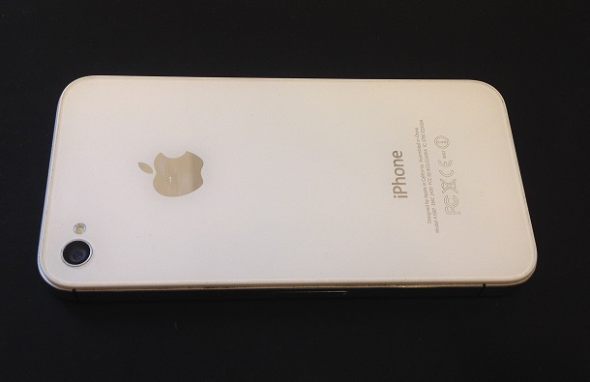
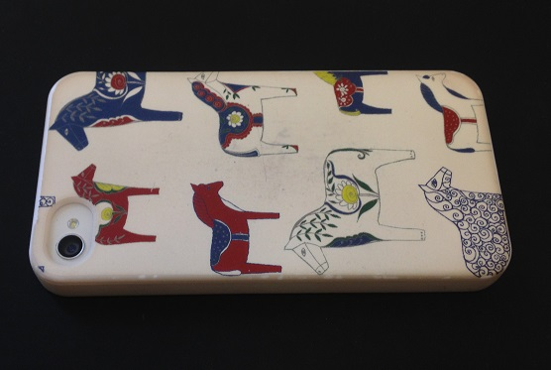
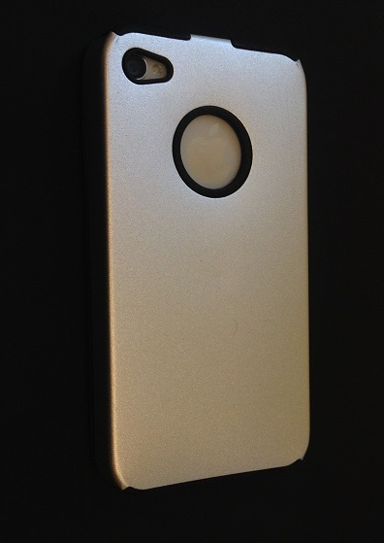
Why OTA
Example 2
Phone | dBm | mW
Phone 1 | 21,29 | 135
Phone 2 | 19,51 | 89
Phone 3 | 17,29 | 54
Broken Phone 4 | 3,282 | 2
Phone | dBm | mW
Phone 2 | 19,51 | 89
Phone 2 Plastic shell | 19,22 | 84
Phone 2 Metal shell | 8,052 | 6

Slide 12
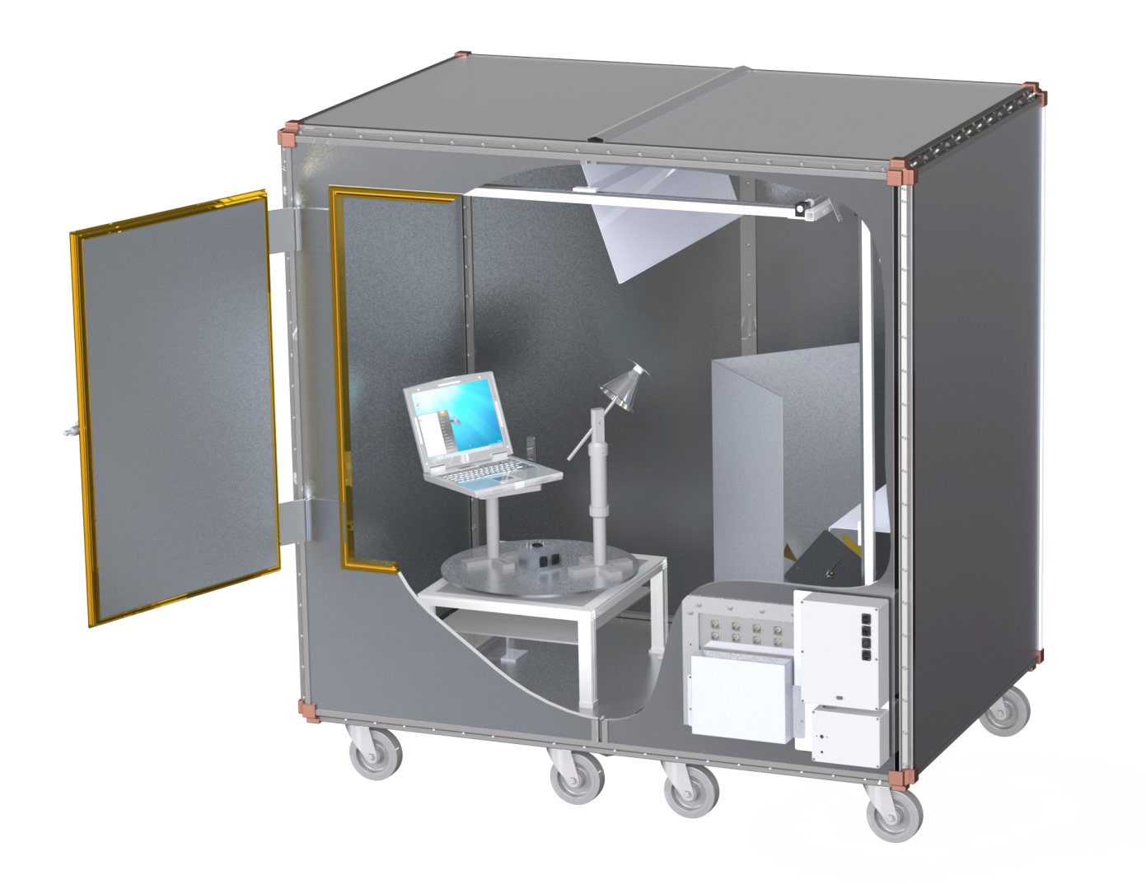
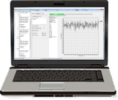
Reverberation chambers for OTA testing
Mode stirrers
(move during measurement)
fixed measurement antennas
with different polarization
      Connected to a
      Network Analyzer or a
      Communication Tester
Walls of reflective
material
Calibration antenna
Control software
Test Object (DUT)
(USB modem on laptop)
Turntable
(moves during measurement)
Access Panel
Network Analyzer or
Radio Communication Tester

Slide 13
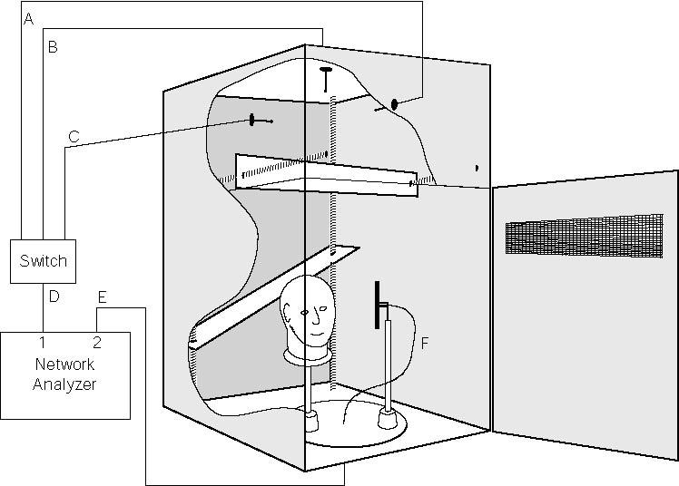
Reverberation chambers for OTA testing
Properties of the Reverberation Chamber
Creates scattering environment
Average transmission level in chamber proportional to
  Total radiated power
  Radiation efficiency of antenna
Isotropic field environment when averaged over large number of independent field samples
Rayleigh faded signal transmission
Received power (dB)‏
Time

Slide 14
Anechoic chambers
”Opposite” of reverberation chamber
Absorbers on walls
Many probes used for creating multi path environment

Slide 15
Lost packages
In throughput tests at package lost WLAN units have to handle two scenarios:
  Package loss due to poor channel conditions
  Package loss due to collision
Added MAC layer throughput test functionality would remedy the test issue.
Retransmission policy proprietary in AP
  Throughput not directly related to the STA only, but a system parameter in 802.11

Slide 16
New application scenarios for 802.11
Mobile phones equipped with WLAN show completely different user scenario wrt. mobility.
  New channel conditions for WLAN
802.11p for V2X communication
  Will experience very high Doppler speed.
802.11ax aiming at open space WLAN; operators outdoor, office buildings, etc.
  Large delay spread
  One faulty unit can affect multiple users experience.

Slide 17
Current 802.11 OTA test standards
CTIA
  Converged devices.
802.11T
  Only a draft
TGn channel models
  11-03-0940-04-000n-tgn-channel-models
  11-09-0308-12-00ac-tgac-channel-model-addendum-document
  11-11-0968-01-00ah-channel-model-text
WiFi Alliance
COST

Slide 18
802.11T
The scope of 802.11T is huge.
The specification draft lacks details
The tests are outdated
  MIMO not taken into account
The specification was never finished
Functionality to execute test not implemented in chip-sets
No limits exists

Slide 19
CTIA
Can only define tests based on current 802.11 standard status.
Focus until now has been on ”WLAN converged devices”. That is, coexistence issues with cellular standards.

Slide 20
Current state of 802.11 OTA testing by vendors
Quite common to not use dedicated OTA testing equipment
Not as mature as OTA testing in cellular wireless systems
Until now, not driven by a strong customer (802.11 equipment mainly targeting consumer segment until now)

Slide 21
Issues related to test equipment
Output power level not well defined.
  Can differ up to 7 dB between vendors.
”We did an implementation according to the standard, and nothing worked. So then we had to go and ask all chip vendors, how do you do this?”

Slide 22
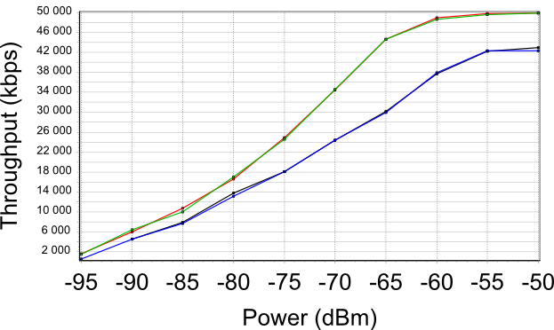
LTE

Slide 23
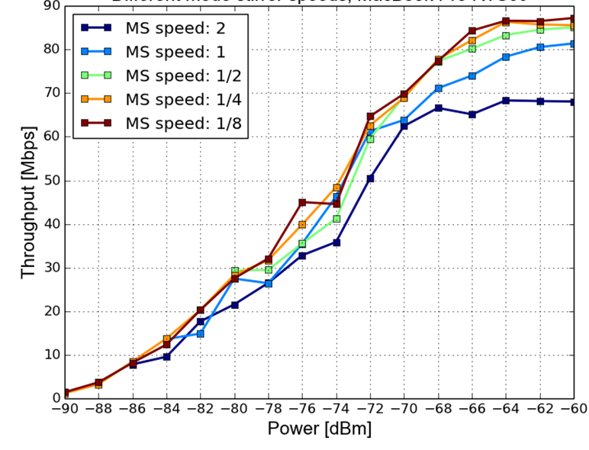
Device stability
Laptop with fairly stable, repeatable and predictable throughput behavior.

Slide 24
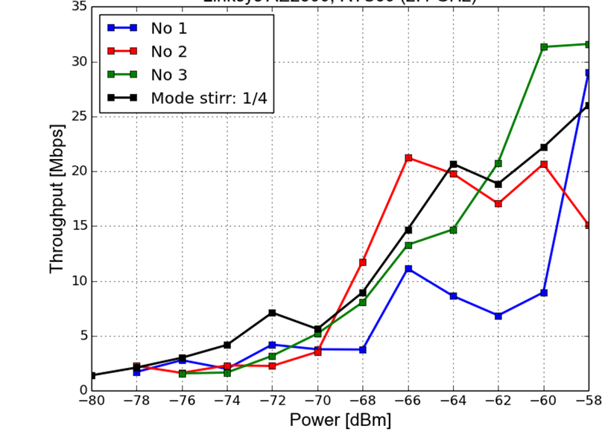
Device stability
802.11 USB dongle with non-repeatable and non-predictable behavior.

Slide 25
Ways forward
Continue the work towards 802.11T
Include the scope of these problems in 802.11ax
Work in WiFi alliance with these issues
Any other way to address these issues?

Slide 26
Summary
The user (=engineer) experience in OTA testing 802.11 equipped devices is significantly degraded compared to testing cellular devices.
802.11 OTA testing is not as mature as testing of cellular devices.
Testing wireless standards employing random access adds complexity.
The importance of OTA testing of 802.11 devices will increase in the future.
Shielded chambers can provide the cost efficient solution required by 802.11 vendors

Slide 27
Continuing the dicussion...
Robert Rehammar
robert.rehammar@bluetest.se
bluetest.se

