Slide 1
Beyond 802.11ad – Ultra High Capacity and Throughput WLAN
Authors:

Slide 2
Abstract
We want to initiate the discussion about creating a new Study Group to explore modifications to the IEEE 802.11ad-2012 PHY and MAC layers, so that modes of operation in the 60 GHz band (57-66 GHz) can be enabled that are capable of a maximum throughput of at least 30 Gbps as measured at the MAC data service access point (SAP), while maintaining the excellent capacity attribute of the 60GHz band.

Slide 3
Agenda
802.11ad Radio/Antenna implementations
Existing 802.11ad systems capacity
Beyond 802.11ad
  High data rates usages
  Channel bonding at 60GHz
  MIMO options for 60GHz
    Traditional MIMO
    “Spatial orthogonal MIMO”
  Possible achievable rates in 60 GHz

Slide 4
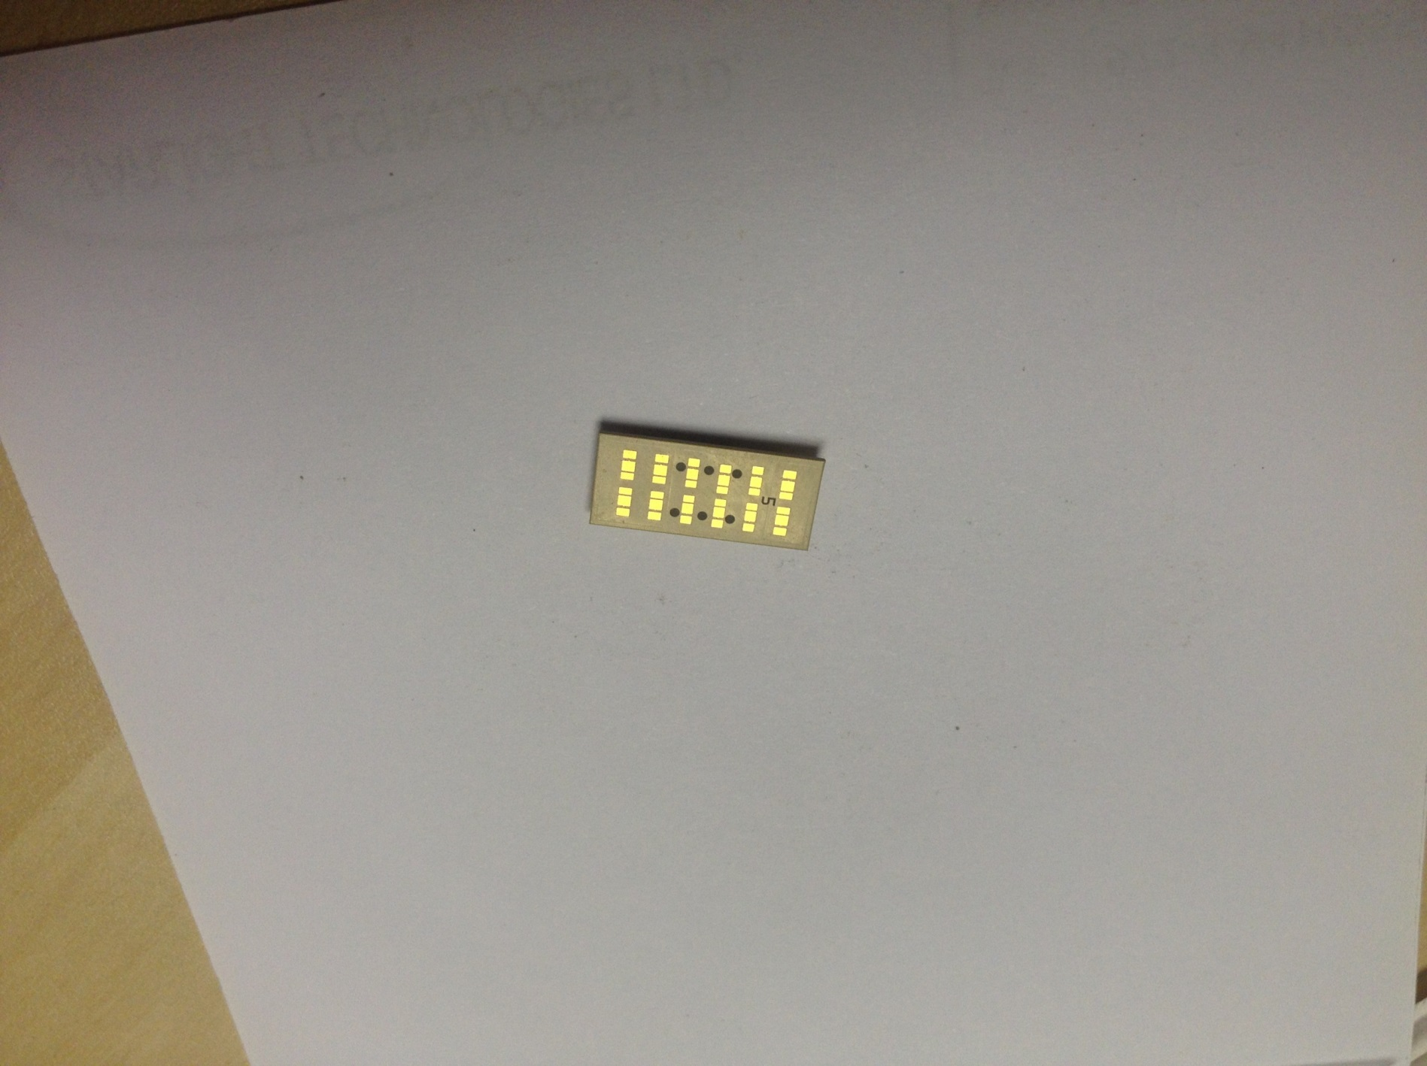
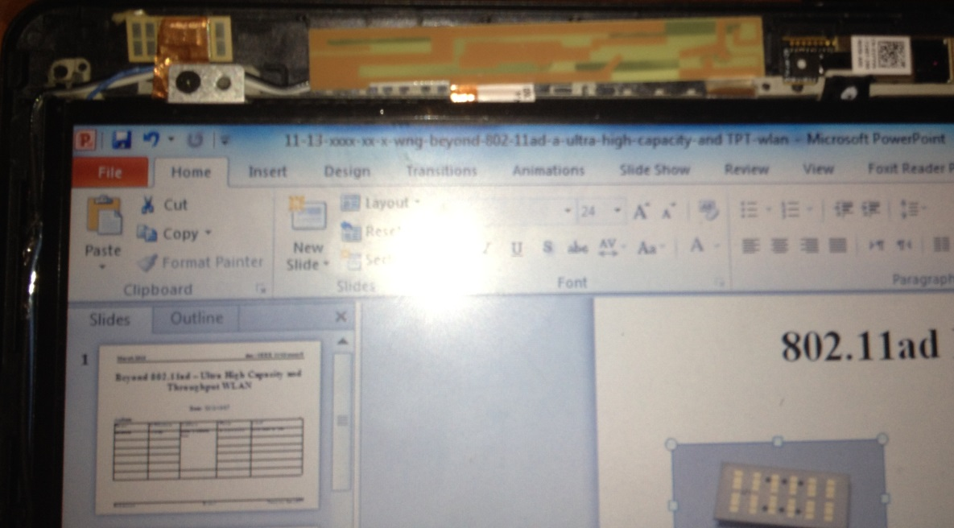
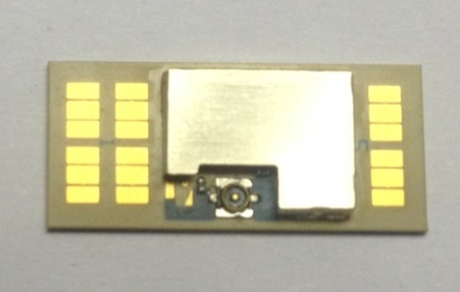
802.11ad Antenna implementation
60GHz 32 antenna array
Single Wi-Fi antenna
32 antennas- 17.5x7.9mm, 3D radiation
Not using tradition planner array
  Can form orthogonal streams

Slide 5
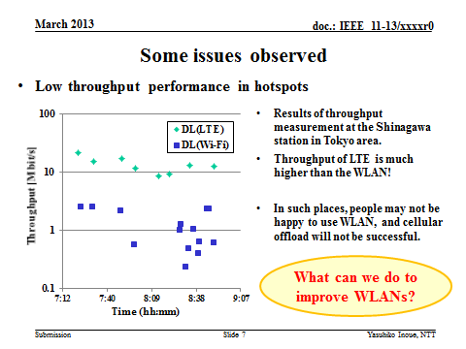
From: 13/0287r3:

Slide 6
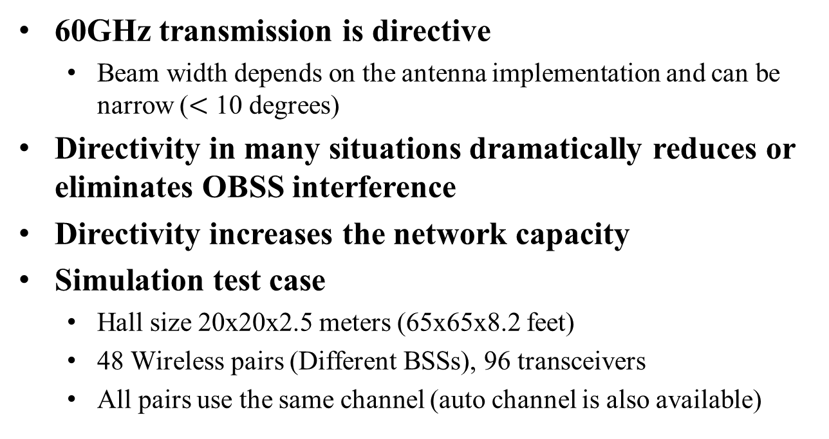
Existing 802.11ad systems capacity
60GHz transmission is directive
  Beam width depends on the antenna implementation and can be narrow ($<$ 10 degrees)
Directivity in many situations dramatically reduces or eliminates OBSS interference
Directivity increases the network capacity
Simulation test case
  Hall size 20x20x2.5 meters (65x65x8.2 feet)
  48 Wireless pairs (Different BSSs), 96 transceivers
  All pairs use the same channel (auto channel is also available)

Slide 7
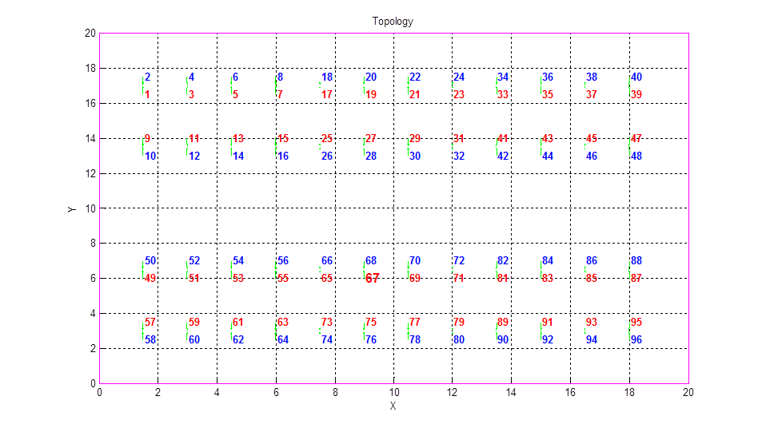
802.11ad capacity example
Room dimension
  20mx20m
48 pairs (PBSSs)
  Client and AP
  96 transceivers
  2 meters separation
Propagation model
  60 GHz is using ray tracing simulation
  BF and TPC were used
Simulation result
  TPT per user
  Aggregated TPT of the entire network
Network topology

Slide 8
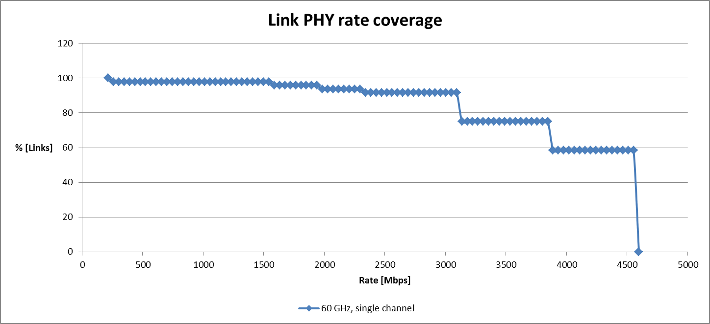
802.11ad capacity example
Aggregated TPT across all PBSSs: ~200 Gbps!
Efficiency
  Efficiency= aggregated TPT/Maximum achievable TPT
  Overall efficiency ~90%!

Slide 9
Results
The 11ad capacity is high due to the following:
  11ad operating SNR is on the order of 10 dB
    11ad 4.6 Gbps requires 13 dB SNR
  Less sensitive to Interference
    SINR required is ~20 dB
  Directivity reduces OBSS interference
One more small detail
  Directivity with steering ability can only be achieved with an array of antennas (unless we use a motor ☺)
http://www.youtube.com/watch?v=4M4ngJsQF70

Slide 10
Beyond 11ad

Slide 11
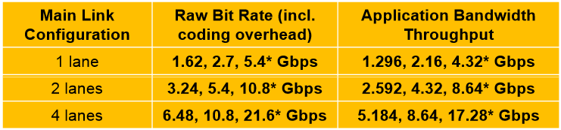
High data rates usages
Display
  DisplayPort Data rates:
  2 screens support is baseline today
  HDMI 2.0 support ultra HD or 4k
    Data rates up to 20 Gbps
Wired bus
  USB 3.1 speed is 10 Gbps
    http://www.engadget.com/2013/08/01/usb-alliance-finalizes-10gbps-specification-as-usb-3-1/
  PCIe gen 4.0 goes all the way till 16 GT/s
  Thunderbolt 1.0: 10Gbps per lane
Assuming docking needs to have a display and a wired bus: > 10 Gbps per dock!

Slide 12
Channel bonding at 60 GHz
Channel bonding can be done with minor algorithmic complexity on the PHY
  Bond 2 or 4 channels.
  SC: modem can double the chip rate, or even slightly more to fill the channel gaps
  OFDM: can simply double the number of tones and fill the channel frequency spacing, or can double the sub carrier spacing (maintain the sane number of tones)
    Pros and cons can be debated later
  Control PHY increasing the rate is definitely not a requirement, suggest to increase sensitivity
MAC changes will require effort
  Coexistence under directivity

Slide 13
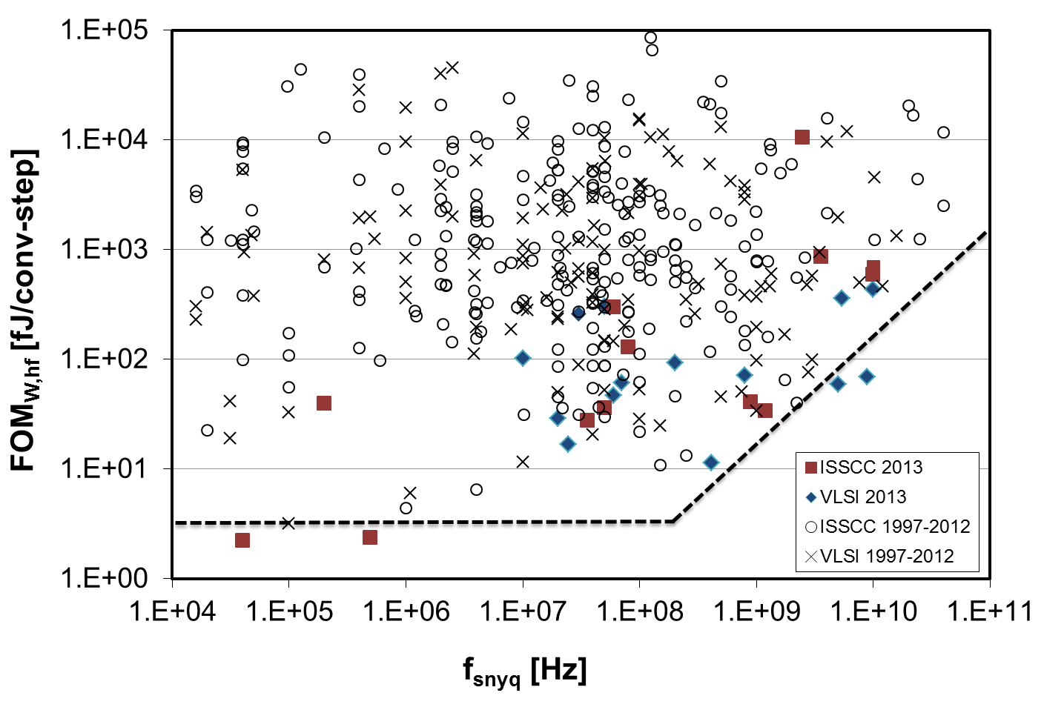
Channel bonding feasibility
Obviously 60GHz RF is wide enough to support the 4 available channels today
  Assuming the above, no change in the RF
ADC/DAC: looking into the literature Figure of merit (FOM)
  Digitally assisted ADCs are
  common in the industry
  ADCs running in 5GHz BW,
  assuming 6 bits
  Power estimated is 32 mW

Slide 14
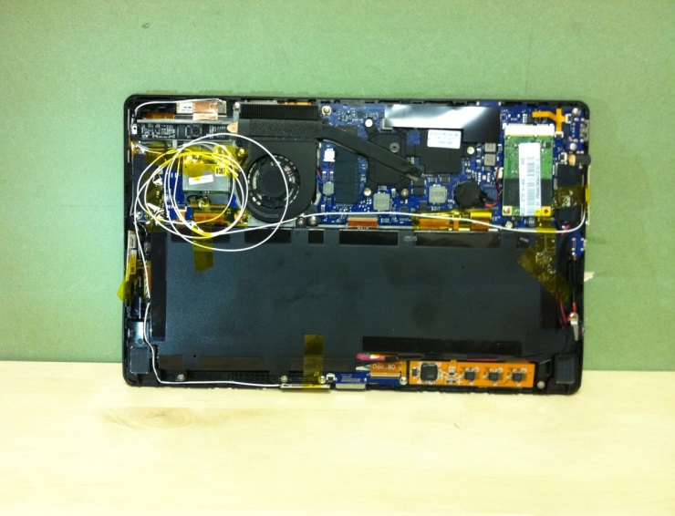
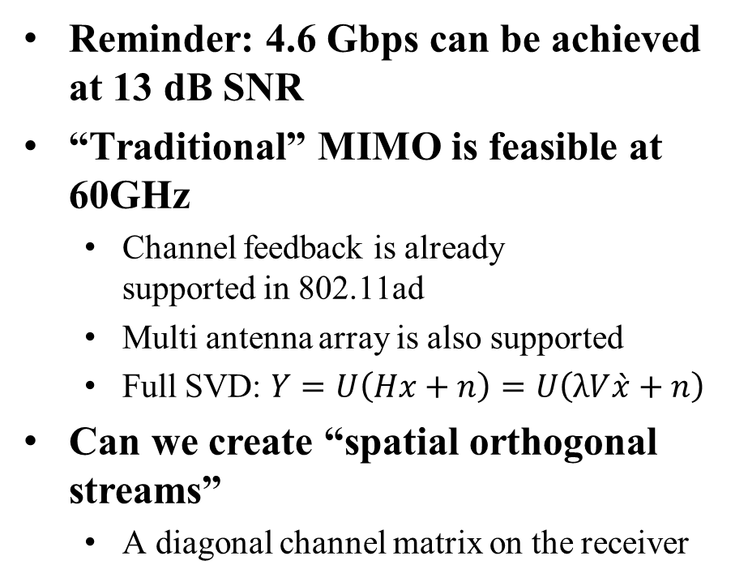
MIMO (>1 stream) at 60 GHz
Reminder: 4.6 Gbps can be achieved at 13 dB SNR
“Traditional” MIMO is feasible at 60GHz
  Channel feedback is already
  supported in 802.11ad
  Multi antenna array is also supported
  Full SVD: $Y=U\left(Hx+n\right)=U\left(λV\grave{x}+n\right)$
Can we create “spatial orthogonal
streams”
  A diagonal channel matrix on the receiver
Tablet integrated with 4 arrays

Slide 15
MIMO at 60 GHz: can we simplify?
Reminder: 4.6 Gbps can be achieved at 13 dB SNR
Can we create “spatial orthogonal
streams”
  A diagonal channel matrix on the receiver
    60 GHz require 10 dB SNR for decoding 3Gbps
    Training should be done via BF mechanism
    Sector sweep and BRP
  Low cost/complexity receiver
    lower digital complexity

Slide 16
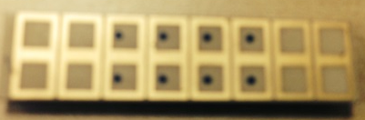
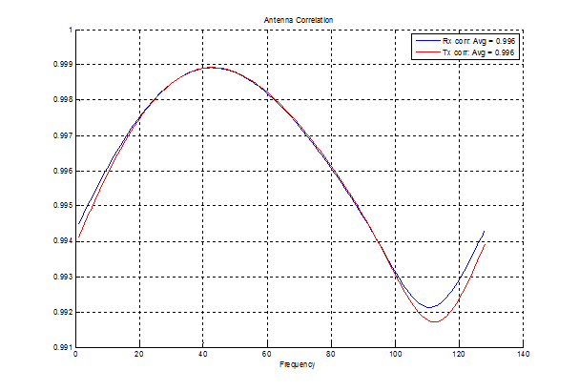
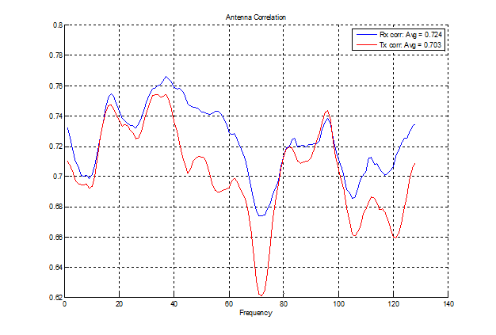
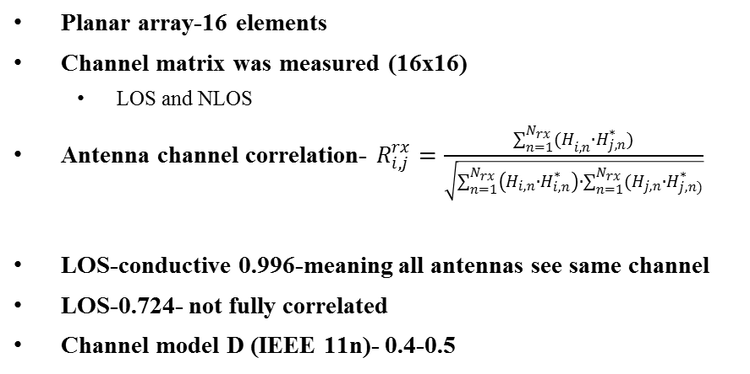
MIMO Channel measurement at 60GHz
LOS-planar array
Planar array-16 elements
Channel matrix was measured (16x16)
  LOS and NLOS
Antenna channel correlation- $R_{i,j}^{rx}=\frac{\sum_{n=1}^{N_{rx}}{{(H}_{i,n}∙H_{j,n}^{∗})}}{\sqrt{\sum_{n=1}^{N_{rx}}{\left(H_{i,n}∙H_{i,n}^{∗}\right)}∙\sum_{n=1}^{N_{rx}}{(H_{j,n}∙H_{j,n)}^{∗}}}}$
LOS-conductive 0.996-meaning all antennas see same channel
LOS-0.724- not fully correlated
Channel model D (IEEE 11n)- 0.4-0.5

Slide 17
MIMO feasibility
MIMO can be achieved in 60 GHz with lower complexity than legacy bands
  By a much smaller footprint antenna
  Much lower digital complexity
  Even on a single array
Protocol already have the infrastructure to support channel feedback, hence SVD
Enhancing BF to support MIMO is needed

Slide 18
Example: rate table

Slide 19
Summary
The 60 GHz band can offer true capacity improvement for 802.11
  100 Gbps over wireless!
60 GHz directivity and its propagation characteristics enable high frequency reuse
Channel bonding is more than feasible even in todays commodity design methods
MIMO (>1 stream) can be realized with low complexity and low power

Slide 20
Straw polls
Would you like to hear more contributions on this topic at a future 802.11 meeting?

